Slide 1
Agile Elasticity in ML: How to do it and how to take advantage of it
Aaron Harlap, Alexey Tumanov, Greg Ganger, Phil Gibbons
Notes:
So today I am going to be talking about agile elasticity in ML. How to achieve agile elasticity and how to take advantage of it.

Slide 2
Overview
Motivation for elasticity in ML
How to make Parameter Servers Elastic
TierML
How to take advantage of Elasticity
BidBrain
Evaluations of cost benefits and runtime benefits of elasticity for ML
Notes:
I want to start this talk with a quick overview. First at the begging of this talk I am going to talk about some motivations for why we want elasticity. Then I am going to describe to you a system called TierML which modified the traditional parameter server architecture to make it efficiently elastic. Then I am going to describe a system called BidBrain which is designed to take advantage of elasticity by intelligently bidding on the Amazon EC2 spot market. Lastly at the end of this talk I will go over some evaluation results showing how valuable elasticity is.

Slide 3
Dynamic Resource Availability
Revocable resources are common in clusters
Best effort resource that can be preempted
Yarn, Borg, Mesos, etc…
Adding the element of cost savings in clouds
Preemptible Instances in Google Compute Engine
Spot Instances in Amazon EC2
Notes:
First I want to provide some motivation for why we need elasticity in our systems. Many popular schedulers have such as Yarn and Messos have shown that they significantly improve their cluster utilization and ability to meet SLAs if they are able to revoke resources. The example that I am going to focus on in this talk is the Amazon EC2 spot market, where users can use cheaper resources with the risk of revocation, which we call eviction.

Slide 4
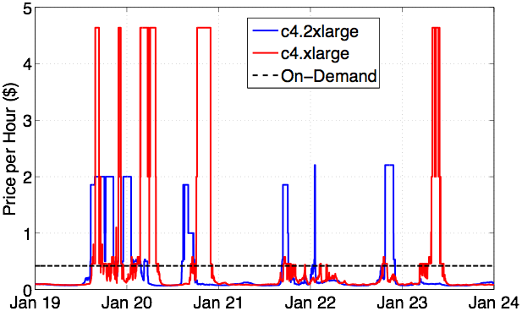
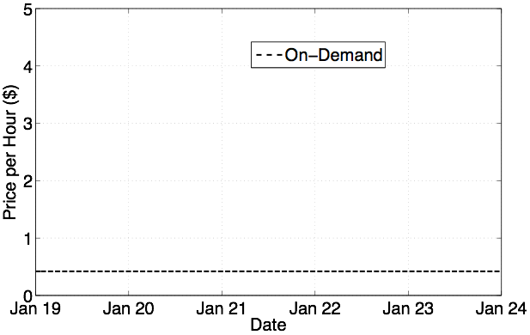
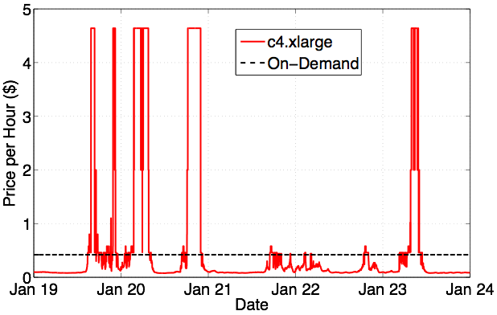
Big $$$ Saving
Often 75-85% cheaper to use Spot Instances
Low Cost
Notes:
what amazon calls the on-demand price
After red describe how cheap it is and explain spot market rules
after blue uncorrelated markets - move indecently
nickels on the dollar

Slide 5
How do you save $$$
Need agile elasticity
Scale in and out efficiently and quickly
Handle bulk revocations/evictions
Don’t lose progress
Little/no overhead
Notes:
So now that we have seen just how much we can save the question becomes how do we do this. The answer is that we need systems that are able to perform efficient elasticity, handle losing large % of their resources efficiently, not lose forward progress, and preferably do all this with no overhead.
Mention this is for ML

Slide 6
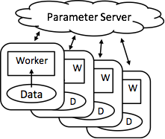
PS are great at Solving Iterative ML
Parameter Servers shard solution state across machines
Current architecture has servers and workers on all machines
Used by IterStore, MxNet, Bosen …
Notes:
Efficient
This diagram shows the high level architecture of the traditional PS framework. The workers read in the data, and then concurrently read and update the solution state stored in the parameter server. Current architectures traditionally have workers running on all the machines, and shard the Parameter across all the machines also.
IterStore, Petuum, MxNet

Slide 7
Current Options for PS Elasticity
Exploiting checkpointing support
Need to checkpoint, stop, start up new resources, load the checkpoint
Expensive and slow
Run-time overhead
Model Parameter Replication
Doesn't tolerate bulk resizing
Run-time overhead
Notes:
Lets say we wanted to perform elastic actions on the traditional PS framework. Our first option would include checkpointing, however this means that every time we want to change the number of workers we would need to checkpoint, and restart from checkpotining. We would also need to incur the run-time overhead of checkpointing if we wanted the system to handle evictions. Another option is to replicate model parameters by keeping several copies of each server shard. However this has a significant run-time overhead and is unable to handle massive failures where all replicas are evicted simultaneously.

Slide 8
TierML: New Approach to Elasticity
Use tiers of reliable and un-reliable resources
Revocable resources are un-reliable (transient)
Maintain all state on reliable resources
Parameter Servers only on On-demand Instances
Spot Instances run workers only (initially)
3 architecture stages
stage set by ratio of transient to reliable resources
Notes:
So we propose a new approach to achieving elasticity called TierML. TireML is a system that is designed to take advantage of tiers of reliability of its resources in order to achieve agile elasticity. It does so by running statefull processes only on reliable on-demand machines, and using unreliable spot machines to only run workers, which are stateless.

Slide 9
TierML Architecture Stage #1
On-Demand Instances (Reliable)
ParamServ
ParamServ
ParamServ
Elasticity
Controller
Worker
Worker
Worker
ParamServ
ParamServ
ParamServ
Worker
Worker
Worker
Worker
Worker
Worker
Worker
Worker
Worker
Spot Instances (Cheap)
Notes:
So shown here in red is the traditional PS architecture, each instance has a server and workers running on it, and these would run on reliable, expensive, on-demand resources. To build tierML we added an elasticity controller, and then we also added instances that run only workers which would be able to live on unreliable spot instances. By having state only on reliable resources, we are able to have agile elasticity while able to experience evictions of any of the unreliable resources.

Slide 10
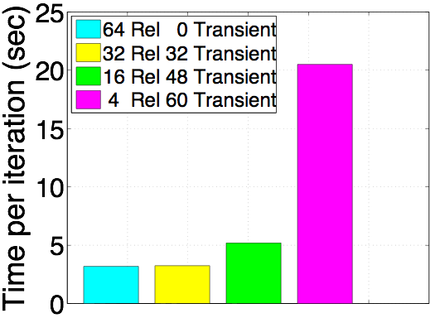
Stage #1 has a Weakness
ParamServs = Instances running server processes
64 c4.2x EC2 Machines
MF on Netflix Dataset
On-Demand Instances (Reliable)
Spot Instances (Cheap)
Costly
Cheaper
Cheap
Notes:
However is soon turned out that this new architecture had a problem, and this experiment here will demonstrate the problem to you. In this experiment we ran on a cluster of 64 ec2 machines and alternated how many of the machines we consider to ‘reliable’ red machines. the results are shown in time-per-iteration. The graph on the very right represents the traditional case where all machine are reliable so they would all be red. then we begin to decrease the number of red machine and substitute them for yellow machines. As you can see once the ratio becomes large 1-15 our performance is pretty terrible. However in order to save a good amount of money, we need this ratio to perform well. This problem happens become the servers running on the reliable resources become bottlenecked.

Slide 11
Solving the Server Bottleneck
Our solution is to shift load from few reliable resource to the many spot resources
Primary - Backup mechanism
Primary copies live on spot instances
ActivePS
Online Backups live on reliable resource
BackupPS
Notes:
So we came up with a solution that introduced the concept of ActivePS. For each shard of the parameter server, multiple ActivePS are assigned to it, each becoming responsible for 1/n of that shards rows. These ActivePS live on un-reliable resources and all workers communicate with only them. The ActivePS aggregate the updates and then push them to the original server shards which are now BackupPS.

Slide 12
ActivePS on Spot Instances (Stage 2)
On-Demand Instances (Reliable)
Elasticity
Controller
BackupPS
BackupPS
Worker
Worker
Worker
Worker
Worker
Worker
ActivePS
ActivePS
ActivePS
ActivePS
Worker
Worker
Worker
Worker
Spot Instances (Cheap)
Notes:
Mention all workers talk to ActivePS
So to show this in a picture. You can the red reliable resources have BackupPS and workers running on them. And the unreliable instances all have workers running on them as well as ActivePS on some of them. So all the workers communicate with only the AcrtivePS until the unreliable resources are turned off/evicted, at which point they can smoothly transition to communicating with the BackupPS who have been kept up to date by the ActivePS until the system adds back more unreliable resources.

Slide 13
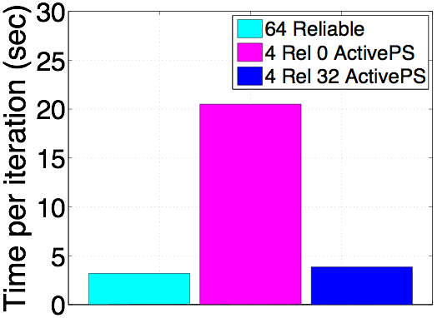
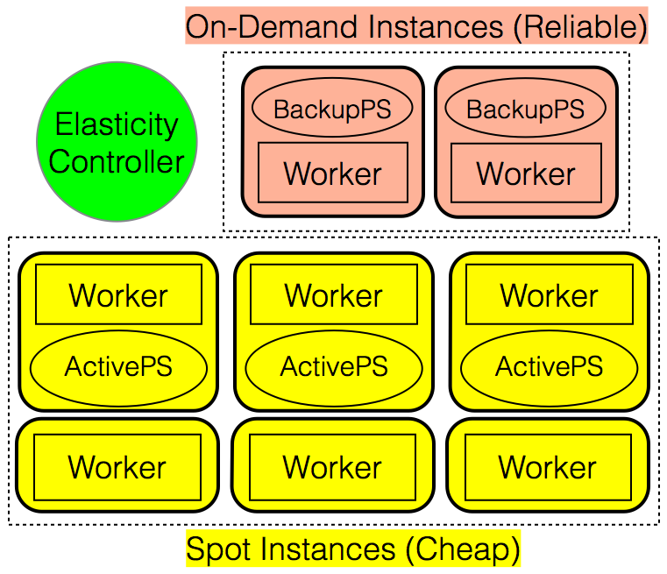
ActivePS Helps a Lot
64 c4.2x Machines
4 On-demand Machines
MF on Netflix Dataset
Costly
Cheap
Cheap
Notes:
It turns out that adding ActivePS to the architecture helps a lot. In this experiment with 64 machines the Y-axis is once agin time-per-iter. Once again the right bar represents the traditional PS case, and the bar on the left shows 4 red 60 yellow with no ActivePS running. Then for the 3 bars in the middle represent how setups with 4 red 60 yellow and different number of yellow machine running ActivePS. As you can see for ratios of 1-15 we are now getting much better results. Instead of 21 we are seeing results pretty close to traditional setup that has 64 reliable resources.

Slide 14
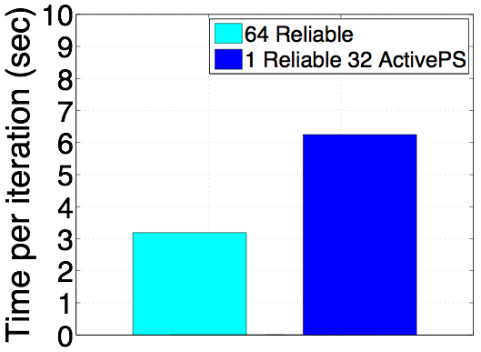
Becomes Slow at High Ratios
64 c4.2x EC2 Machines
1 Server
MF on Netflix Dataset
Costly
Cheap
Notes:
However there is still a problem with this architecture in some cases. This is an experimental result with 1 reliable and 63 unreliable resources. We have ActivePS running on 32 of the machines. You can see that our architecture is running almost twice as slow as the traditional architecture of treating all 64 machines as reliable.

Slide 15
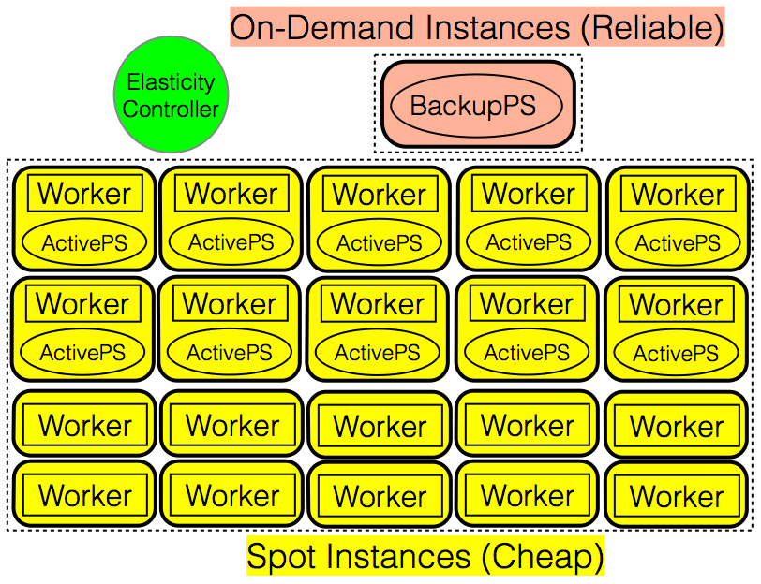
No Workers on Reliable (Stage #3)
Notes:
This happened because the workers running on the reliable resource were required to communicate with the ActivePS, however the updates form all the ActivePS to the BackupPS on that machine was leaving little network for the workers to use thus it was becoming a bottleneck. So for cases where we have steep ratios of reliable vs unreliable resources, we found that turning the workers on the reliable resources off to be an effective mechanism.

Slide 16
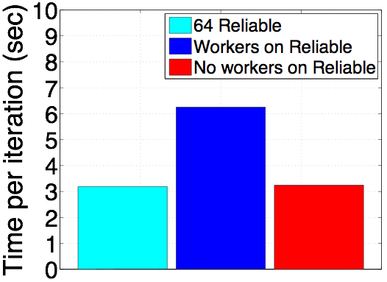
High Ratios no Longer a Problem
64 c4.2x EC2 Machines
1 On-Demand
MF on Netflix Dataset
Costly
Cheap
Cheap
Notes:
So this is the same experiment we just saw, but this time in the red graph, we turned off the workers running on the reliable resource, and as you can see we achieve performance close to that of the traditional architecture. So now we have a system that runs with little to no overhead, the question becomes how well does it actually perform elasticity.

Slide 17
Transitioning between Stages
Stage #1
Stage #2
Stage #3
On-Demand Instances (Reliable)
Spot Instances (Cheap)
Transition between stages at run-time
Little/No overhead for transitions
Transitions based on ratios
Notes:
At the end
Shown you how to design an elastic PS ML system with low overhead, now I want to show you just how low that overhead is

Slide 18
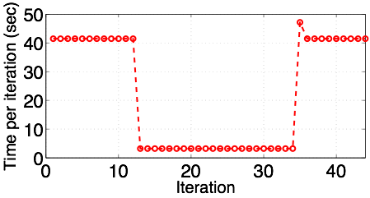
Efficiency of our Elasticity
4 machines ==> 64 machines ==> 4 machines
Notes:
Little overhead in adding resources because it’s done in the background
Small bump occurs because workers need to transition to transition back
to using the backup parameter servers
WHEN WE EVICT

Slide 19
So now we have Agile Elasticity
How do we take advantage of it?
Notes:
So not that we have build TierML, a system that performs agile elasticity, is able to use unreliable resources, and do these things at very little overhead, how do we take advantage of it?

Slide 20
Rules of the Amazon
Amazon EC2 Spot Market Rules:
User specifies bid, number of instances and instance type
Until Market Price rises about Bid Price you have resources
Billed Market Price at the beginning of every hour
If evicted, partial hour is free
Each instance type has its own market in each zone
Notes:
Emphasize partial hour is free
Standard bidding policy

Slide 21
BidBrain knows how to save you $$$$
BidBrain acts as resource manager
Acquires resources from AWS and allocates them to TierML
BidBrain creates allocations:
allocation: (instance type, bid price, number of instances)
Notes:
So to take advatanage of these rules we designed a system called BidBrain. It acts as a resource manager, where it acquires resources from AWS, and provides them to TierML. BidBrain makes all decisions based on allocations, where allocation is the instance type, user bid price, and the # of instances.

Slide 22
BidBrain TierML Implementation
Spot Market
Historical Data
1
2
BidBrain
TierML
6
3
4
5
AWS
1) Application Characteristics
3) Feed Spot Market
Price into BidBrian
5) AWS provides
resources to BidBrain
2) Feed Historic Spot
Market into BidBrian
4) BidBrain makes
allocation request
6) BidBrain provides
TierML with resources
Notes:
Slow down for 4,5,6

Slide 23
Goal is to minimize cost per work
Computes cost per work for current allocations
Builds a set of possible allocations
Allocation = (Bid, Machine Type, # of Instances)
For each possible allocation:
compute cost per work of current allocation + possible allocation
If it finds a lower cost per work, start the new allocation

Slide 24
Compute Expected Cost
Current Market Price
Historic Market Price
Bid Delta = Bid Price - Market Price
c4.2xlarge instance type in zone us-east-1a:
Bid Delta | Evicted within Hour | Expected Time to Eviction
$0.0005 | 55% | 42 Min
$0.01 | 5.5% | 738 Min
Notes:
This historic data is designed to provide BidBrain with an estimation about the reliability of resources depending on how much over the market price it decides to bid.
Mention Ideal Case
If you to take advantage of this free computing, you need a system like TierML that can handle evictions, now i will describe how midbrain decides how well the application will handle aggressive bidding

Slide 25
Compute Expected Work
TierML provides this information to BidBrain
how long after startup do resources become productive
Scalability
Scale in/out overhead
Eviction overhead

Slide 26
When to Consider Allocatons
Every 2 minutes
After any eviction event
End of billing hour
If not evicted
At 58 minutes after allocation decision decide if we want to ‘re-up’ or terminate allocation

Slide 27
Evaluation
TierML vs Checkpointing [Sharma et al ..]
BidBrain vs Bid On-Demand Policy
Bid On-Demand Policy (standard)
Choose cheapest resource
Bid On-demand Price (user bid = on-demand price)
On eviction repeat

Slide 28
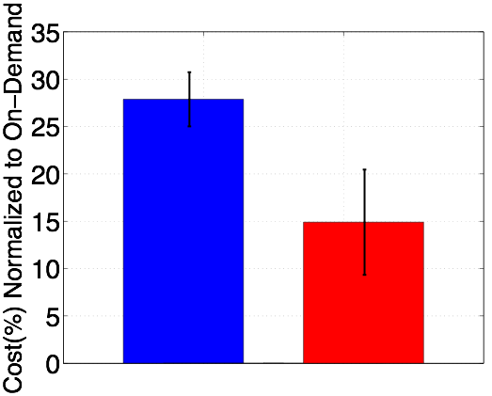
Combination of BidBrain & TierML Wins
Standard
+ CKPts
BidBrain+
TierML

Slide 29
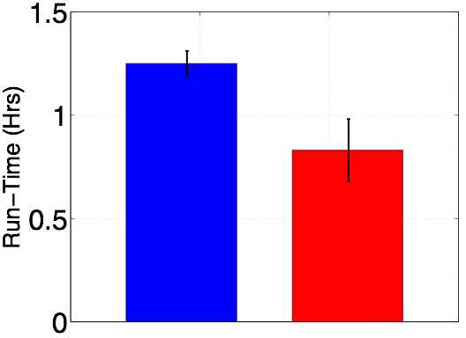
BidBrain + TierML is also Faster
Standard
+ CKPts
BidBrain+
TierML

Slide 30
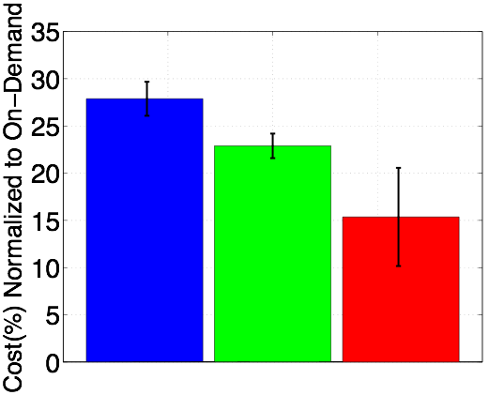
Importance of BidBrain
Standard
+CKPts
Standard
+TierML
BidBrain+
TierML

Slide 31
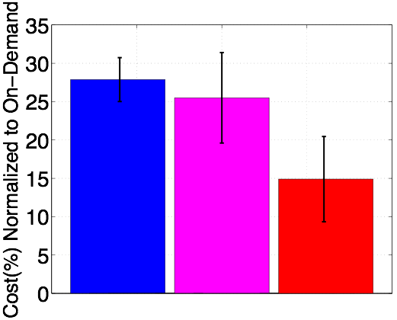
Importance of Elasticity
Standard
+CKPts
BidBrain
+CKPts
BidBrain+
TierML

Slide 32
Summary
Agile Elasticity (TierML) + Smart Bidding (BidBrain) take advantage of dynamic resource availability
Future Work
Generalizing BidBrain for other workloads

Slide 33
Backup Slides

Slide 34
References
Sharma, Prateek, et al. "Flint: batch-interactive data-intensive processing on transient servers." Proceedings of the Eleventh European Conference on Computer Systems. ACM, 2016.

Slide 35
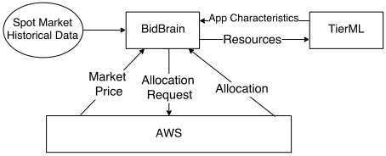
BidBrain TierML Implementation

Slide 36
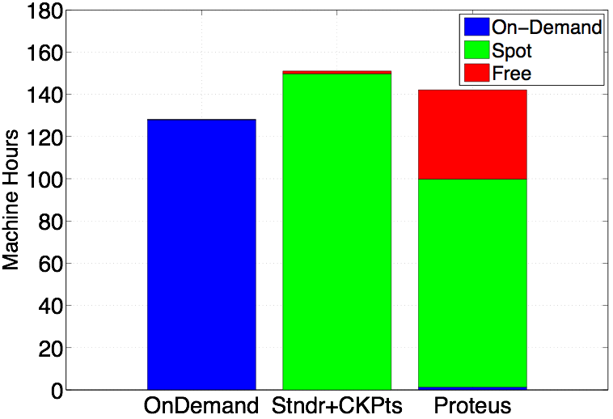
How much free compute do we get?

