Slide 1
Addressing the straggler problem for iterative convergent parallel ML
Aaron Harlap, Henggang Cui, Wei Dai, Jinliang Wei, Greg Ganger, Phil Gibbons, Garth Gibson, Eric Xing

Slide 2
One slide overview
Workers are a single thread on a machine
Stragglers are bad!
FlexRR combines flexible consistency and temporary work re-assignment
Designed for efficiency operation @ large scale
helper groups
Show big improvement across different computing clusters and workloads
Notes:
I want to start with a couple definitions and a brief summary of this talk. First i want to define what a worker is. A worker is a single thread on a machine, and every machine starts a up a worker for every core that it has.The first point I want to make, which you might have guessed from the title of the talk, is that stragglers are bad. Stragglers, which are workers, or machines, that run slower than other workers, have a very negative effect on run-time. We propose a system called FlexRR which combines flexible consistency bound, and temporary work shedding to address stragglers. I will describe FlexRR in detail and the concept of helper groups which are very important for FlexRR to operate efficiently at scale. Lastly I will show results across a number different kinds of clusters demonstrating the effectiveness of FlexRR.
Say that we achieve balancing by moving work from slow workers to faster workers
Say solve instead of address

Slide 3
Iterative Convergent ML
Matrix Factorization, LDA, PageRank, Multi Class Regression, etc…
Start with an initial guess
Iterate over training data improving solution
Converge to a “good” solution
Notes:
The first thing I want to describe to you in detail today is the class of ML algorithms for which FlexRR, our system, is designed for. Iteratively convergent algorithms such as MF, LDA, MLR, & PR start off with an initial guess at the solution, and then proceed to iterate over the training data improving the solution, until reaching the stopping criteria. A key property of these algorithms is that they converge to a good solution even if there are inconstancies in the solution updates, which makes them amenable to efficient distributed implementations.

Slide 4
Single Thread ML
Eg. a web graph
Eg. page ranks
READ, INC
Input data
(training data)
Iterative program fits model
Model parameters
(solution)
Notes:
This diagram shows a single worker implementation of a ML application. In this model, the worker makes a pass through the input data, making adjustment to the model parameters, which are the solutions, when necessary. You can think of each piece of the input as a piece of work. One such pass is called an iteration, also known as a clock cycle. The worker makes multiples passes through the input data until the model parameters converge. For efficiency reasons it’s very important for the workers to keep the input data in memory rather than having to read it from disk every time.

Slide 5
Parallel ML
Parameter server
READ, INC, CLOCK
Input data
(training data)
Parallel iterative
workers
Model parameters
(solution)
Notes:
This is a distributed implementations of ML application.
Here the input data is divided into multiple parts, and each worker works on a separate part of the training data. As you can see in the diagram, the green blocks representing the input data are now divided into separate blocks, with each block going to a different worker. During the computation, these workers concurrently read and update the shared model parameters, which is the solution state depicted in red. As in the single worker implementation, each worker pre-loads its portion of the input data and continues to work only on that data in order to avoid costly disk reads.

Slide 6
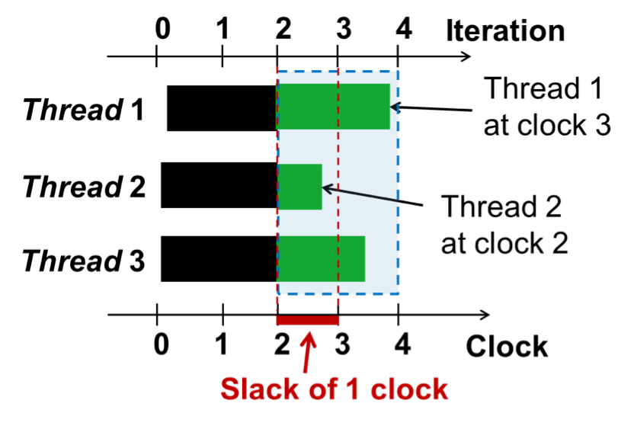
Parallelization Models
BSP: wait at each clock(barrier)
SSP: fastest <= slack + slowest
Increase in Slack bound lowers quality of work
Notes:
Most distributed implementations of iterative convergent algorithms follow the Bulk Synchronous Parallel, also known as BSP. In this model all workers wait for all the other workers to finish the current iteration before advancing to the next iteration. BSP guarantees that all workers will see all the updates from the previous iterations. This model forces the system to run at the speed of the slowest worker. In order to correct this, a newer model was created featuring a flexible consistency, this model is called Stale Synchronous Parallel, also known as SSP. This model allows each worker thread to be ahead of the slowest worker by up to a specified number of iterations. As I will show later, SSP is effective at dealing with stragglers to a certain extent, however once the stragglers exceed the staleness bound, it’s no longer effective. The problem with increasing the staleness bound to deal with higher magnitude stragglers, is that as the staleness bound grows, the convergence per iteration gets worse.
Explain that the quality of work decreases b/c the data you use becomes more stale

Slide 7
Origin of Stragglers
One worker slower than others
Short Term Causes
Garbage collection, Objective function computation (computing stopping criteria), resource contention
Long Term Causes
Load imbalance, heterogeneity of hardware
Notes:
As defined earlier stragglers are workers fall behind other workers. Straggles can occur for a number of different reasons. Some transient causes of stragglers include, garbage collection, resource contention and objective function computation. Long term causes of straggler include unbalanced data distribution and load imbalance to name a few. As the level of parallelism grows, so does the likelihood and the magnitude of the stragglers.

Slide 8
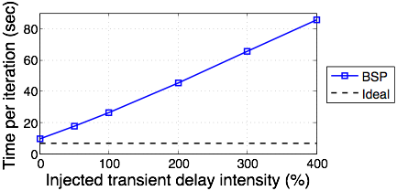
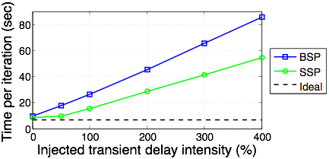
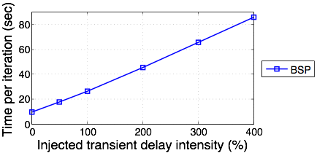
Effect of Stragglers
Emulating the effect of stragglers by injecting artificial stragglers
Notes:
To demonstrate the sever effect of stragglers, we ran an experiment where we injected different magnitudes of stragglers. Stragglers were simulated by injecting sleep commands. This experiment shows the runtime of BSP, and SSP with a slack of 1. The X-axis shows the different magnitudes of stragglers that we injected, while the Y-axis shows the effect these stragglers had on the time-per-iteration. We also show the ideal line which is what the run-time would be if all work was perfectly re-assigned without any overhead. As you can see, BSP suffers a linear increase in run-time. SSP is able to stay close to the ideal at first, but once the stragglers begin to exceed the slack boundary it too suffers from a linear increase in runtime.
Mention that 400% is unlikely but all the % are bad

Slide 9
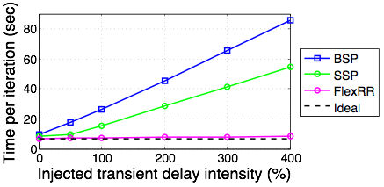
Quick Preview of our Results

Slide 10
New Approach: FlexRR
Initial Work Assignments
Rebalanced Work Assignments
Worker 1
Worker 2
Worker 3
Worker 4
Worker 1
Worker 2
Worker 3
Worker 4
FlexRR uses:
flexible consistency bounds (SSP)
temporary work re-assignment (RapidReassignment)
Notes:
So we came up with a new approach, which we implemented in ours system called FlexRR. FlexRR combines the flexible consistency bound of SSP and a specialized form of temporary work shedding. As shown in the diagram the goal FlexRR is re-assign work in such a way that all workers run as evenly as possibly, thus eliminating stragglers.
RR reassigns from faster workers to slower workers to even out the progress of al workers so that no worker gets stuck at a barrier.

Slide 11
RR Design
Constraints:
Input data is too big fit all of it into memory
All - to - All communication / synchronization is expensive
Central arbiter can be a bottleneck
Solution: Helper Groups
Helpers: eligible to help - if they are ahead they help
Helpees: eligible to provide help to
Notes:
However there are several problems that need to be resolved in order to perform efficient work re-assignment, or as we call it , rapid reassignment. As you remember from earlier in the presentation every worker preloads the input data that it’s going to be working on into memory to avoid expensive disk reads. Thus the worker that is providing the help, will also need to have the appropriate data preloaded into memory in order to help efficiently. The workers will also need to coordinate amongst each other about who helps who, and make sure that all work is performed exactly once. While at small scale it’s possible to have all the workers load all the input data, and perform all-to-all communication, this will not be possible or efficient at larger scale.

Slide 12
Helper Groups
Helpers pre-load input data
Only 25% replication required
avoids costly disk reads
Limited P2P Communication
Cheap messages - no overhead
Unique set of helpers & helpees
provides waterfall effect
4 of each
Notes:
Since we are designing FlexRR for scalability we created the helper groups. Similarly to an overlay network, workers exchange progress reports and offloaded work with only a few other workers. Each worker has a unique set of helpers, who are eligible to provide help, and unique helpees, to whom the worker is eligible to help. The helpers pre-load in the input data of the worker they are eligible to help, thus avoiding having to read the input data from disk at run-time, greatly improving efficiency. The workers groups allow for limited P2P communication eliminating the need for a central arbiter, or for all - to - all communication, thus improving scalability. Our experiments showed that helper and helpee groups of size 4 provided the best performance.

Slide 13
RR Protocol
Ok
Fast
Slow
Driven by fast workers
Multicast to preset eligible helpees
No additional resources
Ignore
(I don’t need help)
I’m this far
I’m this far
I’m behind
(I need help)
Help with N-10 to N
(red work
Started Working
Notes:
This diagram demonstrates an example of the RR protocol. Every worker tracks his own progress, upon reaching a certain checkpoint in the iteration, the worker sends a progress report to the workers who it’s eligible to help. These workers then compare their own progress to the progress report that they received, if they find that they have behind by more than the preset threshold than they re-assign a small portion of their work to the faster worker. Once the faster worker begins helping with this work, it will send a notification to the the original owner, who will then have the option of sending over more work. All these reassignments are temporary, so in the next clock cycle, the original owner will once again be responsible for all its work.
We are not adding addition

Slide 14
Experimental Setup
64 Node Amazon EC2 Clusters
c4.xlarge (4 - core instances) - $0.22 / hr
c4.2xlarge (8 - core instances) - $0.44 /hr
128 Node NSF Probe Cluster
16 Core machines
Movie Recommendation System
Netflix (MF) - 480k-by-18k matrix, 100m known elements
Netflix*256 (MF) - 7634k-by-284k matrix, 4.24b known elements
Notes:
This slide summarizes the 2 different clusters we used to test effectiveness of FlexRR. We used a local dedicated cluster of 16 virtual machine for most early experiments, and to tune the settings of FlexRR. We used 2 different classes of AWS ec2 machines to verify that the results on EC2 match the results on the local cluster. We also used a separate dedicated cluster to experiment on large data-set that did not fit into our other clusters.
Say that we are expecting more stragglers on the cheaper machines.

Slide 15
Acronym Time
BSP - Bulk Synchronous Parallel
SSP - Stale Synchronous Parallel
BSP RR - Rapid Reassignment running in BSP
FlexRR - our solution!

Slide 16
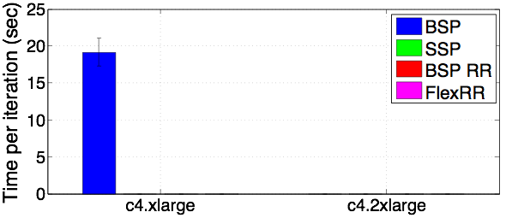
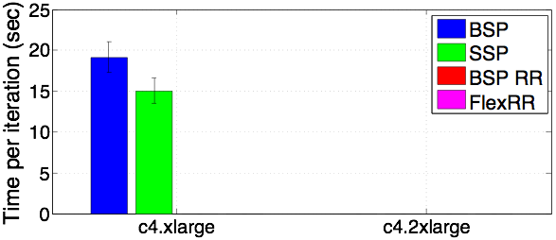
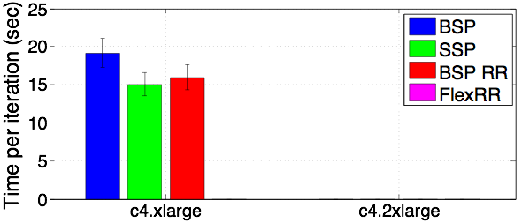
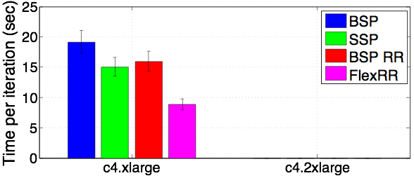
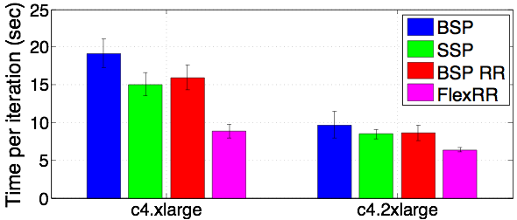
Significant Stragglers on EC2
Netflix (MF) workload (EC2 Clusters)
53% Improvement
Notes:
So now it’s time to examine at the effectiveness of FlexRR. This experiment consists of the two different classes of EC2 machines running the MF application. We show results for BSP, SSP with a slack of 1, RR w/o any slack, and FlexRR. The y-axis shows time per iteration, and x-axis shows the 2 different class of machines, with the c4.xlarge machines being the cheaper and slower of the two. On the lower class of machines FlexRR had an improvement of 53% and 39% on the higher class machines. The improvement on the c4.xlarge machines was greater because they experience more transient straggler effects.
Stress combination of SSP and RR is what is effective
Make sure to remind people what all the different acronyms mean.

Slide 17
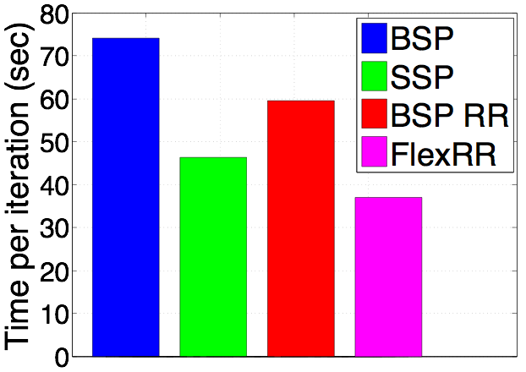
Stragglers at Scale
Netflix*256 workload
128 Node cluster
51% better
Notes:
To verify that FlexRR is still effective at larger scale, we ran MF application using the synthetically enlarged Netflix dataset, which is 256 times bigger than the original. This ran on a dedicated cluster of a 128 16 - core machines. FlexRR showed a 21% improvement from SSP and a 51% improvement over BSP. As expected, as the cluster size increased, we saw more straggler effects even on a dedicated cluster.

Slide 18
Summary
FlexRR solves the straggler problem
combines flexible consistency & rapid reassignment
helper groups are important for efficiency @ scale
35% - 53% improvement on EC2
Many more interesting results in the paper!

Slide 19
Backup Slides

Slide 20
References
[1] Ananthanarayanan, G., Ghosdi, A., Shenker, S., and Stoica, I. Effective straggler mitigation: Attack of the clones.
[2] Cipar, J., Ho, Q., Kim, J. K., Lee, S., Ganger, G. R., Gibson, G., Keeton, K., and Xing, E. Solving the straggler problem with bounded staleness.
[3] Cui, H., Cipar, J., Ho, Q., Kim, J. K., Lee, S., Kumar, A., Wei, J., Dai, W., Ganger, G. R., Gibbons, P. B., Gibson, G. A., and Xing, E. P. Exploiting bounded staleness to speed up big data analytics.
[4] Ho, Q., Cipar, J., Cui, H., Lee, S., Kim, J. K., Gibbons, P. B., Gibson, G. A., Ganger, G. R., AND Xing, E. P. More effective distributed ML via a Stale Synchronous Parallel parame- ter server.

Slide 21
Existing Solutions
Eliminating Performance Variation
Problem: difficult / sometimes impossible
Blacklisting struggling nodes
Problem: kills healthy nodes
Speculative Execution
Problem: Not suitable for iterative ML
Popular for bag of tasks, e.g: Hadoop
Notes:
There have been several prior attempts to address the problem of stragglers in big data. Some of the existing solutions include eliminating performance variation, blacklisting, and speculative execution.
However these solutions are not effective for iterative ML. Eliminating all sources of performance variation, while effective, is difficult and sometimes impossible to accomplish, especially when using a public cloud computing cluster. Blacklisting, where machines that are falling behind are eliminated, ends up killing nodes that are just experiencing transient stragglers. Speculative execution, where identical jobs are started on multiple workers in a race to finish first, is not suitable for iterative ML because of the incorrect behavior redundant work can cause, and it too unnecessarily wastes resource.
Need to mention that speculative execution is popular for Hadoop because all those are idempotent tasks , however iterative ML uses shared memory to hold the solution state, thus speculative executing can cause incorrect behaviour.
Use term work/task not job!
Speculative execution, while very effective for hadoop and other bag of tasks frameworks, is not suitable for iterative ML. Efficient iterative ML depends on non-idempotent tasks, which obviously are not amendable to speculative execution

Slide 22
RR Constraints
Notes:
However there are several problems that need to be resolved in order to perform efficient work re-assignment, or as we call it , rapid reassignment. As you remember from earlier in the presentation every worker preloads the input data that it’s going to be working on into memory to avoid expensive disk reads. Thus the worker that is providing the help, will also need to have the appropriate data preloaded into memory in order to help efficiently. The workers will also need to coordinate amongst each other about who helps who, and make sure that all work is performed exactly once. While at small scale it’s possible to have all the workers load all the input data, and perform all-to-all communication, this will not be possible or efficient at larger scale.

Slide 23
Helper Groups
Notes:
Since we are designing FlexRR for scalability we created the concept of helper groups. Similarly to an overlay network, workers exchange progress reports and offloaded work with only a few other workers. Each worker has a unique set of helpers, who are eligible to provide help, and unique helpees, to whom the worker is eligible to help. The helpers and helpees are never identical. The helpers pre-load in the input data of the worker they are eligible to help, thus avoiding having to read the input data from disk at run-time, greatly improving efficiency. The workers groups allow for limited P2P communication eliminating the need for a central arbiter, or for all - to - all communication, thus improving scalability. Our experiments showed that helper and helpee groups of size 4 provided the best performance.

Slide 24
RR Protocol
Ok
Fast
Slow
Driven by fast workers
Multicast to preset eligible helpees
Ignore
(I don’t need help)
I’m this far
I’m this far
I’m behind
(I need help)
Do assignment #1
(red work
Started Working
Do assignment #2
(green work)
Cancel
Notes:
This diagram demonstrates an example of the RR protocol. Every worker tracks his own progress, upon reaching a certain checkpoint in the iteration, the worker sends a progress report to the workers who it’s eligible to help. These workers then compare their own progress to the progress report that they received, if they find that they have behind by more than the preset threshold than they re-assign a small portion of their work to the faster worker. Once the faster worker begins helping with this work, it will send a notification to the the original owner, who will then have the option of sending over more work. All these reassignments are temporary, so in the next clock cycle, the original owner will once again be responsible for all its work.

Slide 25
Workloads
Movie Recommendation System
Netflix (MF) - 480k-by-18k matrix, 100m known elements
Netflix*256 (MF) - 7634k-by-284k matrix, 4.24b known elements
News classification
Nytimes (LDA) - 100m words in 300k documents, w/ a vocabulary size of 100k
Image classification
ImageNet (MLR) - 64K observations w/ feature dimensions of 21k & 1k classes
Notes:
We experimented using three ML applications, MF, LDA, and MLR. This slide lists some of the workloads that we used. For MF we used the Netflix dataset, we also used a synthetically enlarged version of the Netflix dataset that is 256 times larger than the original. For LDA we used the new york times dataset, and for MLR we used the ImageNet dataset.
Say that the details are not that important.

Slide 26
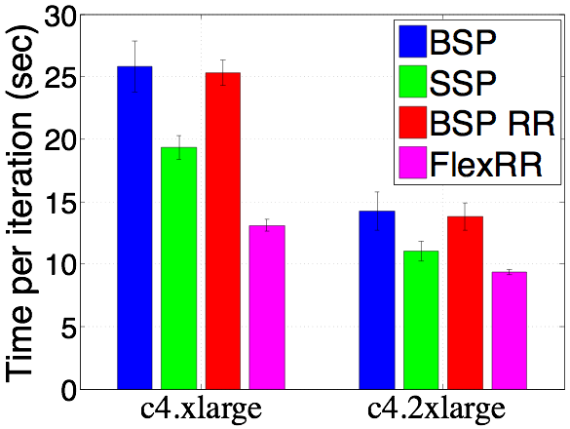
LDA Class Comparison

Slide 27
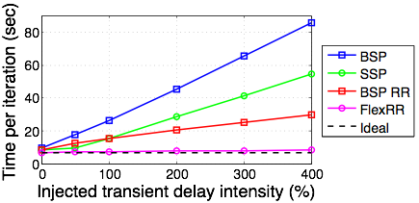
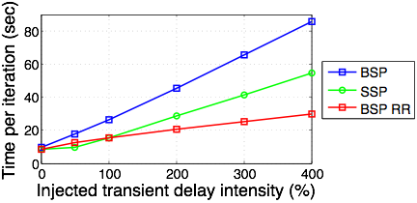
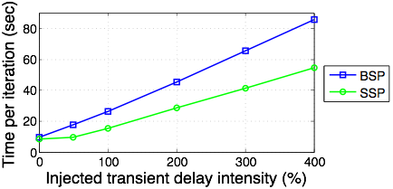
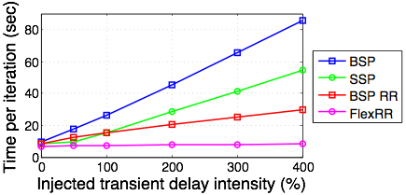
FlexRR close to Ideal
Netflix (MF) workload
c4.2xlarge machines
Notes:
This experiment shows the more expensive class of AWS machines running the MF application with injected stragglers. T stragglers are randomly generated and simulated by inserting sleep commands. This experiment shows the results for BSP, SSP with slack of 1, RR with no slack, FlexRR, and the ideal result. As you can see BSP, SSP, and RR on its own suffers from linear slowdown as the straggler intensity increase. At the same time, FlexRR stays close to the ideal result even with stragglers with intensity of 400% where it runs 10 times faster than BSP. @ 400% you are using 20% of CPU
Each workers independently chooses when to be delayed and how much slower it’s going to run

Slide 28
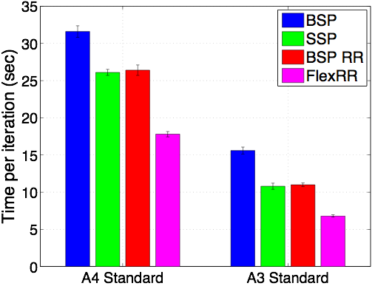
FlexRR Helps on Azure Also
Netflix (MF) workload
X percentage improvement

Slide 29
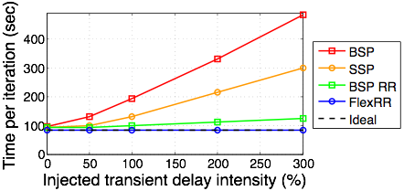
MLR Straggler Test

Slide 30
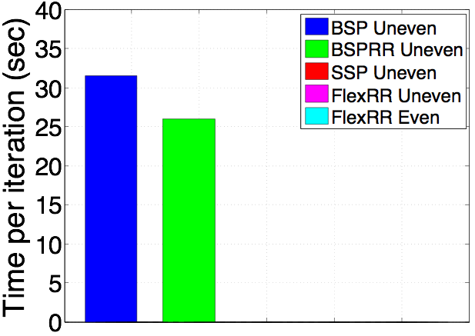
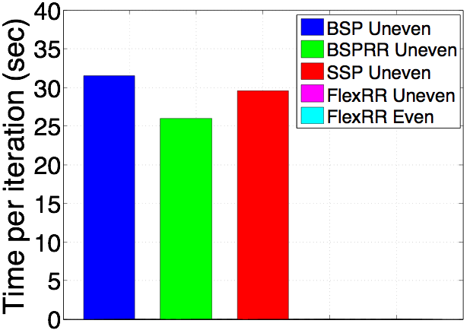
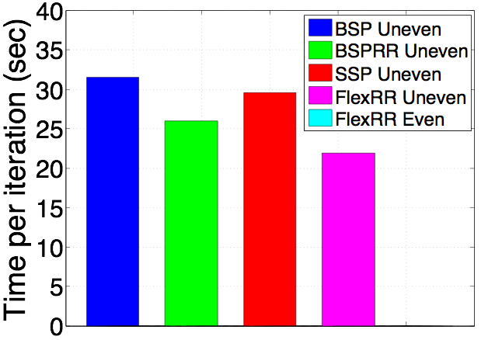
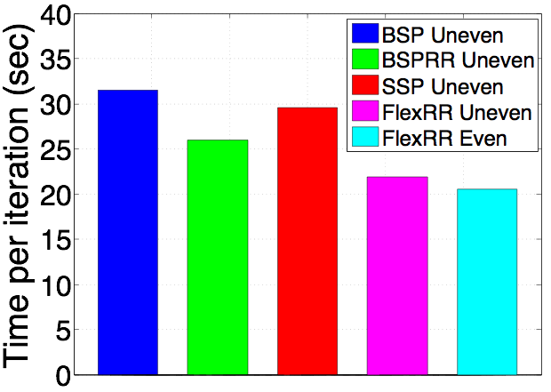
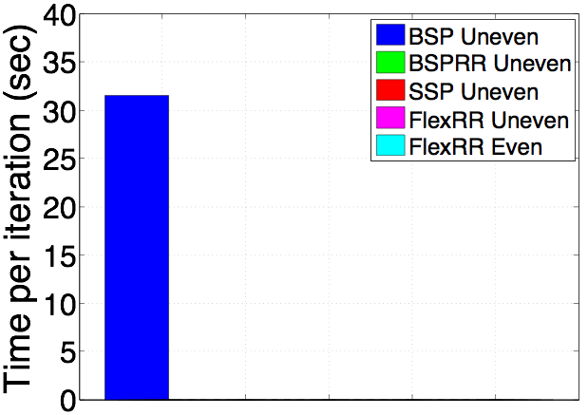
Long Term Stragglers
50% of machines given 75% of the workload
Notes:
While all the stragglers we have presented so far fall into the category of transient stragglers, this experiment shows long term stragglers. This experiment ran the MF application. To simulate long term stragglers half of the machines received 75% of the input data, while the ramming 50% were assigned 25% of the input data. We show results for running the uneven scenarios for BSP, SSP, RR on its own, FlexRR, and FlexRR where the input data is spread out evenly. Only FlexRR came close running at the speed of all work spread out evenly, while BSP experienced a 54% slowdown.
Emphasize that we re-assign work every iteration

Slide 31
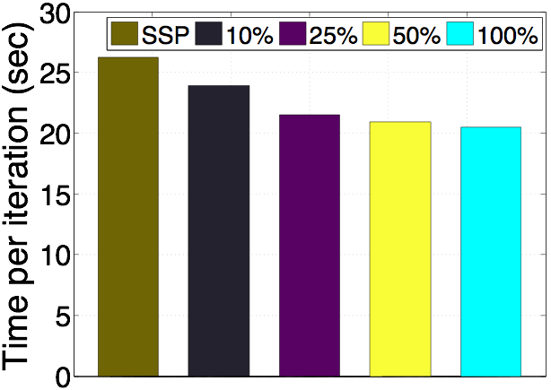
Works well w/ Partial Replication
Netflix workload
Replicate from the end input data / work assignment
Notes:
In all previous experiments worker replicated 100% of the input data belonging to the workers that they are eligible to help. This experiment demonstrates that it’s not necessary to replicate 100 percent of the data. In this experiment we replicated different amount of the input data, thus the helpers are only eligible to help with the portion that is replicated. These results demonstrate that replicating just 25% of the input data provides very similar results full replication.

