Slide 1
PipeDream:
Pipeline Parallelism for DNN Training
Aaron Harlap, Deepak Narayanan, Amar Phanishayee*, Vivek Seshadri*, Greg Ganger, Phil Gibbons

Slide 2
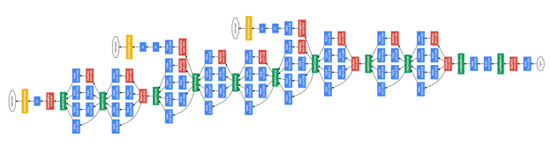


Example DNN
1000s

Slide 3

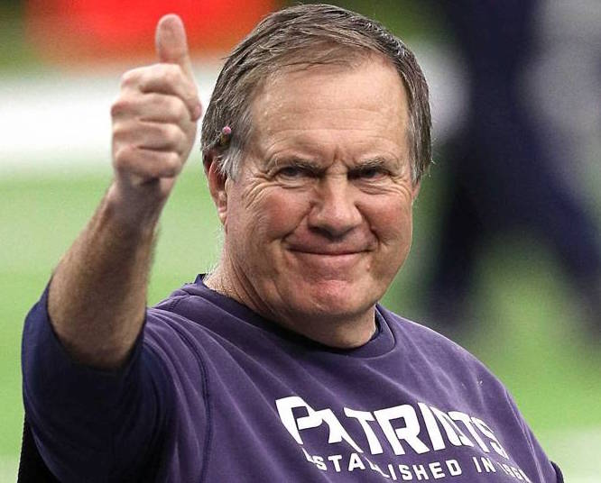
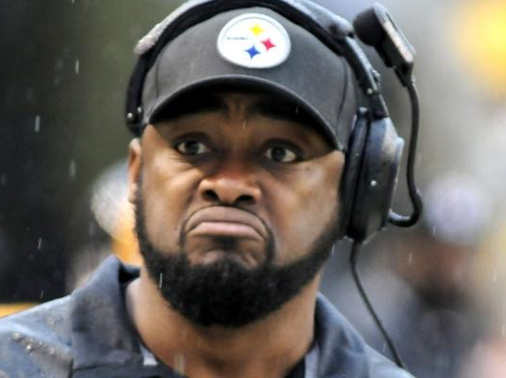

DNN - How they Work
Good NFL Coach?
Yes: 99%
Yes: 12%
Input
Output
No: 88%
No: 1%

Slide 4
DNN Training - How do they Learn
Forward Pass - Make a Prediction
Input
Output
Backward Pass - Update Solution Depending on Error
Notes:
EVALUATE!

Slide 5
Data-Parallel Training
Separate copy of model on each machine
Communicate updates to model parameters
various synchronization models can be used

Slide 6
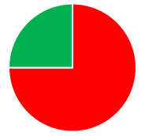
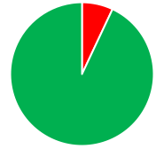
Problem w/ Data Parallel
Communication overhead can be high
Less communication lowers quality of work
Communication
Computation
VGG
OverFeat
Inception-BN
GooLeNet

Slide 7
New Approach: Pipeline Parallel
Assign layers to machines
communicate inter-layer activations
Machine 1
Machine 2
Machine 3

Slide 8
Alternate forward / backward work
Each machine does forward work then backwards work, then forward work etc…
Machine 1
Forward Compute Work #5
Backward Compute Work #1
Fw. Send #5
Machine 2
Forward Compute Work #4
Backward Compute Work #2
Bw. Send #1
Fw. Send #4
Machine 3
Forward Compute Work #3
Backward Compute Work #3
Bw. Send #2

Slide 9
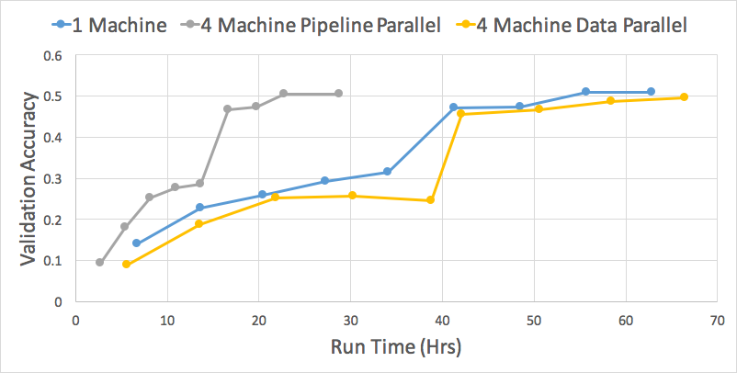
One Quick Result - Pipeline 2.5x better
VGG Network w/ ImageNet Dataset

Slide 10
Many More Interesting Details
Staleness vs Speed trade-off
How staleness in pipelining is different from data-parallel staleness
How to divide works amongst machines
GPU Memory Management
This and more at our poster!

Slide 11
Summary
New way to parallelize for DNN training
Communicate layer activations instead of model parameters
Improves over data-parallel for networks w/ large solution state

