Slide 1
Tributary: spot-dancing for elastic services with latency SLOs
Aaron Harlap, Andrew Chung,
Alexey Tumanov*, Greg Ganger, Phil Gibbons

Slide 2

Services with SLOs
Time varying client workloads
handled with elastically sized resources
How are they sized?
decide how many resources are needed
add/release resources
Notes:
Examples of services with SLOs include web hosting such as online store and machine learning inference services.

Slide 3
Elastic Service Architecture
User Requests
Fwd Requests
Load Balancer
Resources
Stats
Add Remove
Scaling Policy
Resource Manager
How many resources currently needed
Notes:
RM assumes failures are uncorrelated and uncommon

Slide 4
Why Tributary?
CSPs offer cheaper resources that come with potential of being taken away
GCE preemptible instances
AWS EC2 spot instances
Preemptions are bad for services w/ SLOs

Slide 5
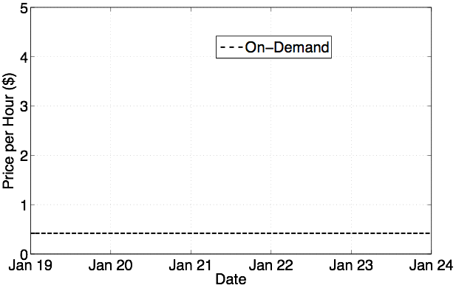
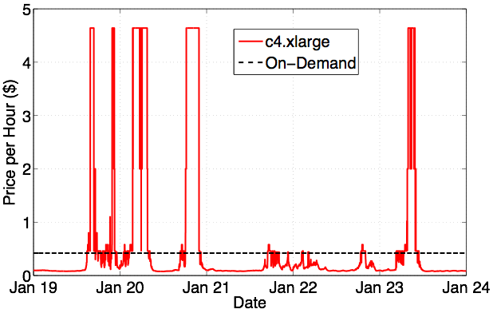
Transient resources much cheaper
Often 75-85% cheaper to use Spot Instances
Low Cost
Notes:
what amazon calls the on-demand price
After red describe how cheap it is and explain spot market rules
after blue uncorrelated markets - move indecently
nickels on the dollar

Slide 6
Spot Market Details
Many different spot markets
each instance type, in each availability zone, in each datacenter
empirically, markets are uncorrelated
If pre-empted, Amazon issues refund
during first hour only
Aquire resource(machines) by specifying:
<spot market, bid price, number of machines>

Slide 7
Tributary Changes how we Aquire Resources
Uses transient instead of reliable resources
while addressing bulk preemptions
Uses resource from multiple spot markets
predicts allocation P[preemption]
tracks inter-market correlations
maintains diverse resource buffer

Slide 8
Tributary Components
Predicting resource reliability
Constructing resource footprint

Slide 9
Influencing P[preemption]
User’s bids influence P[preemption] of spot instances
bid delta = user bid price - spot market price
Bigger Delta
lower P[preemption] and higher cost
Smaller Delta
higher P[preemption] and lower cost

Slide 10
Predicting P[preemption]
Predict P[preemption] as a function of bid deltas
Extract features
calendrical
temporal
Plug features into LSTM Model
models EC2 as a sequence of events

Slide 11
Constructing the Resource Footprint
Need to achieve capacity to satisfy SLO of client workload
Need sufficient diversity across markets
While expected request capacity < SLO:
Add resource that increases expected cost the least and increases request capacity the most.

Slide 12
Computing Expected Request Capacity
Compute probability of exactly 0 - N resources not pre-empted
Accounts for spot market dependencies
Encourages diversity
50%
50%
1 * 0.5 + 0.5 * 0.5 = 0.75

Slide 13
So Why Does this Work?
Creates a diversified, oversized footprint
able to tolerate preemptions
little or no extra cost
Handles unexpected workload spikes
handled via oversized natural resource buffers

Slide 14
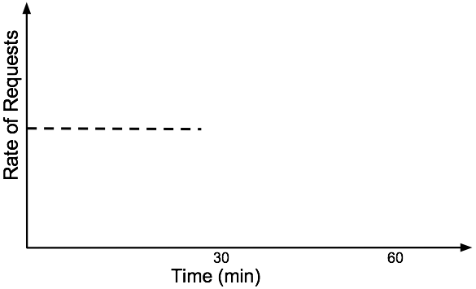
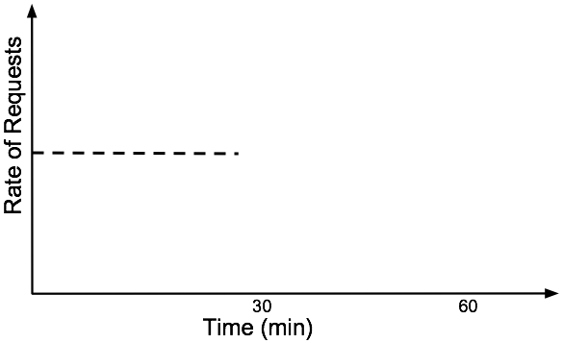
Time for an Example
AutoScale
Tributary

Slide 15
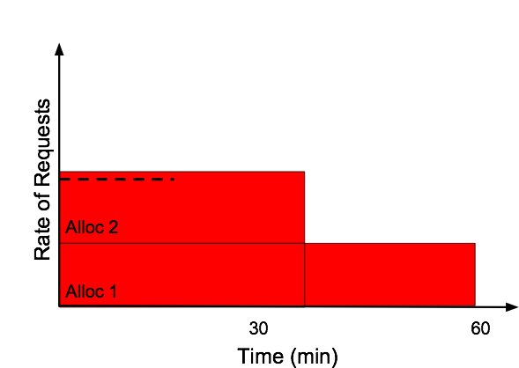
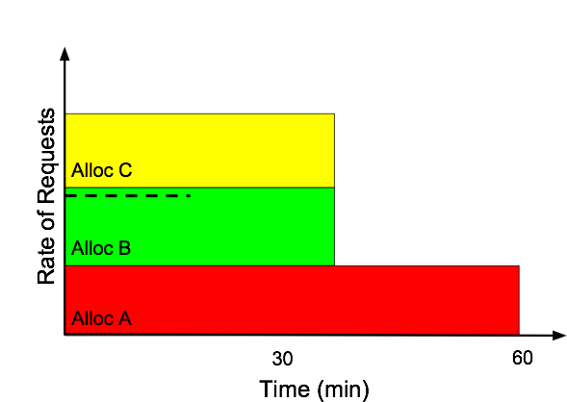
Time for an Example
AutoScale
Tributary

Slide 16
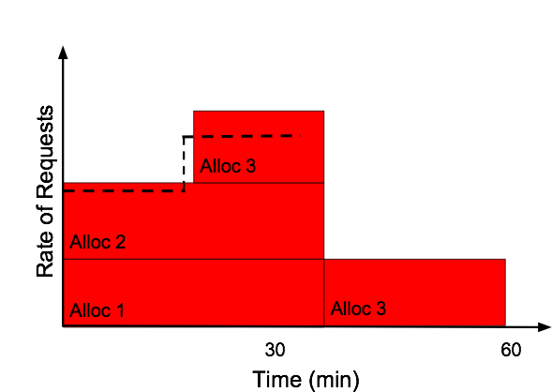
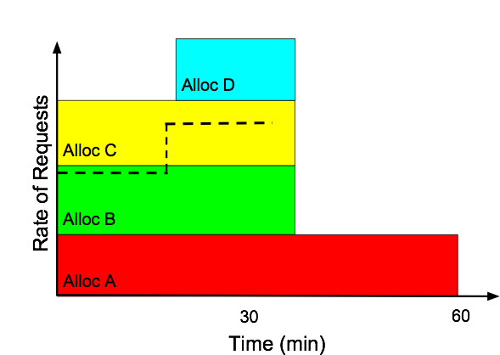
Tributary Serves More Requests
AutoScale
Tributary

Slide 17
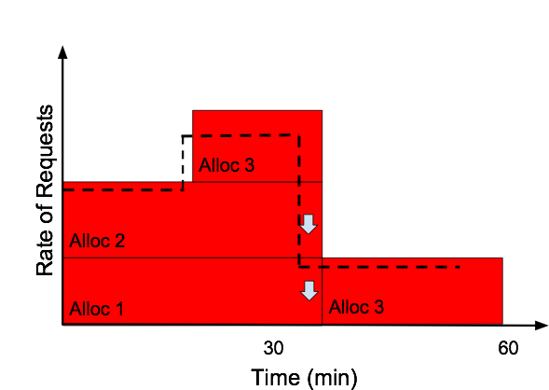
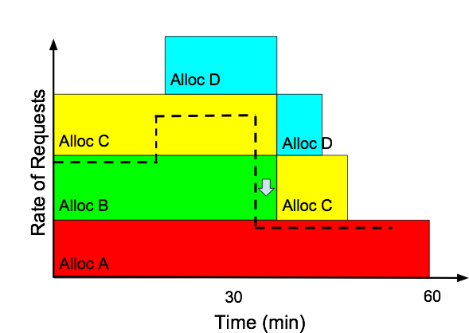
Request Rate Decreases
AutoScale
Tributary

Slide 18
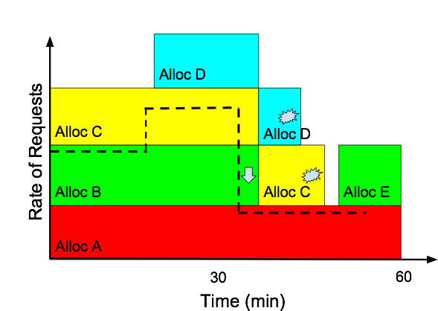
Tributary’s Resources are Pre-empted
AutoScale
Tributary

Slide 19
Experimental Setup
4 Traces Evaluated
show Clarknet
3 Scaling Policies
show reactive
Comparisons
Autoscale on spot
Autoscale+Buffer on spot
Tributary

Slide 20
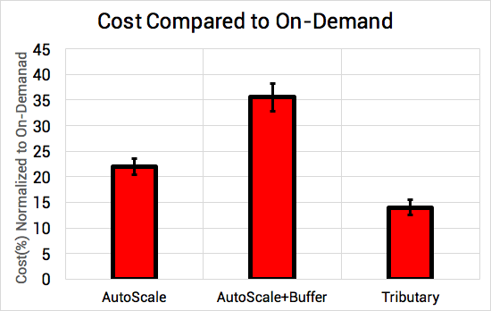
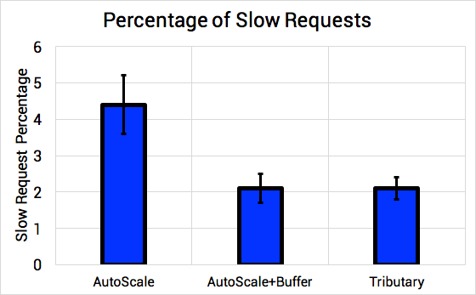
Comparing to AutoScale
AWS AutoScale
AWS service that acquires cheapest spot instances

Slide 21
Other Interesting Results
Across 4 traces Tributary reduces cost by 47-62%
Outperformed recent research systems
ExoSphere [Sharma 2017]
Proteus [Harlap 2017]
Only ~50% of cost saving come from preemptions

Slide 22
Conclusion
Provides reliable service using transient resources
Uses diversified buffers of resources
Reduces cost by ~85% over on-demand

