Slide 1
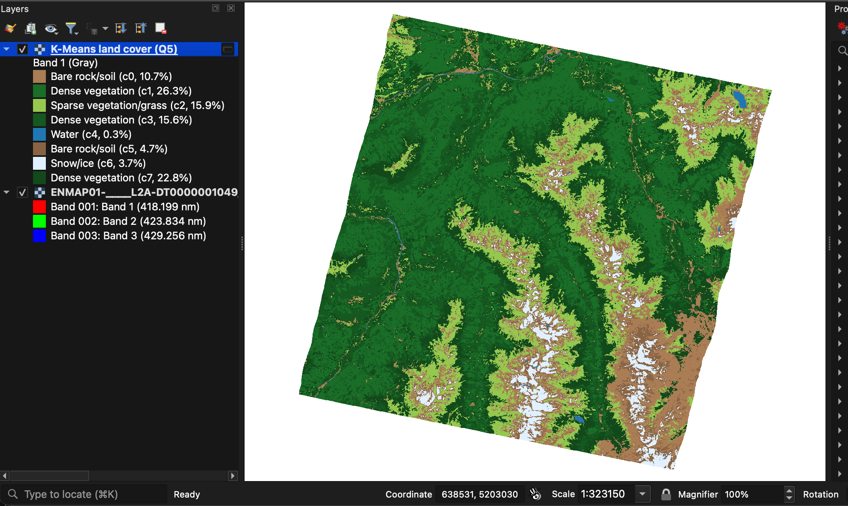
HyperSpatial
PROJECT PRESENTATION · 1. PROJECT TITLE
A local-first parallel and distributed hyperspectral analytics suite for QGIS
Machine-learned land cover of an EnMAP scene (Tyrolean Alps), produced and displayed inside QGIS
Aaron R
Digital University Kerala · October 2026
Notes:
HyperSpatial brings full-scene hyperspectral analysis into QGIS on an ordinary computer. It has two QGIS plugins: HyperSpectral Processer, which drives a native C++ engine for spectral indices, PCA and Spectral Angle Mapper target detection, and HyperSpatial Sedona Analytics, which runs Apache Spark and Apache Sedona jobs and a Spark MLlib K-Means land-cover model. The image on the right is a real result: an 8-class land-cover map of an EnMAP scene over the Tyrolean Alps, computed in about 12 seconds and shown with its automatically labelled legend.

Slide 2




Problem statement and motivation
224
686 MB
240 M
spectral bands per pixel
one EnMAP L2A scene
reflectance values in one scene
Memory-bound desktop tools
Vendor-locked GPU acceleration
In-memory Python tools struggle with full scenes on laptops
Mostly NVIDIA/CUDA or commercial — Macs, AMD, Intel left out
Big data lives outside GIS
ML needs labels and scripting
Spark-style analytics need code, clusters and data engineering
Many users never go beyond a single index such as NDVI
Goal: full-scene hyperspectral analytics inside QGIS — on the computer you already have, with no code and no cloud.
Notes:
Hyperspectral satellites such as EnMAP, PRISMA, EMIT and ISRO's HySIS record hundreds of bands per pixel. One EnMAP scene in this project is 686 MB with 224 bands — about 240 million reflectance values. GIS users face four barriers: desktop tools that load whole scenes into memory, GPU acceleration that is NVIDIA- or licence-bound, big-data engines like Spark that live outside the GIS and require programming, and machine learning that needs labels and code. The project's goal is full-scene analysis inside QGIS on ordinary hardware, without code and without cloud services.

Slide 3
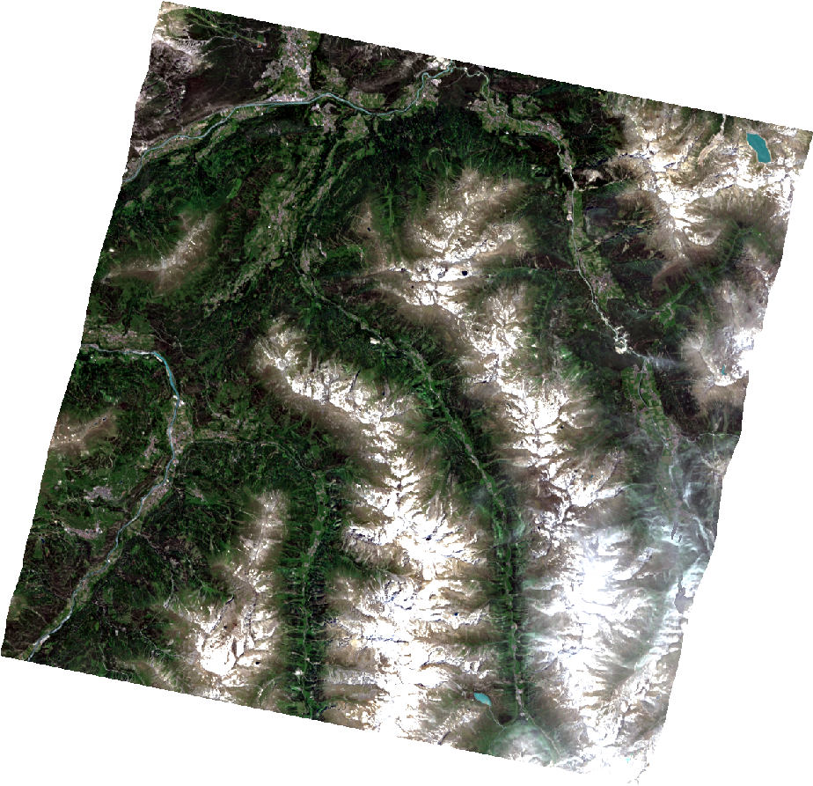
Data and geospatial layers
Layer | Type · source | Intended use
Spectral image cube | Raster · DLR EnMAP L2A | Input to all processing
Quality masks (8) | Raster · DLR, with scene | Validation reference
Metadata, ENVI header | Non-spatial · DLR | Wavelengths, scaling, no-data
AOI / field polygons | Vector · QGIS / authorities | Q1 AOI and Q2 zone statistics
Derived rasters | Raster · engine, Spark | Indices, PCA, SAM, class maps
Result tables | Non-spatial CSV · Spark | Statistics, cluster legend
EnMAP L2A · Tyrolean Alps · 12 Jun 2022 · 30 m · UTM 32N
224 bands (418–2446 nm) · Int16 × 10 000 · 686 MB
Notes:
The study data is one EnMAP Level-2A surface-reflectance scene over the Tyrolean Alps, acquired on 12 June 2022: 1259 by 1216 pixels at 30 metres in UTM zone 32N, with 224 bands from 418 to 2446 nanometres, stored as integer reflectance times ten thousand, 686 megabytes. DLR delivers eight quality layers with it — land/water/background classes, cloud, cloud shadow, haze, cirrus, snow, test flags and a pixel mask — which the project uses as independent reference data. Metadata and the ENVI header supply wavelengths and scaling. Users add AOI or field polygons as GeoJSON. Everything the project produces — tiles, index layers, PCA, SAM, class maps and CSV tables — is standard GeoTIFF, VRT or CSV.

Slide 4
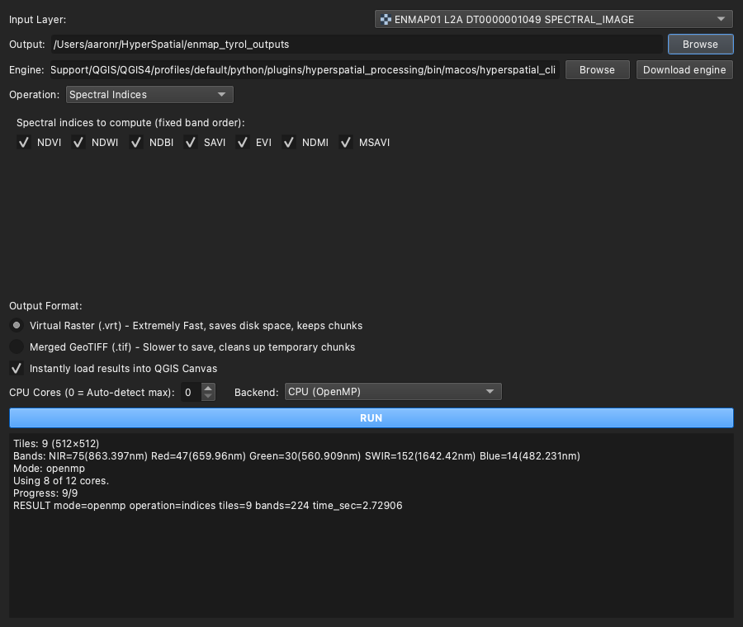
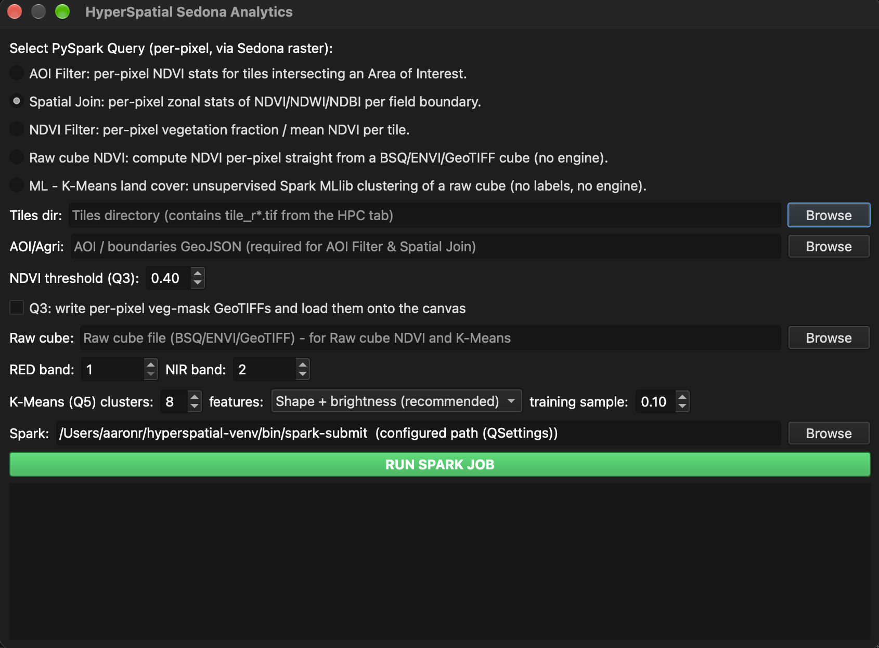




Interactive and dynamic functionalities
Results return to the QGIS canvas as styled layers with legends
Click-to-detect
CPU or GPU
Live and non-blocking
Pick a pixel; SAM finds similar material
OpenMP or OpenCL, automatic fallback
Live log; QGIS stays responsive
Auto-styled layers
Distributed queries
Tunable machine learning
Colour ramps, RGB and legends
Q1–Q5 Spark + Sedona jobs
Clusters, features, training sample
Notes:
The QGIS window is the dashboard: two plugin dialogs act as control panels and the map canvas shows every result. In the processing plugin the user picks a raster layer, chooses indices, PCA or SAM, the CPU or GPU backend and the number of cores, and clicks run; for SAM, clicking a pixel on the map captures its full 224-band spectrum. In the analytics plugin the user chooses one of five Spark jobs — AOI statistics, per-field joins, NDVI filtering, raw-cube NDVI or K-Means land cover — and sets the number of clusters and features for the machine-learning job. Progress streams live into the dialog while QGIS stays responsive; in automated tests the interface never froze for more than 0.21 seconds. Results load automatically as styled layers: stretched indices, RGB principal components, a SAM angle ramp with a detection mask, and a K-Means map with labelled legend.

Slide 5




Relevance, beneficiaries and impact
Researchers and students
Agriculture and forestry
Water and disaster agencies
Planners and the QGIS community
Full scenes on lab laptops, no cluster or licence
Per-field indices, vegetation masks and land cover
Water, snow and glacier detection in seconds
Built-up index; open, reusable plugins
Measured outcomes on the EnMAP study scene (Apple M4 Pro laptop)
2.5 s
3.4×
12 s
100 %
0.92
all 7 indices,
whole scene
faster on
8 CPU cores
machine-learned
land-cover map
model-to-map
agreement
snow precision vs
DLR snow mask
Relevance: growing EnMAP, PRISMA, EMIT and HySIS archives serve crops, forests, water, snow and cities — HyperSpatial puts them in the GIS users already work in.
Notes:
Who benefits: university researchers and students, who can analyse full scenes on lab laptops and Macs without a cluster, an NVIDIA GPU or a commercial licence; agriculture and forestry departments, through per-field index statistics, vegetation masks and land-cover maps; water-resource and disaster agencies, through fast water, snow and glacier detection; and planners and the QGIS community, through the built-up index and open, reusable plugins. The outcomes are measured, not projected: all seven indices for the whole scene in 2.5 seconds, a 3.4 times speed-up on eight cores, a machine-learned land-cover map in about 12 seconds, 100 percent agreement between the trained model and the produced map, and a snow cluster that matches DLR's snow mask with 0.92 precision; the water cluster reaches an intersection-over-union of 0.58.

Slide 6

Architecture and validated results
EnMAP L2A cube
224 bands · 686 MB
Processing plugin
indices · PCA · SAM
C++17 engine
OpenMP · OpenCL GPU
Engine outputs
tiles · VRT · PCA · SAM
QGIS canvas
layers + legends
tiles
GeoJSON zones
AOI · fields
Analytics plugin
Q1–Q5 jobs
Spark + Sedona
spatial SQL · MLlib
Job outputs
CSV · class maps
Validated on the study scene
Raw-cube NDVI = independent NumPy (0.5616)
CPU = GPU except 1 pixel in 1.5 million
Water cluster IoU 0.58 vs DLR water mask
All 10 QGIS-level tests pass
Notes:
The architecture has two lanes that meet in the QGIS canvas. In the upper lane the processing plugin runs the C++17 engine, which splits the scene into tiles and processes them in parallel with OpenMP threads, each with its own GDAL handle, optionally offloading to any OpenCL GPU with an automatic CPU fallback. In the lower lane the analytics plugin launches Spark jobs; Apache Sedona evaluates per-pixel raster functions inside the JVM, and for K-Means the model trained in MLlib is compiled into a map-algebra script so every pixel is classified without leaving the JVM. The engine's tiles are the bridge between the lanes. The chart shows runtime by thread count: 8.5 seconds serial, 2.5 seconds on 8 threads. On this Apple-silicon laptop the GPU path is correct but not faster: the work is dominated by file input and output, and GPU mode drives the kernels from a single host thread, so that I/O is not parallelised. On the right are the validation results: independent NumPy agreement, CPU-GPU parity, agreement with DLR's water mask, and the automated QGIS tests.

