Slide 1
Crushing the Coding Interview for the Anxious
Aaron Patula
Sr. Application Engineer @ Elavon
github.com/aaron678/coding-interview

Slide 2

Attention is a Limited Resource
Software agent model of cognition
Short term memory as a workspace
New situations increases cognitive load
Notes:
Size of short term memory is limited
Attention is a limited resource
White boarding coding tasks add additional cognitive load
Recall and performance declines
Start with something trivial- the method argument, inner loop
!!!! what to do when you are asked somethng you dont know- move forward relate to something you dont know

Slide 3
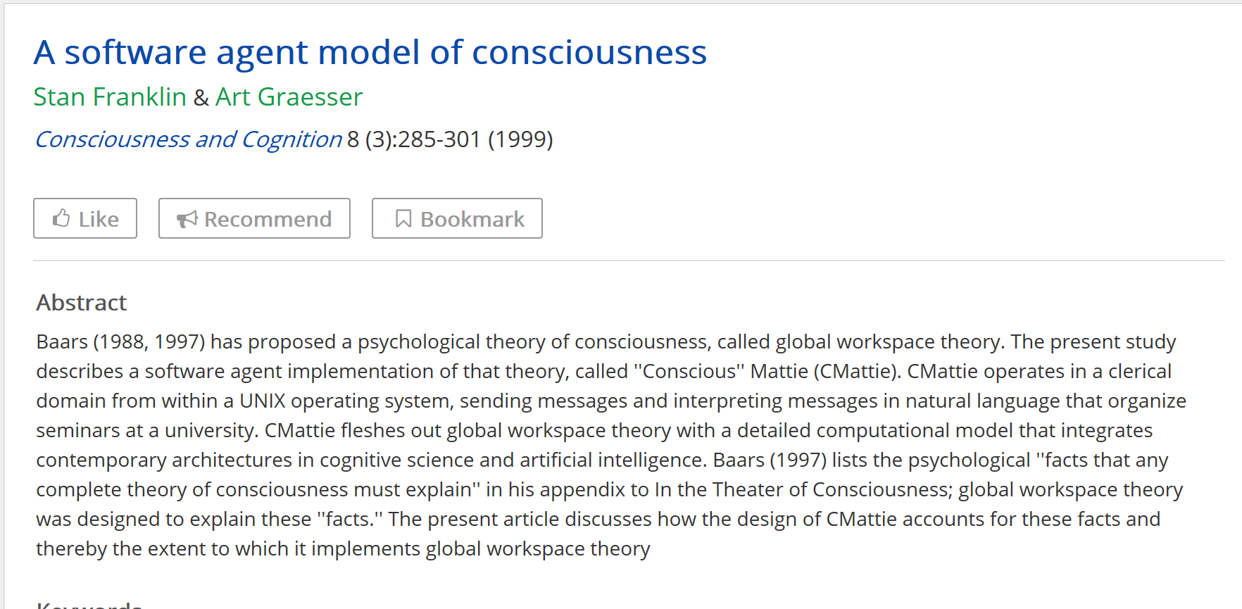


Slide 4
Attention is a Limited Resource
Software agent model of cognition
Short term memory as a workspace
New situations increases cognitive load
Notes:
Size of short term memory is limited
Attention is a limited resource
White boarding coding tasks add additional cognitive load
Recall and performance declines
Start with something trivial- the method argument, inner loop
!!!! what to do when you are asked somethng you dont know- move forward relate to something you dont know

Slide 5
Attention is Limited cont.
Emotional response (panic/ anxiety) can limit bandwidth
May not be able to recall basic facts
Lower problem solving performance
Negative feedback loop vs virtuous feedback loop

Slide 6
Solution- reduce anxiety
Habituate exposure
Simulation
Devise a strategy for when you don’t know something
Notes:
know that what ever feeling occurs you can handle it and still solve algorithmic problems
Talk thu algorithm before coding

Slide 7
Solution- reduce cognitive load
Practice with realistic environment
Overpractice simple coding exercises
Alternatives to whiteboarding
Talk out problem statement and algorithm first
Notes:
talking, writing corner cases, mentally executing code
30% new, 70% what you know
You don’t to be problem solving and coding at the same time
you recall info in the context in which it is studied
Start at the API and corner cases

Slide 8
The Coding Interview
Coding interview is a collaborative problem solving exercise
Not algorithm memorization
Master the simple things. Don’t cram advanced topics.
Take initiative in driving the problem solving
Notes:
Backwards (in context) thinking
Trade-off between space complexity and processing time
Corner cases- throwing an exception fulfills the api
Improve algorithms-
Data- sorted vs unsorted, single case vs collection, pos vs neg numbers, zero, large lists/ collections
Mental code execution, 'make the test fail'
Interviewer may be asking you to consider changed assumptions
Be first to discuss corner cases both in terms of data as well as typical cases (nulls, zero sized collections).
May be asked to consider changes in the initial assumptions of the problem
Consider improving the algorithm
Consider tradeoffs between space and time complexity
with you taking the initiative as opposed to you getting the answer right
Understand the basics well

Slide 9
How to Practice
Create your own coding interview
Backwards (in context) thinking
Overpractice simpler algorithms instead of more complex ones.
Practice with non-hinting cloud IDEs (codebunk.com) AND whiteboarding.
Read the Java source and comments
Notes:
public char[] toCharArray()Converts this string to a new character array.
Returns:a newly allocated character array whose length is the length of this string and whose contents are initialized to contain the character sequence represented by this string.

Slide 10
src/share/classes/java/lang/String.java
/**
* Converts this string to a new character array.
*
* @return a newly allocated character array whose length is the length
* of this string and whose contents are initialized to contain
* the character sequence represented by this string.
*/
public char[] toCharArray() {
// Cannot use Arrays.copyOf because of class initialization order issues
char result[] = new char[value.length];
System.arraycopy(value, 0, result, 0, value.length);
return result;
}

Slide 11
What Interviewers Really Want
How you solve the coding problem
State problem, API first, talk through algorithm
Corner cases, ‘fail the test’
Don’t freeze, make progress
Improve algorithms, refactor
Space complexity vs time complexity tradeoff
Talk tech
Managerial or architectural view
Notes:
Github, cloud, blog, twitter
Managerial or architectural discussion. Ask abt your resume. Ask a basic question about how requests are processed by a server. Have a two minute talk ready.
What problem did it solve? How?
What came before?
In-place vs algorithms that use a target data structure
Space complexity vs time complexity tradeoff- change algorithm or data
Consider orderedness of data, unsort vs grouped or sorted

Slide 12
What Interviewers Really Want cont.
Personal Projects
Github, cloud, blog
Success is CANNOT BE PERSUED but IS ATTRACTED by who you become
-- Jim Rohn
Notes:
Don’t based interview on what you can do, because there are always more asks.

Slide 13
Resources
Non-hinting cloud IDE- www.codebunk.com
N-back game for improving short term memory en.wikipedia.org/wiki/N-back brainworkshop.sourceforge.net/tutorial.html
Google coding interview https://www.youtube.com/watch?v=XKu_SEDAykw
A Software Agent Model of Consciousness - Graesser and Franklin, Consciousness and Cognition, 1999. Takeaway- Automating a task through overpractice reduces load on the conscious attention needed for problem solving. http://ccrg.cs.memphis.edu/assets/papers/Modeling%20Consciousness%20and%20Cognition%20in.doc

