Slide 1
Graduate Team 1’s Semester Project Final Presentation
CS 5320: Software Design
Semester: Fall
Aaron Elofson
Permission is granted for publication on the UCCS website.
Professor: Dr. Armin Moin

Slide 2
Project Idea
Service to pull in step and activity data from multiple services (Garmin, Google Fit, Coros)
Normalize the Data
Allow user to prioritize data based on source, time and activity
Display combined activity data in app or widget

Slide 3
Customer / End User
Athletes / Runners who have different devices or are part of different ecosystems.
Those who need more control over their fitness data.

Slide 4
What makes it Unique
Related Project - Health Sync
  Only transfers activities between services
  Doesn’t allow user to set preferences
  No UI to display activities
  Not open source
Ecosystem Health Apps (Apple, Google)
  Only for one brand of products
  Doesn’t support high end sports gear

Slide 5
Example APIs to be included
Google Health
  Requires android device to sync
Coros
  Requires development updates
Garmin
  Requires development updates
Apple (Health Kit)
  Requires apple device to sync data

Slide 6
Course Connection
Application of ADD 3.0
Architectural Style and Design Patterns
Software System Modeling and Views
Project Development

Slide 7
Project Path
Planning Path
  2 Main reasons
    Complex back end that would take longer than semester months to develop
    API Connection requests could take longer too long to return and require too much upkeep
  Diagrams and modeling will provide good plan for starting development

Slide 8
Design & Architecture
Patterns
  Thread Pool
Architecture
  Pipe and filter
  Repository

Slide 9
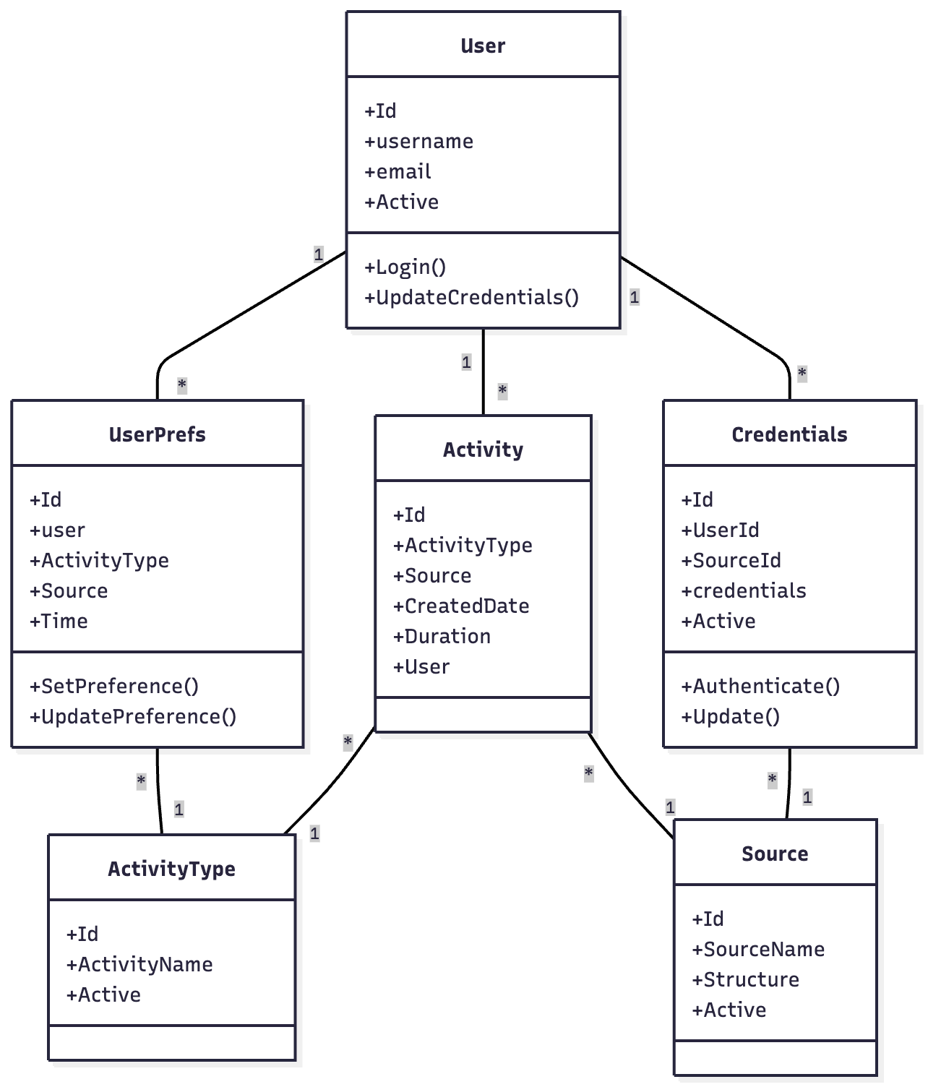
Class Diagram (Structure)

Slide 10
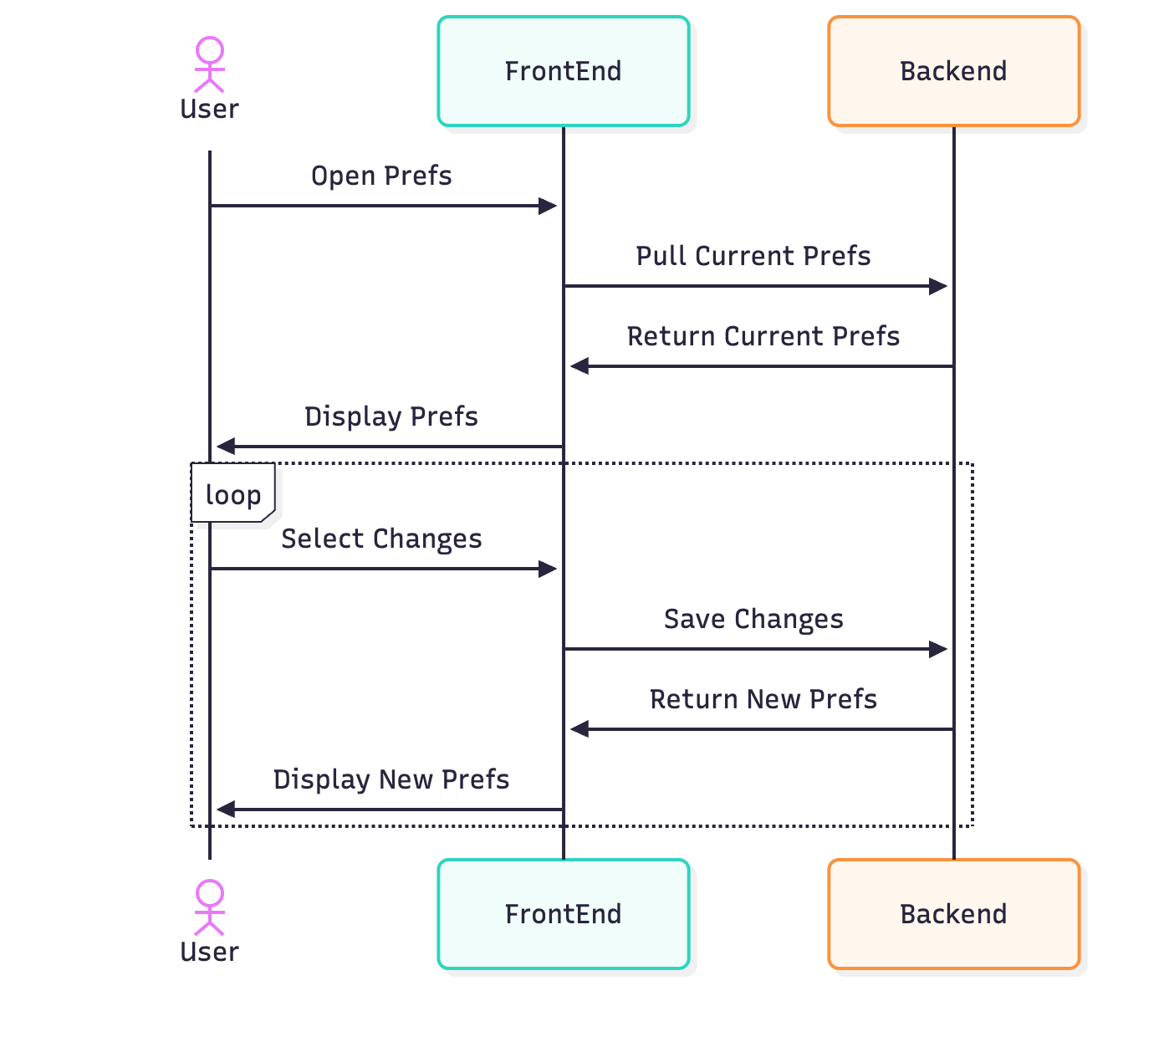
Sequence Diagram (Interaction)

Slide 11
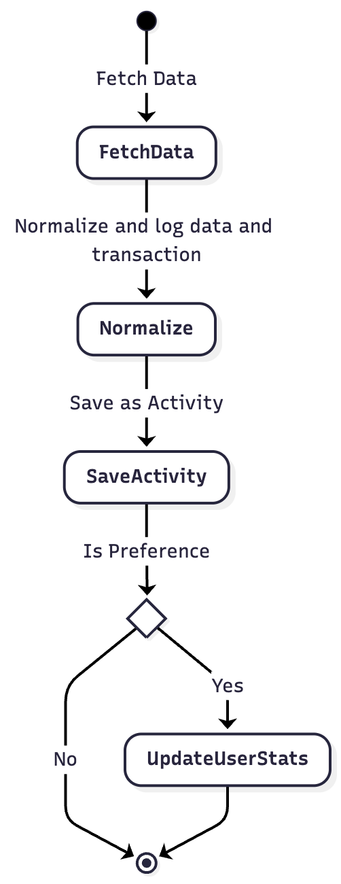
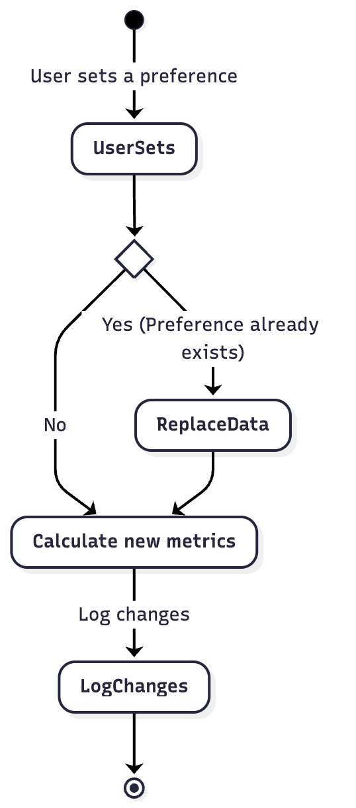
Activity Diagram (Behavior)

Slide 12
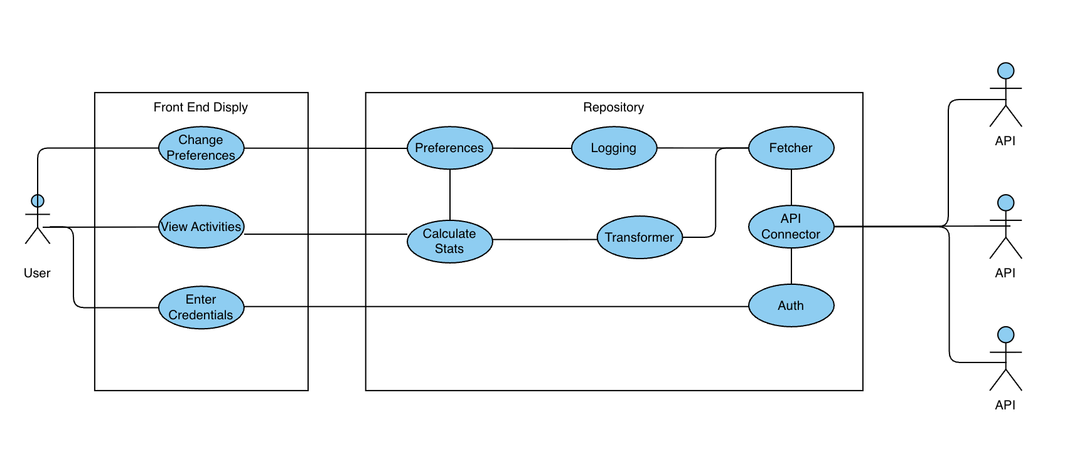
Use Case Diagram (Behavior)

Slide 13
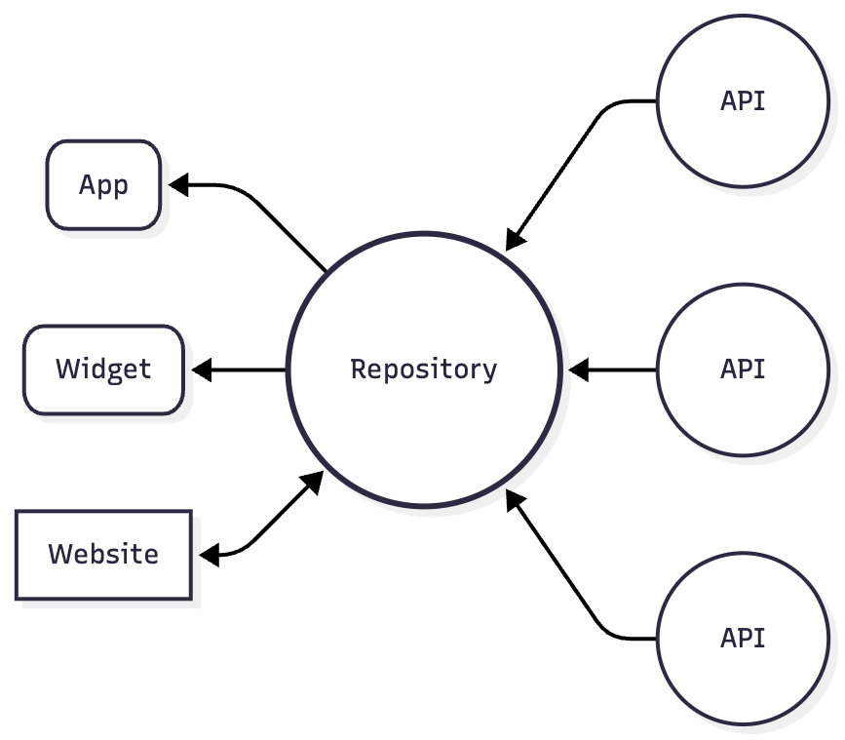
Architecture - Repository

Slide 14
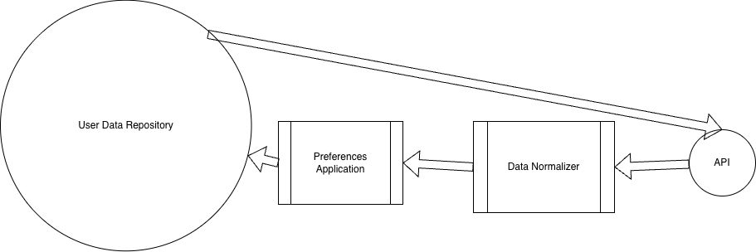
Architecture - Pipe and Filter

Slide 15
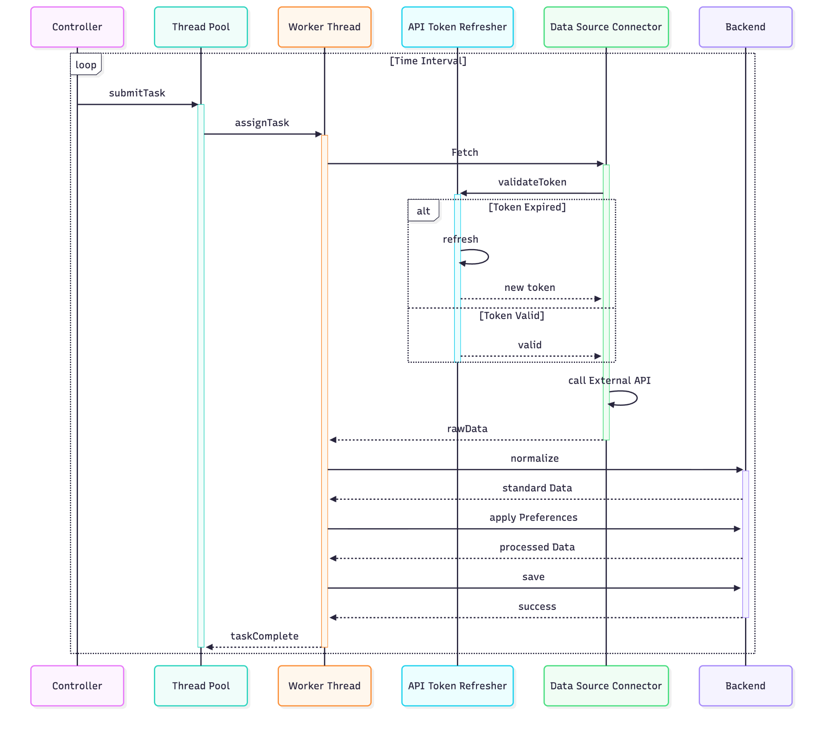
Design Pattern - Thread Pool

Slide 16
Schedule and Task breakdown
3 ADD Iterations
1 - Establishing an Overall System Structure
2 - Refining Application Structure
3 - API Calling and Implementation

Slide 17
ADD 3.0 - Use Cases and QAs
Use Case | Description
UC-1: Import Data from Multiple Sources | The user should be able to import data from multiple health services by connecting their account
UC-2: Set preferences for data | The user should be able to set preferences on which data sources take priority during certain days and times
UC-3: View aggregate step count in multiple ways | The user should be able to view their daily step count in the app, within a widget, and by notification
UC-4: Data from sources should be pulled automatically | Data from the user's connected accounts should be pulled automatically at set intervals
Quality Attributes | Scenario | Associated UC
QA-1 | The User should have the ability to deleted any and all data as requested from our service | UC-1
QA-2 | The user should have a log of all actions taken within the app to verify security | UC-2

Slide 18
ADD 3.0 - Constraints and Concerns
Constraints | Description
CON-1 | API standards must be maintained
CON-2 | User data must be secure
Concerns | Description
CRN-1 | Some API's may require frequent updates to keep active key.
CRN-2 | Some API's are only available on certain devices (Android, Apple)

Slide 19
Open Source & License
Github: https://github.com/aaron730/Coalesce
Allow developers to add different health app data pipelines
MIT License

Slide 20
Research
Consumer API Convergence Across Industries and The Future of APIs in an AI Web
  Compare how similar external APIs are across industries
  Explore structure and depth and see how each industry has converged
  Also view the current state of APIs and how they must evolve to work with AI

Slide 21
Research Questions
What is the state of API Standardization across global industries?
How do these industry-specific standardization drivers dictate the required strategic architectural approach for enterprise API integration
What are the foundational technical protocols and tooling that form the technical bedrock for modern industry APIs, and what are the key emerging trends

Slide 22
Research Methods
Comparative Analysis: The core method was to compare the findings across the ten sectors to draw universal conclusions.
  Count API Required fields
  Look at max nesting dept
Connect Research to other results found to gain broader picture

Slide 23
Research Conclusions
Industries that are more heavily regulated have more API structure.
Some APIs forgo structure and depth for Performance.
Commercial Industries rely on third parties for normalization.
Industries are coalescing around a small group of API technologies (JSON, REST, OAuth)

Slide 24
APIs with AI
Found some industries like Travel that are already looking to make APIs more AI friendly.
  Wrappers
  Ability to have AIs ask API calls what they do in real time

Slide 25
Questions?

