Slide 1
I Am Super SQL (And So Can You!)
Database performance issues, database tuning, and JMeter testing

Slide 2
Agenda
Agenda (what we are discussing right now)
Table structure
EXPLAIN
Indexes (indices?)
Network Optimization
N + 1 queries
Fetch size
Queries in Loops
Questions

Slide 3
Agenda (cont…)
What is Performance Testing?
JMeter
Load Test
Questions?

Slide 4
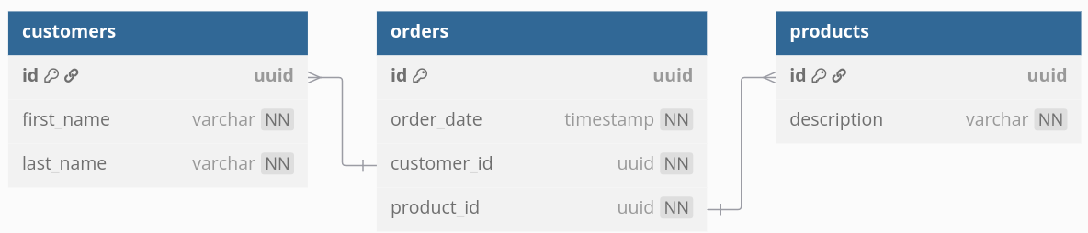
Table Structure + Environment
I also created two environments in the Enrollments database so we can run some queries…

Slide 5
EXPLAIN
Let’s create a simple query to get a particular customer’s order history.
Let’s take a look…

Slide 6
EXPLAIN (cont…)
What just happened?
Our lower environment has far fewer records (1,000,000 orders) than prod (25,000,000 orders)
Depending on the project, row counts can differ dramatically between environments
On a previous project, there were tens of thousands of rows in lower environments vs hundreds of millions of rows in production

Slide 7
EXPLAIN (cont, cont…)
Before we discuss the fix (indexes!), could we have known that this issue existed?
Let’s take a look…

Slide 8
Indexes/Indices
Q: What is an index?
A: At a high level, an index is a sorted copy of a column, pointing back to the corresponding row.
Additional disk space is use for an index and writes take a little longer.
Ask a DBA/tech lead/responsible adult before adding an index, but nearly all should be ok.

Slide 9
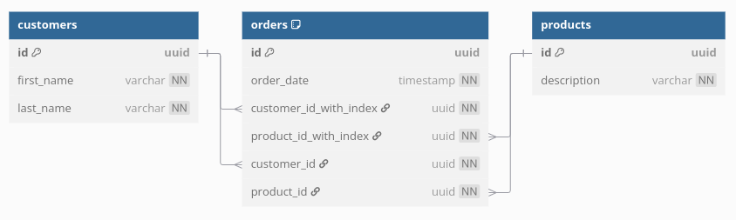
Updated Table Structure
Since adding a new index can take a while, I already added a couple indices (and lied to you about our table structure a little bit).
Let’s try our query out one more time and run another EXPLAIN…

Slide 10
Network Optimization (when good ORMs go bad)
Your ORM (Object Relational Mapper)/database library does quite a bit of work (not all of it good) behind the scenes.
Sometimes your ORM will do things that increase the number of trips in between your app server and the database.
Let’s look at a few different issues a well-meaning ORM might create.
I implemented a Java/Spring Boot app so we can examine some of these scenarios.

Slide 11
N + 1 Queries
Q: What is the n + 1 query problem (besides a great interview question)?
A: An n + 1 query is when your ORM makes multiple (unnecessary) trips between the app and database server to select the records across different tables you asked it for.
Happens a lot!
Let’s take a look at a concrete example…

Slide 12
N + 1 Queries (cont…)
Some symptoms of an N + 1 query are slow loading pages (despite indexes) and out of memory errors
Q: So how do we solve it?
A: SO MANY WAYS!
All ORMs have options to log SQL, let’s look at what that previous query/code generated…
All languages, frameworks, and ORMs handle the problem differently, but at the end of the day make sure your ORM is doing what you ACTUALLY want it to do
Let’s look at a fix for our query in JPA/Hibernate…

Slide 13
Fetch Size
Sometimes you need to bring in a LOT of records from the database to run a workflow on them.
You may need to tell your ORM how many records you want to bring in per round trip because otherwise it will just guess (poorly).
Let’s take a look at an example, and the fix…

Slide 14
Queries in Loops
There is one rule about queries in loops… don’t put queries in loops!
If you are SELECTing, UPDATing, or DELETing, use JOINs and WHEREs to update multiple records at once.
Use custom SQL if your ORM doesn’t provide an easy way to do what you need to do.
But what INSERTs?
All (good) frameworks provide methods of bulk insertion.
Let’s examine a bad way to do INSERTs, and a good one…

Slide 15
To Review!
Run an EXPLAIN on your queries in production (if you don’t have prod access, make friends with someone who does!)
Add indexes where appropriate, but nearly all should be OK.
Enable SQL logging so you know what your ORM is ACTUALLY doing!
Make sure you are writing code in your language/framework to reduce the number of round trips.
NEVER put queries in loops.

Slide 16
SQL/Application Questions?
Any questions on the app side before we transition to performance testing?

Slide 17
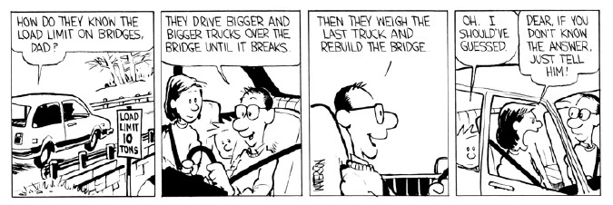
Performance Testing
What is performance testing?

Slide 18
To Quote Google’s Gemini: What is a JMeter and Why Is It Used?
A gem of the open-source community for load testing.
Version 1.0 was released in 1998
Its UI shows ☹
JMeter is a very powerful tool for load testing.
Let’s look at a JMeter script I wrote to test our Spring Boot app…

Slide 19
Questions?

