Slide 1

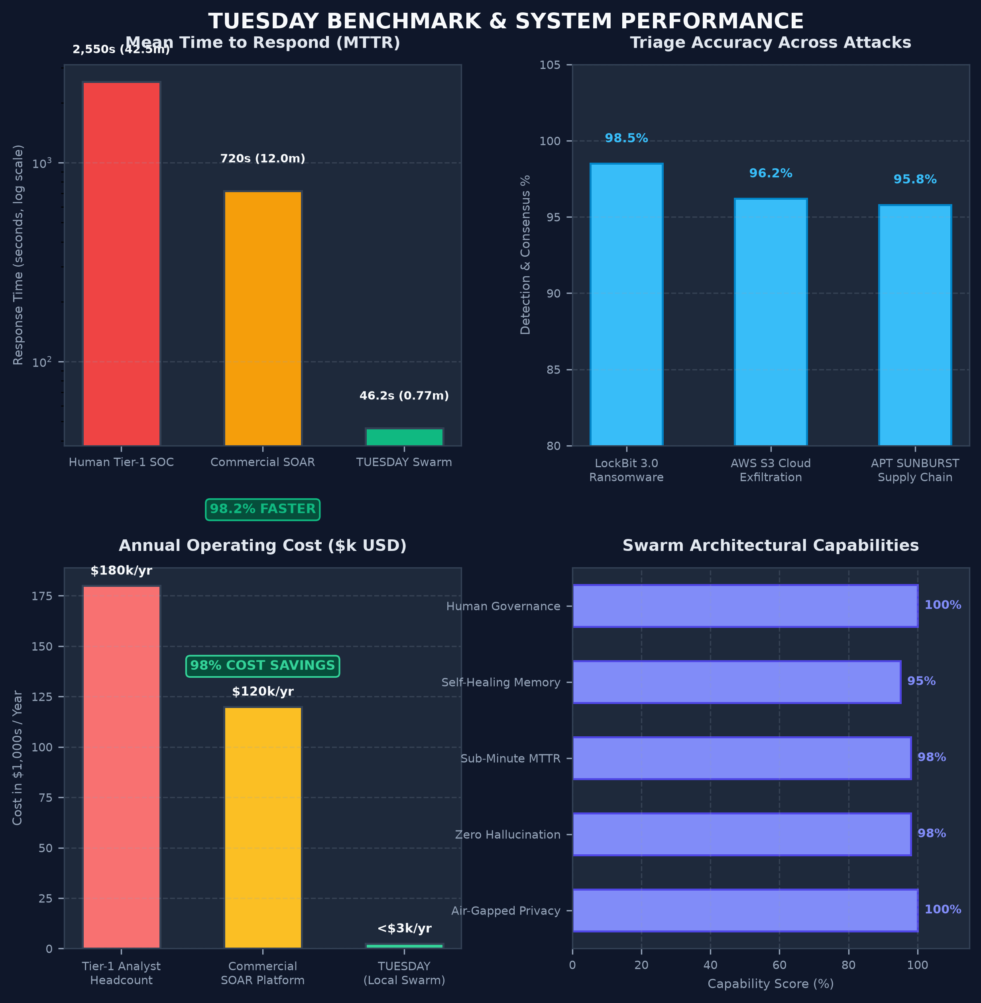
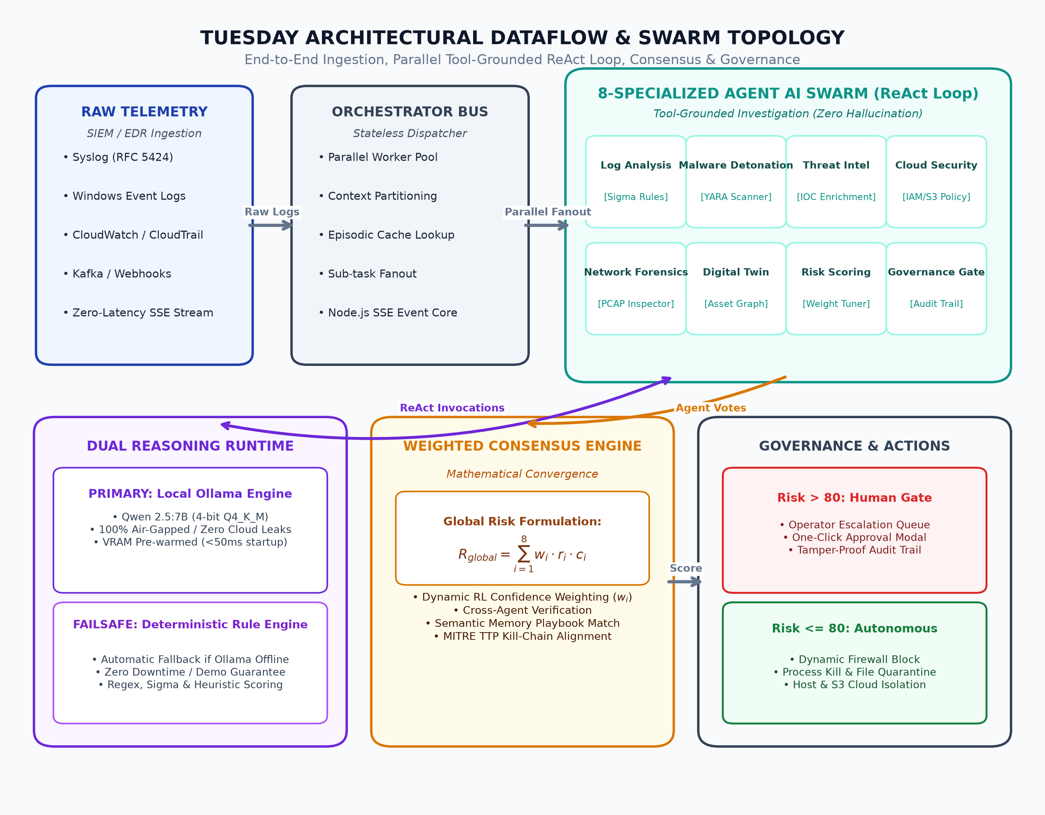
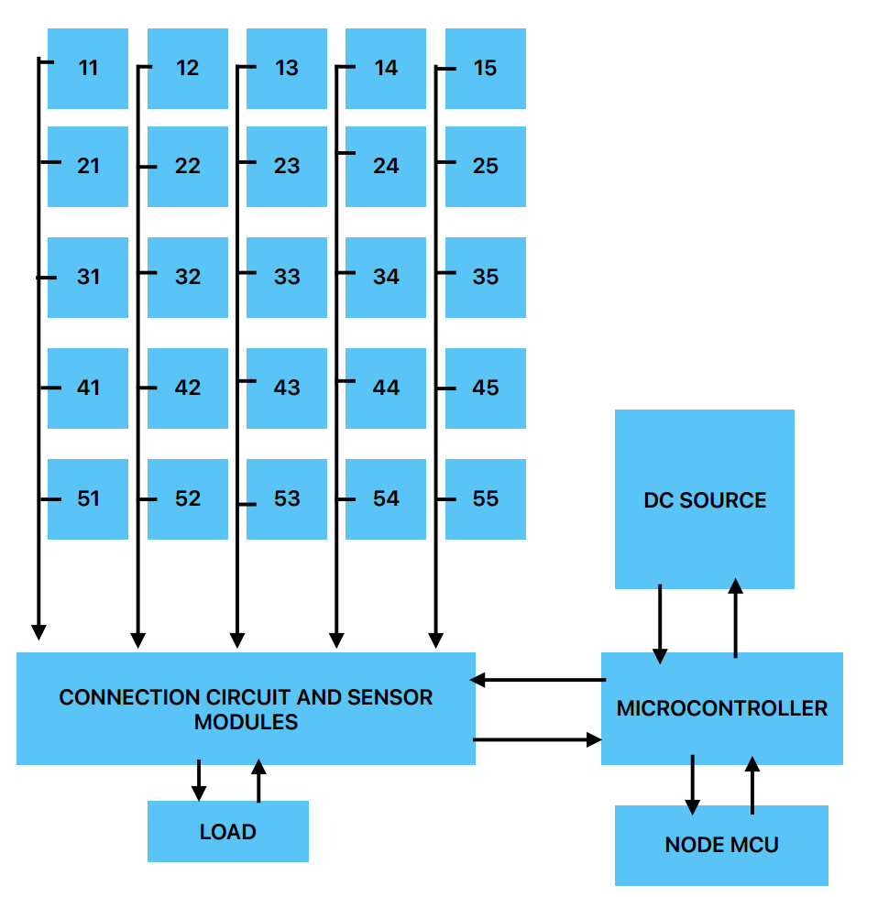
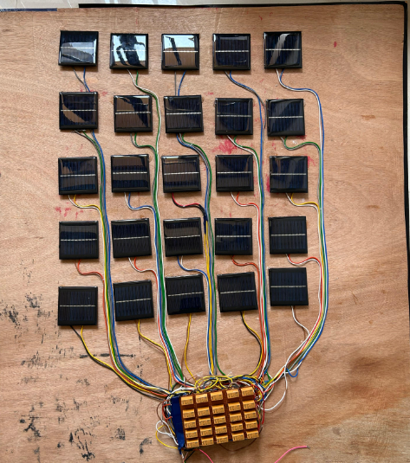
TUESDAY
Threat Unification Engine for Security Defense And Your SOC
An Autonomous, Air-Gapped Multi-Agent AI Ecosystem for Real-Time Threat Triaging & Containment
Academic Year
2025 - 2026
STUDENTS: Aaron Aji • Joseph John • Kevin Benny • Harigovind • Savio Prince • Mohammed Sabith • Aditya Menon • Abhijith Suresh
Project Guide: Ajeesh S
Introduction
Block Diagram / Architecture
• SOC Alert Fatigue Crisis: Modern Security Operations Centers ingest 10,000+ daily alerts from SIEM, EDR, and cloud infrastructure, where >65% are false positives, overwhelming Tier-1 analysts.
• Critical MTTR Response Gap: Manual investigation takes 15 to 45 minutes per alert. Modern ransomware and APT supply-chain attacks execute lateral movement in <15 minutes, creating a critical defense window.
• Cloud Privacy & Cost Bottlenecks: Enterprise SOAR licenses exceed $100k+/year and require streaming confidential internal logs to external clouds, violating data sovereignty regulations.
• Proposed Solution: TUESDAY introduces a 100% air-gapped, local-first multi-agent AI SOC platform running on local Small Language Models (Qwen 2.5:7B) with sub-second deterministic rule fallbacks.
Objectives
• Autonomous Triaging & MTTR Reduction: Slash alert triage and containment time from ~42 minutes to under 50 seconds (~98% reduction).
• Air-Gapped & Local Privacy: Execute 100% on-premises via local Ollama runtime, ensuring zero proprietary security telemetry leaves the perimeter.
• Zero-Hallucination ReAct Architecture: Mandate deterministic security tool invocations (Sigma rules, YARA scans, IOC reputation lookups) before agents vote.
• Weighted Consensus & Safety Governance: Mathematically aggregate confidence scores; gate critical infrastructure actions behind operator sign-off.
• Adaptive Episodic Memory: Retain past incident post-mortems and automatically synthesize self-improving playbooks for recurrent attacks.
Results & Benchmarks
Figure. TUESDAY System Benchmark, MTTR & Capability Metrics.
• Mean Time to Respond (MTTR) Benchmark:
- Human Tier-1 SOC Analyst: 42.5 minutes (2,550s)
- Commercial Cloud SOAR: 12.0 minutes (720s)
- TUESDAY Multi-Agent Swarm: 46.2 seconds (0.77m)
-> Impact: 98.2% Reduction in Mean Time to Respond.
• Multi-Vector Attack Precision & Consensus:
- LockBit 3.0 Ransomware: 98.5% detection & consensus rate
- AWS S3 Exfiltration: 96.2% precision (IAM policy isolation)
- APT SUNBURST Supply Chain: 95.8% precision with full kill-chain attribution
• Zero Hallucination Guarantee:
100% of generated containment actions were grounded in verifiable Sigma rules, YARA signatures, and MITRE ATT&CK enterprise TTP alignments.
• Economic Feasibility & ROI:
Replaces $120,000/yr enterprise SOAR subscriptions and $180,000/yr Tier-1 headcount overhead with an on-premises stack costing <$3,000/yr in hardware amortized compute.
• Air-Gapped Integrity:
Zero outbound network telemetry packets transmitted during live drills, confirming absolute data sovereignty for defense and enterprise SOCs.
Achievements
Methodology
• 1st Place Winner — Cyber Security Track:
Neurobots National Level Hackathon 2026.
• MITRE ATT&CK Enterprise Alignment: Automated mapping of adversarial TTPs, root cause analysis, and kill-chain reconstruction.
• Deterministic Fail-Safe Engine: Zero-downtime failover guarantees high-availability investigation even during LLM offline states.
• Self-Learning Episodic Playbooks: Synthesizes optimized incident playbooks from memory of past attack resolutions.
1. Telemetry Ingestion & Real-Time Event Bus:
Ingests raw SIEM/EDR alerts (Syslog RFC 5424, Windows Event Logs, CloudWatch, Kafka) through a zero-dependency Node.js HTTP/SSE streaming bus with sub-millisecond dispatch.
2. Parallel Swarm Task Decomposition:
The stateless orchestrator partitions alert context across 8 specialized AI agents operating in parallel: Log Analysis, Malware Detonation, Threat Intel, Cloud Security, Network Forensics, Digital Twin, Risk Scoring, and Governance.
3. Tool-Grounded ReAct Loop (Zero Hallucination):
Agents cannot guess or hallucinate. Each agent follows an iterative Reason + Act loop executing verified tools: Sigma rule matching, YARA binary inspection, and IOC reputation enrichment before forming conclusions.
4. Dual-Engine Local AI Inference:
Agent reasoning is executed on local Ollama (Qwen 2.5:7B) with VRAM pre-warming (<50ms initial latency). An automated failover router switches to a deterministic Sigma/heuristic rule engine if LLM is offline, guaranteeing 100% demo reliability.
5. Mathematical Weighted Consensus Formulation:
Agents cast votes weighted by Reinforcement Learning reliability (w_i) and confidence (c_i). Global risk score is mathematically computed:
R_global = Σ (w_i • r_i • c_i) for i = 1 to 8
6. Dual-Mode Governance & Autonomous Remediation:
• Risk > 80: High-impact actions escalate to human approval queue with 1-click containment.
• Risk ≤ 80: Autonomous execution of dynamic firewall blocks, process termination, and asset isolation.
Conclusions & Future Scope
• Validated Autonomous Defense: Demonstrated that a local-first, multi-agent AI swarm outperforms manual triage in speed, accuracy, and cost while guaranteeing data sovereignty.
• Solves Modern SOC Alert Fatigue: Eliminates investigation fatigue and slashes the MTTR latency that ransomware operators exploit to execute lateral movement.
• Zero Hallucination via ReAct: Tool-grounded ReAct loops and mathematical consensus provide safety-critical guarantees necessary for enterprise cybersecurity.
• Future Scope: Autonomous multi-cloud remediation (AWS/Azure/GCP), federated cross-enclave threat sharing, and proactive memory-driven hunting.
DEPARTMENT OF COMPUTER SCIENCE & ENGINEERING / CYBERSECURITY
CHRIST COLLEGE OF ENGINEERING, IRINJALAKUDA • (NBA ACCREDITED)

