Slide 1
DATA REPRESENTATION AND NUMBER SYSTEMS
AMANYA AARON M26B13/006 B36757
WADEJE AARON DAVID M26B13/042 B36791
NOKUKUNDAKWE MARTHA M26B13/035 B36784
KABATETSI SHILLA M26B13/020 B36769
KAINEYESU MELISSA M26B13/021 B36770
WAIHE SAMUEL M26BB13/050 B38041

Slide 2
  BINARY SYSTEM
  DECIMAL SYSTEM
The binary number system is the main language of the computer. It is also known as base 2 and it uses only 0s and 1s as its language. For example, 1010 , 111, 100100.etc
The computers use binary because the electronic devices have two states ON (1) and OFF (0) . Binary matches how computer circuits work.
Importance of binary in computing.
Used for all computer processing.
Stores data and instructions
Forms the basis of programming and machine language
The decimal system is the normal counting system used by people everyday.
Digits used are 0 to 9.
Importance of Decimal number system in computing.
Used by humans to enter and read data.
Makes calculations easier for users.
Computers convert decimal numbers into binary for processing.

Slide 3
OCTAL SYSTEM
The octal number system uses base 8 and digits used are 0-7.
For example;
17,245701
Importance of octal number system in computing.
Shortens long binary numbers
Easier for programmers to read

Slide 4
HEXADECIMAL SYSTEM
The hexadecimal system uses base 16 and the digits used are 0-9 and A-F.
Example;
A=10
B=11
C=12
D=13
E=14
F=15
Importance of hexadecimal in computing.
Represents binary numbers in shorter form
Used in programming and web design
Used for memory addresses and machine code

Slide 5
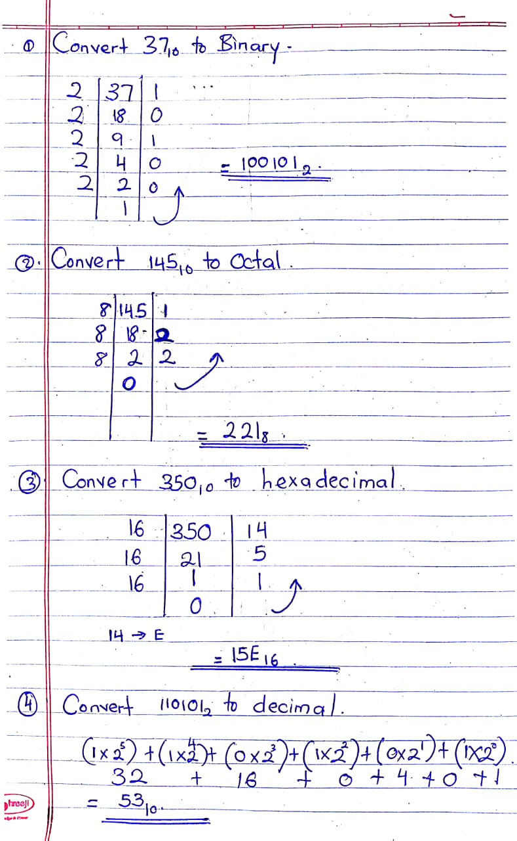
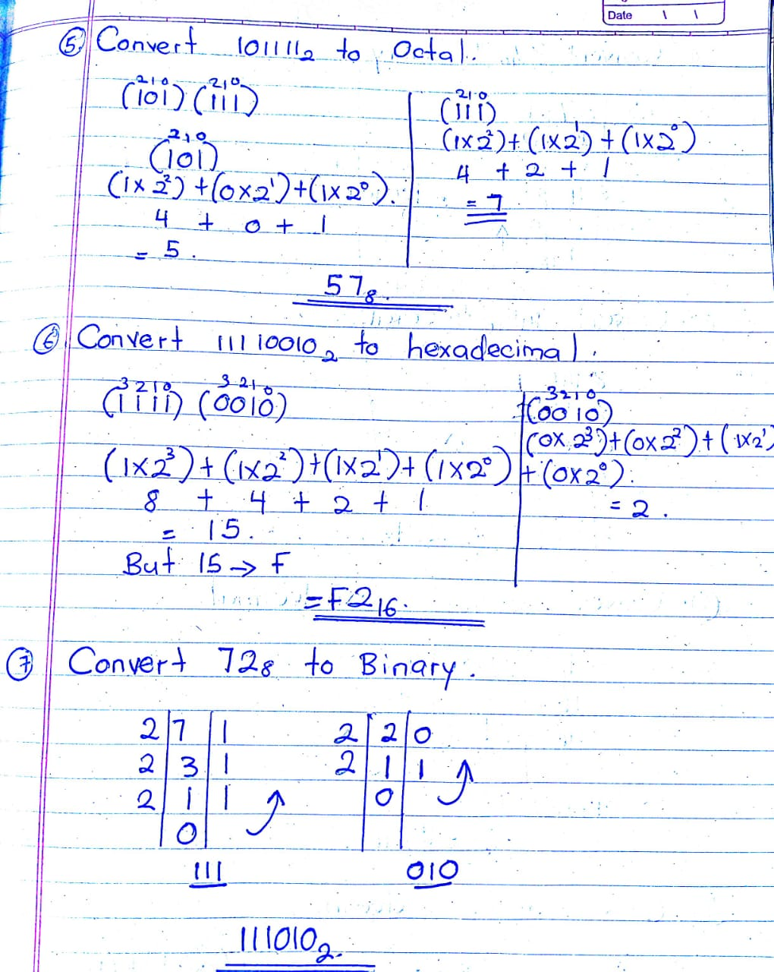
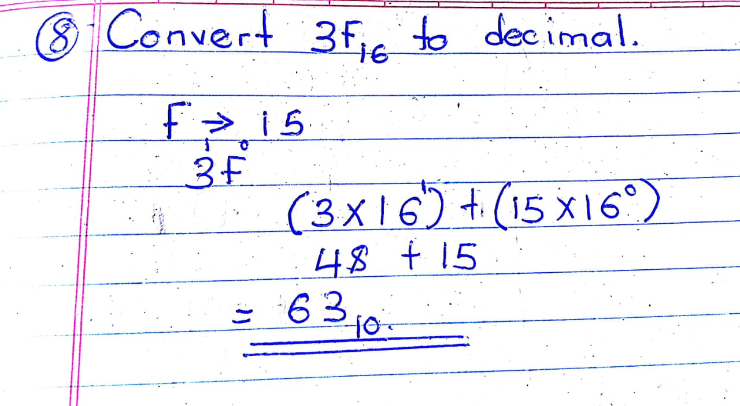
PRACTICAL CONVERSION ACTIVITIES

Slide 6
Part C: Real-World Applications
How is binary data used in mobile phones?
Mobile phones use binary data to process calls, messages, applications, and internet communication.
How is binary data used in computer memory and storage?
Computers store data in binary form using bits and bytes ram and storage devices store programs files etc.
How is binary data used in internet communication?
Data sent through the internet is converted into binary and transmitted in packets between devices through networks .
How is binary data used in digital images?
Images are stored using binary values representing colors and pixels.
How is binary data used in audio and video systems?
Audio and video are converted into binary data for storage, streaming, and playback

Slide 7
Part D: Practical Demonstration
Red Light | Yellow Light | Green Light | Binary
ON | OFF | OFF | 1,0,0
OFF | ON | OFF | 0,1,0
OFF | OFF | ON | 0,0,1

Slide 8
9. Why is hexadecimal preferred over long binary numbers in networking and programming?
Hexadecimal is shorter and easier to read.
Reduces errors when writing binary

Slide 9
10. What challenges would arise if computers used decimal internally instead of binary?
Hardware would become more complicated, slower, and less reliable.

Slide 10
11. How does understanding number systems help IT professionals in networking, cybersecurity, and programming?
It helps professionals understand networking, memory systems, programming, cybersecurity, and troubleshooting.

