Slide 1
COMPUTER NETWORKS · CSC1101
The Transport Layer
End-to-End Communication
Reliable delivery · Multiplexing · Flow control · TCP & UDP
GROUP 4 · SEPTEMBER 2026
Amanya Aaron · Arinaitwe Simon · Ampumuza Esther
Kisige Damella · Nakamya Rehema · Winyi Joel Melvin

Slide 2
01 · INTRODUCTION
What is the Transport Layer?
The Transport Layer (Layer 4) sits between the Network Layer and the Application layers. It is the first layer that provides true end-to-end communication between programs running on different devices.
Layer 4 Position
End-to-End Focus
Two Main Protocols
Sits above Network (IP) and below Session/Application. Receives data from apps and prepares it for the network.
Unlike lower layers that only care about the next hop, Transport cares about the final destination process.
TCP for reliable, ordered delivery. UDP for fast, lightweight delivery when speed matters more than perfection.

Slide 3
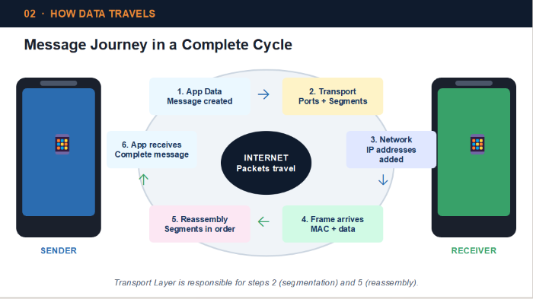

Slide 4
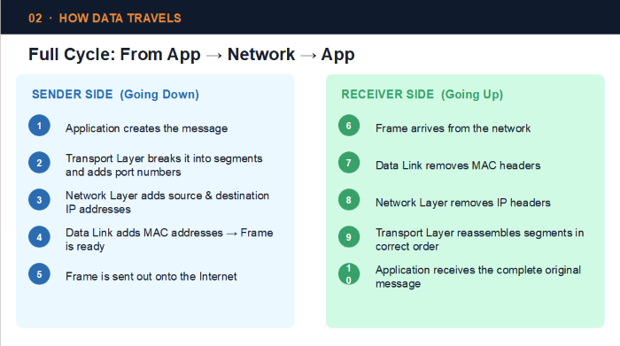

Slide 5
03 · RESPONSIBILITIES
Five Core Jobs of the Transport Layer
Segmentation
01
Large messages are broken into smaller pieces (segments) that travel efficiently across the network.
Reassembly
02
At the destination, segments are put back together in the correct order so the app receives complete data.
Error Control
03
Checksums detect corruption. TCP can request retransmission of lost or damaged segments.
Flow Control
04
Stops a fast sender from flooding a slow receiver. Uses a sliding window mechanism in TCP.
Port Addressing
05
Port numbers identify which application should receive the data (e.g. 80 for web, 443 for HTTPS).

Slide 6
04 · TCP
TCP — Reliable, Connection-Oriented Delivery
TCP first creates a connection (like making a phone call), then carefully tracks every piece of data. If something is lost, it asks for it again.
Connection established before data is sent
The 3-Way Handshake
Sequence numbers keep data in order
How a TCP connection is created
Acknowledgments confirm successful receipt
1
SYN
Client → Server
“I want to talk”
Lost segments are automatically retransmitted
2
SYN-ACK
Flow & congestion control protect the network
Server → Client
“OK, I’m ready”
3
ACK
Client → Server
“Great, let’s start”

Slide 7
05 · UDP
UDP — Fast and Lightweight
UDP does not create a connection and does not guarantee delivery. It simply sends the data and moves on. This makes it extremely fast and efficient.
Minimal Overhead
Connectionless
Best For
• Only 8-byte header
• Fire-and-forget style
• Live video & audio
• No connection setup time
• Each datagram is independent
• Online multiplayer games
• No acknowledgments or retransmits
• No state kept at either end
• DNS queries and VoIP

Slide 8
06 · COMPARISON
When to use TCP and when to use UDP
TCP — Complete & Correct
UDP — Speed First
Websites (HTTP/HTTPS)
Live Video (YouTube Live)
Every part of the page must arrive
A short freeze is better than waiting
Email (Gmail, Outlook)
Online Games
Messages must be complete & ordered
Real-time action needs low delay
File Downloads
Voice & Video Calls
One missing byte can corrupt the file
Conversation continues if packets drop
Banking / Online Forms
DNS Queries
Data integrity is critical
Quick questions need quick answers

Slide 9
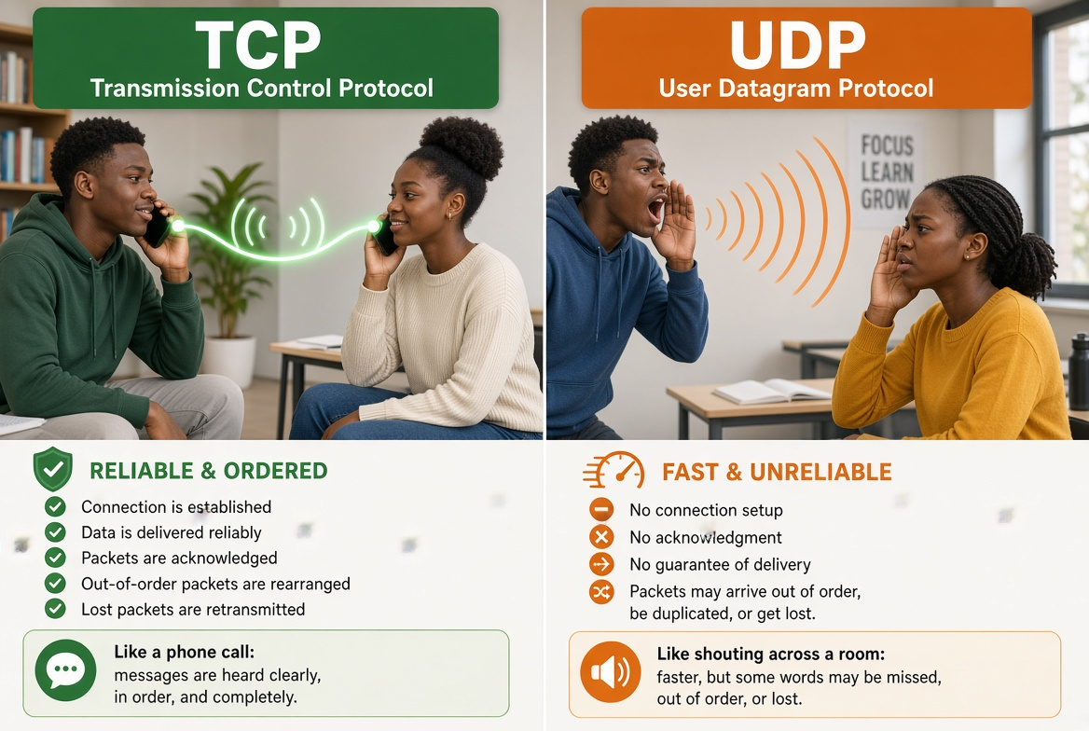

Slide 10
07 · PORTS & MULTIPLEXING
How many apps share one internet connection
Port numbers act like apartment numbers. The IP address gets data to the right computer; the port gets it to the right application.
0 – 1023
1024 – 49151
49152 – 65535
Well-Known Ports
Registered Ports
Dynamic / Ephemeral
80 (HTTP) · 443 (HTTPS)
22 (SSH) · 53 (DNS) · 25 (SMTP)
Used by applications and
vendor services after registration
Temporary ports chosen by
the client for outgoing connections

Slide 11


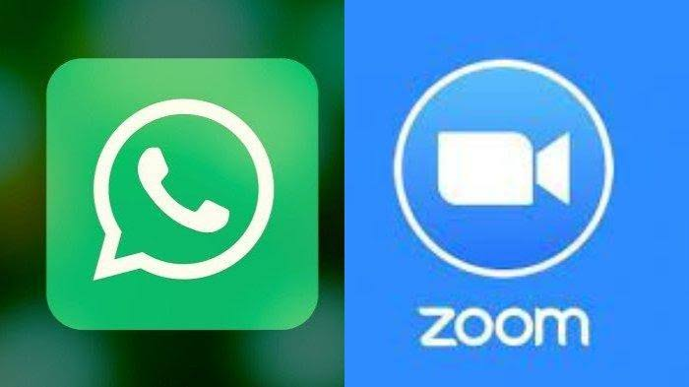

08 · WHY IT MATTERS
Real-World Impact
Without the Transport Layer, websites would break, emails would arrive incomplete, and video calls would be unusable.
Netflix / YouTube
UDP (streaming)
N
Gmail / Outlook
TCP
G
Every email must arrive complete and in order
Zoom / WhatsApp
UDP (media)
Z
Web Browsing
TCP
W

Slide 12
09 · SUMMARY
Key Takeaways
1
Layer 4 is the bridge
It connects the network world (IP packets) to the application world (your browser, email, Zoom).
2
Five main jobs
Segmentation, reassembly, error control, flow control, and port addressing.
3
TCP = Reliable
Connection-oriented, ordered, with retransmission — perfect for web, email, and files.
4
UDP = Fast
Connectionless and lightweight — ideal for streaming, gaming, and real-time calls.
5
Choice matters
Modern services succeed because they pick the right transport protocol for the job.

Slide 13
Thank You
GROUP 4 · CSC1101 · Uganda Christian University

