Slide 1
TIC2002 Software Engineering Lecture 4
AY2022/23 Semester 1

Slide 2
Highlights from previous lecture

Slide 3
Some useful classes
String
Wrapper classes: Integer, Double, Short, etc.
Arrays
Scanner

Slide 4
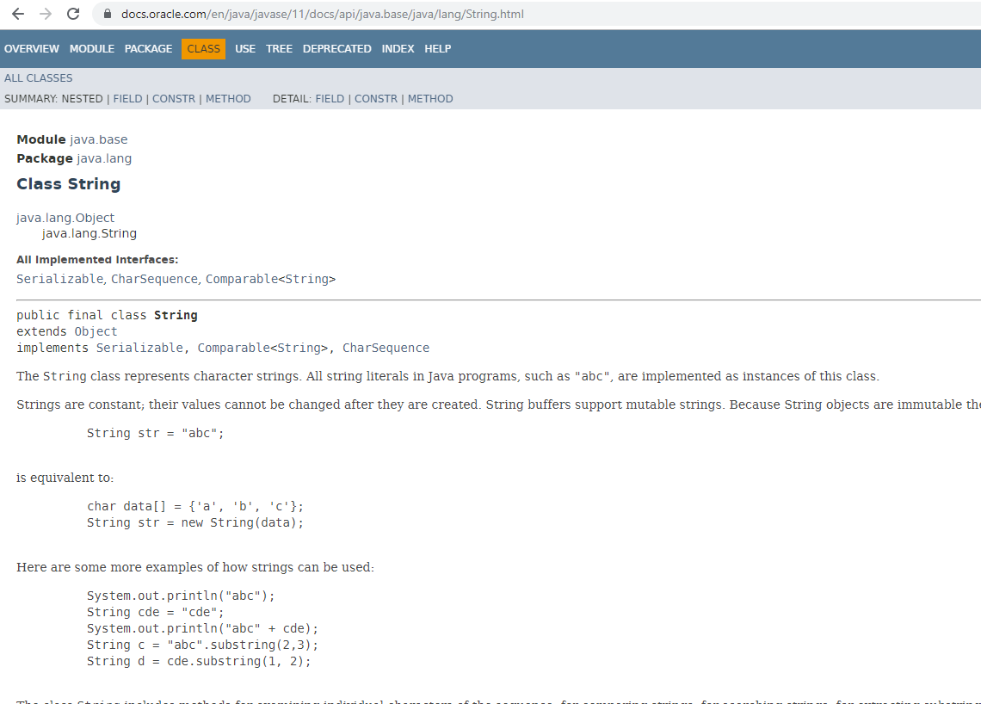
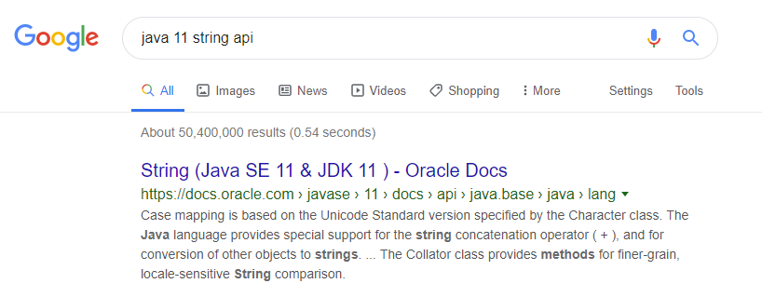
API = Application Programming Interface

Slide 5

Repo on remote server
Forked repo on GitHub
GitHub
fork
pull
push
push
push
clone
Local repo
Local repo
init
commit
Other person
You

Slide 6
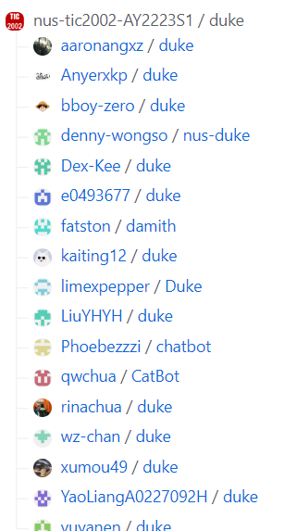

Slide 7
This week’s topics

Slide 8
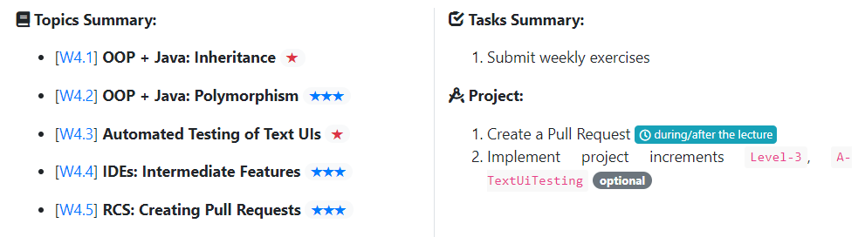
Week 4
Example: creating an application for a bank.
Need to deal with different type of accounts (saving accounts, current accounts, loan accounts, …)

Slide 9
Week 4

Slide 10
Week 4

Slide 11
Week 4

Slide 12
Pull Request (PR)
Repo on remote server
Forked repo on GitHub
GitHub
fork
pull
push
push
clone
Local repo
Local repo
init
commit
Other person
You

Slide 13
If falling behind in Java…
Resist the temptation to skip or take shortcuts
There is time left to catch up

Slide 14


