Slide 1
TIC2002 Intro to SE
AY2022/2023 Semester 1
Keep the mic muted unless you want to ask something.
If you have a question during the lecture,
unmute the mic and speak up (OK to do so as this is a small class).
don’t use the ‘raise hand’ feature in Zoom; I’m unlikely to notice it.
if not urgent, you can also send a message via Zoom or MS Teams.

Slide 2

Pronounced as ‘The Myth’
I have been teaching SE in NUS for 15 years. I worked in the industry before.

Slide 3


PowerPointLabs add-in for PowerPoint
One of the popular software tools I built with my students.

Slide 4
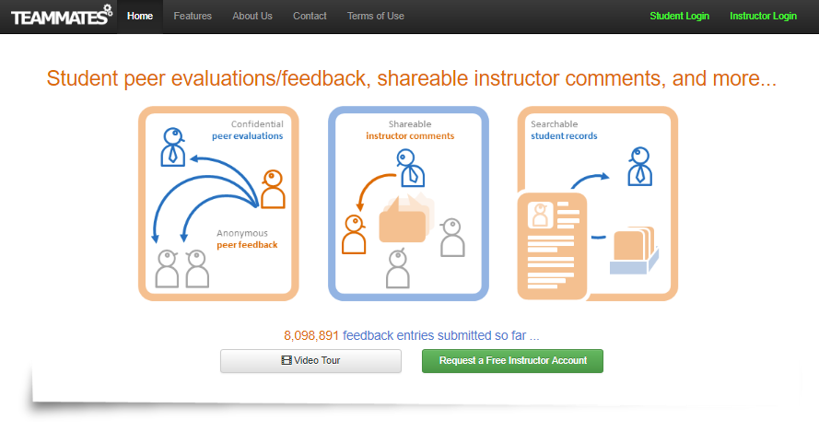
TEAMMATE online peer evaluation software
Another software tools I built with my students. Used by 850,000 users from over 1000 universities.

Slide 5
You are in safe hands!

Slide 6
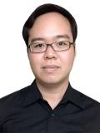
TA: Chan Weizhong
Refer the module website for contact details.
No formal tutorials but the two of us will share the load of handling help requests.

Slide 7
TIC2002 students are diverse in…
Background:
Already doing SE jobs
…
No programming experience outside of TIC__ modules
Goal:
Do better in current SE job
Switch over to a career involving programming
Learn computing to help with the current job
Just to get the paper qualification
Availability:
Doing a full-time job
Full-time student
Family obligations e.g., kids

Slide 8
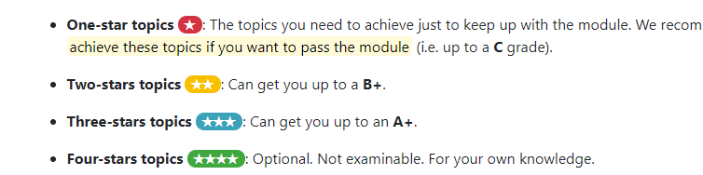
TIC2002 if fairly flexible …
If the pace is too fast,
Omit higher-starred topics
If the pace is too slow,
Do the optional topics
Do more in the project
I assume you to be mature and well-motivated.
The lower bar is low but don’t let that stop you if you want to shoot higher.

Slide 9
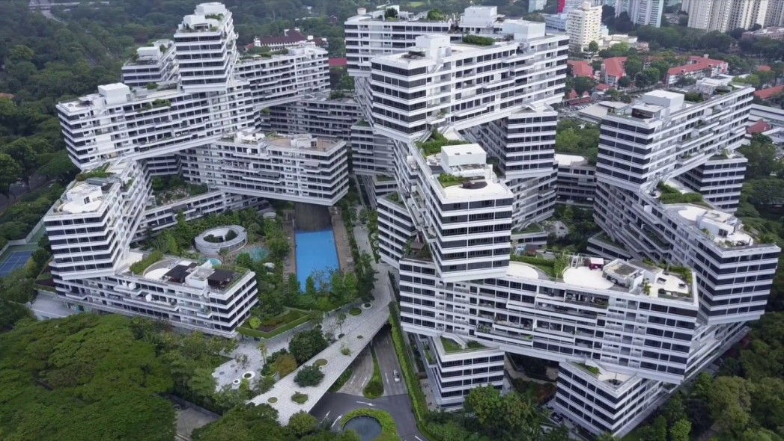
Construction industry
Constructing software is harder than constructing buildings: Agree?
Which professions are involved in constructing a building?
Civil Engineers
Architects
Electrical Engineers
Project managers
…
How much training do they need first?
Will you hire them to create this building if they are fresh out of college?

Slide 10
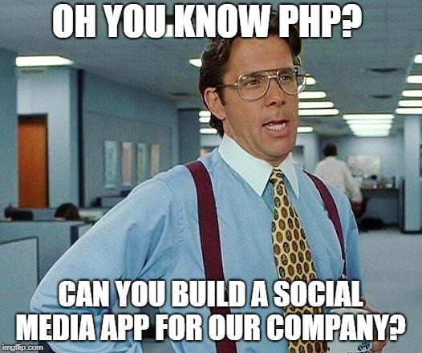
Software industry
In SE, there is a high variance of training needed for a job at hand

Slide 11
Becoming a professional Software Engineer is a long journey!
TIC2002 aim: to introduce you to some basic SE concepts.
TIC2002 (by itself) can only be just a step towards becoming a Software Eng. i.e. It is a significant step but is not enough to become a software engineer But let’s try to move as far in that direction as possible (and keep going after the module)
What you learn here might feel like slowing you down rather than speeding up your programming work. Building big software properly is slow work!
Even if you don’t become a software engineer, this module prepares you to interact better with software engineers that you might work with in future.

Slide 12
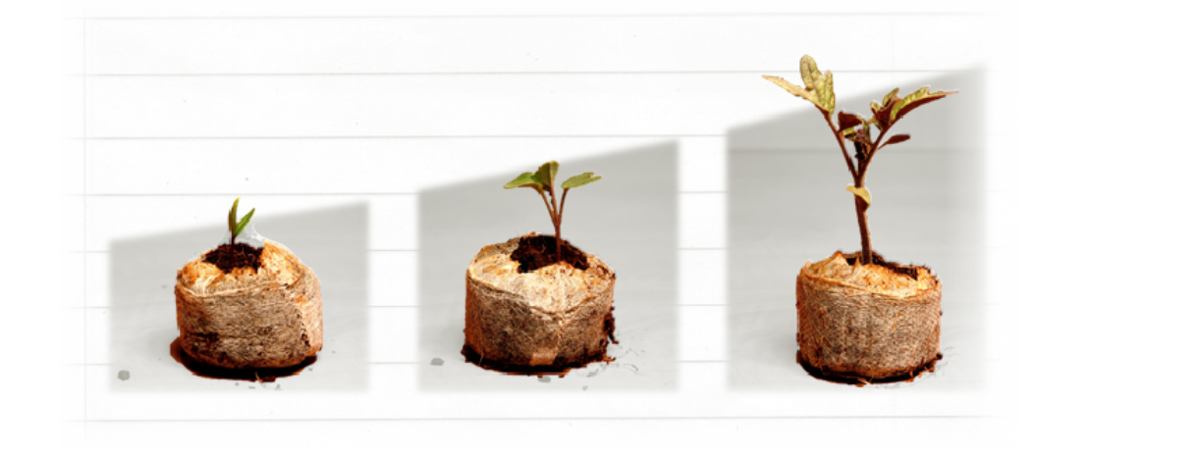
TIC2002 is the first step. More to come in other modules …
TIC2002
TIC…….
TIC…….
If you take shortcuts here, you will suffer later ☹

Slide 13
Three parallel paths through the module
SE theory
SE practice
(Project)
C++ to Java
(Java is used in the exam)
You are here
Week 13

Slide 14
Module infrastructure

Slide 15
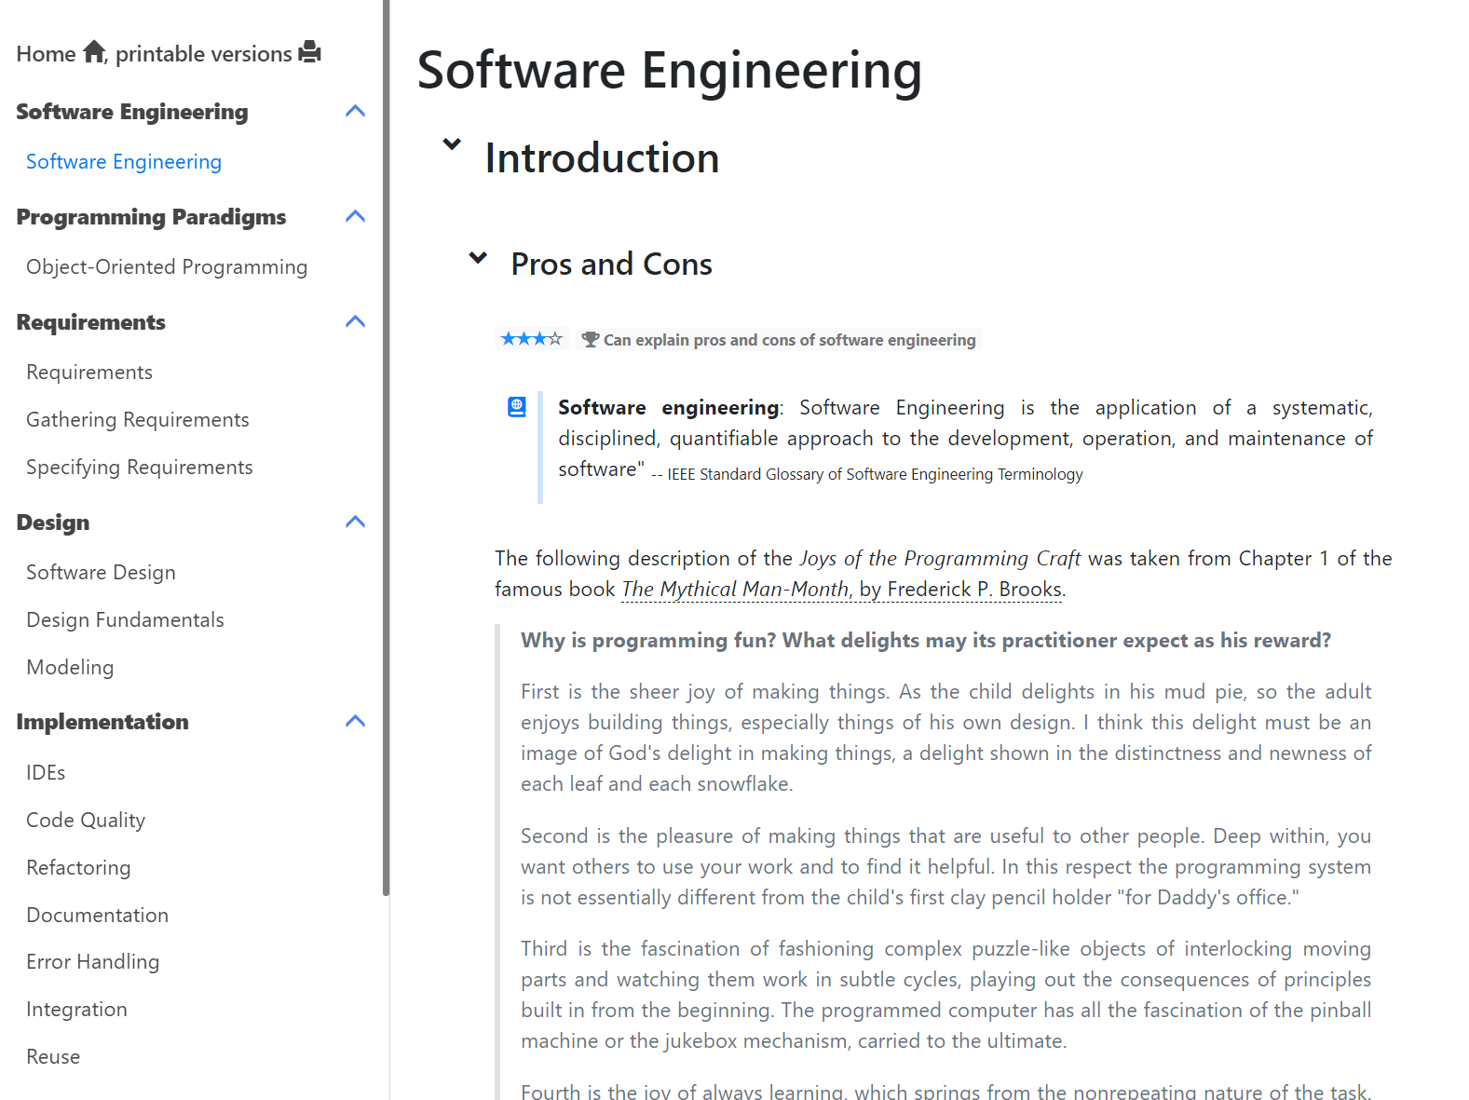
To balance theory with practice, we don’t cover topics in the natural sequential order

Slide 16
Everything relevant to the week can be found under the Schedule

Slide 17
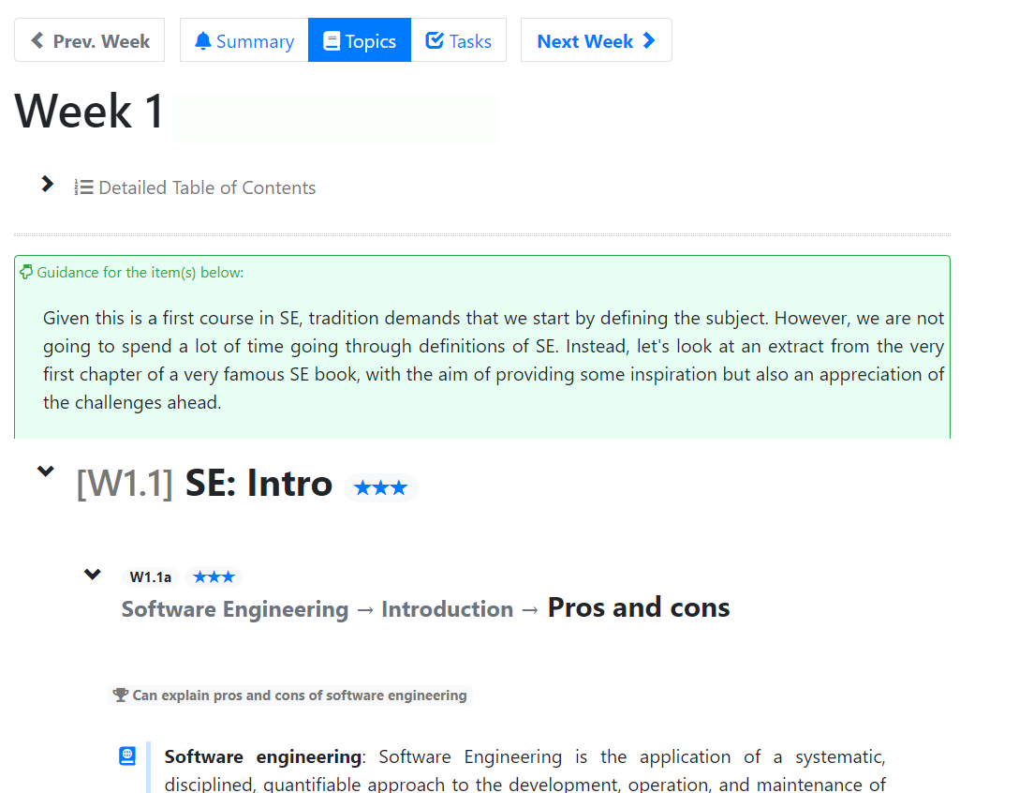
Relevant sections of the textbook are embedded in the schedule page
These provide additional context e.g., how the topic fits in to the big picture

Slide 18
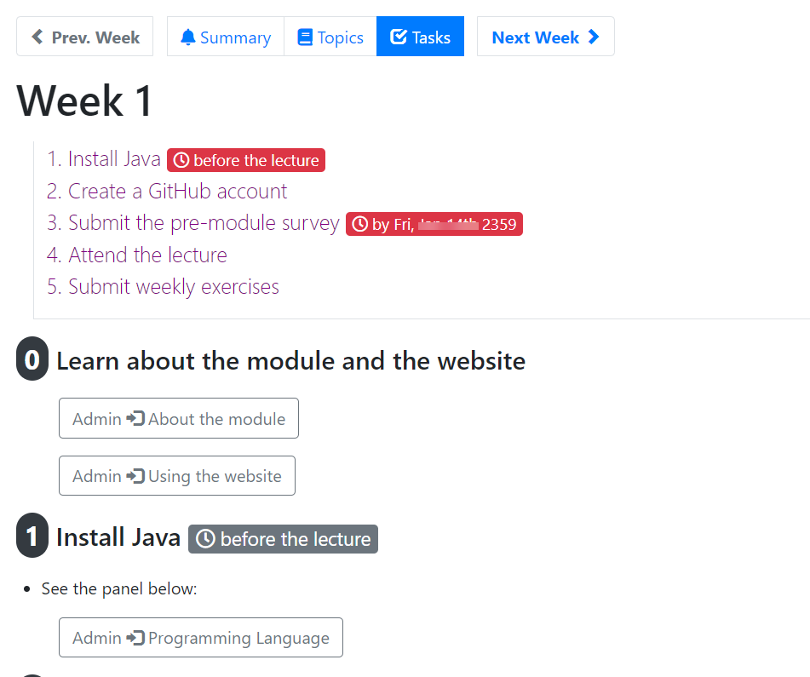
This tab has all the tasks you need to do in the week
Do weekly tasks to earn participation marks.
Deadline: the following lecture
Grace period: 1 more week

Slide 19
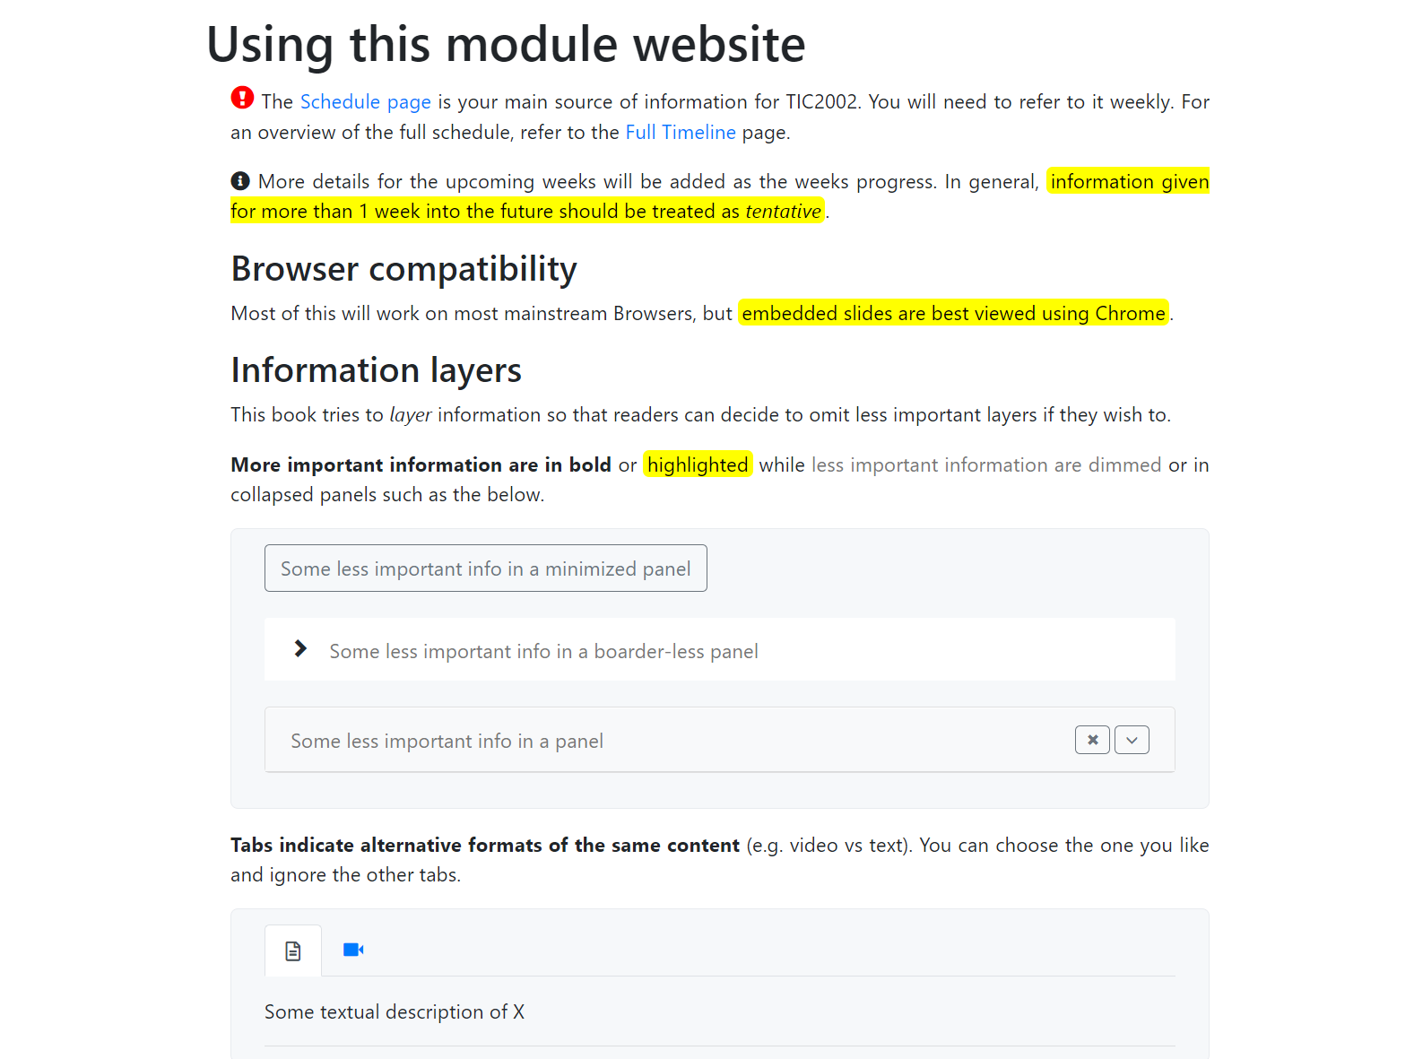
Read this page to find project info, assessment info etc.

Slide 20
Explains conventions used in this website

Slide 21
Learning Materials
Not slides-centric: Due to the practical nature of the subject and the diversity of the students background/expectations
Can upload if requested
Open-ended:
More flexibility to go wider and deeper e.g., Information layers
More reliance of online resources
More self-driven
More self-paced

Slide 22
Lectures + Tutorials
Mix of lectures, tutorials, project work, self-study
Recommended to bring a computer
Try to some of the weekly tasks in the lecture itself
Project
Info available on the website
Assessment
Info available on the website

Slide 23
Lectures + Tutorials
6.30-7.00pm: Pre-lecture consultations
Used for consultations. Use it if you encountered problems during the previous week’s tasks
Done using MS Teams
7.00-8.00pm: Lecture briefing
Done using Zoom for now (might go hybrid later)
For giving an overview of the work allocated for the week
Will be recorded and shared
8.00-9.30pm: Self-study + consultations
Follow topics, watch lecture videos, attempt tasks
If you encounter problems, use MS Teams to ask for help

Slide 25
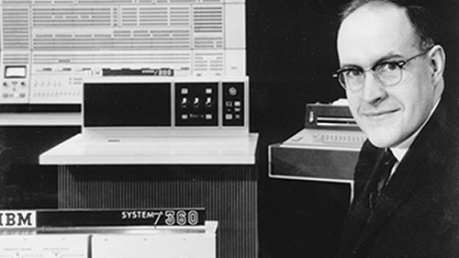

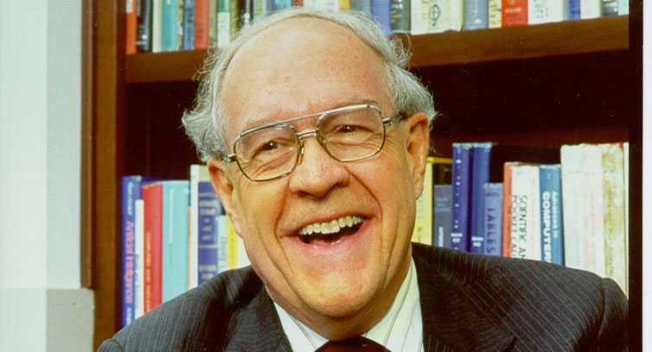
Software Engineering
What is it? It’s engineering of software
Pros and cons (read yourself)

Slide 27
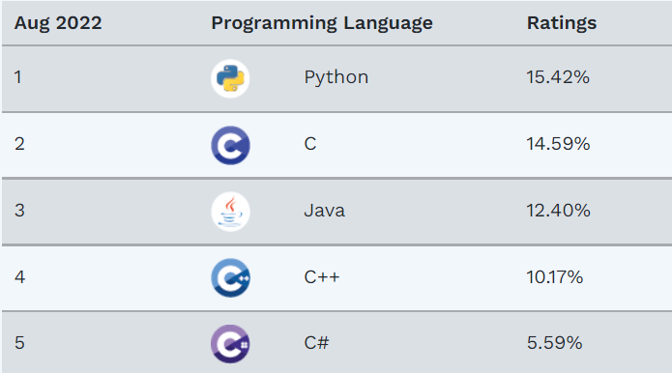
Java
Source: https://www.tiobe.com/tiobe-index/
Popular, well-established, mature
Used for big enterprise systems

Slide 28
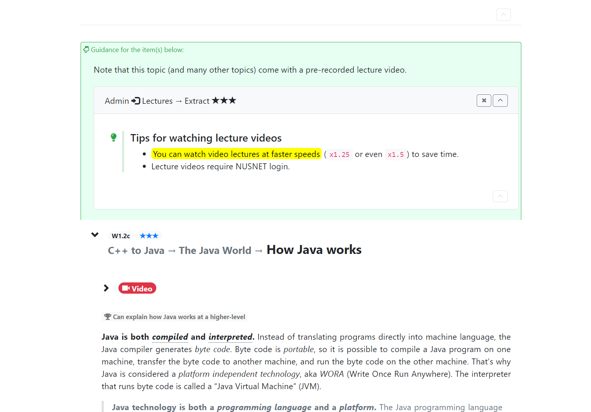
This indicates content ‘cross-embedded’ for your convenience
Lecture video

Slide 29
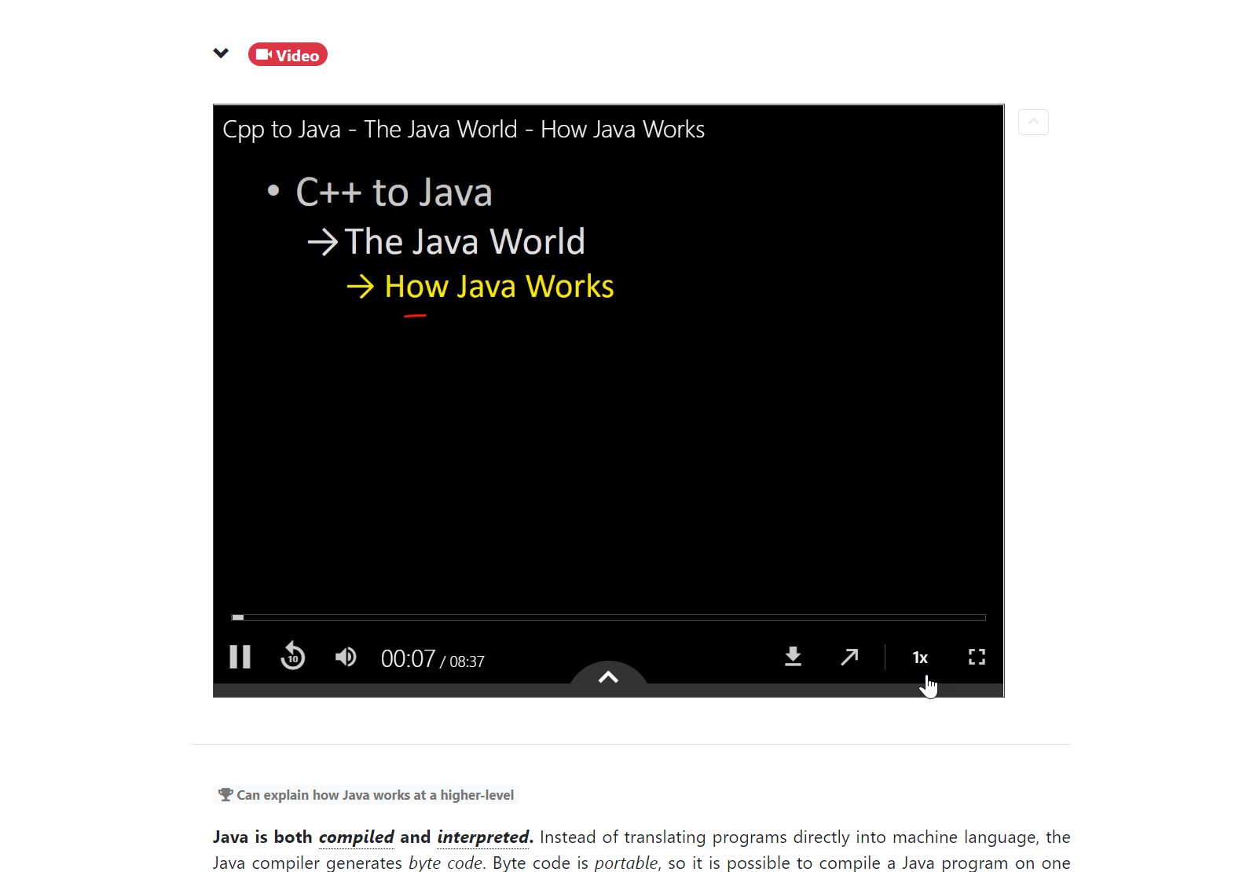
Use x1.25 or x1.5

Slide 30
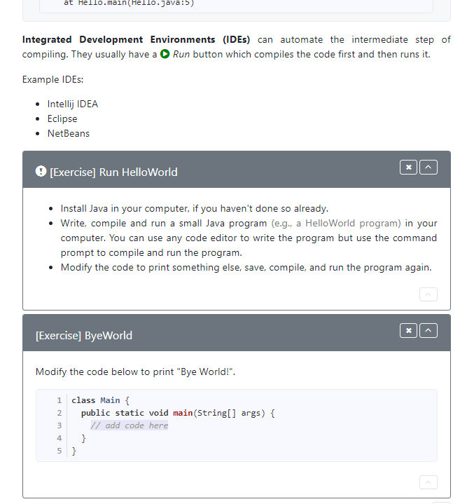
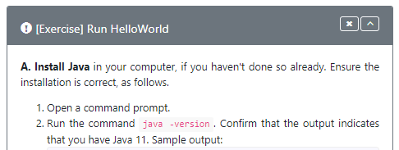
Do these two exercises in your computer. Use the command prompt to compile and run.

Slide 31
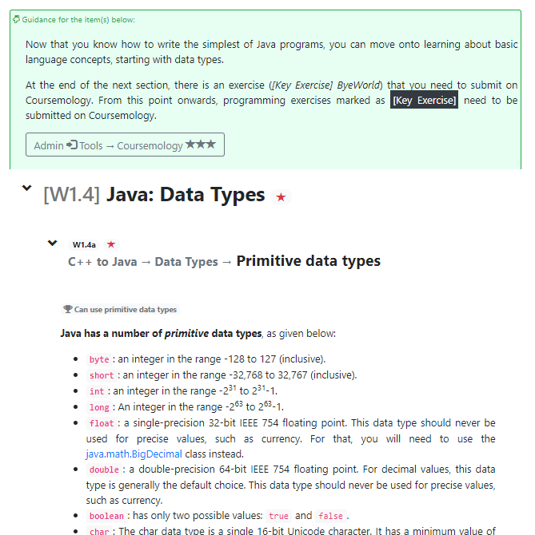

Slide 32
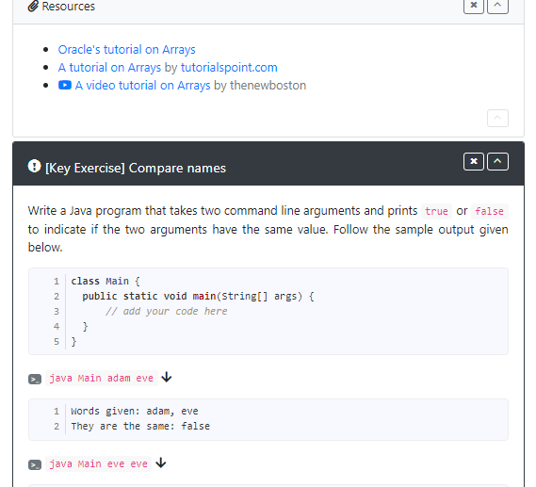
Here’s the first exercise to submit on coursemology
Do not jump ahead to exercises

Slide 33
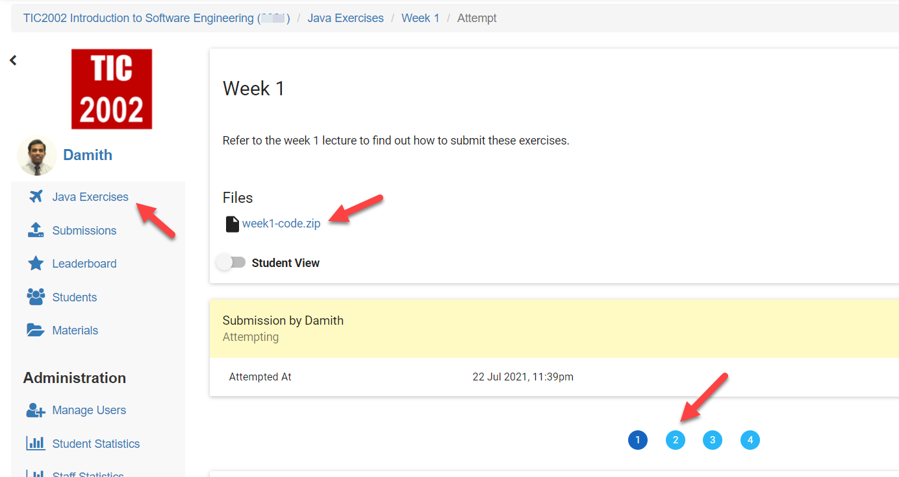
Skeleton code for all exercises for the week

Slide 34
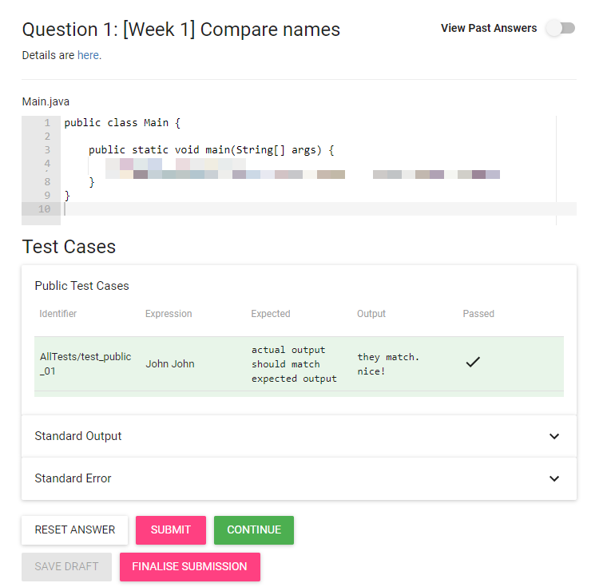
Click here to see exercise description
Write your code here (or code in your computer first and copy paste here when ready)
Test case results. Aim to pass all.
Click this to run test cases
Click this when you are done with ALL exercies.

Slide 35
Tips about coursemology
Coursemology uses Java 11. Ensure you use Java 11 yourself when you code exercises in your computer.
Your output has to match the expected output exactly (spaces, lower/upper-case etc.) for coursemology to accept your solution as correct.
To edit Java code, you can use:
Any code editor that you are familiar with
A simple text editor e.g., sublimetext, notepad
An online editor e.g., repl.it

Slide 37
What to do in the remaining time …
Go through the topics allocated for this week.
Submit exercises on coursemology.
If you need help, ask for help on MS Teams (in the public channel, or as private messages).

Slide 38
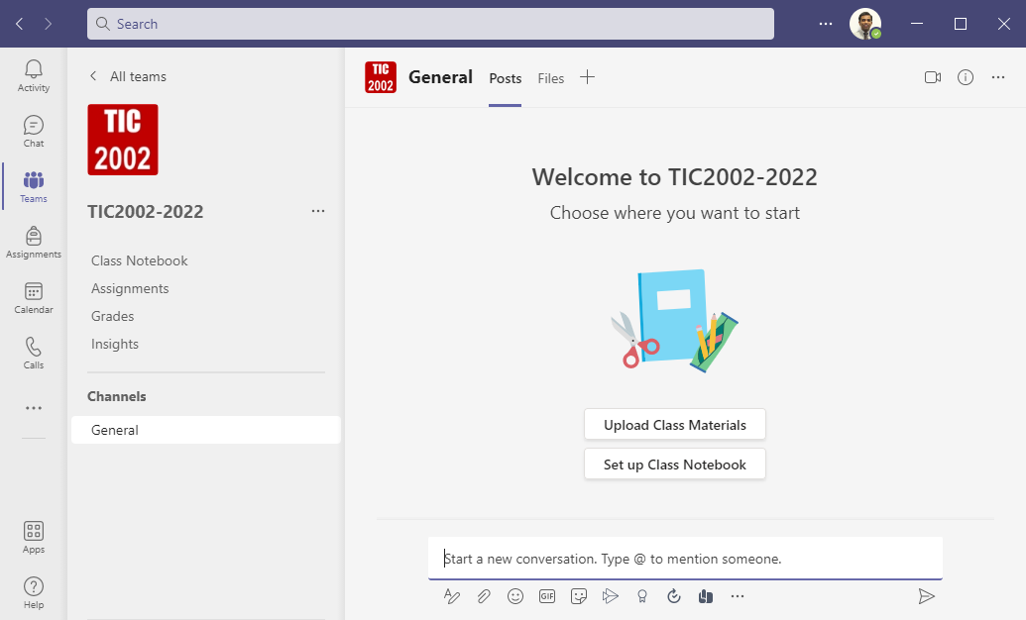
Search for my name (Damith) or tutors name (Chan Weizhong) to send private messages
Teams are here
This is the Team name
You can ask questions here

Slide 39
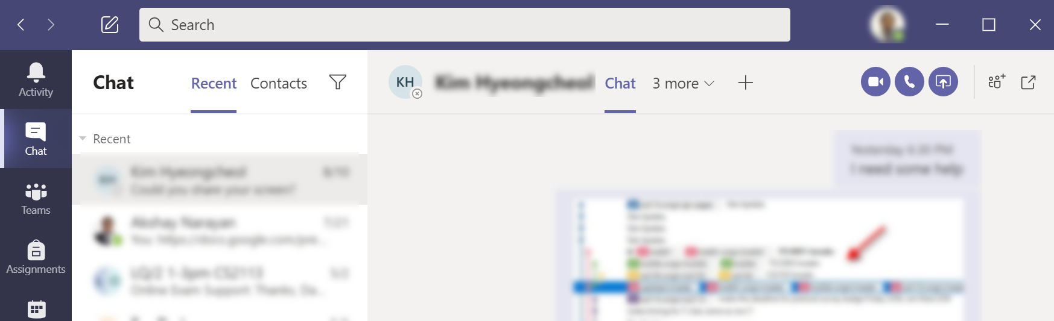
If requested, use this button to share your screen

Slide 40


