Slide 1
TIC2002 Software Engineering Lecture 3
AY2022/23 Semester 1
Things to do while waiting for the lecture to start
Learn previous week’s topics if you haven’t done so already. Ask for my help if you encounter any problems
Install Intellij IDEA in your computer
Read this week’s topics

Slide 2
Highlights from previous lecture

Slide 3


Programming Paradigms
[Styles of structuring a solution]
Higher levels of abstraction
OBJECT-ORIENTED
Objects [ Data + related functions]
PROCEDURAL
function1
function 2
---------------
array
list
High-Level Languages
int i
i=5
ASSEBLY
MOV AL, 1h
MOV CL, 2h
MOV DL, 3h
BINARY
110010101001101110101010101010101010
FUNCTIONAL
function1
function 2
Notes:
As our programs become bigger, we need even higher level ways of structuring our programs.
Several such approaches exist. We call those approaches “Programming Paradigms”.

Slide 4
An object
is an
Abstraction
of
closely-related behavior and data
More details
Less details
X
function
function
Object
Object [ Data + related functions]
Data
Data
Data
function
Data
function
Data
function
Data
Object
Data
function
function
Data
Data
Data
Notes:
This is the more formal way to describe that concept.

Slide 5





An object is an
Encapsulation
Interface/implementation separation
Notes:
This picture is a good analogy to explain these two levels of encapsulation. It is especially suitable because the term encapsulation is related to the word capsule.

Slide 6











OO program at runtime…
f2
function1
data1
data2
function3
f2
function1
data1
data2
function3
f2
function1
data1
data2
function3
Notes:
Because of encapsulation, objects interact with each other through the object interfaces.
In general, one object should not have direct access to what is inside another object.

Slide 7




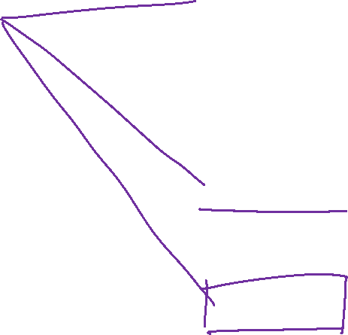

Class
A blueprint for creating objects.
Class: Student
Class: Admin
Data = DOB
Behavior = getAge()
Behavior = calculateAvgAge()
Data = students
Object structure
Class-level members
totalStudents
getTotalStudents()
Notes:
We can use an Admin object or an Age Calculator object in place of Teacher object too. An O.O.P solution usually follows the real world, but it can vary from the real world too, if it improves the solution.

Slide 8
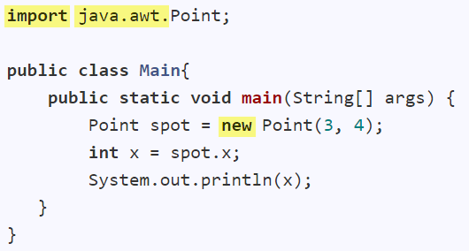


Slide 9
public class Time { private int hours; private int minutes; private int seconds; public Time(int hours, int minutes, int seconds) { this.hours = hours; this.minutes = minutes; this.seconds = seconds; } public Time() { this(0, 0, 0); } public int getHours() { return hours; } public void setHours(int hours) { this.hours = hours; } public int secondsSinceMidnight() { return hours * 60 * 60 + minutes * 60 + seconds; } // ... }

Slide 10
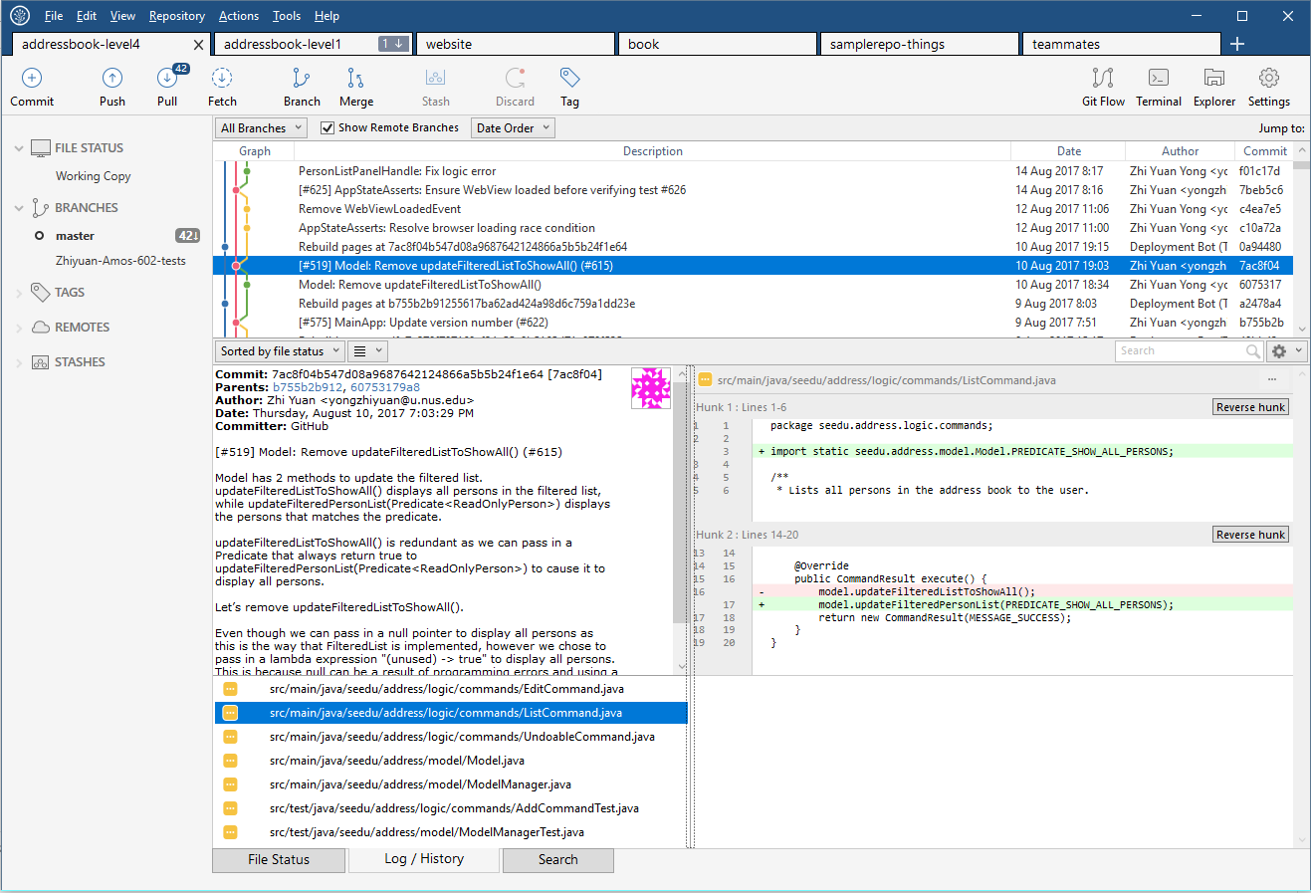
Revision Control Software

Slide 11
checkout
ignore
stage, commit
tag
Local repo
init
John

Slide 12
This week’s topics

Slide 13
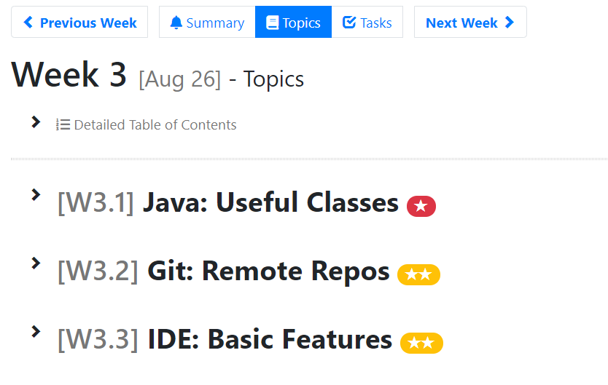

Slide 14
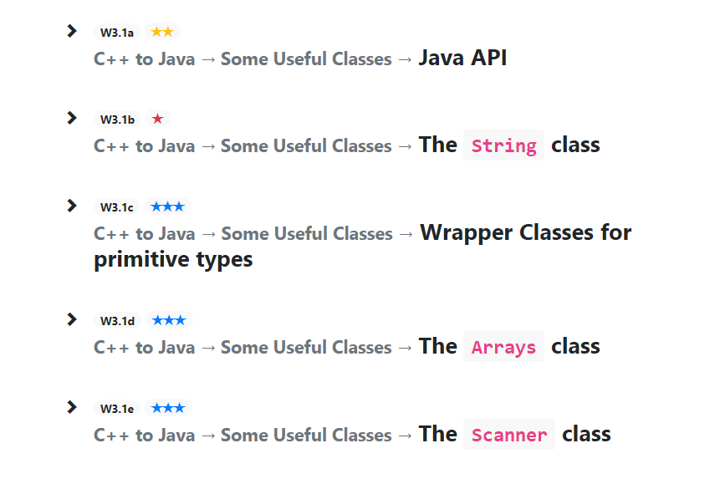

Slide 16

Repo on remote server
Forked repo on GitHub
GitHub
fork
pull
push
push
push
clone
Local repo
Local repo
init
commit
Other person
You

Slide 17
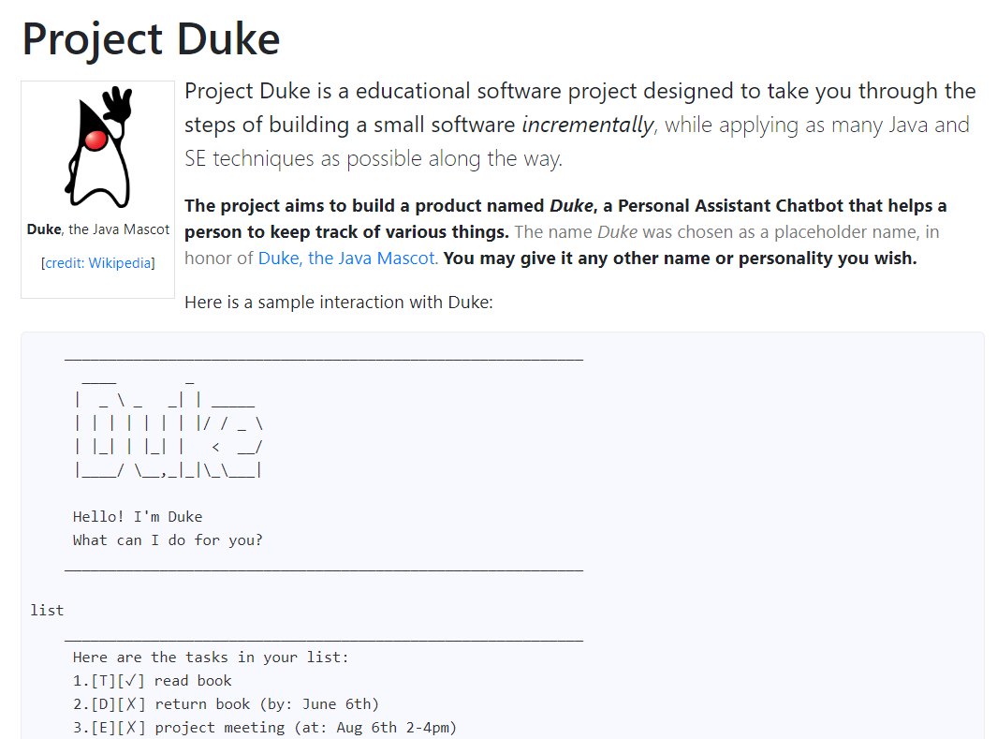

Slide 18
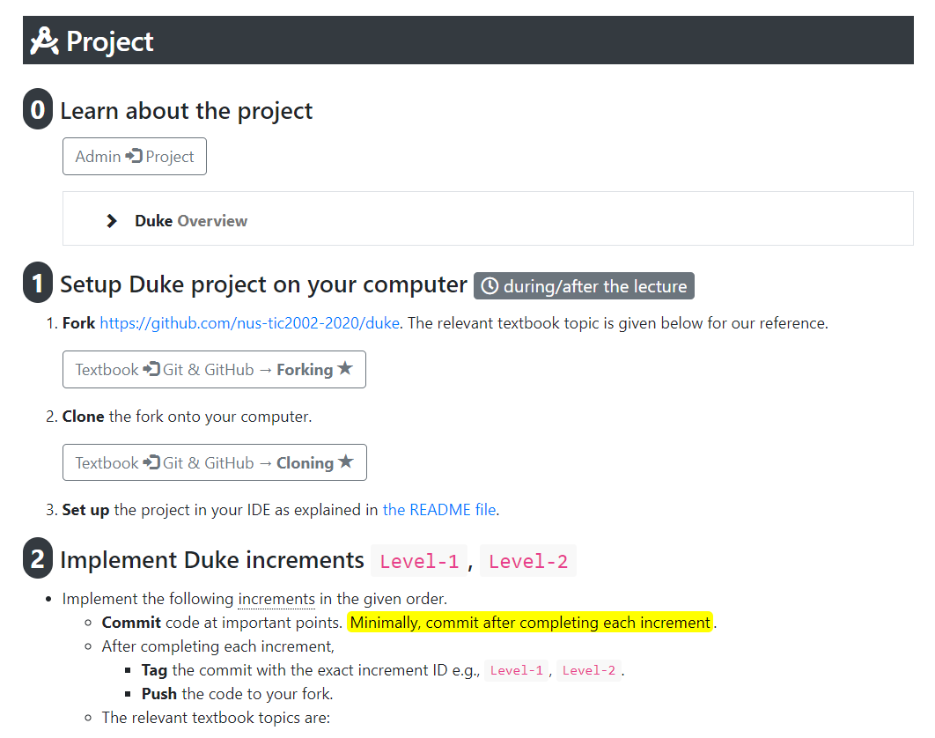

Slide 20
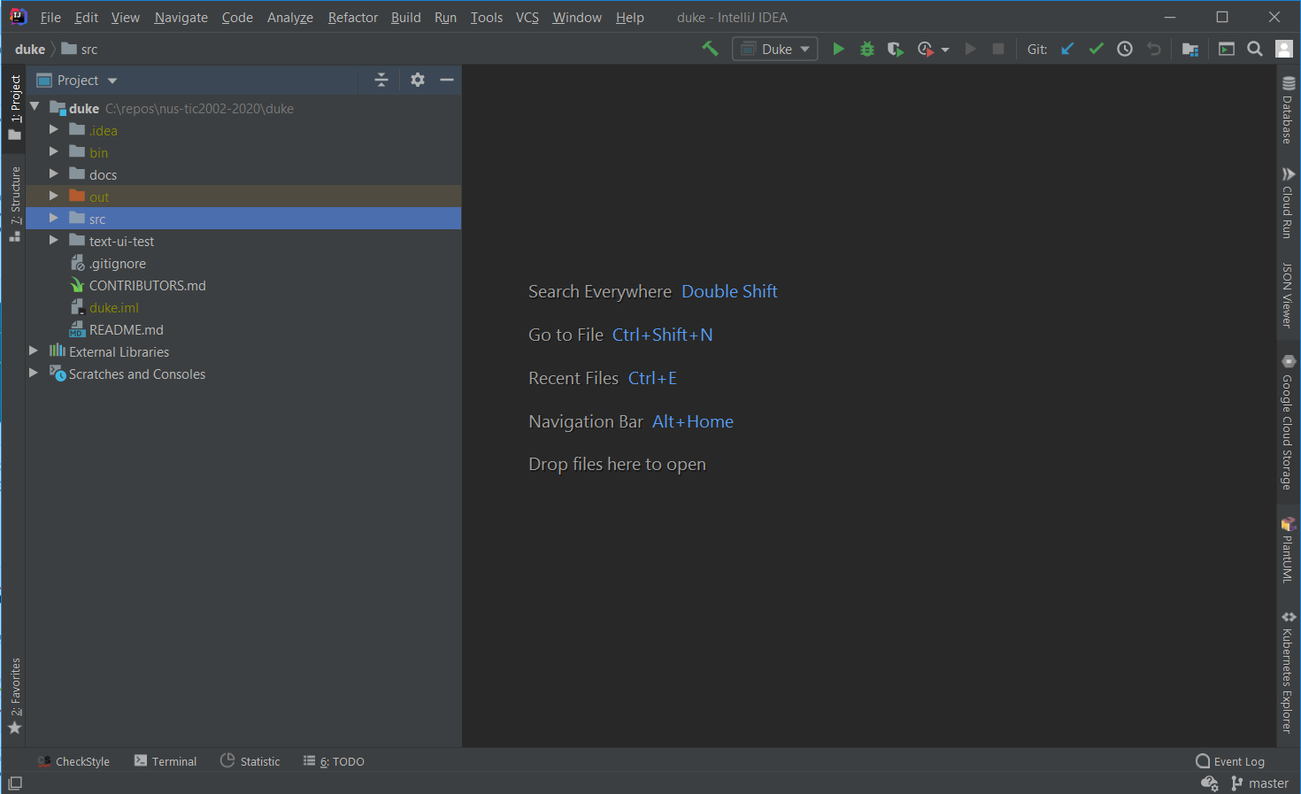

Slide 21
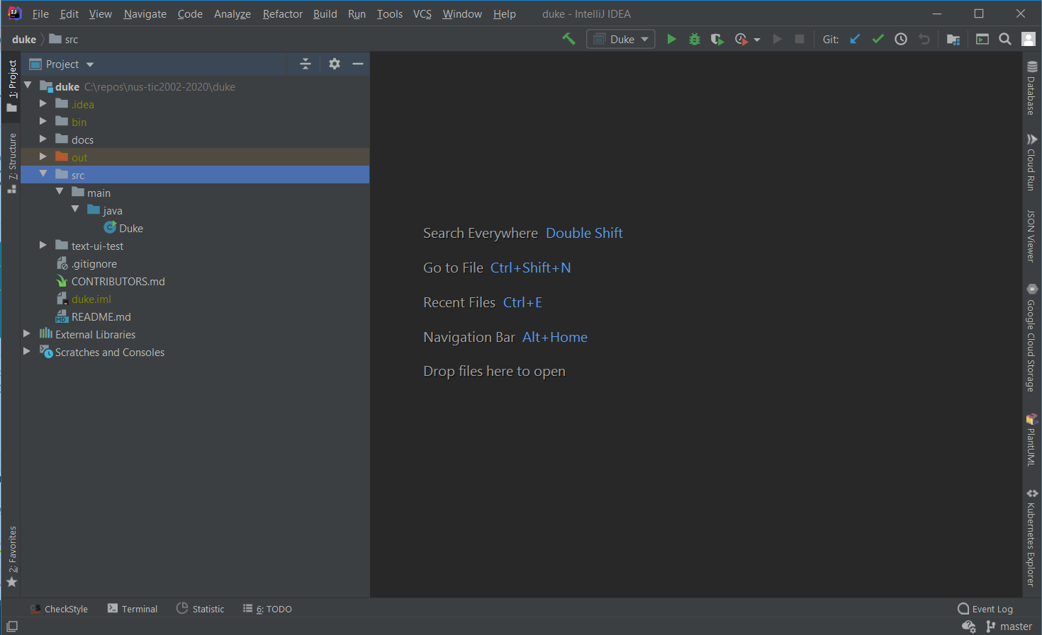

Slide 22
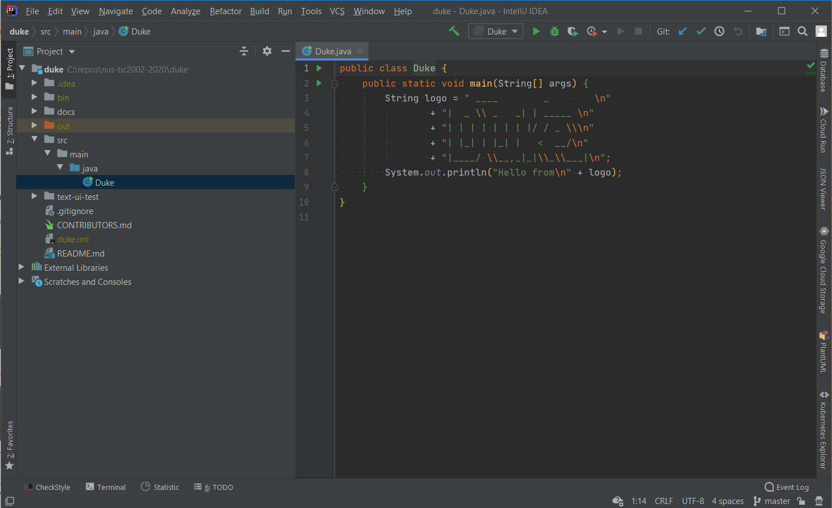

Slide 23
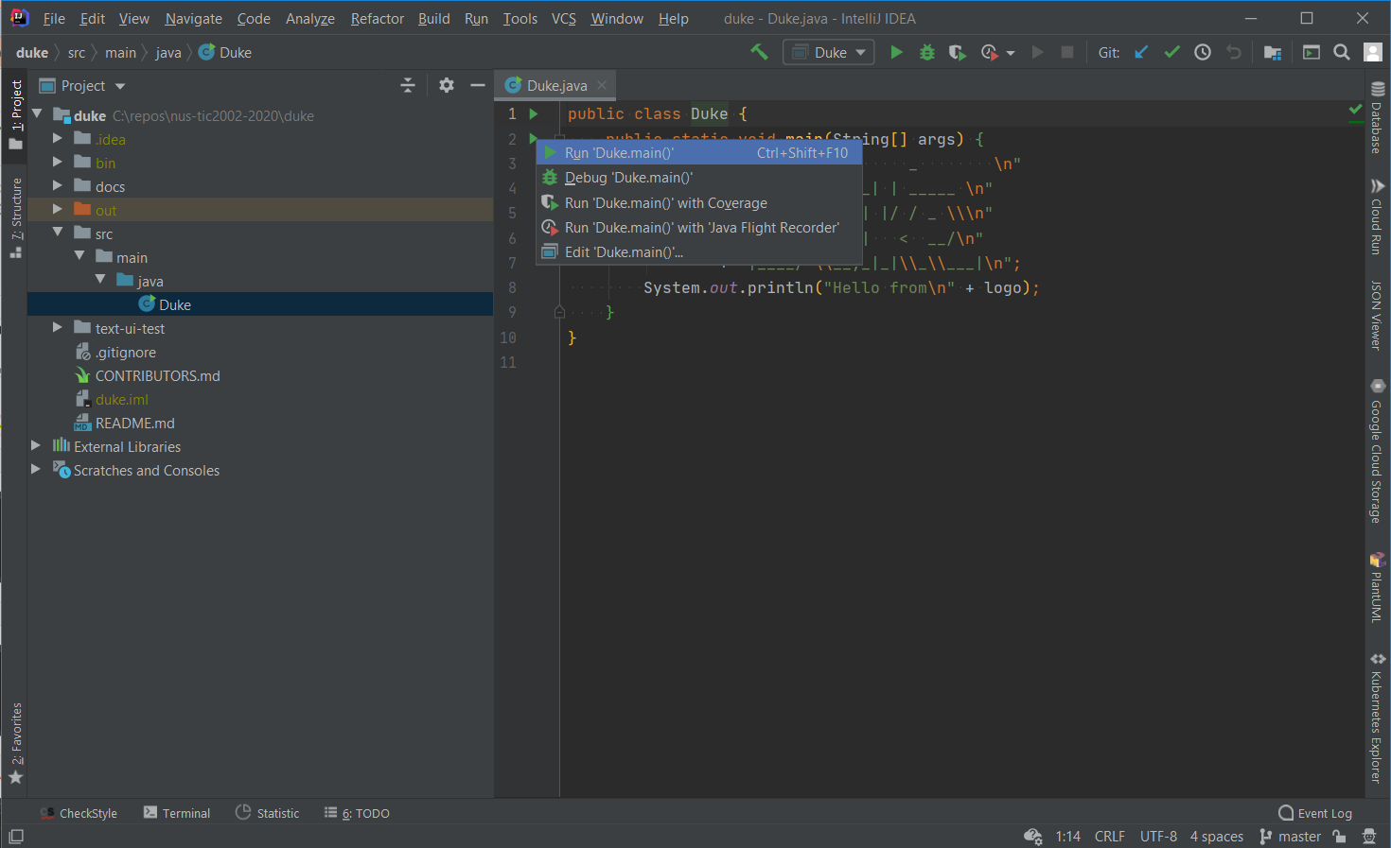

Slide 24
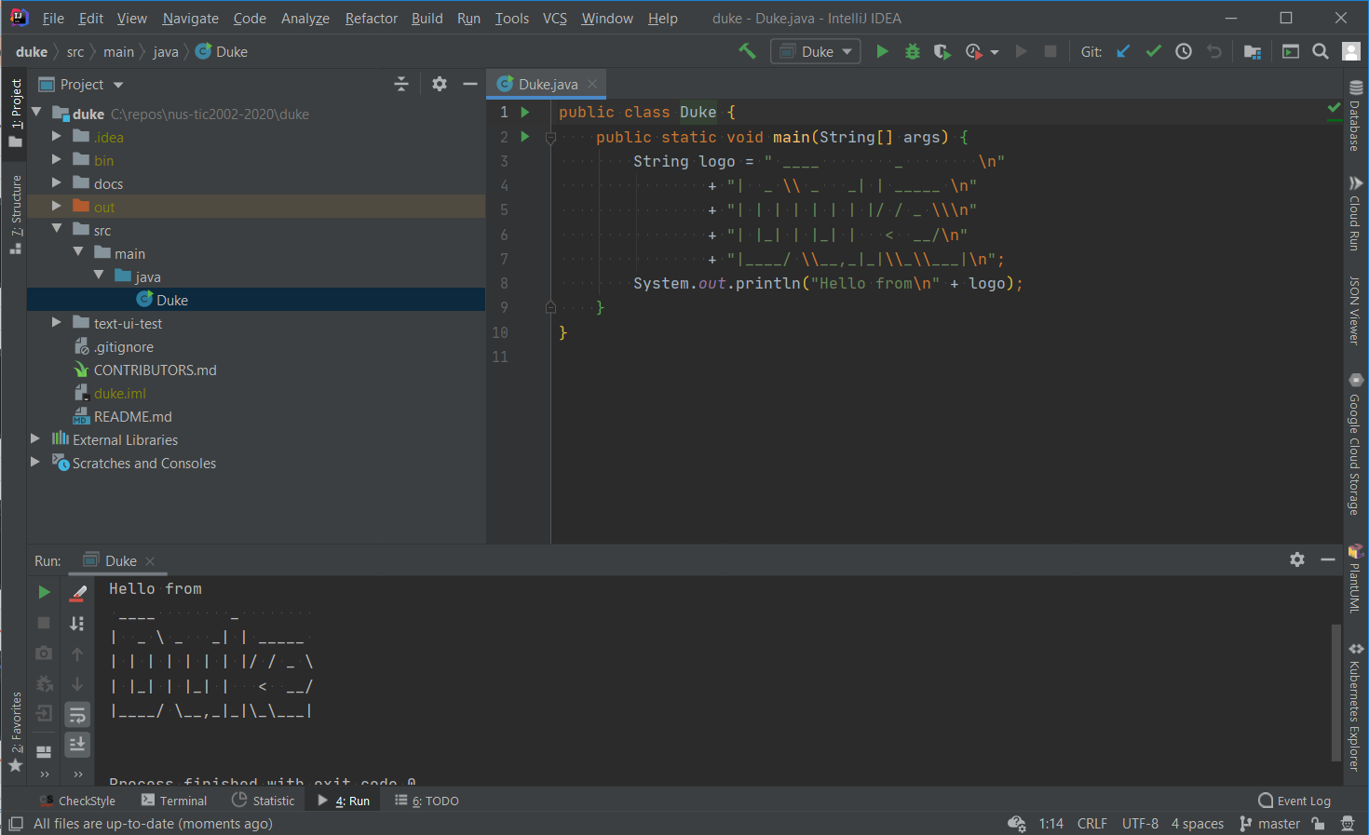

Slide 25
For the remaining time, as usual, …
Follow the schedule page and try to achieve tasks allocated for this week
Ask for my help if you encounter problems or need guidance – via MS Teams

Slide 26
