Slide 1
TIC2002 Software Engineering Lecture 5
AY2022/23 Semester 1

Slide 2
Highlights from previous lecture

Slide 3
OOP
Abstraction
Encapsulation
Inheritance
Polymorphism

Slide 4
Inheritance
class Person{
String name;
String getName(){
return name;
}
}
superclass
Student inherits from Person
Person
class Student extends Person{
String school;
void getSchool(){
return school;
}
}
Student
Subclass inherits members of the superclass
subclass
Student s = new Student();
String name = s.getName();

Slide 5
Overriding
class Person{
String name;
String getName(){
return name;
}
}
superclass
Person
class Student extends Person{
String school;
void getSchool(){
return school;
}
@Override
String getName(){
return “student:” + name;
}
}
Student
subclass
Subclass can override the superclass behavior
Optional

Slide 6
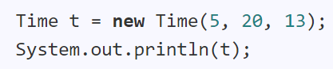

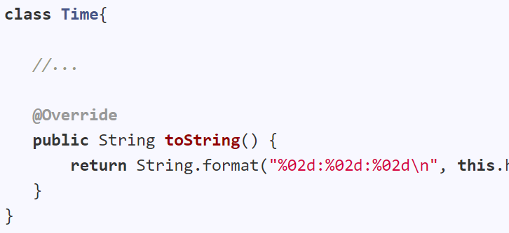

Object class
Overriding the toString method inherited from Object class

Slide 7
Access modifiers, packages, modules
For now, put all classes in the root of the folder i.e., not using packages for your code
Simplified access modifiers (for now)
public: other classes can access
no access modifier: same as public
protected: same as public
private: other classes cannot access
Ignore modules for now

Slide 8
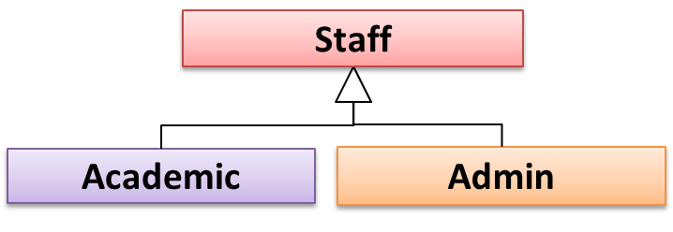
Substitutability
Every instance of a subclass is an instance of the superclass, but not vice-versa.
Academic is a Staff
Staff staff = new Academic(); // OK
Academic academic = new Staff(); // Not OK
Academic academic = new Admin(); // Not OK

Slide 9
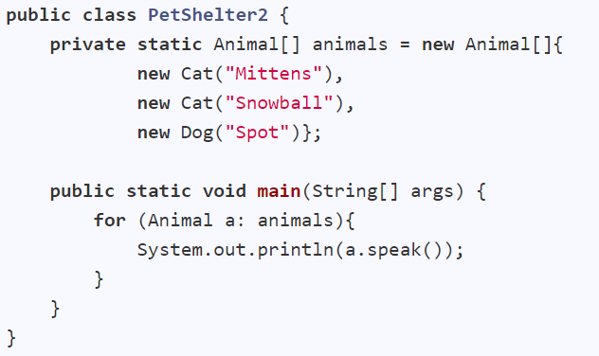
Polymorphism
speak() -> ‘Nothing’
Animal
Cat
Dog
speak() -> ‘Meow’
speak() -> ‘Woof’
This method is in the Animal class but overridden in the Cat and Dog classes
Meow
Meow
Woof
Nothing
Nothing
Nothing

Slide 10
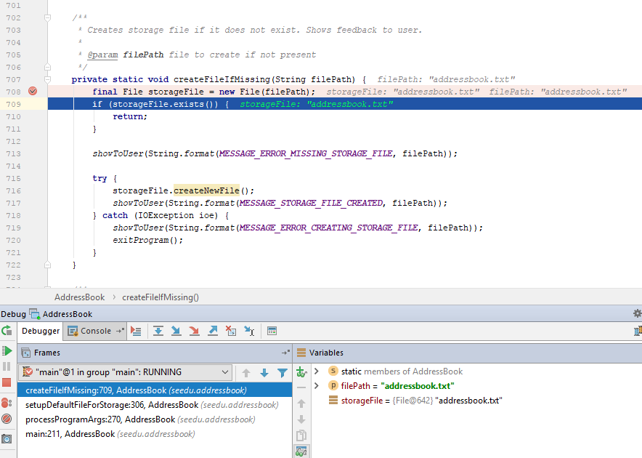
Use the IDE Debugger

Slide 11



Bug fix → break other code?
How to prevent?
REGRESSIONS
[undesirable side effects of modifications]

Slide 12
other test cases
TEST CASE
test input
expected output
Regression testing
Compare
mismatch =
Software Under Test (SUT)
actual output
Locate bug
modify
… is the re-running of existing tests to detect regressions.
bug located!

Slide 13
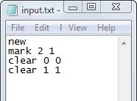
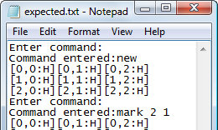
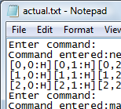




Automate testing (for Text UIs)
C:\java MinesweeperTextUI
FC actual.txt expected.txt
Comparing files actual.txt and expected.txt
FC: no differences encountered
<input.txt >actual.txt
C:\

Slide 14
This week’s topics

Slide 15
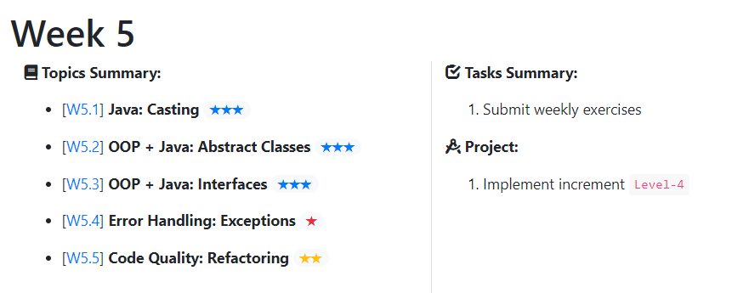
We are given an Animal object.
But we know it is actually a Cat.
How can we start treating it as a Cat?

Slide 16
Does it even make sense to define a speak() method in the Animal class?

Slide 17
What if all methods in the parent class are like the speak method?

Slide 18
… in the OOP way

Slide 19
Systematically improving the code quality as you go

Slide 20
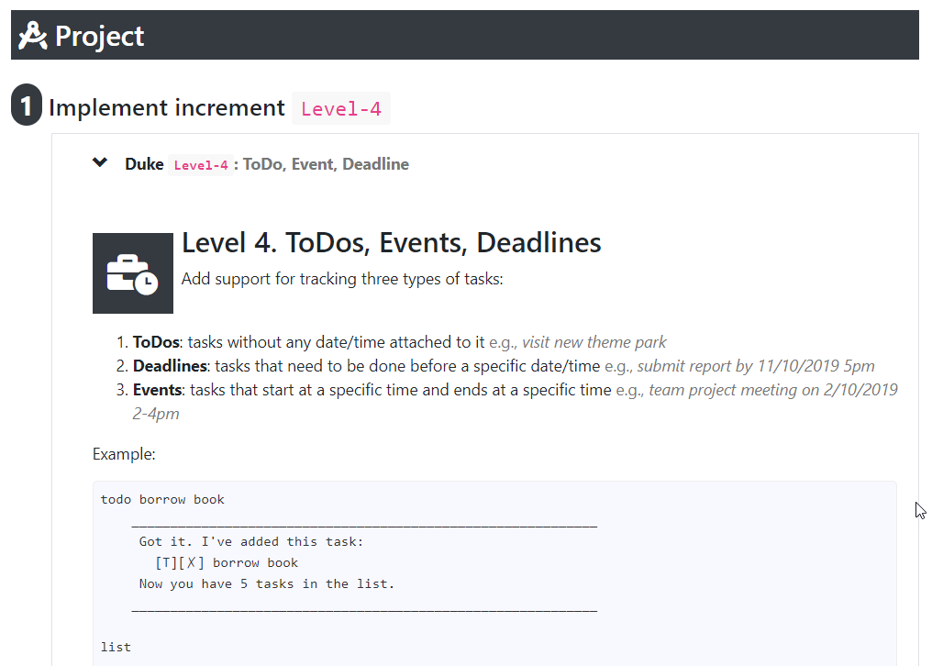

Slide 21
For the remaining time, as usual, …
Try to finish the weekly tasks for this week
Ask for our help if you encounter problems or need guidance

Slide 22


