Slide 1
TIC2002 Software Engineering Lecture 2
AY2022/23 Semester 1
Things to do while waiting for the lecture to start (7.05pm)
Finish week 1 topics/tasks if you haven’t done so already. Ask for my help if you encounter any problems
Install Sourcetree in your Computer
Read this week’s topics to prepare for the lecture

Slide 2
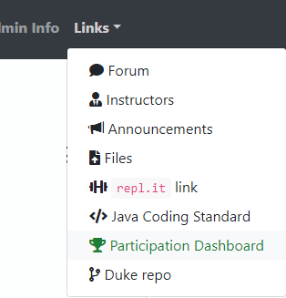
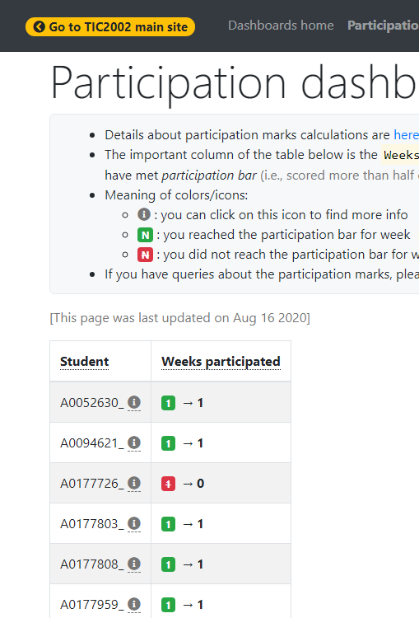

Participation dashboard will be set up next week.

Slide 3
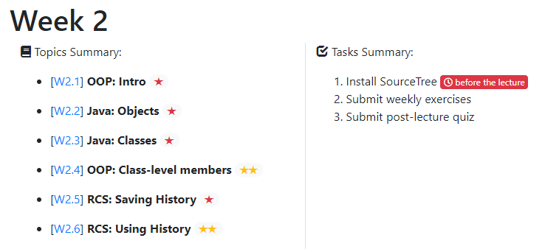
There are many short lecture videos given for these topics
There is a quiz to self-test your OOP knowledge
You can do these two topics first if you wish
These topics contains activities you can do to self-test your knowledge

Slide 4
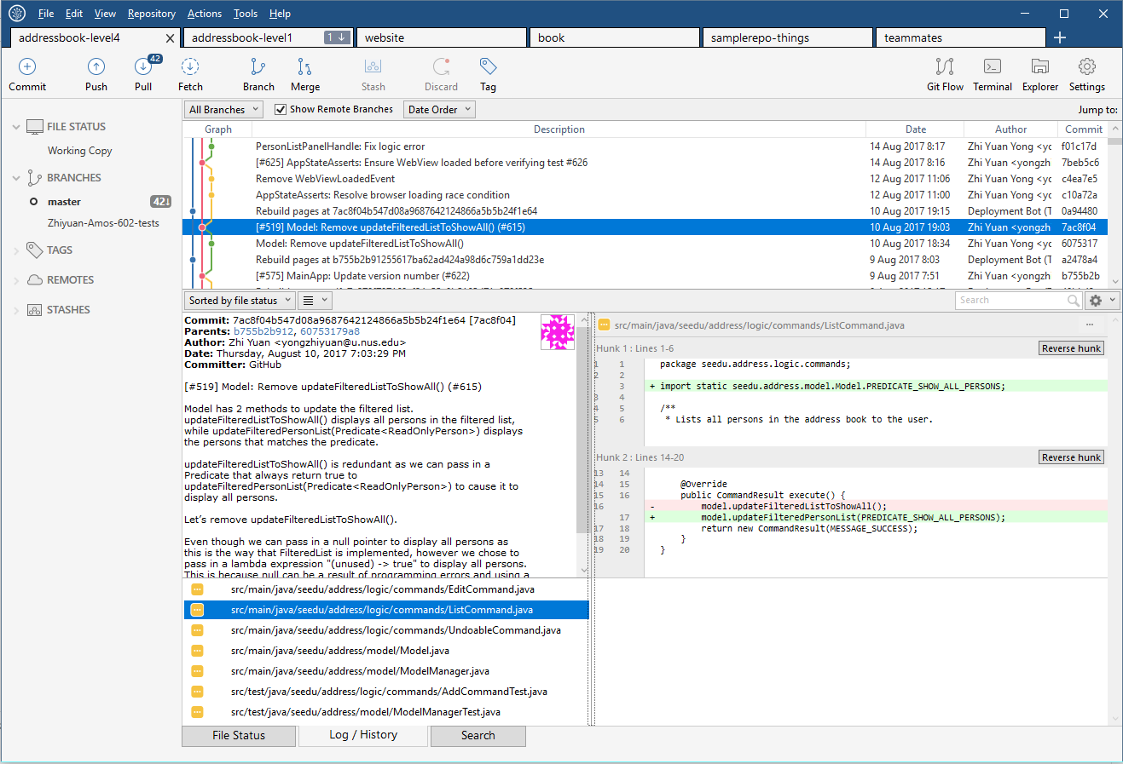
Revision Control Software (Git + SourceTree)

Slide 5
For the remaining time, as usual, …
Follow the schedule page and try to achieve tasks allocated for this week
Ask for help if you encounter problems or need guidance – via MS Teams

Slide 6


