Slide 1

PEER TO PEER FILE DISTRIBUTION SYSTEM
Mini-project presentation
Computer Networks Laboratory (CSE20110)
Department of Computer Engineering and Technology
Rachel Tom (1262240226) Manasi Sharma (1262240248)
Aaron Johnson (1262240581) Aaron Antao (1262240595)
Group No. 5 Panel K Batch 1
Project guide: Dr Uma Pujeri
Academic Year: 2026–2027
Computer Networks Laboratory CSE20110
Group No. 5 | 1

Slide 2
Problem and Objectives
Problem
A single file server is a bandwidth bottleneck and a single point of failure, and every update has to be re-sent to every user. Peers should share verified chunks with each other and stay current when the file changes.
Objectives
1. Split a file into chunks and record SHA-256 digests in a manifest.
2. Retrieve, verify and seed chunks through direct TCP peer connections.
3. Rebuild the original file with an identical SHA-256 digest.
4. Notify every peer of a new version and deliver it through the peers.
Computer Networks Laboratory CSE20110
Group No. 5 | 2

Slide 3
Proposed Design and Tools
Tracker
Chunk index + versions
Seeder peer
Chunks and manifest
Downloading peer
Verifies, then seeds
Another peer
Receives update_available
Python 3.10+ standard library only; no third-party packages
TCP sockets carrying newline-delimited JSON messages
Tracker 127.0.0.1:9000 · seeder 9101 · downloaders 9102–9104
The tracker never carries file data; chunks flow peer to peer
Computer Networks Laboratory CSE20110
Group No. 5 | 3

Slide 4
Implementation and Working
1. Split file
Manifest + chunks
2. Announce
Tracker records owner
3. Download
get_chunk over TCP
4. Verify + seed
Hash check
Message | Direction | Purpose
announce | Peer → tracker | Register owned chunks; reply carries latest version
lookup | Peer → tracker | Return the owners of each chunk
get_chunk | Peer → peer | Return one chunk's data (Base64)
publish | Seeder → tracker | Record a new manifest version
get_manifest | Peer → tracker | Fetch the newest manifest
update_available | Tracker → peer | Push notice that a newer version exists
Computer Networks Laboratory CSE20110
Group No. 5 | 4

Slide 5
File Update Notification
1. Watch
Seeder detects a save
2. publish
Manifest v2 to tracker
3. Notify
update_available
4. Re-sync
Fetch changed chunks
Consistency safeguards
Chunks are stored as <sha256>.bin, so versions never overwrite each other
Unchanged chunks are reused; only changed chunks are downloaded
Whole-file SHA-256 is checked; output is replaced in one atomic step
A peer that misses the push learns of v2 on its next announce (≤ 25 s)
Computer Networks Laboratory CSE20110
Group No. 5 | 5

Slide 6
Testing and Results
ID | Test | Observed result | Status
T1 | Create manifest from DSL.pdf | 26 chunks and manifest.json created | Pass
T2 | Download version 1 | 4 of 4 chunks downloaded and seeded | Pass
T3 | Publish version 2 while peer runs | “Update available: DSL.pdf v2” printed | Pass
T4 | Download the new version | 26 of 26 chunks; 1,639,852 bytes rebuilt | Pass
T5 | Compare SHA-256 digests | Source and output digests identical | Pass
T6 | Start peer with old v1 manifest | Peer switched to v2; digest matched | Pass
T7 | Corrupt a chunk on the seeder | Rejected by SHA-256 check; not saved | Pass
SHA-256 (DSL.pdf) = SHA-256 (DSA_areceived.pdf) = 494dd4ff…eaaee3395b. Rates were measured on loopback, so no network throughput claim is made.
Computer Networks Laboratory CSE20110
Group No. 5 | 6

Slide 7
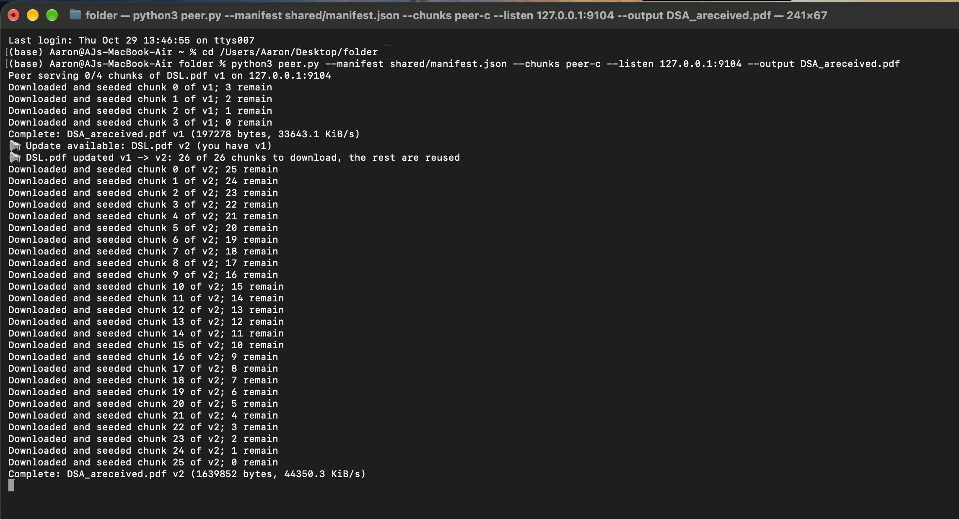
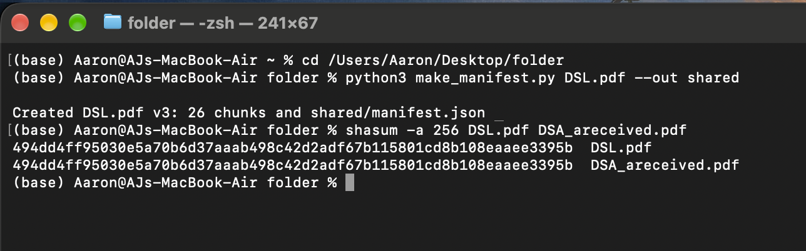
Execution Evidence
Downloading peer log
v1: 4 chunks downloaded and seeded
Update notice for v2 received
v2: 26 chunks fetched, file rebuilt
Integrity check
Source and rebuilt file have identical SHA-256 digests
Computer Networks Laboratory CSE20110
Group No. 5 | 7

Slide 8
Working Demonstration
Function to demonstrate
Chunk distribution, immediate seeding, a live file update and output verification.
1. Start tracker.py and run make_manifest.py DSL.pdf --out shared.
2. Start the seeder on port 9101 with --seed --watch DSL.pdf.
3. Start a downloader on port 9104; show “Downloaded and seeded” lines.
4. Save a new DSL.pdf; show the update notice and re-download.
5. Compare SHA-256 digests of DSL.pdf and DSA_areceived.pdf.
Success criterion: both files have the same SHA-256 digest after the update.
Computer Networks Laboratory CSE20110
Group No. 5 | 8

Slide 9
Conclusion and Contributions
Outcome: working TCP peer-to-peer distribution with version updates
Application: LAN sharing of course files, software images, datasets
Limitation: single tracker, Base64 payloads, unsigned manifests
Future scope: parallel downloads, TLS, signed manifests, DHT
Member | Contribution
Rachel Tom | Testing and execution verification
Manasi Sharma | Chunking and integrity verification (make_manifest.py, peer.py)
Aaron Johnson | Report and presentation
Aaron Antao | Tracker and protocol design (tracker.py, protocol.py)
AI use: code scaffolding and report drafting; the group verified all code and results.
Computer Networks Laboratory CSE20110
Group No. 5 | 9

Slide 10
References
[1] B. Cohen, “The BitTorrent Protocol Specification,” 2008.
https://www.bittorrent.org/beps/bep_0003.html
[2] J. Postel, “Transmission Control Protocol,” RFC 793, 1981.
https://doi.org/10.17487/RFC0793
[3] NIST, “Secure Hash Standard,” FIPS PUB 180-4, 2015.
https://doi.org/10.6028/NIST.FIPS.180-4
Project source: tracker.py, peer.py, make_manifest.py, protocol.py
github.com/aaronantao/p2p-file-distribution
Computer Networks Laboratory CSE20110
Group No. 5 | 10

