Slide 1
2d Lt Aaron Bonner
Validating Assumptions in a Laser Speckle Simulation

Slide 2
Overview
Previous Work on the Simulation
Spatial Coherence
Non-Linear Calibration
Polarization
Phase Retrieval

Slide 3
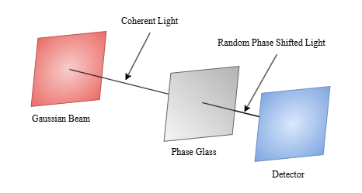
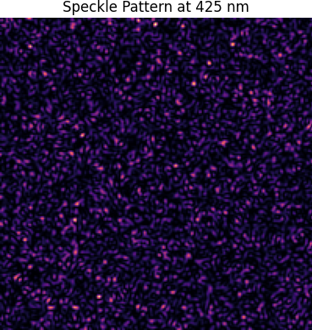
Previous Work
Simulated system based on
Gaussian Beam
Phase Screen w/Aperture
Detector Plane
Assumptions
Phase screen is uniformly random
Speckles are accurately generated
Sensor is correctly calibrated
Speckles appear at low power

Slide 4
Phase Retrival

Slide 5
Spatial Coherence

Slide 6
Non-Linear Calibration

Slide 7
Polarization

Slide 8
Questions

