Slide 1
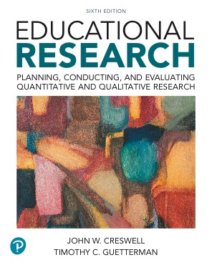
Educational Research: Planning, Conducting, and Evaluating Quantitative and Qualitative Research
Sixth Edition
Chapter 1
The Process of Conducting Research Using Quantitative and Qualitative Approaches
Copyright © 2019, 2015, 2012 Pearson Education, Inc. All Rights Reserved
Notes:
If this PowerPoint presentation contains mathematical equations, you may need to check that your computer has the following installed:
1) MathType Plugin
2) Math Player (free versions available)
3) NVDA Reader (free versions available)

Slide 2
Learning Objectives
1.1 Define and describe the importance of educational research
1.2 Describe the six steps in the process of research
1.3 Identify the characteristics of quantitative and qualitative research in the six steps
1.4 Identify the type of research designs associated with quantitative and qualitative research
1.5 Discuss important ethical issues in conducting research
1.6 Recognize skills needed to design and conduct research
Notes:
Slide 2 is list of textbook LO numbers and statements

Slide 3
What is Research?
The researcher poses a question.
The researcher collects data to answer the question.
The researcher presents an answer to the question.

Slide 4
Importance of Research (1 of 3)
Reason 1: Research adds to our knowledge.
Addresses gaps in knowledge
Expands knowledge
Replicates knowledge
Adds voices of individuals to knowledge

Slide 5
Importance of Research (2 of 3)
Reason 2: Research helps improve practice.
Educators gain new ideas for their job.
Educators gain new insights into approaches.
Educators can connect with other educators.

Slide 6
Importance of Research (3 of 3)
Reason 3: Research helps inform policy debates.
Research allows people to weigh different perspectives on issues.
Research enables people to make informed decisions regarding policy.

Slide 7
Problems with Research Today
Contradictory or vague findings
Questionable data
Unclear statements about the intent of the study
Lack of full disclosure of the data collection procedure
Inarticulate rendering of the research problem

Slide 8
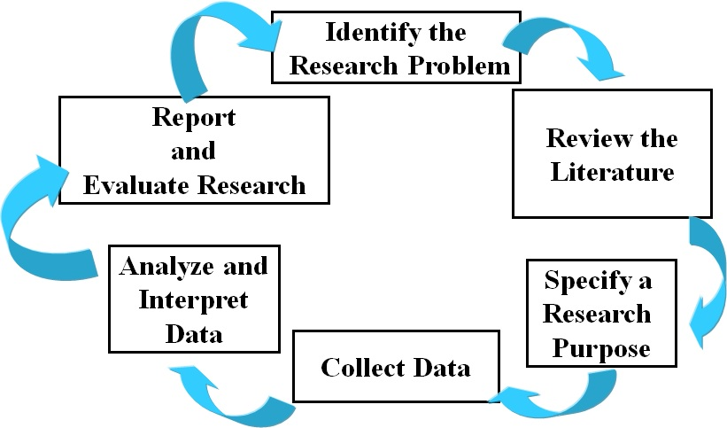
Figure 1.2 The Research Process Cycle
Notes:
The cycle of the six step research process

Slide 9
The Process of Research: Identify the Research Problem
Specify a problem
Justify a problem
Suggest a need to study the problem for audiences

Slide 10
The Process of Research: Review the Literature
Locate resources
Books
Journals
Electronic resources
Choose resources to include in the review
Summarize the literature in a written report

Slide 11
The Process of Research: Specify a Research Purpose
Identify the purpose statement
The major intent of the study
The participants in the study
The site of the study
Narrow the purpose statement to research questions

Slide 12
The Research Process: Collect Data
Determine the data collection method
Select the individuals to study
Obtain permissions
Design data collection instruments and outline data collection procedures
Gather data

Slide 13
The Research Process: Analyze and Interpret Data
Take the data apart to look at individual responses
Represent the data in tables, figures, and pictures
Explain conclusions from the data that address the research questions

Slide 14
The Research Process: Report and Evaluate Research (1 of 2)
Report research
Determine the audience for the report
Structure the report
Write the report sensitively and accurately

Slide 15
The Research Process: Report and Evaluate Research (2 of 2)
Evaluate research
Assess quality of research using recognized standards
Standards arise from the
academic community
school districts
federal or state agencies

Slide 16
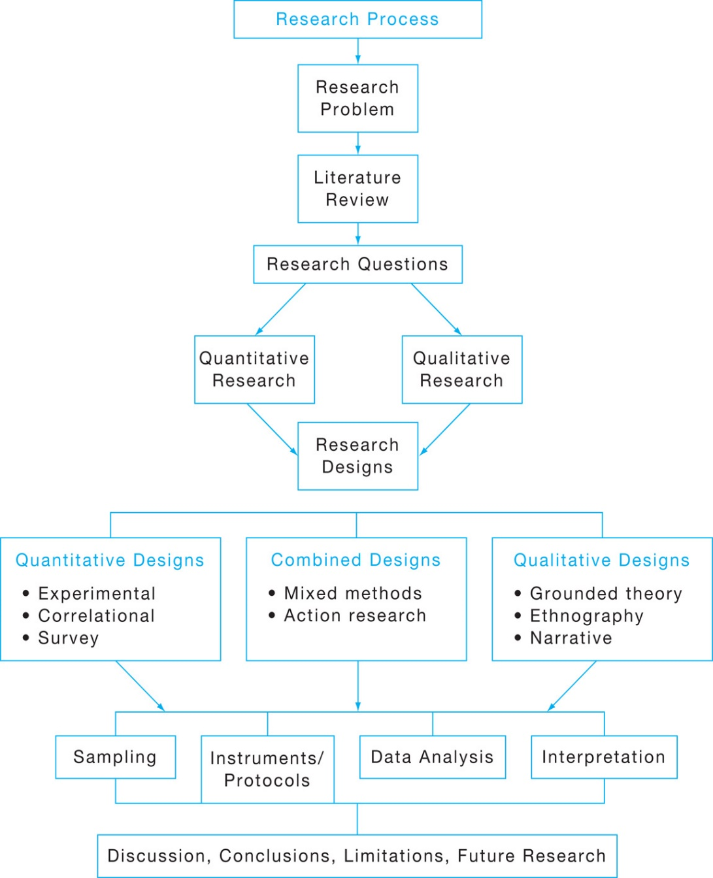
Figure 1.3 Flow of the Research Process through Quantitative and Qualitative Research
Notes:
Figure of the research process including designs

Slide 17
Quantitative Research Characteristics (1 of 2)
Describe a research problem through trends and relationships
Give major role for the literature to suggest questions and justify the research problem
Create purpose statements, research questions, and hypotheses that are specific, narrow, measureable, and observable

Slide 18
Quantitative Research Characteristics (2 of 2)
Collect numeric data from a large number of people using instruments
Analyze data for trends, group comparisons, and relationships among variables
Write the research report using standard, fixed structures and an objective, unbiased approach

Slide 19
Qualitative Research Characteristics (1 of 2)
Explore a problem through obtaining a detailed understanding of a central phenomenon
Have the literature justify the problem and play a minor role
State the purpose and research questions in a general, open-ended way

Slide 20
Qualitative Research Characteristics (2 of 2)
Collect data based on words from a small number of participants
Analyze the data using text analysis to obtain detailed descriptions and themes
Write the research report using flexible and emerging structures

Slide 21
Similarities between Quantitative and Qualitative Research
Both follow the six steps in the process of research
Both have introductions that establish the importance of the research problem
Both use interviews and observations

Slide 22
Differences between Quantitative and Qualitative Research
Quantitative research problems direct hypotheses and questions; Qualitative problems establishes importance
Quantitative data collection is more closed-ended; Qualitative more open-ended
Quantitative data analysis is based on statistics; Qualitative analysis based on text or image analysis
Quantitative reporting has a set structure; Qualitative reporting is more flexible
Different points on a continuum

Slide 23
Factors in Deciding to Use Quantitative or Qualitative Research
Match type of research to your research problem
Fit type of research to your audiences
Relate type of research to your experiences and training

Slide 24
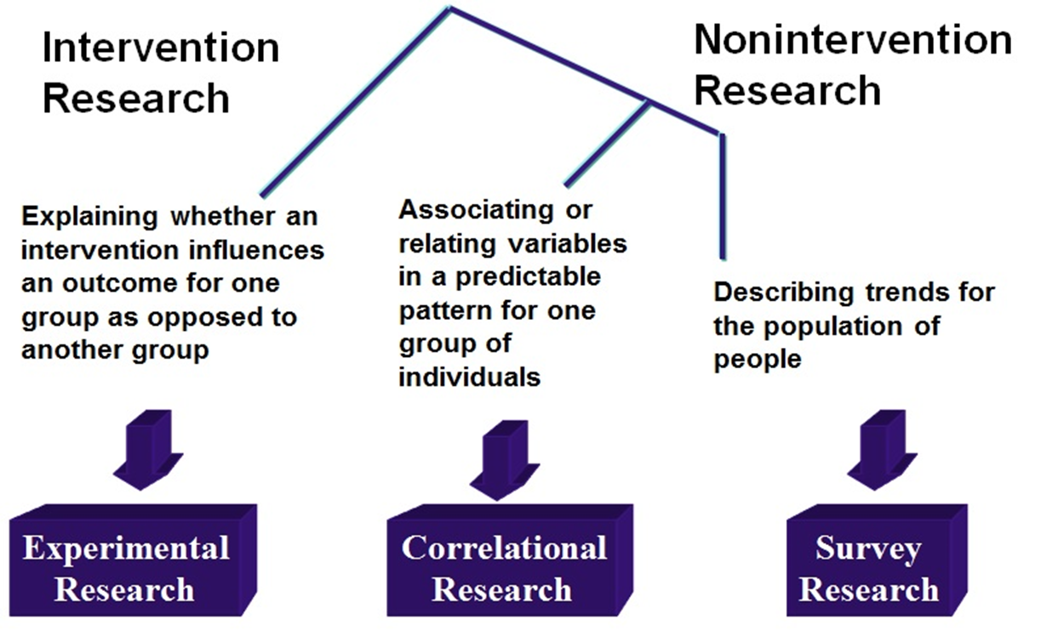
Figure 1.4 Types of Quantitative and Qualitative Research Designs and Their Primary Uses (1 of 3)

Slide 25
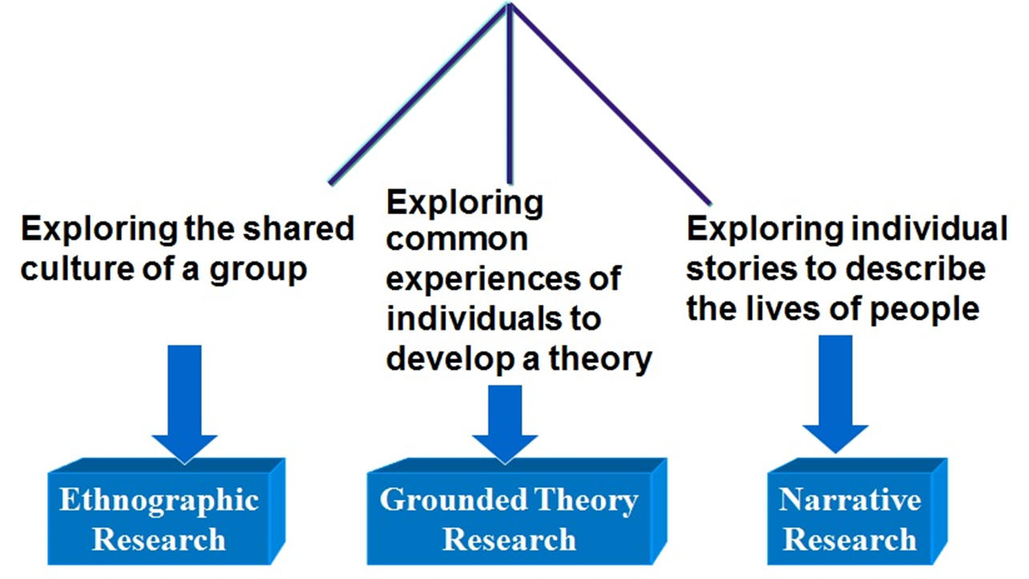
Figure 1.4 Types of Quantitative and Qualitative Research Designs and Their Primary Uses (2 of 3)

Slide 26
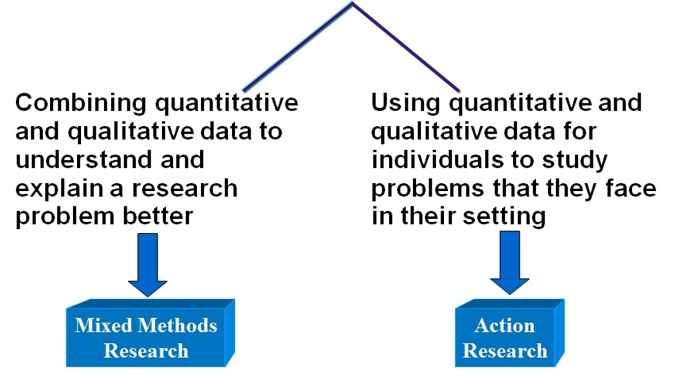
Figure 1.4 Types of Quantitative and Qualitative Research Designs and Their Primary Uses (3 of 3)

Slide 27
Important Ethical Issues in Conducting Research
Learn to apply for approval from your institutional review board
Recognize guidelines from professional associations
Use ethical practices throughout research
Use respectful data collection procedures
Show respect to audiences who read and use research

Slide 28
Skills Needed for Research
Curiosity to solve puzzles
Long attention spans
Library and computer resource skills
Writing and editing skills

Slide 29

Copyright

