Slide 1
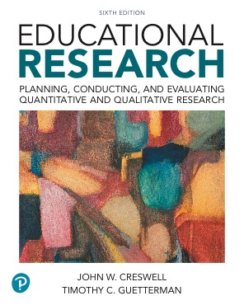
Educational Research: Planning, Conducting, and Evaluating Quantitative and Qualitative Research
Sixth Edition
Chapter 2
Identifying a Research Problem
Copyright © 2019, 2015, 2012 Pearson Education, Inc. All Rights Reserved
Notes:
If this PowerPoint presentation contains mathematical equations, you may need to check that your computer has the following installed:
1) MathType Plugin
2) Math Player (free versions available)
3) NVDA Reader (free versions available)

Slide 2
Learning Objectives
2.1 Define a research problem and explain its importance in a study
2.2 Distinguish between a research problem and other parts of the research process
2.3 Identify criteria for deciding whether you can or should study a research problem
2.4 Describe how quantitative and qualitative research problems differ
2.5 Learn the five elements that compromise a “statement of the problem” section
2.6 Identify strategies useful in writing a “statement of the problem” section

Slide 3
What is a Research Problem and Why is it Important? (1 of 3)
Research problem:
Educational issues
Controversies
Concerns
Guide the need for conducting a study

Slide 4
What is a Research Problem and Why is it Important? (2 of 3)
Locating the Research Problem:
What is the issue or problem?
What controversy leads to the need for a study?
What concern is being addressed behind the study?
Is there a sentence such as, “The problem being addressed in this study is…”?

Slide 5
What is a Research Problem and Why is it Important? (3 of 3)
The research problem
Is in the opening paragraphs
Sets the stage for the study
Tells the reader why the study is important
Tells the reader why they should read

Slide 6
How Does the Research Problem Differ from Other Parts of Research
A research topic is the broad subject matter being addressed in a study.
A research problem is an educational issue or problem addressed in the study.
A purpose is the major intent or objective of the study.
Research questions are those that the researcher would like answered or addressed in the study.

Slide 7
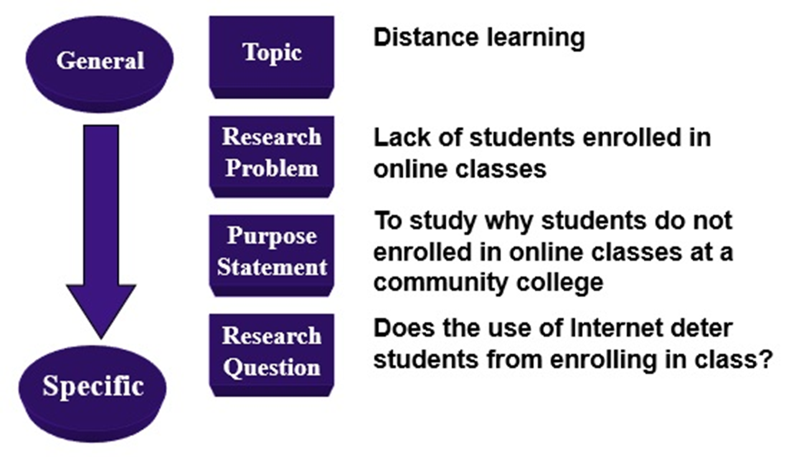
Figure 2.1 Distinguishing Among the Topic, Problem, Purpose, and Research Questions

Slide 8
Can and Should Problems Be Researched? (1 of 2)
Can you study the problem?
Do you have access to people and sites?
Do you have the time, resources, and skills to carry out the research?
Should you study the problem?
Does it advance knowledge?
Does it contribute to practice?

Slide 9
Can and Should Problems Be Researched? (2 of 2)
Will your study fill a gap or void in the existing literature?
Will your study replicate a past study but examine different participants and different research sites?
Will your study extend past research or examine the topic more thoroughly?
Will your study give voice to people not heard, silenced, or rejected in society?
Will your study inform practice?

Slide 10
How Research Problems Differ in Quantitative and Qualitative Research
Use quantitative research if your research problem requires you to:
Measure variables
Assess the impact of these variables on an outcome
Test theories or broad explanations
Apply results to a large number of people
Use qualitative research if your research problem requires you to:
Learn about the views of the people you plan to study
Assess a process over time
Generate theories based on participant perspectives
Obtain detailed information about a few people or research sites

Slide 11
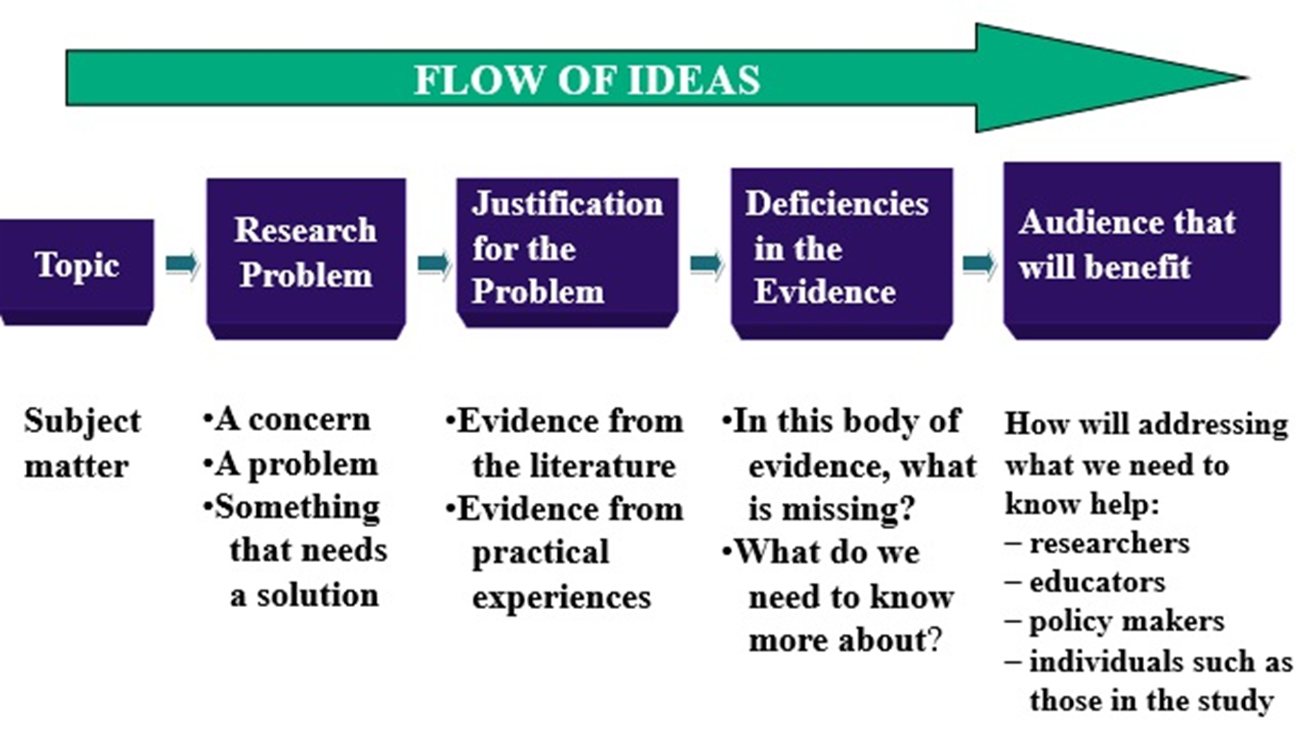
How Do You Write A “Statement of the Problem” Section? (1 of 7)

Slide 12
How Do You Write A “Statement of the Problem” Section? (2 of 7)
The Topic
Is introduced in the first paragraphs
Includes the general subject matter
Must be introduced with general ideas so that the reader can relate to it

Slide 13
How Do You Write A “Statement of the Problem” Section? (3 of 7)
The Topic
Functions of the narrative hook
Causes the reader to pay attention
Elicits an emotional or attitudinal response from the reader
Causes the reader to continue reading
Information that can be included in the narrative hook
Statistical data
A provocative question
Need for research
Intent of the study

Slide 14
How Do You Write A “Statement of the Problem” Section? (4 of 7)
The Research Problem
Introduce the problem in the opening paragraph
Identify an issue
Practical research problems
Research-based research problems
Reference the problem using the literature

Slide 15
How Do You Write A “Statement of the Problem” Section? (5 of 7)
Justification of the Importance of the Problem
Justification based on what other researchers have found
Justification based on your workplace or personal experiences
Justification based on the experiences others have had in the workplace

Slide 16
How Do You Write A “Statement of the Problem” Section? (6 of 7)
Deficiencies in What We Know
Past research or experience not adequate
Need to extend research, replicate, explore, lift voices of marginalized, add to practice
Identify two or three deficiencies

Slide 17
How Do You Write A “Statement of the Problem” Section? (7 of 7)
The Audience
Ask the following question: “Who will profit from reading my study?”
Other researchers
Practitioners
Policy makers
Participant groups (e.g., parents, administrators)

Slide 18
What Are Some Strategies for Writing the “Statement of the Problem” Section? (1 of 2)
Include one paragraph for each of the five elements
Write the sections in order
Develop the flow of ideas

Slide 19
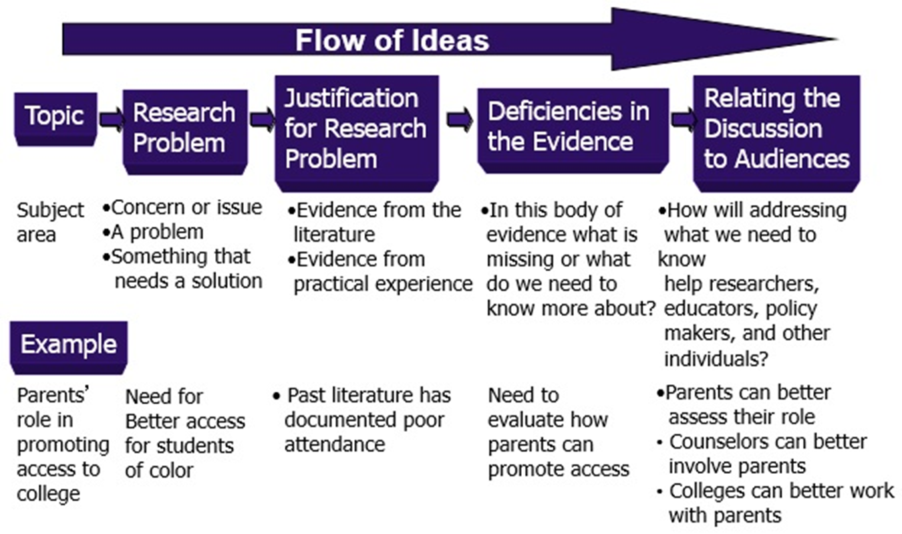
Example of the Flow of Ideas in the Problem Statement

Slide 20
What Are Some Strategies for Writing the “Statement of the Problem” Section? (2 of 2)
Other Writing Strategies
Heavily reference this section to the literature
Provide statistics to support trends
Use quotes from participants (in moderation)

Slide 21

Copyright

