Slide 1
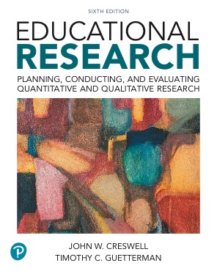
Educational Research: Planning, Conducting, and Evaluating Quantitative and Qualitative Research
Sixth Edition
Chapter 3
Reviewing the Literature
Slides in this presentation contain hyperlinks. JAWS users should be able to get a list of links by using INSERT+F7
Copyright © 2019, 2015, 2012 Pearson Education, Inc. All Rights Reserved
Notes:
If this PowerPoint presentation contains mathematical equations, you may need to check that your computer has the following installed:
1) MathType Plugin
2) Math Player (free versions available)
3) NVDA Reader (free versions available)

Slide 2
Learning Objectives
3.1 Define what a literature review is and why it is important
3.2 Identify the six steps in conducting a literature review

Slide 3
What is a Literature Review and Why is it Important?
A written summary of the literature
Describe past and current information and research
Organize into subtopics
Base mainly on research reported in journal articles
Document how your study adds to literature

Slide 4
How Does the Literature Review Differ for Quantitative and Qualitative Studies? (1 of 2)
For a quantitative study:
Justifies the importance of the research problem at the beginning of the study
Supports the theory or explanation used in the study
Foreshadows the purpose and research questions
Compare results at the end of the study

Slide 5
How Does the Literature Review Differ for Quantitative and Qualitative Studies? (2 of 2)
For a qualitative study:
Documents the importance of the research problem at the beginning of the study
Compare and contrast findings with other studies at the end of the study

Slide 6
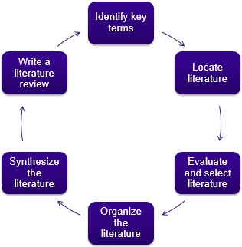
What Are the Six Steps in Conducting a Literature Review?

Slide 7
Six Step Literature Review: Identifying Key Terms (1 of 2)
Write a preliminary “working title”
Select two or three key words that capture the central idea
Pose a short general research question to answer in the study

Slide 8
Six Step Literature Review: Identifying Key Terms (2 of 2)
Use words that authors report in the literature
Use online databases to search literature (eric.ed.gov)
Review journal holdings and scan tables of contents for key terms
Examine electronic databases (e.g., Academic Search Premier)

Slide 9
Six Step Literature Review: Locate the Literature (1 of 2)
Use academic library sources
Peer-reviewed articles
Textbooks
Be cautious of Wikipedia
Primary and secondary sources

Slide 10
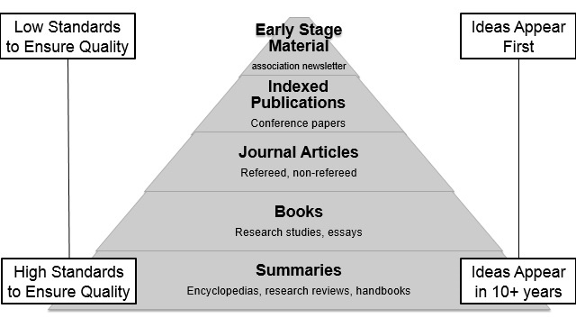
Figure 3.2. A Classification of Sources of Literature Review Materials from Summaries to Early-Stage Materials

Slide 11
Six Step Literature Review: Locate the Literature (2 of 2)
Databases that index journal articles
Social Science Citation Index
E B S C O
Google Scholar
Dissertation Abstracts
E R I C
Psyc INFO
Sociological Abstracts
Reference management software

Slide 12
Six Step Literature Review: Evaluate and Select the Literature (1 of 2)
Is it a good, accurate source?
National journal?
Refereed (peer reviewed) source?
Research study?
Include quantitative and qualitative sources

Slide 13
Six Step Literature Review: Evaluate and Select the Literature (2 of 2)
Is the source worthy of inclusion?
Topic relevance: Is the literature on the same topic as your proposed study?
Individual and site relevance: Does the literature examine the same individuals and sites you want to study?
Problem relevance: Does the literature examine the same research problem as you propose in your study?
Accessibility relevance: Is the literature available in your library or can it be downloaded from a Web site?

Slide 14
Six Step Literature Review: Organize the Literature
Gather studies, take notes, abstract
The structure is essentially the same for quantitative and qualitative research studies:
Research problem
Research questions or hypotheses
Data collection procedure
Results of the study

Slide 15
Six Step Literature Review: Synthesize the Literature (1 of 3)
Organize important concepts rather than chronology
Might develop a table of major concepts and related literature
Might develop a visual diagram of the literature
It is important to interrelate the concepts

Slide 16
Six Step Literature Review: Synthesize the Literature (2 of 3)
Literature map: figure or drawing displaying research literature on a topic
Constructing a literature map:
Identify key terms for the topic and put them at the top of the map
Sort studies into topical areas or “families of studies”
Provide a label for each box which will become a heading for the review
See Figure 3.7 for an example

Slide 17
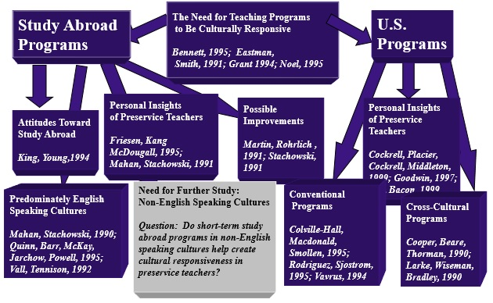
Figure 3.7 A Literature Map Hierarchical Design

Slide 18
Six Step Literature Review: Synthesize the Literature (3 of 3)
Constructing a literature map (continued):
Develop the map on as many levels as possible
Draw a box toward the bottom of the figure that says “my proposed study”
Draw lines connecting the proposed study with other branches of the literature
Figure 3.8 shows a circular literature map

Slide 19
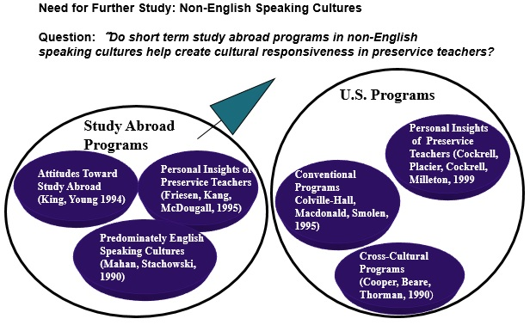
Figure 3.8 Literature Map, Circular Design

Slide 20
Six Step Literature Review: Writing a Literature Review (1 of 3)
Use a consistent style manual approach
End-of-text references are listed at the end
Within-text references are brief citations within the text
Headings and subheadings divide the material
Various levels of headings

Slide 21
Six Step Literature Review: Writing a Literature Review (2 of 3)
Thematic review
Literature documents the theme identified by researcher
No study is discussed in detail
Study-by-study review
Detailed review of each study
Studies grouped by themes
Summaries linked by transitional sentences and organized under subheadings

Slide 22
Six Step Literature Review: Writing a Literature Review (3 of 3)
Concluding statement
Summarize the major themes found in the literature review
End with a rationale for the need for your study based on this literature review

Slide 23
Reexamining the Parent Involvement and the Mothers’ Trust in Principals Studies (1 of 2)
Literature in the quantitative parent involvement study:
Documents the importance of the research problem at the beginning of the study
Provides evidence for important factors of the model to be tested
Provides evidence for the research questions
Provides an explanation for the results at the end, citing other studies and by returning to theoretical predictions

Slide 24
Reexamining the Parent Involvement and the Mothers’ Trust in Principals Studies (2 of 2)
Literature in the qualitative trust in principals study:
Documents the importance of the research problem at the beginning of the study
Does not foreshadow the research questions (which are broad in scope to encourage participants to provide their views)
Is used to compare with the findings of the present study at the end of the study

Slide 25

Copyright

