Slide 1
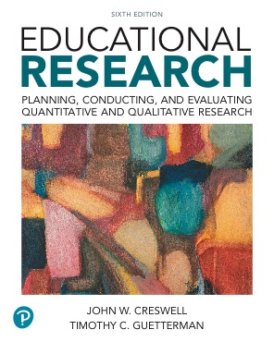
Educational Research: Planning, Conducting, and Evaluating Quantitative and Qualitative Research
Sixth Edition
Chapter 4
Specifying a Purpose and Research Questions or Hypotheses
Copyright © 2019, 2015, 2012 Pearson Education, Inc. All Rights Reserved
Notes:
If this PowerPoint presentation contains mathematical equations, you may need to check that your computer has the following installed:
1) MathType Plugin
2) Math Player (free versions available)
3) NVDA Reader (free versions available)

Slide 2
Learning Objectives
4.1 Distinguish among purpose statements, research questions, hypotheses, and objectives
4.2 Describe why these statements and questions are important
4.3 Write quantitative purpose statements, research questions, and hypotheses
4.4 Write qualitative purpose statements and research questions
Notes:
Slide 2 is list of textbook LO numbers and statements

Slide 3
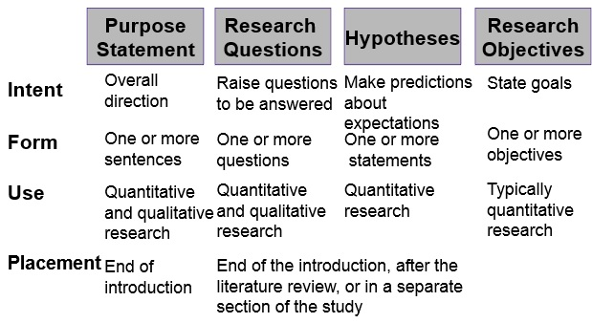
Figure 4.1 What Are Purpose Statements, Research Questions, Hypotheses, and Objectives

Slide 4
What Are Purpose Statements, Research Questions, Hypotheses, and Objectives (1 of 4)
The Purpose Statement
Advances overall direction or focus of the study
Example:
The purpose of this study is to examine the relationship between use of Internet communication between teachers and parents in a Midwestern school district and student achievement on tests in high school social studies.

Slide 5
What Are Purpose Statements, Research Questions, Hypotheses, and Objectives (2 of 4)
Research Questions
Narrow the purpose statement to specific questions to answer
Example
Do parent–teacher Internet communications affect student performance in the classroom?
What types of Internet experiences do parents have with teachers about the performance of the parents’ children?

Slide 6
What Are Purpose Statements, Research Questions, Hypotheses, and Objectives (3 of 4)
Hypotheses
Prediction or a conjecture about the outcome of a relationship among attributes or characteristics
Example
Students in high schools in the school district in which parents and teachers communicate through the Internet will have higher grades than students whose parents and teachers do not communicate through the Internet.

Slide 7
What Are Purpose Statements, Research Questions, Hypotheses, and Objectives (4 of 4)
Research Objectives
Statement of intent that specifies goals to achieve in a study
Example
To describe the frequency of Internet communication between parents and teachers regarding the parents’ children in high school social studies classes

Slide 8
Why Are These Statements and Questions Important?
Represent major signposts
Help identify appropriate methods
Help link intent with the results

Slide 9
How Do You Design Quantitative Purpose Statements, Research Questions, and Hypotheses? (1 of 25)
What is a variable?
What is a theory?
What elements go into these statements and questions?

Slide 10
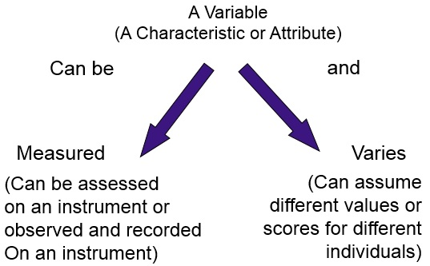
Figure 4.2 A Variable Can Be Measured, and it Varies Among Individuals

Slide 11
How Do You Design Quantitative Purpose Statements, Research Questions, and Hypotheses? (2 of 25)
Specify Variables
Variables
Leadership style
Organizational control
Autism
Difficult, but possibly measurable, variables
Socialization
Imagination
Intuition
Discrimination
Almost impossible to measure variables
Subconscious thoughts
World poverty
Stereotypes

Slide 12
How Do You Design Quantitative Purpose Statements, Research Questions, and Hypotheses? (3 of 25)
Specify Variables: Distinguish between Variables
Measured as Categories and as Continuous Scores
A categorical measure is a value of a variable assigned by the researcher into a small number of categories (e.g., gender).
A continuous measure is the value of a variable assigned by the researcher to a point along a continuum of scores, from low to high (e.g., age).

Slide 13
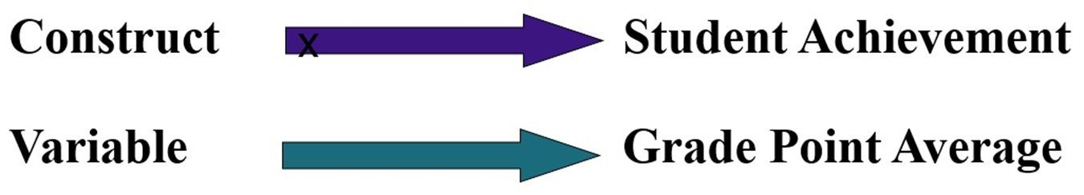
How Do You Design Quantitative Purpose Statements, Research Questions, and Hypotheses? (4 of 25)
Specify Variables: Distinguish Variables from Constructs
A variable is an attribute or characteristic stated in a specific or applied way.
A construct is an attribute or characteristic expressed in an abstract, general way.

Slide 14
How Do You Design Quantitative Purpose Statements, Research Questions, and Hypotheses? (5 of 25)
The Family of Variables
Dependent variables
What outcomes in my study am I trying to explain?
Independent variables
What variables or factors influence the outcomes?

Slide 15
How Do You Design Quantitative Purpose Statements, Research Questions, and Hypotheses? (6 of 25)
The Family of Variables
Control variables
What variables do I need to also measure (i.e., control) so that I can make sure my major factors (independent variables) influence outcomes (dependent variables) and not other factors? (the control variables and the mediating variables).
Confounding variables
What variables might influence the outcomes but cannot or will not be measured?

Slide 16
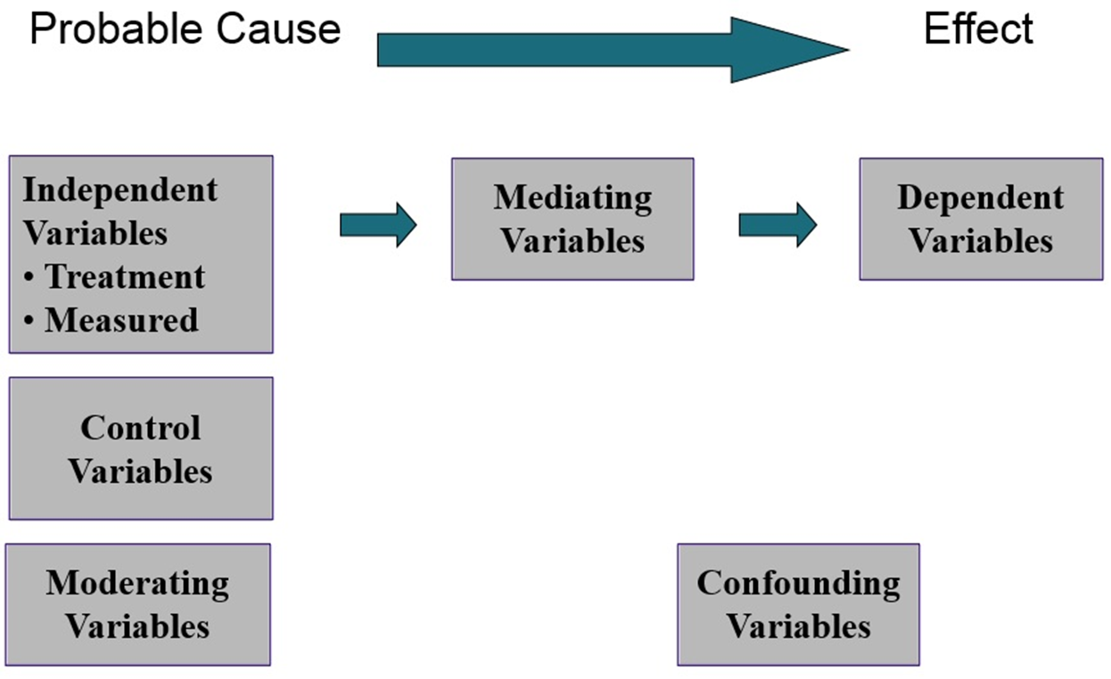
Figure 4.3 The Family of Variables in Quantitative Studies

Slide 17
How Do You Design Quantitative Purpose Statements, Research Questions, and Hypotheses? (7 of 25)
Family of Variables: Dependent Variables
Dependent variables: An attribute or characteristic influenced by the independent variable.
The outcome
The effect
The criterion
The consequence

Slide 18
How Do You Design Quantitative Purpose Statements, Research Questions, and Hypotheses? (8 of 25)
Family of Variables: Independent Variables
Independent variable: An attribute or characteristic that influences or affects an outcome or dependent variable
Treatment variable
Measured variable
Control variable
Moderating variable

Slide 19
How Do You Design Quantitative Purpose Statements, Research Questions, and Hypotheses? (9 of 25)
Family of Variables: Additional Forms of Independent Variables
Control variable: measured, important to consider and “neutralize”
Treatment variable: manipulated by researcher
Moderating variable: interacts with another independent variable to influence dependent variable

Slide 20
Table 4.1 Three Additional Forms of Independent Variables
Blank | Control Variable | Treatment Variable | Moderating Variable
Definition | A special type of independent variable that is of secondary interest and is neutralized through statistical or design procedures | An independent variable manipulated by the researcher | A special type of independent variable that is of secondary interest and combines with another independent variable to influence the dependent variable
Type of variable measurement | A variable not directly manipulated but controlled through statistical or research design procedures | A categorical variable actively manipulated by the researcher and composed of two or more groups | A categorical or continuous variable measured or observed as it interacts with other variables
Use in | Experiments, correlational studies, and survey studies | Experiments | Experiments, correlational studies, and surveys
Examples | Often demographic variables, such as age, gender, race, socioeconomic level | Classroom learning: one group receives standard lecture, and one group receives discussion; researcher assigns students to groups and thus manipulates group membership | Demographic variables, such as age, gender, race, or socioeconomic level; a measured variable, such as performance or attitude; or a manipulated variable, such as classroom instruction

Slide 21
How Do You Design Quantitative Purpose Statements, Research Questions, and Hypotheses? (10 of 25)
Family of Variables: Mediating
Mediating variables: An attribute or characteristic that “stands between” the dependent and independent variables

Slide 22
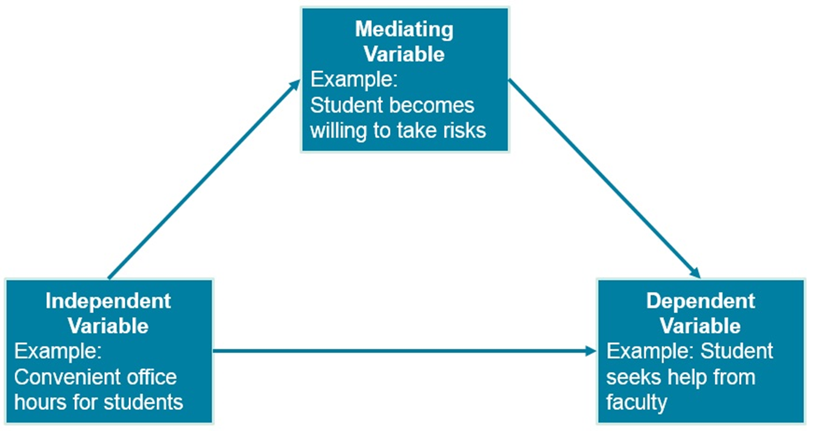
Figure 4.4 Mediating Variables “Stand between” Independent and Dependent Variables

Slide 23
How Do You Design Quantitative Purpose Statements, Research Questions, and Hypotheses? (11 of 25)
Family of Variables: An Unmeasured Influence in the Family of Variables
Confounding variables (spurious variables):
Cannot directly measure
Effects cannot be easily separated from the other variables
May influence the relationship between the independent and the dependent variable

Slide 24
How Do You Design Quantitative Purpose Statements, Research Questions, and Hypotheses? (12 of 25)
Theories and Testing of Variables
First step is describing variables
May test the relationship between variables
Probable cause establishes likely cause-and-effect
Theories predict relationships to test

Slide 25
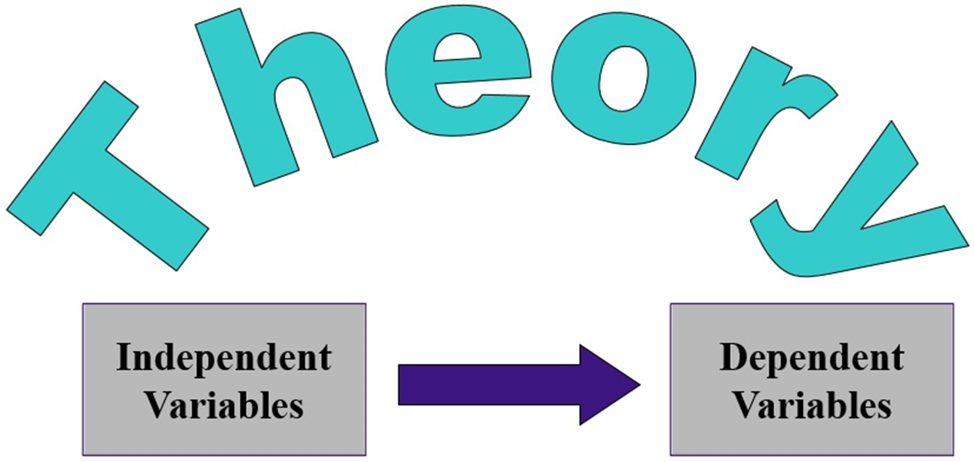
Figure 4.5 Theories as Bridges between Independent and Dependent Variables

Slide 26
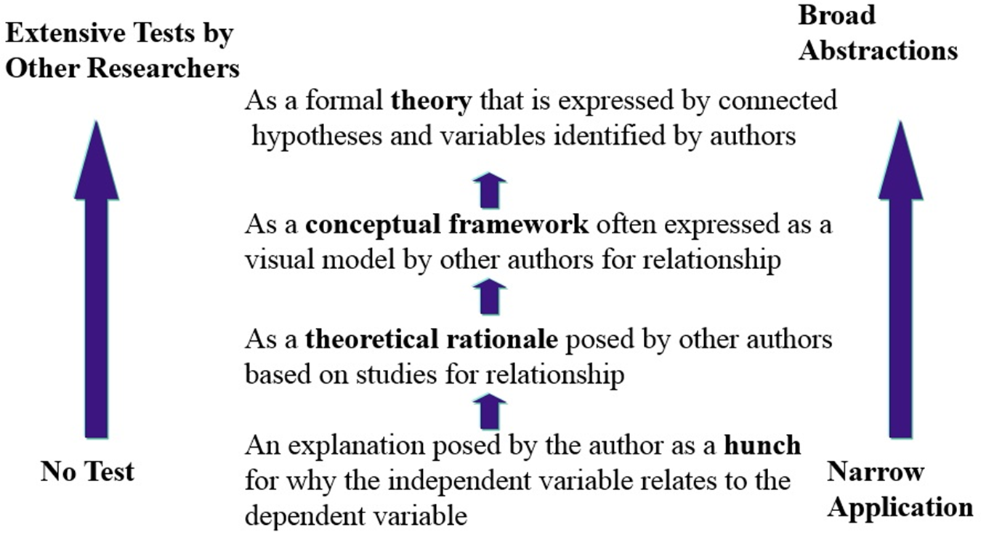
Figure 4.6 Different Types of Explanations in Quantitative Research

Slide 27
How Do You Design Quantitative Purpose Statements, Research Questions, and Hypotheses? (13 of 25)
Writing Quantitative Purpose Statements: Guidelines
A quantitative purpose statement identifies the variables, their relationship, and the participants and site for research
Use a single sentence
Use wording such as The purpose of this study...
If using a theory, state the theory you plan to test
Use quantitative words (e.g., “relate,” “compare,” “describe”) to describe the relationships between variables

Slide 28
How Do You Design Quantitative Purpose Statements, Research Questions, and Hypotheses? (14 of 25)
Writing Quantitative Purpose Statements: Guidelines
Independent variable (1st position in sentence)
Dependent variable (2nd position in sentence)
Control and/or mediating variable (3rd position in sentence)
Research site
Participants

Slide 29
How Do You Design Quantitative Purpose Statements, Research Questions, and Hypotheses? (15 of 25)
Writing Quantitative Purpose Statements: Sample Scripts
The purpose of this study is to test (the theory) by relating (the independent variable) to (the dependent variable) for (participants) at (the research site)
or
by comparing (independent variable) with (Group 1) and (Group 2) in terms of (dependent variable) for (participants) at (the research site).

Slide 30
How Do You Design Quantitative Purpose Statements, Research Questions, and Hypotheses? (16 of 25)
Writing Quantitative Research Questions
Describe results of your variables
Compare two or more groups on the independent variable in terms of the
dependent variable
Relate two or more variables

Slide 31
How Do You Design Quantitative Purpose Statements, Research Questions, and Hypotheses? (17 of 25)
Writing Quantitative Research Questions: Guidelines
Pose a question
Begin with “how,” “what,” or “why”
Specify the independent, dependent, and mediating or control variables
Use the words describe, compare, or relate to indicate the action or connection among the variables
Indicate the participants and the research site for the study

Slide 32
How Do You Design Quantitative Purpose Statements, Research Questions, and Hypotheses? (18 of 25)
Writing Quantitative Research Questions: Descriptive Questions
Identify response to a single variable or question
Script:
How frequently do (participants) (variable) at (research site)?
How frequently do African Americans feel isolated on college campuses?

Slide 33
How Do You Design Quantitative Purpose Statements, Research Questions, and Hypotheses? (19 of 25)
Writing Quantitative Research Questions: Relationship Questions
Answer the degree and magnitude of the relationship between two or more variables.
Script:
How does (independent variable) relate to (dependent variable) for (participants) at (research site)?
How do feelings of isolation relate to (or influence) the ethnic identity of African Americans in the United States?

Slide 34
How Do You Design Quantitative Purpose Statements, Research Questions, and Hypotheses? (20 of 25)
Writing Quantitative Research Questions: Comparison Questions
How two or more groups on an independent variable differ in terms of one or more outcome variables
Script:
How does (Group 1) differ from (Group 2) in terms of (dependent variable) for (participants) at (research site)?
How do African Americans and European Americans compare in their perceptions of ethnic identity?

Slide 35
How Do You Design Quantitative Purpose Statements, Research Questions, and Hypotheses? (21 of 25)
Writing Quantitative Hypotheses
Narrows the purpose statement
Advances a prediction
Example
The more students feel alienated, the more likely they are to carry weapons to school.

Slide 36
How Do You Design Quantitative Purpose Statements, Research Questions, and Hypotheses? (22 of 25)
Writing Quantitative Hypotheses: Guidelines
State the variables in this order: independent (first position), dependent (second position), and control (third position).
When comparing, explicitly state the groups; if variables are related, specify the relationship between the variables.
Make a prediction about changes you expect in your groups.
State information about the participants and the site unless it repeats information stated in your purpose statement.

Slide 37
Table 4.2 The Null and Alternative Hypotheses
Type of Hypothesis | Null Hypothesis | Alternative Hypothesis
Purpose | To test in the general population that there is no change, no relationship, or no difference | The hypothesis that may be true if the null is rejected; it suggests a change, a relationship, or a difference
Specific language found in the hypothesis | There is no difference (or relationship) between... | Magnitude statements, such as higher, lower, more positive, or more favorable
How researchers test the hypothesis | A test of the hypothesis | A test of the hypothesis

Slide 38
How Do You Design Quantitative Purpose Statements, Research Questions, and Hypotheses? (23 of 25)
Writing Quantitative Hypotheses: Null Hypotheses
Null hypothesis
No change in the dependent variable.
Example: There will be no significant difference in test scores between fifth-grade boys and girls on the X Y Z achievement test.

Slide 39
How Do You Design Quantitative Purpose Statements, Research Questions, and Hypotheses? (24 of 25)
Writing Quantitative Hypotheses: Alternative Hypotheses
Directional alternative hypothesis
Specifies the direction of the change in the dependent variable the researcher predicts will take place.
Example: Fifth-grade girls will have higher scores on the X Y Z achievement test than fifth-grade boys.

Slide 40
How Do You Design Quantitative Purpose Statements, Research Questions, and Hypotheses? (25 of 25)
Writing Quantitative Hypotheses: Alternative Hypotheses
Nondirectional alternative hypothesis
Does not specify the direction of the change in the dependent variable.
Example: There will be a difference in test scores on the X Y Z achievement test for fifth-grade boys and girls.

Slide 41
How Do You Design Qualitative Purpose Statements and Research Questions? (1 of 11)
Understand how these statements and questions differ from quantitative research.
Understand the role of a central phenomenon in qualitative research.
Understand qualitative research as an emerging process.

Slide 42
How Do You Design Qualitative Purpose Statements and Research Questions? (2 of 11)
Differentiating between Quantitative and Qualitative Purpose Statements and Research Questions
Quantitative—more closed
Probable cause/effect (“Why did it happen?”)
Use of theories (“Why did it happen in view of an explanation or theory?”)
Assess differences and magnitude (“How much happened?”) (“How many times did it happen?”) (“What were the differences among groups in what happened?”)
Qualitative—more open-ended
Descriptive (“What happened?”)
Interpretive (“What was the meaning to people of what happened?”)
Process-oriented (“What happened over time?”)

Slide 43
How Do You Design Qualitative Purpose Statements and Research Questions? (3 of 11)
The Central Phenomenon in Qualitative Research
Concept or a process explored in qualitative research
Focus on a single concept or process
Example:
Ethnic identity of Chinese American immigrants
The process of negotiation by a female superintendent with her principals

Slide 44
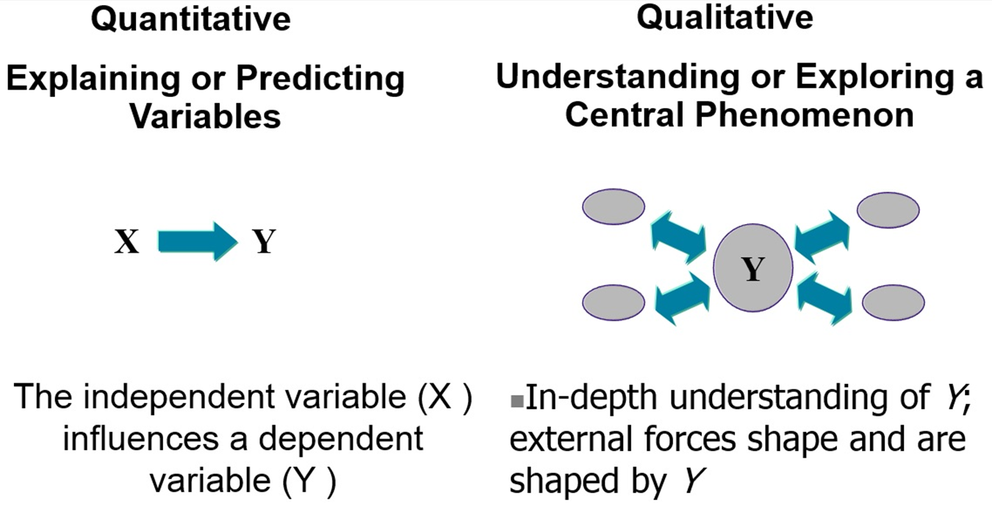
Figure 4.7 How Researchers Explain or Predict Variables Versus Exploring or Understanding a Central Phenomenon

Slide 45
How Do You Design Qualitative Purpose Statements and Research Questions? (4 of 11)
Emerging Processes in Qualitative Research
Qualitative research is an emerging design
Purpose statements and research questions may change
Feedback and responses of participants inform changes

Slide 46
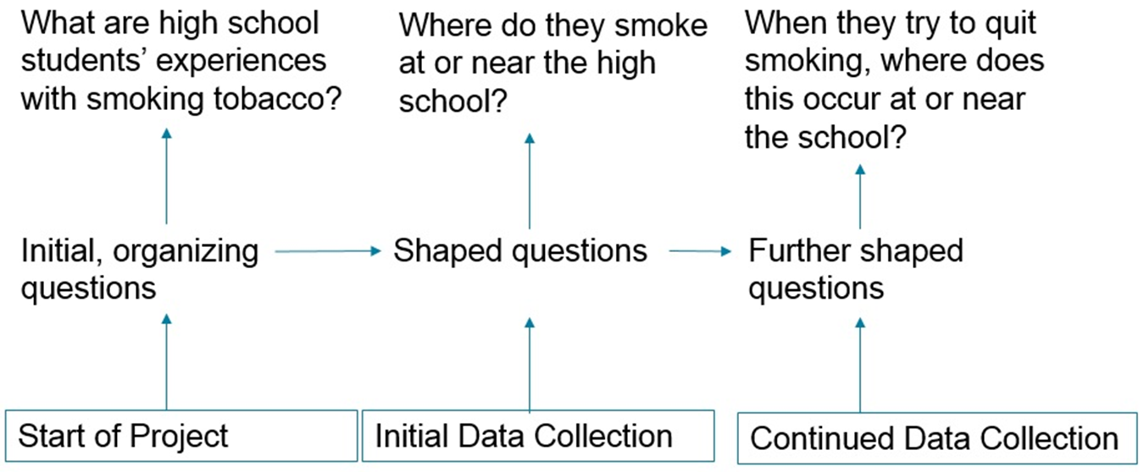
Figure 4.8 Emerging Questions in Qualitative Research
Example

Slide 47
How Do You Design Qualitative Purpose Statements and Research Questions? (5 of 11)
Writing Qualitative Purpose Statements
Purpose statement in qualitative research: indicates the intent to explore or understand the central phenomenon with specific individuals at a certain research site
Sentence, at the end of the introduction

Slide 48
How Do You Design Qualitative Purpose Statements and Research Questions? (6 of 11)
Writing Qualitative Purpose Statements: Sample Script
Script:
The purpose of this qualitative study will be to (explore/discover/understand/ describe) (the central phenomenon) for (participants) at (research site).
Example:
The purpose of this qualitative study is to describe classroom learning using the Internet for five high school students participating in a sign language class.

Slide 49
How Do You Design Qualitative Purpose Statements and Research Questions? (7 of 11)
Writing Qualitative Research Questions: Guidelines
Qualitative research questions: open-ended, general questions that the researcher would like answered
Guidelines
Change and emerge based on participants’ views and your understanding
Only a few general questions
Neutral, exploratory language

Slide 50
How Do You Design Qualitative Purpose Statements and Research Questions? (8 of 11)
Writing Qualitative Research Questions: The Central Question
Central question: The overarching question you explore in the research study
Begin with how or what
Specify central phenomenon to explore
Identify participants
Mention research site

Slide 51
How Do You Design Qualitative Purpose Statements and Research Questions? (9 of 11)
Writing Qualitative Research Questions: A Sample Script
Script:
What is (the central phenomenon) for (participants) at (research site)?
Example
What is creativity for five students at Roosevelt High School?
In this example, identify the components

Slide 52
Table 4.3 Problems Typically Found in Central Questions in Qualitative Research
Problems | Poor Example of a Central Question | Better Example of a Central Question
Too general | What is going on here? | What is the process being used by the general education committee at the liberal arts school?
Too focused | How did the committee make a curriculum decision about a course on the environment? | What is the process of the curriculum committee in making decisions about courses?
Too laden with assumptions | How did the curriculum committee address its alienation from the college administration? | What was the role of the college administration in the curriculum committee’s deliberations?

Slide 53
How Do You Design Qualitative Purpose Statements and Research Questions? (10 of 11)
Writing Qualitative Research Questions: Subquestions
Subquestions: Divides the central question into smaller, specific questions
Issue subquestions: Narrow the focus of the central question into specific issues.
Procedural subquestions: Indicate the steps to be used in analyzing the data in a qualitative study.

Slide 54
Table 4.4 Types of Subquestions in Qualitative Research
Blank | Issue Subquestions | Procedural Subquestions
Intent | To subdivide the central question into detailed questions | To subdivide the central question into steps for data collection during the study
Example | Central question: What does it mean to be a professional teacher? Issue subquestions: What do professional teachers do? What is difficult/easy about being a professional educator? When did the teacher first become aware of being a professional? | Central question: What is the change process in the revision of a general education curriculum on a college campus? Procedural subquestions: How did the process unfold? Who were the people involved? What events occurred? What was the outcome?

Slide 55
How Do You Design Qualitative Purpose Statements and Research Questions? (11 of 11)
Writing Qualitative Research Questions: Distinguishing Qualitative Research Questions from Data Collection Questions
Interview questions are based on issues subquestions.
Also, ask other questions, like and opening about the participants.
Might close with question about others to interview.

Slide 56
Reexamining the Parent Involvement and Mothers’ Trust in Principals Studies (1 of 2)
Quantitative parent involvement study has a purpose statement and guiding research questions (Deslandes & Bertrand, 2005)
To examine how the four psychological constructs influence parent involvement decisions across the three secondary grade levels, we posed the following research question: What are the relative contributions of parents’ role construction, self-efficacy, perceptions of teacher invitations, and perceptions of adolescent invitations to predict parent involvement at home and at school in Grades 7, 8, and 9? (p. 166)

Slide 57
Reexamining the Parent Involvement and Mothers’ Trust in Principals Studies (2 of 2)
Qualitative mothers’ trust in principals study has purpose statement and research questions (Shelden, Angell, Stoner, & Roseland, 2010)
What are the perspectives of mothers of children with disabilities on trust in school principals? (p. 161)
We employed a qualitative research methodology to gain insight into the nature of trust of mothers of children with disabilities in school principals. (p. 161)

Slide 58

Copyright

