Slide 1
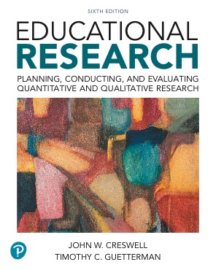
Educational Research: Planning, Conducting, and Evaluating Quantitative and Qualitative Research
Sixth Edition
Chapter 5
Collecting Quantitative Data
Slides in this presentation contain hyperlinks. JAWS users should be able to get a list of links by using INSERT+F7
Copyright © 2019, 2015, 2012 Pearson Education, Inc. All Rights Reserved
Notes:
If this PowerPoint presentation contains mathematical equations, you may need to check that your computer has the following installed:
1) MathType Plugin
2) Math Player (free versions available)
3) NVDA Reader (free versions available)

Slide 2
Learning Objectives
5.1 State the five steps in the process of quantitative data collection
5.2 Identify how to select participants for a study
5.3 Identify the permissions needed for a study
5.4 List different options for collecting information
5.5 Locate, select, and assess an instrument(s) for use in data collection
5.6 Describe procedures for administering quantitative data collection
Notes:
Slide 2 is list of textbook LO numbers and statements

Slide 3
Five Steps in the Process of Data Collection
Determining participants to study
Obtaining permissions needed
Considering what types of information to collect
Locating and selecting instruments
Administering the data collection

Slide 4
What Participants Will You Study? (1 of 7)
Identify Your Unit of Analysis
Unit of analysis is the level (e.g., individual, family, school, school district) from which the data will be gathered
There may be different units of analysis:
One for the dependent variable
One for the independent variable

Slide 5
What Participants Will You Study? (2 of 7)
Specify the Population and Sample
Population: group of individuals that have the same characteristic(s).
Sample: subgroup of the target population that the researcher plans to study for the purpose of making generalizations about the target population.
Samples are only estimates.
The difference between the sample estimate and the true population is the “sampling error.”

Slide 6
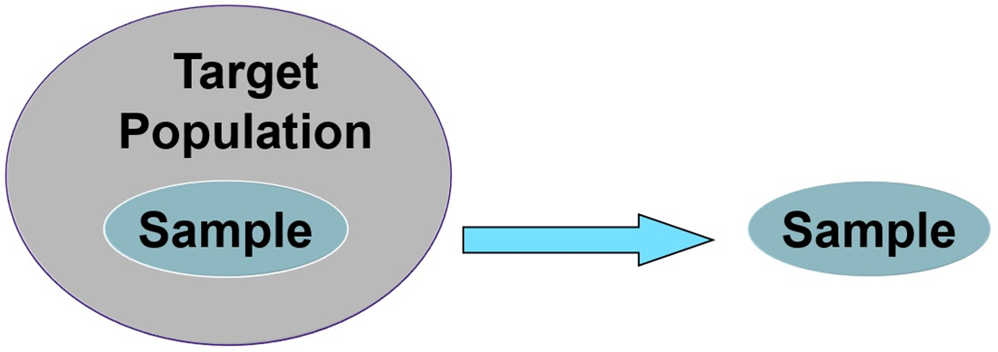
Figure 5.1 Populations and Samples
Population
All teachers in high schools in one city
College students in all community colleges
Adult educators in all schools of education
Sample
All high school biology teachers
Students in one community college
Adult educators in five schools of education in the Midwest

Slide 7
What Participants Will You Study? (3 of 7)
Specify the Population and Sample: Probability Sampling Approaches
Probability sampling is the selection of individuals from the population so that they are representative of the population.
Nonprobability sampling is the selection of participants because they are available, convenient, or represent some characteristic the investigator wants to study.

Slide 8
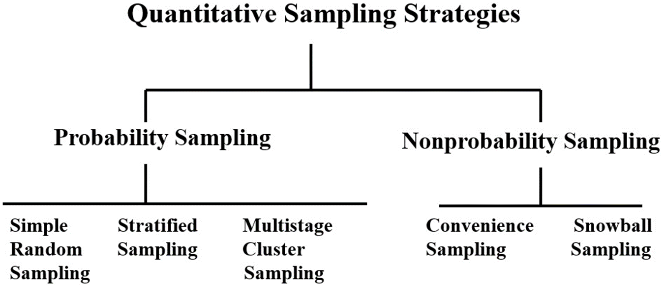
Figure 5.2 Types of Quantitative Sampling Strategies

Slide 9
What Participants Will You Study? (4 of 7)
Specify the Population and Sample: Probability Sampling Approaches
Simple random: Selecting a sample from the population so all in the population have an equal chance of being selected
Systematic: Choosing every “nth” individual or site in the population until the desired sample size is achieved

Slide 10
What Participants Will You Study? (5 of 7)
Specify the Population and Sample: Probability Sampling Approaches
Stratified sampling: Stratifying the population on a characteristic (e.g., gender) then sampling from each stratum
Multistage cluster sampling: A sample chosen in one or two stages because the population is not easily identified or is large

Slide 11
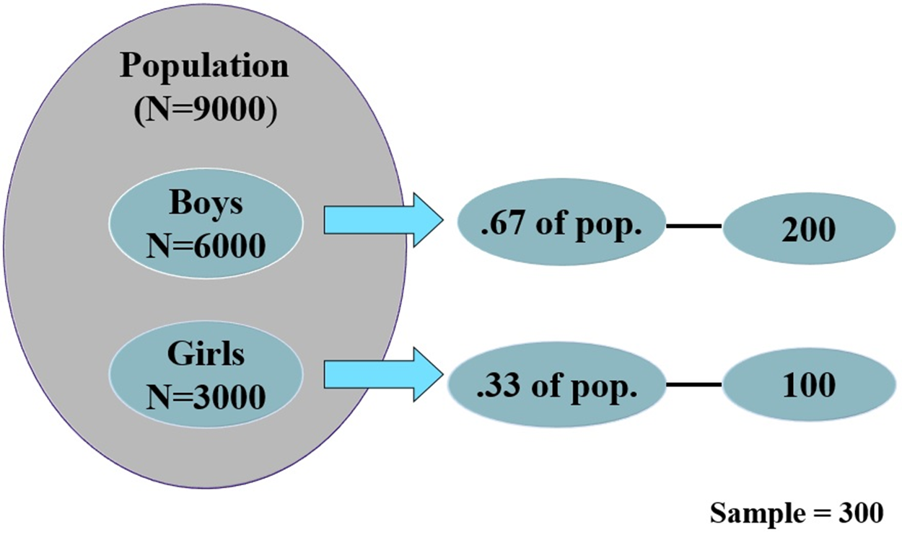
Figure 5.3 Proportional Stratification Sampling Approach

Slide 12
What Participants Will You Study? (6 of 7)
Specify the Population and Sample: Probability Sampling Approaches
Convenience sampling: select participants because they are willing and available to be studied
Snowball sampling: researcher asks participants to identify other participants to become members of the sample

Slide 13
What Participants Will You Study? (7 of 7)
Specify the Population and Sample: Sample Size
Important to determine size
Larger the size, the less the potential error
Sampling error: difference between the sample estimate and the true population score
Sample size formula: calculate estimate based on confidence, test, sampling error

Slide 14
What Permissions Will You Need (1 of 3)
Obtain Different Types of Permissions
Institutions or organizations (e.g., school district)
Specific sites (e.g., secondary school)
Individual participants
Parents of participants who are not considered adults
Campus approval (e.g., university or college) and Institutional Review Board (I R B)

Slide 15
What Permissions Will You Need (2 of 3)
Obtain Informed Consent: Review Board Approval
Committee of faculty and at least one person not affiliated with institution
Review to ensure research protects the rights of the participants

Slide 16
What Permissions Will You Need (3 of 3)
Obtain Informed Consent: Process of Obtaining Approval from Review Boards
Start by finding out about the review process used at your campus
Determine what information the review board needs about your project
Develop an informed consent form for participants to sign before they participate in the study
Submit a description of your proposed study to the I R B

Slide 17
Figure 5.4 An Example of an Informed Consent Form
The example consent includes
Title
Voluntary participation statement
Right to withdraw
Purpose
Procedures
Right to: ask questions, obtain results, anonymity
No known risks (or state risks if known)
Benefits
Signature line for participant
Information about investigator

Slide 18
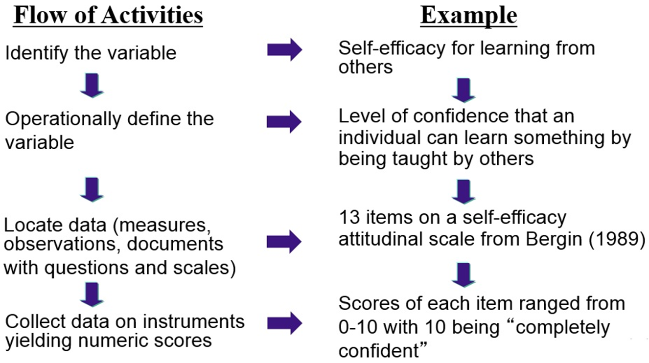
Figure 5.5 The Flow of Activities in Collecting Data

Slide 19
What Are Your Options for Collecting Information? (1 of 8)
Operationally Define Each Variable
Operational definition: specification of how you will define and measure the variable
Identify how to measure
Cite other authors who have defined

Slide 20
What Are Your Options for Collecting Information? (2 of 8)
Choose Types of Data and Measures
Instrument: a tool for measuring, observing, or documenting quantitative data
Types of data:
Measures of individual performance
Measures of individual attitude
Observations of individual behavior
Factual information

Slide 21
What Are Your Options for Collecting Information? (3 of 8)
Choose Types of Data and Measures: Performance Measures
Performance measures: assess an individual’s ability to perform on
achievement test
intelligence test
aptitude test
interest inventory
personality assessment inventory

Slide 22
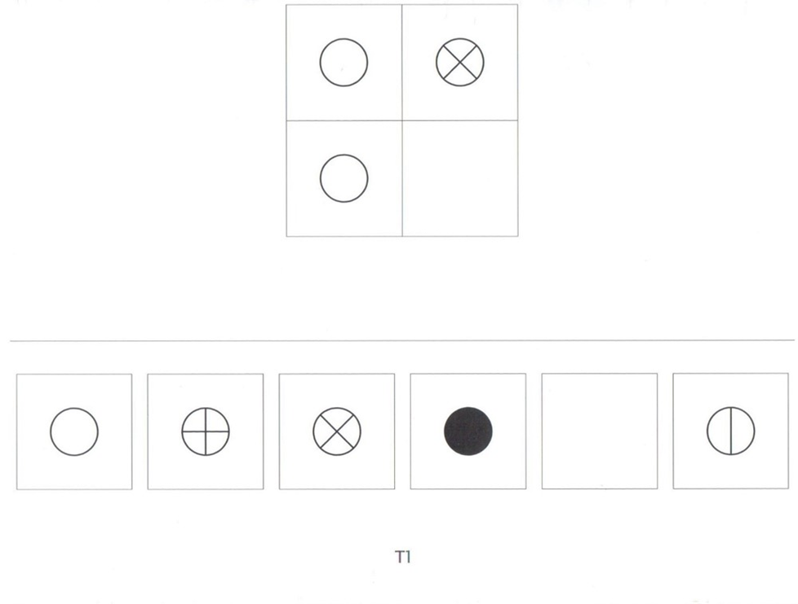
Figure 5.6 Example of an Instrument That Measures Performance

Slide 23
What Are Your Options for Collecting Information? (4 of 8)
Choose Types of Data and Measures: Attitudinal Measures
Attitudinal measures: measures feelings toward educational topics
Write to encourage honest response
Limitation is no evidence of specific behaviors

Slide 24
What Are Your Options for Collecting Information? (5 of 8)
Choose Types of Data and Measures: Behavioral Observations
Behavioral observations:
selecting instrument to record a behavior
observing individuals for that behavior
checking points on a scale that reflect the behavior

Slide 25
What Are Your Options for Collecting Information? (6 of 8)
Choose Types of Data and Measures: Factual Information
Factual information or personal documents: consist of numeric, individual data available in public records
Examples:
grade reports
school attendance records
student demographic data
census information
Privacy regulations may apply

Slide 26
What Are Your Options for Collecting Information? (7 of 8)
Choose Types of Data and Measures: Digital Methods of Data Collection
Use of websites and the Internet for
Administering surveys
Gathering interviews
Mining social media (e.g., Facebook, Twitter)
Using existing databases

Slide 27
What Are Your Options for Collecting Information? (8 of 8)
Choose Types of Data and Measures: How to Decide What Types to Choose
What am I trying to learn?
What is realistic to collect?
What are the advantages and disadvantages?

Slide 28
What Instrument Will You Use to Collect Data? (1 of 7)
Locate or Develop an Instrument
Develop it yourself
Modify an instrument: locate an existing instrument, obtain permission to change it, and make changes in it to fit your requirements
Locate one to use in its entirety

Slide 29
Figure 5.9 Steps in Developing or Constructing an Instrument
Phase I: Planning State purpose of test and target groups Identify and define domain of test Review literature on construct or variable of interest Give open-ended questions to target group Interpret open-ended comments Write objectives Select item format | Phase III: Quantitative Evaluation Prepare instrument for first pilot test Administer first pilot test Debrief subjects Calculate reliability Run item analysis Revise instrument Prepare for second pilot test
Phase II: Construction Develop table of specifications Hire and train item writers Write pool items Validate content Have judges complete qualitative evaluation Develop new or revise items | Phase IV: Validation Administer second pilot test Run item analysis Repeat steps of revision, pilot administration, and item analysis Begin validation Administer for validation data Continue validation

Slide 30
What Instrument Will You Use to Collect Data? (2 of 7)
Search for an Instrument
Look in published journal articles
Run an E R I C search and a descriptor for the instrument you want in an online search to see if there are articles that contain instruments
Check Tests in Print
Check Mental Measurements Yearbook published by the Buros Center at the University of Nebraska, Lincoln, N E (http://buros.org)
Develop your own instrument

Slide 31
What Instrument Will You Use to Collect Data? (3 of 7)
Criteria for Choosing a Good Instrument
Have authors developed the instrument recently?
Is the instrument widely cited by other authors?
Are reviews available for the instrument?
Is there information about the reliability and validity of scores from past uses of the instrument?
Does the procedure for recording data fit the research questions/hypotheses in your study?
Does the instrument contain accepted scales of measurement?

Slide 32
What Instrument Will You Use to Collect Data? (4 of 7)
Criteria for Choosing a Good Instrument: Are Scores on Past Use of the Instrument Reliable and Valid?
Reliability: Scores from measuring variables that are stable and consistent
Example: Bathroom scale
Types of reliability
Test-retest (scores are stable over time)
Alternate forms (equivalence of two instruments)
Alternate forms and test-retest
Inter-rater reliability (similarity in observation of a behavior by two or more individuals)
Internal consistency (consistent scores across the instrument)

Slide 33
What Instrument Will You Use to Collect Data? (5 of 7)
Criteria for Choosing a Good Instrument: Are Scores on Past Use of the Instrument Reliable and Valid?
Validity: Evidence to demonstrate that the test interpretation of scores matches its proposed use
Types of validity
Evidence based on test content
Evidence based on response processes
Evidence based on internal structure
Evidence based on relations to other variables
Evidence based on the consequences of testing

Slide 34
Figure 5.10 Reliability and Validity Questions for Selecting/Evaluating a Test or Instrument
Reliability | Validity
Did the author check for reliability? | Did the author check for validity?
If so, what form of reliability was reported? | If so, what type of validity was reported?
Was an appropriate type used? | Was more than one type reported?
Were the reliability values (coefficients) reported? | Was the validity evidence reported with appropriate statistics?
Were they positive, high coefficients? | Was the evidence strong?

Slide 35
What Instrument Will You Use to Collect Data? (6 of 7)
Criteria for Choosing a Good Instrument: Do the Instrument’s Data-Recording Procedures Fit the Research Questions/Hypotheses?
Recording procedures fit the data you need to answer the question
Who records data?
Is it self-reported or does the researcher record?
Participant supplied takes less time
Researcher supplied may be higher quality

Slide 36
What Instrument Will You Use to Collect Data? (7 of 7)
Criteria for Choosing a Good Instrument: Are Adequate Scales of Measurement Used?
Nominal (categorical): Categories that describe traits or characteristics participants can check
Ordinal (categorical): Participants rank order a characteristic, trait, or attribute
Interval (continuous): Provides “continuous” response possibilities to questions with assumed equal distance
Ratio (true zero): A scale with a true zero and equal distances among units
Combined: More than one scale

Slide 37
How Will You Administer the Data Collection? (1 of 2)
Standardization
Develop standard written procedures for administering an instrument
Train researchers to collect observational data
Obtain permission to collect and use public documents

Slide 38
How Will You Administer the Data Collection? (2 of 2)
Ethical Issues
Respect individuals and sites during data gathering (ethics)
Obtain permissions
Protect anonymity by assigning numbers to instruments
Respect those who do not want to participated
Observations can be disruptive

Slide 39
Reexamining the Quantitative Parent Involvement Study
Examine method section
Assume consent and permissions obtained
Sampling strategy?
Know number of sites and sample size
Instrument
Sharing the Dream! Parent Questionnaire
Likert-type, interval data
Parametric statistics
Reliability from past use reported, not validity evidence

Slide 40

Copyright

