Slide 1

Educational Research: Planning, Conducting, and Evaluating Quantitative and Qualitative Research
Sixth Edition
Chapter 6
Analyzing and Interpreting Quantitative Data
Slides in this presentation contain hyperlinks. JAWS users should be able to get a list of links by using INSERT+F7
Copyright © 2019, 2015, 2012 Pearson Education, Inc. All Rights Reserved
Notes:
If this PowerPoint presentation contains mathematical equations, you may need to check that your computer has the following installed:
1) MathType Plugin
2) Math Player (free versions available)
3) NVDA Reader (free versions available)

Slide 2
Learning Objectives
6.1 Identify the steps in the process of analyzing and interpreting quantitative data
6.2 Describe the process of preparing your data for analysis
6.3 Identify the procedures for analyzing your data
6.4 Learn how to report the results of analyzing your data
6.5 Describe how to interpret the results
Notes:
Slide 2 is list of textbook LO numbers and statements

Slide 3
What Are the Steps in the Process of Quantitative Data Analysis?
Preparing the data for analysis
Conducting the data analysis
Reporting the results
Interpreting the results

Slide 4
How Do You Prepare the Data for Analysis? (1 of 11)
Score the Data
Score data by assigning numeric codes to responses
Continuous scale example: score “Strongly agree” as a “5” and “Strongly disagree” as a “1”
Categorical scale example: Score “Female” as a “1” and “Male” as a “2”
Create a codebook using information from instruments, when possible

Slide 5
Figure 6.1 Codebook for High School Smoking Project
Variable 1. | ID—identification number assigned to each student; from 1 to 50
Variable 2. | Gender—sex of the student; 1 Male, 2 Female
Variable 3. | Grade—grade level of the student; 10 10th grade, 11 11th grade, 12 12th grade
Variable 4. | Parents—parents’ marital status; 1 married, 2 divorced, 3 separated
Variable 5. | Smoke—whether the student smokes or not; 1 no; 2 yes
Variable 6. | Chewer—whether student chews tobacco; 1 no; 2 yes
Variable 7. | Ability—academic ability based on grade point average last semester; 1 below 2.0; 2 2.0 to 2.9; 3 3.0 to 3.5; 4 3.6 to 4.0
Variable 8. | Depression—total depression score for all items on an instrument measuring depression; scores from 20 to 100

Slide 6
How Do You Prepare the Data for Analysis? (2 of 11)
Determine the Types of Scores to Analyze
Single item
Summed scores
Difference scores

Slide 7
How Do You Prepare the Data for Analysis? (3 of 11)
Determine the Types of Scores to Analyze: Single-Item Scores
Single-item score: an individual score assigned to each question for each participant in your study
Example
“Will you vote yes or no for the tax levy in the election next Tuesday?”

Slide 8
How Do You Prepare the Data for Analysis? (4 of 11)
Determine the Types of Scores to Analyze: Summed Scores
Summed scores: scores of an individual added over several questions that measure the same variable
One item alone will not capture perspective
Add across items for a summed score

Slide 9
How Do You Prepare the Data for Analysis? (5 of 11)
Determine the Types of Scores to Analyze: Difference Scores
Net or difference scores: represent a difference or change for each individual
Consider whether gain/loss is meaningful
Examples
Time 1 to time 2 (pretest/posttest)

Slide 10
How Do You Prepare the Data for Analysis? (6 of 11)
Select a Statistical Program
Find documentation or online tutorials
Ease of use is important
Ensure the program includes statistics, graphs, and tables you need to use
Look at amount and type of data accepted
Consider cost and what is used on campus

Slide 11
How Do You Prepare the Data for Analysis? (7 of 11)
Select a Statistical Program
I B M S P S S Statistics 24 for Windows and Mac (www.spss.com)
J M P (www.jmp.com)
Minitab (minitab.com)
S Y S T A T 13 (systatsoftware.com)
S A S/S T A T (sas.com)
Stata (stata.com)

Slide 12
How Do You Prepare the Data for Analysis? (8 of 11)
Input Data
Transfer the data from the responses on instruments to a computer file for analysis
Similar to a spreadsheet
Use a codebook to assign a number to categorical data. Example:
Parents: Parent status 1 = married, 2 = divorced, 3 = separated.
Smoke: Do you smoke cigarettes? 1 = no, 2 = yes.
Chewer: Do you chew tobacco? 1 = no, 2 = yes.

Slide 13
Table 6.2 Sample Data Grid for Inputting Information
Blank | id | Gender | Grade | Parents | Smoke | Chewer | Ability | Depression
1 | 1.00 | 1.00 | 10.00 | 1.00 | 1.00 | 2.00 | 1.00 | 70.00
2 | 2.00 | 1.00 | 11.00 | 1.00 | 1.00 | 2.00 | 3.00 | 75.00
3 | 3.00 | 2.00 | 12.00 | 2.00 | 2.00 | 1.00 | 2.00 | 80.00
4 | 4.00 | 1.00 | 11.00 | 3.00 | 2.00 | 1.00 | 4.00 | 75.00
5 | 5.00 | 2.00 | 10.00 | 3.00 | 1.00 | 1.00 | 3.00 | 60.00

Slide 14
How Do You Prepare the Data for Analysis? (9 of 11)
Clean and Account for Missing Data
Identify scores outside of the accepted range (Errors)
Participants provide scores outside the range
Input mistakes
Assess the database for missing data and determine how to handle

Slide 15
How Do You Prepare the Data for Analysis? (10 of 11)
Clean and Account for Missing Data: Cleaning the Database
Process of inspecting the data for scores (or values) that are outside the accepted range
To identify errors
Visual inspection
Examine frequencies
Sort cases

Slide 16
How Do You Prepare the Data for Analysis? (11 of 11)
Clean and Account for Missing Data: Assessing the Database for Missing Data
Missing in the database because participants do not supply them
Fewer cases in the analysis
Options
Eliminate participants with missing scores
Code values as missing (“-9”)

Slide 17
How Do You Analyze the Data? (1 of 12)
Descriptive statistics: general tendencies in the data (mean, median, mode), the spread of scores (variance, standard deviation, range), a comparison of how one score relates to all others (z scores or percentile rank)
Inferential statistics: analyze data from a sample to draw conclusions about an unknown population
differences of groups (their means) or the relationship among variables
Relate two or more variables
Advanced statistics procedures

Slide 18
How Do You Analyze the Data? (2 of 12)
Conduct Descriptive Analysis: Choosing a Descriptive Statistics Test
Measures of central tendency (value or score that represents the entire distribution)
Mean: Typically called the “average”
Median: The value or score that divides the top half of a distribution from the bottom half
Mode: The value or score that occurs most often

Slide 19
How Do You Analyze the Data? (3 of 12)
Conduct Descriptive Analysis: Choosing a Descriptive Statistics Test
Measures of variability (describes the “spread” of the scores
Range: The difference between the highest and lowest scores
Standard deviation: The standard distance the scores are away from the mean

Slide 20
How Do You Analyze the Data? (4 of 12)
Conduct Descriptive Analysis: Choosing a Descriptive Statistics Test
Measures of relative standing
Percentile rank: The percentage of participants in the distribution with scores at or below a particular score
Standard score: Enables a researcher to compare scores from different scales
Z score: A popular form of the standard score, has a mean of 0 and a standard deviation of 1

Slide 21
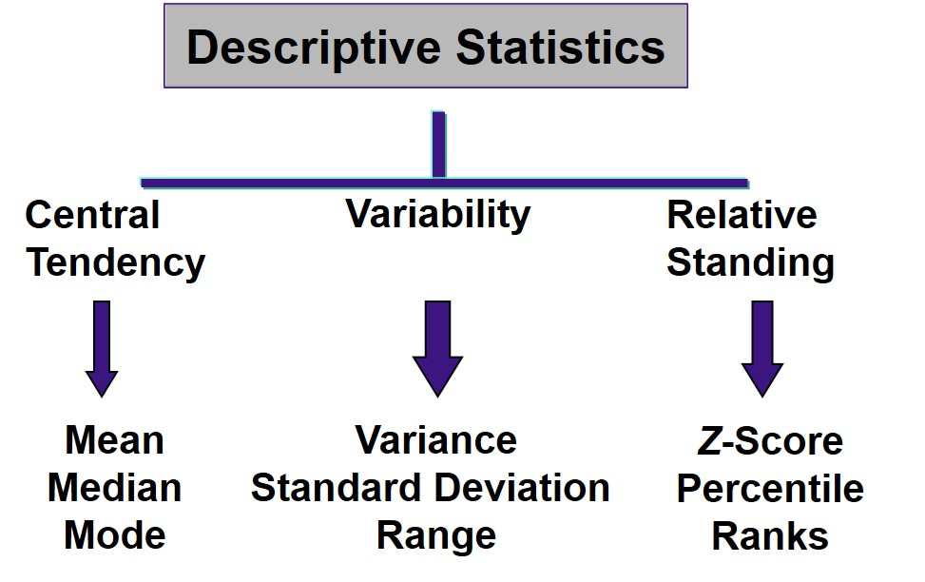
Figure 6.3 Examples of the Family of Statistics in Educational Research (1 of 3)

Slide 22
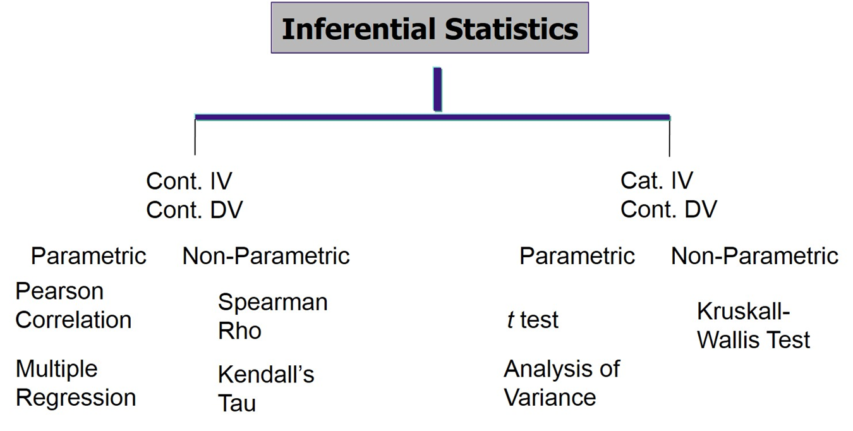
Figure 6.3 Examples of the Family of Statistics in Educational Research (2 of 3)

Slide 23
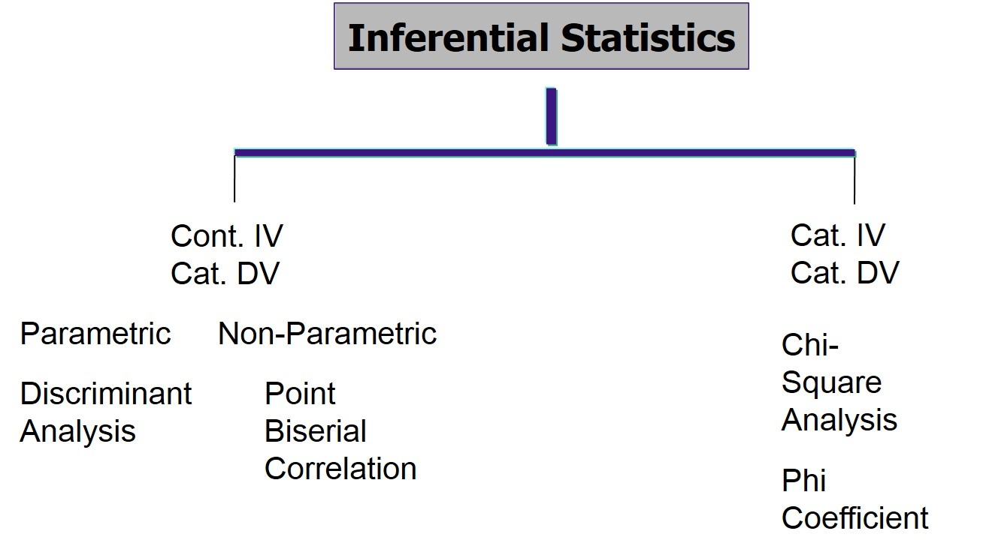
Figure 6.3 Examples of the Family of Statistics in Educational Research (3 of 3)

Slide 24
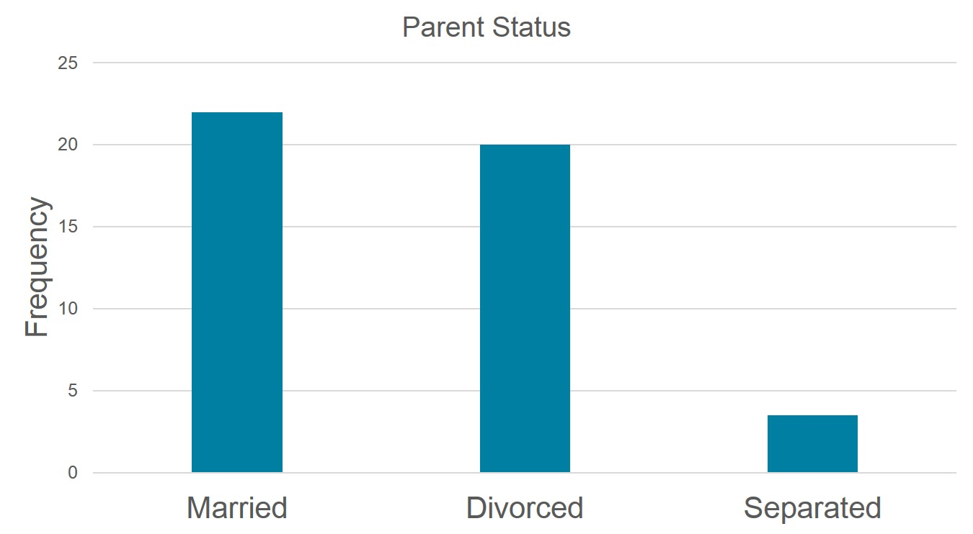
Figure 6.4 Bar Chart Depicting the Frequencies for the Categorical Variable “Parent Status”

Slide 25
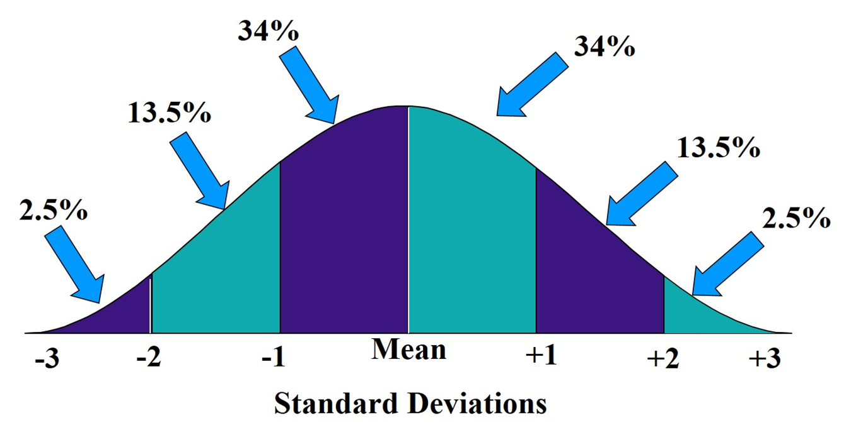
Figure 6.5 The Normal Curve

Slide 26
How Do You Analyze the Data? (5 of 12)
Conduct Inferential Analysis
Hypothesis testing: A procedure for making decisions about results by comparing an observed value of a sample with a population value to determine if no difference or relationship exists between the values
Confidence interval: The range of upper and lower statistical values that is consistent with observed data and is likely to contain the actual population mean

Slide 27
How Do You Analyze the Data? (6 of 12)
Conduct Inferential Analysis
Effect size: A means for identifying the practical strength of the conclusions about group differences or about the relationship among variables

Slide 28
How Do You Analyze the Data? (7 of 12)
Conduct Inferential Analysis: Hypothesis Testing
Identify a null and alternative hypothesis
Set the level of significance (alpha level) for rejecting the null hypothesis (critical region)
Collect the data
Compute the sample statistic
Make a decision about rejecting or failing to reject the hypothesis

Slide 29
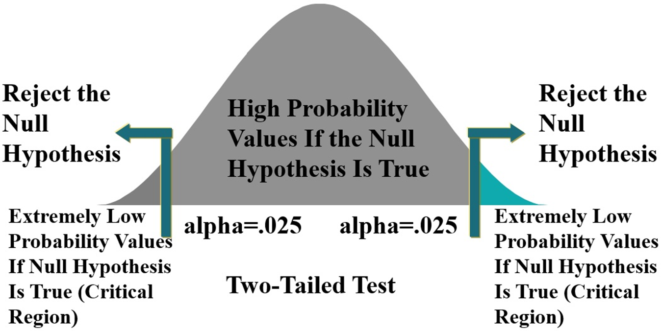
Figure 6.6 Normal Curve Distribution of Mean Differences of All Possible Outcomes If the Null Hypothesis is True

Slide 30
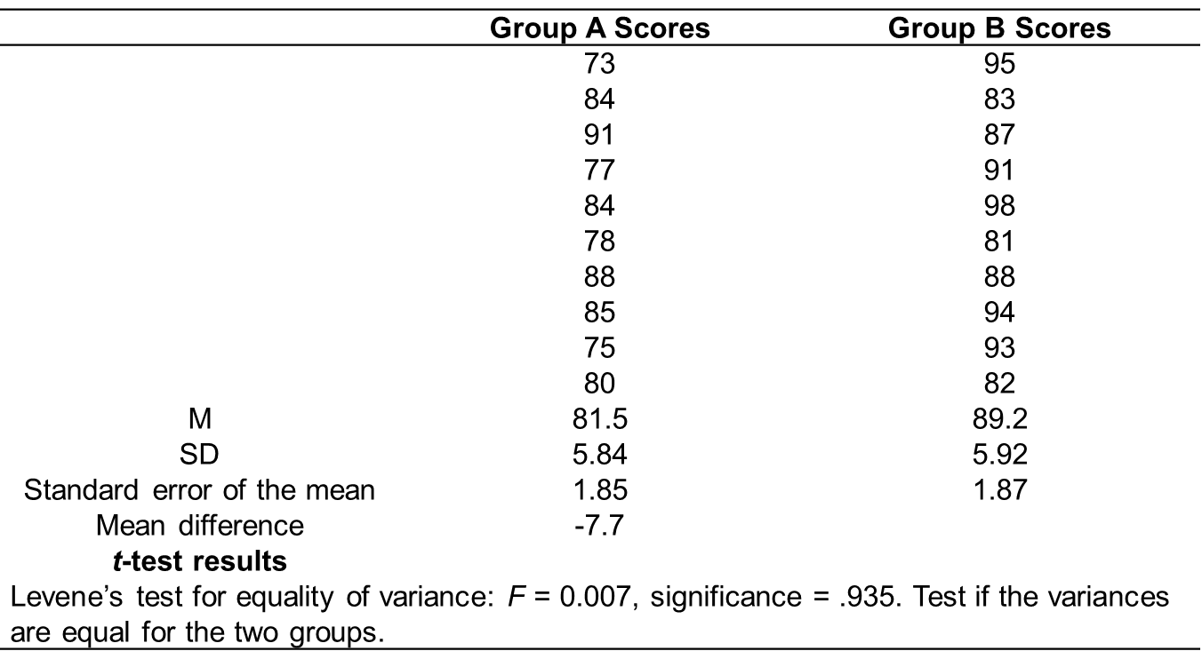
Table 6.6 t Test for Independent Samples for Group A and Group B Test Scores (1 of 2)

Slide 31
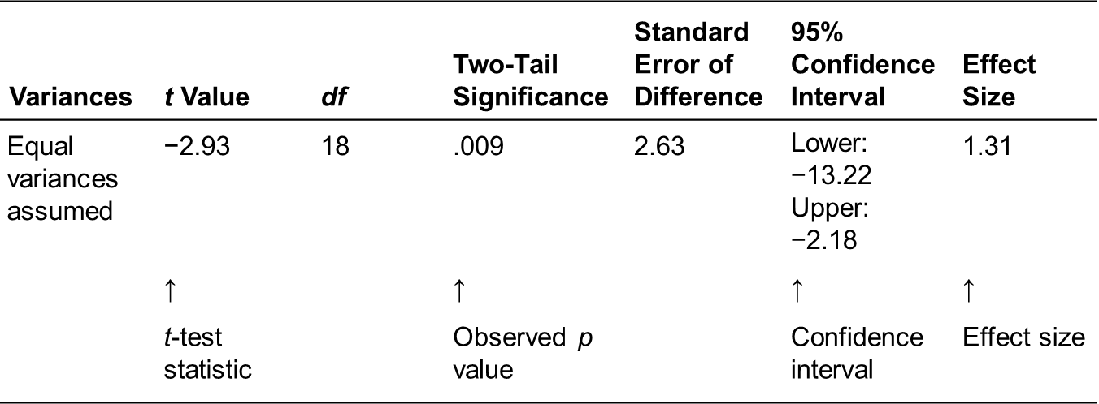
Table 6.6 t Test for Independent Samples for Group A and Group B Test Scores (2 of 2)

Slide 32
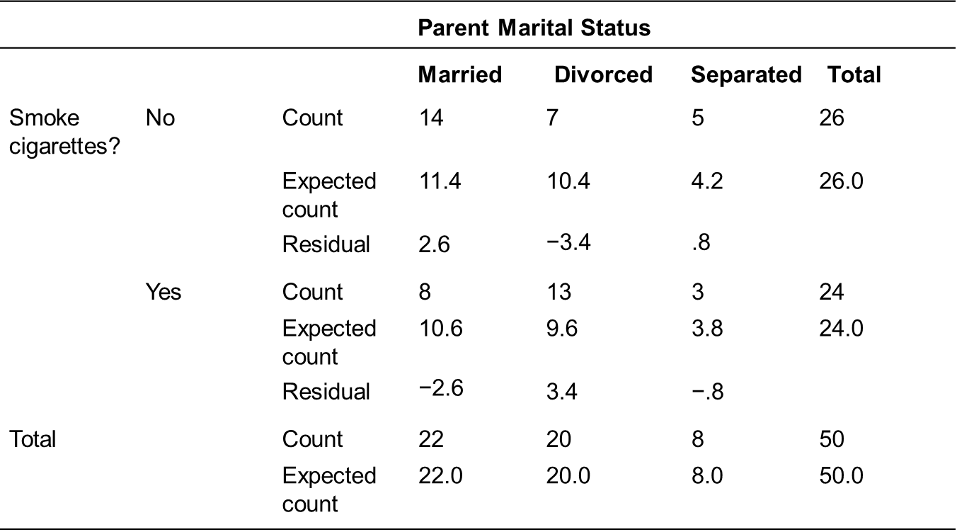
Table 6.7 Chi-Square Analysis, Smoking by Parent Marital Status (1 of 2)

Slide 33
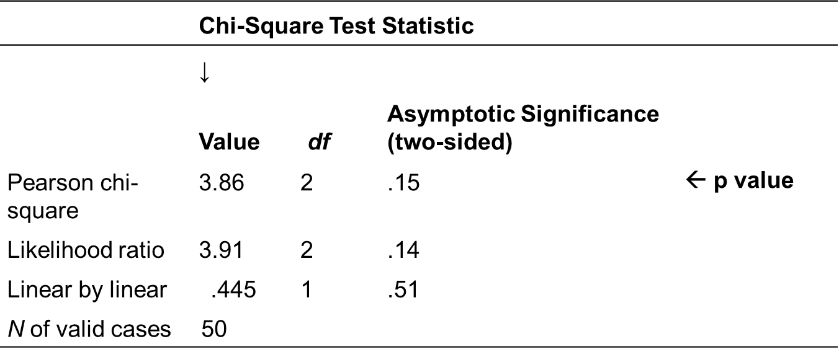
Table 6.7 Chi-Square Analysis, Smoking by Parent Marital Status (2 of 2)

Slide 34
How Do You Analyze the Data? (8 of 12)
Conduct Inferential Analysis: Hypothesis Testing
Select an appropriate statistical test:
Determine the type of quantitative research question or hypothesis you want to analyze (e.g., compare or relate)
Identify the number of independent variables
Identify the number of dependent variables
Identify whether covariates and the number of covariates are used in the research question or hypothesis

Slide 35
How Do You Analyze the Data? (9 of 12)
Conduct Inferential Analysis: Hypothesis Testing
Consider the scale of measurement for your independent variable(s) in the research question or hypothesis
Identify the scale of measurement for the dependent variables (e.g., continuous or categorical)
Determine if the distribution of the scores is normal or skewed

Slide 36
How Do You Analyze the Data? (10 of 12)
Conduct Inferential Analysis: Potential Errors in Outcomes
Type I error: the null hypothesis is rejected by the researcher when it is actually true (false positive)
Type II error occurs when the researcher fails to reject the null hypothesis when an effect actually occurs in the population (false negative)
Power: probability of correctly reject null hypothesis when an effect exists

Slide 37
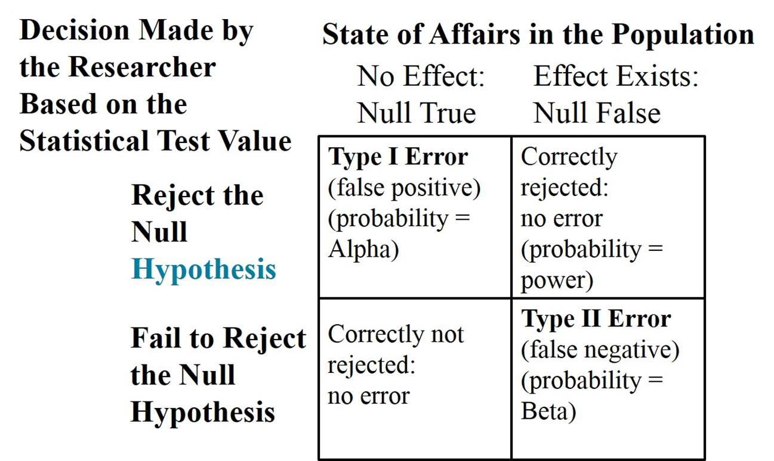
Table 6.8 Possible Outcomes in Hypothesis Testing

Slide 38
How Do You Analyze the Data? (11 of 12)
Conduct Inferential Analysis: Estimating Using Confidence Intervals
Help us decide how large the difference actually might be
Upper and lower statistical values, likely to contain the actual population mean
Example:
95% of the test scores would fall between -13.3 and -2.2, around the difference of -7.7 for the mean scores between teaching method A and method B (81.5 - 89.2 = -7.7)

Slide 39
How Do You Analyze the Data? (12 of 12)
Conduct Inferential Analysis: Determining Effect Size
Quantify the strength of the difference between two means or relationship between two variables
A N O V A: effect size (eta square) measured using the percentage of the variance due to the variable under study
t test:

Slide 40
How Do You Report the Results? (1 of 4)
Tables
Summarize statistical information
Title each table
Present one table for each statistical test
Organize data into rows and columns with simple and clear headings
Report notes that qualify, explain, or provide additional information in the tables.
Notes include information about the sample size, the probability values used in hypothesis testing, and the actual significance levels of the statistical test

Slide 41
How Do You Report the Results? (2 of 4)
Figures
charts, pictures, and drawings portray variables and their relationships
Labeled with a clear title that includes the number of the figure
Augment rather than duplicate the text
Convey only essential facts

Slide 42
How Do You Report the Results? (3 of 4)
Figures
Omit visually distracting detail
Easy to read and understand
Consistent with and are prepared in the same style as similar figures in the same article
Carefully planned and prepared

Slide 43
How Do You Report the Results? (4 of 4)
Present Results
Report whether the hypothesis test was significant or not
Provide important information about the statistical test, given the statistics
Include language typically used in reporting statistical results

Slide 44
Figure 6.7 Examples of Results Statements Using an Analysis of Variance Test
The scores varied for the three groups (questions only—M =4.5, S D =.98; lecture only—M =3.4, S D =.88; in-class discussion—M =4.8, S D =.90). At an alpha of .05, the analysis indicated a statistically significant difference among the groups, F(3,8) = 8.98, p = .034, effect size =.93 S D.

Slide 45
How Do You Interpret the Results? (1 of 4)
Summarize the Major Results
Review major conclusions to each question or hypothesis
Explain the implications of the results for the audiences
Implications: suggestions for the importance of the study for different audiences

Slide 46
How Do You Interpret the Results? (2 of 4)
Explain Why the Results Occurred
Return to predictions made from a theory or conceptual framework
Discuss existing literature
Contrast and compare

Slide 47
How Do You Interpret the Results? (3 of 4)
Advance Limitations
Limitations: potential weaknesses or problems with the study identified by the researcher
Examples: inadequate measures of variables, loss or lack of participants, small sample sizes, errors in measurement, etc.
To what extent can findings generalize
Bridge to recommend future research

Slide 48
How Do You Interpret the Results? (4 of 4)
Suggest Future Research
Future research directions: suggestions about additional studies that need to be conducted based on the results
Direct new researchers and readers
End with a positive note about the contribution

Slide 49
Reexamining Data Analysis and Interpretation in the Parent Involvement Study
Deslandes and Bertrand (2005) surveyed 770 parents of secondary-level students
Tables
Demographics
Variables
Descriptive statistics
Multiple regression analysis
Discussion provides interpretation, implications, limitations, future research, ends positively

Slide 50

Copyright

