Slide 1

Educational Research: Planning, Conducting, and Evaluating Quantitative and Qualitative Research
Sixth Edition
Chapter 7
Collecting Qualitative Data
Copyright © 2019, 2015, 2012 Pearson Education, Inc. All Rights Reserved
Notes:
If this PowerPoint presentation contains mathematical equations, you may need to check that your computer has the following installed:
1) MathType Plugin
2) Math Player (free versions available)
3) NVDA Reader (free versions available)

Slide 2
Learning Objectives
7.1 Identify the five process steps in collecting qualitative data
7.2 Identify different sampling approaches to selecting participants and sites
7.3 Describe the types of permissions required to gain access to participants and sites
7.4 Recognize the various types of qualitative data you can collect
7.5 Identify the procedures for recording qualitative data
7.6 Recognize the field issues and ethical considerations to anticipate in administering the data collection
Notes:
Slide 2 is list of textbook LO numbers and statements

Slide 3
What Are the Five Process Steps in Qualitative Data Collection? (1 of 2)
Identify participants and sites
Gain access to individuals and sites
Identify what types of information will answer your research questions
Design protocols or instruments for collecting and recording information
Administer the data collection

Slide 4
What Are the Five Process Steps in Qualitative Data Collection? (2 of 2)
Qualitative researchers identify participants and sites through purposeful sampling.
Qualitative studies are usually conducted at the research site.
Qualitative studies rely on general interviews or observations not others’ instruments.
Qualitative researchers record information through self-designed protocols.
Qualitative studies require sensitivity to challenges and ethical issues from gathering face-to-face information, often in homes and workplaces.

Slide 5
What Are the Different Purposeful Sampling Approaches for Selecting Participants and Sites (1 of 12)
Intent is not to generalize to a population, but to develop an in-depth exploration of a central phenomenon
Quantitative focus is probability
Qualitative focus is the best understanding

Slide 6
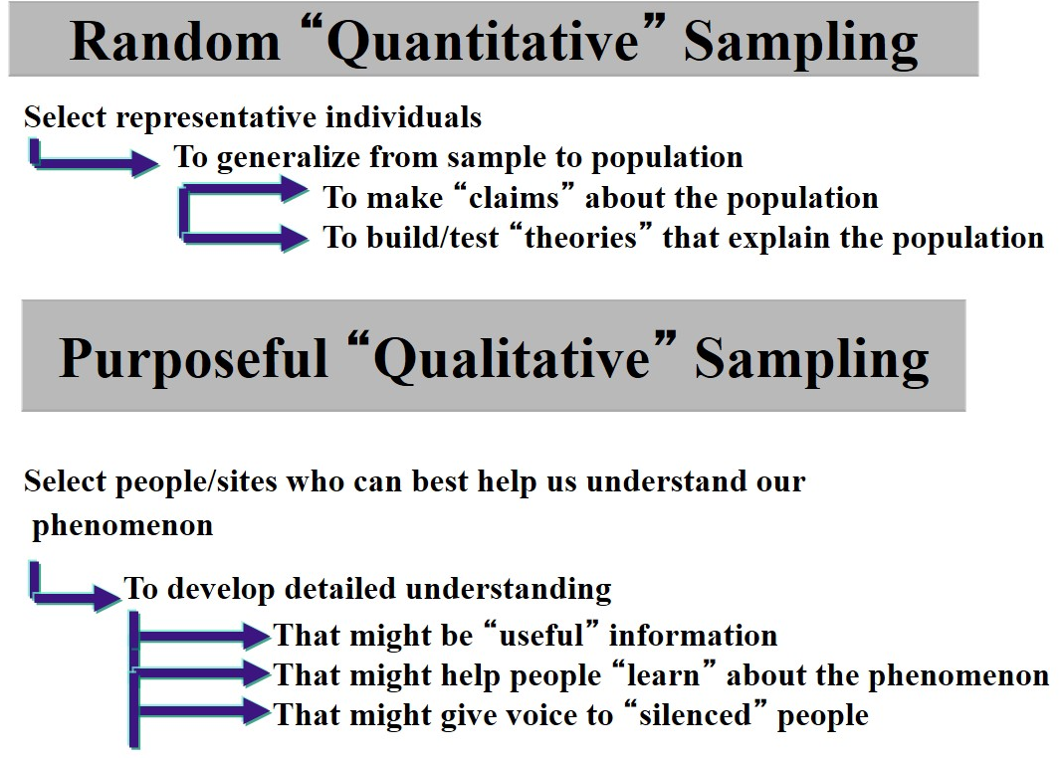
Figure 7.1 Difference between Probability Sampling and Purposeful Sampling

Slide 7
What Are the Different Purposeful Sampling Approaches for Selecting Participants and Sites (2 of 12)
Purposeful Sampling
Intentionally select individuals and sites to understand the central phenomenon
Choose participants and sites that are information rich
Identify a sampling strategy based on intent

Slide 8
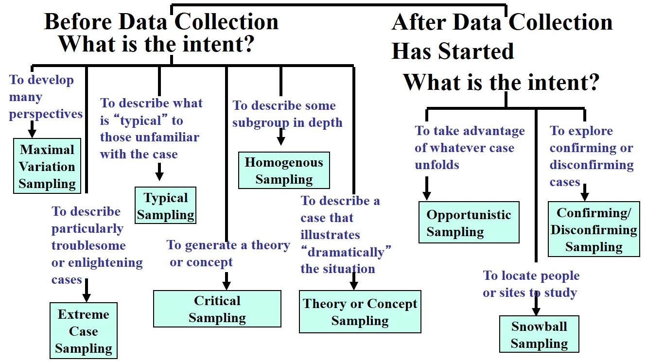
Figure 7.2 Types of Purposeful Sampling

Slide 9
What Are the Different Purposeful Sampling Approaches for Selecting Participants and Sites (3 of 12)
Purposeful Sampling: Maximal Variation Sampling
Sample cases that differ on characteristic or trait
Example characteristics
Different age groups
Different racial background
Different sites

Slide 10
What Are the Different Purposeful Sampling Approaches for Selecting Participants and Sites (4 of 12)
Purposeful Sampling: Extreme Case Sampling
Study an outlier case or one that has extreme characteristics
Particularly troublesome or enlightening
Noticeable for success or failure
Cited by others

Slide 11
What Are the Different Purposeful Sampling Approaches for Selecting Participants and Sites (5 of 12)
Purposeful Sampling: Typical Sampling
Study person or site that is typical
Concerned with what is typical or normal
May find based on demographic data or survey data
Example
Typical faculty member with long experience

Slide 12
What Are the Different Purposeful Sampling Approaches for Selecting Participants and Sites (6 of 12)
Purposeful Sampling: Theory or Concept Sampling
Help to generate or discover a theory
Discover concepts within a theory
Based on concept or theory expected to emerge
Example: select sites to generate a theory of student attitudes towards online education

Slide 13
What Are the Different Purposeful Sampling Approaches for Selecting Participants and Sites (7 of 12)
Purposeful Sampling: Homogeneous Sampling
Select sites or participants based on membership in a subgroup with defined characteristics
All possess similar trait or characteristic
Identify characteristics and find sites or individuals that possess it
Example: all parents in a school parenting program

Slide 14
What Are the Different Purposeful Sampling Approaches for Selecting Participants and Sites (8 of 12)
Purposeful Sampling: Critical Sampling
Individuals or sites represent central phenomenon dramatically
Exceptional case to learn about central phenomenon
Example: study teenage violence in school that experienced a gun incident

Slide 15
What Are the Different Purposeful Sampling Approaches for Selecting Participants and Sites (9 of 12)
Purposeful Sampling: Opportunistic Sampling
Take advantage of unfolding events
Sample emerges through the research
Example: pregnancy of individual leads to unique ability to understand central phenomenon

Slide 16
What Are the Different Purposeful Sampling Approaches for Selecting Participants and Sites (10 of 12)
Purposeful Sampling: Snowball Sampling
Proceeds after study begins
Because researcher may not know the best people to study
Ask participants to recommend others

Slide 17
What Are the Different Purposeful Sampling Approaches for Selecting Participants and Sites (11 of 12)
Purposeful Sampling: Confirming and Disconfirming Sampling
Follow up on specific cases to test or explore findings further
Verify accuracy of findings
Example:
Learn that department chairs act as mentors, confirm role by sampling those identified as good mentors

Slide 18
What Are the Different Purposeful Sampling Approaches for Selecting Participants and Sites (12 of 12)
Sample Size or Number of Research Sites
Small for in-depth perspective
A few individuals
A few cases
30 – 40 in some situations
Collecting and analyzing qualitative data takes time

Slide 19
What Types of Permissions Will Be Required to Gain Access to Participants and Sites? (1 of 4)
Seek Institutional Review Board Approval
Gain permission from Institutional Review Board (I R B).
Gain permission from “gatekeepers” at the research site
Gatekeepers are individuals at the site who provide site access, help researcher locate people and identify places to study.
The gatekeeper may require written information about the project.

Slide 20
What Types of Permissions Will Be Required to Gain Access to Participants and Sites? (2 of 4)
Seek Institutional Review Board Approval
Determine whether reviewers are family with qualitative inquiry.
Develop detailed description of procedures.
Detail how you will protect anonymity.
Discuss the need to respect the site and minimize disruption.

Slide 21
What Types of Permissions Will Be Required to Gain Access to Participants and Sites? (3 of 4)
Seek Institutional Review Board Approval
Describe opportunities to reciprocate.
Develop detailed description of procedures.
Acknowledge you may adopt participant beliefs.
Specify power imbalances.
Detail time required at the site.
Provide the list of interview questions.

Slide 22
What Types of Permissions Will Be Required to Gain Access to Participants and Sites? (4 of 4)
Gatekeepers
Why their site was chosen
What time and resources are required
What will be accomplished at the site
What potential there is for your presence to be disruptive
What individuals at the site will gain from the study
How you will use and report the results

Slide 23
What Types of Qualitative Data Will You Collect? (1 of 10)
Observations
Interviews and questionnaires
Documents
Audiovisual materials

Slide 24
Table 7.1 Forms of Qualitative Data Collection
Forms of Data Collection | Type of Data | Definition of Type of Data
Observations | Field notes and drawings | Unstructured text data and pictures taken during observations by the researcher
Interviews and questionnaires | Transcriptions of open-ended interviews or open-ended questions on questionnaires | Unstructured text data obtained from transcribing audio recordings of interviews or by transcribing open-ended responses to questions on questionnaires
Documents | Hand-recorded notes about documents or optically scanned documents | Public (e.g., notes from meetings) and private (e.g., journals) records available to the researcher
Audiovisual materials | Pictures, photographs, video recording, objects, and sounds | Audiovisual materials consisting of images or sounds of people or places recorded by the researcher or someone else

Slide 25
What Types of Qualitative Data Will You Collect? (2 of 10)
Observations: Observational Roles
An observation is the process of gathering first-hand information by observing people and places at a research site.
Observational roles
Participant observer: An observational role adopted by researchers when they take part in activities in the setting they observe.
Nonparticipant observer: An observer who visits a site and records notes without becoming involved in the activities of the participants.
Observational roles can be changed.

Slide 26
What Types of Qualitative Data Will You Collect? (3 of 10)
Observations: The Process of Observing
Select a site that will help you understand the central phenomenon and obtain the required permissions to gain access to the site
Ease into the site slowly by looking around, getting a general sense of the site, and taking limited notes, at least initially
Identify who or what to observe, when to observe, and how long to observe
Determine, initially, your role as an observer

Slide 27
What Types of Qualitative Data Will You Collect? (4 of 10)
Observations: The Process of Observing
Conduct multiple observations over time to obtain the best understanding of the site and the individuals.
Design some means for recording notes during an observation.
Consider what information to record
Descriptive field notes describe the events, activities, and people.
Reflective field notes record personal reflections that relate to their insights, hunches, or broad themes that emerge.
Remain unobtrusive.
When complete, slowly withdraw from the site.

Slide 28
Figure 7.5 Observational Checklist
Fill in the blank Did you gain permission to study the site? | Fill in the blank Will you develop rapport with individuals at the site?
Fill in the blank Do you know your role as an observer? | Fill in the blank Will your observations change from broad to narrow?
Fill in the blank Do you have a means for recording field notes, such as an observational protocol? | Fill in the blank Will you take limited notes at first?
Fill in the blank Do you know what you will observe first? | Fill in the blank Will you take both descriptive as well as reflective notes?
Fill in the blank Will you enter and leave the site slowly, so as not to disturb the setting? | Fill in the blank Will you describe in complete sentences so that you have detailed field notes?
Fill in the blank Will you make multiple observations over time? | Fill in the blank Did you thank your participants at the site?

Slide 29
What Types of Qualitative Data Will You Collect? (5 of 10)
Interviews: Types of Interviews and Open-Ended Questions on Questionnaires
Types: One-on-one, focus group, phone, web-based video, e-mail
General open-ended questions that are asked allow the participant to:
Create options for responding
Voice their experiences and perspectives
Information is recorded, then transcribed for analysis

Slide 30
What Types of Qualitative Data Will You Collect? (6 of 10)
Interviews: Conducting Interviews
Identify the interviewees
Determine the type of interview you will use (e.g., focus group, one-on-one)
Record the audio of the conversation
Take brief notes during the interview
Locate a quiet, suitable place
Obtain consent from the interviewee to participate in the study

Slide 31
What Types of Qualitative Data Will You Collect? (7 of 10)
Interviews: Conducting Interviews
During the interview, have an interview plan using your interview protocol, but be flexible
Use probes to elicit more information
Include possible probes in your interview protocol
Use probes to elaborate and clarify
Be courteous and professional when the interview is over

Slide 32
Table 7.2 Types of Probes Used in Qualitative Interviewing
Blank | Examples Clarifying Probes | Examples Elaborating Probes
A question in the study asks, “What has happened since the event that you have been involved in?” Assume that the interviewee says, “Not much” or simply does not answer. | Probe areas Comments to other students: “Tell me about discussions you had with other students.” Role of parents: “Did you talk with your parents?” Role of news media: “Did you talk with any media personnel?” | “Tell me more.” “Could you explain your response more?” “I need more detail.” “What does ‘not much’ mean?”

Slide 33
Figure 7.6 Checklist for Interviewing
Fill in the blank Who will participate in your interviews?
Fill in the blank What types of interviews are best to conduct?
Fill in the blank Is the setting for your interview comfortable and quiet?
Fill in the blank If you are audiotaping, have you prepared and tested the equipment?
Fill in the blank Did you obtain consent from the participants to participate in the interview?
Fill in the blank Did you listen more and talk less during the interview?
Fill in the blank Did you probe during the interview? (ask to clarify and elaborate)
Fill in the blank Did you avoid leading questions and ask open-ended questions?
Fill in the blank Did you keep participants focused and ask for concrete details?
Fill in the blank Did you withhold judgments and refrain from debating with participants about their views?
Fill in the blank Did you withhold offering advice and suggestions and focus on the task of gathering participant views?
Fill in the blank Were you courteous and did you thank the participants after concluding the interview?

Slide 34
What Types of Qualitative Data Will You Collect? (8 of 10)
Documents: Collecting Documents
Identify types of documents that may be useful
Consider public and private documents
Obtain permission before using documents
Provide specific instructions if you ask participants to keep a journal
Examine for accuracy, completeness, and usefulness
Optically scan documents when possible

Slide 35
What Types of Qualitative Data Will You Collect? (9 of 10)
Audiovisual Materials
Images or sounds to help understand the central phenomenon
Examples
Photographs
Video records
Digital images
Paintings and drawings
Are more difficult to analyze

Slide 36
What Types of Qualitative Data Will You Collect? (10 of 10)
Audiovisual Materials: Collecting Audiovisual Materials
Determine what material can provide evidence to address your research questions
Determine what visual material is available and obtain permission to use it
Check the accuracy and authenticity of the material if you do not record it yourself
Collect the data and organize it

Slide 37
What Procedures Will Be Used to Record Data? (1 of 3)
Using Protocols: An Interview Protocol
Interview protocol:
Instructions for the process of the interview
The questions to be asked
Possible probes associated with each question
Space to take notes on responses from the interviewee

Slide 38
What Procedures Will Be Used to Record Data? (2 of 3)
Using Protocols: An Interview Protocol
The header: Essential information about the interview, such as purpose, reminder to obtain consent and record.
Open-ended questions
“Ice-breaker”
Questions that address major research questions
Probes that clarify and elaborate
Include space between each question for notes
Closing comments thanking the participant

Slide 39
Figure 7.7 Sample Interview Protocol
Project: University Reaction to a Gunman Incident
Time of interview:
Date:
Place:
Interviewer:
Interviewee:
Position
Questions:
Please describe your role in the incident.
What has happened since the event that you have been involved in?

Slide 40
What Procedures Will Be Used to Record Data? (3 of 3)
Using Protocols: An Observational Protocol
Used for taking field notes during an observation
In the header, record information about the time, place, setting, and your observational role
Divide the rest of the protocol into two columns:
Left column to record descriptive notes about the activities at the site
Right column to record reflective notes about themes, quotes, and personal experiences at the site
Include a sketch of the site

Slide 41
What Field and Ethical Issues Need to Be Anticipated? (1 of 2)
Field Issues
Sufficient access to the site for data collection
Sufficient time for data collection
Limit initial collection to one or two observations or interviews
Time is needed to establish a substantial database
Observational role
Building rapport with participants
Obtaining permission to use documents and audiovisual materials

Slide 42
What Field and Ethical Issues Need to Be Anticipated? (2 of 2)
Ethical Issues
Informing participants of purpose
Refraining from deceptive practices
Sharing your role as researcher
Being respectful of the research site
Giving back or reciprocity
Using ethical interview practices
Maintaining confidentiality
Collaborating with participants

Slide 43
Revisiting the Mothers’ Trust in Principals Qualitative Study
Wrote they plan on conducting a qualitative case study
Provided a justification for the use of the qualitative case study approach to understand processes across many cases
Discussed purposeful sampling and snowball sampling to recruit heterogeneous sample
Aware of field issues
Small sample
Face-to-face interviews and provided topics of questions

Slide 44

Copyright

