Slide 1

Educational Research: Planning, Conducting, and Evaluating Quantitative and Qualitative Research
Sixth Edition
Chapter 8
Analyzing and Interpreting Qualitative Data
Copyright © 2019, 2015, 2012 Pearson Education, Inc. All Rights Reserved
Notes:
If this PowerPoint presentation contains mathematical equations, you may need to check that your computer has the following installed:
1) MathType Plugin
2) Math Player (free versions available)
3) NVDA Reader (free versions available)

Slide 2
Learning Objectives
8.1 Identify the six steps in the process of analyzing and interpreting qualitative data
8.2 Describe how to prepare and organize the data for analysis
8.3 Describe how to explore and code the data
8.4 Use codes to build description and themes
8.5 Construct a representation and reporting of qualitative findings
8.6 Make an interpretation of the qualitative findings
8.7 Advance validation for the accuracy of your findings
Notes:
Slide 2 is list of textbook LO numbers and statements

Slide 3
What Are the Six Steps in Analyzing and Interpreting Qualitative Data?
Preparing and organizing the data for analysis
Exploring the data through coding
Using codes to develop description and themes
Representing the findings through narratives and visuals
Making an interpretation of the meaning of the findings
Using strategies to validate the accuracy of the findings

Slide 4
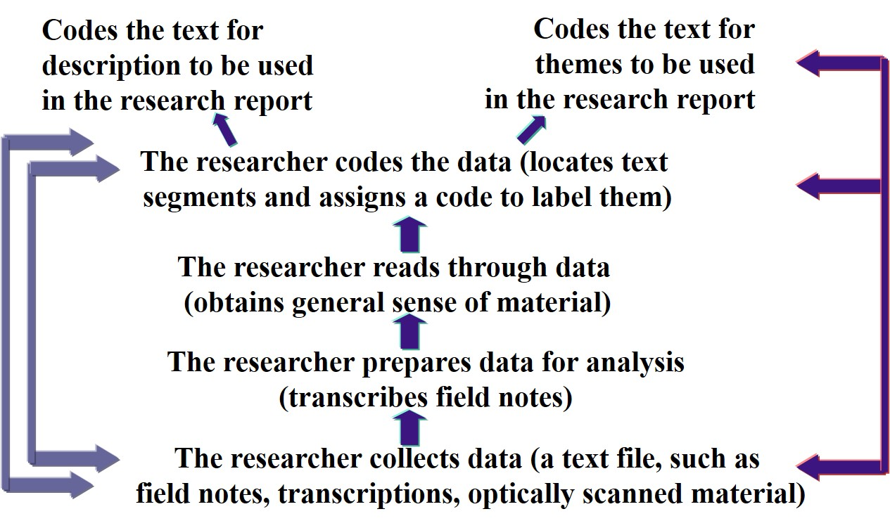
Figure 8.1 The Qualitative Process of Data Analysis

Slide 5
How Do You Prepare and Organize the Data for Analysis? (1 of 7)
Organize Data
Develop a matrix or table of sources that can be used to organize the material
Organize material by type (all interviews, all documents, etc.)
Keep duplicate copies of materials
Transcribe data
Prepare data for hand or computer analysis (and select computer program)

Slide 6
How Do You Prepare and Organize the Data for Analysis? (2 of 7)
Transcribe Data
Transcription is the process of converting audio recordings or field notes into text data
Consider software, a professional transcriptionist, or transcribe yourself word-for-word
Approximately 4 hours to transcribe 1 hour of audio

Slide 7
Figure 8.2 Hints for Transcribing Audio-Recorded Interviews (1 of 2)
During data collection
Have a high quality audio recording by conducting interview in a quiet setting.
Use a high quality recording device with an external microphone.
Use lapel microphones for both the interviewer and the interviewee.
Create a digital recording for storing on your computer.
Take back-up notes during the interview in the event that the recording device does not work.
Bring to the interview extra batteries or a charger for the recording device.

Slide 8
Figure 8.2 Hints for Transcribing Audio-Recorded Interviews (2 of 2)
During the transcription
Create a word processing file from the recorded audio.
Place title information at the top of the file (e.g., name of interviewer, name of interviewee, date, place of the interview).
Create a file in which there are ample margins on both the left and right sides of the pages for writing notes.
Double space the text file.
Before the questions asked by the interviewer, identify the question number from the interview protocol (e.g., Question 1: Comment, comment).
Clearly identify the interviewer comments (e.g., in bold) from the interviewee comments.

Slide 9
How Do You Prepare and Organize the Data for Analysis? (3 of 7)
Analyze by Hand or Computer
Hand analysis of qualitative data: researchers read the data, mark it by hand, and divide it into parts
Hand analysis if you
Prefer not to use software
Want to be close to the data
Have the time

Slide 10
How Do You Prepare and Organize the Data for Analysis? (4 of 7)
Analyze by Hand or Computer
Computer analysis of qualitative data: researchers use qualitative software to facilitate the process of storing, analyzing, sorting, and representing or visualizing the data
Use software if you
Have a large database
Are trained
Have resources to purchase or locate
Need close inspection of words

Slide 11
How Do You Prepare and Organize the Data for Analysis? (5 of 7)
Use of Qualitative Data Analysis Software Programs: Procedures for Using Qualitative Data Analysis Software
Organize your files
Select a program
Import the file into the software
Mark sentences that pertain
Code the blocked text
Search for text matching each code
Collapse codes into broad themes

Slide 12
How Do You Prepare and Organize the Data for Analysis? (6 of 7)
Use of Qualitative Data Analysis Software Programs: Basic Features of Qualitative Software
Ease of integration
Type of data program will accept
Reading and reviewing text
Memo writing
Categorization
Analysis inventory and assessment
Quantitative data
Merging project

Slide 13
How Do You Prepare and Organize the Data for Analysis? (7 of 7)
Use of Qualitative Data Analysis Software Programs: Specific Programs Available
ATLAS.t i(Mac and Windows)
Dedoose (cloud-based)
Hyper RESEARCH (Mac and Windows)
MAX Q D A (Mac and Windows)
Nvivo (Mac and Windows)

Slide 14
How Do You Explore and Code the Data? (1 of 4)
Explore the General Sense of the Data
Obtain a general sense of the data by performing a preliminary exploratory analysis
Read through field notes and interviews several times to get a sense of the interview and the observation
Write memos in the margins of interviews, field notes, or images of your initial reflections on the data

Slide 15
How Do You Explore and Code the Data? (2 of 4)
Code the Data
Read through all transcripts
Start with one document
Ask, “What is this person saying?”
Identify text segments
Assign a code
One, two, or three words that describe what is being said
When possible use a participant’s actual words (in vivo code)
Terms from the literature can be used
Practice lean coding (e.g., 10-15 codes for 20 p g transcript)

Slide 16
How Do You Explore and Code the Data? (3 of 4)
Code the Data
Reduce redundancy
Take out codes that are duplicate ideas
Reduce to a manageable list (20–30 codes)
Go back to data
Look for new codes
Find supporting quotes

Slide 17
How Do You Explore and Code the Data? (4 of 4)
Code the Data
Collapse codes into 5-7 themes
Themes: similar codes aggregated together to form a major idea in the database
The ideas the participants most frequently discuss, are unique or surprising, have the most evidence to support them, or those you might expect to find
Description of people, places, or events

Slide 18
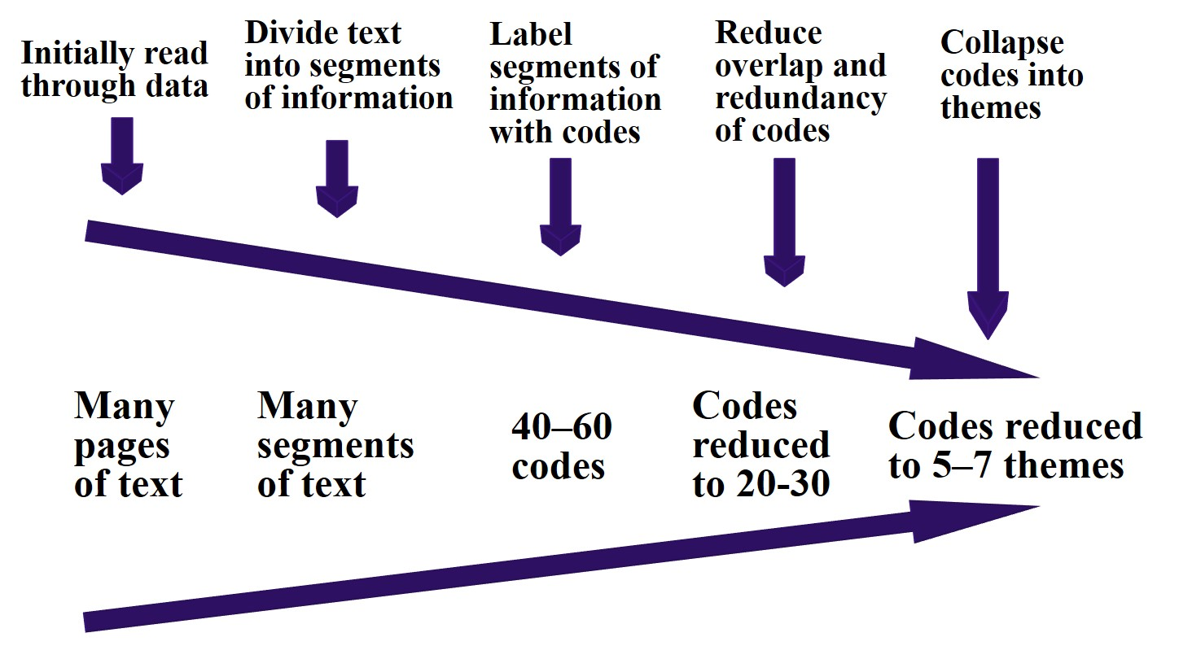
Figure 8.4 Visual Model of the Coding Process in Qualitative Research

Slide 19
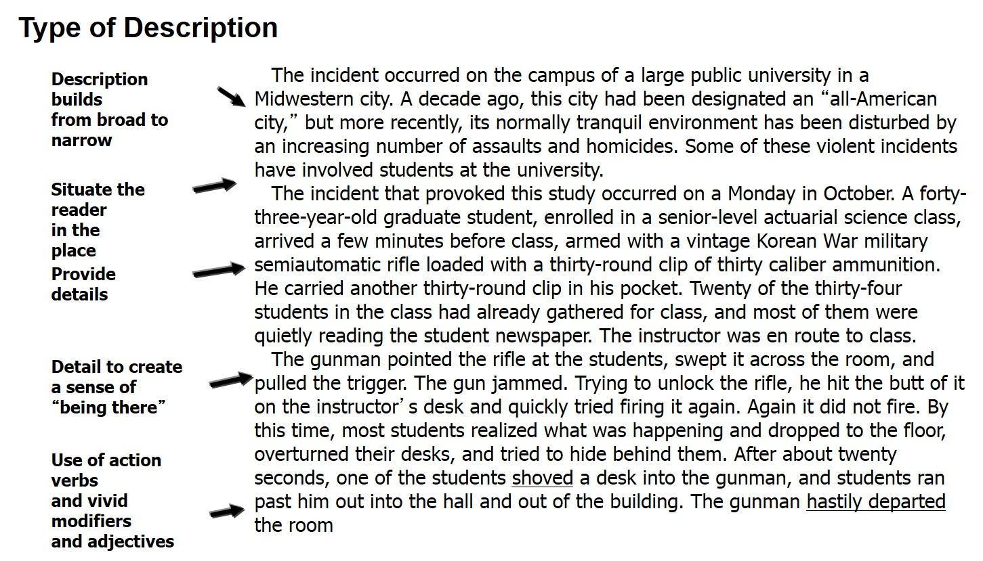
Figure 8.5 Hand-Coding a Page from a Sample Interview Transcript

Slide 20
How Do You Use Codes to Build Description and Themes? (1 of 5)
Describing and developing themes from data
Answering research questions
Forming in-depth understanding of central phenomenon

Slide 21
How Do You Use Codes to Build Description and Themes? (2 of 5)
Description
Detailed rendering of people, places, or events in a setting
Ask
What is this place like?
What is this person like?

Slide 22
How Do You Use Codes to Build Description and Themes? (3 of 5)
Themes
Types
Ordinary themes
Unexpected themes
Hard-to-classify themes
Major and minor themes
Multiple perspectives: several viewpoints and sources

Slide 23
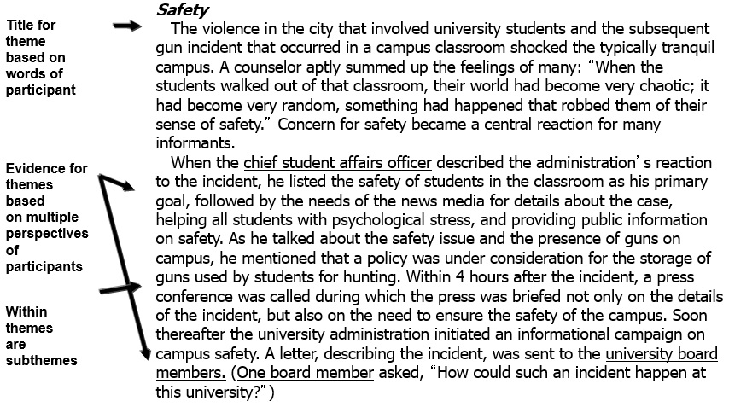
Figure 8.8 Elements of Theme Development in a Narrative Passage

Slide 24
How Do You Use Codes to Build Description and Themes? (4 of 5)
Layering and Interrelating Themes: Layering Themes
Layering organizes themes
minor → major → broader themes
Interconnected levels of themes
Work upwards towards broader levels of abstraction
data → description → themes → broad perspectives

Slide 25
How Do You Use Codes to Build Description and Themes? (5 of 5)
Layering and Interrelating Themes: Interrelating Themes
Interrelating themes involves interconnecting themes into
Chronology
Sequence of events
Theoretical or conceptual models

Slide 26
How Do You Represent and Report Findings? (1 of 2)
Representing Findings
Comparison table: A table used to compare groups on one theme
Hierarchical tree: A diagram that visually represents themes and their interconnections
Figures/diagrams: A visual depiction that shows the connections between themes
Drawings: Maps of the physical layout of the site
Demographic table: A table of demographics on individual participants or research site

Slide 27
Table 8.1 Sample Comparison Table Used to Represent Information in a Qualitative Study
Female Statements about “Professionalism” | Male Statements about “Professionalism”
Helping fellow teachers is part of my day. | Being concerned about following the coordinator’s advice about curriculum shows a high level of professionalism.
When another teacher asks for advice, I am generally a good listener. | It is important to be in charge in the classroom and to be aware of student off-task behavior.
It is important, once I achieve a certain level of experience, that I become a mentor to other teachers, especially new ones. | I set standards for myself and try to achieve these goals each year.
Caring about how other teachers employ high standards in their classroom is a sign of my own professionalism. | It is necessary that each teacher “pull” his or her weight in this school—a sure sign of professionalism.

Slide 28
Table 8.2 Sample Demographic Table in a Qualitative Study
Name | Years Teaching | Gender | Class Level of Instruction | Instructional Approach in the Classroom | Primary Form of Technology in the Classroom
Rosa | 25 | Female | 12 | Discussion | Internet
Harry | 20 | Male | 11 | Critique | Not used
Joan | 18 | Female | 11 | Discussion | Tablets and Internet
Ray | 20 | Male | 12 | Interactive | Simulations, Internet, laptops
Jamal | 15 | Male | 11 | Discussion | Not used
Yun | 36 | Male | 10 | Lecture | Internet

Slide 29
How Do You Represent and Report Findings? (2 of 2)
Reporting Findings
Multiple perspectives and contrary evidence
Metaphors and analogies
Report quotes from interviews
Write in detail
Tensions and contradictions
Include a dialogue to support themes

Slide 30
Table 8.3 Forms of a Narrative Discussion in Qualitative Research
Forms of Narrative Discussion | Examples
A discussion that presents a chronology | The chronology of a teacher’s experiences with her special education coordinator leading to her resignation from the school
A discussion that describes events and setting (context) | A description of adolescents reading “teen” magazines
A discussion of themes | A discussion about the theme of the “in-classroom” landscape of a teacher

Slide 31
How Do You Interpret Findings?
Summarize the findings
Include personal reflections about the meaning of the data
Compare findings with the literature, perhaps including personal views
Address limitations of the study
Make suggestions for future research

Slide 32
How Do You Validate the Accuracy of Your Findings?
Validating findings: researcher determines the accuracy or credibility of the findings
Triangulation: Using corroborating evidence
Member checking: Asking members to check the accuracy of the account
External audit: Hiring the services of an individual outside the study to review the study

Slide 33
Reexamining Qualitative Data Analysis in the Mothers’ Trust in Principals Case Study
The authors
Transcribed semi-structured interviews (preparation)
Entered text into NVivo Q D A software (computer assisted data analysis)
Analyzed transcripts line-by-line, coded, grouped codes into themes (analysis)
Drew a concept map (representing findings)
Discussed each theme with quotes and subthemes (reporting findings)
Returned to literature and implications (interpreting findings)

Slide 34

Copyright

