Slide 1

Educational Research: Planning, Conducting, and Evaluating Quantitative and Qualitative Research
Sixth Edition
Chapter 10
Experimental Designs
Copyright © 2019, 2015, 2012 Pearson Education, Inc. All Rights Reserved
Notes:
If this PowerPoint presentation contains mathematical equations, you may need to check that your computer has the following installed:
1) MathType Plugin
2) Math Player (free versions available)
3) NVDA Reader (free versions available)

Slide 2
Learning Objectives
10.1 Define experimental research, and describe when to use it, and how it developed
10.2 Identify the key characteristics of experiments
10.3 State the types of experimental designs
10.4 Recognize the potential ethical issues in experimental research
10.5 Describe the steps in conducting an experiment
10.6 Evaluate the quality of an experiment
Notes:
Slide 2 is list of textbook LO numbers and statements

Slide 3
What is an Experiment, When Should You Use It, and How Did It Develop? (1 of 4)
In an experiment, you test an idea (or practice or procedure) to determine whether it influences an outcome or dependent variable
Experimental design process
Decide on idea with which to experiment
Assign individuals to experience it (and have some experience something different)
Determine whether those who experienced the idea (or practice or procedure) performed better on some outcome than those who did not experience

Slide 4
What is an Experiment, When Should You Use It, and How Did It Develop? (2 of 4)
When Do You Use an Experiment?
Used to establish probable cause and effect
Between independent and dependent variables
Control for all variables that might influence the outcome
Used when comparing two or more groups

Slide 5
What is an Experiment, When Should You Use It, and How Did It Develop? (3 of 4)
Making Causal Inferences
Four criteria
Causal relativity-can compare between effects of one cause and another
Causal manipulation-each participant can potentially be part of the intervention or control
Temporal order-cause comes first and the effect second
Elimination of alternative explanations-what else may account for relationship?

Slide 6
What is an Experiment, When Should You Use It, and How Did It Develop? (4 of 4)
When Did Experiments Develop?
Psychological experiments (late 19th, early 20th century)
Procedures for comparing groups (McCall, 1925)
Statistics for comparing groups (e.g., chi-square)
Identification of types of experimental designs (Campbell and Stanley,1963)
Types of basic designs and threats (Cook and Campbell, 1979)
Complicated experiments with many variables (since 1980)
Observational studies (Rosenbaum, 2002)

Slide 7
What Are Key Characteristics of Experiments? (1 of 17)
Random assignment
Control over extraneous variables
Manipulation of the treatment conditions
Outcome measures
Group comparisons
Threats to validity

Slide 8
What Are Key Characteristics of Experiments? (2 of 17)
Random Assignment
Randomly assign individuals to conditions or to groups
Random assignment equates groups and distributes variability between or among groups and conditions
Different from random selection probability sampling

Slide 9
What Are Key Characteristics of Experiments? (3 of 17)
Control Over Extraneous Variables
Extraneous variables: Influences in participant selection, procedures, statistics, or the design likely to affect the outcome and provide an alternative explanation of results than what was expected
Random assignment of participants before beginning the experiment
Other control procedures:
Pretests and posttests
Covariates
Matching participants
Homogenous samples
Blocking variables

Slide 10
What Are Key Characteristics of Experiments? (4 of 17)
Control Over Extraneous Variables: Pretests and Posttests
Experimental researchers may use a pretest to “equate” the characteristics of the groups
Pretest: measure on some attribute or characteristic in an experiment before participants receive a treatment
Pretest: measure on some attribute or characteristic in an experiment after a treatment
Disadvantages: take time, can raise expectations, can affect posttest scores

Slide 11
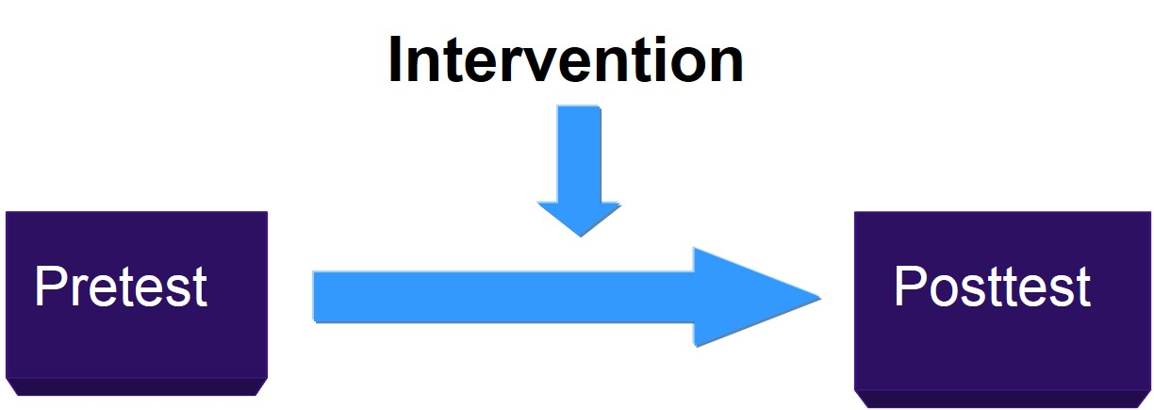
Pretests and Posttests

Slide 12
What Are Key Characteristics of Experiments? (5 of 17)
Control Over Extraneous Variables: Covariates
Covariates:
Variables that the researcher controls for using statistics
Relate to the dependent variable but not the independent variable
Removes the variance between a covariate and a dependent variable to assess the variance between the independent and the dependent variable

Slide 13
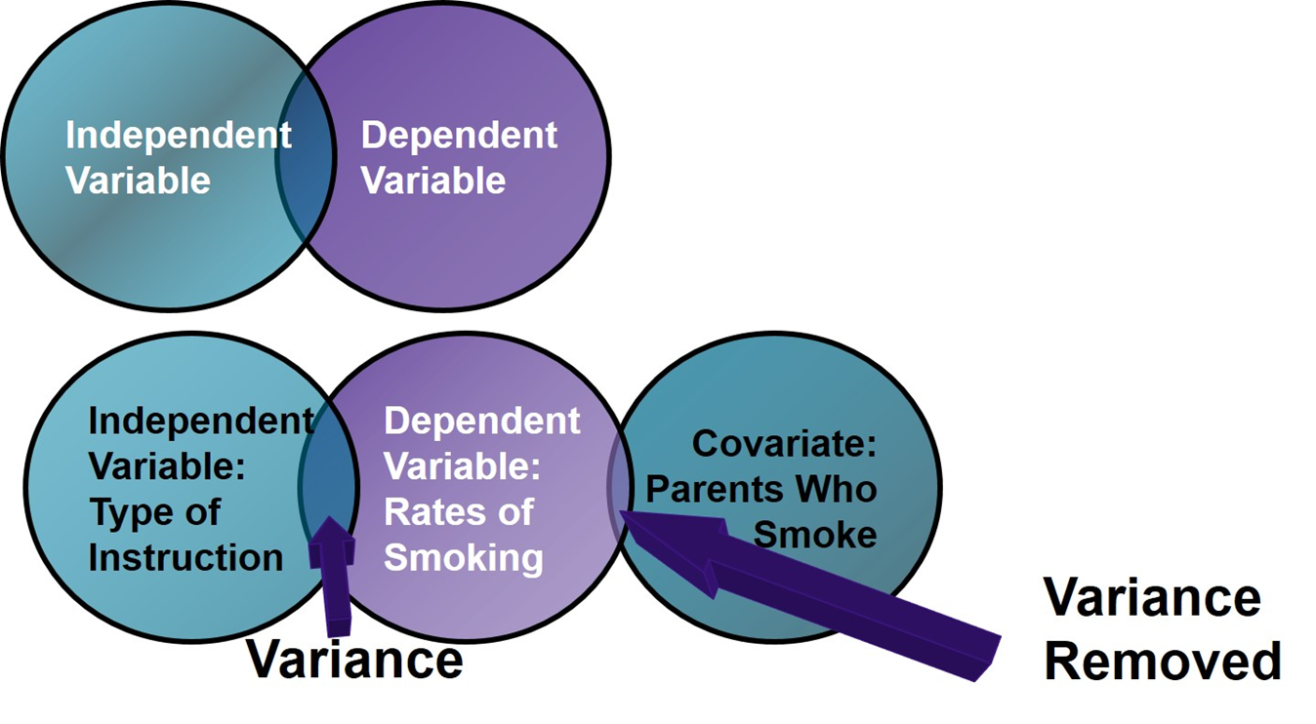
Figure 10.1 Controlling for Covariate

Slide 14
What Are Key Characteristics of Experiments? (6 of 17)
Control Over Extraneous Variables: Matching of Participants
Matching
Identifying one or more personal characteristics that influence the outcome
Assigning individuals with that characteristic equally to the experimental and control groups
Examples: gender, pretest scores, individual abilities

Slide 15
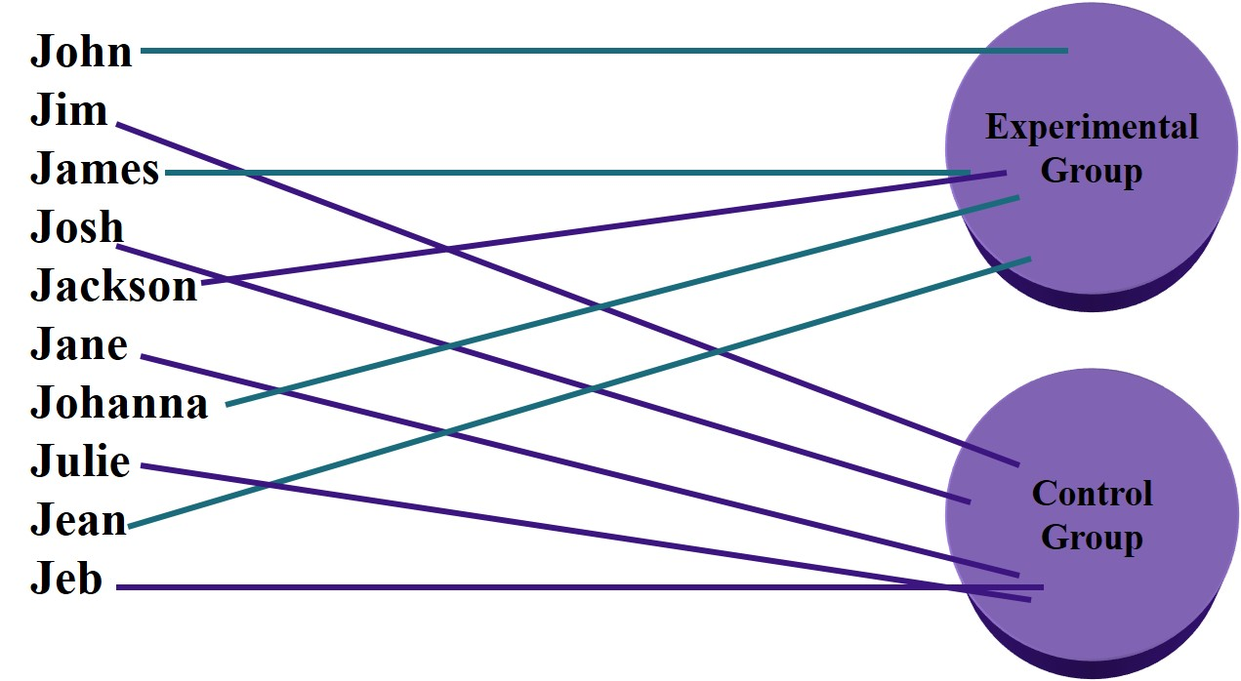
Figure 10.2 The Matching Process Based on Gender

Slide 16
What Are Key Characteristics of Experiments? (7 of 17)
Control Over Extraneous Variables: Homogeneous Sample
Homogeneous samples: selecting people who vary little in their personal characteristics
Example
Assume students in two classrooms randomly assigned to the treatment or control are similar in terms of characteristics
Only assign junior grade level students to the two classes
Practically, may be unlikely and hard to achieve

Slide 17
What Are Key Characteristics of Experiments? (8 of 17)
Control Over Extraneous Variables: Blocking Variables
Blocking variable
Variable the researcher controls before the experiment starts
Controls by dividing (or “blocking”) the participants into subgroups (or categories)
Analyzes the impact of each subgroup on the outcome
Example:
High school grade level blocked into four categories
Age of students
If participants are all 15 and 16 years old, assign equal number of 15 year olds and 16 year olds to experimental and control groups

Slide 18
What Are Key Characteristics of Experiments? (9 of 17)
Manipulating Treatment Conditions
Identify a treatment variable
Identify the conditions or levels of the treatment variable
Manipulate the treatment conditions

Slide 19
What Are Key Characteristics of Experiments? (10 of 17)
Manipulating Treatment Conditions: Treatment Variables
What the researcher manipulates to determine effect on an outcome
Typically categorical levels
Type of instruction (small group or large group)
Type of reading group (phonics or whole language)
Type of intervention (standard or standard plus health hazards)

Slide 20
What Are Key Characteristics of Experiments? (11 of 17)
Manipulating Treatment Conditions: Intervening in the Treatment Conditions
Interventions:
researcher physically intervenes with (or manipulates) one or more condition
individuals experience something different in the experimental conditions than the control conditions
In an experiment, need to be able to manipulate at least one condition

Slide 21
Figure 10.3 Experimental Manipulation of a Treatment Condition
Independent variables
Age (cannot manipulate)
Gender (cannot manipulate)
Types of instruction (can manipulate)
Dependent variable
Frequency of smoking
a. Lecture (control)
b. Lecture + hazard discussion (comparison)
c. Lecture + hazard discussion + slides of damaged lungs (experimental)

Slide 22
What Are Key Characteristics of Experiments? (12 of 17)
Outcome Measures
Outcome is dependent variable (also called response, criterion, posttest)
Presumed effect of treatment variable
Need to be responsive and valid measure
Examples
Achievement test scores
Aptitude test scores
Mental health assessment scores

Slide 23
What Are Key Characteristics of Experiments? (13 of 17)
Group Comparisons
Process of a researcher obtaining scores for individuals or groups on the dependent variable
Compare the means and variance both within the group and between the groups

Slide 24
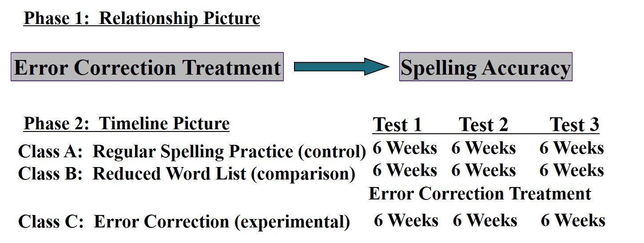
Figure 10.4 Treatment Comparisons in an Experiment (1 of 2)

Slide 25
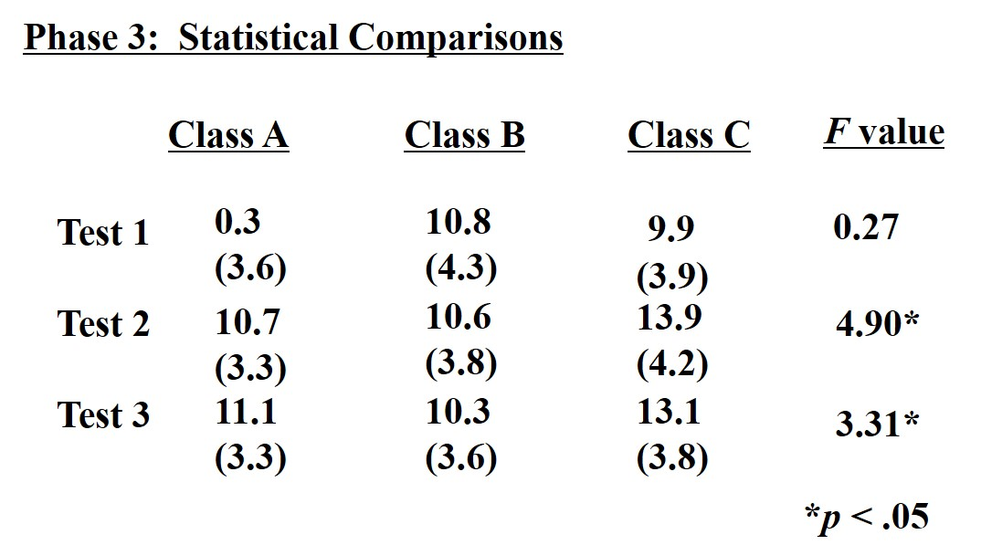
Figure 10.4 Treatment Comparisons in an Experiment (2 of 2)

Slide 26
What Are Key Characteristics of Experiments? (14 of 17)
Threats to Validity
Specific reasons for why we can be wrong when we make an inference in an experiment
Statistical conclusion validity
Construct validity
Internal validity
External validity

Slide 27
What Are Key Characteristics of Experiments? (15 of 17)
Threats to Validity: Threats to Internal Validity
Internal validity: The observed changes that took place are a result of your intervention or your program and are not the result of other causes
History
Maturation
Regression
Selection
Mortality
Interactions with selection
Diffusion of treatments
Compensatory equalization
Compensation rivalry
Resentful demoralization
Testing
Instrumentation

Slide 28
What Are Key Characteristics of Experiments? (16 of 17)
Threats to Validity: Threats to Internal Validity
Internal validity: The observed changes that took place are a result of your intervention or your program and are not the result of other causes
History
Maturation
Regression
Selection
Mortality
Interactions with selection
Diffusion of treatments
Compensatory equalization
Compensation rivalry
Resentful demoralization
Testing
Instrumentation

Slide 29
What Are Key Characteristics of Experiments? (17 of 17)
Threats to Validity: Threats to External Validity
External validity: The degree to which the findings are generalizable to other persons, settings, treatment variables, and measures
Interaction of selection and treatment
Interaction of setting and treatment
Interaction of history and treatment

Slide 30
What Are the Types of Experimental Design? (1 of 10)
Between Group designs
True experiments (pre- and posttest, posttest only)
Quasi-experiments (pre- and posttest, posttest only)
Causal comparative research
Factorial designs
Within-group or individual designs
Time-series (interrupted, equivalent)
Repeated measure
Single subject

Slide 31
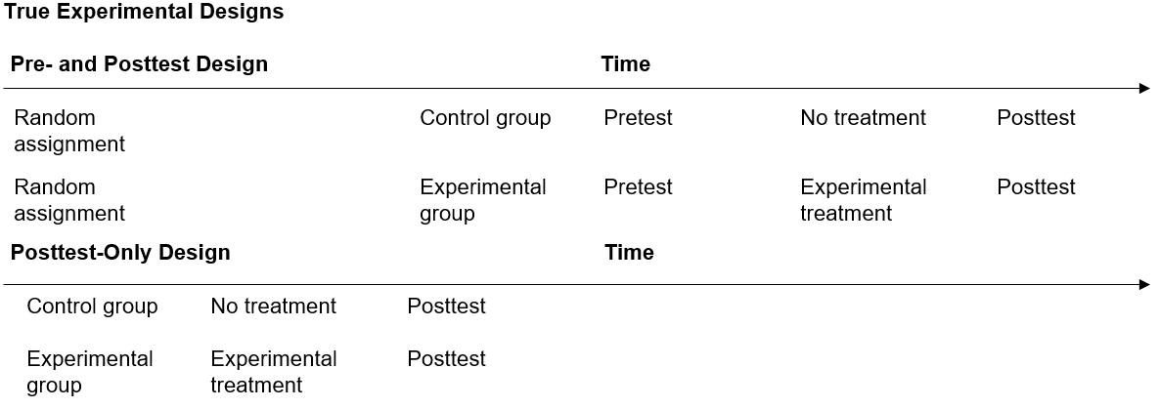
Table 10.3 Types of Between-Group Designs (1 of 3)

Slide 32
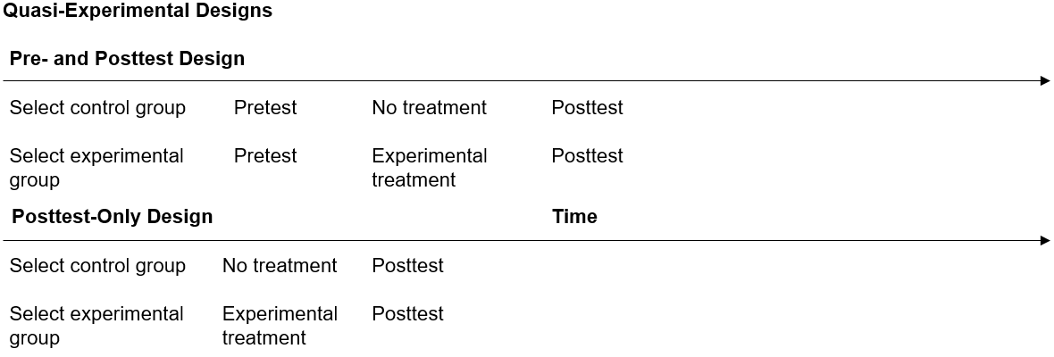
Table 10.3 Types of Between-Group Designs (2 of 3)

Slide 33
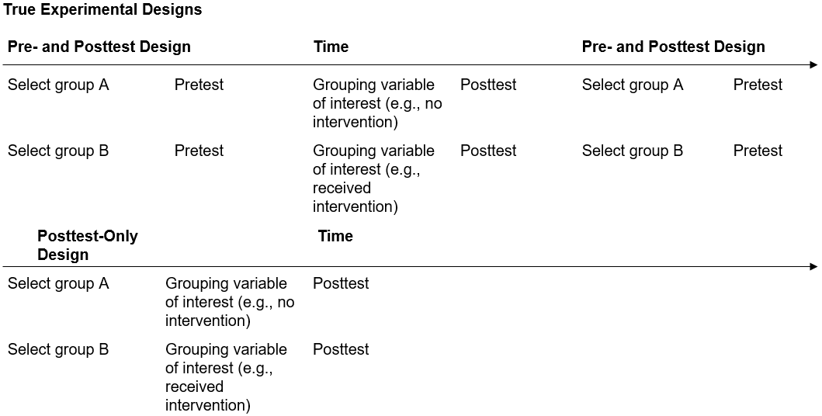
Table 10.3 Types of Between-Group Designs (3 of 3)

Slide 34
What Are the Types of Experimental Design? (2 of 10)
Between-Group Designs: True Experiments
Random assignment
Two or more groups compared
One or more interventions
Dependent variable measured once
Typical controls include pretest, matching, blocking, covariates
Most threats to internal validity minimized

Slide 35
What Are the Types of Experimental Design? (3 of 10)
Between-Group Designs: Quasi-Experiments
No random assignment
Two or more groups compared
One or more interventions
Dependent variable measured once
Typical controls include pretest, matching, blocking, covariates
Greater threats to internal validity

Slide 36
What Are the Types of Experimental Design? (4 of 10)
Between-Group Designs: Causal Comparative Research
No random assignment
Two or more groups compared
One or more interventions
Dependent variable measured once
Typical controls include matching, blocking, covariates
More potential threats to internal validity

Slide 37
What Are the Types of Experimental Design? (5 of 10)
Between-Group Designs: Factorial Designs
Involve two or more categorical, independent variables, each examined at two or more levels
Main effects: the influence of each independent variable on the outcome in an experiment
Interaction effects: exist when the influence on one independent variable depends on the other independent variable in an experiment

Slide 38
What Are the Types of Experimental Design? (6 of 10)
Between-Group Designs: Factorial Designs
Two-by-three Factorial Design Example
Factor 1. Types of instruction
Level 1—a health lecture
Level 2—a standard lecture
Factor 2. Levels of depression
Level 1—high
Level 2—medium
Level 3—low

Slide 39
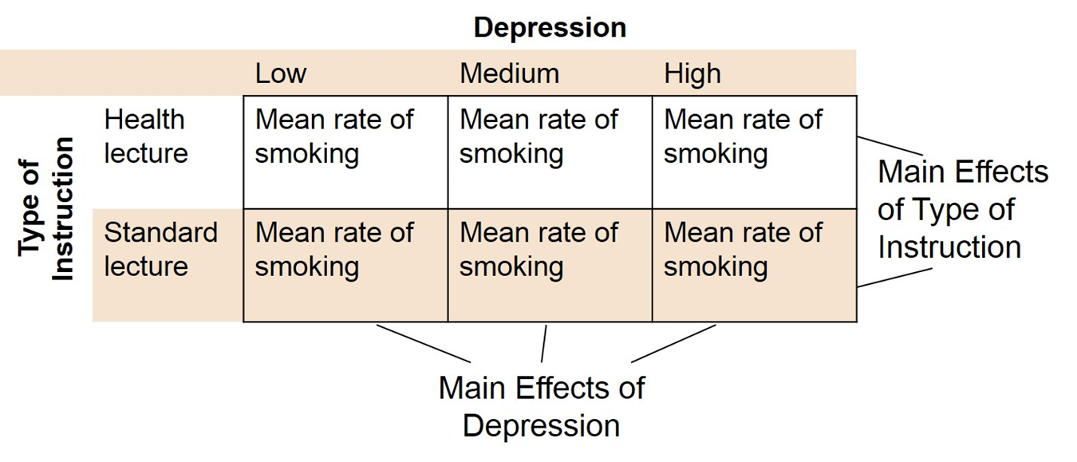
Figure 10.5 Means and Main Effects of the Six Groups in the Factorial Design

Slide 40
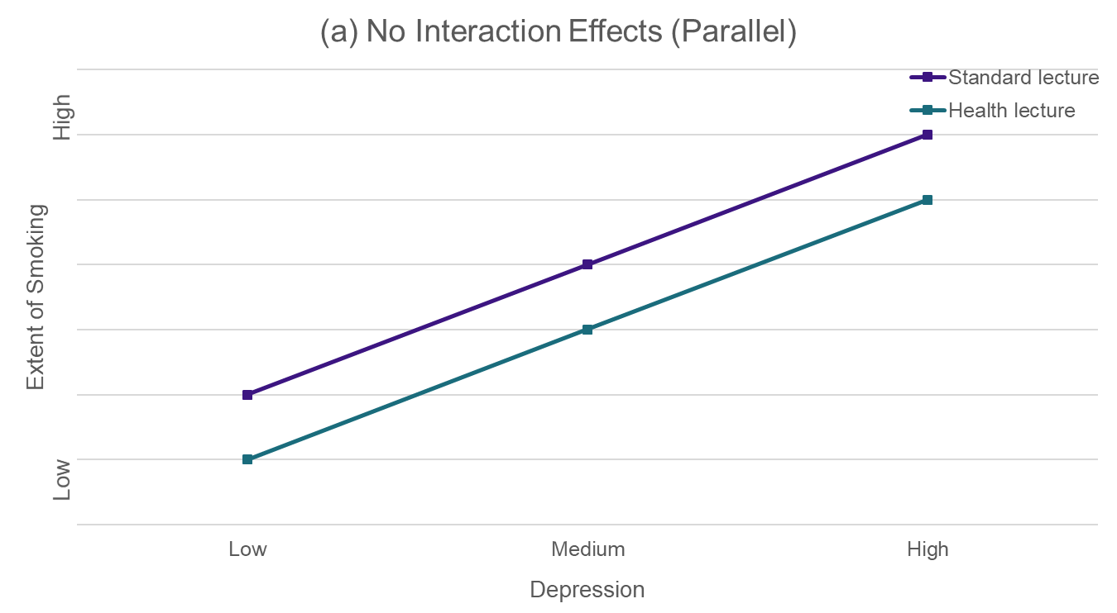
Figure 10.6 Graphs of Scores Showing Main Effects and the Interaction Effects (1 of 3)

Slide 41
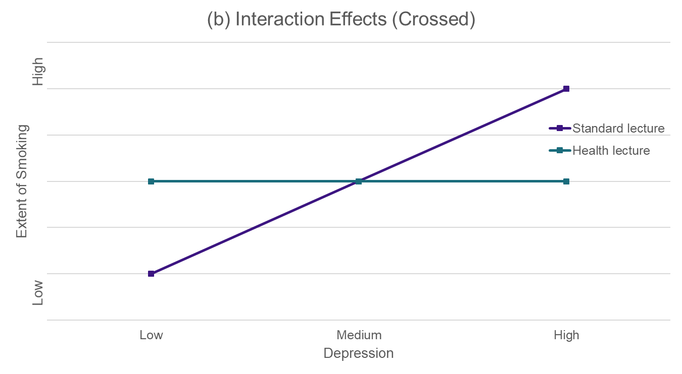
Figure 10.6 Graphs of Scores Showing Main Effects and the Interaction Effects (2 of 3)

Slide 42
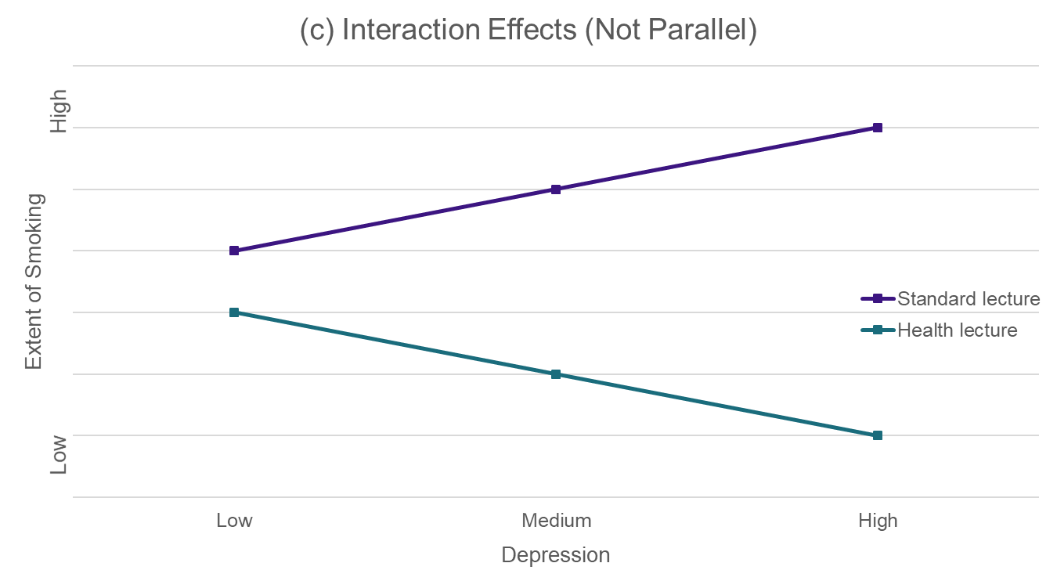
Figure 10.6 Graphs of Scores Showing Main Effects and the Interaction Effects (3 of 3)

Slide 43
What Are the Types of Experimental Design? (7 of 10)
Within-Group or Individual Designs: Time Series
Time series experiments
Interrupted time series
Equivalent time series
Repeated measures experiments
Measure → Treatment #1 → Measure → Treatment #2 → Measure

Slide 44
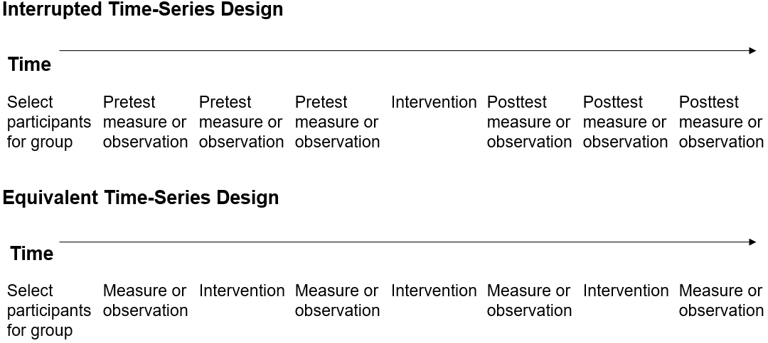
Table 10.5 Time-Series Experimental Designs

Slide 45
What Are the Types of Experimental Design? (8 of 10)
Within-Group or Individual Designs: Repeated Measures
No random assignment
Single group design
Two or more interventions
Dependent variable measured after each intervention
Typical controls include covariates
Most threats to internal validity minimized

Slide 46
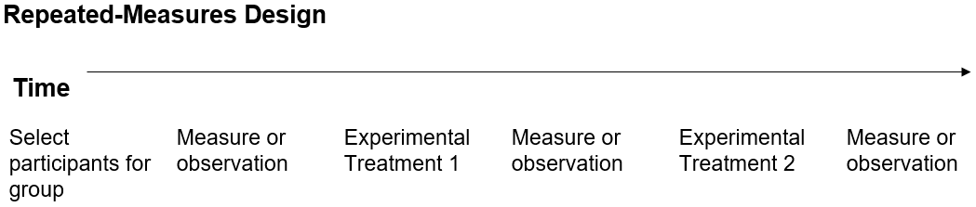
Table 10.6 Repeated-Measures Design

Slide 47
What Are the Types of Experimental Design? (9 of 10)
Within-Group or Individual Designs: Single-Subject Designs
Use within a planned intervention
Intra-participant research
Notation: A (baseline phase), B (behavior under intervention), C, etc.
Target behavior: outcome
Analysis focuses on whether behavior changed from target to intervention
Data collection sheets: situational information, performance, summary of behavior
Outcome: magnitude of effect of intervention on target

Slide 48
What Are the Types of Experimental Design? (10 of 10)
Within-Group or Individual Designs: Single-Subject Designs
A - B designs: observe and measure behavior during a trial period (A), administer an intervention, and observe and measure the behavior during the intervention (B)
Multiple baseline design: series of stacked A - B designs with varying baseline length
Alternating treatment design: examine relative effects of two or more interventions

Slide 49
What Are Potential Ethical Issues in Experimental Research?
Withholding experimental treatment from individuals
Whether random assignments are ethical
Not concluding an experiment when it is necessary
Whether the experiment will provide the best answer to a problem
Whether stakes are high in conducting an experiment

Slide 50
What Are the Steps in Conducting Experimental Research?
Decide if an experimental design fits research problem
Form hypotheses to test cause-and-effect
Select experimental unit and identify study participants
Select an experimental treatment and introduce it
Choose a type of experimental design
Conduct the experiment
Organize and analyze the data
Develop an experimental research report

Slide 51
How Do You Evaluate Experimental Research?
The experiment has substantial intervention
Participants gain from the intervention
The researcher systematically selects and adequate number of participants
The researcher uses valid, reliable, and sensitive measures
The researcher controls for extraneous factors that might influence the outcome.
The researcher addresses threats to internal and external validity

Slide 52

Copyright

