Slide 1
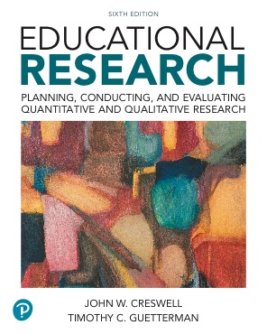
Educational Research: Planning, Conducting, and Evaluating Quantitative and Qualitative Research
Sixth Edition
Chapter 11
Correlational Designs
Copyright © 2019, 2015, 2012 Pearson Education, Inc. All Rights Reserved
Notes:
If this PowerPoint presentation contains mathematical equations, you may need to check that your computer has the following installed:
1) MathType Plugin
2) Math Player (free versions available)
3) NVDA Reader (free versions available)

Slide 2
Learning Objectives
11.1 Define correlation research, and describe when to use it, and how it developed
11.2 Identify the two types of correlational designs
11.3 Describe the key characteristics of correlational designs
11.4 Identify potential ethical issues in conducting correlational research
11.5 Identify steps in conducting a correlational study
11.6 List the criteria for evaluating a correlational study
Notes:
Slide 2 is list of textbook LO numbers and statements

Slide 3
What is Correlational Research, When Do You Use It, and How Did It Develop? (1 of 3)
In correlational research designs, investigators use the correlation statistical test to describe and measure the degree of association (or relationship) between two or more variables or sets of scores
Product-moment correlation coefficient: statistic that expresses linear relationships

Slide 4
What is Correlational Research, When Do You Use It, and How Did It Develop? (2 of 3)
When Do You Use Correlational Research?
To examine the relationship between two or more variables
To predict an outcome:
Look at how the variables co-vary together
Use one variable to predict the score on another variable

Slide 5
What is Correlational Research, When Do You Use It, and How Did It Develop? (3 of 3)
How Did Correlational Research Develop?
1895 Pearson develops correlation formula.
1897 Yule develops solutions for correlating two, three, and four variables.
1935 Fisher pioneered significance testing and analysis of variance.
1963 Campbell and Stanley write about experimental and quasi-experimental designs (including correlational designs).
1970s and 1980s computers give the ability to statistically control variables and do multiple regression.

Slide 6
What are the Types of Correlational Designs (1 of 3)
The explanatory design
The prediction design

Slide 7
What are the Types of Correlational Designs (2 of 3)
The Explanatory Design
Correlate two or more variables
Collect data at one point in time
Analyze all participants as a single group
Obtain at least two scores for each individual in the group—one for each variable
Report the correlation statistic (or advanced form)
Interpretation based on statistical test results indicate that the changes in one variable are reflected in changes in the other

Slide 8
What are the Types of Correlational Designs (3 of 3)
The Prediction Designs
Predictor variable: A variable that is used to make a forecast about an outcome in the correlational study
Criterion variable: The outcome being predicted
“Prediction” usually used in the title
Predictor variable(s) usually measured at one point in time; the criterion variable measured at a later point in time
Purpose is to forecast future performance

Slide 9
What are the Key Characteristics of Correlational Designs (1 of 19)
Displays of scores (scatterplots and matrices)
Associations between scores (direction, form, and strength)
Multiple variable analysis (partial correlations and multiple regression)

Slide 10
What are the Key Characteristics of Correlational Designs (2 of 19)
Associations between Scores: What Is the Direction of the Association?
Direction
Positive correlation (“+” correlation coefficient) means points move in the same direction
Negative correlation (“-” correlation coefficient) means points move in the opposite direction
If scores do note relate in a pattern, no linear association

Slide 11
What are the Key Characteristics of Correlational Designs (3 of 19)
Associations between Scores: What Is the Form of the Association?
Positive linear relationship: low (or high) scores on one variable relate to low (or high) scores on a second variable
Negative linear relationship: low scores on one variable relate to high sores on a second variable
Curvilinear (or nonlinear): a U-shaped relationship of scores

Slide 12
What are the Key Characteristics of Correlational Designs (4 of 19)
Associations between Scores: What Is the Form of the Association?
Spearman rho (r s): Correlation coefficient for nonlinear ordinal data
Point-biserial correlation: Used to correlate continuous data with a dichotomous variable
Phi-coefficient: Used to determine the degree of association when both variable measures are dichotomous

Slide 13
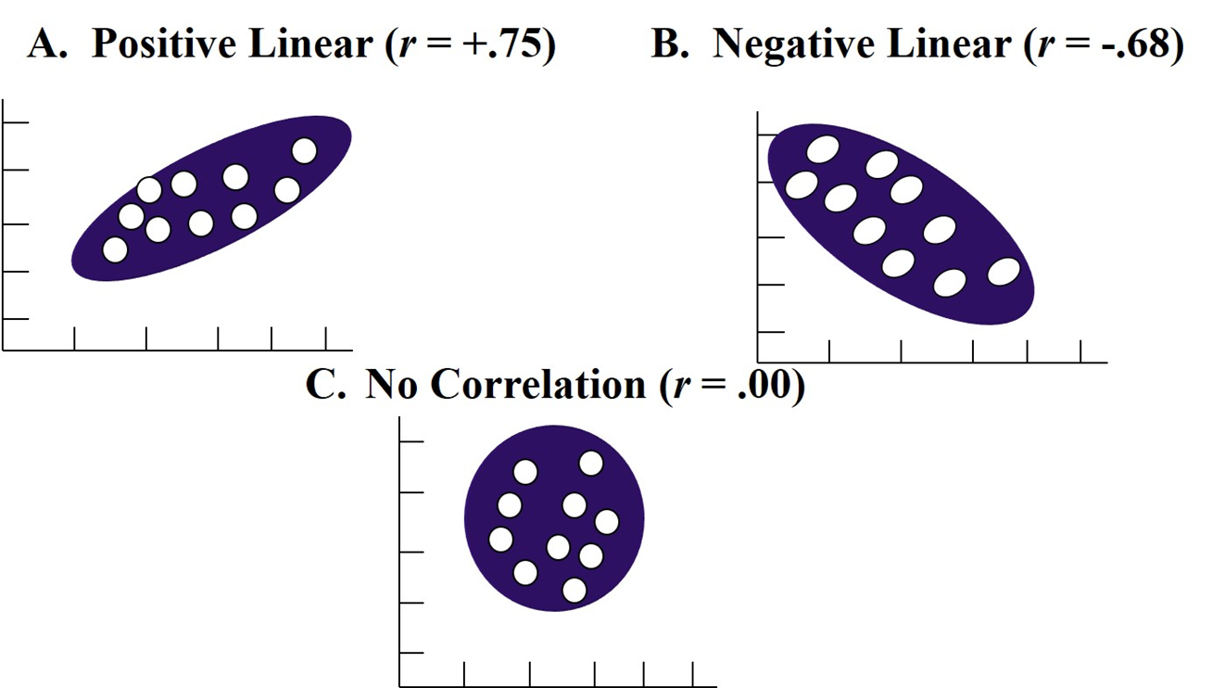
Figure 11.1 Patterns of Association between Two Variables

Slide 14
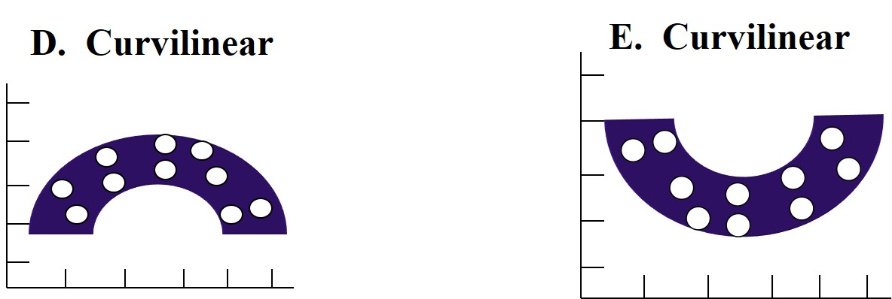
Linear and Nonlinear Patterns

Slide 15
What are the Key Characteristics of Correlational Designs (5 of 19)
Associations between Scores: What Are the Degree and Strength of Association?
Degree and strength (size of coefficient)
From −1.0 to +1.0
0 indicates no correlation
Valence sign (+ or −) indicates direction
Coefficient of determination: proportion of variance in one variable that can be explained by the other

Slide 16
What are the Key Characteristics of Correlational Designs (6 of 19)
Associations between Scores: What Are the Degree and Strength of Association?
.20–.35: only a slight relationship
.35–.65: useful for limited prediction
.66–.85: good prediction can result from one variable to the other, considered very good
.86 and above: high correlation, typically achieved for studies of construct validity or test-retest reliability

Slide 17
What are the Key Characteristics of Correlational Designs (7 of 19)
Associations between Scores: Cautions When Interpreting Correlations
In very large datasets, small correlations are statistically significant
Consider whether meaningful correlation is
Multiple comparisons require a more conservative p value

Slide 18
What are the Key Characteristics of Correlational Designs (8 of 19)
Displays of Scores: Scatter Plots
Pictorial image displayed on a graph of two sets of scores for participants
Typically X on horizontal axis, and Y on vertical
Can tell direction, form of association, degree of relationship

Slide 19
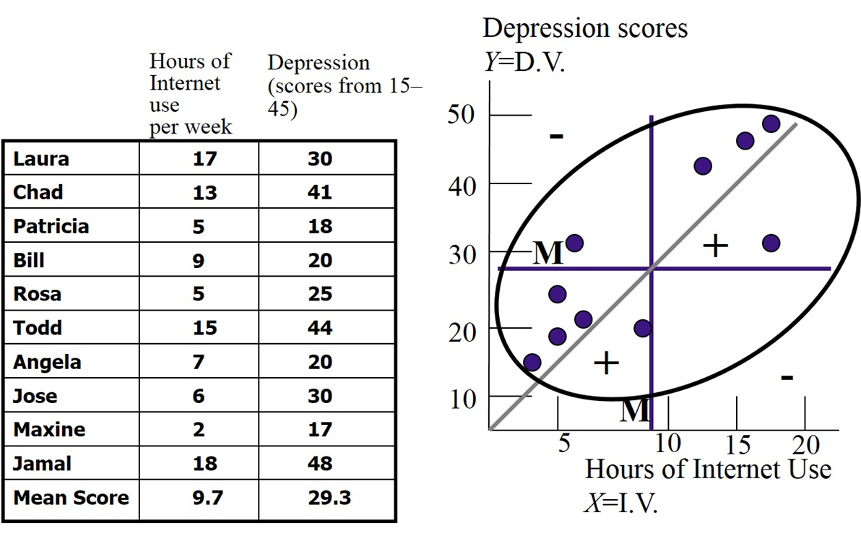
Figure 11.2 Example of a Scatter Plot

Slide 20
What are the Key Characteristics of Correlational Designs (9 of 19)
Displays of Scores: A Correlation Matrix
Visual display of the correlation coefficients for all variables in a study
List all variables on both a horizontal row and a vertical column in a table
To simplify, include only the numbers in the column headings
Asterisks (*) can indicate significance

Slide 21
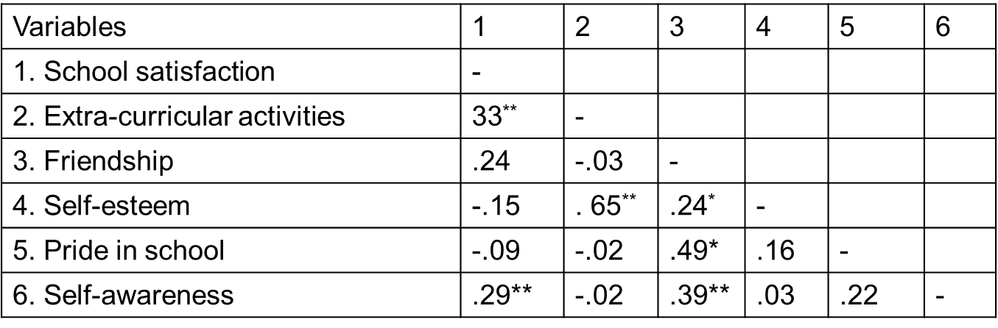
Table 11.1 Example of a Correlation Matrix

Slide 22
What are the Key Characteristics of Correlational Designs (10 of 19)
Multiple Variable Analysis: Partial Correlations
Mediating variable “stands between” the independent and dependent variables and influences both of them
Partial correlation: to determine the amount of variance that a mediating variable explains in both the independent and dependent variables
Removes shared variance of third variable

Slide 23
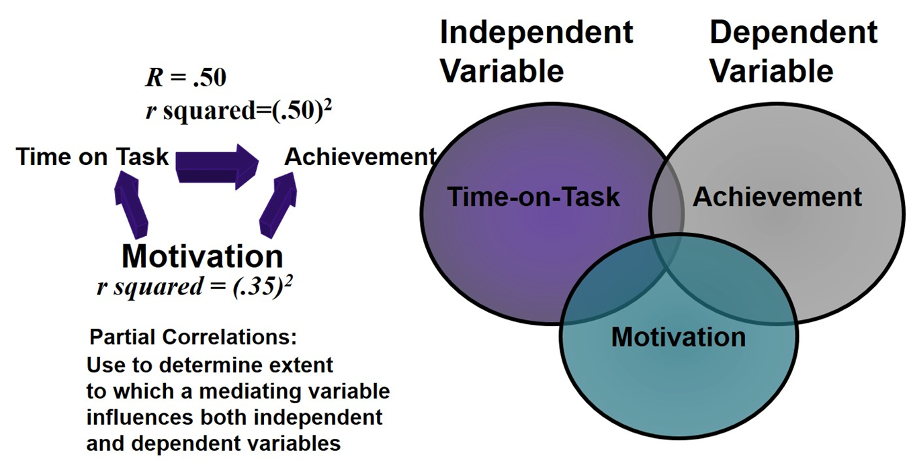
Figure 11.3 Common Variance Shared for Bivariate and Partial Correlations

Slide 24
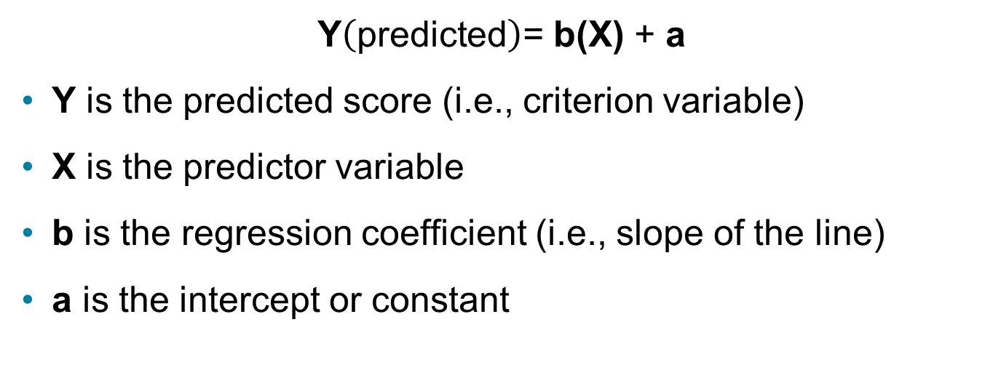
What are the Key Characteristics of Correlational Designs (11 of 19)
Multiple Variable Analysis: Multiple Regression
$\text{Y}\left(\text{predicted}\right)\text{=}$ b(X) + a
Y is the predicted score (i.e., criterion variable)
X is the predictor variable
b is the regression coefficient (i.e., slope of the line)
a is the intercept or constant

Slide 25
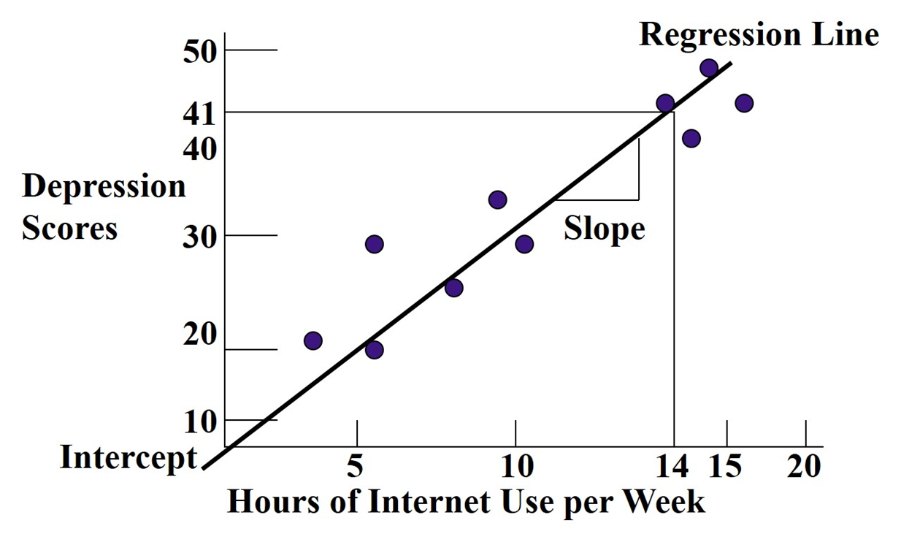
Figure 11.4 Simple Regression Line

Slide 26
What are the Key Characteristics of Correlational Designs (12 of 19)
Multiple Variable Analysis: Meta-Analysis
Intent – to summarize the results of two or more studies on the same or similar issues
Steps in conducting a meta-analysis
Problem formation
Search databases and gather studies
Criteria for review of studies
Effect sizes and statistical analysis of results of studies’
Calculate the summary effect
Interpret the meaning of the summary effect across all studies

Slide 27
What are the Key Characteristics of Correlational Designs (13 of 19)
Using Advanced Correlational Statistical Procedures
Factor analysis
Discriminant function analysis
Path analysis
Structural equation modeling
Hierarchical linear modeling

Slide 28
What are the Key Characteristics of Correlational Designs (14 of 19)
Using Advanced Correlational Statistical Procedures: Factor Analysis
Look at moderately to highly correlated variables
Reduce to smaller set of variables
Combines into one variable or scale

Slide 29
What are the Key Characteristics of Correlational Designs (15 of 19)
Using Advanced Correlational Statistical Procedures: Discriminant Functional Analysis
Used when
dependent variable is categorical and
independent variable is continuous
Determine what independent variables explain differences in categories
Example:
What accounts for high versus. low achievement scores?

Slide 30
What are the Key Characteristics of Correlational Designs (16 of 19)
Using Advanced Correlational Statistical Procedures: Intraclass Correlation
Establish interrater reliability
Multiple raters or observers making assessment
Need to measures the extent to which raters agree
Intraclass correlation coefficient (I C C): statistical test to measure correlation when data are in groups
Also used with group data, such as families

Slide 31
What are the Key Characteristics of Correlational Designs (17 of 19)
Using Advanced Correlational Statistical Procedures: Path Analysis
Statistical procedure for looking at the relationship among three or more variables that influence an outcome
Specify a theory, measure variables, examine correlation

Slide 32
What are the Key Characteristics of Correlational Designs (18 of 19)
Using Advanced Correlational Statistical Procedures: Structural Equation Modeling
Analyzes relationships among multiple variables at the same without increasing our Type I error rate
Linear, cross-sectional statistical techniques
Provide extensive information about which variables affect other variables and the direction of these effects
Start with theoretical model
Able to analyze manifest and latent variables
Accounts for measurement error

Slide 33
What are the Key Characteristics of Correlational Designs (19 of 19)
Using Advanced Correlational Statistical Procedures: Hierarchical Linear Modeling
Applicable when units of analysis are at different levels
Hierarchical data-nested within layers
Advanced approach to linear regression
Example:
Individual students in a class are level 1, class is level 2, school is level 3

Slide 34
Potential Ethical Issues in Conducting Correlational Research
Not measuring appropriate controls
Not having a sufficient sample size and meeting the assumptions of the statistic
Making up or editing data
Stating cause and effect when data show patterns of relationships
Not reporting effect sizes or significance testing
Plagiarizing others
Not reporting contradictory findings
Not sharing data reports with others

Slide 35
What are the Steps in Conducting a Correlational Study?
Determine if a correlational study best addresses the research problem
Identify individuals to study
Identify two or more measures for each individual in the study
Collect data and monitor potential threats
Analyze the data and represent the results
Interpret the results

Slide 36
How Do You Evaluate a Correlational Study? (1 of 2)
Adequate sample for hypothesis testing
Display of correlational results in a table or graph
Selection of an appropriate statistical test
Interpretation about the direction, form, and magnitude of association
Assessment of magnitude of association based on the coefficient of determination, p values, effect size, or coefficient size

Slide 37
How Do You Evaluate a Correlational Study? (2 of 2)
Identification of the predictor and criterion variables
In a visual model, presentation of the expected (or predicted) relationships based on observed data

Slide 38

Copyright

