Slide 1

Educational Research: Planning, Conducting, and Evaluating Quantitative and Qualitative Research
Sixth Edition
Chapter 12
Survey Designs
Copyright © 2019, 2015, 2012 Pearson Education, Inc. All Rights Reserved
Notes:
If this PowerPoint presentation contains mathematical equations, you may need to check that your computer has the following installed:
1) MathType Plugin
2) Math Player (free versions available)
3) NVDA Reader (free versions available)

Slide 2
Learning Objectives (1 of 2)
12.1 Define survey research, and describe when to use it, and how it developed
12.2 Describe the types of survey designs
12.3 Identify the key characteristics of survey research
12.4 Describe how to construct and use a mailed questionnaire
12.5 Describe how to design and conduct an interview survey
Notes:
Slide 2 is list of textbook LO numbers and statements

Slide 3
Learning Objectives (2 of 2)
12.6 Identify potential ethical issues in survey research
12.7 List the steps in conducting survey research
12.8 Identify criteria useful for evaluating survey research
Notes:
Slide 2 is list of textbook LO numbers and statements

Slide 4
What is Survey Research, When Do You Use It, and How Did It Develop? (1 of 3)
Survey research designs are procedures in quantitative research in which investigators administer a survey to a sample or to the entire population of people in order to describe the attitudes, opinions, behaviors, or characteristics of the population.

Slide 5
What is Survey Research, When Do You Use It, and How Did It Develop? (2 of 3)
When Do You Use Survey Research?
To assess trends
To assess opinions, beliefs, and attitudes of individuals
For follow-up analyses
For program evaluation

Slide 6
What is Survey Research, When Do You Use It, and How Did It Develop? (3 of 3)
How Did Survey Research Develop?
1817 International Survey of Education Systems
1890 Stanley Hall survey of children
1907 The Pittsburgh Survey examined social problems
W W I and W W II sampling techniques improved
Wide applications in social sciences-marketing research, public opinion research, journalism
Universities established social science research centers
Private organizations such as Gallup, Rand Corporation, and Roper formed
Internet-based surveys widely used

Slide 7
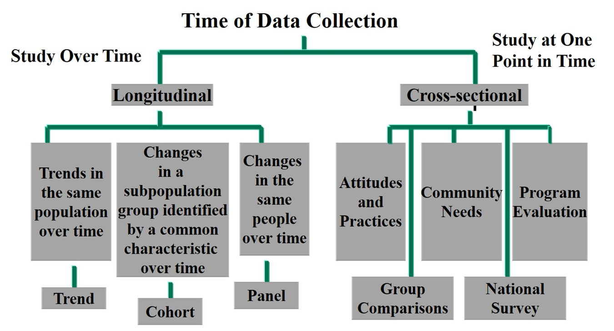
Figure 12.1 Types of Cross-Sectional and Longitudinal Survey Designs

Slide 8
What Are the Types of Survey Design? (1 of 5)
Cross-Sectional Survey Designs
Researcher collects data at one point in time
Measures current attitudes, beliefs, opinions, or practices
Provides information in short amount of time
Examples:
Compare groups, such as students with teachers or different settings
Measure community needs
Evaluate a program by asking about perceptions
Gather a national survey with 1000s

Slide 9
What Are the Types of Survey Design? (2 of 5)
Longitudinal Survey Designs
Collect data over time
Used to understand
Trends with the same population
Changes in a cohort group or subpopulation
Changes in a panel group of the same individuals over time
Example: follow-up about how views change over time

Slide 10
What Are the Types of Survey Design? (3 of 5)
Longitudinal Survey Designs: Trend Studies
Identify a population and examine changes over time
Assess how trends change
Example: the Gallup Poll monitors voters during elections

Slide 11
What Are the Types of Survey Design? (4 of 5)
Longitudinal Survey Designs: Cohort Studies
Identify a subpopulation (cohort) based on a characteristic
Study that subpopulation over time
Example:
Study a cohort of 18-year olds in 2017
Five years later, study a group of 23-year olds (may not be the same individuals)
Continue over time as long as individuals were 18 in 2017

Slide 12
What Are the Types of Survey Design? (5 of 5)
Longitudinal Survey Designs: Panel Studies
Examine the same people (i.e., panel) over time
Advantage is the ability to determine actual changes in specific individuals
Disadvantage is that people may be difficult to locate
Example:
Study a graduating class in 2017, follow the exact same individuals at 1 year, 2 years, 5 years, etc.
Might also compare groups

Slide 13
What Are the Key Characteristics of Survey Research? (1 of 20)
Sampling from a population
Collecting data through questionnaires or interviews
Designing instruments for data collection
Obtaining a high response rate

Slide 14
What Are the Key Characteristics of Survey Research? (2 of 20)
Sampling from a Population
Typically select a sample from a population
Generalize results from the sample to the population
Broadest level as population, most specific is sample
Use probability sampling for rigorous sampling
Select as large a sample as possible
Census study uses entire population

Slide 15
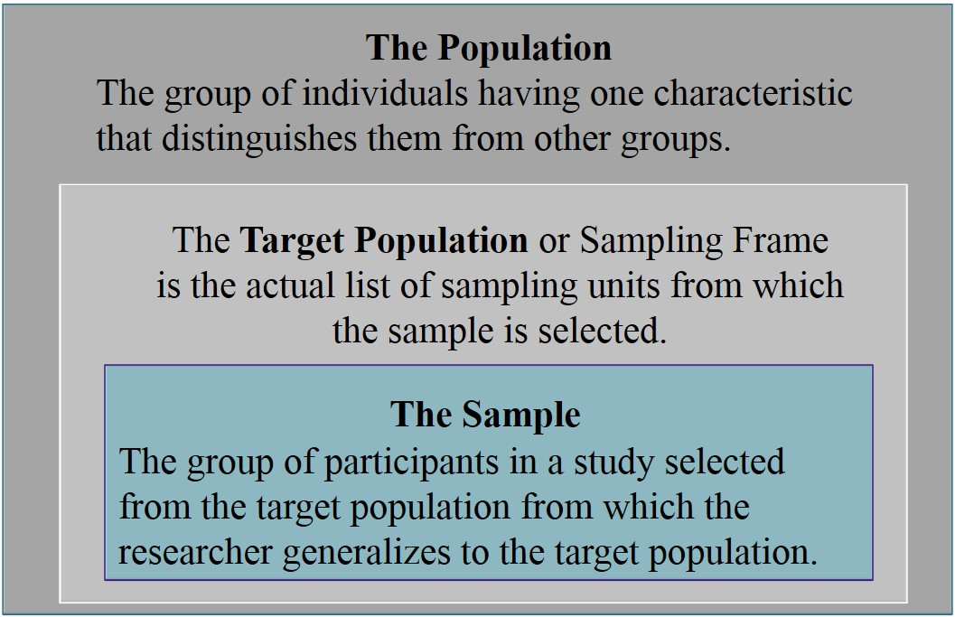
Figure 12.2 Differences between the Population, Target Population or Sampling Frame, and Sample

Slide 16
What Are the Key Characteristics of Survey Research? (3 of 20)
Sampling from a Population
Drawing valid inferences:
To reduce coverage error, have a good sampling frame
To reduce sampling error, select as large a sample as possible
To reduce measurement error, use a good instrument
To reduce nonresponse error use rigorous administration to achieve a large response rate

Slide 17
What Are the Key Characteristics of Survey Research? (4 of 20)
Questionnaires and Interviews
Questionnaire: form used that participants in a study complete and return to the researcher
Interview survey: form on which the researcher records answers supplied by the participant in the study

Slide 18
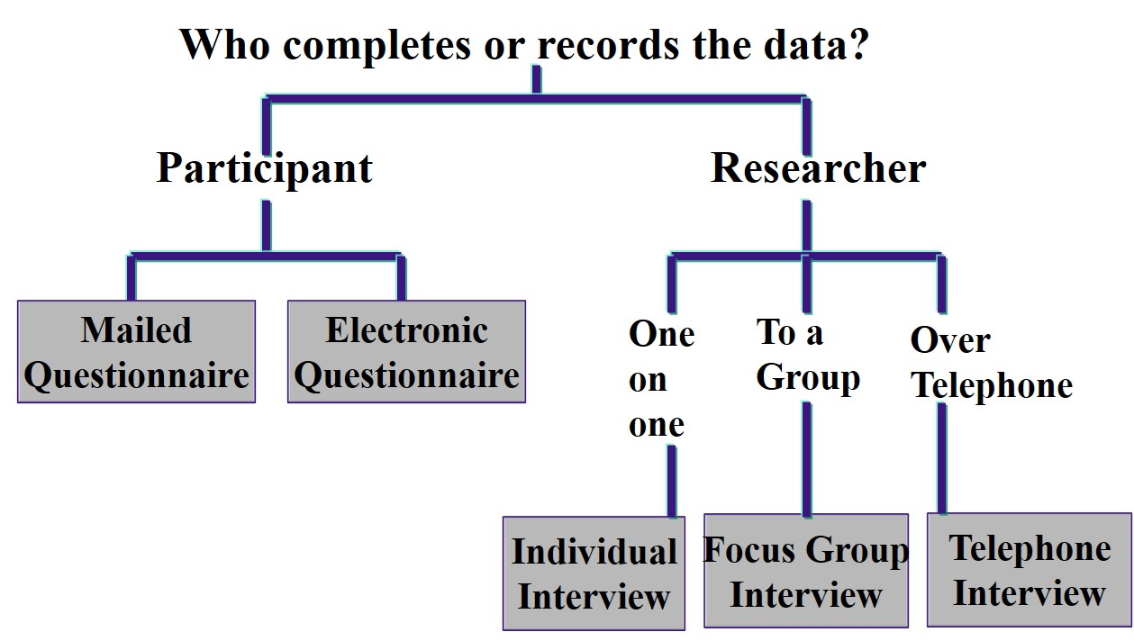
Figure 12.3 Forms of Data Collection to Survey Research

Slide 19
What Are the Key Characteristics of Survey Research? (5 of 20)
Questionnaires and Interviews: Mailed Questionnaires
Investigator mails a questionnaire to members of the sample
Might develop, modify, or use existing questionnaire
Advantages: reaching large geographic area, relatively fast, may be economical
Disadvantages: may not return instrument, no way to probe

Slide 20
What Are the Key Characteristics of Survey Research? (6 of 20)
Questionnaires and Interviews: Online Surveys or Questionnaires
Survey instrument available through the Internet
Advantages: quickly gather data, tested forms, takes advantage of internet, economical
Disadvantages: may have low response rate, sometimes have nonprobability sampling, technical problems

Slide 21
What Are the Key Characteristics of Survey Research? (7 of 20)
Questionnaires and Interviews: One-on-One Interviews
Interview with an individual in the sample and record responses to closed-ended questions
Train interviewers in good interview procedures
Advantages: can probe or clarify, high response rate
Disadvantages: do not protect anonymity, interviewer may influence answers, requires training interviewer

Slide 22
What Are the Key Characteristics of Survey Research? (8 of 20)
Questionnaires and Interviews: Focus Group Interviews
Convene small group (e.g., 4-6) to answer survey questions
Example:
Focus group of international students about cultural integration
Advantages: interaction, extensive data, participation by all
Disadvantages: need to reach consensus, prevent one from dominating the conversation

Slide 23
What Are the Key Characteristics of Survey Research? (9 of 20)
Questionnaires and Interviews: Telephone Interviews
Record the participants’ comments to questions on instruments over the telephone
Advantages: easy access for those geographically diverse
Disadvantages: cannot see nonverbal communication, people may dislike calls

Slide 24
What Are the Key Characteristics of Survey Research? (10 of 20)
Instrument Design
Write different types of questions
Use strategies to construct good questions
Perform a pilot test of the questions

Slide 25
What Are the Key Characteristics of Survey Research? (11 of 20)
Instrument Design: Personal, Attitudinal, and Behavioral Questions
Background questions
Age, years' experience
Attitudes or opinion questions
Agreement with a statement
Behavior questions
Did you do take a semester off? Yes or No

Slide 26
What Are the Key Characteristics of Survey Research? (12 of 20)
Instrument Design: Sensitive Questions
Use care with questions about sensitive topics like drug and alcohol use or mental health issues
Strategies include
Including late in the survey after a warm up
Include comments that lead into the questions
“In past surveys, many have reported…”

Slide 27
What Are the Key Characteristics of Survey Research? (13 of 20)
Instrument Design: Open- and Closed-Ended Questions
Closed-ended questions: pose a question and provide preset response options for the participant
Practical and easy to compare responses
Useful for sensitive questions
Can code numerically
Open-ended questions: participants provide their own response
Semi-closed-ended questions: request additional response, another category to write in

Slide 28
What Are the Key Characteristics of Survey Research? (14 of 20)
Instrument Design: Question Construction
Question is unclear because of vague words
Two or more questions in one
Question is wordy
Question contains negatives
Question contains jargon
Overlapping response options

Slide 29
What Are the Key Characteristics of Survey Research? (15 of 20)
Instrument Design: Question Construction
Unbalanced response options
Mismatch between questions and response options
Respondent does not have understanding to answer the question
Not all respondents can answer the question—need branching

Slide 30
What Are the Key Characteristics of Survey Research? (16 of 20)
Instrument Design: Pilot Testing the Questions
Test on a small number of individuals in the sample
Ask for written feedback on the questions
Revise the survey based on the written comments
Exclude the pilot participants from the final sample for the study

Slide 31
What Are the Key Characteristics of Survey Research? (17 of 20)
Response Rate
High response rates increase confidence in generalizing
Response return rate: percentage of questionnaires that participants return to the researcher
Bias is larger concern than return rate
Researchers use strategies to improve

Slide 32
What Are the Key Characteristics of Survey Research? (18 of 20)
Response Rate: Response Rates for Online Questionnaires
Prenotify participants
Use follow-up procedures
Study a problem interesting to the population under study
Use a brief instrument
Consider the use of incentives

Slide 33
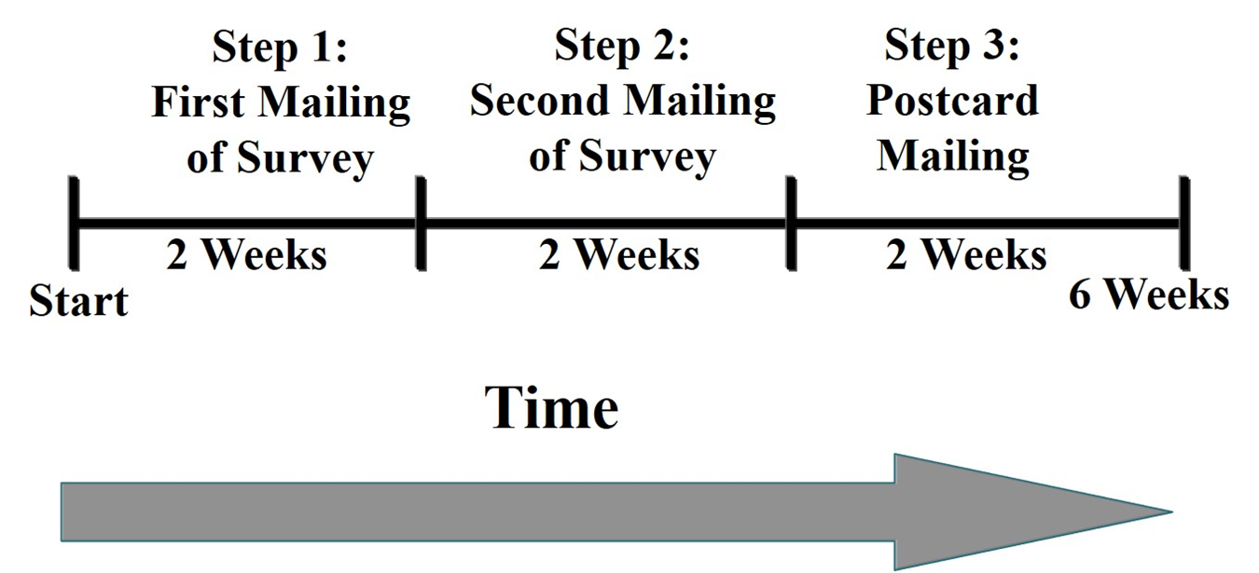
Figure 12.4 Three-Phase Survey Administration Procedure

Slide 34
What Are the Key Characteristics of Survey Research? (19 of 20)
Response Rate: Response Bias
The responses do not accurately reflect the views of the sample and the population.
Overly positive or negative
Assess response bias, particularly when response rates remain low
Wave analysis: procedure to check for response bias in which investigators group returns by intervals

Slide 35
What Are the Key Characteristics of Survey Research? (20 of 20)
Response Rate: Response Set
Participants tend to respond in a certain way to more than one question that does not reflect their true beliefs
Examples:
Always rate “strongly agree” because quickly responding and not reading questions carefully
Respond because it seems that is what the researcher wants to hear
Give socially acceptable responses

Slide 36
How Do You Construct and Analyze an Online or Mailed Questionnaire? (1 of 4)
Write a cover letter to invite the participants to complete the questionnaire
Form and construct the questionnaire
Identify what statistical procedures will be used to analyze data from the mailed questionnaire

Slide 37
How Do You Construct and Analyze an Online or Mailed Questionnaire? (2 of 4)
The Cover Letter
Importance of participant to encourage completion
Purpose of study
Assurance of confidentiality
Sponsorship of research (adviser, institution, funder)
Completion time and return procedures

Slide 38
How Do You Construct and Analyze an Online or Mailed Questionnaire? (3 of 4)
Overall Questionnaire Construction
Easy to read
Begin with demographic or personal questions that are easy to answer
Different times of closed-ended questions
Open-ended questions encourage participants to elaborate
Visually appealing layout: white space, group questions
One scale that applies to multiple questions
Closing statement and thank you

Slide 39
How Do You Construct and Analyze an Online or Mailed Questionnaire? (4 of 4)
Data Analysis of a Research Questionnaire
Report response rate and check for bias
Descriptive analysis of responses
Build scales that reflect multiple items
Internal consistency and validity
Test hypotheses using inferential statistics

Slide 40
Figure 12.7 Checklist for Analyzing Questionnaire Data (1 of 2)
Step 1. Identify response rate and response bias.
Develop table for percent of responses to the survey.
Develop table for the wave analysis response bias.
Step 2. Descriptively analyze the data to identify general trends.
Calculate and present a table of descriptive statistics (mean, variance, and range) for each question on the instrument.
Analyze data to develop a demographic profile of the sample (analyze questions about personal factors).
Analyze data to provide answers to descriptive questions in the study (if any).

Slide 41
Figure 12.7 Checklist for Analyzing Questionnaire Data (2 of 2)
Step 3. Write the report presenting the descriptive results or use advanced statistics.
Develop scales by combining questions on the instrument (i.e., correlate items using the statistical procedure of factor analysis).
Check for the reliability of the scores on the scales (i.e., use a coefficient of internal consistency).
Check for the validity of the scores on scales (or factors) (i.e., use factor analysis).
Analyze data using inferential statistics to address research questions or hypotheses (i.e., comparing groups, relating variables).

Slide 42
How Do You Design and Conduct an Interview Survey? (1 of 5)
Stance of the Interviewer
The interviewer should maintain a neutral stance during the interview
Train the interviewers prior to the interview
Take good notes of responses or use an audio recorder
For telephone interviews, develop a telephone interview guide prior to the interview

Slide 43
How Do You Design and Conduct an Interview Survey? (2 of 5)
Training of Interviewers
Role play and practice interviews
Anticipate problems that arise
Not asking questions in order
Deviating from question
Subvert because of disinterest
Bring expectations
Not dressing appropriately
Disrespecting interviewee

Slide 44
How Do You Design and Conduct an Interview Survey? (3 of 5)
Steps in Interviewing
Obtain interview survey
Train individual interviewers
Gain access, use cover letter, find time and place
Ask questions, indicate response options, record
Thank the participant
Comment on demeanor and personal feelings

Slide 45
How Do You Design and Conduct an Interview Survey? (4 of 5)
A Telephone Interview Guide
Introductory remarks to establish rapport and direction
Clearly marked instructions
Closed-ended response options with space to comment
Coding for responses

Slide 46
How Do You Design and Conduct an Interview Survey? (5 of 5)
Unique Considerations of Telephone Interviews
Decreasing in use
Probabilistic sampling advantage with random digit dialing
Offer human contact and can improve response rates
Can introduce measurement error and variability

Slide 47
What Are Potential Ethical Issues in Survey Research?
Overstating the benefits of participating in the study
Placing interviewers or participants in unsafe situations
Protecting confidentiality of survey responses
Disclosing identity of individuals through data analysis of a subset
Not destroying instruments at the conclusion of the study

Slide 48
What Are the Steps in Conducting Survey Research? (1 of 2)
Decide if a survey is the best design to use
Identify the research questions or hypotheses
Identify the population, the sampling frame, and the sample
Determine the survey design and data collection procedures

Slide 49
What Are the Steps in Conducting Survey Research? (2 of 2)
Develop or locate an instrument
Administer the instrument
Analyze the data to address the research questions or hypotheses
Write the report

Slide 50
How Do You Evaluate Survey Research? (1 of 2)
Describes the target population
Identifies and uses a systematic approach to identifying the sample
Identifies the size of the sample and means for identifying the sample size
Identifies the type of survey used
Mention survey instrument for data collection

Slide 51
How Do You Evaluate Survey Research? (2 of 2)
Reports the reliability and validity of past scores on the instrument
Discusses procedures for administering the instrument
Administration procedures provide a discussion about the follow-up procedures to ensure a high return rate
Provides a systematic procedure for analyzing the survey data

Slide 52

Copyright

