Slide 1

Educational Research: Planning, Conducting, and Evaluating Quantitative and Qualitative Research
Sixth Edition
Chapter 13
Grounded Theory Designs
Copyright © 2019, 2015, 2012 Pearson Education, Inc. All Rights Reserved
Notes:
If this PowerPoint presentation contains mathematical equations, you may need to check that your computer has the following installed:
1) MathType Plugin
2) Math Player (free versions available)
3) NVDA Reader (free versions available)

Slide 2
Learning Objectives
13.1 Define grounded theory research, and describe when to use it, and how it developed
13.2 Distinguish among three types of grounded theory designs
13.3 Identify the key characteristics of grounded theory research
13.4 Identify some potential ethical issues in conducting grounded theory research
13.5 Describe the steps in conducting a grounded theory study
13.6 Evaluate the quality of a grounded theory study
Notes:
Slide 2 is list of textbook LO numbers and statements

Slide 3
What is Grounded Theory Research, When Should You Use It, and How Did It Develop? (1 of 3)
A grounded theory design is a systematic, qualitative procedure used to generate a theory that explains, at a broad conceptual level, a process, an action, or an interaction about a substantive topic.

Slide 4
What is Grounded Theory Research, When Should You Use It, and How Did It Develop? (2 of 3)
When Do You Use Grounded Theory?
To generate a theory rather than use one “off the shelf”
To explain a process, action, or interaction
When you want a step-by-step, systematic procedure
When you want to stay close to the data

Slide 5
What is Grounded Theory Research, When Should You Use It, and How Did It Develop? (3 of 3)
How Did Grounded Theory Develop?
1967 Glaser and Strauss book, The Discovery of Grounded Theory
1990, 1998 Strauss and Corbin prescriptive form with predetermined categories and concerns about reliability and validity
2000 Charmaz introduces “constructivist” method

Slide 6
Table 13.1 Comparing Systematic, Emergent, and Constructivist Approaches to Grounded Theory
Type of Grounded Theory
Grounded Theory Elements | Systematic | Emergent | Constructivist
Procedures of Research | Detailed, rigorous, prescribed | Flexible, less prescribed | Flexible, active role of researcher
Process of Coding | Open, axial, selective coding | Examine data, compare data with emerging categories, refine | Use active codes to capture experiences, researcher determined
Development of Categories | Preset categories: causal conditions, context, core category, intervening conditions, strategies, consequences | Categories develop from the data | Categories develop from views, values, beliefs, feelings, assumptions, and ideologies of individuals
Focus of analysis | Describing categories | Connecting categories and emerging theory | Understanding meaning ascribed by participants
Representation of Theory Generated | Concrete logical paradigm or visual diagram of findings | More abstract-level explanation of basic social processes | More abstract, avoids diagrams and conceptual maps; conclusions are suggestive, incomplete, inconclusive

Slide 7
Types of Grounded Theory Designs (1 of 5)
The Systematic Design
Emphasizes the use of data analysis steps of open, axial, and selective coding
Development of a logic paradigm or a visual picture of the theory generated
Detailed, rigorous procedures of Strauss and Corbin (1999)
Three phases of coding

Slide 8
Types of Grounded Theory Designs (2 of 5)
The Systematic Design
Phases of coding
Open coding: Properties and dimensionalized properties
Axial coding: Researcher selects one open coding category and places it at the center as the central phenomenon and then relates all other categories to it
Selective coding: Writing a theory based on the interrelationship of the categories from axial coding

Slide 9
Figure 13.2 Example of Coding Categories in Grounded Theory with Properties and Dimensionalized Properties
Broad Categories* | Category | Properties | Dimensionalized Examples | Dimensionalized Examples
Administrative role | Provider | With funding | Start-up seed money | Short-term travel
Administrative role | Provider | With nonfinancial aid | Laboratory equipment | Student personnel
Administrative role | Enabler | With more money | Faculty committees | Long-term sabbatical
Administrative role | Enabler | With more visibility | Faculty committees | Administrative assignments
*Broad categories are higher-level concepts

Slide 10
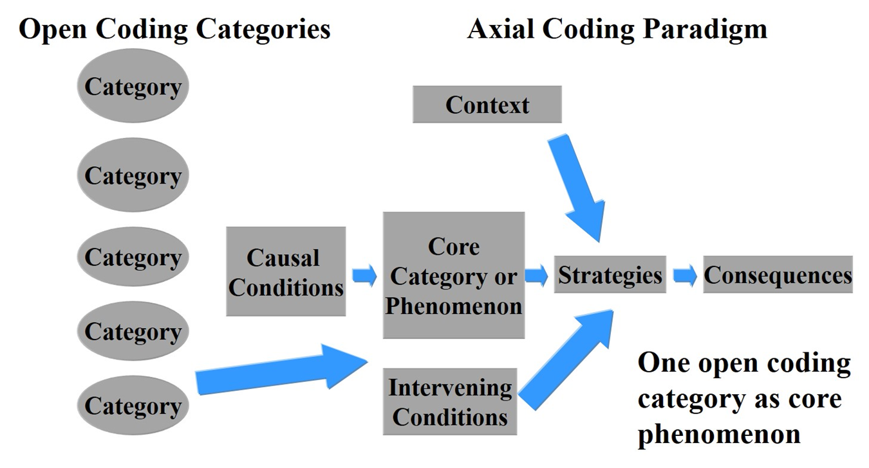
Figure 13.3 Grounded Theory Coding from Open Coding to the Axial Coding Paradigm

Slide 11
Types of Grounded Theory Designs (3 of 5)
The Emerging Design
Grounded theory exists at the most abstract conceptual level rather than the least abstract level as found in visual data presentations (e.g., coding paradigm)
A theory is grounded in the data, not forced into categories
Four central criteria are fit, work, relevance, and modifiability

Slide 12
Types of Grounded Theory Designs (4 of 5)
The Constructivist Design
Philosophically positioned between positivist and postmodern researchers
Theorist explains feelings of individuals as they experience a phenomenon or process
Study mentions beliefs and values of the researcher and eschews predetermined categories
Narrative is more explanatory, discursive, and probing the assumptions and meanings for the individuals
Conclusions suggestive, incomplete, and inconclusive

Slide 13
Types of Grounded Theory Designs (5 of 5)
Choosing among the Designs
How strongly to emphasize procedures
Whether to use predetermined categories in analysis
Whether to position yourself as a researcher
How to end a study – with tentative questions or specific hypotheses

Slide 14
The Key Characteristics of Grounded Theory Research (1 of 9)
Elements of systematic, emerging, and constructivist approaches
Process approach
Theoretical sampling
Constant comparative data analysis
A core category
Theory generation
Memos

Slide 15
The Key Characteristics of Grounded Theory Research (2 of 9)
A Process Approach
A process approach: sequence of actions and interactions among people and events pertaining to a topic
Categories in grounded theory designs: themes of basic information identified in the data by the researcher and used to understand a process
In vivo codes: labels for categories (or themes) that are phrased in the exact words of participants

Slide 16
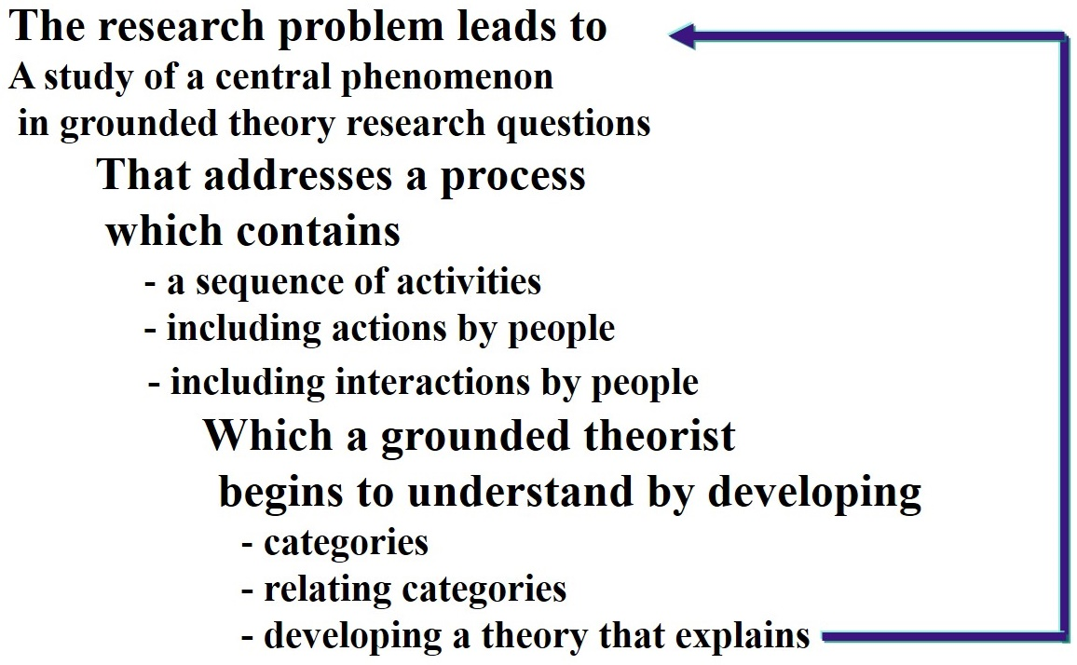
Figure 13.4 Process and Categories within the Flow of Research in Grounded Theory

Slide 17
The Key Characteristics of Grounded Theory Research (3 of 9)
Theoretical Sampling
Theoretical sampling: The researcher chooses forms of data collection that will yield text and images useful in generating a theory
Researcher collects data and analyzes immediately
Saturation: researcher makes the subjective determination that new data will not provide any new information or insights for the developing categories

Slide 18
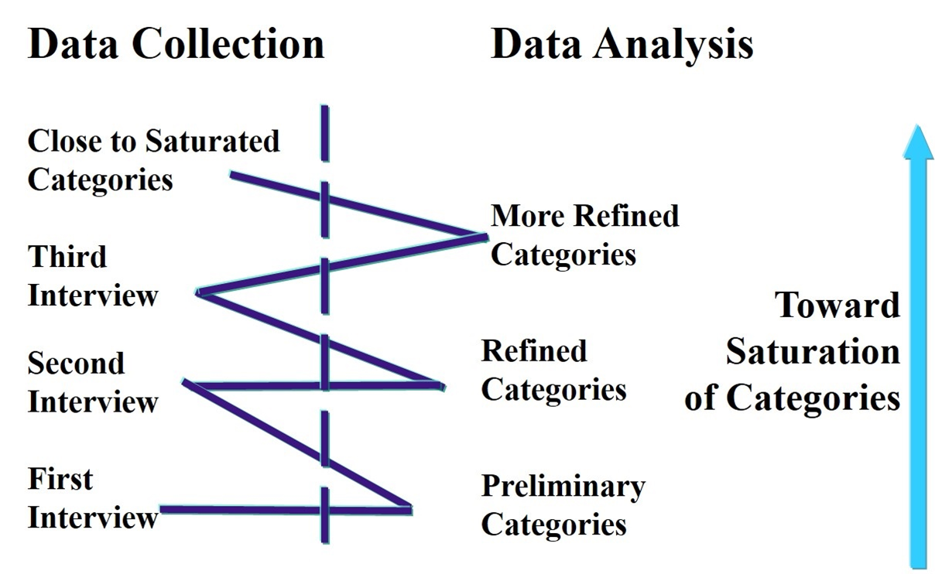
Figure 13.5 Zigzag Data Collection and Analysis to Achieve Saturation of Categories

Slide 19
The Key Characteristics of Grounded Theory Research (4 of 9)
Constant Comparative Data Analysis
Inductive (from specific to broad) data analysis procedure
Generate and connect categories by
comparing incidents in the data to other incidents,
incidents to categories
categories to other categories
“Ground” categories in data

Slide 20
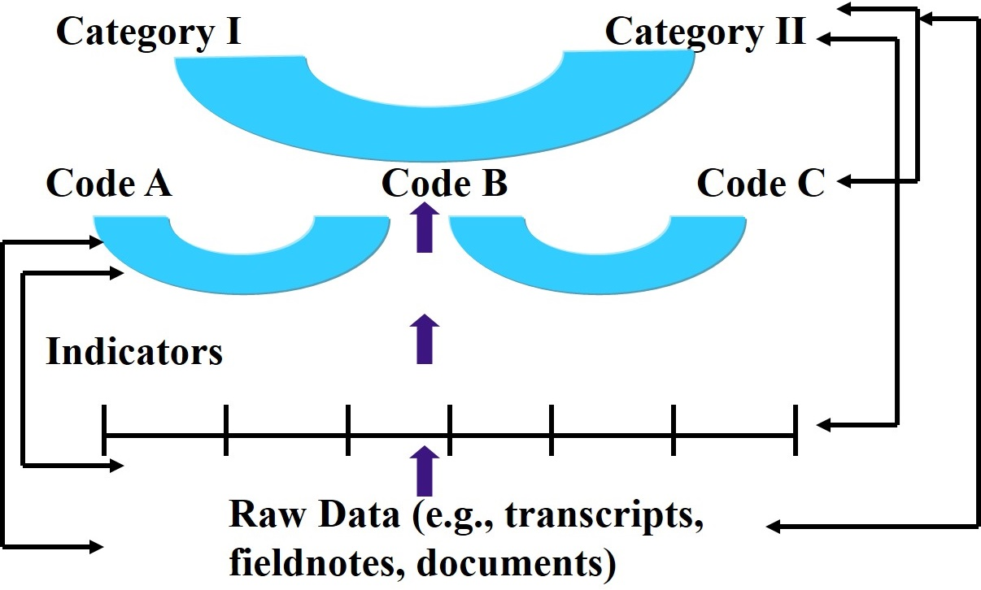
Figure 13.6 Constant Comparison Procedures in Grounded Theory

Slide 21
The Key Characteristics of Grounded Theory Research (5 of 9)
Constant Comparative Data Analysis
Example
Study of becoming an adult student
Collected observations, interviews, participant diary, questionnaires
Returned to data repeatedly as themes emerged

Slide 22
The Key Characteristics of Grounded Theory Research (6 of 9)
A Core Category
Select a core category as basis for writing the theory.
Criteria for choosing
Must be central; all other major categories can relate to it.
Must appear frequently in the data—indicators pointing to that concept.
Explanation that evolves by relating the categories is logical and consistent. No forcing of data.

Slide 23
The Key Characteristics of Grounded Theory Research (7 of 9)
A Core Category
Name or phrase used to describe the central category should be sufficiently abstract
As the concept is refined, the theory grows in depth and explanatory power
When conditions vary, the explanation still holds though way phenomenon is expressed may differ

Slide 24
The Key Characteristics of Grounded Theory Research (8 of 9)
Theory Generation
Theory generation: abstract explanation or understanding of a process about a substantive topic grounded in the data
Theoretical propositions: statements indicating the relationship among categories
When writing, researchers may identify causal condition, outcomes, and context to describe the theory of the process

Slide 25
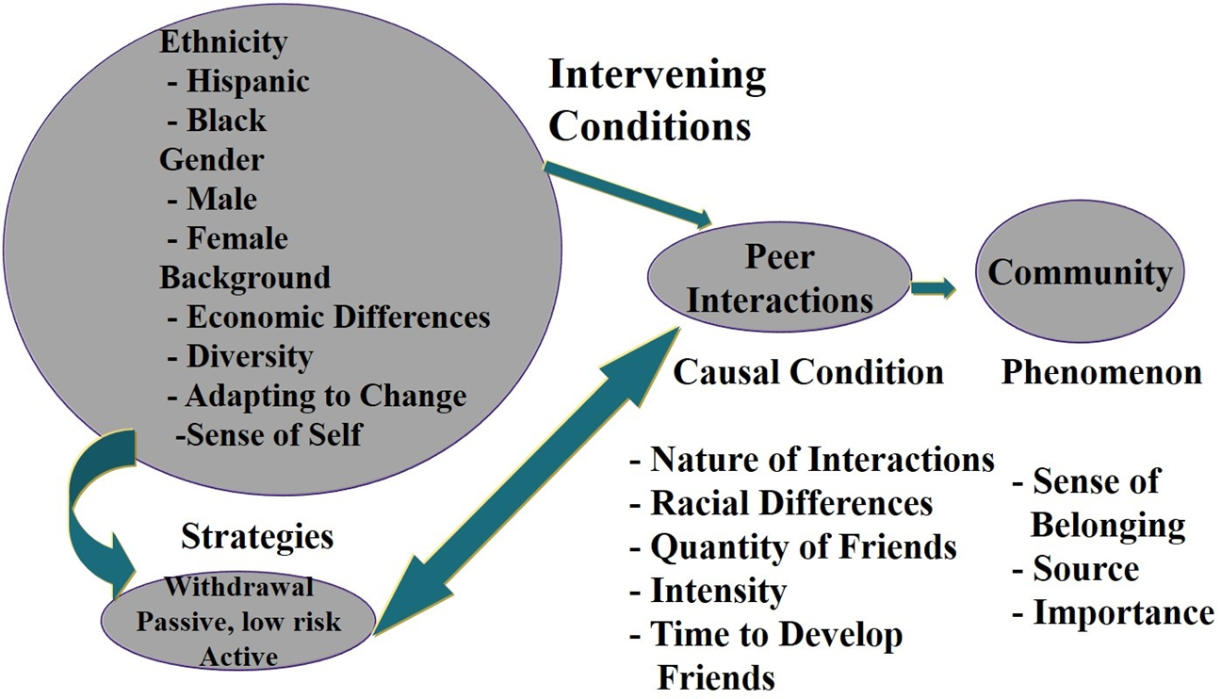
Figure 13.8 Example of a Theory—A Model of Ethnic Minority Students’ Process of Community Building

Slide 26
The Key Characteristics of Grounded Theory Research (9 of 9)
Memos
Notes the researcher writes throughout the research process
Used to elaborate on ideas about the data and the coded categories
Explores hunches, ideas, and thoughts, and then takes them apart
Searches for the broader explanations at work in the process

Slide 27
Potential Ethical Issues in Grounded Theory Research
Not advancing the purpose of the study
Creating power and authority imbalances in interviewing
Not building logically from concepts or categories to a theoretical for others to re-create
Not engaging in a study that benefits participants

Slide 28
What Are the Steps in Conducting Grounded Theory Research?
Decide if a grounded theory design best addresses the research problem
Identify a process to study
Seek approval and access
Conduct theoretical sampling
Code the data
Use selective coding and develop the theory
Validate your theory
Write a grounded theory research report

Slide 29
How Do You Evaluate Grounded Theory Research? (1 of 2)
The researcher identifies the process or action being studied.
The researcher generates a theory in the grounded theory project.
Throughout the study there is a link among the data, the categories, and the theory.

Slide 30
How Do You Evaluate Grounded Theory Research? (2 of 2)
The researcher uses memoing in the procedure.
The grounded theory report presents a visual model of the theory.
The researcher uses one of the types of grounded theory designs.

Slide 31

Copyright

