Slide 1

Educational Research: Planning, Conducting, and Evaluating Quantitative and Qualitative Research
Sixth Edition
Chapter 14
Ethnographic Designs
Copyright © 2019, 2015, 2012 Pearson Education, Inc. All Rights Reserved
Notes:
If this PowerPoint presentation contains mathematical equations, you may need to check that your computer has the following installed:
1) MathType Plugin
2) Math Player (free versions available)
3) NVDA Reader (free versions available)

Slide 2
Learning Objectives
14.1 Define ethnographic research, and describe when to use it, and how it developed
14.2 Identify three types of ethnographic designs
14.3 List the key characteristics of ethnographic research
14.4 Identify potential ethical issues in conducting an ethnography
14.5 Describe the steps in conducting an ethnography
14.6 List criteria useful for evaluating an ethnographic research study

Slide 3
What is Ethnographic Research, When Should You Use it, and How Did it Develop? (1 of 4)
Ethnographic designs: qualitative research procedures for describing, analyzing, and interpreting a culture-sharing group’s shared patterns of behavior, beliefs, and language that develops over time
Culture: “everything having to do with human behavior and belief”

Slide 4
What is Ethnographic Research, When Should You Use it, and How Did it Develop? (2 of 4)
When Do You Conduct an Ethnography?
When the study of a group helps you understand a larger issue
When you have a culture-sharing group to study
When you want a detailed day-to-day picture of the events
When you have long-term access to a culture-sharing group

Slide 5
What is Ethnographic Research, When Should You Use it, and How Did it Develop? (3 of 4)
How Did Ethnographic Research Develop?
Ethnography has been shaped by cultural anthropology with an emphasis on writing about culture
1928: Mead’s study of child rearing, adolescence, and influence of culture on personality in Samoa
1920s–1950s: Single-case emphasis at the University of Chicago

Slide 6
What is Ethnographic Research, When Should You Use it, and How Did it Develop? (4 of 4)
How Did Ethnographic Research Develop?
1980s: Educational ethnographies
1997: Publication of Writing Culture that highlighted two major issues
Crisis of representation: How ethnographers interpret the groups they are studying
Crisis of “legitimacy”: Standards do not come from “normal science.” Studies must be evaluated by standards within the participants’ historical and cultural influences and interactive forces of race, gender, and class

Slide 7
What Are the Types of Ethnographic Design?
Realist Ethnographies
Realist ethnographer narrates study from the third-person voice reporting what is observed
Researcher reports objective data free from personal bias, political goals, or judgment
Researcher produces the participants’ views through closely edited quotes and has the final word on how the culture is to be interpreted and presented

Slide 8
Table 14.1 Types of Ethnographies
Realist ethnography—an objective, scientifically written ethnography | Critical ethnography—a study of the shared patterns of a marginalized group with the aim of advocacy about issues of power and authority
Confessional ethnography—a report of the ethnographer’s fieldwork experiences | Feminist ethnography—a study of women and the cultural practices that serve to disempower and oppress them
Life history—a study of one individual situated within the cultural context of his or her life | Postmodern ethnography—an ethnography written to challenge the problems in our society that have emerged from a modern emphasis on progress and marginalizing individuals
Autoethnography—a reflective self-examination by an individual set within his or her cultural context | Ethnographic novels—a fictional work focused on cultural aspects of a group
Microethnography—a study focused on a specific aspect of a cultural group and setting | Blank
Ethnographic case study—a case analysis of a person, event, activity, or process set within a cultural perspective | Blank

Slide 9
What Are the Types of Ethnographic Design? (1 of 3)
Case Studies
A case study is an in-depth exploration of a bounded system (e.g., activity, event, process, individuals)
Types of cases
Individual or several individuals
Series of steps that form a sequence of activities
Researcher develops understanding of the case by collecting multiple forms of data
Researcher locates the “case” or “cases” within their larger context

Slide 10
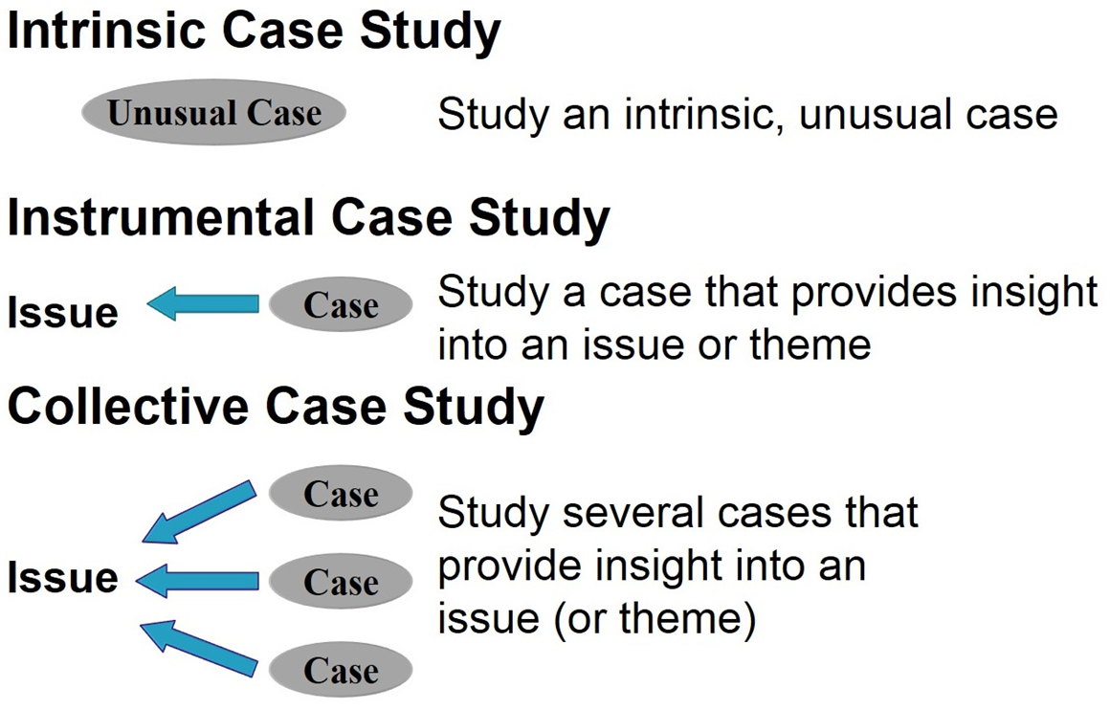
Figure 14.1 Types of Qualitative Case Studies

Slide 11
What Are the Types of Ethnographic Design? (2 of 3)
Critical Ethnographies
Used by politically minded researchers
Advocate against inequality and domination
Seek to empower people
Value laden orientation
Challenge status quo
Concerned about power and control

Slide 12
What Are the Types of Ethnographic Design? (3 of 3)
Critical Ethnographies
Social issues include power, empowerment, inequity, dominance, repression, hegemony, victimization
Collaborate actively with participants and negotiate final report
Self-conscious about their own interpretation
Reflexive and self-aware of their role
Non-neutral position of researcher
Uses contradictions, imponderables, and tension (Denzin, 1997)

Slide 13
What are the Key Characteristics of Ethnographic Research? (1 of 9)
Cultural themes from cultural anthropology
A culture-sharing group
Examination of shared patterns of behavior, belief, and language
Data collection through fieldwork
Description, themes, interpretation
Context is the setting, situation, or environment
Researcher reflexivity

Slide 14
What are the Key Characteristics of Ethnographic Research? (2 of 9)
Cultural Themes
Cultural Theme: General position, declared or implied, that is openly approved or promoted in a society or group
Drawn from cultural anthropology or literature
Found in purpose statements or research questions as a central phenomenon
Examples:
Persistence
Identity development
Social skills
Enculturation

Slide 15
What are the Key Characteristics of Ethnographic Research? (3 of 9)
A Culture-Sharing Group
Two more individuals who have shared
Behaviors
Beliefs
Language
Groups vary in size
Individuals meet on regular basis
Individuals interact over a period of time
Representative of a larger group

Slide 16
Table 14.2 Study of a Culture-Sharing Group in a Third-Grade Elementary Classroom
Characteristics of a Culture-Sharing Group | An Example
The group consists of two or more individuals, and it may be small or large. | A small group—two readers in a classroom. A larger group—6 to 10 readers in a classroom.
The group interacts on a regular basis. | For a period three times a week, the group meets to discuss a reading.
The group has interacted for some time. | Since the beginning of September, the reading group has met three times a week for three periods.
The group is representative of some larger group. | The small reading group is representative of third-grade readers.
The group has adopted some shared patterns of behaving, thinking, or talking. | The group has certain rituals they perform as they begin to read, such as sitting on the floor, opening their book to the assigned page, and waiting to speak until the teacher calls on them to answer a question.

Slide 17
What are the Key Characteristics of Ethnographic Research? (4 of 9)
Shared Patterns of Behavior, Belief, and Language
A shared pattern is a common social interaction that stabilizes as tacit rules and expectations of the group
Behavior: action taken by an individual in a cultural setting
Belief: how an individual thinks or perceives things in a cultural setting
Language: how an individual talks to others in a cultural setting

Slide 18
What are the Key Characteristics of Ethnographic Research? (5 of 9)
Shared Patterns of Behavior, Belief, and Language
Types of patterns
Ideal: What should occur
Actual: What did occur
Projective: What might have occurred

Slide 19
What are the Key Characteristics of Ethnographic Research? (6 of 9)
Fieldwork
Fieldwork: The researcher gathers data in the setting where the participants are located and where their shared patterns can be studied
Types of data
Emic data: supplied by the participants
Etic data: ethnographer’s interpretation of participant’s perspectives
Negotiation data: information participants and researcher agree to use in a study
Popular forms of data: observations, interviews, documents

Slide 20
What are the Key Characteristics of Ethnographic Research? (7 of 9)
Description, Themes, and Interpretation
Description: Detailed rendering of individuals and scenes to depict what is going on in the culture-sharing group (detailed, thick, rich)
Themes: How things work and naming the essential features in themes in the cultural setting (shared patterns of behavior, thinking, talking)
Interpretation:
Inferences and conclusions about what was learned
Relates descriptions and themes back to what was learned

Slide 21
Figure 14.2 Broad-to-Narrow Description in the Gunman Incident Case Study
From a broad description to a specific description: The Gunman Case Study
Brad description of the setting of the case
The town where the event occurred
Narrower description of the setting of the case
The building on the campus where the event occurred
Narrower yet description of the setting of the case
The classroom where the event occurred
Narrower yet description of the students in the case
The “gunman” and the students in the class

Slide 22
What are the Key Characteristics of Ethnographic Research? (8 of 9)
Context or Setting
Setting, situation, or environment that surrounds the cultural group being studied
History, religion, politics, economy, the environment

Slide 23
What are the Key Characteristics of Ethnographic Research? (9 of 9)
Researcher Reflexivity
Researchers
Openly discuss role in the study
Respect the participants and sites
Talk about themselves
Share their experiences
Identify how their interpretations shape their discussions about sites and groups

Slide 24
Ethical Issues in Conducting Ethnographic Research
Need to be open and transparent about gathering data
Need to study participants and sites respectfully
Need to have a responsibility to the scholarly community (e.g., falsifying evidence)
Need to give back to participants
Need to be aware of potential negative influences of presentations and publications

Slide 25
Table 14.4 Procedures for Conducting a Realist Ethnography, a Case Study, and a Critical Ethnography (1 of 4)
Procedures | Realist Ethnography | Case Study | Critical Ethnography
Identify your intent, the appropriate design, and how intent relates to your research problem. | The problem relates to a culture-sharing group and how it works. The problem requires a detailed description of the daily lives of people. The problem relates to understanding a cultural theme. Identify your cultural theme. | The problem relates to developing an in-depth understanding of a “case” or bounded system. The problem relates to understanding an event, activity, process, or one or more individuals. Identify the type of “case,” such as intrinsic, instrumental, or collective. | The problem relates to a need to address inequities in our society or schools. The problem calls for action and advocacy. Identify the “critical” issue (e.g., inequality) that you wish to explore.

Slide 26
Table 14.4 Procedures for Conducting a Realist Ethnography, a Case Study, and a Critical Ethnography (2 of 4)
Procedures | Realist Ethnography | Case Study | Critical Ethnography
Discuss how you plan to receive approval and gain access to study sites and participants. | Receive approval from institutional review board. Locate a research site using purposeful sampling procedures. Identify a gatekeeper to provide access. Guarantee provisions for respecting the site. | Receive approval from institutional review board. Locate a research site using purposeful sampling procedures. Identify how many cases you plan to study. Identify a gatekeeper to provide access. Guarantee provisions for respecting the site. | Receive approval from institutional review board. Locate a research site using purposeful sampling procedures. Identify a gatekeeper to provide access. Guarantee provisions for respecting the site.
Collect appropriate data, emphasizing time in the field, multiple sources of information, and collaboration. | Spend extensive time at the site and with the culture-sharing group. Enter the site slowly and build rapport. Plan to reciprocate for data provided. Emphasize observations and record field notes. | Collect extensive data using multiple forms of data collection (observations, interviews, documents, and audiovisual materials). | Collaborate with participants by actively involving them in data collection. Collect multiple forms of data that individuals are willing to provide.

Slide 27
Table 14.4 Procedures for Conducting a Realist Ethnography, a Case Study, and a Critical Ethnography (3 of 4)
Procedures | Realist Ethnography | Case Study | Critical Ethnography
Analyze and interpret your data within a design. | Read through data to develop an overall understanding of it. Develop a detailed description of the cultural setting to establish a context for the group being studied. Develop themes about the culture-sharing group. Make interpretations in view of the cultural theme you are studying. | Read through data to develop an overall understanding of it. Describe the case(s) in detail and establish a context for it. Develop issues or themes about the case(s). If more than one case is studied, consider a within-case analysis followed by a cross-case analysis. | Read through data to develop an overall understanding of it. Develop a detailed description of the cultural setting to establish a context for the group being studied. Develop themes that relate to the “critical” issues being explored in the ethnography. Identify changes that need to occur, advocate for specific changes, and advance a plan for change.

Slide 28
Table 14.4 Procedures for Conducting a Realist Ethnography, a Case Study, and a Critical Ethnography (4 of 4)
Procedures | Realist Ethnography | Case Study | Critical Ethnography
Write and report your research so it is consistent with your design. | Report it as an objective study. As a researcher, remain in the background within the written report. Keep your biases out. Identify how your exploration of the cultural theme advances knowledge. | Report it based primarily on a description of the case, or weigh the description, analysis, and interpretation differently or equally. Choose to be objective or subjective in your reporting. Include your biases. Generalize to other cases. | Report it as a call to action to address the “critical” issue that you are studying. Include a specific plan of action for change based on your findings. Discuss how you, as well as those you studied, changed (be reflexive).

Slide 29
What are the Steps in Conducting an Ethnography? (1 of 2)
Spradley’s developmental research sequence begins with the researchers locating an informant (participants)
Highly structured approach
Cycles between collecting data and making analyses of various type
Also consider a set of steps as a general template

Slide 30
What are the Steps in Conducting an Ethnography? (2 of 2)
Identify intent and type of design and relate intent to your research problem
Discuss approval and access considerations
Use appropriate data collection procedures depending on design
Analyze and interpret data within a design
Write report consistent with your design

Slide 31
How do you Evaluate an Ethnography? (1 of 2)
The ethnographer
Identifies a culture sharing group or case for study
Focuses on understanding cultural concept
Seeks to learn how the culture-sharing group establishes patterns of behavior, language, and beliefs over time

Slide 32
How do you Evaluate an Ethnography? (2 of 2)
The ethnographer
Analyzes multiple sources of data including interviews and observations for patterns
Presents an analysis of the data through description, theme development, and interpretations as to how the culture-sharing group works
Reflects on their role in the study and how it shapes their interpretation

Slide 33

Copyright

