Slide 1

Educational Research: Planning, Conducting, and Evaluating Quantitative and Qualitative Research
Sixth Edition
Chapter 15
Narrative Research Designs
Copyright © 2019, 2015, 2012 Pearson Education, Inc. All Rights Reserved
Notes:
If this PowerPoint presentation contains mathematical equations, you may need to check that your computer has the following installed:
1) MathType Plugin
2) Math Player (free versions available)
3) NVDA Reader (free versions available)

Slide 2
Learning Objectives
15.1 Describe narrative research, and describe when to use it, and how it developed
15.2 Identify the types of narrative designs
15.3 Describe the key characteristics of narrative designs
15.4 Identify some potential ethical issues in gathering stories
15.5 Understand the steps used in conducting narrative research
15.6 List criteria for evaluating a narrative study

Slide 3
What is Narrative Research, When Do You Use It, and How Did It Develop? (1 of 3)
Narrative research: describe the lives of individuals, collect and tell stories about people’s lives, and write narratives of individual experiences
Narrative focuses on
studying a single person
gathering data through the collection of stories
reporting individual experiences
discussing the meaning of those experiences for the individual

Slide 4
What is Narrative Research, When Do You Use It, and How Did It Develop? (2 of 3)
When Do You Use Narrative Research?
When individuals:
Are willing to tell their stories
Want their story to be heard
When you:
Want to report personal experiences in a particular setting
Want a close bond with participants
Have a chronology of events
Want to write in a persuasive, literary form

Slide 5
What is Narrative Research, When Do You Use It, and How Did It Develop? (3 of 3)
How Did Narrative Research Develop?
1990 Clandinin and Connelly provided first overview of narrative research in education
Trends influencing the development of narrative research
Increased emphasis on teacher reflection
Emphasis placed on teachers’ knowledge
Attempt to bring teachers’ voices to the forefront

Slide 6
What Are the Types of Narrative Design? (1 of 6)
Who writes or records the story? (biography, autobiography)
How much of a life is recorded or presented? (life history, personal experience story)
Who provides the story? (e.g., teachers’ stories)
Is a theoretical lens being used? (ideology that provides structure)
When can narrative forms be combined? (biography and personal account)

Slide 7
What Are the Types of Narrative Design? (2 of 6)
Who Writes or Records the Story?
Distinguishes narrative studies
Biography: form of narrative study in which the researcher writes and records the experiences of another person’s life
Autobiography: individual who is the subject of the study writes the account

Slide 8
What Are the Types of Narrative Design? (3 of 6)
How Much of a Life Is Recorded and Presented?
Life history: narrative story of the entire life experiences of a person
Focus on turning points or significant events
Personal experience story: individual’s personal experience found in single or multiple episodes, private situations, or communal folklore
May be individual or social

Slide 9
What Are the Types of Narrative Design? (4 of 6)
Who Provides the Story?
Different individuals in the setting can provide the story
Accounts of professionals (teachers, educators, nurses, counselors, etc.)
Accounts of children

Slide 10
What Are the Types of Narrative Design? (5 of 6)
Is a Theoretical Lens Being Used?
Theoretical lens: guiding perspective or ideology that provides structure for advocating for groups or individuals in the written report
Lens may be to advocate
Testimonies
Stories of women through feminist lens
Stories of marginalized individuals
Provide voice for those seldom heard

Slide 11
What Are the Types of Narrative Design? (6 of 6)
Can Narrative Forms Be Combined?
Possible to have different elements
Example
Biographical and a personal study of an educator
Also addresses life event of someone who decides to leave their profession
Might also include a feminist narrative to examine power and control issues

Slide 12
What Are the Key Characteristics of Narrative Design? (1 of 10)
Individual experiences
Chronology of the experiences
Collecting individual stories
Restorying
Coding for themes
Context or setting
Collaboration with participants

Slide 13
Table 15.1 The Research Process, Qualitative Characteristics, and Narrative Research Characteristics (1 of 5)
The Research Process | Qualitative Characteristics | Narrative Research Characteristics
Identify a research problem | A qualitative problem requires exploration and understanding. | Seeks to understand and represent experiences through the stories individual(s) live and tell.
Review the literature | The qualitative literature plays a minor role. The qualitative literature justifies the research problem. | Seeks to minimize the use of literature and focuses on the experiences of the individual(s).

Slide 14
Table 15.1 The Research Process, Qualitative Characteristics, and Narrative Research Characteristics (2 of 5)
The Research Process | Qualitative Characteristics | Narrative Research Characteristics
Develop a purpose statement and research questions | The qualitative purpose statement and research questions are broad and general. The qualitative purpose statement and research questions seek participants’ experiences. | Seeks to explore the meaning of the individual’s experiences as told through a story or stories.

Slide 15
Table 15.1 The Research Process, Qualitative Characteristics, and Narrative Research Characteristics (3 of 5)
The Research Process | Qualitative Characteristics | Narrative Research Characteristics
Collect qualitative data | Qualitative data collection is based on using protocols developed during the study. Qualitative data collection involves gathering text or image data. Qualitative data collection involves studying a small number of individuals or sites. | Seeks to collect field texts that document the individual’s story in his or her own words.

Slide 16
Table 15.1 The Research Process, Qualitative Characteristics, and Narrative Research Characteristics (4 of 5)
The Research Process | Qualitative Characteristics | Narrative Research Characteristics
Analyze / interpret qualitative data | Qualitative data analysis consists of text analysis. Qualitative data analysis consists of describing information and of developing themes. | Seeks to analyze the stories by retelling the individual’s story. Seeks to analyze the stories by identifying themes or categories of information. Seeks to situate the story within its place or setting. Seeks to analyze the story for chronological information about the individual’s past, present, and future.

Slide 17
Table 15.1 The Research Process, Qualitative Characteristics, and Narrative Research Characteristics (5 of 5)
The Research Process | Qualitative Characteristics | Narrative Research Characteristics
Write and evaluate a study | Qualitative research reports use flexible and emerging structures and evaluation criteria. Qualitative researchers take a reflexive and biased approach. | Seeks to collaborate with the participant when writing the research study. Seeks to write the study in a flexible storytelling mode. Seeks to evaluate the study based on the depth, accuracy, persuasiveness, and realism of the account.

Slide 18
What Are the Key Characteristics of Narrative Design? (2 of 10)
Individual Experiences
The narrative researcher
Explores experiences of a single individual typically
Is interested in understanding individual history and how it contributes to present and future experiences
Is also interested in how the individual interacts with others

Slide 19
What Are the Key Characteristics of Narrative Design? (3 of 10)
Chronology of the Experiences
The narrative researcher
Analyzes and reports a chronology of an individual’s experiences
Emphasizes the chronology of an individual’s life using a time sequence of events

Slide 20
What Are the Key Characteristics of Narrative Design? (4 of 10)
Collecting Individual Stories
Story: first-person oral telling or retelling of an individual’s experiences
Stories:
Have a beginning, middle, and end
Involve a predicament, conflict, or struggle; a protagonist or character; and a sequence with implied causality (a plot) during which the predicament is resolved in some fashion
Like novels, have time, place, plot, and scene
Field texts: information collected from different sources

Slide 21
What Are the Key Characteristics of Narrative Design? (5 of 10)
Restorying
Restorying the individual stories
Researcher gathers stories and analyzes them for elements of the story.
Researcher rewrites the story to place it in a chronological sequence.
Restorying provides a causal link among ideas.
Information would include interaction, continuity, and situation.

Slide 22
What Are the Key Characteristics of Narrative Design? (6 of 10)
Restorying
Transcription
Conducts the interview and transcribes the recording
Retranscription
Identifies the story’s key elements (setting, characters, actions, problem, and resolution) from the transcript
Restorying
Organizes the key codes into a sequence

Slide 23
What Are the Key Characteristics of Narrative Design? (7 of 10)
Restorying
Setting: Context, environment, conditions, time, place locale, year, and era
Characters: Individuals in the story described as archetypes, personalities, their behaviors, style, and patterns
Actions: Movements of individuals through the story illustrating characters’ thinking or behavior
Problem: Questions to be answered
Resolution: Answers to the questions

Slide 24
Table 15.4 Three-Dimensional-Space Narrative Structure
Interaction | Interaction | Continuity | Continuity | Continuity | Situation
Personal | Social | Past | Present | Future | Place
Look inward to internal conditions, feelings, hopes, aesthetic reactions, moral dispositions | Look outward to existential conditions in the environment with other people and their intentions, purposes, assumption, and points of view | Look backward to remembered stories and experiences from earlier times | Look at current stories and experiences relating to actions of an event | Look forward to implied and possible experiences and plotlines | Look at context, time, and place situated in a physical landscape or in a setting bounded by characters’ intentions, purposes, and different points of view

Slide 25
What Are the Key Characteristics of Narrative Design? (8 of 10)
Coding for Themes
Themes
Provide the complexity of the story
Add depth to the insight about understanding an individual’s experiences
Can be incorporated into the passage retelling the individual’s experience or as a separate section of the study

Slide 26
What Are the Key Characteristics of Narrative Design? (9 of 10)
Context or Setting
Describes the context or setting for the individual stories:
Includes the people involved in the story
Includes the physical setting
Setting may be described before events or actions, or can be woven throughout the study

Slide 27
What Are the Key Characteristics of Narrative Design? (10 of 10)
Collaborating with Participants
Collaboration: Inquirer actively involves the participant in the inquiry as it unfolds
Strategies
Negotiating relationships
Explaining the purpose of the inquiry
Negotiating transitions in the research process
Arranging ways to intermingle with participants

Slide 28
What Are Some Potential Ethical Issues in Gathering Stories?
Is the story authentic? (“Faking the data” is possible.)
Is the story “real”? (Participants may not be able to tell the “real story.”)
Who “owns” the story? (Does the researcher have permission to share it?)
Is participant’s voice lost?
Does the researcher gain at the expense of the participant?

Slide 29
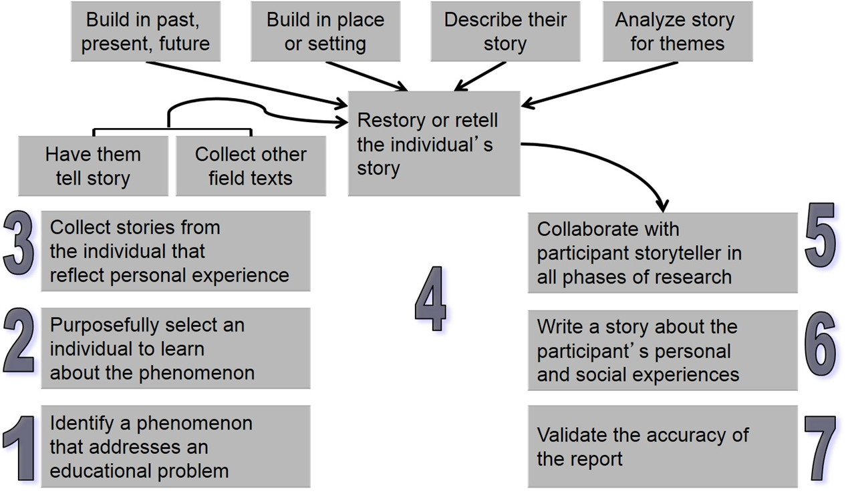
Figure 15.3 Steps in Conducting Narrative Research

Slide 30
What Are the Steps in Conducting Narrative Research? (1 of 7)
Step 1. Identify a Phenomenon to Explore That Addresses an Educational Problem
Process begins by focusing on a research problem to study and identifying, in qualitative research, a central phenomenon to explore
Identify an issue or concern
Example
Stories about teachers having difficulty meeting diverse needs of students
Understand personal or social experiences of one or more individuals

Slide 31
What Are the Steps in Conducting Narrative Research? (2 of 7)
Step 2. Purposefully Select an Individual from Whom You Can Learn about the Phenomenon
Who can provide understanding of phenomenon?
Typical individual
Someone who is critical to study because of experiences
My gather stories from several individuals

Slide 32
What Are the Steps in Conducting Narrative Research? (3 of 7)
Step 3. Collect the Story from That Individual
Have the individual record story in a journal or diary
Observe the individual and record field notes
Collect letters sent by the individual
Assemble stories about the individual from family members
Gather documents, such as memos or official correspondence, about the individual
Obtain photographs, memory boxes, and other personal/family/social artifacts
Record the individual’s life experiences

Slide 33
What Are the Steps in Conducting Narrative Research? (4 of 7)
Step 4. Restory or Retell the Individual’s Story
Examine raw data (individuals do not often tell in order)
Identify elements of story
Sequence the elements into story to present
Might present time, place, plot (events or actions), and scene

Slide 34
What Are the Steps in Conducting Narrative Research? (5 of 7)
Step 5. Collaborate with the Participant–Storyteller
Interacts with all other steps
Actively work with participant during process
Entry to site and participant
Obtain field texts
Write and tell

Slide 35
What Are the Steps in Conducting Narrative Research? (6 of 7)
Step 6. Write a Story about the Participant’s Experiences
Include features of narrative for reader to better understand
Analysis to highlight themes
Incorporate literature into final sections

Slide 36
What Are the Steps in Conducting Narrative Research? (7 of 7)
Step 7. Validate the Accuracy of the Report
Collaborating with participants
Member checking
Triangulating data sources
Searching for disconfirming evidence

Slide 37
How do You Evaluate Narrative Research?
The researcher
Focuses on a single individual or two
Reports life experiences of individuals through their stories
Takes stories and restories them, possibly developing a chronology of events
Describes the context of the story, setting, and people involved in the final report
Reports themes that arise out of the story
Collaborates with participants

Slide 38

Copyright

