Slide 1

Educational Research: Planning, Conducting, and Evaluating Quantitative and Qualitative Research
Sixth Edition
Chapter 16
Mixed Methods Designs
Copyright © 2019, 2015, 2012 Pearson Education, Inc. All Rights Reserved
Notes:
If this PowerPoint presentation contains mathematical equations, you may need to check that your computer has the following installed:
1) MathType Plugin
2) Math Player (free versions available)
3) NVDA Reader (free versions available)

Slide 2
Learning Objectives
16.1 Describe mixed methods, its use, and its development
16.2 Identify the major types of mixed methods designs
16.3 Describe the key characteristics of mixed methods research
16.4 Identify some potential ethical issues in mixed methods research
16.5 Understand the steps using in conducting mixed methods research
16.6 List criteria for evaluating a mixed methods study

Slide 3
What is Mixed Methods Research, When is It Used, and How Did It Develop? (1 of 9)
A mixed methods research design is a procedure for collecting, analyzing, and “mixing” both quantitative and qualitative methods in a single study or a series of studies to understand a research problem.

Slide 4
What is Mixed Methods Research, When is It Used, and How Did It Develop? (2 of 9)
When Do You Conduct a Mixed Methods Study?
When you have both quantitative and qualitative data
When both will provide a better understanding of your research problem than either type by itself
When you want to build on the strengths of either quantitative or qualitative research
When one type of research (qualitative or quantitative) is not enough to address the research problem or questions
When you want alternative perspectives
When you want to experience the latest research approach

Slide 5
What is Mixed Methods Research, When is It Used, and How Did It Develop? (3 of 9)
How Did Mixed Methods Research Develop?
Mixing forms of quantitative data
Combing quantitative and qualitative data (triangulation of data)
Questioning the integration of worldviews and methods – the paradigm debate
Developing procedures for mixed methods studies
Advocating for mixed methods as a separate and distinct design
Reflective period: assessment and mapping of the field, constructive criticism, expansion to disciplines and countries throughout the world

Slide 6
What is Mixed Methods Research, When is It Used, and How Did It Develop? (4 of 9)
How Did Mixed Methods Research Develop? Mixing Forms of Quantitative Data
Collecting multiple types of data
Multitrait, multimethod approach to examine psychological traits (Campbell & Fiske, 1959)
If measures correlated, trait considered valid
Encouraged researchers to collect more than one type of data

Slide 7
What is Mixed Methods Research, When is It Used, and How Did It Develop? (5 of 9)
How Did Mixed Methods Research Develop? Combining Quantitative and Qualitative Data
Early studies combined case studies with surveys
Examples:
Jick (1979) combined surveys with interviews, observations, archival material to understand anxiety and job insecurity
Augment qualitative observations within a quantitative survey for a more complete understanding of leadership in an organization

Slide 8
What is Mixed Methods Research, When is It Used, and How Did It Develop? (6 of 9)
How Did Mixed Methods Research Develop? Questioning the Integration of Worldviews and Methods
Arose because of different philosophical assumptions underlying qualitative and quantitative research
Paradigm debates through late 1980s and early 1990s
Pragmatism developed as a way to use procedures that work to best understand a research problem
Dialectical pluralism urges researchers to engage with differences across disciplines, paradigms, theories, and stakeholders

Slide 9
What is Mixed Methods Research, When is It Used, and How Did It Develop? (7 of 9)
How Did Mixed Methods Research Develop? Developing Procedures for Mixed Methods Studies
Purposes for mixed methods research
To understand a phenomenon and research problem
To use one data source to enhance, elaborate, or complement another
To collect data at multiple levels (district, school, teacher, and student)
Embedding one form of data

Slide 10
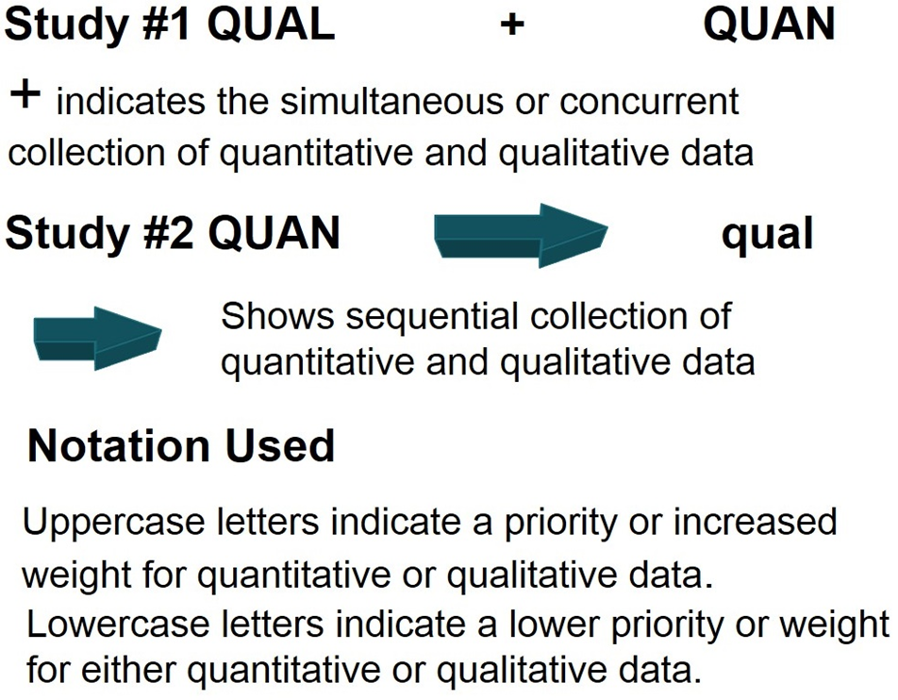
Figure 16.1 Notation System for a Mixed Methods Study

Slide 11
What is Mixed Methods Research, When is It Used, and How Did It Develop? (8 of 9)
How Did Mixed Methods Research Develop? Advocating for a Distinct Design
Viewing mixed methods as a distinct design along with experiments, grounded theory, etc.
Refinements in the process of analysis
The use of computer program for merging data

Slide 12
What is Mixed Methods Research, When is It Used, and How Did It Develop? (9 of 9)
How Did Mixed Methods Research Develop? Reflective Period
In 2010s, current assessment or mapping the field
Constructive criticism and reassessment
Expansion across many disciplines and countries
Growth in social and health sciences including increased funding
Journal of Mixed Methods Research
Mixed Methods International Research Association (mmira.org) as scholarly community

Slide 13
What Are the Types of Mixed Methods Designs? (1 of 15)
To identify a mixed methods study
Look for evidence in the title
In the methods section, determine if quantitative and qualitative data are collected
Examine the purpose statement and research questions for the intent to use both quantitative and qualitative data

Slide 14
What Are the Types of Mixed Methods Designs? (2 of 15)
To determine the mixed methods design:
What is the intent for combining quantitative and qualitative data?
Compare, validate one with the other, gain more complete understanding
What is the sequence of collecting qualitative and quantitative data?
Qualitative (or quantitative) comes first or concurrently
What priority or weight does the researcher give to the quantitative and quantitative data?
One is emphasized or equal emphasis

Slide 15
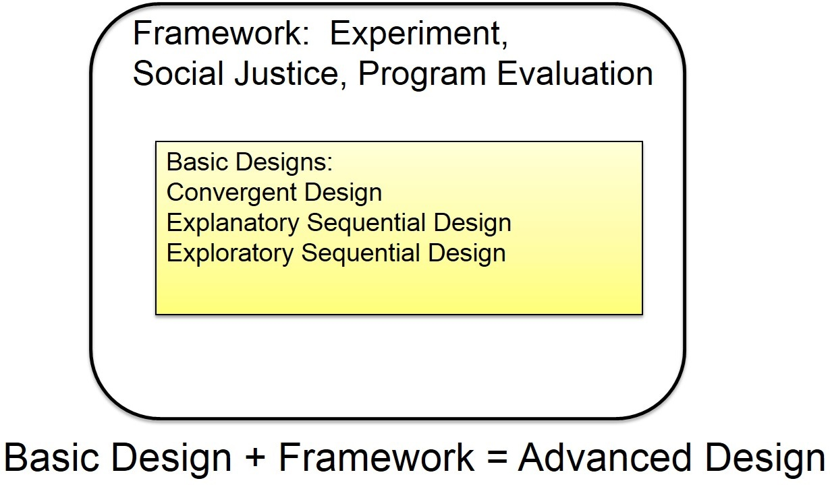
Figure 16.2 Mixed Methods Basic and Advanced Designs

Slide 16
What Are the Types of Mixed Methods Designs? (3 of 15)
The basic designs
The convergent design
The explanatory sequential design
The exploratory sequential design
The complex (advanced) designs
The experimental design
The social justice design
The multistage evaluation design

Slide 17
What Are the Types of Mixed Methods Designs? (4 of 15)
The Convergent Design
Collect both qualitative and quantitative data at the same time, merge the data, compare results, explain discrepancies
Both forms have strengths and weaknesses
Quantitative data is generalizable, but lacks detail
Qualitative data gives detailed understanding, but small sample
Advantage: combining strengths of each form
Challenge: how to integrate and dealing with divergence

Slide 18
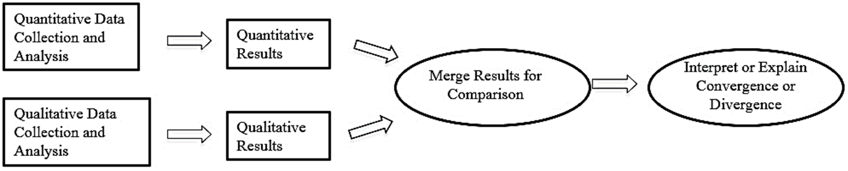
Figure 16.3 Basic Mixed Methods Designs: Convergent Design
Intent: to compare quantitative and qualitative results
Priority: equal to quantitative (Q U A N) and qualitative (Q U A L)
Collect quantitative and qualitative data concurrently
Compares the results to determine similarity/disimilarity

Slide 19
What Are the Types of Mixed Methods Designs? (5 of 15)
The Convergent Design
Example:
Guetterman and Mitchell (2016) examined role of leadership and culture in promoting faculty assessment practices
Quantitative outcomes measured pre-post, Anova test
Qualitative sources from surveys, written responses
Integrating gave context about how faculty view assessment and learn from it

Slide 20
What Are the Types of Mixed Methods Designs? (6 of 15)
The Explanatory Sequential Design
Two phase model
First collect quantitative data then gather qualitative data to help explain or elaborate
Advantage: clearly identified qualitative and quantitative pieces, does not converge the two forms
Challenge: determine what aspects of quantitative results to follow-up, deciding participants to sample

Slide 21
Figure 16.3 Basic Mixed Methods Designs: Explanatory Sequential Design
Intent: explain quantitative results with qualitative data.
Priority: quantitative (Q U A N)
Collects quantitative data first in the sequence
Use the qualitative data to refine the results of the quantitative data

Slide 22
What Are the Types of Mixed Methods Designs? (7 of 15)
The Explanatory Sequential Design
Example:
Ivankova and Stick (2007) examined factors contributing to persistence in an online doctoral program in educational leadership
Quantitative survey from current and former students
Qualitative case study with four respondents to explore results in detail

Slide 23
What Are the Types of Mixed Methods Designs? (8 of 15)
The Exploratory Sequential Design
Begins with qualitative data to explore a phenomenon and then collects quantitative data
2 or 3 phases
Often used to design and test instruments
Used when existing instruments not known or available
Advantage: identify measures grounded in data
Challenge: requires extensive data collection, time required, how to use qualitative data appropriately

Slide 24
Figure 16.3 Basic Mixed Methods Designs: Exploratory Sequential Design
Intent: first explore qualitatively to determine questions to ask, variables to measure, and people to ask
Priority: qualitative (Q U A L)
Sequence involves first collecting qualitative data followed by quantitative data
Use quantitative data to build on or explain the initial qualitative findings

Slide 25
What Are the Types of Mixed Methods Designs? (9 of 15)
The Exploratory Sequential Design
Example:
Crede and Borego examined retention of graduate engineering students
First, ethnographic qualitative study with observations and interviews
Systematically used themes to identify quantitative constructs and develop survey items
Tested the survey to gather validity evidence and reliability

Slide 26
What Are the Types of Mixed Methods Designs? (10 of 15)
The Experimental Design
Encase basic mixed methods designs within an experiment
Advantage: emphasis on quantitative approach may appeal to some fields
Challenge: have clear intent of secondary databases, may be hard to compare

Slide 27
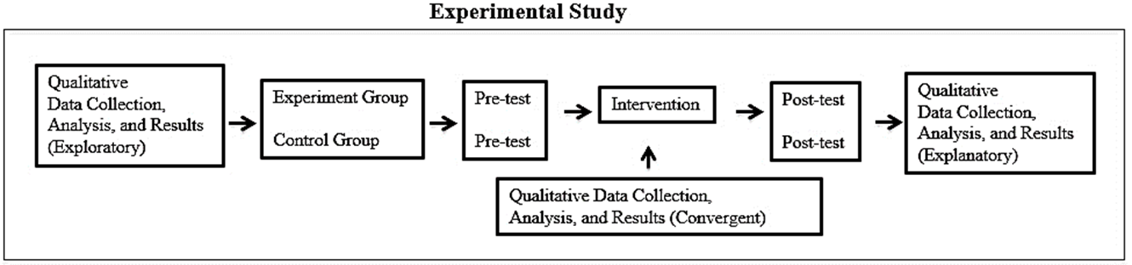
Figure 16.4 Complex Mixed Methods Designs: Experimental Mixed Methods Design
Intent: add qualitative data into an experiment, either before it begins, during, or after it concludes
Priority: to the major form of data collection and secondary status to the supportive form
Collect data either concurrently or sequentially
Use secondary form of data to augment the primary

Slide 28
What Are the Types of Mixed Methods Designs? (11 of 15)
The Experimental Design
Example:
Kron et al. (2017) conducted mixed methods randomized trial of a medical education intervention
Quantitative outcomes through measures of skills and attitudes
Qualitative process through gathering observations and written reflection about experiences
Integrated forms to understand outcomes in light of processes and experiences of students

Slide 29
What Are the Types of Mixed Methods Designs? (12 of 15)
The Social Justice Design
A framework to transform society or address injustice encases the basic designs
Frameworks include feminist, racial, ethnic, disability, gay, or lesbian perspectives
Participation of marginalized groups or communities
Advantage: value-based and ideological
Challenge: how to best integrate into a mixed methods study

Slide 30
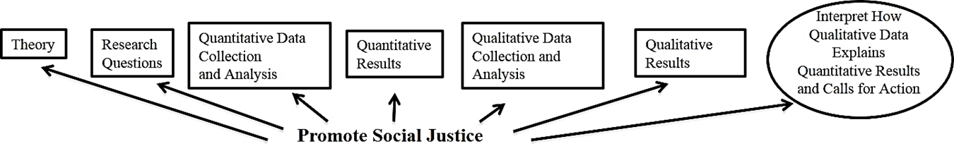
Figure 16.4 Complex Mixed Methods Designs: Social Justice Design (using an Explanatory Sequential Design example)
Intent: conduct the study within a framework to address a social justice issue
Use a convergent, explanatory, or exploratory design
Use an overall orientating lens (e.g., feminist) as a transformative framework
Call for change that will address the social issue for the group under study

Slide 31
What Are the Types of Mixed Methods Designs? (13 of 15)
The Social Justice Design
Example:
Buck, Cook, Quigley, Eastwood, and Lucas (2009) used a feminist lens to study African American girls orientations towards learning science
Begins with theoretical framework from feminist researchers
Quantitative phase of attitudes measured with inventory
Qualitative second phase of focus groups with girls
Ended with call for reforming instructional strategies

Slide 32
What Are the Types of Mixed Methods Designs? (14 of 15)
Multistage Evaluation Design
Evaluate impact of a program or project
Formative and summative evaluation consisting of needs assessment, conceptualization or theory, instruments, test of program, and revisions
Common in large scale health research and program evaluation
Challenges: forming a team, ensuring stages link together, having all studies provide insight

Slide 33
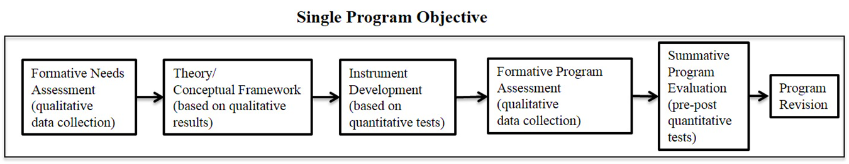
Figure 16.4 Complex Mixed Methods Designs: Multistage Evaluation Design (using an Exploratory Sequential Design example)
Use a convergent, explanatory, or exploratory design in multiple stages in the program implementation
Need to clearly identify stages that help address a larger program objective
Need to interrelate the different stages to address a common research objective

Slide 34
What Are the Types of Mixed Methods Designs? (15 of 15)
Multistage Evaluation Design
Example:
Nastasi et al. (2007) had a program development research study of culture-specific definitions of mental health constructs for adolescents in Sri Lanka
Twelve phases with formative research, instrument development, program development, and evaluation research
Combined quantitative and qualitative research at phases

Slide 35
What Are the Key Characteristics of Mixed Methods Designs? (1 of 9)
Collect and analyze quantitative and qualitative data
Use rigorous methods
Integrate through merging, connecting, building, or embedding
Use a specific mixed methods design
Frame the study (often) within a theory and philosophy
Give priority to qualitative, quantitative, or both
Consider sequence
Diagram the procedures

Slide 36
What Are the Key Characteristics of Mixed Methods Designs? (2 of 9)
Collect and Analyze Quantitative and Qualitative Data
Quantitative data (closed-ended), such as on instruments
Qualitative data (open-ended), such as in open-ended interviews or observations

Slide 37
What Are the Key Characteristics of Mixed Methods Designs? (3 of 9)
Use Rigorous Methods
Data collection features: sampling, recruitment, sample size, identify forms of data collection, recording, transcribing, and storing data.
Analysis steps: cleaning the database, initial analysis, advanced analysis.
In some cases, involve community of stakeholders.

Slide 38
Table 16.1 Quantitative and Qualitative Methods of Data Collection and Types of Data
Quantitative Research
Qualitative Research
Methods of Data Collection | Data
Instruments (e.g., questionnaire, closed-ended interview, closed-ended observation) | Numeric scores
Documents (e.g., census or attendance records) | Numeric scores
Methods of Data Collection | Data
Open-ended interviews | Text data from transcribed interviews
Open-ended questions on questionnaires | Text data transcribed from questionnaires
Open-ended observations | Field notes (text) from researcher’s notes
Documents (e.g., private or public) | Text data optically scanned from diaries, journals, letters, or official documents

Slide 39
What Are the Key Characteristics of Mixed Methods Designs? (4 of 9)
Integration (Combining the Databases)
Merging as in a convergent design, such as comparing results or arraying data in a table.
Connecting as in an explanatory design, such as from quantitative results to follow-up interviews.
Building as in an exploratory design, such as from qualitative exploration to an instrument.
Embedding as in an experimental design.
Joint displays as visual representations of integration.

Slide 40
What Are the Key Characteristics of Mixed Methods Designs? (5 of 9)
Use a Specific Mixed Methods Design
The intent of the researcher (e.g., to merge data)
The researcher’s familiarity with the designs
The time and resources available
The designs that are popular in the researcher’s field

Slide 41
What Are the Key Characteristics of Mixed Methods Designs? (6 of 9)
Frame the Study within Theory and Philosophy
Social science theories (e.g., a mentoring theory)
Social justice theories (e.g., feminist perspective)
Identify the worldview and philosophy the researcher is using (e.g., pragmatism)

Slide 42
What Are the Key Characteristics of Mixed Methods Designs? (7 of 9)
Give Priority to Either Quantitative or Qualitative Research or Both
What does the researcher emphasize in the purpose statement?
Which data collection process does the researcher give the most attention?
Which data collection process does the researcher examine in the most depth?

Slide 43
What Are the Key Characteristics of Mixed Methods Designs? (8 of 9)
Sequence the Quantitative and Qualitative Methods
Collect both quantitative and qualitative data at the same time
Collect quantitative data first, followed by qualitative data
Collect qualitative data first, followed by quantitative data
Collect both quantitative and qualitative data at the same time and in sequence

Slide 44
What Are the Key Characteristics of Mixed Methods Designs? (9 of 9)
Diagram the Procedures
Visualization: diagram of design depicting the procedures
Indicates the process of data collection, analysis, and interpretation
Diagram of procedures
Use notation system
Label quantitative and qualitative data
Identify priority
Identify sequence

Slide 45
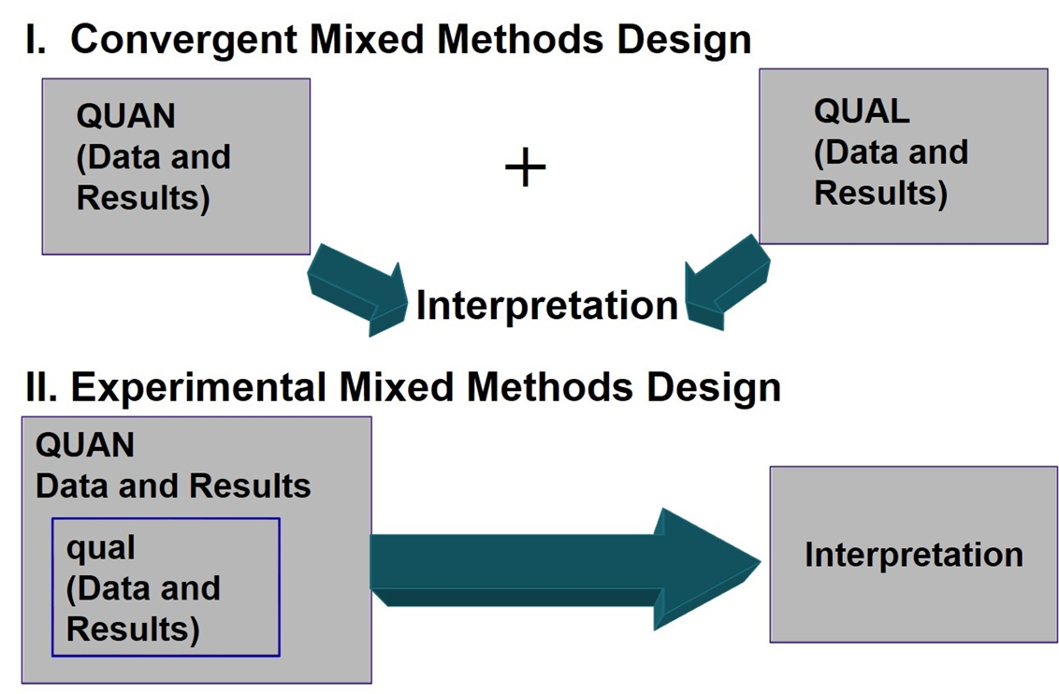
Examples of Visual Diagrams (1 of 2)

Slide 46
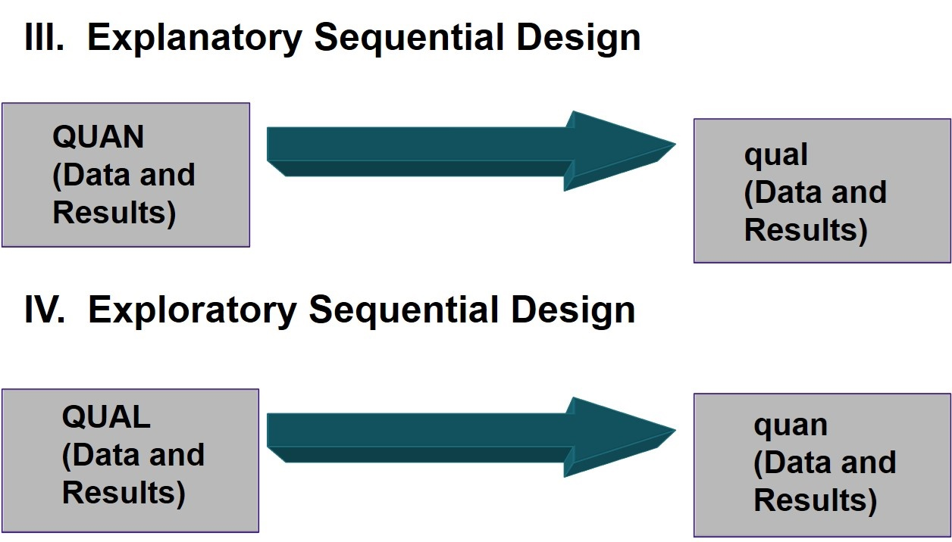
Examples of Visual Diagrams (2 of 2)

Slide 47
What Are Some Potential Ethical Issues in Mixed Methods Research?
Grouping participants together that may stereotype them
Issues that arise in quantitative and qualitative research
Issues that arise in specific types of mixed methods designs (e.g., sample size, links between databases, influencing experiments, further marginalizing participants, overlooking participants’ needs in a multistage design)

Slide 48
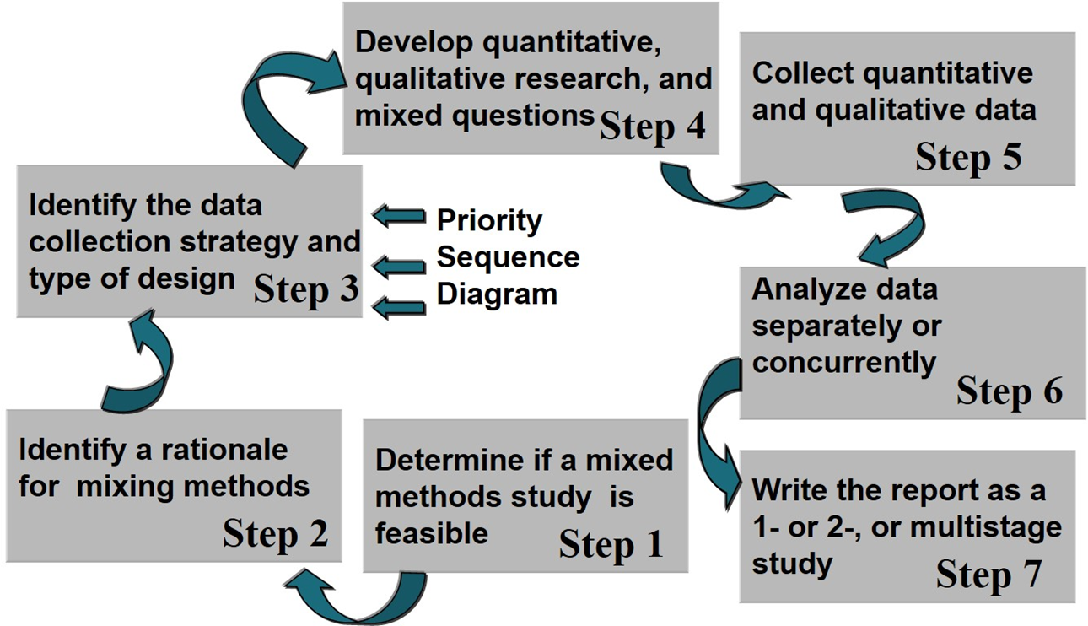
Figure 16.5 Steps in the Process of Conducting a Mixed Methods Study

Slide 49
What Are the Steps in Conducting a Mixed Methods Study? (1 of 8)
Step 1. Determine If a Mixed Methods Study Is Feasible
Need skills in quantitative and qualitative research
Time to collect extensive information
Knowledge of different designs
Consider audiences

Slide 50
What Are the Steps in Conducting a Mixed Methods Study? (2 of 8)
Step 2. Identify a Rationale for Mixing Methods
Why you are collecting quantitative and qualitative data
Review the intent of the designs
Be explicit in the rationale

Slide 51
What Are the Steps in Conducting a Mixed Methods Study? (3 of 8)
Step 3. Identify a Data Collection Strategy
The intent will guide planning
Identify
Specific forms of quantitative data (e.g., surveys, attendance records) and qualitative data (e.g., interviews pictures)
Priority you will give to quantitative and qualitative data
Sequence of data collection

Slide 52
What Are the Steps in Conducting a Mixed Methods Study? (4 of 8)
Step 4. Develop Quantitative, Qualitative, and Mixed Methods Questions
Present exploratory (qualitative) and variable oriented (quantitative) questions
Mixed methods research questions
Do the two databases converge and present consistent findings or diverge? (convergent)
How does qualitative follow-up help to better understand quantitative results? (explanatory sequential)
Is the instrument better than those available? (exploratory sequential)

Slide 53
What Are the Steps in Conducting a Mixed Methods Study? (5 of 8)
Step 4. Develop Quantitative, Qualitative, and Mixed Methods Questions
How do the qualitative findings provide support and enhanced understanding for the quantitative results? (experimental design)
How can the social issue be better addressed using results from both quantitative and qualitative findings? (social justice design)
How do the stages of the evaluation contribute to the overall project aim? (multistage design)

Slide 54
What Are the Steps in Conducting a Mixed Methods Study? (6 of 8)
Step 5. Collect Quantitative and Qualitative Data
Rigorous quantitative and qualitative procedures
Sequence depends on design
Statistical programs and text analysis programs can be useful to store, manage, and record data

Slide 55
What Are the Steps in Conducting a Mixed Methods Study? (7 of 8)
Step 6. Analyze Data Separately, Concurrently, or Both
Analysis relates to the design
May analyze separately (e.g., first qualitative and then quantitative in exploratory sequential design)
May integrate the data analysis (e.g., iteratively back and forth in convergent design)

Slide 56
What Are the Steps in Conducting a Mixed Methods Study? (8 of 8)
Step 7. Write the Report as a One- or Two-Phase Study or a Multiple-Stage Study
Variations in writing structure
Report can be written in two phases following order of research
Data collection for quantitative and qualitative
Data analysis for quantitative and qualitative
Interpretation of quantitative and qualitative
Report can integrate the phases
Problem statement contains both need to explain and explore
One data collection section integrating both
Analysis section converging two

Slide 57
How do You Evaluate a Mixed Methods Study?
Uses the words “mixed methods” in the study
Study contains both quantitative and qualitative data
Report displays integration of the quantitative and qualitative data
Specifies a type of mixed methods design
Cites mixed methods literature to document the use of mixed methods.

Slide 58

Copyright

