Slide 1
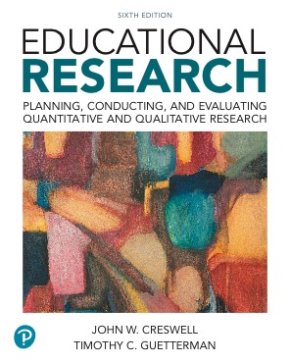
Educational Research: Planning, Conducting, and Evaluating Quantitative and Qualitative Research
Sixth Edition
Chapter 17
Action Research Designs
Copyright © 2019, 2015, 2012 Pearson Education, Inc. All Rights Reserved
Notes:
If this PowerPoint presentation contains mathematical equations, you may need to check that your computer has the following installed:
1) MathType Plugin
2) Math Player (free versions available)
3) NVDA Reader (free versions available)

Slide 2
Learning Objectives
17.1 Define action research, and describe when to use it, and how it developed
17.2 Identify the types of action research designs
17.3 Describe the key characteristics of action research
17.4 Anticipate potential ethical issues in action research
17.5 Identify the steps in conducting an action research study
17.6 List the criteria for evaluating an action research report

Slide 3
What is Action Research, When Do You Use It, and How Did It Develop? (1 of 4)
Action research is systematic inquiry done by teachers (or other individuals in an educational setting) to gather information about, and subsequently improve, the ways their particular educational setting operates, their teaching, and their student learning (Mills, 2013).

Slide 4
What is Action Research, When Do You Use It, and How Did It Develop? (2 of 4)
When Do You Use Action Research?
When you have an educational problem to solve
When educators want to reflect on their own practices
When you want to address schoolwide problems
When teachers want to improve their practices
When educators want to participate in a research project

Slide 5
What is Action Research, When Do You Use It, and How Did It Develop? (3 of 4)
How Did Action Research Develop?
First stage of identification of a process for addressing societal issues
Second stage on practice and need to involve practitioners (e.g., teachers, professionals) in the solution to their problems
Third stage of the participatory, emancipatory, or community action research approach

Slide 6
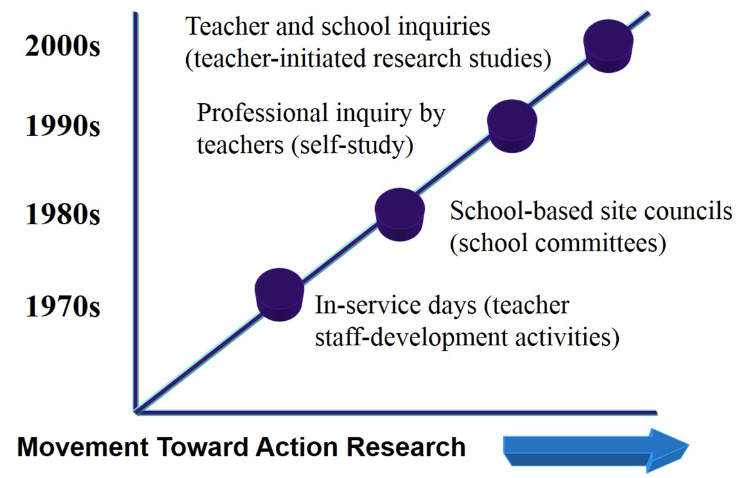
Figure 17.1 Evolution of Action Research for Teachers and Schools

Slide 7
What is Action Research, When Do You Use It, and How Did It Develop? (4 of 4)
How Did Action Research Develop?
Encourages change in the schools
Fosters a democratic (involvement of many individuals) approach to education
Empowers individuals through collaboration on projects
Positions teachers and other educators as learners who seek to narrow the gap between practice and their vision of education
Encourages educators to reflect on their practices
Promotes a process of testing new ideas (Mills, 2018)

Slide 8
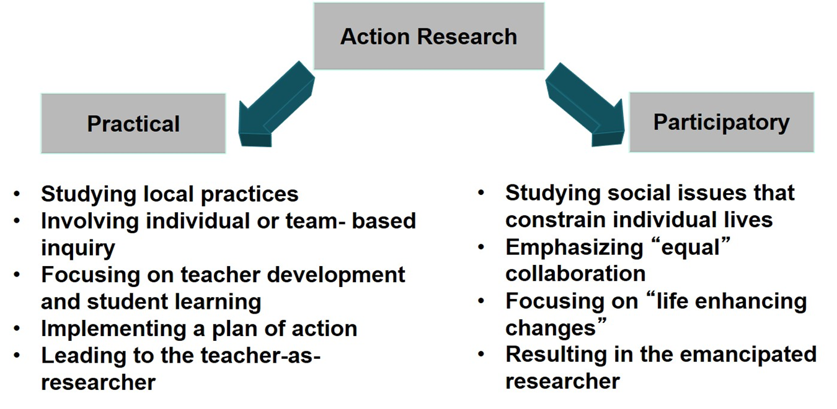
Figure 17.2 Two Types of Action Research Designs

Slide 9
What Are the Types of Action Research Designs? (1 of 8)
Practical Action Research
Professionals focus on problems in their own workplace
Teams of teachers, students, counselors, administrators, and others address common issue
Practical action research: purpose is to research a specific situation, such as a school, with a view toward improving practice
Advantages: practitioners test their own theories and explanations within their setting
Drawback: professionals have little time to engage in research

Slide 10
What Are the Types of Action Research Designs? (2 of 8)
Practical Action Research
Teachers as learners, reflective practitioners, engaged in small-scale research:
Have decision-making authority to study a practice as professional development
Are committed to continued professional development and school improvement
Want to reflect on their practices to improve

Slide 11
What Are the Types of Action Research Designs? (3 of 8)
Practical Action Research
Teachers as learners, reflective practitioners, engaged in small-scale research:
Use a systematic approach, identifiable procedures to study their own problems rather than using a random, anything-goes design
Choose an area of focus, determine data collection techniques, analyze and interpret data, and develop action plans

Slide 12
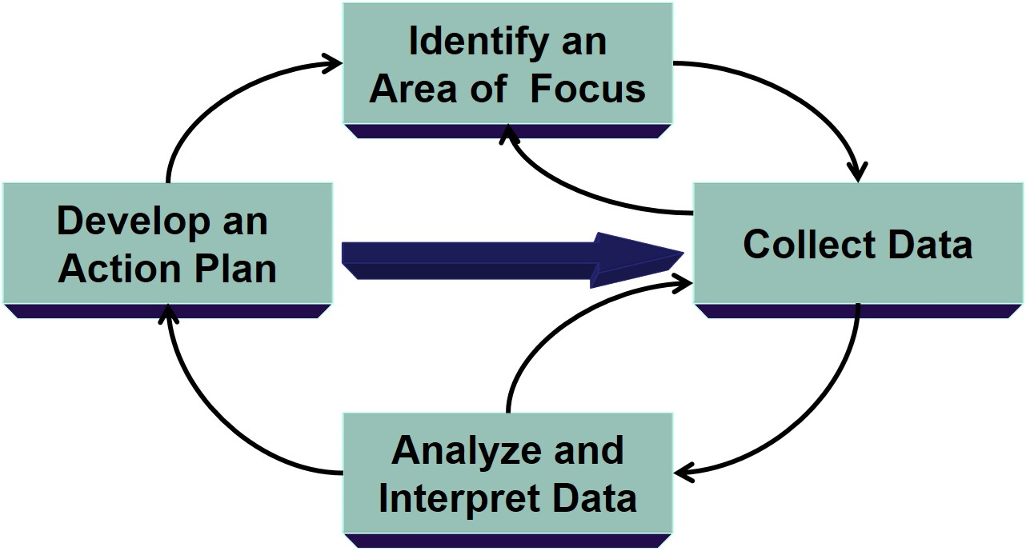
Figure 17.3 Mills’s (2011) Dialectic Action Research Spiral

Slide 13
What Are the Types of Action Research Designs? (4 of 8)
Practical Action Research
Example
Sarraj, Bene, Li, and Burley (2015) developed and implemented a multicultural education program for fifth-grade students
Process:
Identified the topic of multicultural education
Developed the multicultural program
Conducted a 2-week implementation study
Gathered and analyzed data
Reflected on implications and recommendations

Slide 14
What Are the Types of Action Research Designs? (5 of 8)
Participatory Action Research
Participatory action research (P A R): approach to improve quality of organizations, communities, and family lives
Deliberate exploration of a relationship between the individual and others
Participatory: People conduct studies on themselves
Practical and collaborative

Slide 15
What Are the Types of Action Research Designs? (6 of 8)
Participatory Action Research
Emancipatory: unshackle people from constraints of irrational and unjust structures
Helps individuals free themselves from constraints found in media, language, work procedures, and power relationships
Reflexive or dialectical: Focused on bringing about change in practices

Slide 16
What Are the Types of Action Research Designs? (7 of 8)
Participatory Action Research
Stinger’s (2007) action research spiral
Three interacting (nonlinear) phases
“Look” to build a picture to help stakeholders understand issues
“Think” to interpret issues in depth and identify priorities for action
“Act” to devise practical solutions to problems

Slide 17
What Are the Types of Action Research Designs? (8 of 8)
Participatory Action Research
Example
Stanulis and Jeffers (1995) studied the mentoring relationship among a fifth-grade classroom teacher, student teacher, and university coordinator
Collected 5 video-recorded conference between student and teachers, journal entries and interviews with classroom teachers and student teachers
Identified themes (e.g., process of gaining students’ respect)
Mentioned authority and structure
Transformed the mentoring relationship

Slide 18
What Are the Key Characteristics of Action Research? (1 of 4)
A practical focus: Researchers study practical issues that will have immediate benefits to teachers, schools, and communities.
The educator-researcher’s own practices: Self-reflective research by the educator-researchers turns the lens on their own educational classroom, school, or practices
Collaboration: Involve co-participants in the research.

Slide 19
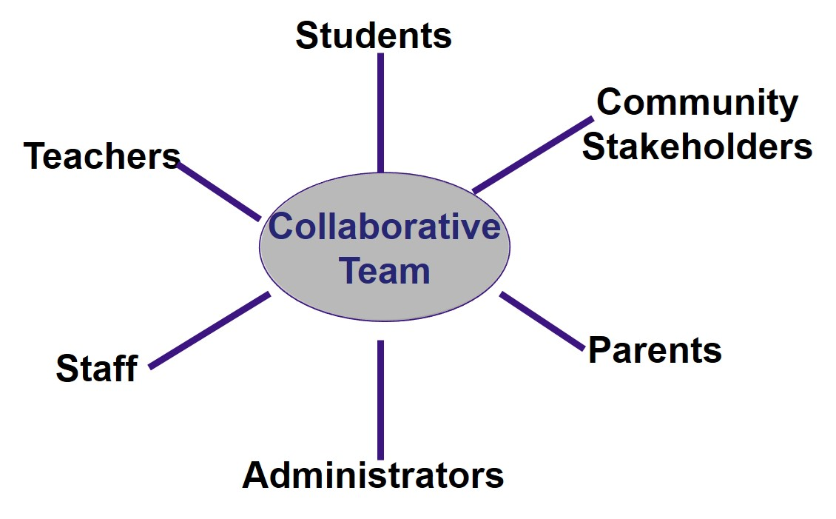
Figure 17.6 Collaborative Teams in Action Research

Slide 20
What Are the Key Characteristics of Action Research? (2 of 4)
A Dynamic Process
Process spirals back and forth among reflection, data collection, and action
Does not follow a linear pattern
Does not follow a causal sequence from problem to action

Slide 21
What Are the Key Characteristics of Action Research? (3 of 4)
A Plan of Action
The action researcher develops a plan of action
Formal or informal—involve a few individuals or an entire community
May be presenting data to stakeholders, establishing a pilot program, or exploring new practices

Slide 22
What Are the Key Characteristics of Action Research? (4 of 4)
Sharing Research
Sharing reports with individuals or groups who can immediately use the results
Local schools, educational personnel
Parent associations
Community

Slide 23
What Are Some Potential Ethical Issues in Action Research
Coercive data collection
Dual role of educator and researcher
Lack of caring relationships
Not renegotiating the purpose of the study
Not considering how results will be used
Not involving participants in all phases of the research

Slide 24
What Are the Steps in Conducting an Action Research Study? (1 of 3)
Determine if action research is the best design to use
Identify a problem to study
Locate resources to help address the problem
Identify the information you will need

Slide 25
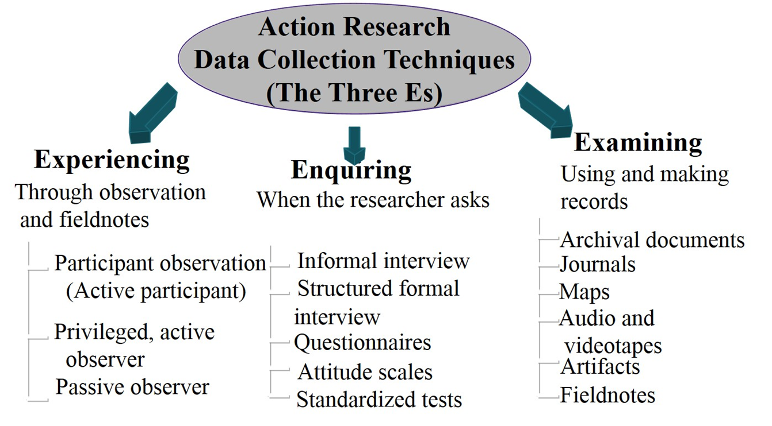
Figure 17.7 A Taxonomy of Action Research Data Collection Techniques

Slide 26
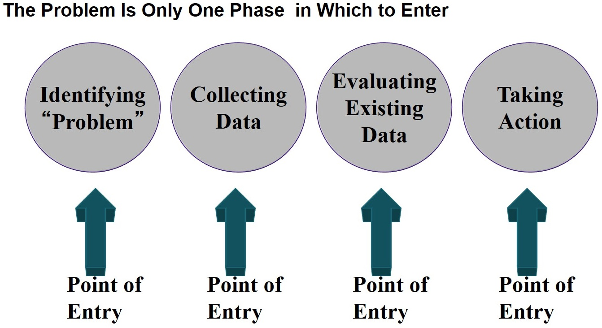
What Are the Steps in Conducting an Action Research Study? (2 of 3)

Slide 27
What Are the Steps in Conducting an Action Research Study? (3 of 3)
Implement the data collection
Analyze the data
Develop a plan for action
Implement the plan and reflect

Slide 28
How do You Evaluate an Action Research Study?
Focuses on practice or community issues
Includes multiple sources of quantitative and qualitative data
Engages in collaboration with participants
Advances a plan for action to address problem or need
Researcher grows professionally as a result of the study
Reports in a way that is acceptable to stakeholders and community audience

Slide 29

Copyright

