Slide 1
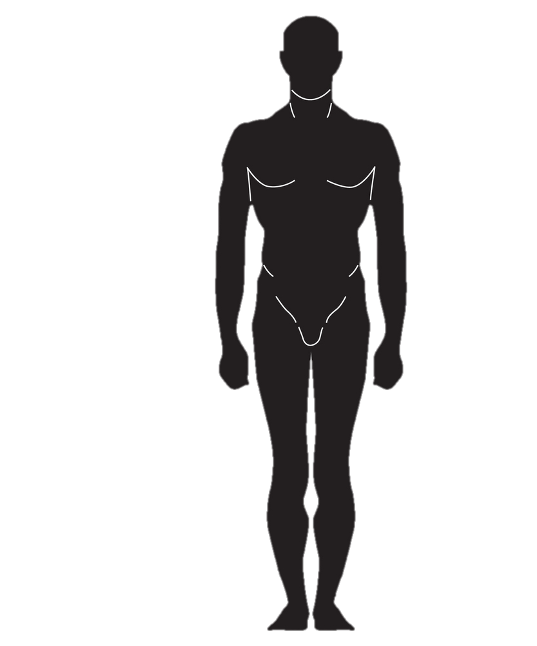
STATURE
SUPRASTERNAL HEIGHT
WAIST HEIGHT NATURAL
WAIST HEIGHT OMPHALION
PATELLA MID HEIGHT
STATURE

Slide 2
WAIST HEIGHT NATURAL
PATELLA MID HEIGHT
GROUND

Slide 3
