Slide 1
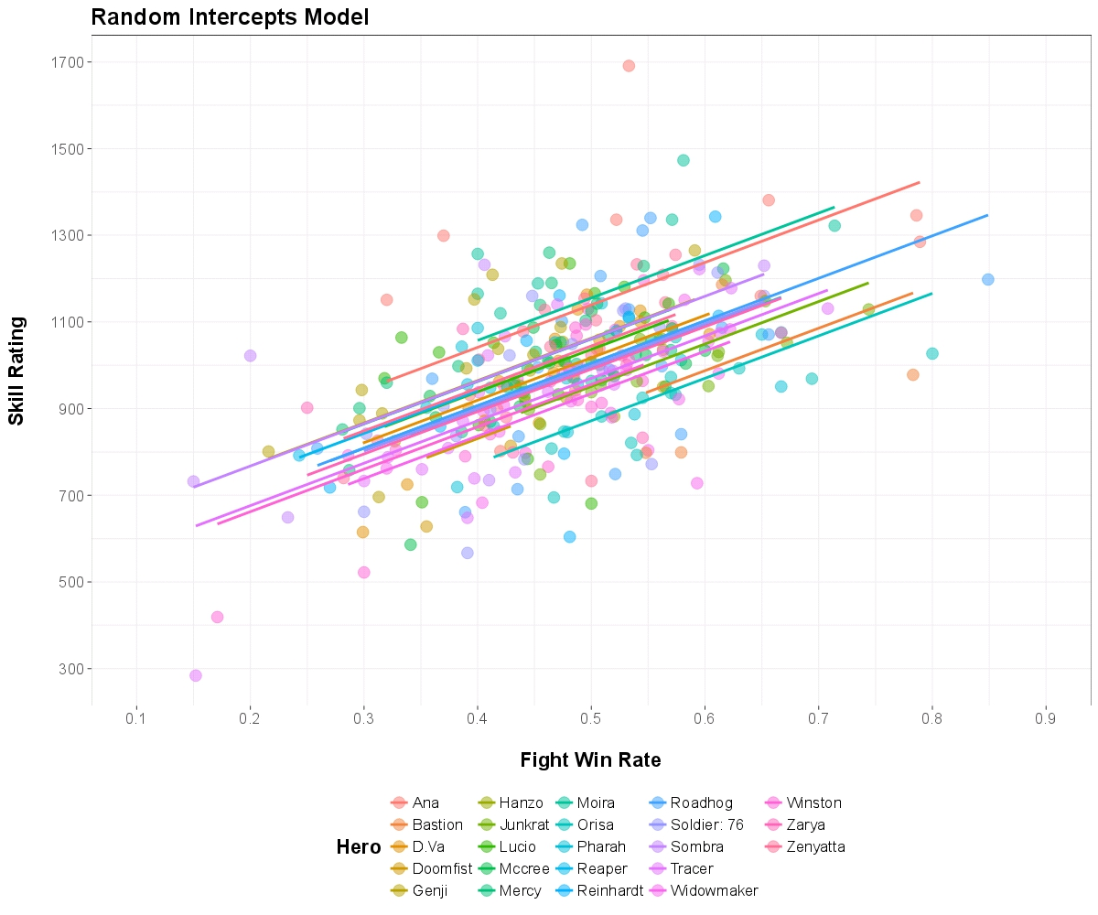
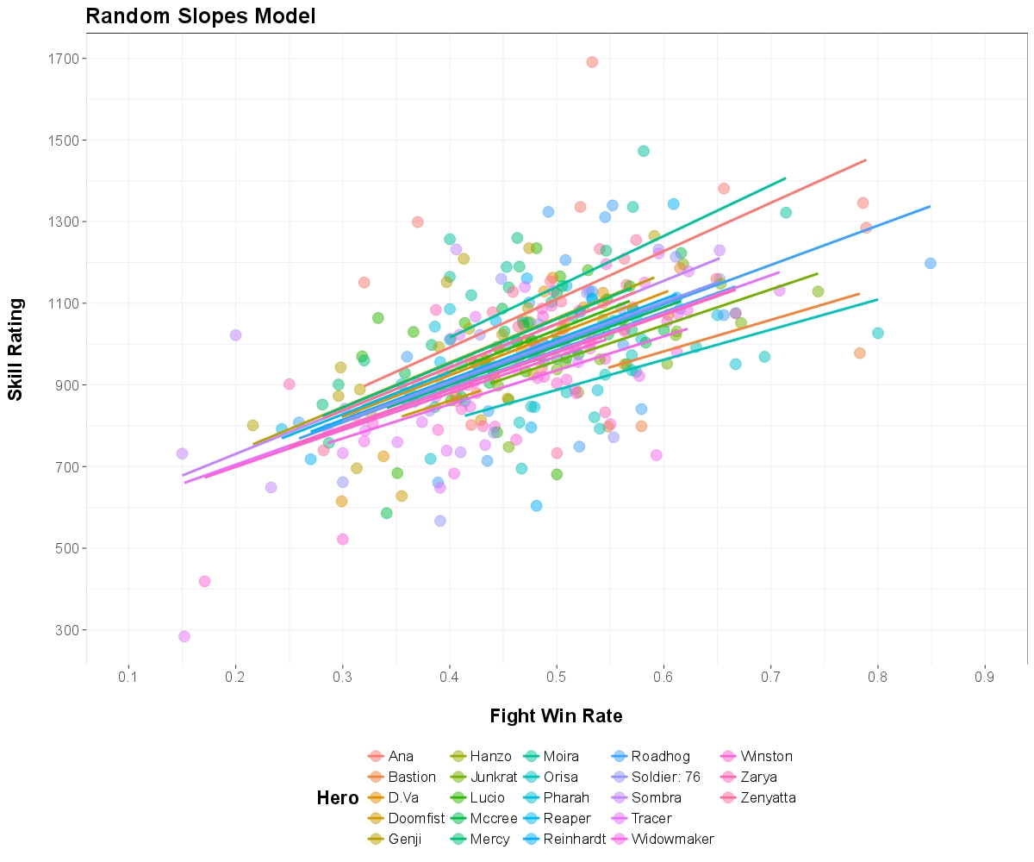
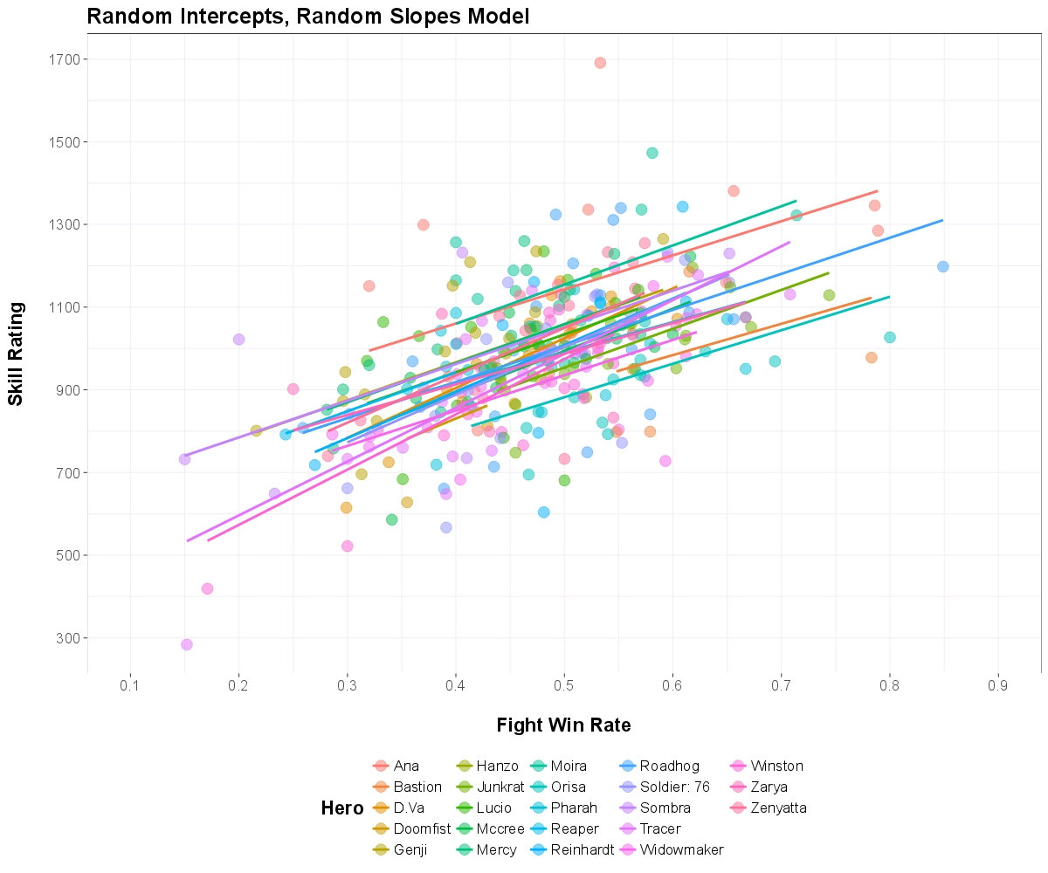
An Application of Mixed Effects Modeling to eSports Data
ABSTRACT
Brett Cutts
Department of Psychology
University of Mary Hardin-Baylor
RESULTS
Overwatch League is one of several burgeoning professional, competitive eSports leagues with 12 franchises, or teams, across the U.S. and South Korea. Overwatch is classified as a team-based multiplayer online first-person shooter video game. In 2016, the franchise winning the Overwatch League regular season championship earned a total prize pool of $3.5 million, while the industry at-large generated $493 million.
As other professional sports leagues (e.g., MLB, NBA, NFL) continually apply data analytics to the forecasting of player and team performance, eSports leagues are in a similar position. In the context of Overwatch League, all game play statistics are generated and made available for public review. Examples include, players' skill rankings, results of in-game competitions, character role, and duration of game play, to name a few.
This data is a compilation of a five-week long stage, with three matches played four days a week (Wednesday through Saturday) with twelve teams competing.
This data has shown that fight win rate does in fact predicte 51% of the variance in an individual players skill rating.
DESCRIPTION
This study applied mixed effects regression models to data from the eSports Overwatch League to estimate the degree to which fight win rate predicts individual players' overall skill ranking, resulting in a random intercepts model explaining approximately 51% of the variance in players' skill ranking.
QUESTION
To what degree does fight win rate predict an individual players skill rating?
METHOD
The current study applied mixed effects linear regression models to player-level and in-game data from the eSports Overwatch League to estimate the degree to which fight win rate predicts individual players' overall skill ranking.
For the purposes of the current analysis, players' skill ranking was modeled against each in-game character's fight win rate, across all players. In addition to a completely fixed-effects model, three mixed effects models were estimated: (a) a random intercepts model, (b) a random slopes model, and (c) a random intercepts, random slopes model. A conditional R-squared estimate was used to examine model fit, with fight win rate in the random intercepts model explaining approximately 51% of the variance in individual players' skill ranking.
DISCUSSION
bacutts@mail.umhb.edu

