Slide 1

SiteGuard
Five more
minutes.
A worker asks. The team can respond.
Notes:
Cover image is conceptual AI-generated imagery, not a worksite record. Open with a worker asking for five more minutes of rest.
Sources:
- docs/pitch-assets/worker-break-concept.png
- README.md

Slide 2
THE GAP
A schedule knows
the break ended.
It cannot know whether the worker feels ready.
The worker needs a clear way to ask. The safety team needs a way to make room.
Notes:
Keep this worker-centered. Protected break time remains fixed. The product helps surface a voluntary request and coordinate coverage.
Sources:
- docs/PROJECT_SPEC.md

Slide 3
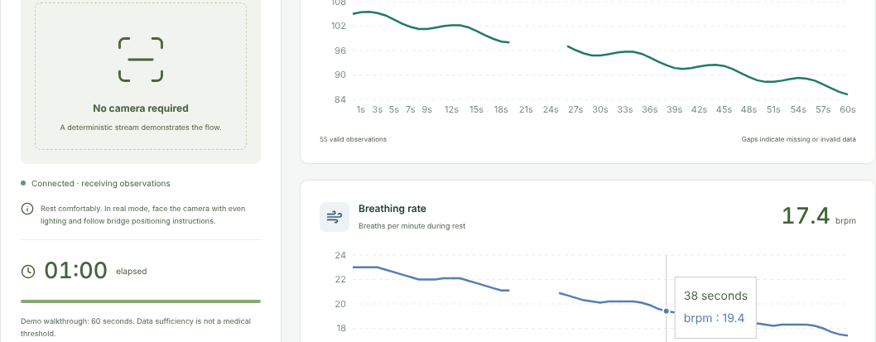
01 CHECK IN
The worker starts a check-in
Synthetic demo readings
Notes:
This screenshot uses a synthetic source and does not show a live Presage reading. The worker can stop the check-in.
Sources:
- docs/demo-screenshots/04b-measurement-60s.png
- docs/DEMO_RUN_REPORT.md

Slide 4
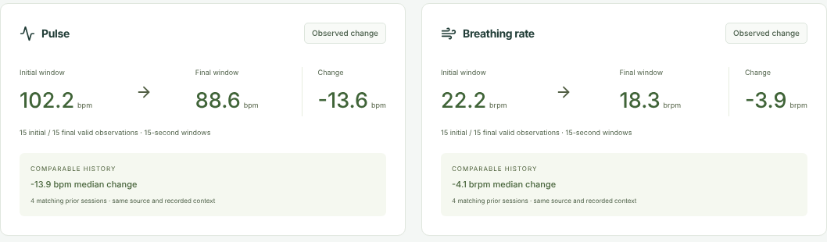
02 UNDERSTAND
A change the worker can see
This demo session: pulse 102.2 to 88.6 bpm
The app shows the evidence and its source.
Notes:
The numeric values belong to the synthetic demo screenshot. They illustrate descriptive change within this session; they do not determine readiness or a rest need.
Sources:
- docs/demo-screenshots/05a-summary.png

Slide 5
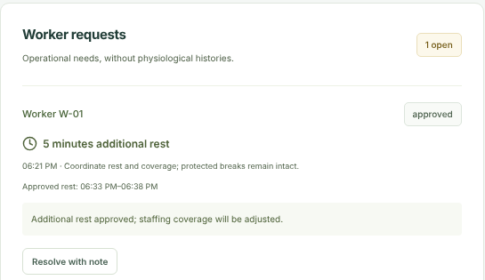
03 ASK
Five more minutes of rest
Notes:
The request is worker initiated. This screenshot is a fictional demo scenario. The supervisor approves additional rest as a separate request.
Sources:
- docs/demo-screenshots/06b-approved.png

Slide 6
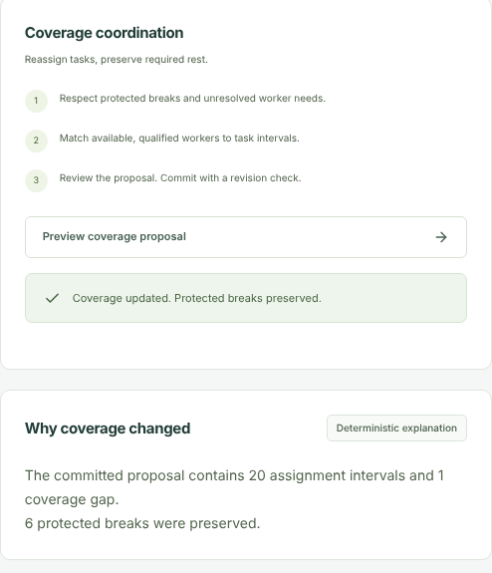
04 RESPOND
The schedule makes room.
6
protected breaks
preserved
Coverage updates after review.
Notes:
The fictional demo's committed proposal preserves six protected breaks. The supervisor reviews the coverage update, with any remaining gap visible.
Sources:
- docs/demo-screenshots/07b-committed.png

Slide 7
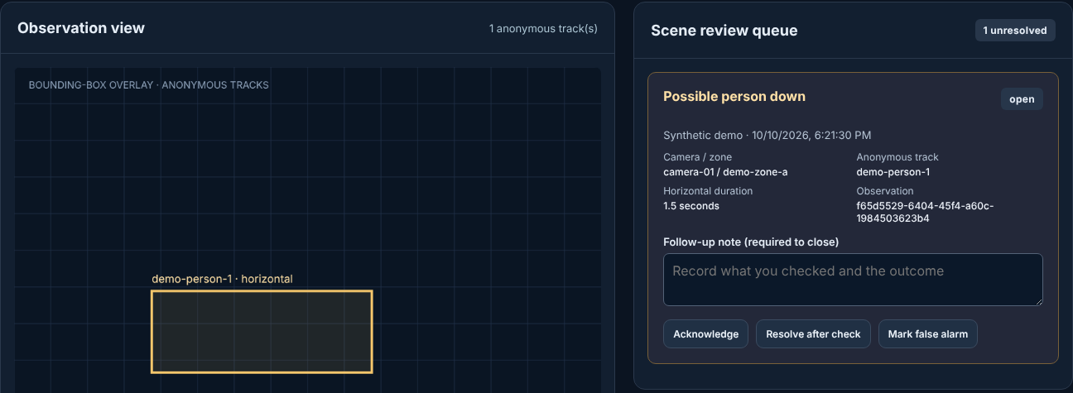
ANOTHER SAFETY MOMENT
Possible person down
The alert goes to a person for review.
Notes:
This is a synthetic bounding-box prototype. A possible person-down posture raises a review item. The UI requires a human follow-up note to close the event.
Sources:
- docs/demo-screenshots/11a-fall-incident.png
- docs/DEMO_RUN_REPORT.md

Slide 8
UNDER THE HOOD
Four jobs. One response.
01
02
03
04
Observe
Remember
Explain
Act
Presage
Tiger Data
Gemini
Worker + team
Camera pulse and breathing
Worker history over time
Approved facts in plain language
Request, review, coverage
Notes:
Presage provides source-labeled observations when the bridge is available. Tiger Data stores history. Gemini explains server-approved facts. Worker and safety operations decide what to do. The screenshots shown in this deck are synthetic demo material.
Sources:
- README.md
- docs/PRESAGE_CONTRACT.md
- docs/TIGER_DATA_VERIFICATION.md

Slide 9
SiteGuard
A request becomes
a response.
Presage Gemini API Tiger Data
Watch the demo: youtube.com/watch?v=CzoFM4OR6TA
Notes:
Close by returning to the worker's five-minute request. State the three sponsor categories: Best Use of Presage, Best Use of Gemini API, and Best Use of Tiger Data.
Sources:
- README.md
- https://www.youtube.com/watch?v=CzoFM4OR6TA

