Slide 1
Object Oriented Programming

Slide 2
What is an object?

Slide 3
There are many ways to think of objects

Slide 4
Objects are containers for information and functionality that logically goes together

Slide 5
Objects are like containers
For information and functionality that logically goes together

Slide 6
Objects are like recipes
a defined data structure
that is reusable
and allows us to answer questions about a system

Slide 7
Four Principles of Object Oriented Programming

Slide 8
Encapsulation
- Objects contain methods and properties that logically go together
- Objects may communicate with each other, but they are only aware of their own state
- This state is private and unknown to other objects unless an object is asked or tells another

Slide 9
You can think of
A Class as a table
An Object as a row
An Object’s properties as the columns

Slide 10
Our first object.
A Student!

Slide 11
JavaScript objects
JavaScript didn’t have traditional class system (until recently!)
We instead use a constructor function which constructs objects

Slide 12
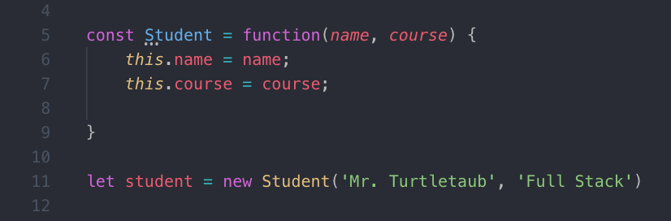
Student is a constructor function. We use capital letters for constructors.
name, course in Line 5 are parameters
‘Mr. Turtletaub’ and ‘Full Stack’ are arguments
this.name and this.course are properties. They store information about the internal state of the object.
Notice that when we create an object, we don’t return anything

Slide 13
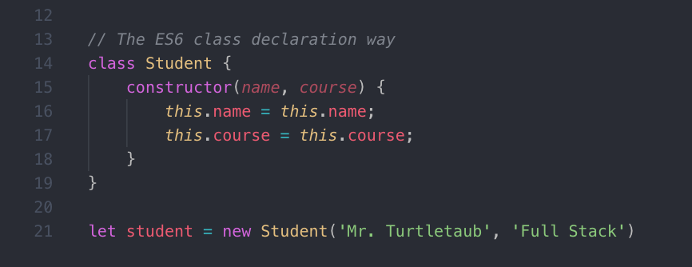
We now have class declaration in JavaScript.
Thank you ES6

Slide 14
Student
Student.prototype
constructor(name) {
this.name = name;
}
enroll = function
A name is unique to a student but all students have the same enroll functionality.
Rather than recreate the same function for all Student objects, we can have all Student objects point at the prototype.

Slide 15
Let’s design a enrollment system for our university’s bootcamps

Slide 16
Requirements for our enrollment system
It must answer these questions:
1) What bootcamp am I enrolled in?
2) What term did I take the bootcamp?
3) Who was the instructor?

Slide 17
Student
Name
Status: Pass/F
Bootcamp
Subject
Term
Instructor
Name
Technology
1..*
1..*
1..*
A student has many bootcamps
A bootcamp has many students
A bootcamp has a single instructor
An instructor has many bootcamps

Slide 18

That’s Unified Model Language Diagramming.
A common tool to map out systems.
Don’t worry about it right now!

Slide 19
Person
Name
Bootcamp
Subject
Student
Status
Instructor
Technology
Term
Bootcamp Offering
1
1…*

Slide 20
Inheritance
Classes may share qualities from another class.

Slide 21
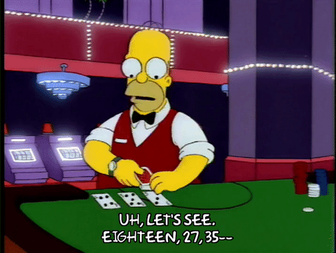
How do you play Blackjack again?

Slide 22
A player places a bet and is then given two cards.
To win, the sum of a players’ cards is
21 or beats the dealer.
Ace counts as 11 or 1.
To draw more cards, you “hit.”
When you’re done drawing cards, you “stay.”
If you get over 21, you lose.

Slide 23
What objects are in our blackjack game?

Slide 24
Player
Name
Funds
Hand
Points
Dealer
Bets
Game
Deck
Card
Rank, Value, Suit

Slide 25
Build the Card
There’s new syntax.
We’re taking on new concepts.
Work with your neighbor!
Pair programming FTW

