Slide 1
PDDL4J – Test and Analysis of Search Algorithm and Heuristics
By,
Aaron Boyd
Team MAGMA
Supervisors – Damien Pellier,
Humbert Fiorino
Notes:
Hi everyone and welcome to my presentation on PDDL4J, test and analysis of search algorithms and heuristics.
If at any time you need further information, please dont hesitate to stop and ask

Slide 2
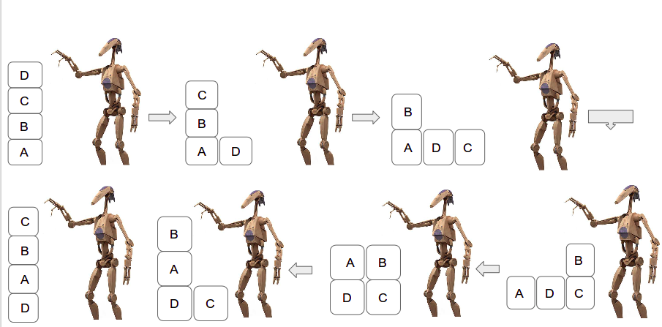
What is Planning?
We can define planning as:
  ''Explicit deliberation process that chooses and organises actions by anticipating their outcomes''[Malik Ghallab]
  The aim is to achieve some pre-stated objective(s)
Notes:
Planning is easily defined as a set of actions used to complete a task, we all make goals everyday, and to achieve the goals, certain actions need to be completed before that is possible..
If we look at the example on screen, the blocks in the top left corner are stacked D, C, B, A. This is our initial state. The set of blocks directly below, bottom left, is the goal state. So from the starting position the robot must complete a series of actions in order to achieve the goal state of C, B, A, D.. The robot will use certain actions that are at its disposal, like pick up block D and so forth. Each of these actions have preconditions, these are certain parameters that need to be achieved before the action can take place, for example, we cant pick up block D unless there are no blocks above it.. We also have positive and negative effects for all actions, so a positive effect of placing D here is that now C is free, and the negative effect is that the robots hand is now not free.

Slide 3
What is a planner?
A planner is a collection of algorithms that, when combined, are able to produce a plan from a planning problem.
A planner can be broken down in to three basic sub categories:
  Preprocessing:
    Takes in the actions in a domain file and the correlating problem
  Search Algorithm:
    Assists the heuristic to search through the state-space to find the goal
  Heuristic:
    Guides the search algorithm in the correct direction and tries to seek the goal
Notes:
A planner, like PDDL4J, produces plans from a given problem.. A planner can be broken down in to the three sub categories,
The preprocessing handles the parsing of the problem which is in a format called planning domain description language or otherwise known as, PDDL.
The search algorithm will search through a state space to try and find a solution to the planning problem. A search algorithm is able to find a solution to a planning problem on its own but it works well when incorporated with a heuristic.
The heuristic is what guides the search. It can do this in a number of different ways depending on the type of heuristic used.

Slide 4
What is a planning problem?
A classical planning problem is written in PDDL
  Planning Domain Description Language
PDDL provides the planner with a list of actions that can be used to achieve a goal
  i.e. Pick-up, Put-down, Stack, Un-stack
For each domain are problem files, which provide information about the environment
  How many objects, the initial state of the environment and the goal that needs to be achieved
Notes:
A planning problem for classical planning is written in PDDL. The reason we use PDDL is because of the information it can provide about the environment and also about what are the preconditions and effects of those actions when performed in the environemnt.
We have already saw an example with blocks called Blocksworld, but there are many other domains that require different levels of sophistication developed inside a planner. Problems are ranked from easy, medium and hard. The more actions the domain has and the amount of objects a problem file has determines the level of difficulty.
A solution to a planning problem is outputted by a planner and it will display a sequence of actions that need to be performed to reach the defined goal state.

Slide 5
PDDL
(:action pick-up
:parameters (?x - block)
:precondition (and (clear ?x) (ontable ?x) (handempty))
:effect
(and (not (ontable ?x))
(not (clear ?x))
(not (handempty))
(holding ?x)))
(:objects D B A C – block)
(:INIT (CLEAR C) (CLEAR A) (CLEAR B) (CLEAR D) (ONTABLE C) (ONTABLE A) (ONTABLE B) (ONTABLE D) (HANDEMPTY))
(:goal (AND (ON D C) (ON C B) (ON B A)))
Notes:
PDDL is the main language used for classical planning, there are many different versions of PDDL and different extensions but we will be using a small subset of the language.
PDDL expresses what actions can be used to complete a problem, it defines the objects and it also provides information about each action. Like the preconditions that must occur before that action can be completed and what is the effect of completing that action on the environment.
This is also a part of the preprocessing task, with the number of objects, they all be placed in every combinations possible so that the planner has knowledge of what each actions preconditions and effects are for every object.

Slide 6
Demonstration
Notes:
This is a small demo of the Blocksworld problem. The planner is run within the terminal. We can see the set of actions that the PDDL4J library must take in order to complete the blocksworld task. The library is able to solve the problem within a matter of seconds and use a small amount of memory to solve. We can also see at the bottom, the number of nodes explored. This shows how many nodes the planner expanded in order to arrive at the goal node.

Slide 7
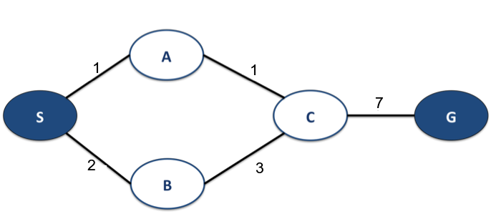
What is a Heuristics?
Admissible heuristic: The heuristic will never over estimate the distance from a starting node to the goal
Non-Admissible heuristic: The heuristic will potentially over estimate or under estimate the distance from the starting node to the goal
Notes:
With regards to heurisitcs, we have two categoreis, admissible or not admissible. Admissible being that it will never over estimate the distance from the starting node to the goal node from any given state and not admissible which will potentiall over or under estimate the distance to the goal from any state.
With the small graph on the screen, we can see the weights or cost given to each of the nodes in the search tree, S is the starting node and G is the goal. An admissible heuristic will be able to estimate the distance from the start to the end and also select the most optimal route, in this case, it is to expand node A, then C and then reach the goal.
An non admissible heuristic may also chose this route but there is no guarentee, it may select the opposite route by expanding B and then C which in total will have a high cost to reach the goal.

Slide 8
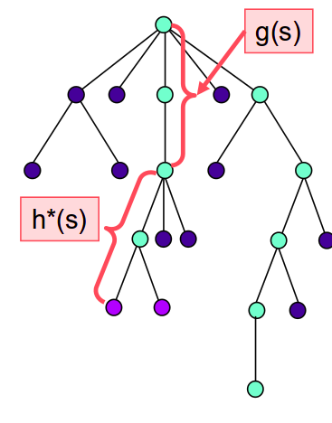
How do heurstics work with the search algorithm?
A* is one of the most widely used search algorithm and is used in PDDL4J.
A heuristic helps A* by appromiximating the function h*(s), this is the minimum cost from any node s to the goal.
Notes:
A* is the main driving algorithm for the PDDL4J library, it works by using a function f(s) = g(s) + h(s)
s being the last node in the path
g(s) being the cost of the path from the start to s
h(s) is the heuristic estimate from s to the goal.
Using this small function, it will try to find the fastest and most efficient route to the goal from starting node.
Within the library there are many heuristic implemented, one of which is Max. Max works by considering a state in a planning graph and uses all applicable actions to make every proposition true. The cost of the actions required to make all propositions true is the basis for the heuristic value that is produced.
For max the heuristic value for a given state is the cost of the most expensive proposition in that state and Max is also an admissible heuristic

Slide 9
State of the Art
Research teams attempt to make existing planners better to compete against each other in a planning competition.
The two most famous planners are; Fast Forward and Fast Downward.
They have been used as a basis for multiple planners and are still used today.
Notes:
From the research conducted in classical planning approaches, a number of planners that were developed years ago have been re-introduced with different search algorithm or heuristic etc.. We can see this with the most recent winner of the annual planning competition, arnvanherd, it was built from the Fast Downward planner which competed over 10 years ago.
The state of the art for search algorithms has been working towards multi-heuristic algorithms like A* which is able to incorportate two heuristic values for g(n) and h(n) which are independent. This will provide more information to the search algorithm and also help get through any plateaus one of the heuristics might face in a problem.

Slide 10
Implementation
The goal is to implement an algorithm called Greedy Best First Search, with an added method of Enforced Hill Climbing. [Jorg Hoffmann, Bernhard Nebel]
Also, to implement an admissible heuristic, H^{M}. The book 'Automated Planning: Theory and Practise' provided the theory for the Hm heuristic as well as Patrik Haslum paper on Admissible Heuristics. [Dana S. Nau, Malik Ghallab, and Paolo Traverso]

Slide 11
Hypotheses
For the new search algorithm I assumed that it would be able to solve more problems that the current algorithm A*, as well as be faster when solving problems and use less memory.
The H^{M} heuristic will be able to spot anomalies between admissible and not admissible heuristics, as well as be more efficient in terms of plan size.
Notes:
From the research gathered on planners, the GBFS algorithm with Enforced hill climbing was an algorithm used in the Fast Forward planner back in 2004. It uses a casual graph heuristic function which relaxes the problem by ignoring the negative effects that occur by completing an action. I felt that this algorithm would be able to incorporate the Fast Forward heuristic that has been implemented within the PDDL4J library and rival A*. I chose this algorithm because the fast forward heuristic also relaxes the problem so I would be able to use an already built in heuristic for the search algorithm.
The HM heuristic was taken from the automated planning book as well as work done by Patrik Haslum. The hm heuristic works by getting the least costly subset of size m which is less than or equal to the esitmated length from the starting node to the goal. But as the computational completixy gets higher we will restrict the M to size of 2.

Slide 12
How can we evaluate these algorithms?
Carlos Linares Lopez defined 4 criteria that will be used for evaluating;
  Objectability: Keep the same setting for all tests.
  Exhaustiveness: We will use problems of a different nature.
  Comparability: That we will have a well studied algorithm for a baseline.
  Reproducibility: Detailed test environment so someone can replicate it.
Notes:
These are the 4 categories that I used for testing the new search algorithm against A*. As well as the heuristics.
Objectibility means that we will keep the same setting for all tests
Exhaustiveness means that we will use problems of a different nature.
Comparability means that we will have a well studied algorithm for a baseline
Reproducibility means that the test environment must be explained so someone else can replicate it

Slide 13
How can we achieve this?
Well studied baseline for result comparison
  A* has been studied multiple times since its release in 1968
The same computer was used for all tests
  Linux Server, 24 CPUs, 2.3GHz, 264GB of memory
Memory used was kept the same
  8048Mb for each test
A wide range of problems were used
  Two subsets of PDDL were used, STRIPS and ADL
Plan validator was used to ensure the output from the planners were logically sound
  VAL plan validator, with 5 random examples to test
Notes:
How we achieved this was by using the same testing environment and the same script to run each of the tests
Well studied baseline algorithm, A*
We allowed for a 600 second time limit for all tests
We kept the same amount of memory allocation each time for the planner, 8048mb.
We varied the problems from STRIPS and ADL which are two subsets of the PDDL language, as well as over 20 different domains totaling 1089 total problems.
For objectability we used evaluation metrics like memory consumption, speed and plan size and plan quality for heuristics. Also we used a plan validator called VAL which was able to test the output to see if all steps were valid.

Slide 14
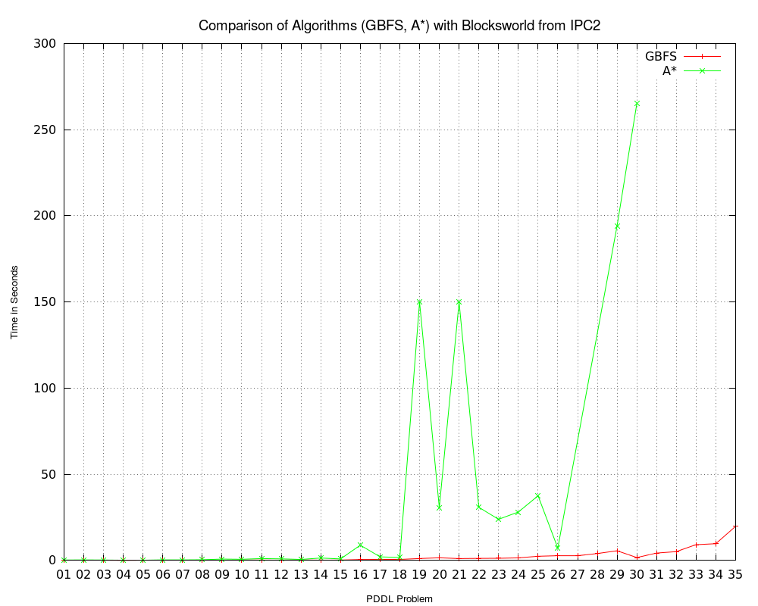
GBFS with EHC vs A* (Time taken)
Notes:
This is a graph takin from the blocksworld domain were we tested them together, we can see by GBFS in red and A* in green that GBFS was faster in completing all problems as well as being able to solve the final 5 problems where A* could not.

Slide 15
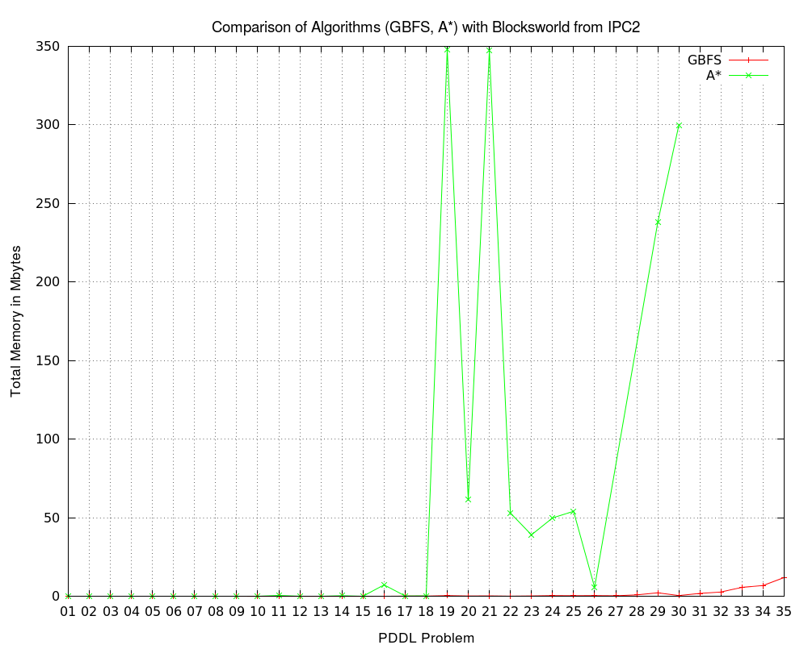
GBFS with EHC vs A* (Memory used)
Notes:
This is the memory consumption for both algorithms in the blocksworld domain, we can see as the problems get harder, the memory rapidly increases for A* but with GBFS, it is staying consdierably low but slighltly increasing as it reaches to the last of the problems within the domain. These two sets of results for time and memory are good for the planner as it shows that in terms of speed and memory, GBFS is a better algorithm

Slide 16
Total Results Across All Domains
We can see the total number of solved problems by both the new algorithm and the current algorithm, A*.
GBFS with EHC was able to solve 21 more problems than A*.
 | GBFS with EHC using the Fast Forward Heuristic | A* using the Fast Forward Heuristic
Total Problems | 559/1089 | 538/1089
Percentage of Solved Problems | 51.33% | 49.40%
Notes:
At the end of the testing stage, I totalled all the solved problems by each planner, the new search algorithm was able to solve 1.93% more problems than A* which is 21 problems out of a possible 1089. This shows that for the PDDL4J planner, GBFS is the better algorithm

Slide 17
Sum vs H^{M} vs FF vs Max
H^{M} heuristic was unable to solve more problems than the other 3 heuristics.
It was down to the computational cost of generating all the subsets of medium and large problems. A 600 second time limit was not sufficient.
We will show one example with the domain Elevator, the evaluation metrics we will show are;
  Time taken to solve the problems
  Memory used
  Plan size.
Notes:
To test the heuristics I took two non admissible heuristics, sum and Fast forward as well as an admissible heuristic Max to test against. This meant in total I had two admissible and two non admissible heuristics.
With regards to the hm heurstic, it did not fair as well as the new search algorithm. Overall, it did not solve more problems than the others and it was not faster by any means in solving problems. We still found some results that are interesting to show within the Elevator domain, which is another type of problem in classical planning.

Slide 18
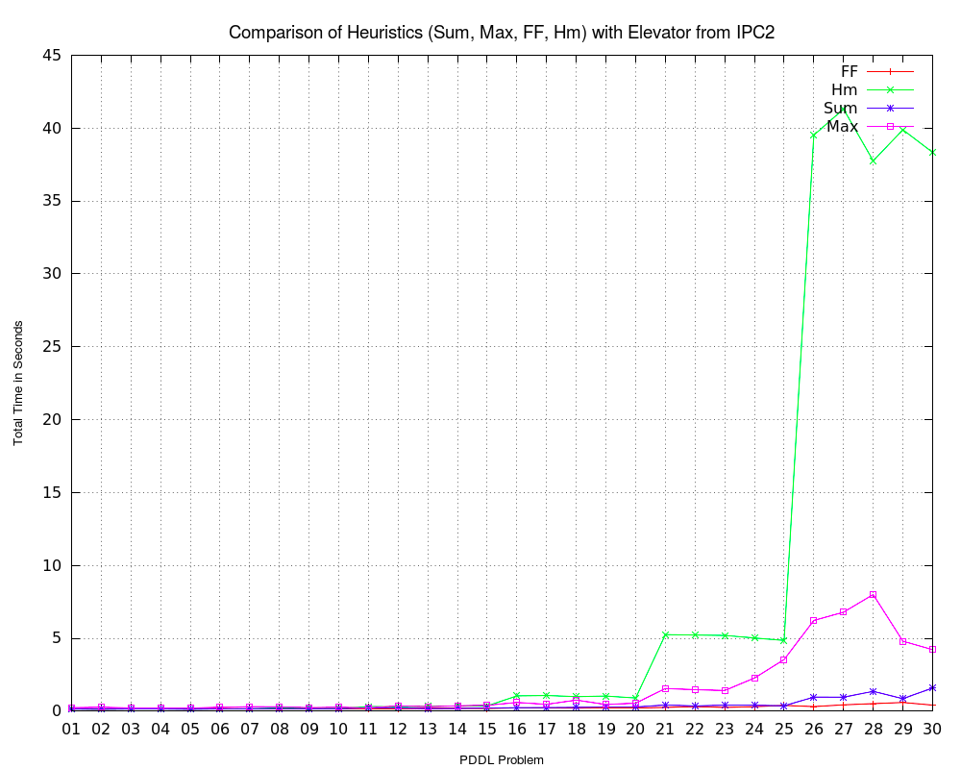
Notes:
We can see by the graph that the two non admissible heuristics were able to solve the first 30 problems from the Elevator task in and around the same time, but with the HM heuristic, as the problems got harder, it became more difficult for the hm heuristic to find a solution.

Slide 19
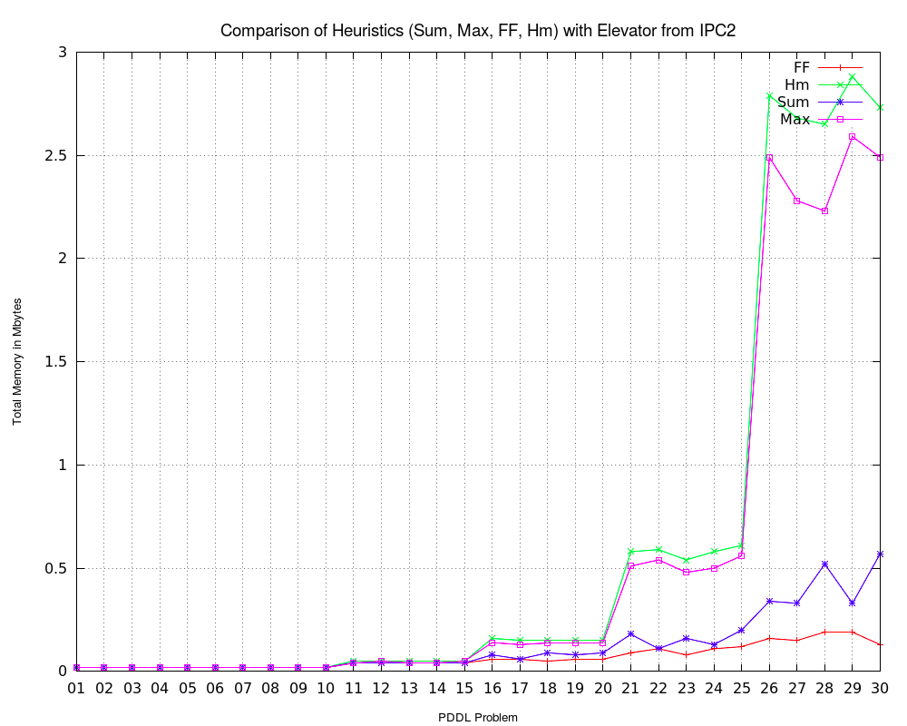
Notes:
This is the memory consumption used by each heuristic for the same set of problems. We can see a direct corelation between the harder the problem, the time it takes to solve and the memory used to solve the problem for the Hm heuristic. We can also see that the other admissible heuristic Max consumed a lot of memory to solve the problems in the last third.

Slide 20
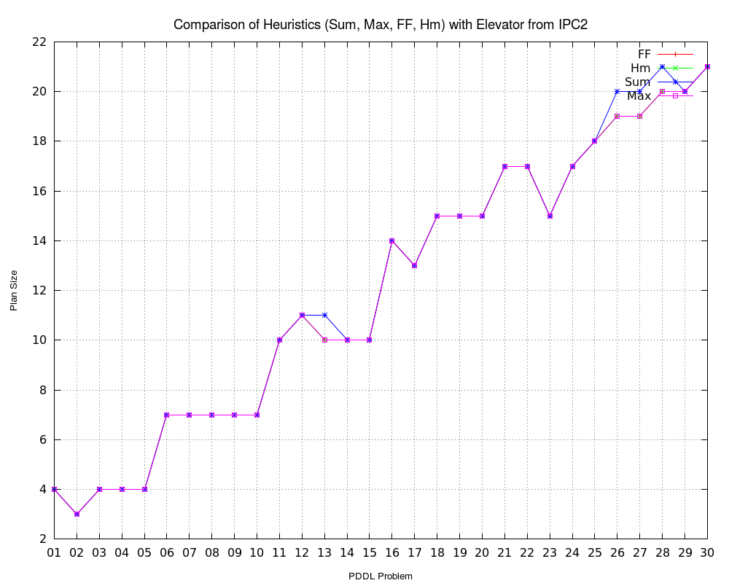
Notes:
Now looking at plan size for each of the heuristics, we saw that three of the heuristics Fast forward, sum and HM all had the same size of plans throughout the problems but max took more steps in some of the problems. This is not what we expected as I assumed that sum and FF would have different results than the two admissible heuristics because according to research, an admissible heuristic should find the most optimal plan and we can see from these results that this is not the case.

Slide 21

IPC Competition
The competition is held every year for the planners to compete in the same environment, under the same conditions, and with the same testing domains.
The planner with the better overall score after numerous rounds of testing is crowned the winner.
Notes:
Now if we go back to IPC planning competition, the goal of the IPC competition is to test the planners within the same environement with different levels of domain, ranging from STRIPS, numeric domains and other subsets of the PDDL language. This will give the fairest results as all planners entered are tested in the same way. The one that completes the most problems and in the best time are allocated a score, the score then is added up at the end and the planner with the best score is crowned 1st place in the competition. To test how the PDDL4J library would fair against competitors from the competition, I have chosen the most famous planner, FF which PDDL4J is based upon, to test with domains from the same IPC competition. I tested 5 of the domains on the same STRIPS problems and we will now see the results.

Slide 22
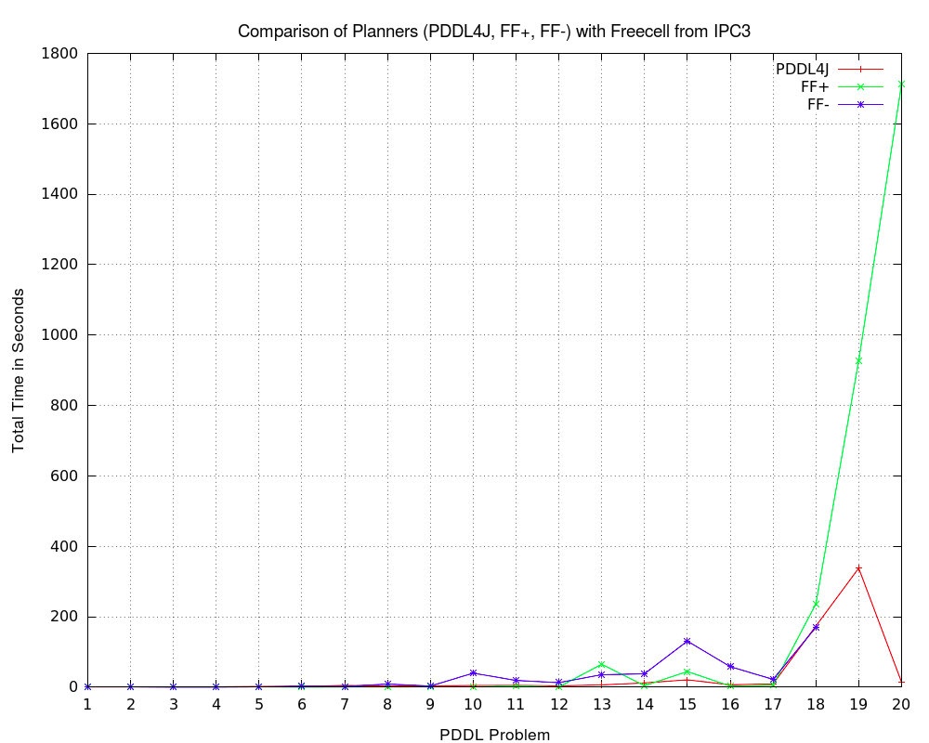
FF vs new PDDL4J
Notes:
The FF planner submitted two types, FF speed which is denoted FF+ and FF quality which is denoted FF-
If we look at the results with FF speed and FF quality on the Freecell task from the IPC 3 competition we can see that the new algorithm implemented within the library was able to match the speed of the FF planners and then with the last two problems, PDDL4J was able to solve the problems faster then FF speed. FF quality was unable to complete the last two problems. The results for this were taken from the IPC competition website and the time given to the others was longer than PDDL4J but for representation sake I allowed them to be kept in the graph. .

Slide 23
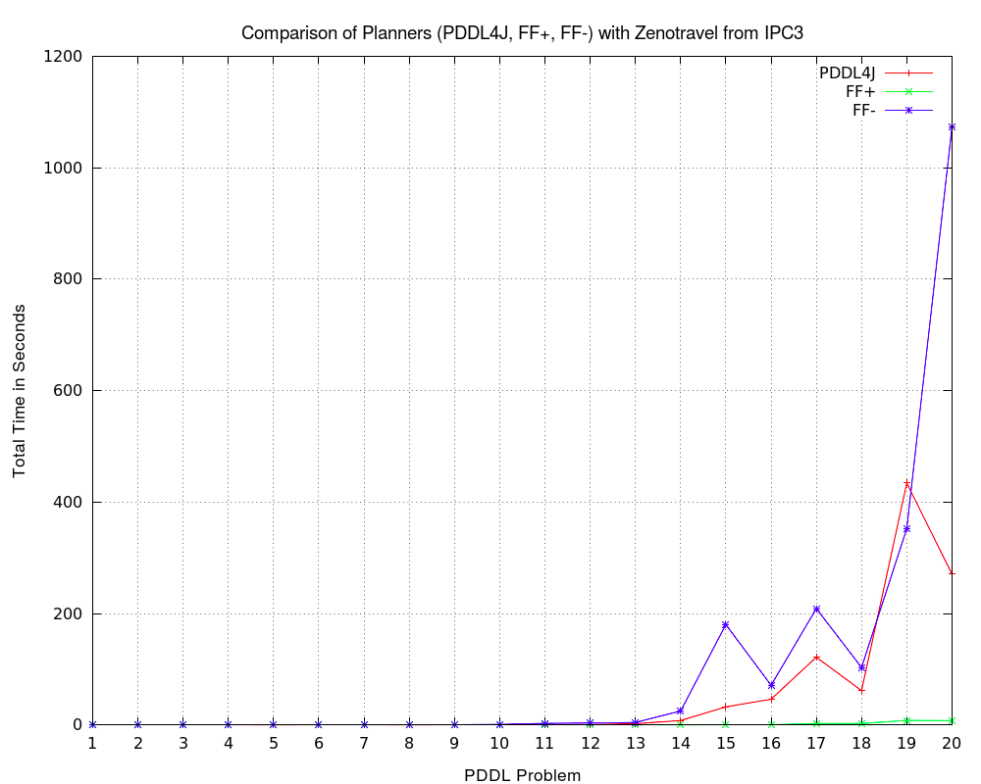
FF vs new PDDL4J
Notes:
If we look to Zenotravel which was from the competition, PDDL4J was unable to beat the FF speed but was still able to beat the FF quality in the final 6 problems, except for 19 which it was a little slower. These problems for FF speed were relatively easy and completed them all in well under 100 seconds.

Slide 24
Total Results Across the 5 Domains
The total number of tests for PDDL4J against the Fast Forward (FF speed and FF quality) planners from IPC 2004.
PDDL4J solved more problems than FF quality but not FF speed.
 | Fast Forward Quality | Fast Forward Speed | New PDDL4J
Total Number of Solved Problems | 83/102 | 97/102 | 84/102
Percentage of Solved Problems | 81.37% | 95.09% | 82.35%
Notes:
These are the total number of solved problems for the FF planners and PDDL4J. There were 102 problems in total and the results showed that the FF speed is still considerably better overall but PDDL4J was able to solve more problems than FF quality by only 1. This is a good base for continuing research in this area with potential adaptation of other heuristics., I feel that PDDL4J could rival FF speed for solved problems as well as time taken to complete the problems

Slide 25
Conclusion
From the testing and analysis of the results, we can see that GBFS with EHC is better than A*. It was able to solve more problems, in a faster time and using less memory, as we stated in the beginning.
The H^{M} heuristic did not achieve its full potential as small errors made it more difficult to obtain results because of time limit set.
Notes:
To conclude, I felt that the new search algorithm GBFS with Enforced hill climbing has proven to be the better algorithm overall in terms of sovled problems, time used and memory consumption. Even though it was unable to beat the FF speed planner as we saw in the previous slide, but it was able to provide a good basis for what can be achieved.
The HM heuristic sadly did not live up to its full potential and this could be down to the time limit set, with an increased time limit for solving problems, the results may have been a better. But we were able to see some anomalies between two admissible heuristics which could be looked in to further.

Slide 26
Future Work
Researching different techniques to be implemented within the library
  Multi-heuristic search algorithms
  New, more informed heuristics
  Satisfiability solver
Notes:
As there are a lot of different techniques and heurstics that have not been implemented within the library. I could look in to adding more heuristics to PDDL4J, like Set Additive heuristic which is able to use the relaxed version of a problem and provide a closer estimate to a goal, also for testing purposes we could incorporate VAL into the library which would be able to test the output and ensure they are logically sound.
Implementation of a satisfibility solver within the library as I worked within this area and found that using SAT is very efficient in terms of speed, memory and plan size at solving all types of PDDL problems.
Multi-heuristic algorithms like A* have been starting to emmerge but no real work has been done with classical planning with multiheuristic values so this could be a potential research opportunity.

Slide 27
Thank you for your attention,
I will now answer any questions

Slide 28
How does GBFS with EHC work?
We perform EHC in each state to pick the best valued successor in a search tree. This can lead to an optimal solution as long as there are no dead-ends within the problem (which is possible)
When this happens, the GBFS algorithm takes over and because it keeps the parents of the nodes stored, then it is able to back track and hopefully find a solution to the goal without the EHC and with the heuristic.

Slide 29
STRIP and ADL
STRIPS is the most basic form of PDDL, it uses only preconditions, positive and negative effects. For an action to be applicable in any state, each of the preconditions specified must hold in that state.
ADL is an extended version of STRIPS, it uses all of the above as well as disjunctive, quantified and negative preconditions. ie. In ADL, we can have a precondition( A, B, C) in STRIPS we would need to have three instances, precondition(A). precondition(B) and precondition(C)

