Slide 1
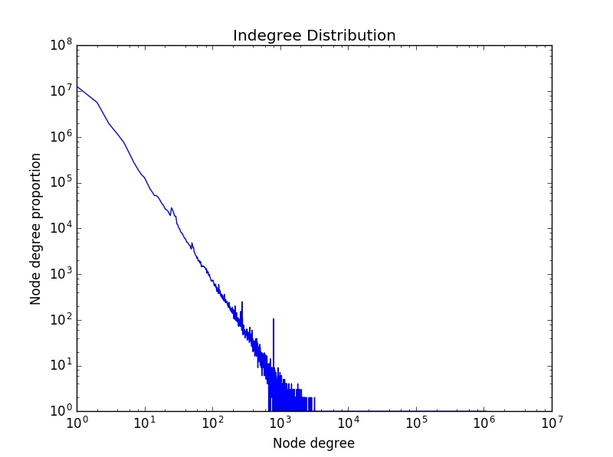
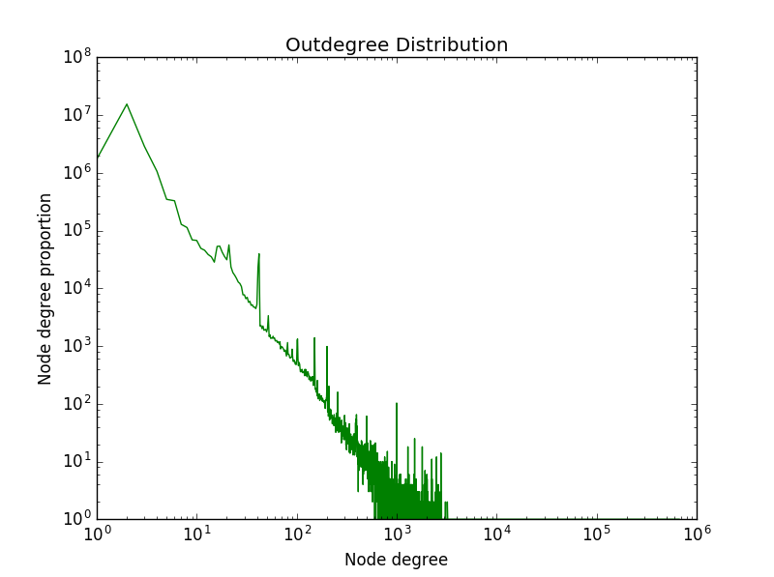
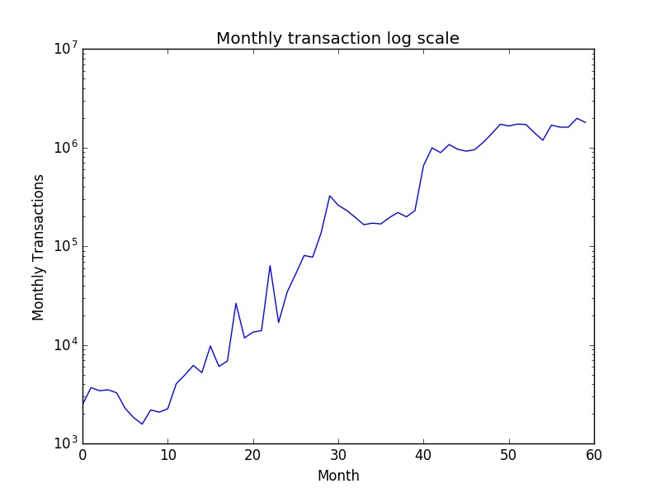
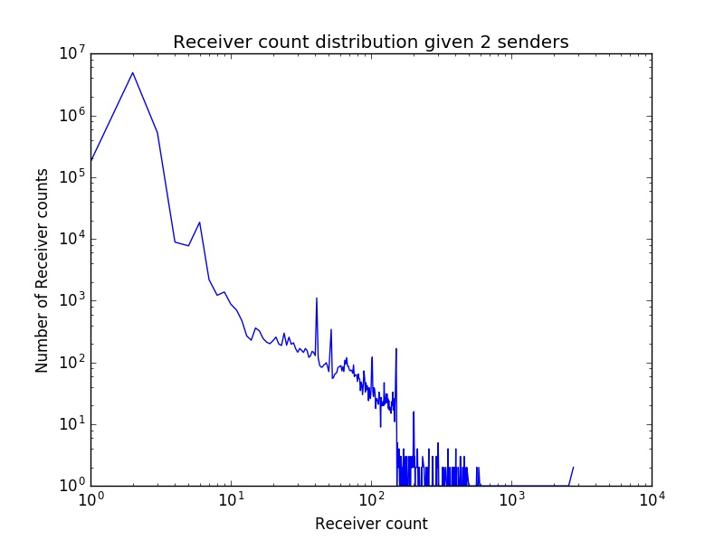
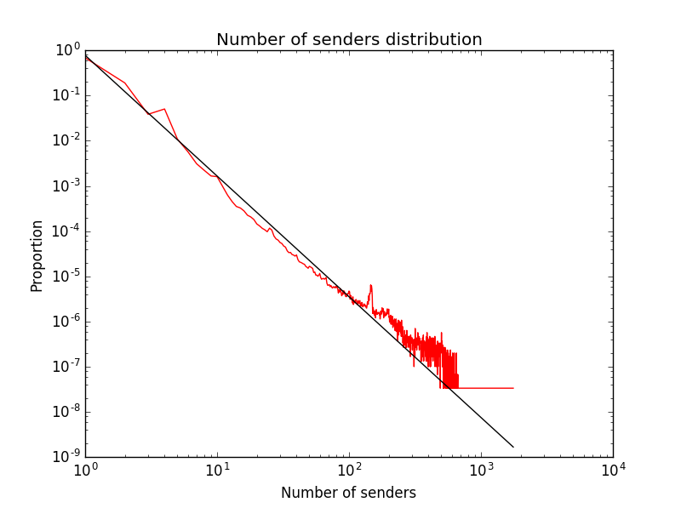
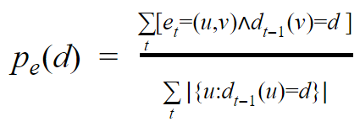
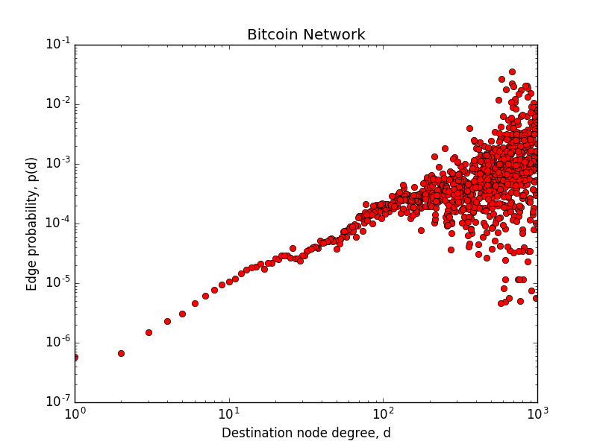
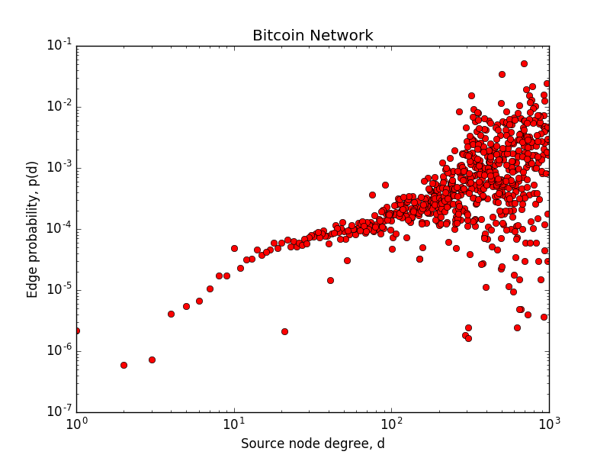
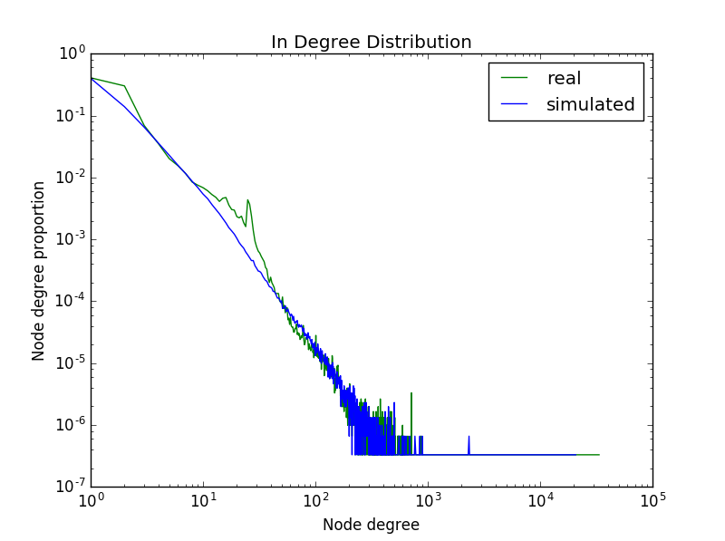
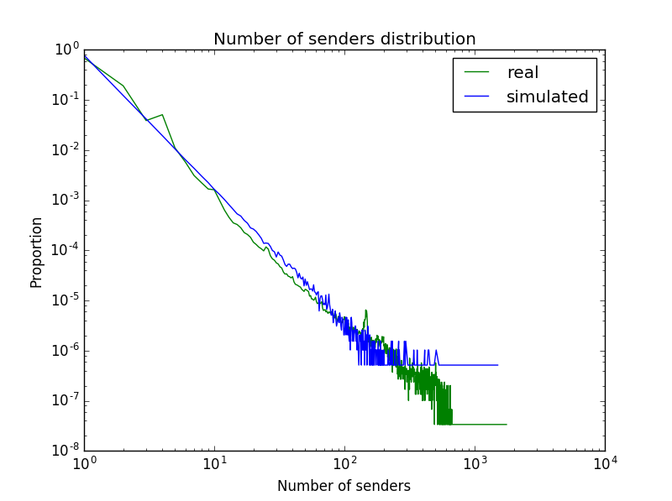
Structure and Evolution of Bitcoin Transaction network
Aaron Brackett, Yixin Cai, Lucas Liu
Department of Computer Science, Stanford University
Abstract
Introduction
Conclusion
We pursued our project in three steps.
  First, we took detailed measurements
  Second, we tried to understand the evolutionary mechanism underlying the transaction network.
  Last, we developed a mathematical model based on our metrics from the first step and generated a simulation network using this model.
We obtained the following results
  As discovered in our related work, the degree distribution of the network matches a power law
  New nodes seem to follow some preferential attachment, preferring nodes with higher degrees
  Our simulated graph had a very similar number of nodes, a close number of edges, but a significantly smaller diameter.
Bitcoin is a new cryptocurrency
The transactions of all users are stored in the block chain
Now have the data to study financial systems
Able to study how a recently started network evolves and grows
Studied how other researchers were able to simulate other networks, hoped to do the same for the Bitcoin Network
Gathered Data from ELTE Bitcoin project
Represented network as a directed graph
Model successfully captured how a transaction affects the growth of the Bitcoin network
Does not take into consideration are mostly the internal structure of the Bitcoin network
Failed to model the V-shaped sender number distribution
Can explore seasonal fluctuation, community structure, node Bitcoin balance and edge occurrence counts in the future
Graph Statistics
Preferential Attachment
Want to determine whether the destination node of a new edge is chosen proportional to the destination’s degree
Divide our data into monthly graphs
Both source and destination nodes are more likely to get attached to a node with higher degrees
Simulation Algorithm
Simulation Results
Generate the total number of transaction based on the exponential model.
For each transaction, randomly select the number of senders according to power law.
Given number of senders, we determine max number of recipient from our power law model and set min number as 1. We normalize the number of recipient distribution based on the max number, then select the number of recipients randomly according to the distribution.
Senders and Receivers have a certain probability to be new nodes
We choose existing senders and existing recipients proportional to node degree. Ideally we should have a p where with probability p the node is chosen uniformly random and with (1-p) node is chosen according to node degree, but we do not have time to tune with different p values due to the large number of transactions.
After the sender nodes and recipients nodes are selected, we add new nodes to the existing graph, and add edges between each pair of sender and recipient..
Repeat for the number of transaction times.
 | Real graph | Simulated graph
Nodes | 3031288 | 3441156
Edges | 10986324 | 7655108
Diameter | 25.5428182905 | 8.24465871597

