Slide 1


HTML & CSS: FUNDAMENTALS OF DEVELOPMENT
Instructor: Aaron Bronow
Week 5

Slide 2

SESSION OVERVIEW
Review Week Four
CSS positioning
Responsive design
Fun CSS tricks
Evaluations

Slide 3

REVIEW!

Slide 4
{} classes and ids
You can add class and id to any HTML element to identify it for styling.
You decide the class and id values – be descriptive!
<p class="important">Big text</p>
<p class="anyLettersOrNumbersOr_Or-">Still totally valid</p>

Slide 5
{} classes
Multiple elements can have the same class
In CSS, target a class with a period
.kittens { color: gray; }
<p class="kittens">This will be gray.</p>

Slide 6
{} ids
Only one element per page can use the same id
In CSS, target an id with a hash:
#kittenContainer { color: gray; }
<div id="kittenContainer">This will be gray.</div>

Slide 7
{} how to choose between them
If you think it’s likely or possible that you’ll want to apply the same style to multiple things, definitely use class
If your element is guaranteed to be the only one on the page, you can use id – or you can still use class
If your element needs to be linked to directly, use id

Slide 8
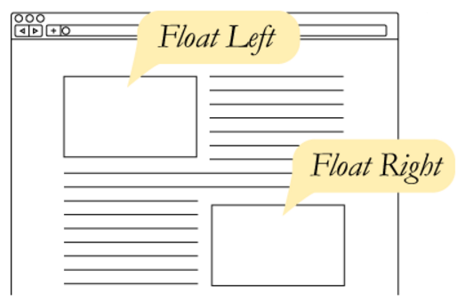
CSS Floats
The float property takes an element out of the normal flow and “floats” it to the left or right side of its container.
This allows other content
to flow around it
img { float: left; }

Slide 9
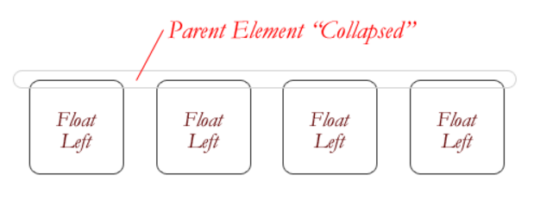
CSS Floats
The three values for float are:
left
right
none
If everything in a container is floated, then the container thinks it’s empty.

Slide 10
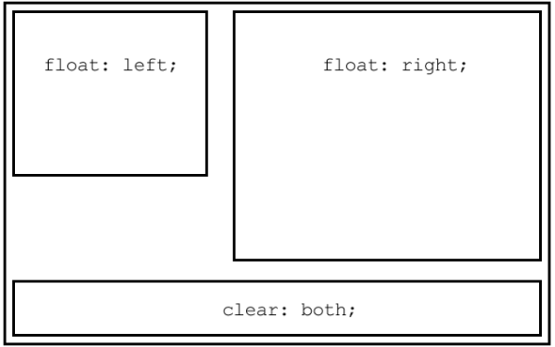
The CLEAR PROPERTY
The clear property is the sister property to float
It doesn’t do much until there are floated elements on the page
An element with clear applied to it will force itself below the floated element
Everything after that will be back in the normal flow
This “stretches” out the container and keeps it from collapsing

Slide 11
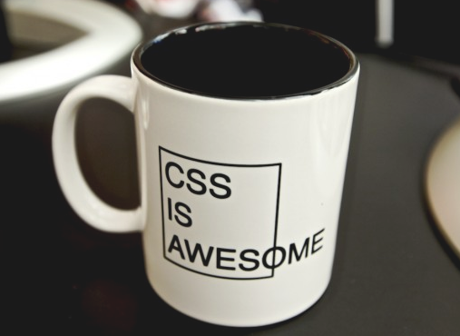
The overflow PROPERTY
overflow is a CSS property that governs how content looks when it breaks out of its container.
By default, elements have
overflow: visible,
which means all content
is fully visible.
overflow: auto
adds scrollbars when
the content is bigger than
its container.

Slide 12
QUESTIONS?

Slide 13

CSS POSITIONING

Slide 14
3 web layout properties
display: dictates how elements behave within the box model
float: moves elements around within the page flow
position: takes elements entirely out of the page flow

Slide 15
CSS POSITIONing
The position property specifies how an element is positioned on the page. Possible values are:
static
fixed
absolute
relative
The default position is static, which just means that the element obeys whatever its box model rules tell it to do.

Slide 16
CSS POSITIONing
There are 4 directional properties that affect positioning:
left
right
top
bottom
The value is a number (positive or negative) followed by a unit.
They define how far an element is offset that direction.

Slide 17
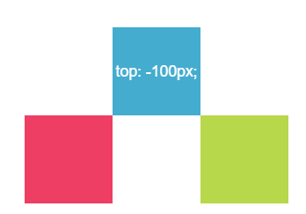
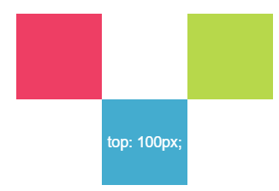
CSS POSITIONing
top defines how far an element is offset from its original top edge.
Positive top values push an element down
Negative top values push an element up

Slide 18
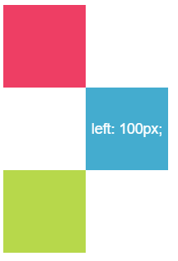
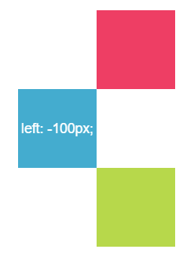
CSS POSITIONing
Similarly, left defines how far it’s offset from its original left edge.
Positive left values push an element right
Negative left values push an element left

Slide 19
POSITION: FIXED
position: fixed makes content “stick” to the browser window, regardless of where the user scrolls.
Commonly used to make headers, navigation menus, or sidebars that follow the page as it scrolls.
nav {
position: fixed;
left: 0;
top: 0;
}
Hard to describe, see a live demo

Slide 20
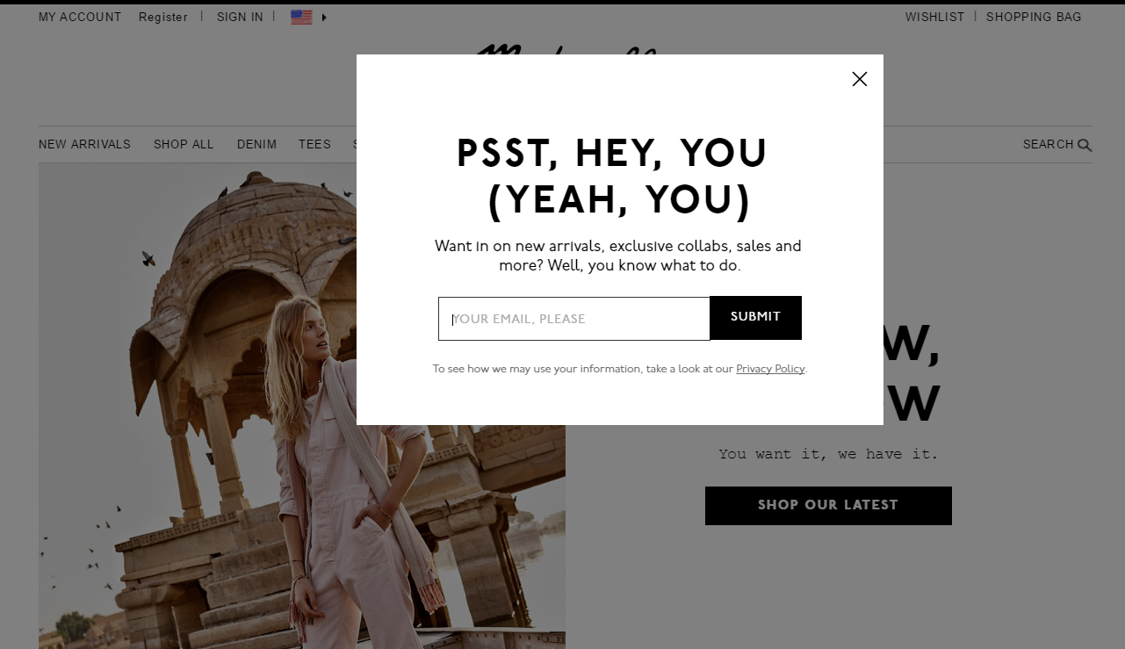
Fixed
This popup background uses position: fixed to grey-out the entire page, even if the user scrolls.

Slide 21
absolute
position: absolute is a powerful tool that allows you to place any page element exactly where you want it, down to the pixel.
When an element has position: absolute, it is entirely removed from the normal flow of the page.
That means its padding, margins, and borders no longer affect the elements around it

Slide 22
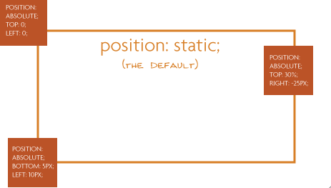
absolute
An element with position: absolute is absolutely positioned:
To its closest parent with positioning
Or if it has no parents with positioning (other than static), to the body of the page

Slide 23
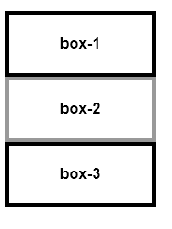
Default positioning
Remember that by default, block elements full up their entire row, and push any content to the next line, like this:

Slide 24
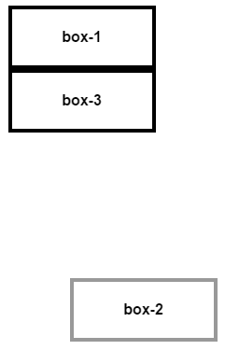
absolute
If we give box-2 absolute positioning:
#box-2 {
position: absolute;
right: 0px;
bottom: 0px;
}
box-2 is moved to the bottom right of the page
box-3 moves up to occupy the space
vacated by box-2

Slide 25

Absolute power
position: absolute is commonly used when creating page modals that pop up over other content

Slide 26
Get your z’s
When you start changing how elements are positioned, you may need to specify which ones should be “on top”, if they begin to overlap.
Elements with no position declared will appear under elements that have absolute, fixed, or relative positioning
By default, the last item on the webpage will appear on top of earlier elements that have the same type of position

Slide 27
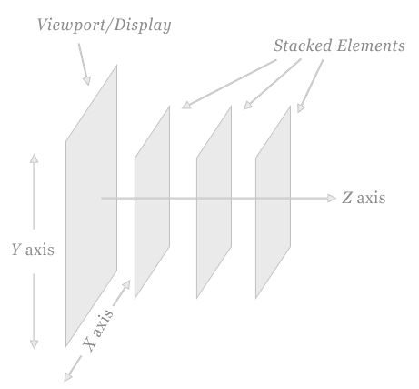
Get your z’s
The CSS property z-index can be applied to force an element with position on top of any other by giving it a higher number
By default all elements have z-index: 0
Can assign negative or positive values to z-index

Slide 28
relative
position: relative allows you to move an element using directional attributes (top, bottom, etc).
If you set position: relative but no directional attributes, the element won’t change at all
If you set top: 10px; then it will be shifted 10 pixels down from where it would normally be

Slide 29
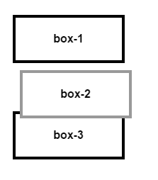
relative
box-2 has the following style, which moves it down and right:
The other boxes behave like box-2 was in its original position (unlike using negative margins).
#box-2 {
position: relative;
left: 10px;
top: 10px;
}

Slide 30
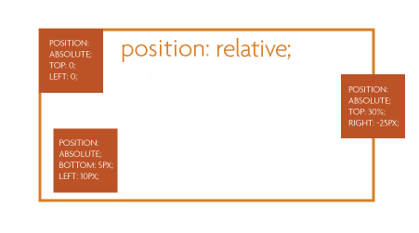
relative
More commonly, position: relative is used to position other absolutely-positioned elements inside the container

Slide 31

PRACTICE TIME!

Slide 32
ASSIGNMENT
Create a new page using this page as a template:
Modal Demo
Write CSS so that the modal (the div with the class modal) appears over the boilerplate text
Apply box model properties to the content until it looks nice
Hint: Recall that you target a class in CSS like this:
.modal

Slide 33
Responsive
design

Slide 34
Mobile first
An important principle of responsive design is “Mobile First”
Both design and code should default to mobile resolution, adding progressive enhancements as the screen gets larger
One benefit of considering mobile first is that it trims down website content to its most vital elements
Mobile first = content first

Slide 35
Responsive != adaptive
Responsive design means that your design (and code) needs to function on a continuum of devices and screen sizes
Although you should make care that things look great at specific “breakpoints” (640px wide for iPhone 4/5, 768px for iPad), it’s just as important to make sure things look good at any resolution
Users resize their browser windows
Technology changes

Slide 36


Example – mobile

Slide 37

Example – desktop

Slide 38
Media queries
Media queries are used to apply different CSS to different devices.
Some things you can use a media query to detect:
The minimum or maximum screen height or width
Whether the screen is rotated (in “landscape view”)
If the page is being printed
If the user is on a touch screen device
The screen’s resolution

Slide 39
Media queries
Media queries have a different format than any other CSS we’ve seen so far
They always start with @media and have curly braces that contain all the CSS that applies to that media query rule
Multiple rules can be tested for, separated by and
@media (max-width: 480px) and (orientation: landscape) {
}

Slide 40
Media queries
To specify different styles when a webpage is being printed, use this media query:
@media print {}
This allows you to format your page so that it looks better on paper
Remove dark colored backgrounds
Make the page full screen
Remove non-essential page elements (such as navigation links)

Slide 41
Media queries
Most modern “mobile first” websites have CSS that applies to phone-sized screens first
Then, anything specific to bigger screens goes in media queries that test for a minimum screen width, like this:
@media (min-width: 768px) {
}

Slide 42
Media queries
/* CSS that is used for phones, and also
applies generally
*/
@media (min-width: 768px) {
/* CSS that is different for tablets */
}
@media (min-width: 920px) {
/* CSS that is different for desktops */
}

Slide 43
Media queries - example
h1 {
font-size: 12px;
color: gray;
}
@media (min-width: 768px) {
h1 { font-size: 20px; }
}
@media (min-width: 920px) {
h1 { font-size: 25px; }
}

Slide 44
PRACTICE TIME!

Slide 45
ASSIGNMENT
Apply a media query to an element on your page so that it looks different when you resize your browser screen
Things to consider doing:
Float a section right only in desktop
Give buttons or links in navigation a bigger “click target” in mobile

Slide 46
Fun CSS tricks

Slide 47
filter
The filter property can be used to apply graphical effects similar to Photoshop filters on images, backgrounds, or borders.
Some options include blur, grayscale, brightness, saturate, and sepia.
Its value is one of the above options, followed by parenthesis indicating how much to apply the effect, like this:
img { filter: grayscale(1); }

Slide 48
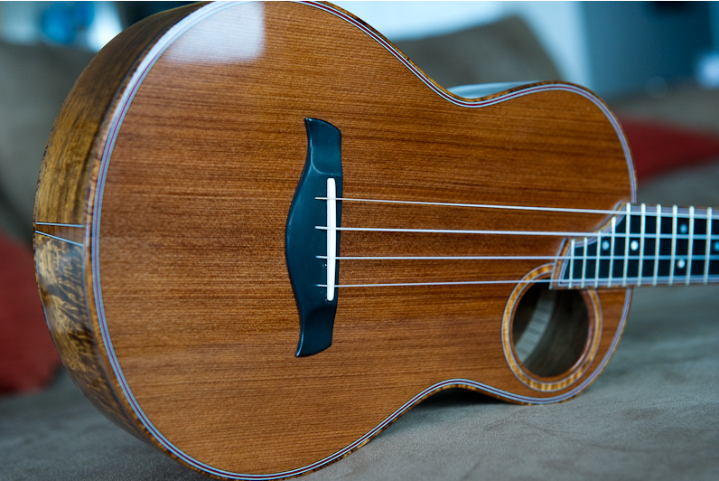

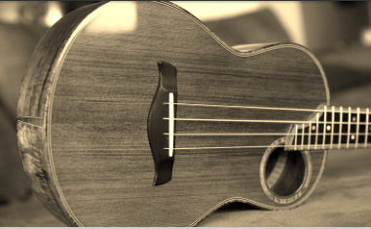
filter
Original image
filter: grayscale(1);
Converts the image to gray. 1 is fully gray, 0 is original. Any value between 0 and 1 is allowed
filter: sepia(1);
Converts the image to sepia. 1 is fully sepia, 0 is original. Any value between 0 and 1 is allowed

Slide 49
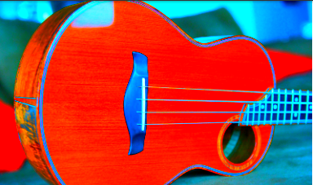
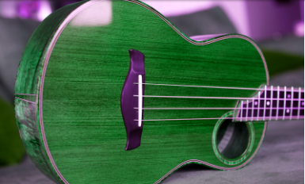
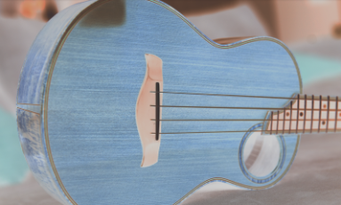
filter
filter: saturate(8);
Larger values are more saturated. Anything under 1 will make the element less saturated than the original
filter: hue-rotate(90deg);
Must be an angle of rotation in degrees, that will affect how far around the color circle the input is adjusted
filter: invert(.8);
Must be a percentage. Flips RGB values by that amount

Slide 50
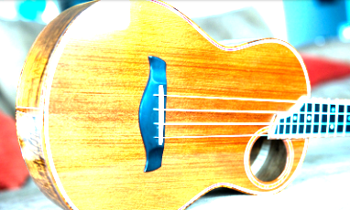
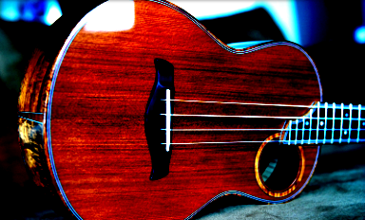
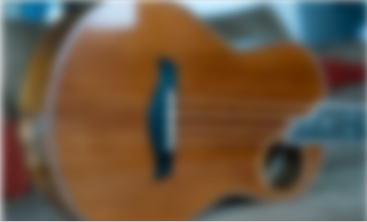
filter
filter: brightness(3);
Larger values are brighter. Anything under 1 will make the element darker
filter: contrast(4);
Larger values apply greater contrast. Anything under 1 will apply less contrast than the original
filter: blur(5px);
Applies a Gaussian blur. The px value is how many pixels will blend into each other

Slide 51
Animate
To allow elements on your page to animate using CSS, use the transition property
By default, an element that transforms will change abruptly – for example, when you changed the text color of links using :hover
transition makes those changes occur smoothly over time, instead of suddenly

Slide 52
Animate
nav { transition: all 1s; }
This means, animate all CSS properties that happen to nav for 1 second
The first value: which CSS properties can be animated
The second value: how long the animation should take to finish
Separate the values with spaces

Slide 53
Animate
Until there is a CSS property that changes, transition won’t have any noticeable effect
Remember that you can give any element a different style when the user hovers on it
Use the CSS rule :hover
This will allow us to see the animation effect as the style changes from one value to another

Slide 54
Filter on hover
img {
filter: grayscale(0);
transition: all 1s;
}
img:hover {
filter: grayscale(1);
}
Note that a grayscale of 0 (ie, none) is applied to the “normal” image. This allows the transition to run both when the user hovers and when they move their mouse away

Slide 55
transformation
The transform property lets you manipulate an element by skewing, rotating, moving, or scaling
Like filter, the value is the type of transformation you want to apply, with the degree of transformation inside parentheses
.bigger {
transform: scale(20);
}

Slide 56
transformation
transform options include:
scale – changes the size of an element
skew – tilts the element
rotate – rotates the element a specified number of degrees
translate – moves an element

Slide 57
transformation
Potential uses for transform:
Flip an arrow when sorting or expanding a menu
.toggle {
transform: rotateZ(0deg);
transition: all .11s;
}
.toggle:hover {
transform: rotateZ(180deg);
}

Slide 58
transformation
“Lift” a card when the user interacts with it
.card {
transform: scale(1);
transition: all .15s ease-in;
}
. card:hover {
transform: scale(1.01);
}

Slide 59
Practice time!

Slide 60
Play with animation
Apply transition to at least one element on your page
Give that element a different style on hover so that you can see the animation occur
Apply filter or transform to at least one element on your page
Play with all the possibilities!
Reference https://robots.thoughtbot.com/transitions-and-transforms to see more options for transform

Slide 61
“the end”

Slide 62
End times
I will be keeping all slides and demos up on the class site indefinitely
You can continue to ask me questions anytime at aaron@bronow.net

Slide 63
Thats ALL FOLKS!
Please provide feedback for this class!
https://svcseattle.com/evaluation

