Slide 1
Economic Impact of Federal Reserve Speeches
Dave Smith GitHub: davidjsmith44

Slide 2
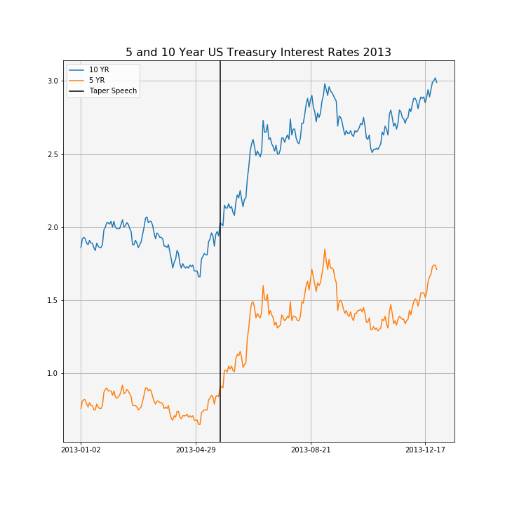
Motivation
Federal Reserve is responsible for setting short term interest rates and the money supply in an attempt to keep inflation and unemployment within an acceptable range.
Speeches and press releases by Federal Reserve Board members may provide insights into future changes in interest rates
Natural Language Processing (NLP) used to determine how different new speeches and press releases are from recent text in an attempt to explain changes in interest rates
483 public speeches from Federal Reserve Board members dating back to 2006
43 Federal Open Market Committee (the committee that votes to change interest rates) minutes since 2014

Slide 3
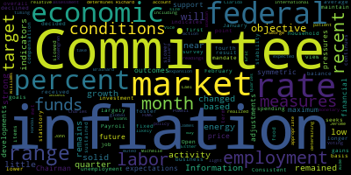
NLP
Text from speeches is highly variable based on speech title and location
Text from press releases is measured and concise

Slide 4
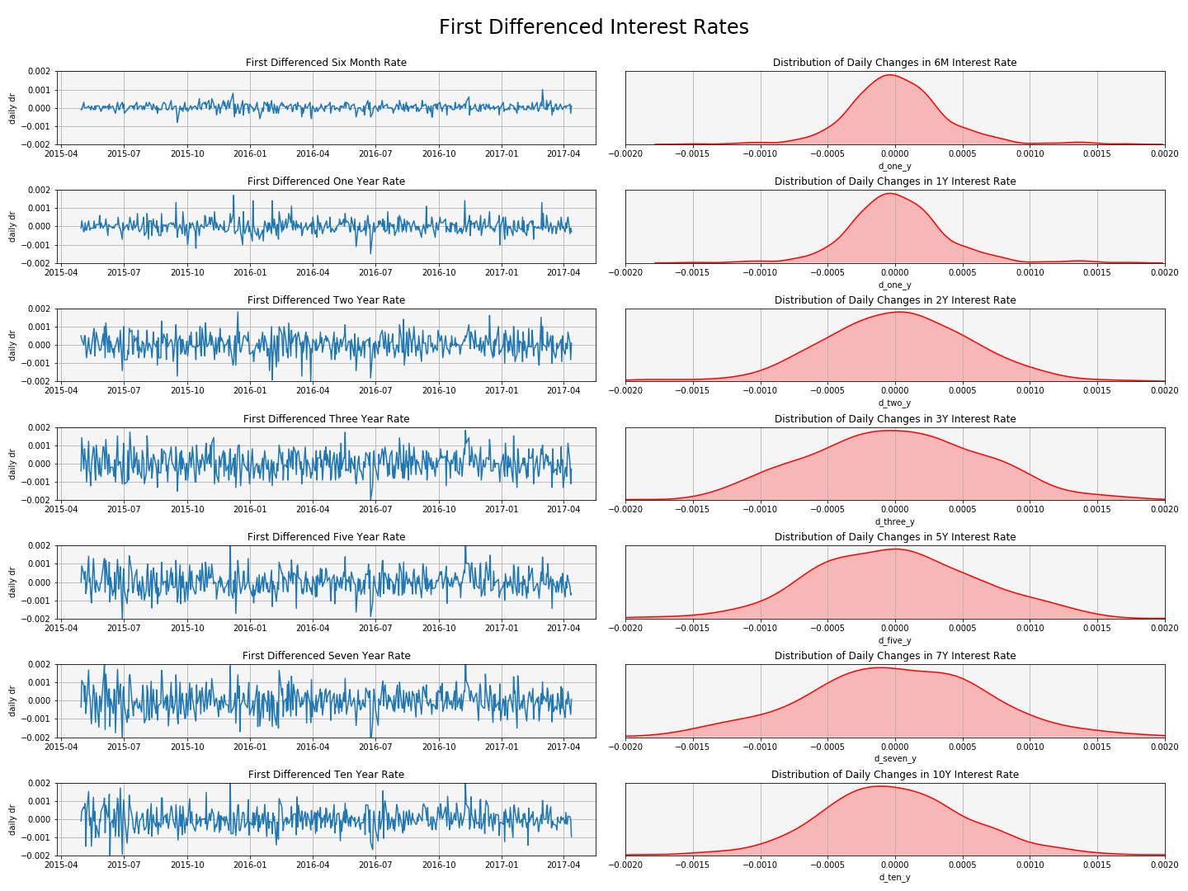
Notes:
yy776666666666

Slide 5

Time Series Models
ARIMA model for each interest rate
$∆^{D}r_{t}=\sum_{i=1}^{p}{∅_{i}}$ $∆^{D}r_{t−1}$+ $\sum_{j=1}^{q}{θ_{j}}$ $ε_{t−1}+ε_{t}$
ARIMAX model for each forward rate
$∆^{D}r_{t}=\sum_{i=1}^{p}{∅_{i}}$ $∆^{D}r_{t−1}$+ $\sum_{j=1}^{q}{θ_{j}}$ $ε_{t−1}$+ $\sum_{m=1}^{M}{β_{m}}$ $X_{m,t−1}+ε_{t}$
where p is the number of autoregressive lags,
d is the degree of differencing
q is the number of moving average lags
X is the distance metric for the new speech/minutes release
ARIMA model on principal components of all interest rates
ARIMAX model on principal components of all interest rates

Slide 6
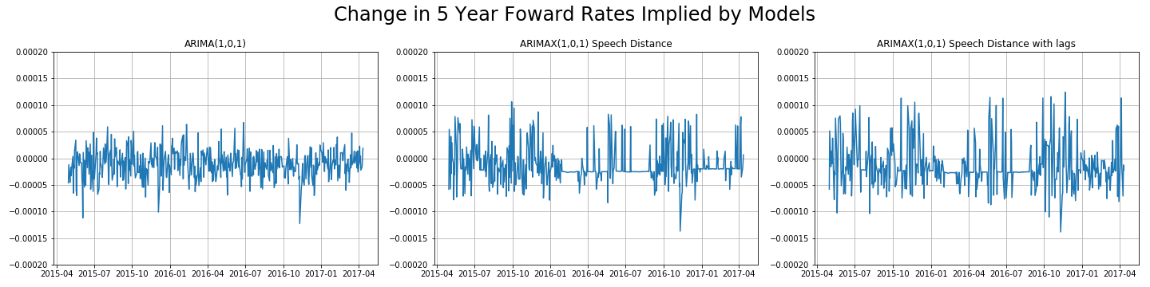
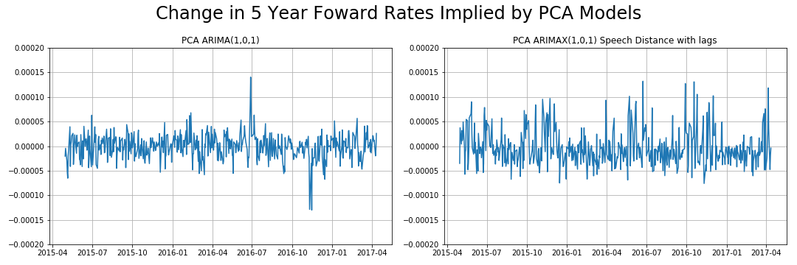

Slide 7
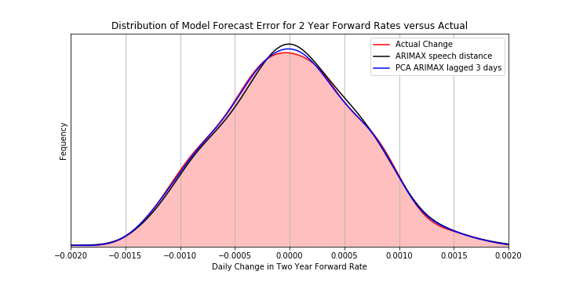
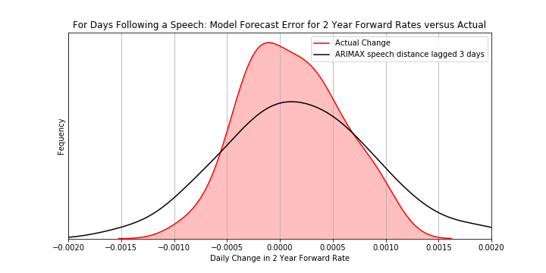
Final Model Distribution

Slide 8
Conclusions/Further Study
Time series models show very little impact on changes in interest rates based on differences in federal reserve speech and press release text
We are measuring differences in what the Fed is saying, but not differences between what the Fed says and what the market expects after seeing the same data
Potential paths for future study
Include a metric for inflation expectations that can be observed every day
Include metrics for interest rate expectations that can be observed daily
Do differences in Fed speeches impact the volatility of interest rates

