Slide 1
Economic Impact of Federal Reserve Speeches
Dave Smith
GitHub: davidjsmith44

Slide 2
Motivation
Federal Reserve is responsible for setting short term interest rates in an attempt to keep inflation and unemployment within an acceptable range.
Federal Reserve Governor speeches can provide insights into future changes in interest rates
INSERT MOST IMPORTANT WORDS
CHART OF THE DIFFERENCES HERE

Slide 3
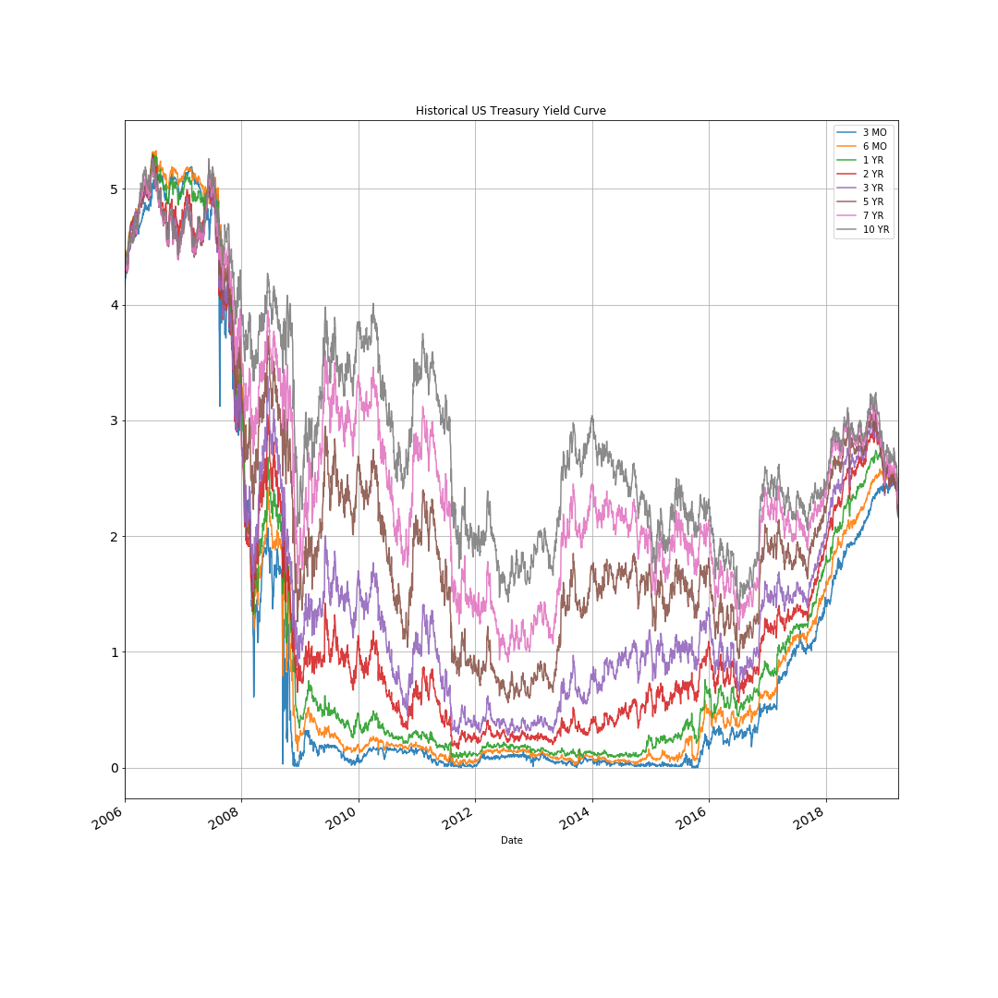

Slide 4
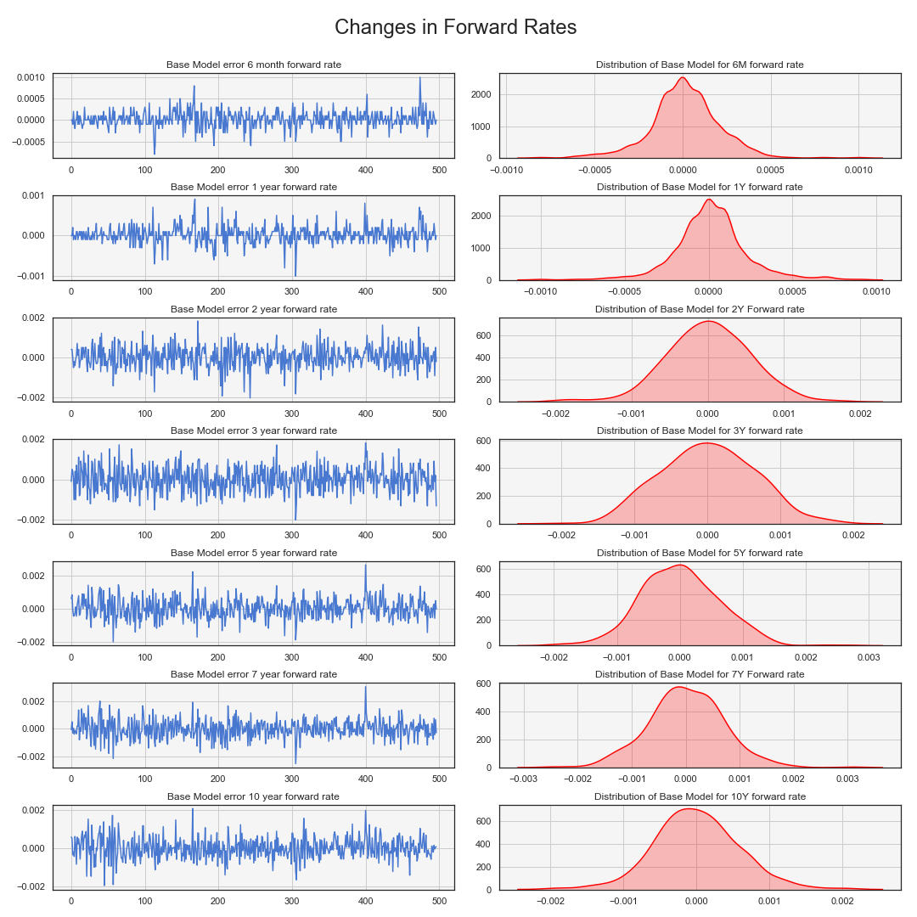
Notes:
yy776666666666

Slide 5
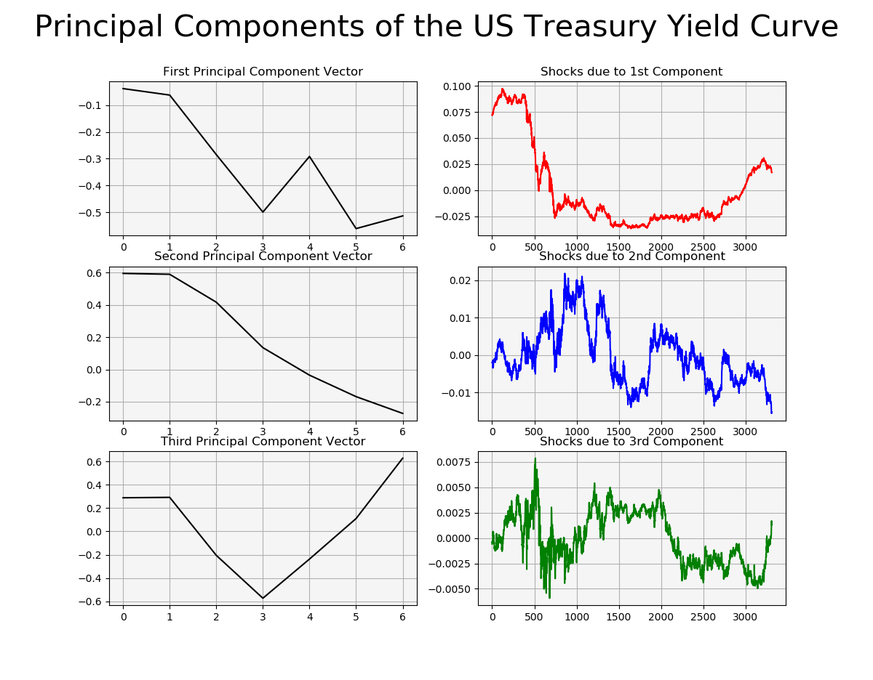
ARIMA model for each interest rate
ARIMAX model for each forward rate
ARIMA model on principal components of all interest rates
ARIMAX model on principal components of all interest rates

Slide 6
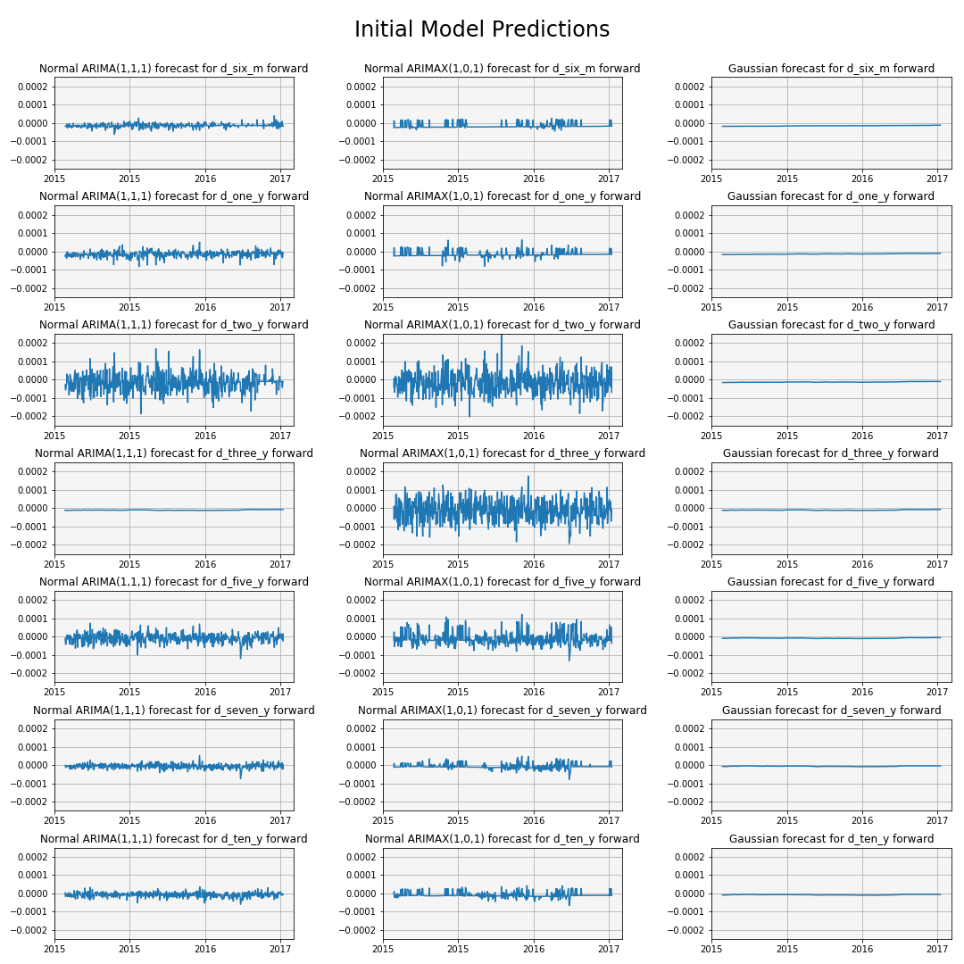

Slide 7
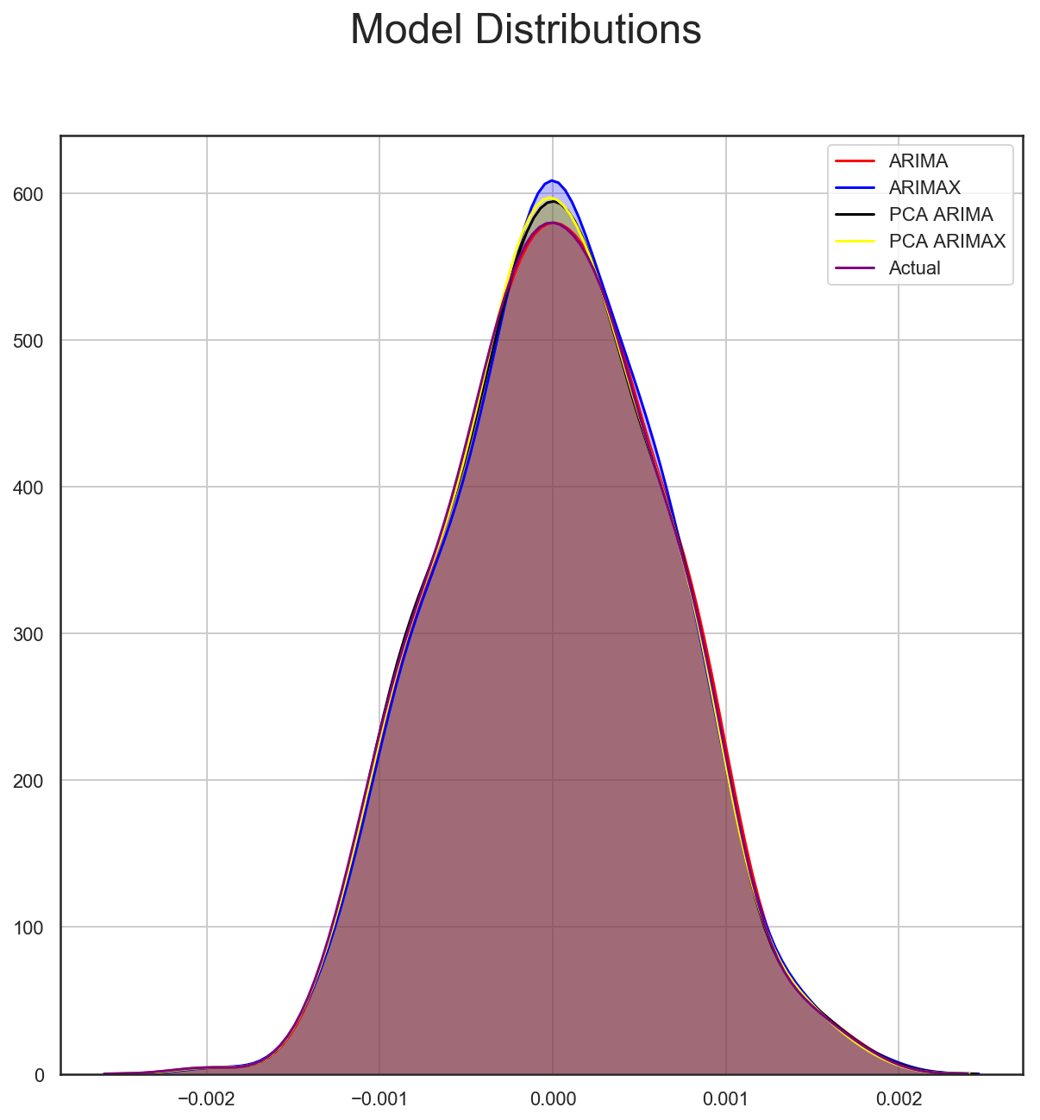
Final Distributions relative to Actual

