Slide 1

Final Project Machine Learning with H2O.ai
Galvin, Owen
CSCI E-63 Big Data Analytics
2016
Harvard University Extension School
Prof. Zoran B. Djordjević

Slide 2
H2O.ai – the company
founded in 2011 by SriSatish “Sri” Ambati, who previously co-founded Platfora, and Cliff Click, the lead developer of the Java Virtual Machine
Their “Scientific Advisory Council” has some big names in the world of machine learning, include below Stanford professors:
Stephen Boyd
Robert Tibshiranii
Trevor Hastie

Slide 3
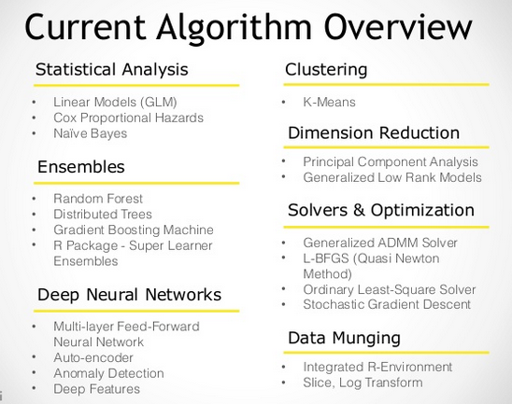
and the tech

Slide 4
Problem Statement
Illustrate use of both simple and multiple linear regression in H2O.ai using movie data set. Examples are in Python
simple linear regression
predict average critic’s rating by using a calculated value that attempts to estimate “star power” of a movie combined with the average audience rating
visualize the results via D3
multiple linear regression
predict average critic’s ratings using above value plus several more features available in the combined dataset
Preceding the main event, a preliminary assessment of the same regression techniques using the Small Car (and explanatory and dependent variables) from Assignment 11
visualize the results in D3, comparing to model produced by Spark’s MLlib

Slide 5
Installation
Use H2O directly from Python
1. Prerequisite: Python 2.7 or 3.5
2. Install dependencies (prepending with `sudo` if needed):
[sudo] pip install -U requests
[sudo] pip install -U tabulate
[sudo] pip install -U future
[sudo] pip install -U six
3. At the command line, copy and paste these commands one line at a time:
# The following command removes the H2O module for Python.
[sudo] pip uninstall h2o
# Next, use pip to install this version of the H2O Python module.
[sudo] pip install http://h2o-release.s3.amazonaws.com/h2o/rel-turchin/3/Python/h2o-3.8.2.3-py2.py3-none-any.whl
http://www.h2o.ai/download/h2o/python

Slide 6
test, train, variables
import h2o
h2o.init() #uses all cores by default
h2o.remove_all() #clean slate, in case cluster was already running
from h2o.estimators.glm import H2OGeneralizedLinearEstimator
import numpy as np
df = h2o.import_file('small_car.csv')
#help(h2o.import_file)
train, test = df.split_frame([0.8], seed=63)
print len(train), len(test)
target_simple_Y = 'Horsepower'
exp_simple_X = 'Displacement'
target_multi_Y = 'Horsepower'
exp_multi_X = ['Cylinders', 'Displacement', 'Manufacturer', 'Model_Year', 'Origin', 'Weight']

Slide 7
create model, train, predict
glm_simple_cars = H2OGeneralizedLinearEstimator(
model_id='glm_simple_cars', #will appear in Flow by this name
family='gaussian',
solver='IRLSM' #'L_BFGS' is the other GLM solveraka
,lambda_search = True
)
glm_multi_cars = H2OGeneralizedLinearEstimator(
model_id='glm_multi_cars',
family='gaussian',
solver='IRLSM'
,lambda_search = True
)
glm_simple_cars.train(exp_simple_X, target_simple_Y, training_frame=train)
glm_multi_cars.train(exp_multi_X, target_multi_Y, training_frame=train)
glm_simple_pred = glm_simple_cars.predict(test_simple)

Slide 8
help(h2o.import_file)
Help on function import_file in module h2o.h2o:
import_file(path=None, destination_frame='', parse=True, header=(-1, 0, 1), sep='', col_names=None, col_types=None, na_strings=None)
Have H2O import a dataset into memory. The path to the data must be a valid path for
each node in the H2O cluster. If some node in the H2O cluster cannot see the file, then
an exception will be thrown by the H2O cluster. Does a parallel/distributed multi-threaded pull
of the data. Also see upload_file.
Parameters
----------
path : str
A path specifying the location of the data to import.
destination_frame : str, optional
The unique hex key assigned to the imported file. If none is given, a key will
automatically be generated.
parse : bool, optional
A logical value indicating whether the file should be parsed after import.
header : int, optional
-1 means the first line is data, 0 means guess, 1 means first line is header.
sep : str, optional
The field separator character. Values on each line of the file are separated by this
character. If sep = "", the parser will automatically detect the separator.
col_names : list, optional
A list of column names for the file. . . .

Slide 9
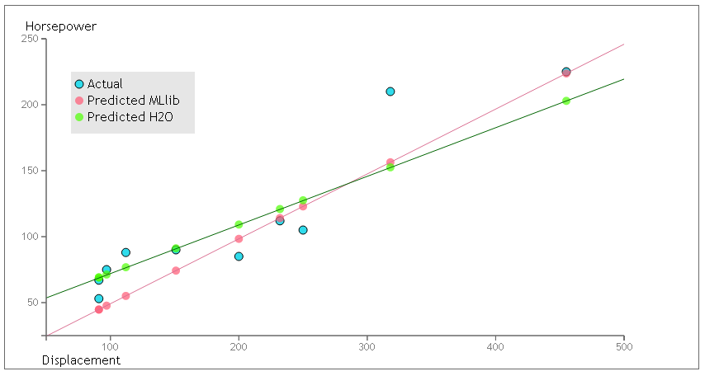
viz
Note: My MLlib had an RMSE of 23.3, H2O came up with 17.82 … but I wouldn’t read too much into the values, lots of knobs can be turned in either

Slide 10
movies
Data files: movies.dat, movie_countries.dat, movie_directors.dat, movie_genres.dat (hetrec2011-movielens-2k-v2.zip)
Description of data: Links the movies of MovieLens dataset with their corresponding web pages at Internet Movie Database (IMDb) and Rotten Tomatoes movie review systems, includes data on actors, country, genre tags, ratings from both critics and audience members.
URL To get data: original .zip @ on http://grouplens.org/datasets/hetrec-2011/. Data joined through common movie_id values via SQL Server + feature engineering to create new values. Full massaged dataset available at FP_movies.psv.
Size: Orig zip: 18MB, used .dat files: ~12MB uncompressed, final input data file: 1MB uncompressed.
Format of data file: csv orig, psv final export file for ingestion by H2O

Slide 11
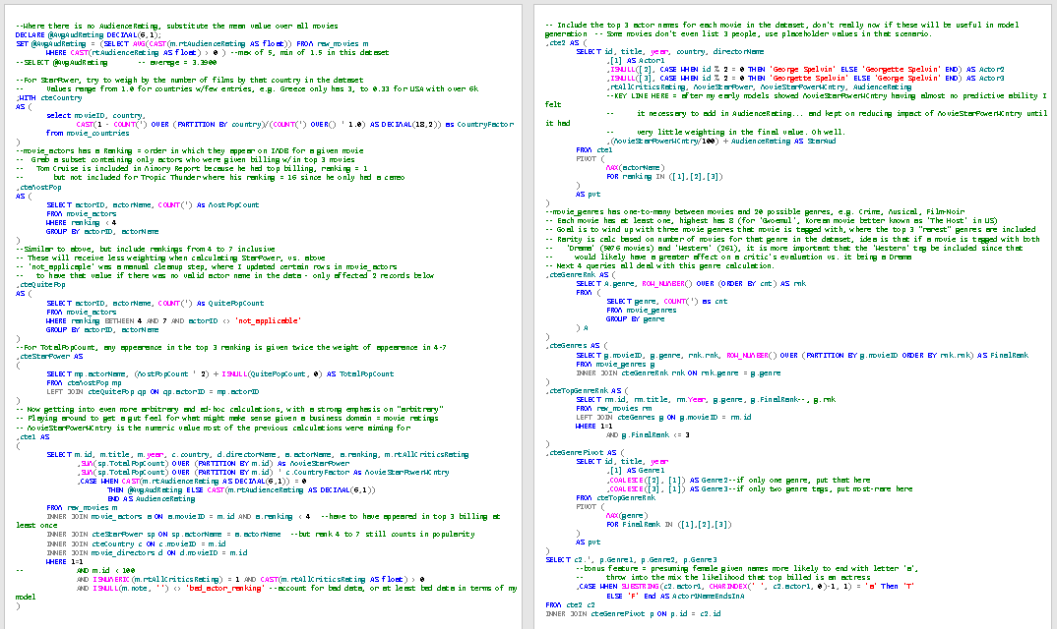
munge, engineer

Slide 12
StarAud
Original idea was to predict Box Office proceeds using the stars of a film
Unsurprisingly couldn’t find a dataset that had everything
So went with idea of predicting the average rating film critics gave a movie
dataset included order in which actors were listed on imdb, a ranking
algorithm that weighted presence in top three slots 2x in slots four to seven
then tried to offset lack of representation for smaller countries
Tried prediction with this MovieStarPowerWCntry value
it was near useless, all predicts around mean with low variance
As might be expected, AudienceRating had promise
combined that with MovieStarPowerWCntry reducing latter progressively until I got a model that would at least result in a meaningful viz
Add in a little extra (T/F value to see if top actor’s given name ends in ‘a’, which is indicative of female name) and then return some of the orig data columns: year, country, director, top 3 genre tags
,(MovieStarPowerWCntry/100) + AudienceRating AS StarAud

Slide 13
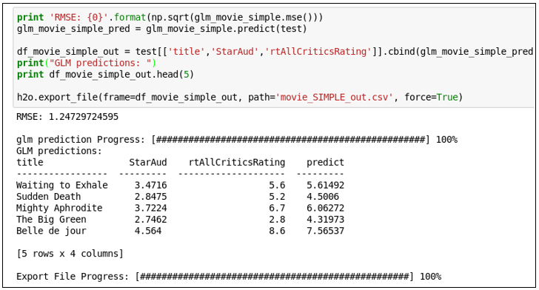
input data
sample input data
id|title|year|country|directorName|Actor1|Actor2|Actor3|rtAllCriticsRating|MovieStarPower|MovieStarPowerWCntry|AudienceRating|StarAud|Genre1|Genre2|Genre3|Actor1NameEndsInA
2|Jumanji|1995|USA|Joe Johnston|Robin Williams|Bonnie Hunt|Kirsten Dunst|5.6|159|52.47|3.2|3.724700|Children|Fantasy|Adventure|F
4|Waiting to Exhale|1995|USA|Forest Whitaker|Whitney Houston|Angela Bassett|Loretta Devine|5.6|52|17.16|3.3|3.471600|Romance|Comedy|Drama|F
9|Sudden Death|1995|USA|Peter Hyams|Jean-Claude Van Damme|Powers Boothe|Raymond J. Barry|5.2|75|24.75|2.6|2.847500|Action|Action|Action|F
H2O predicterize

Slide 14
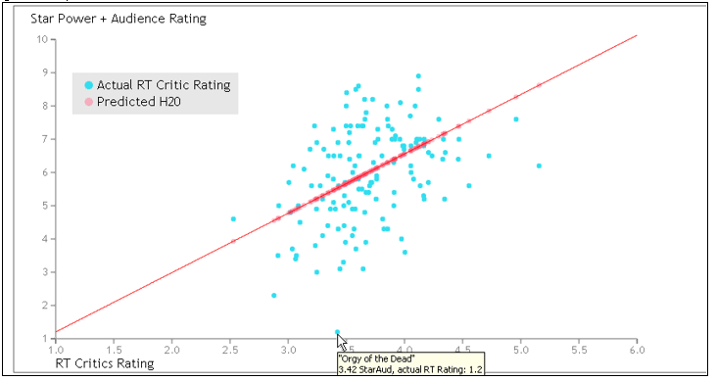
and D3 visualize

Slide 15
Lessons Learned
H2O does indeed seem like a very powerful machine learning platform, though I’m no expert
There are a lot of knobs available… and a lot of knowledge necessary to turn them correctly
The company emphasizes speed and scalability though even my ‘big data’ wasn’t so big and I couldn’t begin to judge their claims
but I believe them
The overall cohesiveness of the programming model was striking, along with the extensive documentation
R, Python and Scala fully supported, platform includes interfaces for Java, JSON, and CoffeeScript/JavaScript (+ a web-based tool named Flow)
Yes, Hadoop and Spark
“Sparkling Water”, what they call the killer app for Spark
H2O, not H20

Slide 16
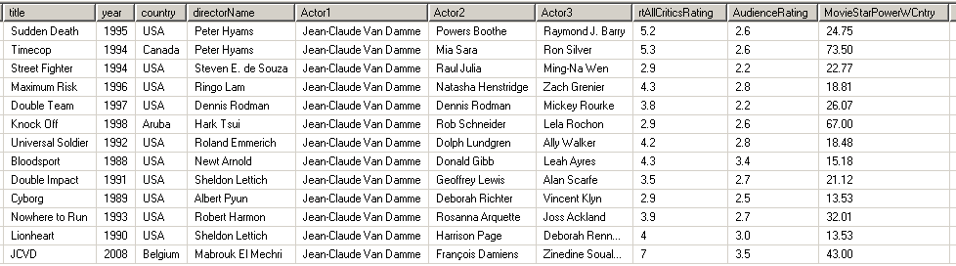
The Outlier from Brussels
StarAud didn’t work out too well, perhaps and analysis of Jean-Claude Van Damme can point out some areas for improvement
Jean-Claude Van Damme has apparently never been in a movie without receiving top billing (“Breakin’” doesn’t count) – how to account for that?
In both Double Impact and Maximum Risk he played siblings – shouldn’t he really be ranked 2nd also in each
How can TimeCop only have a critic’s rating of 5.2? Are there problems with the data?
In JCVD the movie JCVD was top-billed AND playing himself – is that unique?
Is Van Damme simply an outlier that broke the entire model? Maybe if I remove him from the dataset and do everything again…

Slide 17
YouTube URLs, Last Page
Two minute (short): https://youtu.be/uAxmUhqxOFY
15 minutes (long): https://youtu.be/OxjCc99Jer0

