Slide 1
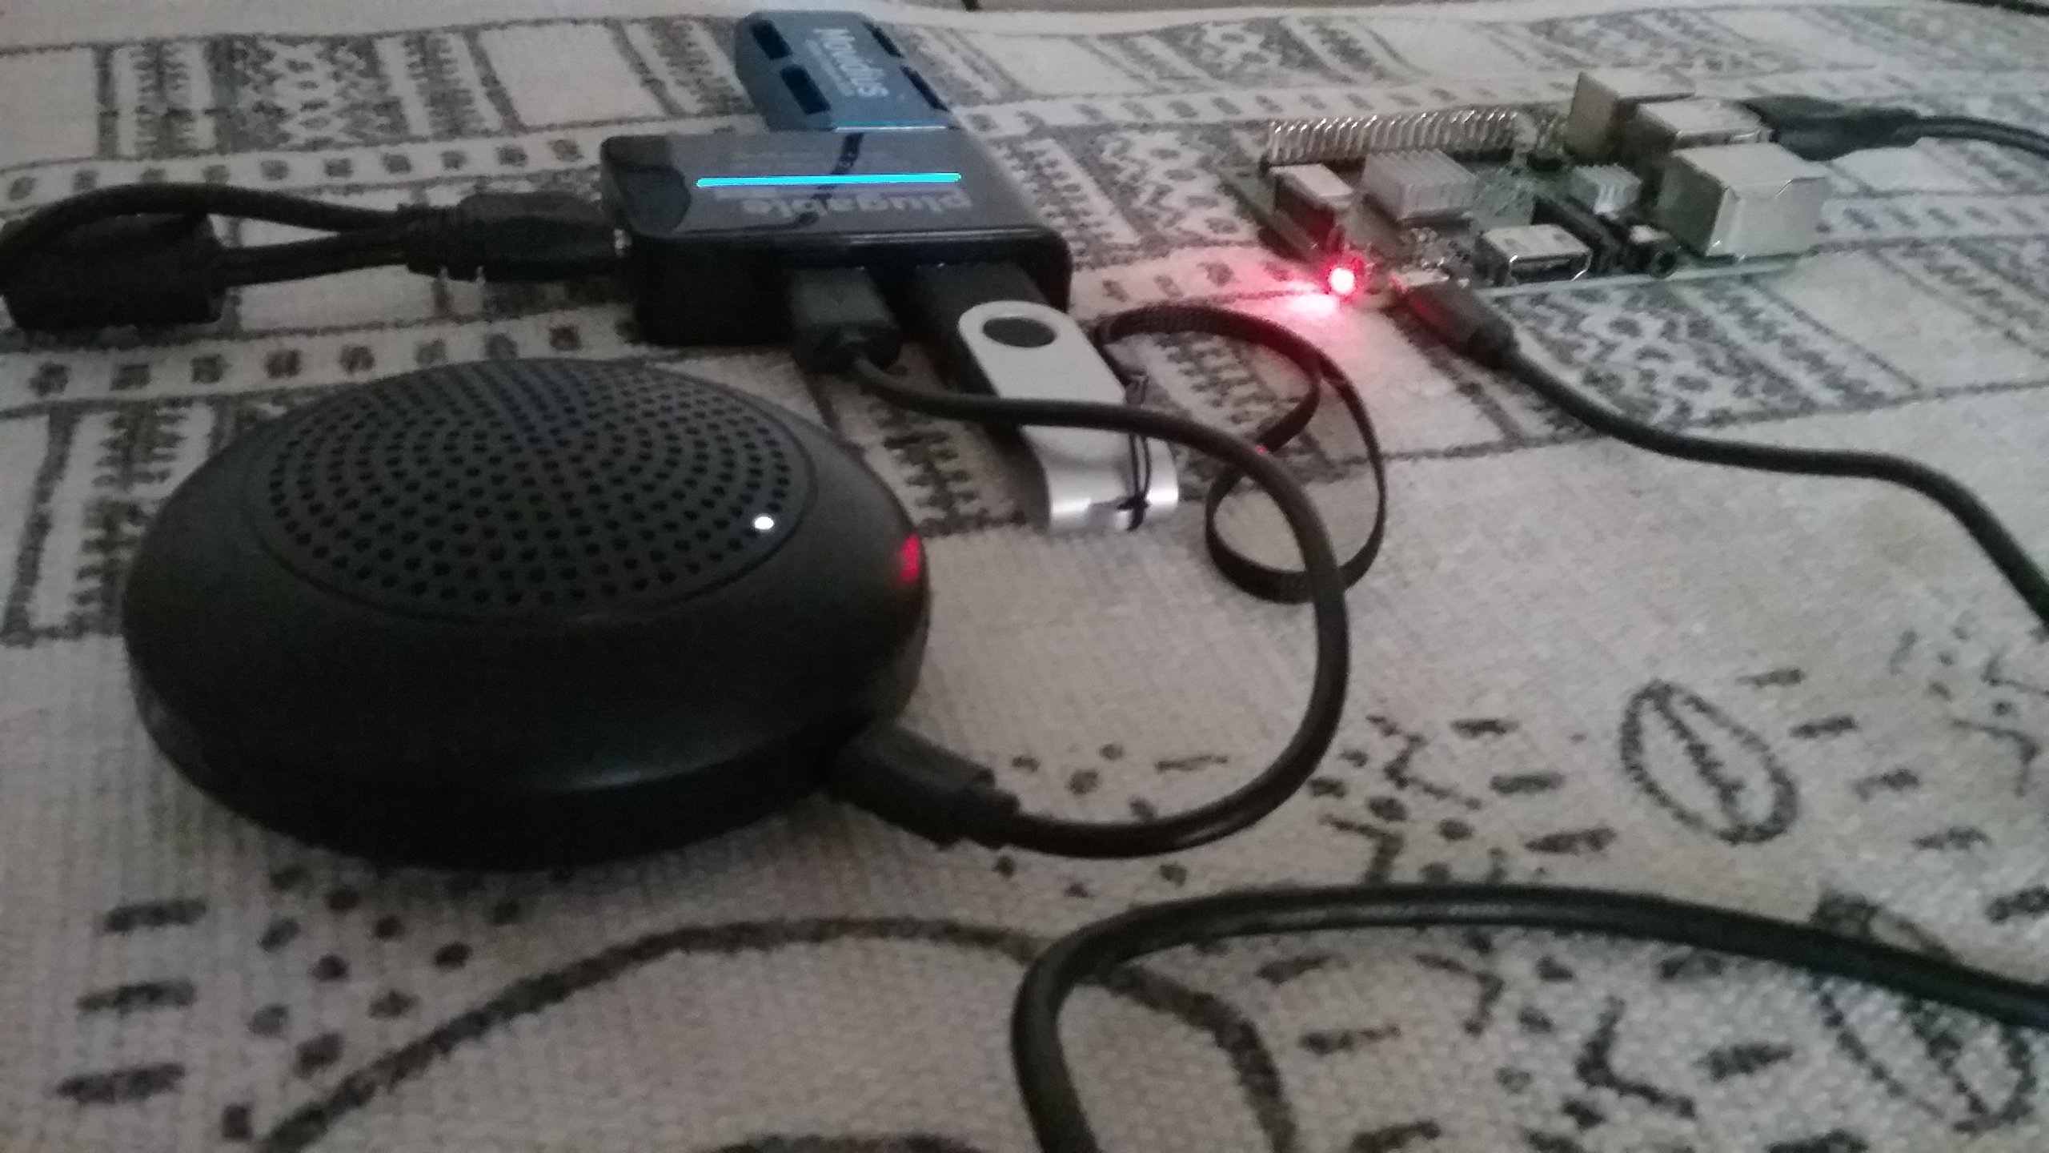
The Naomi Project

Slide 2
Outline
Why now?
  Convenience
  Safety
  Privacy
Notable OpenSource Projects
Parts of a voice assistant
  ASR
  Intent Parsing
  Text to Speech
Naomi
  Collect and format samples for training
  Simple, and developer friendly
  How can I help?

Slide 3
Why Now?
A verbal interface is helpful any time you can’t use your hands or your eyes
A verbal interface has been a goal forever
Commercial Assistants have a lot of room for improvements

Slide 4
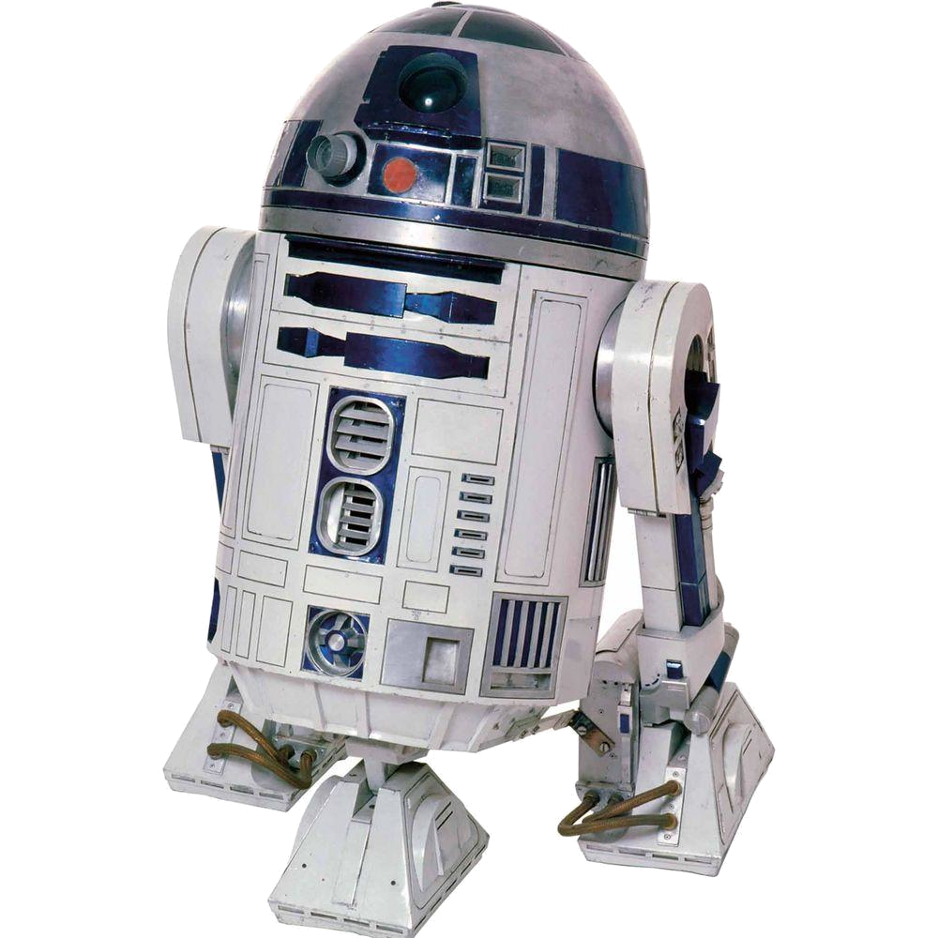
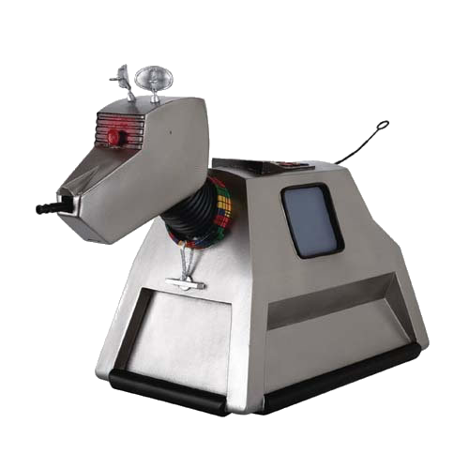
I grew up with R2D2 and K-9

Slide 5
The goal of Smart Speakers
These and other tech corporations have grand ambitions. They want to colonize space. Not interplanetary space. Everyday space: home, office, car. In the near future, everything from your lighting to your air-conditioning to your refrigerator, your coffee maker, and even your toilet could be wired to a system controlled by voice.
-SHULEVITZ, J. (2018). “Alexa, HOW WILL YOU CHANGE US?” Atlantic, 322(4), 94–104.

Slide 6
If you designed a speech assistant that you would need to work in order to flush your toilet
Reliability
Security

Slide 7
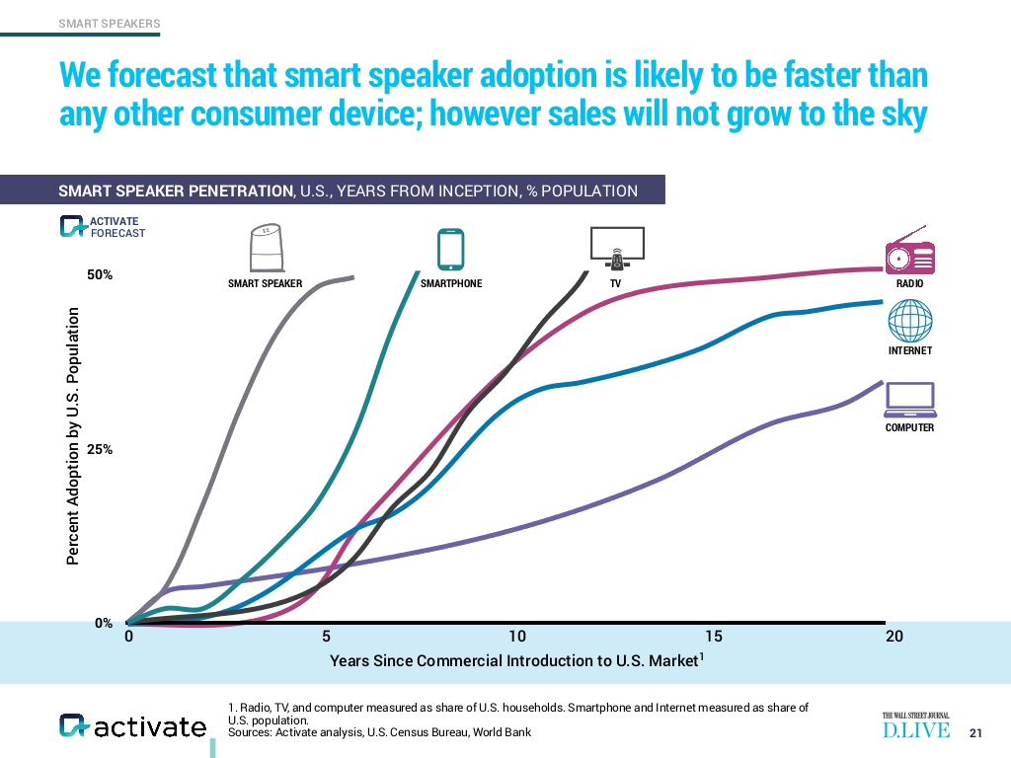
Adoption rates

Slide 8
How the public thinks smart speakers work
“...the speakers possess artificial intelligence, can conduct basic conversations, and are hooked up to the internet, which allows them to look stuff up and do things for you.”
-SHULEVITZ, J. (2018). “Alexa, HOW WILL YOU CHANGE US?” Atlantic, 322(4), 94–104.

Slide 9
How the smart speaker makers want you to think they work:
News
Weather
Music
Will it rain
tomorrow?
Speaker
Yes, it is likely
to rain tomorrow

Slide 10
How they actually work
News
Weather
Music
Server
Will it rain
tomorrow?
Speaker
Yes, it is likely
to rain tomorrow

Slide 11
Notable Open Source Assistants
Mycroft (https://mycroft.ai/)
Rhasspy (https://rhasspy.readthedocs.io/)
Almond (https://almond.stanford.edu)
Jasper (https://jasperproject.github.io/)
Naomi (https://projectnaomi.com)

Slide 12
Mycroft
Simple to set up
Compatible with Node Red, Hass.io, Home Assistant
Voice recognition and speech generation happen in the cloud

Slide 13
How Mycroft Works
Google STT
Cloud
Weather
Corporate
servers
Music
News
WAV file
WAV file
Text
Text
Will it rain
tomorrow?
Speaker
Yes, it is likely
to rain tomorrow

Slide 14
Rhasspy
Well documented
Works with Node-Red, Hass.io and Mozilla Home Assistant
MIT license
Uses pre-built models

Slide 15
Almond
Available as an application for Gnome desktop or Android
More of a chat bot
Fairly new
Works with Mozilla Home Assistant

Slide 16
Jasper
Plugin based
100% python
Source code available and pretty simple
Development stopped in 2017

Slide 17
Naomi
Based on Jasper-dev branch
100% Python
Simple
Personal

Slide 18
How Naomi and Rhasspy work:
News
Weather
Music
Will it rain
tomorrow?
Speaker
Yes, it is likely
to rain tomorrow

Slide 19
Parts of a Voice Assistant
Speech Recognition
Intent Parsing
Speaking result

Slide 20
STT Engines
Kaldi – Needs to be simplified for use
PocketSphinx – Very fast, not good with large vocabularies
Mozilla DeepSpeech – Slow, difficult to install, uses a non-standard version of tensorflow. Based on Baidu’s DeepSpeech papers
PaddlePaddle DeepSpeech – Based on the same research paper as Mozilla DeepSpeech, but this one uses a standard PaddlePaddle engine.
Wav2Letter++ - Brought to you by the fine folks at Facebook

Slide 21
STT Trade-offs
Accuracy
Speed
Dictionary Size

Slide 22
Intent Parsers
Naomi (based on edit distances and weighted keywords)
Adapt (keyword matching)
Padatious (neural network)
FuzzyWuzzy (edit distance matching)
Fsticuffs (FST based, words must appear in the correct order to match, very fast)

Slide 23
Text to Speech
Festival
Flite
Espeak
Mary TTS
Mimic

Slide 24
Demonstration
Options (./Naomi.py --help)
Voice control
Training
Store

Slide 25
Wishlist
Testing
Better documentation
Simpler/automated setup process
More tools for Speech to Text training
Intent parsing plugins
WebRTC interface
Support for ESP-01/other devices
Pulseaudio
Help building voices
Help user submit recordings and transcriptions to VoxForge and Common Voice
Help forming a nonprofit LLC

Slide 26
References
Adobe Digital Insights (2019) State of the Voice Assistants 2019. Retrieved from https://www.slideshare.net/adobe/state-of-voice-assistants-2019
Edara, K. (2014) U.S. Patent No. 20,140,337,131 Cupertino, CA: U.S. Patent and Trademark Office
Finley, K. (2016) Nest's Hub Shutdown Proves You're Crazy to Buy Into the Internet of Things. Wired. Retrieved from https://www.wired.com/2016/04/nests-hub-shutdown-proves-youre-crazy-buy-internet-things/
Gaida, C., Lange, P., Petrick, R., Proba, P., Malatawy, A., Suendermann-Oeft, D. (2014) Comparing Open-Source Speech Recognition Toolkits. Siani Diagnostics. Retrieved from http://sinaidiagnostics.com/su/pdf/oasis2014.pdf
Hern, A. (2019) Apple contractors ‘regularly hear confidential details’ on Siri recordings. The Guardian. Retrieved from https://www.theguardian.com/technology/2019/jul/26/apple-contractors-regularly-hear-confidential-details-on-siri-recordings
Kelly, M (2019) Amazon confirms it holds on to Alexa data even if you delete audio files. The Verge. Retrieved from https://www.theverge.com/2019/7/3/20681423/amazon-alexa-echo-chris-coons-data-transcripts-recording-privacy
Reid, K. (2020, February). Open Source Voice for Makers. Make Magazine, 72, 38–45. Retrieved from https://makezine.com/
Meyer, R. J. (2019) Multi-task and Transfer Learning in Low-resource Speech Recognition. Retrieved from https://jrmeyer.github.io/misc/MEYER_dissertation_2019.pdf
Rizk, Basem. (2019) Evaluation of State Of Art Open-source ASR Engines with Local Inferencing. 10.13140/RG.2.2.34901.37603. Retrieved from https://www.researchgate.net/publication/335524542_Evaluation_of_State_Of_Art_Open-source_ASR_Engines_with_Local_Inferencing
SHULEVITZ, J. (2018) “Alexa, HOW WILL YOU CHANGE US?” The Atlantic, 322(4), 94–104. Retrieved from https://wgu.idm.oclc.org/login?url=http://search.ebscohost.com/login.aspx?direct=true&db=a9h&AN=132171212&site=eds-live&scope=site
Stucke, M. E., & Ezrachi, A. (2017) How Digital Assistants Can Harm Our Economy, Privacy, and Democracy. Berkeley Technology Law Journal, 32(3), 1239–1299. https://doi.org/10.15779/Z383B5W79M

Slide 27
This work is licensed under a Creative Commons Attribution-ShareAlike 3.0 Unported License.
It makes use of the works of Mateus Machado Luna.

