Slide 1
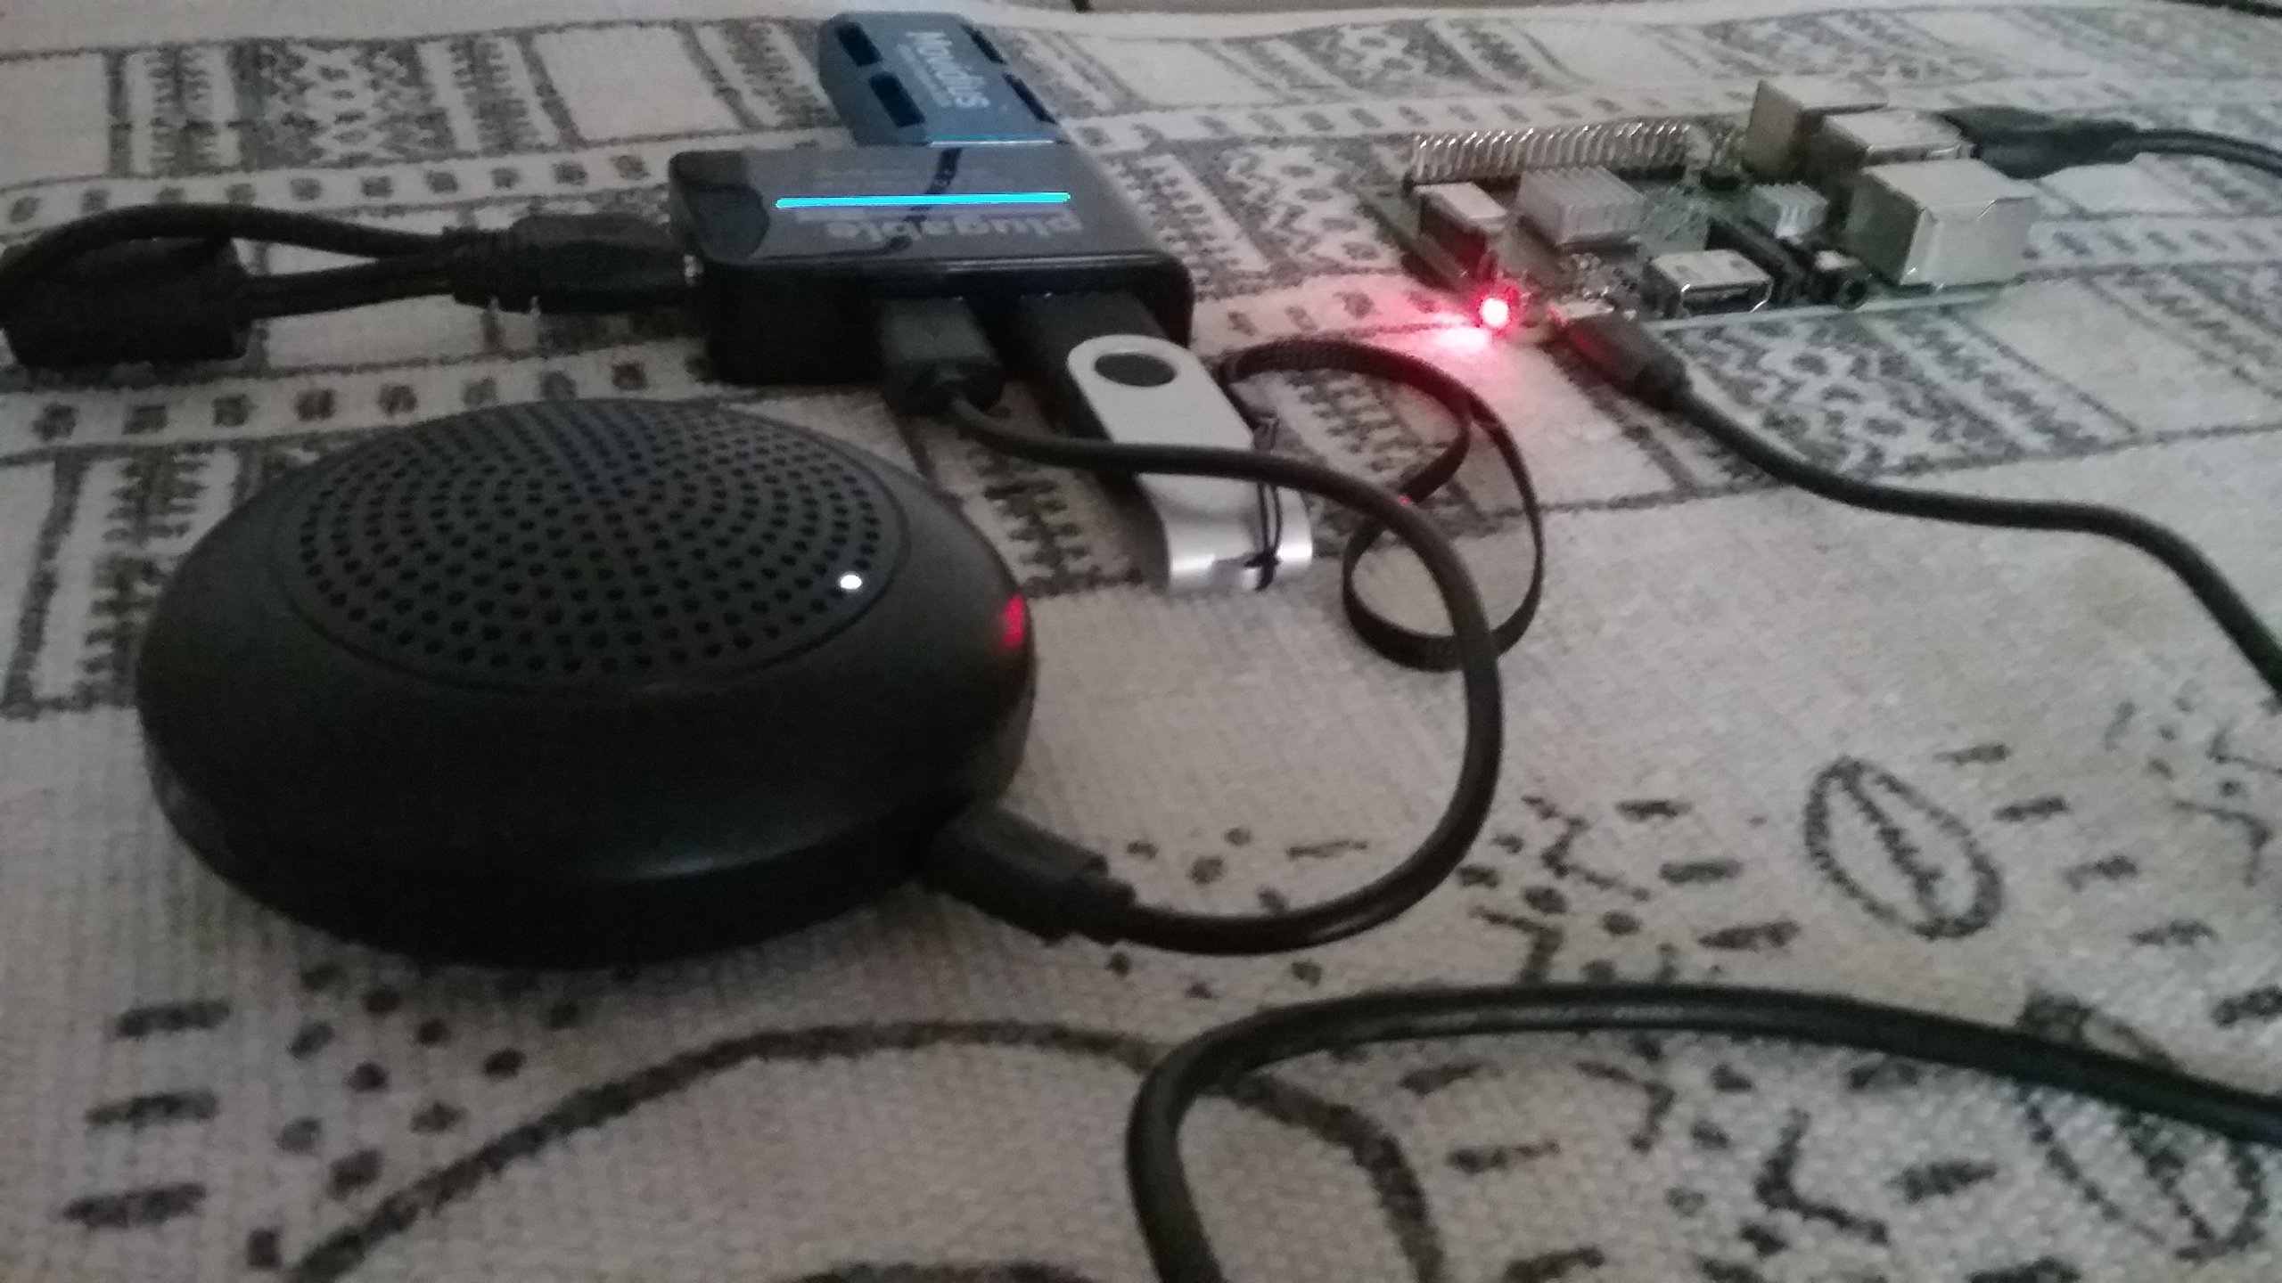
The Naomi Project

Slide 2
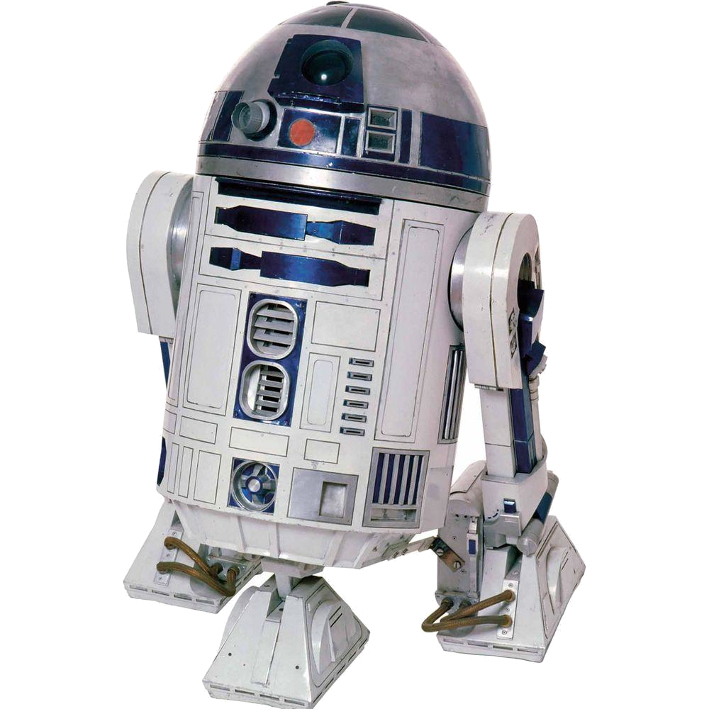
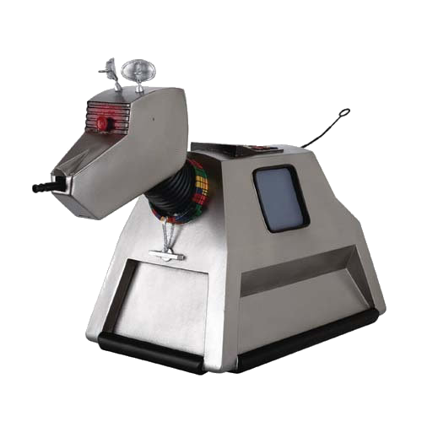
I grew up with R2D2 and K-9

Slide 3
How the public thinks smart speakers work
“...the speakers possess artificial intelligence, can conduct basic conversations, and are hooked up to the internet, which allows them to look stuff up and do things for you.”
-SHULEVITZ, J. (2018). “Alexa, HOW WILL YOU CHANGE US?” Atlantic, 322(4), 94–104.

Slide 4

How the smart speaker makers want you to think they work:
News
Weather
Music
Firewall
Speaker
Will it rain
tomorrow?
Yes, it is likely
to rain tomorrow

Slide 5
How they actually work
News
Weather
Music
Server
Firewall
Will it rain
tomorrow?
Speaker
Yes, it is likely
to rain tomorrow

Slide 6
The goal of Smart Speakers
These and other tech corporations have grand ambitions. They want to colonize space. Not interplanetary space. Everyday space: home, office, car. In the near future, everything from your lighting to your air-conditioning to your refrigerator, your coffee maker, and even your toilet could be wired to a system controlled by voice.
-SHULEVITZ, J. (2018). “Alexa, HOW WILL YOU CHANGE US?” Atlantic, 322(4), 94–104.

Slide 7
If you designed a speech assistant that you would need to work in order to flush your toilet
Reliability
Security

Slide 8
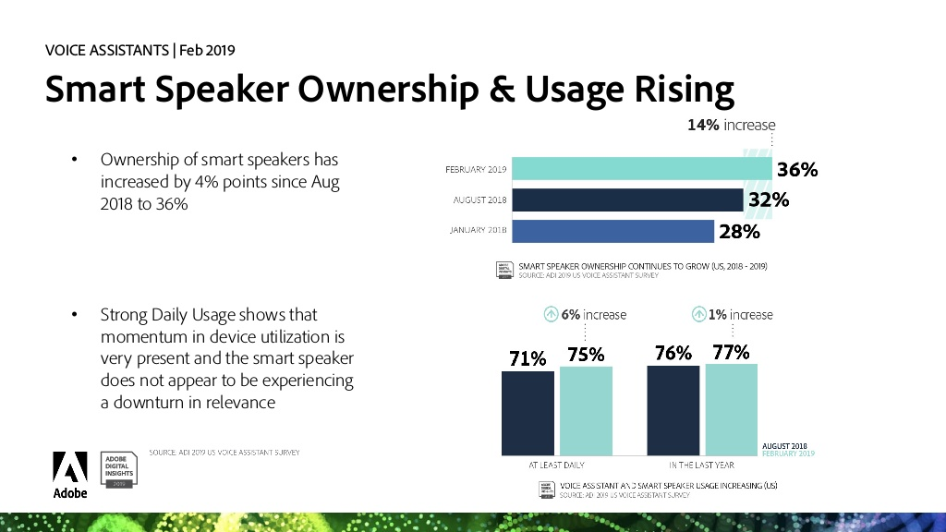
Popularity of Smart Speakers

Slide 9
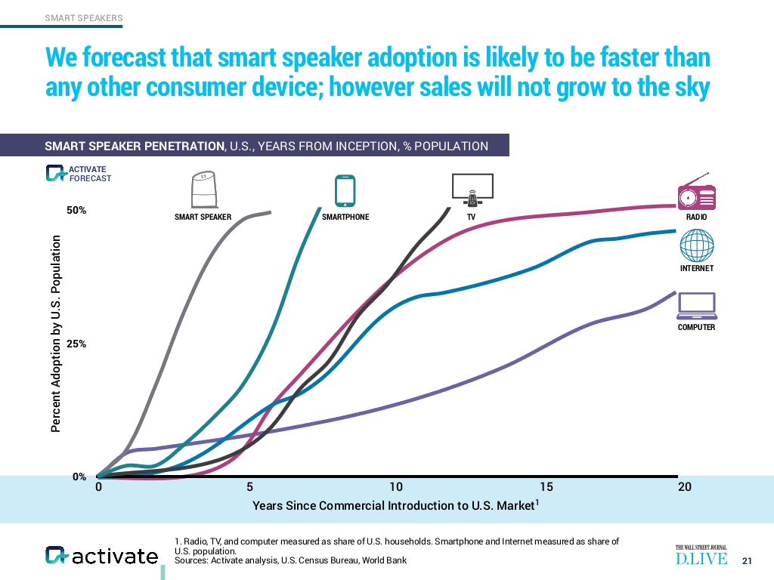
Adoption rates

Slide 10
This did not go as expected
Predictions in Q4 2018 were that the 2018 holiday season would see smart speakers adoption over 50%.
Are people catching on?

Slide 11
The Toaster

Slide 12
Demonstration
Options (./Naomi.py --help)
Voice control
Training
Store

Slide 13
Wishlist
Testing
Better documentation
Simpler/automated setup process
More tools for Speech to Text training
Intent parsing plugins
WebRTC interface
Support for ESP-01/other devices
Pulseaudio
Help building voices
Help user submit recordings and transcriptions to VoxForge and Common Voice
Help forming a nonprofit LLC

Slide 14
References
Adobe Digital Insights (2019) State of the Voice Assistants 2019. Retrieved from https://www.slideshare.net/adobe/state-of-voice-assistants-2019
Finley, K. (2016) Nest's Hub Shutdown Proves You're Crazy to Buy Into the Internet of Things. Wired. Retrieved from https://www.wired.com/2016/04/nests-hub-shutdown-proves-youre-crazy-buy-internet-things/
Gaida, C., Lange, P., Petrick, R., Proba, P., Malatawy, A., Suendermann-Oeft, D. (2014) Comparing Open-Source Speech Recognition Toolkits. Siani Diagnostics. Retrieved from http://sinaidiagnostics.com/su/pdf/oasis2014.pdf
Hern, A. (2019) Apple contractors ‘regularly hear confidential details’ on Siri recordings. The Guardian. Retrieved from https://www.theguardian.com/technology/2019/jul/26/apple-contractors-regularly-hear-confidential-details-on-siri-recordings
Kelly, M (2019) Amazon confirms it holds on to Alexa data even if you delete audio files. The Verge. Retrieved from https://www.theverge.com/2019/7/3/20681423/amazon-alexa-echo-chris-coons-data-transcripts-recording-privacy
SHULEVITZ, J. (2018). “Alexa, HOW WILL YOU CHANGE US?” Atlantic, 322(4), 94–104. Retrieved from https://wgu.idm.oclc.org/login?url=http://search.ebscohost.com/login.aspx?direct=true&db=a9h&AN=132171212&site=eds-live&scope=site
Stucke, M. E., & Ezrachi, A. (2017). How Digital Assistants Can Harm Our Economy, Privacy, and Democracy. Berkeley Technology Law Journal, 32(3), 1239–1299. https://doi.org/10.15779/Z383B5W79M

Slide 15
This work is licensed under a Creative Commons Attribution-ShareAlike 3.0 Unported License.
It makes use of the works of Mateus Machado Luna.

