Slide 1
Remote Laser Welding Defect Classification
Notes:
Welcome everyone. My project revolves around building machine learning classifiers to classify defects produced during remote laser welding.

Slide 2
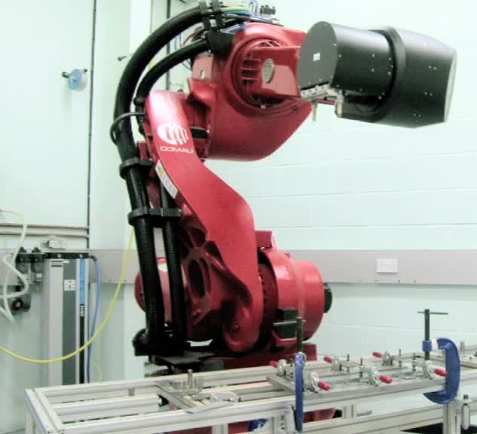
Presentation Outline
Introduction
Project Overview
Methodology
Results Analysis
Conclusion
Project Management
Future Work
Notes:
I’ll start with a brief introduction on the welding process:

Slide 3


Introduction: Background
Remote Laser Welding (RLW)
RLW is a welding technique used in the assembly of battery packs for electric vehicles.
Welding Defect Classification
Supervised machine learning models can use welding process features to predict whether a weld will be defective or non-defective.
Closed-Loop Quality Control
If the model predicts a weld will be defective, process parameters can be adjusted to prevent the defect from occurring.
Notes:
1)Remote laser welding, or RLW, is a welding technique used in the assembly of battery packs for electric vehicles. The aim of this project is to classify welding defects produced via the welding of copper-to-steel battery tab connectors.
2) The main idea is that machine learning algorithms can use features from the welding process to predict whether or not a weld will contain a defect.
And the overall goal of this is to produce a closed-loop system in which welds can be automatically classified in real-time, and adjustments can be made if the model predicts that a weld will be defective.
3) So, in a wider context, this is especially exciting with the projected boom in electric vehicle usage; instead of someone having to manually check for defects, we can have a system that not only automatically detects defects but makes the necessary adjustments to prevent the defect in the first place.
--------------------------------------------------------
Summarise main points all in one slide
Add picture + reference
Constructing a single battery pack requires about 20,000 cell-to-tab welds.
Cell-to-tab welding involves joining various dissimilar thin metal foils. This project considers copper-to-steel battery tab connectors.
Due to the rapid increase in the usage of electric car vehicles, tighter and more reliable quality control mechanisms are required to meet the demand.

Slide 4
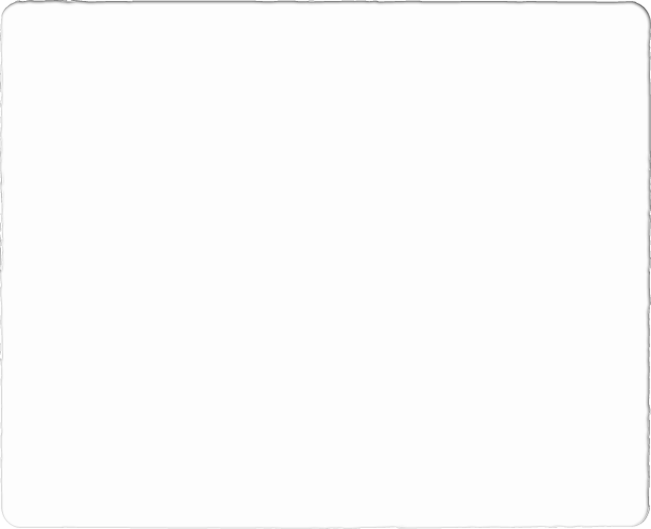
Introduction: Primary Challenges
1) The datasets are very small.
RLW requires the use of sophisticated machinery and consumes raw materials; only a limited number of experiments can be performed.
No validation set for any experiments.
2) The datasets have imbalanced classes.
Certain classes are underrepresented in training – harder to reliably predict.
3) The signal data is time-series.
Two types of welding features: statistical features and time-series features.
Time-series data is high-dimensional.
Notes:
So, there are three major challenges in this project:
The first is that the datasets are very small – somewhere in the range of 40-140 datapoints; as a marker, many of the standard machine learning datasets often have tens of thousands of samples.
Additionally, the welding classes that the models are trying to predict aren’t equally represented; some classes occur more frequently than others and the underrepresented classes can be especially hard to classify.
So, these first two challenges are really what separate this project from a standard machine learning project where you can just import a few models, optimise them on a validation set, and then magically achieve a high accuracy during testing.
3) The third challenge is slightly different. Since the welding features are extracted from sensors that monitor the process over time, the signals produced are naturally a function of time.
Because classical models are unable to process high-dimensional time series data, a set of statistical welding features have been produced from the time-series data which summarise the raw signal data.
However, this naturally destroys a lot of the signal information so I’ll explain later on how deep learning models have been implemented to operate directly on the time-series data.
--------------------------------------------------------------------------------------------------------
I’ll explain the structure of the datasets in more detail in a few slides, but for context the dataset sizes range from approximately 40 to 120 examples. Many of the standard datasets used to test machine learning algorithms will be in the order of tens of the thousands of examples.
No validation set – this is what prevents this project from being a simple task of importing a model, and optimising it on a validation set.
2) The datasets were not originally composed for the purpose of supervised learning.
[Show the actual tabular breakdown].
3) Much of the key information is lost in this summary.

Slide 5
Presentation Outline
Introduction
Project Overview
Methodology
Results Analysis
Conclusion
Project Management
Future Work

Slide 6
Project Overview: Ensemble Framework
Welding Features
Welding Features
KNN
Model
DT
Model
SVM
Model
Supervised Learning Model
KNN
Prediction
DT
Prediction
SVM Prediction
Voting Model
Welding Class Prediction
Welding Class Prediction
Notes:
So, I’ve hinted at deep learning being a major contribution in this project, but the other major contribution is ensemble learning. And Ensemble Learning is essentially a technique in which multiple machine learning models are combined to make a final prediction.
On the left here, we’ve got a classical machine learning framework in which we provide welding features as input and it predicts whether the corresponding weld is defective or non-defective.
On the right, it’s a similar process but we’re using three different models to get three different class predictions. And then we apply an additional voting model to aggregate the predictions of the of the three constituent models.
And the primary motivation behind ensemble learning directly links back to the first challenge I mentioned on the previous slide; since the datasets are so small, there is no easy way to optimise a single algorithm to learn the patterns between the welding features and the welding classes. So instead, the idea is to combine multiple different algorithms; if one model produces an incorrect prediction, then there is a chance that the other two models can mitigate this incorrect prediction. So voting adds an element of redundancy in this case.
--------------------------------------------------------------------------------------------------------
Discuss how classical machine learning models have already been applied.

Slide 7

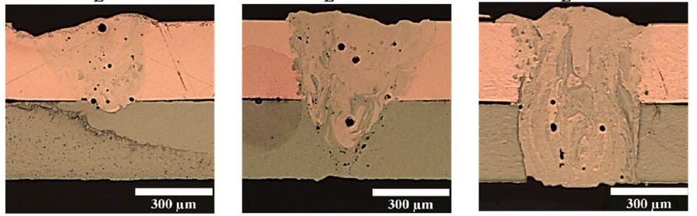
Project Overview: RLW Classes
Class 1: Sound Weld
Ideal Weld
Class 2: Lack of Connection
Results in voltage drops which can cause the entire battery pack to malfunction.
Class 3: Over Penetration
Risks piercing adjacent components.
Notes:
1) I’ve mentioned welds can be defective or non-defective, but the classes aren’t binary; there are two types of defective welds. We can have a case where the metal foils aren’t sufficiently connected, and also a case where the laser goes through both foils completely and risks damaging components underneath.
2) So, we have three classes in total; two defective and one non-defective.
--------------------------------------------------------------------------------------------------------
Add figures.
Discuss the two types of defects.

Slide 8
Project Overview: Datasets
Three datasets in total, each with different welding configurations.
Dataset 2 contains a significant class imbalance.
Dataset 3 contains all datapoints from datasets 1 and 2, as well as some additional datapoints.
 | Dataset 1 | Dataset 2 | Dataset 3
Sound Weld | 16 | 9 | 33
Lack of Connection | 12 | 55 | 73
Over Penetration | 18 | 22 | 40
Total Datapoints | 46 | 86 | 146
Notes:
1) I’ve mentioned that we have small, unbalanced datasets. Here’s a closer look at the actual class breakdowns.
2) Linking back to the three main challenges, dataset 1 is relatively balanced but also the smallest dataset.
3) Dataset 2 has a huge imbalance: just 9 sound weld examples in total.
4) Dataset 3 at first glance seems to be the least interesting, but it actually contains every datapoint from the first two datasets, as well as some new datapoints. So Dataset 3 actually contains data from multiple different experiments which each had different welding configurations. And the main idea is that we can use it as a pseudo-validation set since models that generalise well should in theory perform well on dataset 3.

Slide 9
Statistical Welding Features
Photodiode-based sensors are used to extract welding features during the welding process itself.
These sensors collects three signals:
Plasma Signal (S_{P})
Temperature Signal (S_{T})
Back Reflection Signal (S_{R})
For each signal, two key features are extracted:
Energy Intensity (μ)
Scatter Level (σ)
Each welding experiment (datapoint) is represented as a six-tuple:
{μ_{P}, μ_{T}, μ_{R}, σ_{P}, σ_{T}, σ_{R}}.
Notes:
1) So, recall I mentioned that the time-series signal data was summarised into simpler statistical features. I won’t go too much into the details but essentially, during the welding process, sensors collect three types of signals. From each signal, two key features are extracted, energy intensity and scatter level, and hence every datapoint can be represented by a six-tuple; these six-tuples are the model inputs.
--------------------------------------------------------------------------------------------------------
Classification needs to be performed automatically, so welding features need to be extracted in realtime.
Essentially, the three signals correspond to radiation detected in three different bandwidths, during the RLW process. For this project, the details of the signals aren’t too important; the main idea is that these signals have been shown to capture a significant amount of information about the RLW process.
So to summarise, every time a welding experiment is performed, we can extract these 6 values which correspond to a data point. And each data point will be associated with one of the three welding classes mentioned previously. The main goal of the project is to construct a model that can learn the relationship between the welding features and welding classes, and then be able to, given a data point it wasn’t trained on, accurately predict its welding class.

Slide 10
Presentation Outline
Introduction
Project Overview
Methodology
Results Analysis
Conclusion
Project Management
Future Work
Notes:
Now I’ll move on to the methodology.

Slide 11
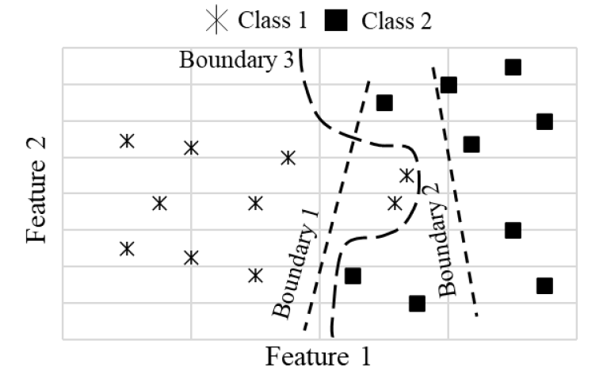
Supervised Machine Learning for Defect Classification
Supervised machine learning is a technique in which a machine is trained to learn the relationships between inputs (features) and outputs (classes).
In RLW, the goal is to accurately classify a welding class given a set of welding process features.
The machine learning model is first trained on labelled data. After training, the model can make predictions on new, unseen datapoints.
Notes:
Why is automatic classification so useful?

Slide 12
Methodology: Classical Machine Learning Models
K-Nearest Neighbours
Decision Trees
Decision Trees perform classification by recursively partitioning the features space into smaller regions based on the most informative features.
Support Vector Machines
SVMs find hyperplanes that maximally separate the classes in the feature space, classifying new data points based on which side of the hyperplane they fall on.
KNN classifies a data point based on the majority class of its K-nearest neighbours in the feature space.
Notes:
So here we have three different classical machine learning models: K-Nearest Neighbours, Decision Trees and Support Vector Machines. They’re essentially the main protagonists when it comes to building the ensemble classifiers.
--------------------------------------------------------------------------------------------------------
Why is automatic classification so useful?
Introduce classical models with a picture

Slide 13
Methodology: Ensemble Voting Strategy
Hard Voting
Soft Voting
Features
Features
KNN
DT
SVM
KNN
DT
SVM
LoC
SW
LoC
[0.2, 0.7, 0.1]
[0.6, 0.4, 0]
[0.1, 0.8, 0.1]
Hard Voting
Soft Voting
LoC
LoC
Notes:
So, I showed a simple voting framework a few slides back, but there are two different types of voting strategies.
On the left, we have hard-voting, in which the ensemble classifier simply outputs the majority class predicted by its constituent classifiers.
On the other hand, the soft-voting classifier asks its constituent models to produce predicted probabilities for each class, and then it outputs the class that has the highest predicted probability summed over all constituent models.
--------------------------------------------------------------------------------------------------------
So I’ve discussed the motivation behind supervised machine learning
Contribution – originally only classical models used.
Q)
What happens if there is a tie?
The voting model selects the class based on ascending sort order: e.g., class 0 before class 1.
Why three classifiers?
How does each algorithm predict probabilities?

Slide 14
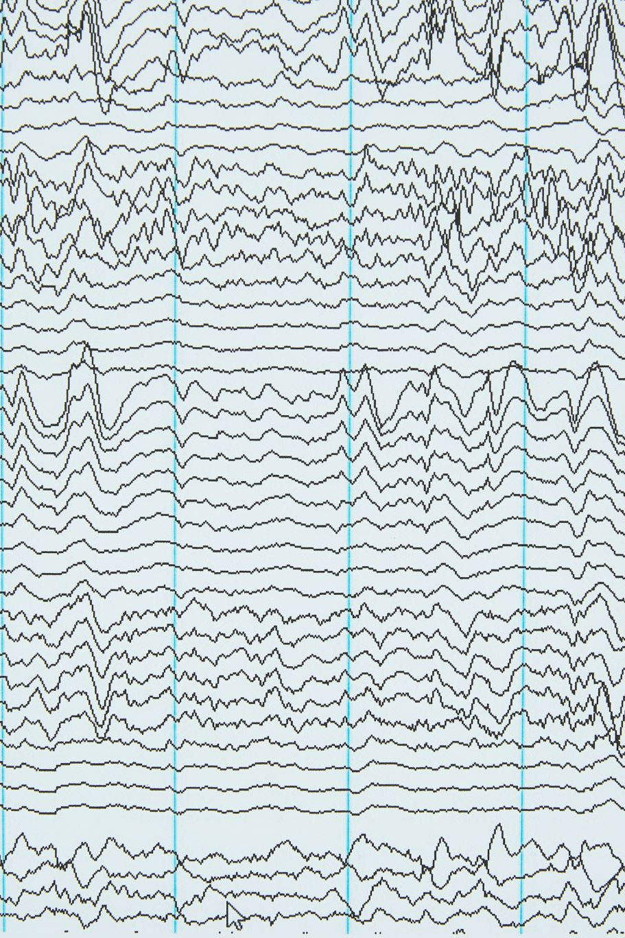
Time-Series Welding Features
Discrete Wavelet Transform (DWT) has been used to extract time-series features from the three raw signals.
The statistical features summarised these signals in two values: μ and σ. For each datapoint, there are 6 feature values.
DWT data extracts information about the signals across 2500 time steps. For each datapoint, there are 3 x 2500 feature values.
Notes:
I mentioned previously that the classical models operate on statistical welding features where each datapoint is represented as a six-tuple.
But each datapoint can also alternatively be represented using time-series features. Again, the details aren’t too important, but we essentially have the same 3 signals and each signal can be represented with a value across 2500 time steps.

Slide 15
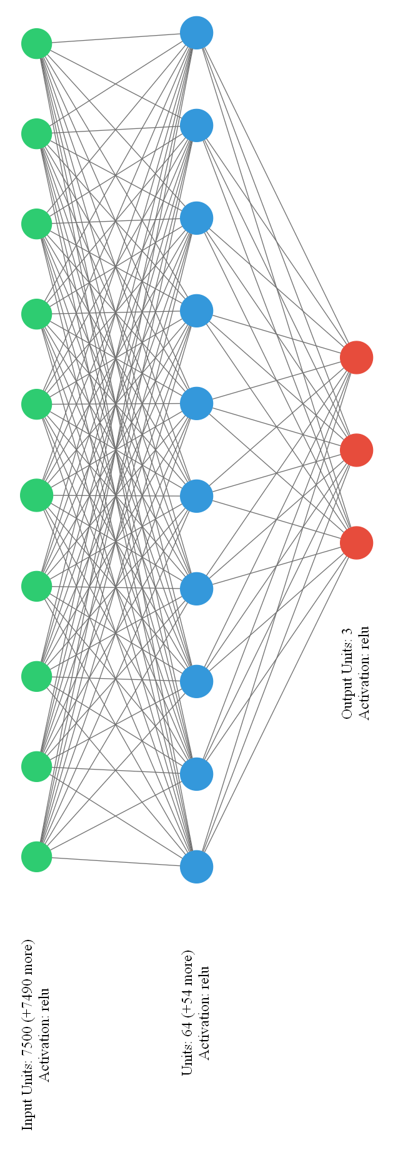
Methodology: Fully-Connected Neural Network (FCNN)
A fully-connected neural network consists of multiple layers of neurons.
Each neuron computes a weighted sum of inputs from all neurons in the previous layer.
The weighted sum is combined with a bias term, and an activation function to produce the neuron’s output.
The final layer contains three neurons, one for each class.
During training, a loss function is used to optimise the weights and biases.
Notes:
1) As hinted before, the classical models are unable to process high-dimensional time-series data, which is why deep learning was introduced.
2) In total, three deep models were implemented, I’ll give a brief overview of their architectures and I’m happy to go into further detail on how they’re trained at the end of the presentation.
3) The first deep learning model was the fully-connected neural network, or FCNN. A simplified diagram of the FCNN architecture is shown on the right here; the main idea is that the time-series data is passed through the input layer in green, then to a hidden layer in blue, and finally an output layer in red.
4) There are three output neurons; each one corresponding to a predicted class probability.
5) And since the network is fully connected, every neuron contains a weighted connection to every neuron in an adjacent layer. The network aims to learn suitable weight parameters such that the output neuron corresponding to the correct class will produce the highest predicted probability.
--------------------------------------------------------------------------------------------------------
Each output neuron essentially produces a predicted probability for its corresponding class.
Naturally, the loss is high when the network predicts the wrong class.

Slide 16
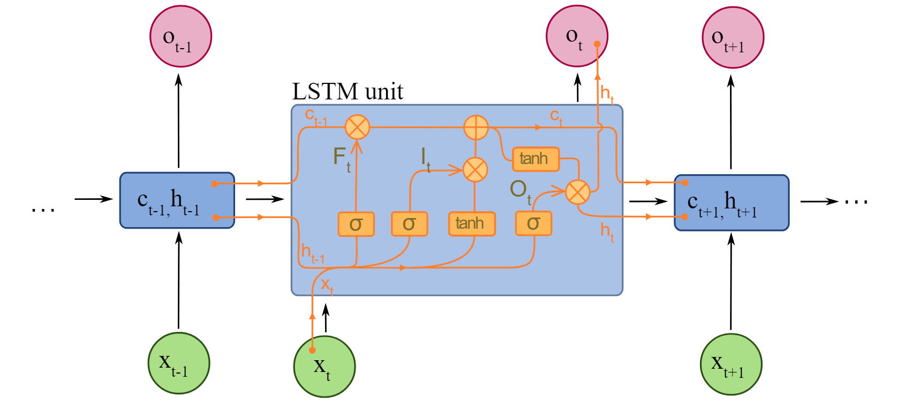
Methodology: LSTM
Long Short-Term Memory networks are specifically designed for working with sequences of data.
Each neuron has a memory cell that allows the network to remember information from previous time steps.
LSTM networks process input data one time step at a time, updating its memory cell each time.
The outputs in the final time step are passed to a fully-connected layer, which is used to determine the predicted class.
Notes:
1) The second deep learning model was the LSTM. And the motivation behind the LSTM is that is specially designed for processing sequences, including time-series data.
2) It differs from the FCNN model in that it has a memory cell which can remember information from previous time-steps.
3) So, it processes the input at every time step, updates its memory and then produces an output. And then its final output is fed to a fully-connected layer to produce predictions as before.

Slide 17
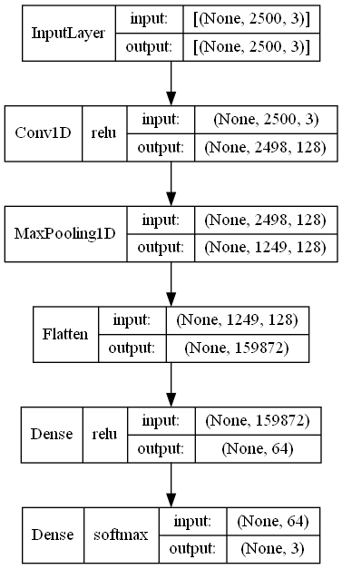
Methodology: 1D-Convolutionl Neural Network
The input data has shape 2500x3: 2500 timesteps and 3 signals.
The CNN model uses 3x3 filters to generate new features from the input data.
The max pooling layer reduces the size of the new features by half to reduce computational load.
The newly learned features are then passed into a FCNN for classification.
Notes:
1) Lastly, we have the convolutional neural network architecture or CNN. And the CNN model operates by sliding filters over the input data to generate new feature values. And these new feature values are passed into a fully connected layer to produce predictions.
2) The main idea behind the CNN model is that it uses these filters to learn something about the shape of the signal data across multiple time steps
--------------------------------------------------------------------------------------------------------
The model slides filters down the signal data, producing a 1D feature map of size approximately 2500 for each filter.

Slide 18
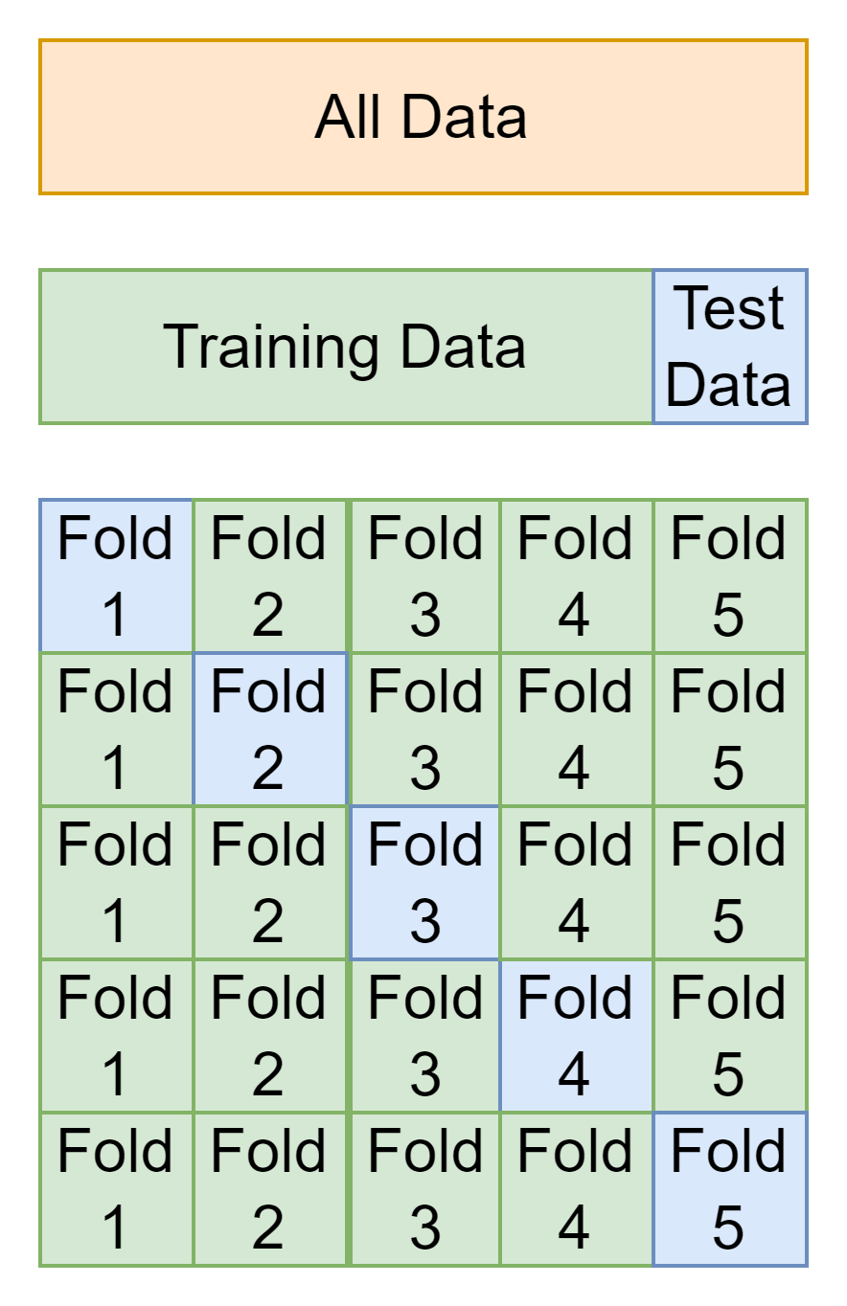
Methodology: Stratified Cross Validation
5-fold cross-validation (CV) used to compare machine learning models.
Stratified cross-validation used to tackle the imbalanced datasets problem.
Each test fold approximately preserves the class proportions of the dataset.
Notes:
1) 5-fold cross validation was used to compare the performance of all models.
2) So, the main idea is the dataset is split into 5 folds of roughly equal size. 4 folds are selected for training and a fifth fold is held out for testing.
3) And this process is repeated such that every fold is used as a test set exactly once.
4) Also of note, in order to tackle the imbalanced problem, the test folds were stratified such that test folds preserved the class proportions of the wider dataset.
--------------------------------------------------------------------------------------------------------
Discuss 10CV and 5CV
Stratified and standard CV – unbalanced datasets problem

Slide 19
Presentation Outline
Introduction
Project Overview
Methodology
Results Analysis
Conclusion
Project Management
Future Work

Slide 20
Results Analysis: Classical and Voting Models (Dataset 1)
Statistical Welding Features Results
The soft-voting model produces the highest accuracy.
Results imply that different classical machine learning algorithms produce different errors.
The performance of the soft-voting model is heavily tied to the performance of the decision tree model.
Dataset 1 | 1 | 2 | 3 | 4 | 5 | AVG (%)
DT | 80.0 | 66.7 | 88.9 | 100 | 77.8 | 82.7
KNN | 70.0 | 66.7 | 77.8 | 88.9 | 66.7 | 74.0
SVM | 70.0 | 66.7 | 55.6 | 66.7 | 77.8 | 67.3
HV | 90.0 | 66.7 | 88.9 | 100 | 66.7 | 82.4
SV | 100 | 77.8 | 88.9 | 100 | 77.8 | 88.9
Notes:
1) Looking at the results of the classical and voting models, for dataset 1, on the statistical data, we can see that the soft-voting model produces the highest average accuracy. The fact that one of the voting models produces the best result suggests that, on some level, different machine learning algorithms do make different misclassifications. This is emphasised by looking at the results for fold 1 in which none of the individual models correctly classified every point but the soft voting model was able to use their predicted probabilities to achieve 100% accuracy on the first fold.
2) Further analysis of the dataset 1 results suggests that the soft-voting model is heavily influenced by the decision tree model. When the decision tree model makes predictions, it almost always predicts classes with a probability of 1, irrespective of whether it is correct or not. So this means that when the decision tree performs relatively well, the soft-voting model is also likely to perform well, whereas when the decision tree performs less well, it will also drag down the performance of the soft-voting classifier.
--------------------------------------------------------------------------------------------------------
SV correctly classifies every data point in fold 1 despite no individual classifier achieving 100% accuracy. This generally reinforces the idea that voting models have the potential to improve the results of individual classifiers in this problem domain, even if the dataset is very small.

Slide 21
Results Analysis: Classical and Voting Models (Dataset 2)
Statistical Welding Features Results
KNN produces the strongest performance.
The decision tree model, when incorrect, predicts an incorrect class with a probability of 1.
The hard-voting classifier outperforms the soft-voting classifier as it is able to completely ignore the predicted probabilities of the decision tree.
Dataset 2 | 1 | 2 | 3 | 4 | 5 | AVG (%)
DT | 88.9 | 88.2 | 88.2 | 94.1 | 88.2 | 89.5
KNN | 94.4 | 94.1 | 100 | 88.2 | 100 | 95.4
SVM | 83.3 | 88.2 | 88.2 | 88.2 | 94.1 | 88.4
HV | 94.4 | 94.1 | 88.2 | 94.1 | 94.1 | 93.0
SV | 94.4 | 88.2 | 88.2 | 94.1 | 94.1 | 91.8
Notes:
1) This observation is reinforced by the results on dataset 2 where the KNN model produces the best performance. Here, the hard-voting classifier outperforms the soft-voting classifier as the hard-voting classifier can completely ignore the decision tree output as long as the SVM and KNN models are correct.
--------------------------------------------------------------------------------------------------------
SV correctly classifies every data point in fold 1 despite no individual classifier achieving 100% accuracy. This generally reinforces the idea that voting models have the potential to improve the results of individual classifiers in this problem domain, even if the dataset is very small.

Slide 22
Results Analysis: Deep Learning Models
Dataset 1 | AVG (%)
FCNN | 89.1
CNN | 82.6
LSTM | 82.6
Dataset 2 | AVG (%)
FCNN | 93.0
CNN | 93.0
LSTM | 83.7
Dataset 3 | AVG (%)
FCNN | 91.5
CNN | 93.0
LSTM | 76.1
Time-Series Welding Features Results
Notes:
1) So now if we move on to some of the results produced by the deep learning models on the time-series data, we can see that the LSTM model performs significantly worse than the FCNN and CNN models. And not only does it produce a lower accuracy, we can see from the pie chart that it also takes significantly longer to train than the other two models.
2) Digging a bit deeper into the LSTM training results, it was found that the LSTM actually doesn’t always fully fit the training data so that suggests that the model isn’t complex enough to fully process up to 2500 time steps, despite requiring the longest training time.
--------------------------------------------------------------------------------------------------------
Accuracy
Running Time
Model size/complexity
The LSTM model struggles to fit the training data, despite requiring highest training time by a significant margin. So, the LSTM is not even able to predict the classes of datapoints that it has trained on.

Slide 23
Results Analysis: Deep Learning Models
Dataset 1 | AVG (%)
SV | 88.9
FCNN | 89.1
CNN | 82.6
Dataset 2 | AVG (%)
KNN | 95.4
FCNN | 93.0
CNN | 93.0
Dataset 3 | AVG (%)
DT | 83.2
KNN | 85.9
SVM | 78.2
HV | 86.0
SV | 84.5
FCNN | 91.5
CNN | 93.0
Deep learning models have similar performance to ensemble and classical classifiers on dataset 1 and 2.
Deep learning models produce the best performance on the generalised dataset.
Notes:
1) If we now compare the performance of the classical models against the deep learning models, we can see that there isn’t necessarily a significant different in performance on the first two datasets. However, on the third dataset, which contains the most generalised data, the neural networks perform significantly better than all of the classical and voting models.
2) This has interesting applications for building larger welding datasets because welding datasets can be expensive to compile but here there is some evidence it is possible to combine data from different experiments and the neural networks can still learn the pattern between the welding features and classes
--------------------------------------------------------------------------------------------------------
Dataset 3 contains samples with various different welding configurations.

Slide 24
Presentation Outline
Introduction
Project Overview
Methodology
Results Analysis
Conclusion
Project Management
Future Work

Slide 25
Conclusions
Voting models show potential to improve accuracy but results are heavily dependent on the constituent models.
The decision tree strongly influences the soft-voting model since it has absolute confidence in its predictions, regardless of accuracy.
Deep learning models produce the best performance on the generalised dataset – this could mitigate the problem of RLW datasets being expensive to generate.
Scaling the feature data has a significant impact on the model performance. SVMs and neural networks perform poorly without scaling.
Certain datapoints are almost always misclassified by every model.
Notes:
I’ll give an overview of some of the main conclusions:
We have seen tht the voting model results do support the hypothesis that different machine learning algorithms make different classification errors, and hence it is possible to aggregate multiple individual models and produce a higher overall accuracy.
However, the performance of the ensemble models can be heavily dependent on the selection of constituent models. For example, to produce an optimal soft-voting model, it may be a good idea to select constituent models that don’t typically produce absolute probabilities like the decision tree model.
We also saw that the deep learning models should the greatest ability to generalise when applied to time-series data, as opposed to the statistical welding features.
Another point that I haven’t mentioned yet is that some models performed significantly better when the features were scaled to have a mean of zero and a standard deviation of 1, whereas others performed worse under scaling. So it could be worth scaling features selectively, depending on whether it suits the machine learning algorithm itself.
And one final observation was that there were certain datapoints that no model was able to successfully classify, so it could be that these points were either outliers, or there just wasn’t enough training data to be able classify them correctly, or the sensors aren’t able to fully capture the variance of the welding process. But either way, these datapoints suggest that 100% accuracy may not be achievable without improving the sensor technology or increasing the size of the datasets.
--------------------------------------------------------------------------------------------------------
It’s difficult to perform a large number of welding experiments under the exact same welding configuration, but larger welding datasets could be compiled using experiments performed by multiple different people with multiple different welding configurations, and the deep learning models may still be able to learn the general pattern of what constitutes a sound weld.
StandardScaler transforms data such that its distribution will have a mean value 0 and standard deviation of 1.

Slide 26
Presentation Outline
Introduction
Project Overview
Methodology
Results Analysis
Conclusion
Project Management
Future Work

Slide 27
Project Management
All core objectives completed according to the original schedule:
Construct three classical machine learning models: DT, KNN, SVM
Construct a voting ensemble classifier.
Construct an FCNN.
Construct an LSTM neural network.
An adaptive plan was used based on the results of each classifier.
Scheduled buffer time was used to tackle unpredictable challenges:
Identical test folds.
Scaling strategy.
Debugging the data loggers.
Notes:
I’ve just got a brief slide on project management. The original plan was to construct the three classical machine learning models, and then use them to produce the voting models. And originally, only the FCNN and LSTM models were planned for deep learning, but the relatively poor performance of the LSTM motivated the implementation of the CNN model.
2) So generally, there was no specific design paradigm required – the plans were largely adaptive depending on how different models performed.
3) All models were completed in line with the original schedule, and buffer time was scheduled to handle some of the unexpected challenges, such as making sure the statistical and time-series data loggers worked correctly and produced identical test folds. And also figuring out that some models needed to have scaled feature values.
--------------------------------------------------------------------------------------------------------
Talk about the buffer time left to try new models.
Scaling strategy and the need to produce stratified test folds were unpredictable but managed using the buffer time

Slide 28
Presentation Outline
Introduction
Project Overview
Methodology
Results Analysis
Conclusion
Project Management
Future Work

Slide 29
Future Work: Additional Classical Models
Dataset 2 | AVG (%)
DT | 89.5
KNN | 93.0
SVM | 93.0
Gaussian Process | 95.4
Random Forest | 89.5
AdaBoost | 89.5
Naïve Bayes | 88.4
QDA | 87.3
Gradient Boosting | 89.5
HV | 95.4
SV | 91.9
Enumerate all combinations to produce improved voting classifiers.
Apply feature scaling selectively, based on model performance.
Notes:
1) So, I’ll conclude by talking about opportunities for future work. I’ve focused on three main classical machine learning models, but there are several other machine learning algorithms that have the potential to improve the voting models.
2) In particular, because the classical models run so quickly, it may be possible to enumerate all of the 3-way combinations of classical models to see which triple is best suited for ensemble classification.
--------------------------------------------------------------------------------------------------------
These results use standard scaling.

Slide 30
Areas for Future Work
Data Augmentation – solve the imbalanced classes problem by generating new datapoints.
Ensemble Deep Learning – combine classical and deep models.
Autoencoders – neural network architectures designed for time series classification.
\par
Notes:
1) And there are a few other ideas that can explored. So data augmentation is one strategy that can be used to tackle the imbalanced classes problem. We could essentially create new data by taking the average of every pair of signals in a given class.
2) We could also try combining the deep models and the classical models into an ensemble classifier, or try other deep learning architectures that are well-suited for time-series classification such as the autoencoder.
3) And lastly, many of the machine learning hyperparameters that having to be manually set weren’t optimised due to the small size of the datasets, but there are tools such as KerasTuner which can use cross validation to optimise these hyperparameters and potentially improve the models.
--------------------------------------------------------------------------------------------------------
SeLU Activation

Slide 31
Questions?

