Slide 1


Kronos
Lightweight application to manage the events
April 2, 2025
HJM RAM

Slide 2


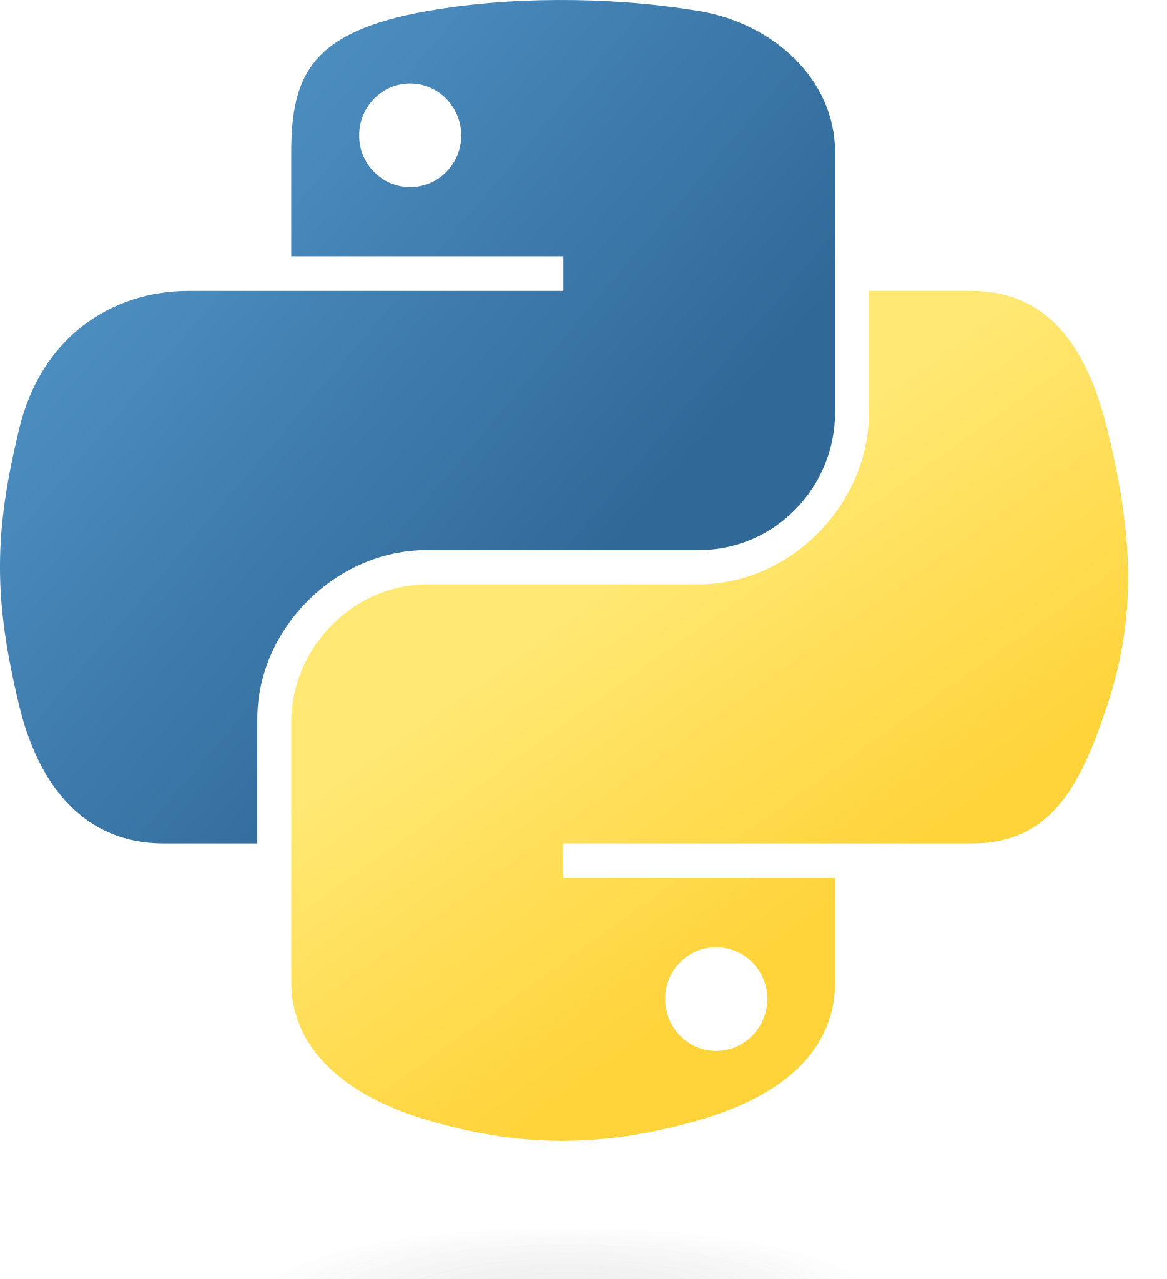
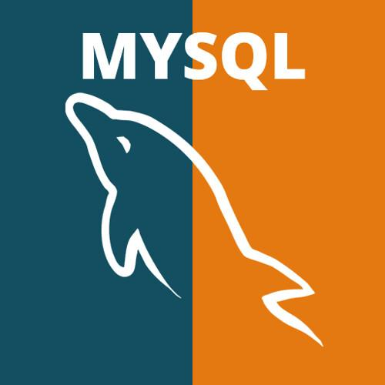
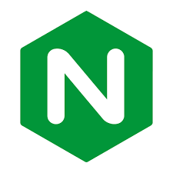
Design Architecture
Vue JS
Python
MySQL
Nginx
Podman
Our tech stack used a variety of different applications each having there own unique usage.
VueJS was used for frontend to keep the code simplistic
Flask python was used instead of python due to it being more optimized for web design
Podman was used to help optimize our ram usage
MySql is used for data storage
Nginx Is used to hosting the server
Notes:
Podman - used for containring tools so it’s easy to maintain in terms of memory and code
Vue - js framework because of its light weight and easy to manipulate DOM using states Python - programming language used since its to understand and can be used to manipulate database using “ORM” using sqlalchemy and use of alembic for migrations
Nginx - used to serve static vue content and proxy the backend APIs to manipulate database CRUD operations
Mysql - used as data storage for relational database.
Github, VScode

Slide 3

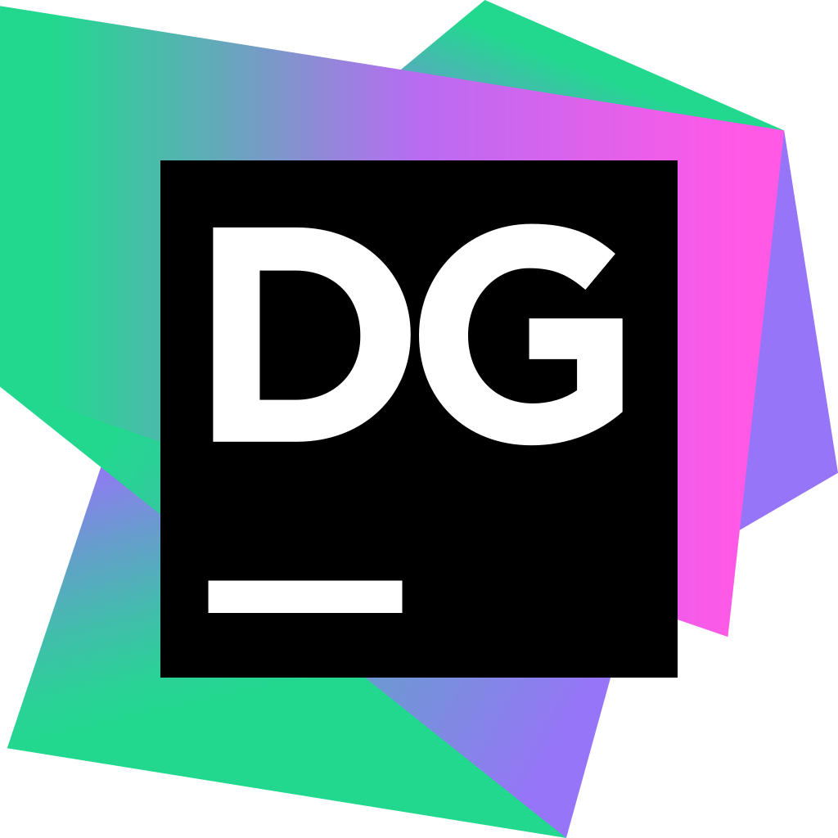
Design Architecture
Github for management and keeping code stored safely.
Datagrip was used to allow us to work with databases.

Slide 4
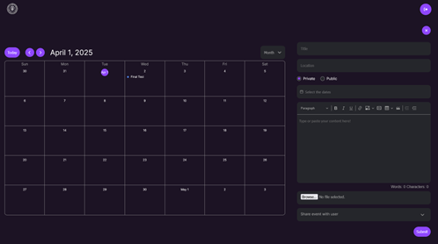
Features and functions
Creation, editing and deletion of events.
Moderation of public and private events
The ability to swap between day, week, month and year views

Slide 5
Deployment Process
Python, Podman or Docker
Containerises program
Docker requires no further input
Podman requires terminal commands
Extra dependencies installed
Program runs on port 8080
Ensures that there are no extra dependencies
Limits resource usage
Simplifies build process

Slide 6
Testing Processes
The testing process is manual and includes
Core functionality tests
Authentication tests
File upload tests
UI and Interaction tests
Error handling

Slide 7
Design challenges
Technical challenges -
Switch from podman to docker
Switch from vannila to flash framework
General challenges -
We lacked experience with Vue.js and had to learn it from scratch
Encountered challenges with time scheduling

Slide 8
Deployment & Maintenance
Deployment Approach
Kronos is packaged as Docker containers for easy scalability and portability.
Nginx is used as a reverse proxy for handling frontend requests and API routing.
The database runs in a separate container to ensure data persistence.

Slide 9
Deployment & Maintenance
Maintenance Strategy
Centralized logging using MySQL.
Automating daily backups using cron jobs.
Follow least privilege principles for container permissions.
Developing CI/CD pipeline to streamline the deployment process.

Slide 10
Future Plans
Migrate to a microservices architecture for better modularity and scalability
Introduce AI-driven scheduling suggestions based on user patterns.
Introduce AI-driven scheduling suggestions based on user patterns.

Slide 11
Demo

Slide 12
Q and A

