Slide 1
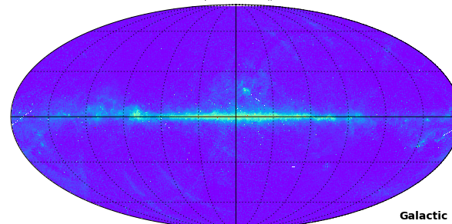

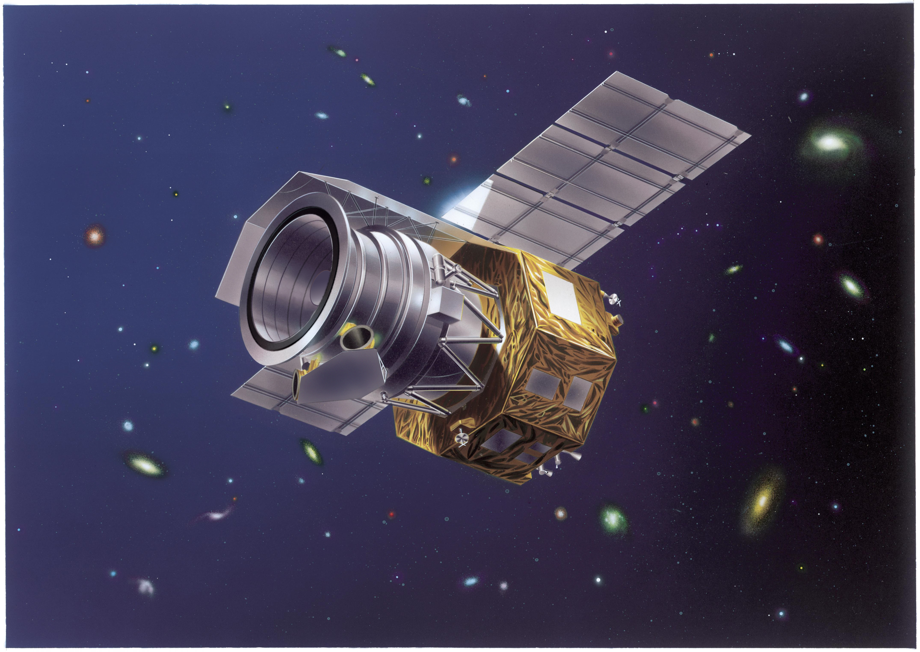
A look at potential microwave dust emission via あかり:
Aaron Bell
Ph.D. Student, UTokyo
AKARI Conference 2017
@ Ito Hall
With:
T. Onaka, Y. Doi (U.Tokyo);
R. Wu (Obs. Paris);
F. Galliano (CEA/Saclay);
H, Kaneda, D. Ishihara, (Nagoya U.);
M. Giard, (IRAP)
Notes:
Hello, my name is Aaron Bell.
I’m a 2nd year Ph.D. student, working with Takashi Onaka, along with my labmates Tomoyuki Kimura and Ayato Ikeuchi.
3 Things:
1) No, I’m not Japanese.
2) My family lives in Kentucky
3) This is not my first international conference, however I am quite nervous.
So let’s talk about some spinning dust.

Slide 2
Menu:
What is anomalous microwave emission?
  Excess galactic microwave emission (from Spinning Dust???)
What can AKARI do for AME study?
  PAH abundance, ionization to AME Comparison
All-sky Analysis:
  Cross-correlation of all IR bands with
Future (Ongoing) work:
  SED Fitting (with Galliano-san)
  All-sky Blind Component Decomposition

Slide 3
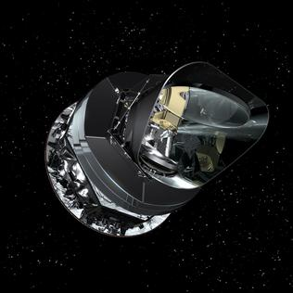
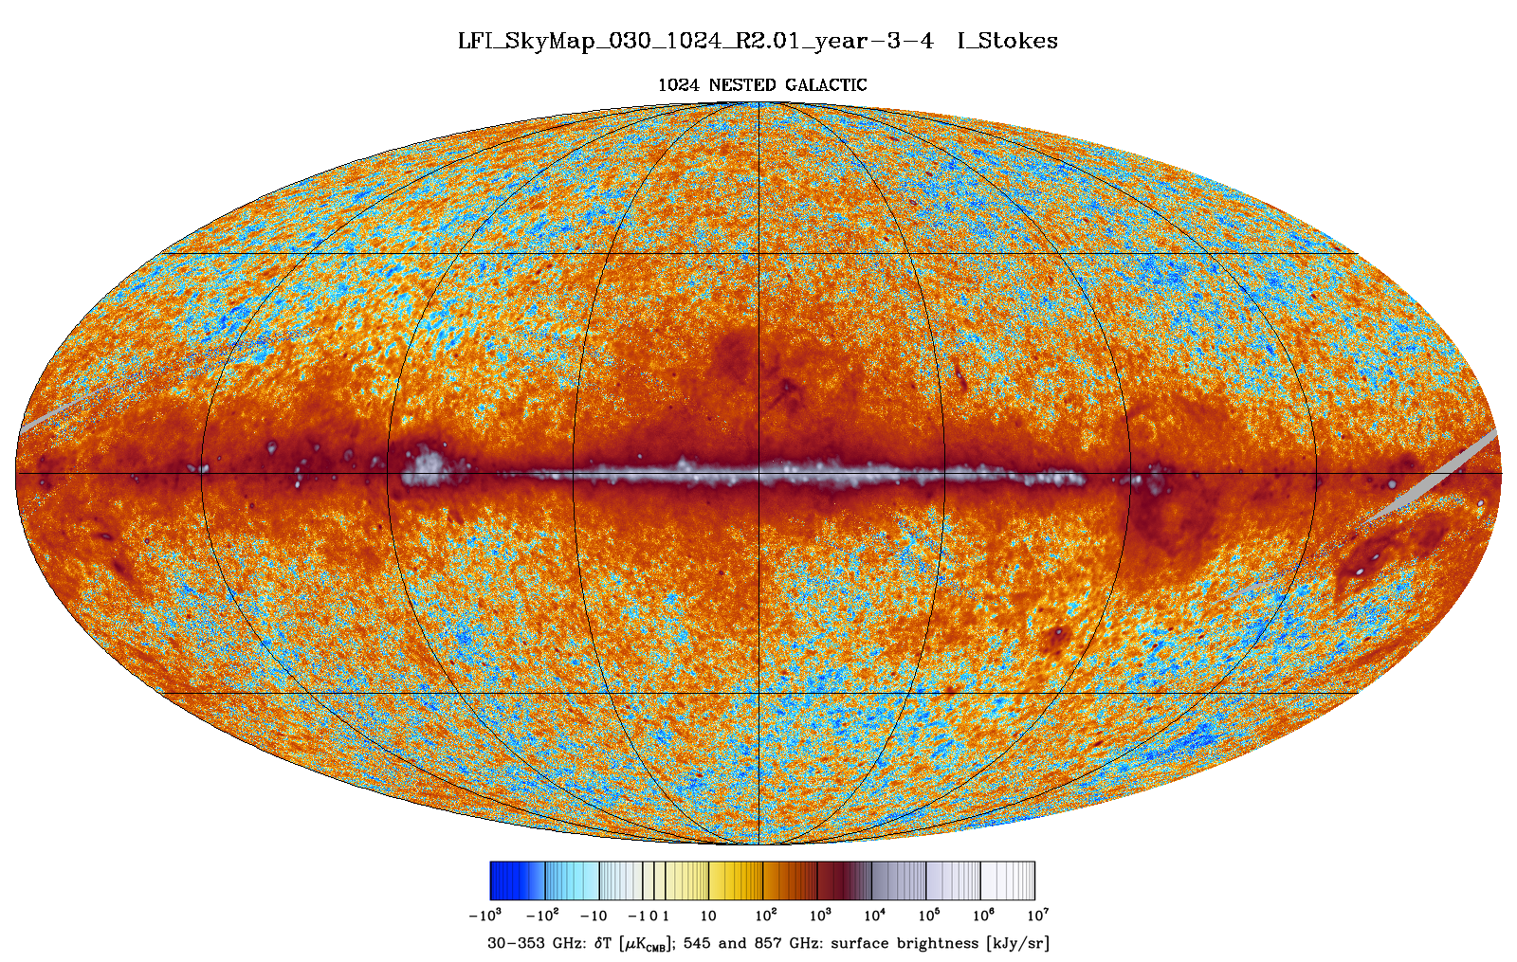

Intro: What’s in the microwave sky?
[Planck LFI 28 GHz All-sky Map]
Image courtesy of ESA/Planck Collaboration
Notes:
If we take a look at the infrared to radio SED of the most prominent region in this AME map, Perseus, we get this.

Slide 4
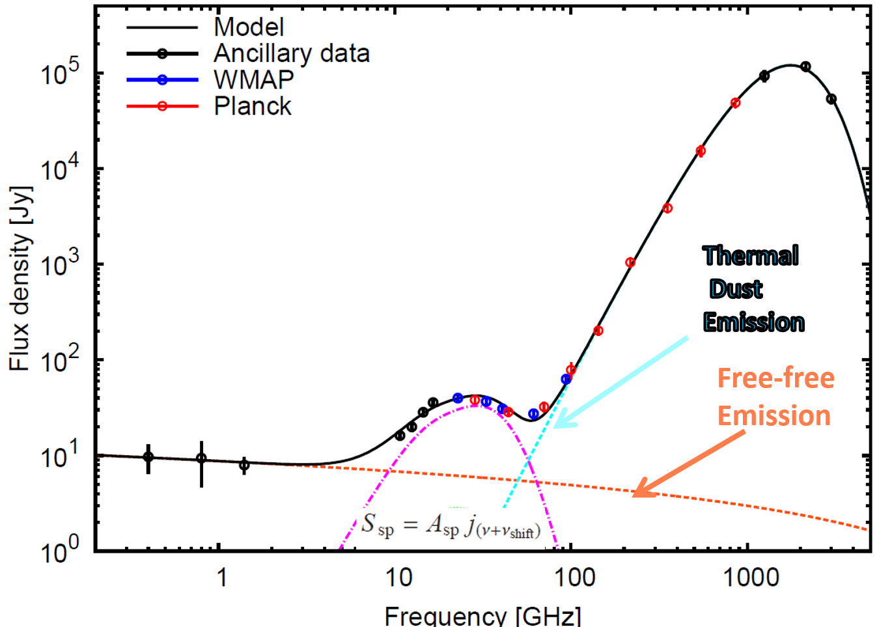
Intro: What is Anomalous Microwave Emission?
The Sky @ 30 GHz (via Planck)
**Synchrotron also present, but very weak in this region.
Image courtesy of ESA/Planck Collaboration; SED from Planck Collaboration+ (2011)
Notes:
If we take a look at the infrared to radio SED of the most prominent region in this AME map, Perseus, we get this.

Slide 5
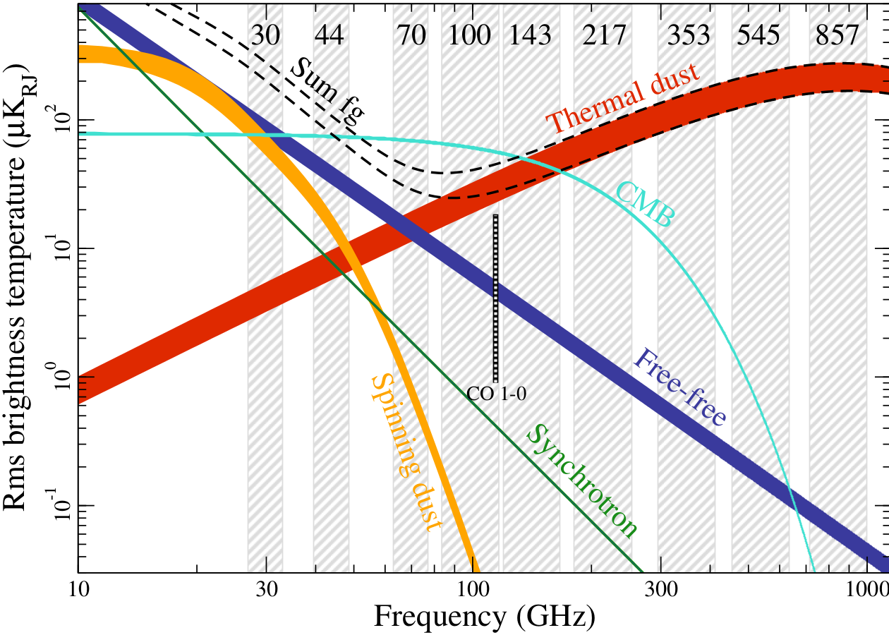
Intro: What is Anomalous Microwave Emission?
Dickinson+ (in. prep): The State of Play of AME Research

Slide 6
Intro: Most popular explanation
Tiny Spinning Dust：
Draine & Lazarian (1998)
Implies rotators ~1 nm *
(* if dipole moment is ~1 D)
duo
trio
UV photon
quartet
H
H
H
H
C
C
H
C
C
C
H
C
C
C
C
C
H
C
C
C
C
C
C
C
H
C
C
C
C
C
C
H
H
solo
Polycyclic Aromatic Hydrocarbons
Diagram courtesy of I. Sakon.
Draine & Lazarian (1999)
Notes:
There is another, overlapping idea: magnetic dipole emission from dust. This hasn’t been explored as much, but does predict a level of polarization of the AME which has not been detected yet. Anyways, we focus on the spinning dust hypothesis here, but acknowledge that both should be explored.

Slide 7
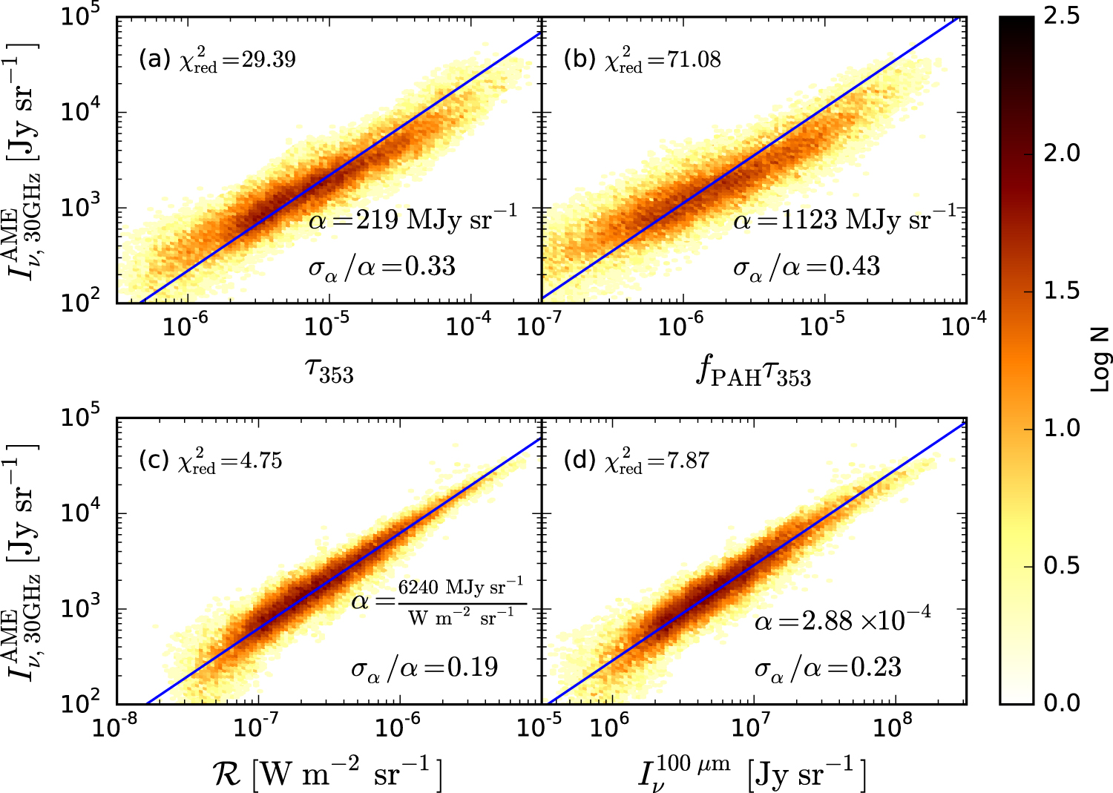
Intro: A Previous Dust vs. AME Study
Hensley, Draine, and Meissner (2016)
Notes:
Additionally, the claim that scaling by the ISRF gives a nicer correlation too. This is what we’d expect from a spinning dust sceneario, since spinning dust emission shouldn’t significantly depend on the radiation field- just on the dust abundance.

Slide 8
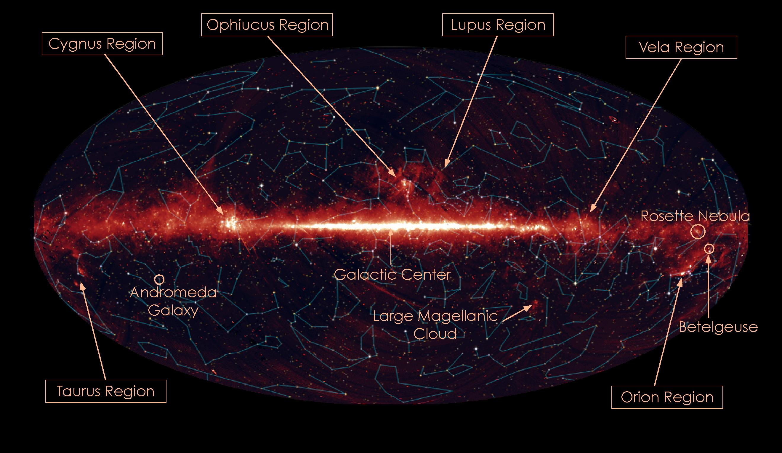
Our approach: Compare AKARI/IRC (and many other allsky maps) to AME Data

Slide 9
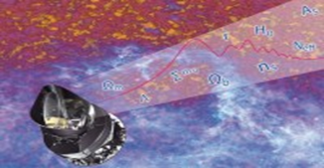
Analysis: A full sampling of the dust SED
AKARI/IRC:
9 and 18 µm
Traces the PAH-UIR bands
AKARI/FIS:
65, 90, 140, 160µm
Approximates peak of thermal dust emission
Planck/HFI:
345 and 550 µm
Constrains the FIR emissivity
Dust SED:*From DustEM, Compiegne+11
PAHs
Very Small Grains
Big Grains
Notes:
Draw attention to the bands which the modified blackbody is fitted to.
The color of IRC should be changed.
Give this one a rough size range.

Slide 10
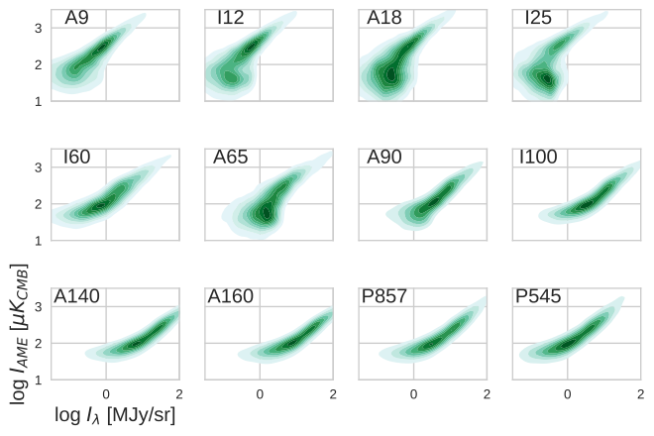
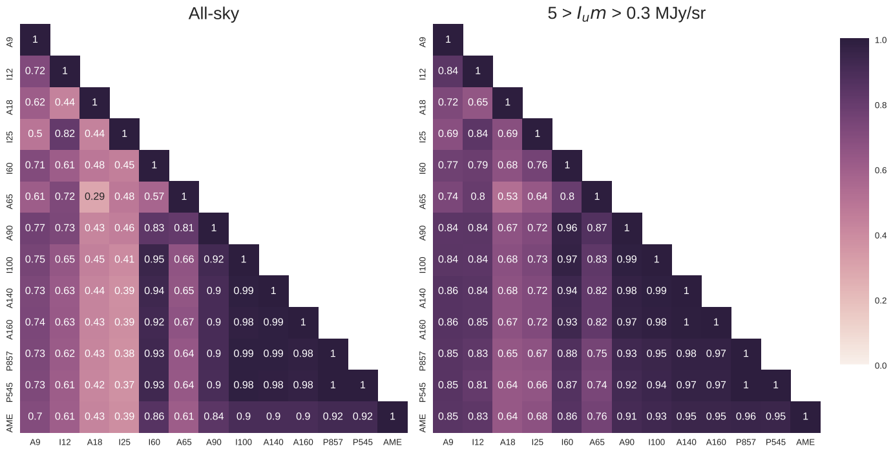

Slide 11
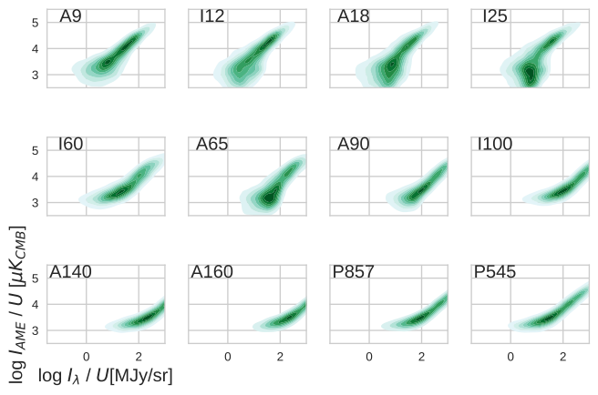

Slide 13
Our results: All-sky IR Bands Cross Correlation Matrix
Spearman correlation coefficient
At 1-degree scale- AME map is extremely similar to FIR maps.
Incomplete component separation of microwave foreground?
Thermal dust is more important for AME than tiny dust/PAHs?
Notes:
If we separate the AME regions into high-confidence AME and low-to-no confidence AME, and use the spearman rank coefficients, as in PCXV, we find a very weak correlation for the confident AME regions. We think this is due to the updated AME map which we used, which could have a better compoenet separation. Interestingly, the low-confidence AME regions have a stronger correlation (but also a larger samplesize)

Slide 14
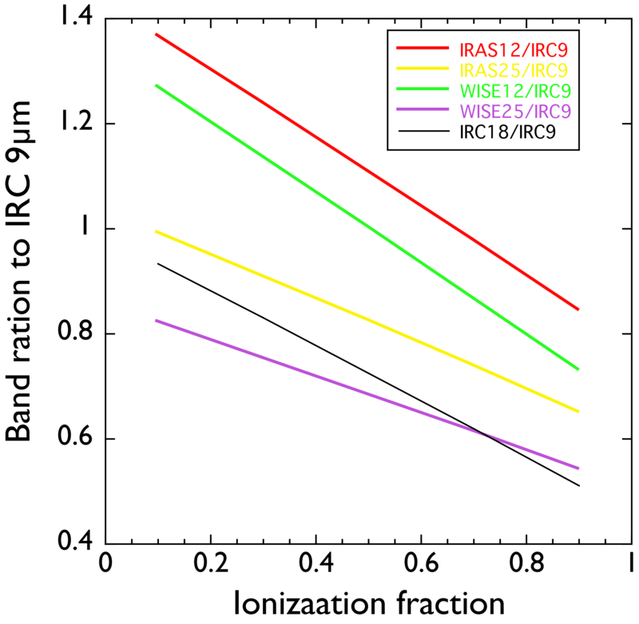

Slide 15
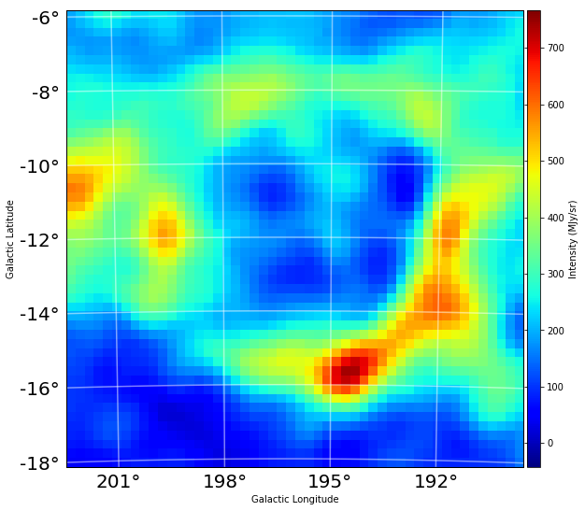
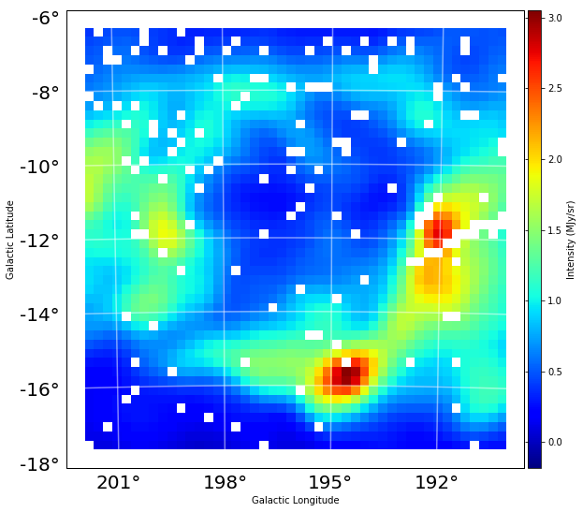
Our Results: Closer look at a famous AME region
Lambda Orionis Molecular Ring
AME Intensity
AKARI IRC 9 micron
(>95% emission)

Slide 16
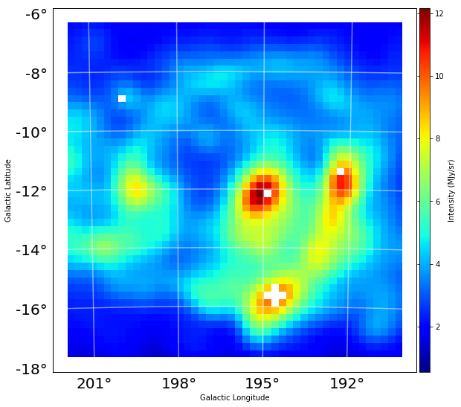
Our Results: Closer look at a famous AME region
Lambda Orionis Molecular Ring
AME Intensity
IRAS 60 micron emission
(~warm thermal dust + very small grain emission)

Slide 17
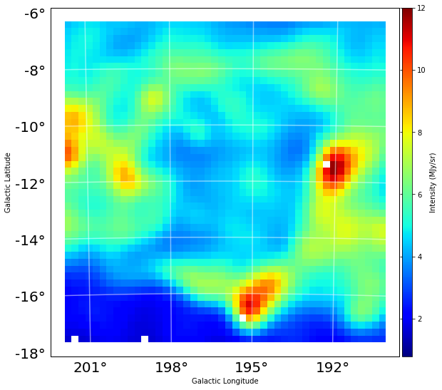
Our Results: Closer look at a famous AME region
Lambda Orionis Molecular Ring
AME Intensity
IRAS 100 micron emission
(~99% warm dust emission)

Slide 18
Conclusions:
1. All-sky maps:
Spearman(PAH:AME) < Spearman(DustRad.:AME)
May suggest AME not carried by PAHs- but noise can still play a role.
2. Lambda Orionis:
[In contrast with allsky analysis!]
Warmer dust → Weaker AME
Suggests intense ISRF/warm dust temp. destroys AME carrier? (If not PAHs, perhaps tiny silicates?)
Notes:
But before we get to spinning dust… let’s talk about the mystery that made as care about the possibility of spinning dust in the first place:
anomalous microwave emission, or AME

Slide 19
Shoulders of Giants
Leitch, E. M.; Readhead, A. C. S.; et al., 1997, ApJ, 486, 23L
・ Draine, B.T., and Lazarian, A., 1998, ApJ, 508, 157
・de Oliveira-Costa, A., Kogut, A., et al., 1997, ApJ, 482, L17
・Allamandola, L., Tielens, A.,1985, ApJ, 290, L25
・Planck Collaboration, et al., 2013, Planck 2013 results,arXiv:1303.5062
・Onaka, T., Matsuhara, et al.,., 2007, arXiv:0705.4144
・ Planck Collaboration, et al., 2013, Planck intermediate results. XV. AA, 536
Acknowledgements:
This research is based on observations with AKARI, a JAXA project with the participation of ESA; Planck, an ESA science mission with instruments and contributions directly funded by ESA Member States, NASA, and Canada; and IRAS, a joint project of the US, UK and the Netherlands. Aaron is supported by the MEXT Scholarship. Special thanks to Steven Gibson (Western Kentucky University) for helpful discussions.

