Slide 1
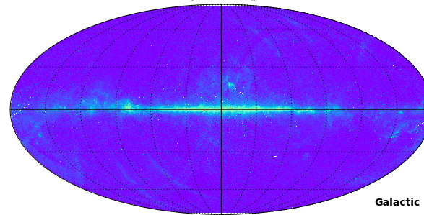
Investigation of Interstellar Dust Emission in the Infrared-Microwave Range with All-sky Surveys
全天サーベイによる赤外線マイクロ波帯での星間ダスト放射の研究
Aaron Bell

Slide 2
Introduction What is AME?
Data All-sky Maps
All-sky analysis Comparison to previous works λ Orionis Famous AME region
Conclusion Spinning PAHs?
Future work New data needed?

Slide 3
Introduction
What is Anomalous Microwave Emission?

Slide 4
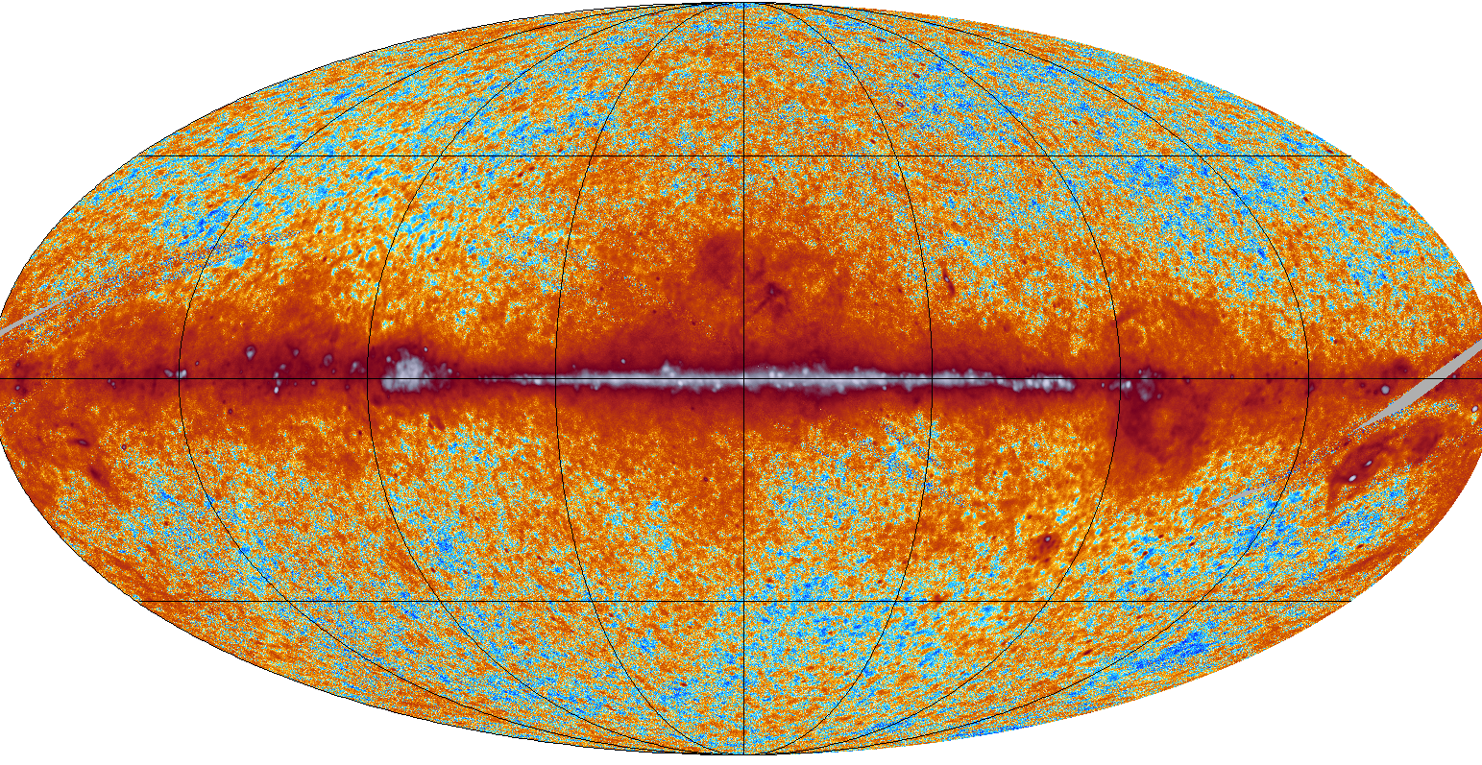
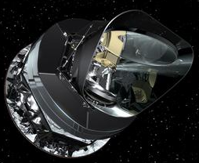

Introduction: What is AME?
An unexplained microwave foreground
Planck LFI 28 GHz All-sky Map: ESA/Planck Collaboration
Notes:
If we take a look at the infrared to radio SED of the most prominent region in this AME map, Perseus, we get this.

Slide 5
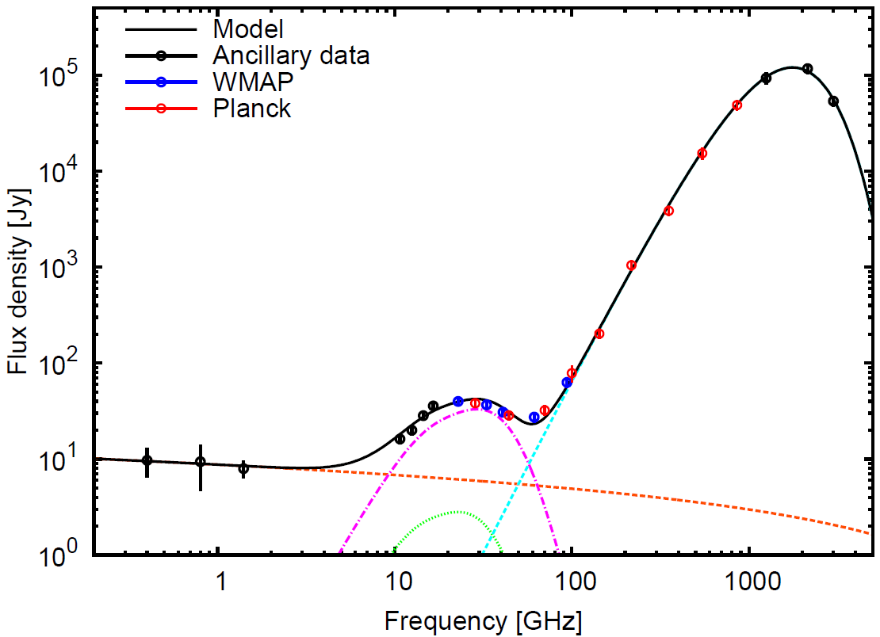

Introduction: What is AME?
An unexplained microwave foreground
Sample low-res microwave SED from the rho Ophiuchus region.
Thermal
Dust Emission
Free-free
Emission
Planck Collaboration+ (2011)
Notes:
If we take a look at the infrared to radio SED of the most prominent region in this AME map, Perseus, we get this.

Slide 6
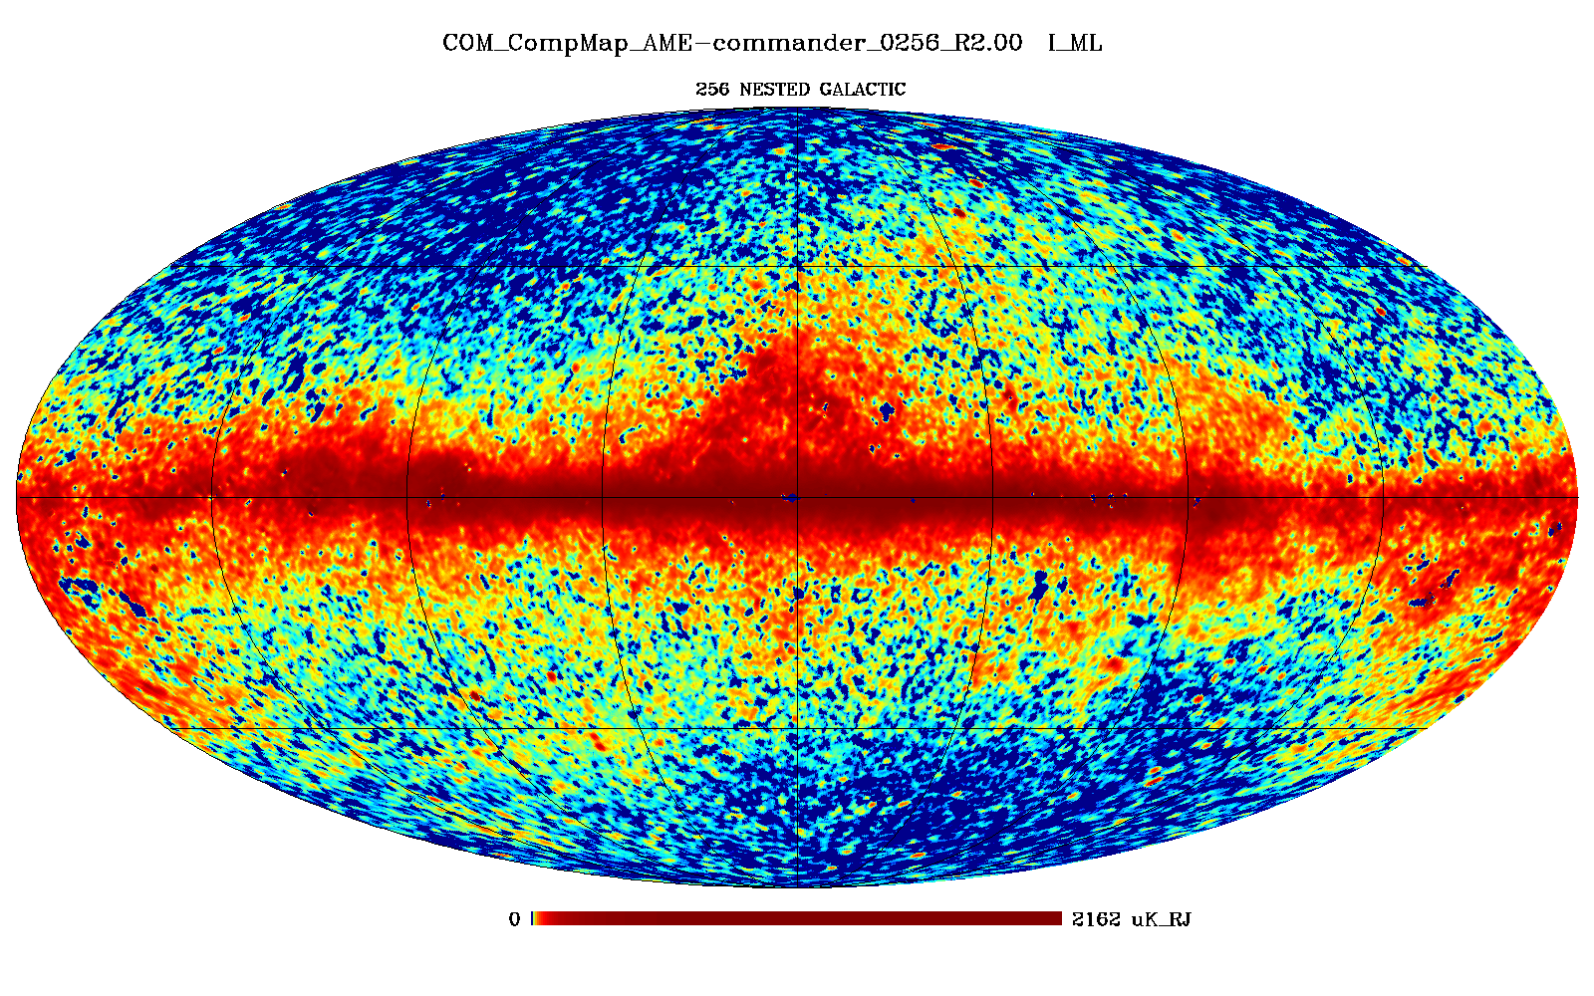
Introduction: What is AME?
Planck AME All-sky Map: ESA/Planck Collaboration
Notes:
If we take a look at the infrared to radio SED of the most prominent region in this AME map, Perseus, we get this.

Slide 7
Introduction - Past Works - Draine & Lazarian (1998a)
Prevailing AME Explanation:
Rotational emission from dust
Via electric dipole emission

Slide 8
Introduction - Past Works - Draine & Lazarian (1998b)
Spinning Dust SED:
Varies with environment

Slide 9
Introduction - Past Works - Draine & Lazarian (1998b)
Spinning Dust SED:
Varies with environment
Various excitation factors
Collision
Photon emission
H₂ formation

Slide 10
Introduction - Past Works - Draine & Lazarian (1998b)
Notes:
There is another, overlapping idea: magnetic dipole emission from dust. This hasn’t been explored as much, but does predict a level of polarization of the AME which has not been detected yet. Anyways, we focus on the spinning dust hypothesis here, but acknowledge that both should be explored.

Slide 11
Introduction - Past Works - Draine & Lazarian (1998b)
Draine & Lazarian (1998)
Implies rotators ~1 nm
Notes:
There is another, overlapping idea: magnetic dipole emission from dust. This hasn’t been explored as much, but does predict a level of polarization of the AME which has not been detected yet. Anyways, we focus on the spinning dust hypothesis here, but acknowledge that both should be explored.

Slide 12
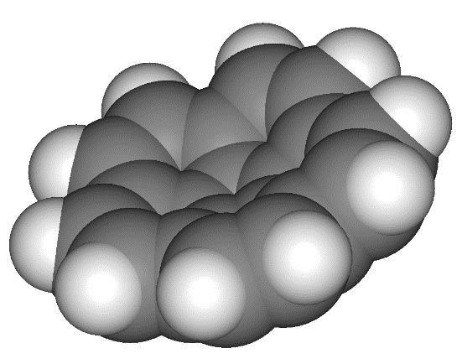
Introduction - Past Works - Draine & Lazarian (1998b)
Draine & Lazarian (1998)
Implies rotators ~1 nm
Polycyclic Aromatic Hydrocarbons ???
Rotational emission from corranulene C₂₀H_{10 ( ~2.07D)}
has been searched for in the Red Rectangle, by Pilleri et al. (2009)
Notes:
There is another, overlapping idea: magnetic dipole emission from dust. This hasn’t been explored as much, but does predict a level of polarization of the AME which has not been detected yet. Anyways, we focus on the spinning dust hypothesis here, but acknowledge that both should be explored.

Slide 13
Introduction - Past Works – Compiegne, et al. (2011)

Slide 14
Introduction - Past Works – Compiegne, et al. (2011)
Stochastic
Small
Emission

Slide 15
Introduction - Past Works – Compiegne, et al. (2011)
Stochastic
Small
Emission
Thermal
Emission

Slide 16
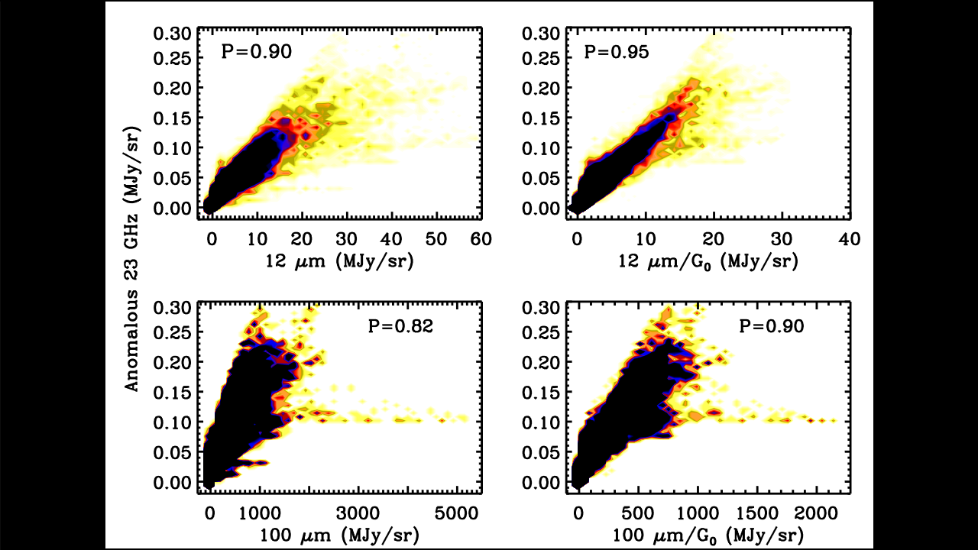
Introduction - Past Works – N. Ysard, et al. (2010)
WMAP
IRAS

Slide 17
Introduction - Past Works – N. Ysard, et al. (2010)
Stochastic
Small
Emission
Thermal
Emission
Model interstellar dust mixture SED
Compiegne+ (2011)

Slide 18
Introduction - Past Works – N. Ysard, et al. (2010)

Slide 19
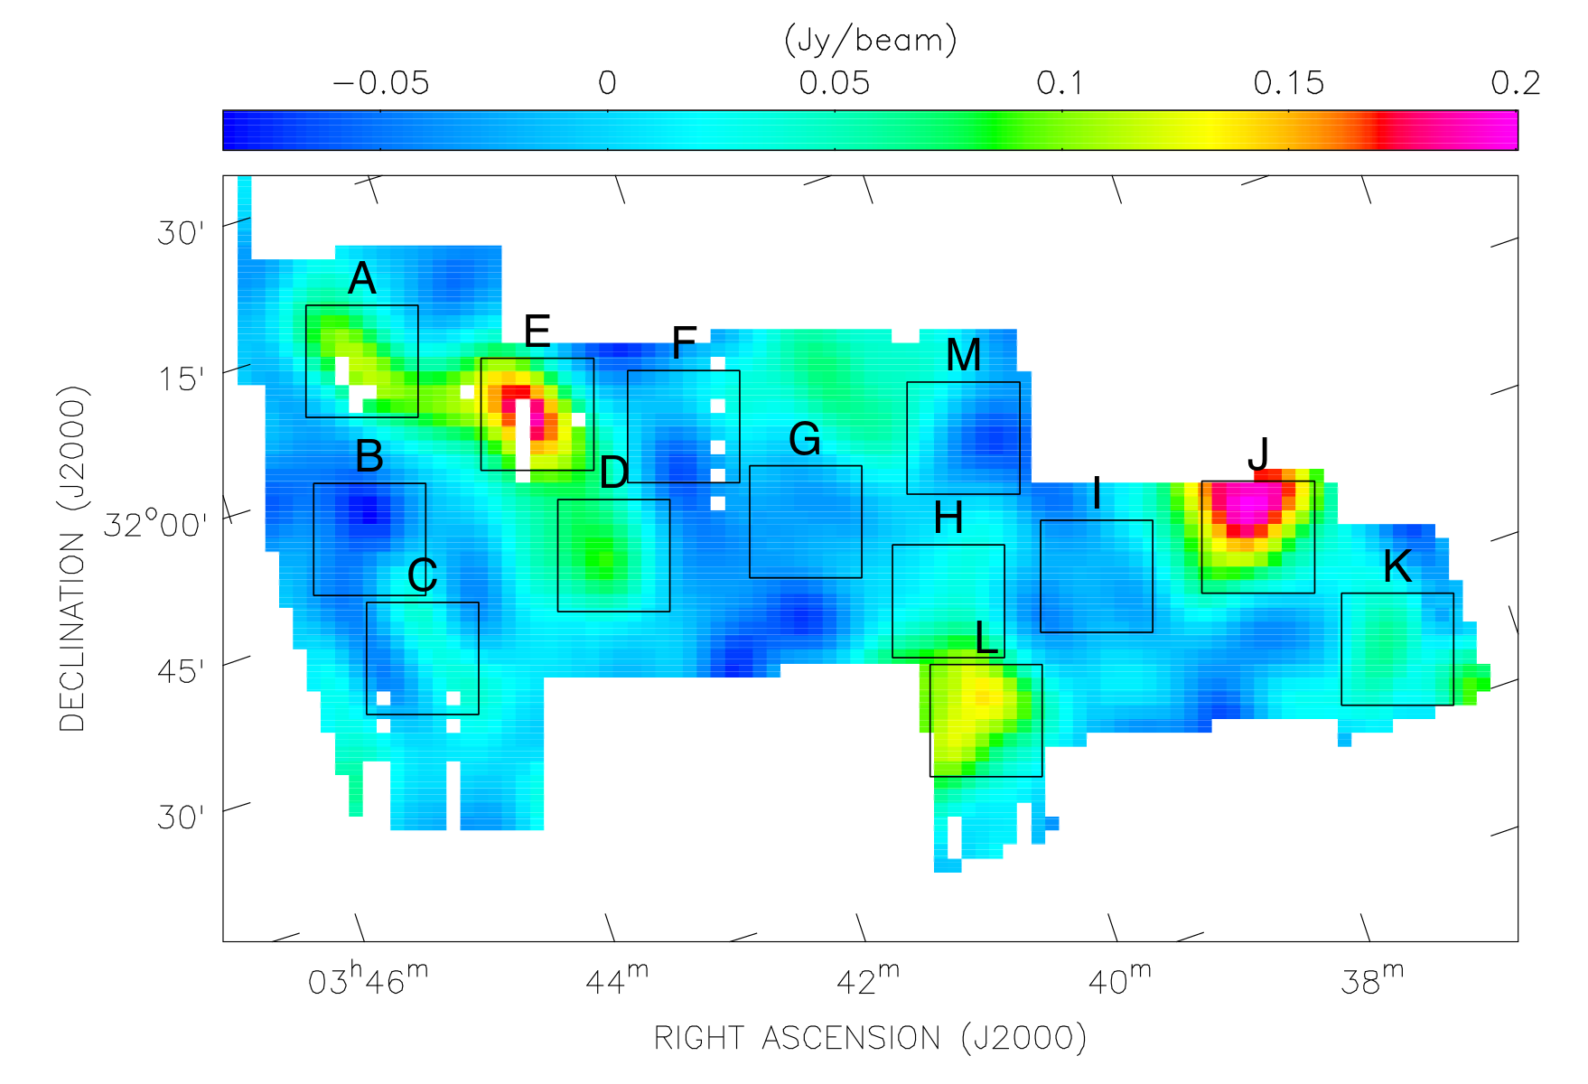
Introduction – Previous Works – C. Tibbs et al. (2011)
C. Tibbs+ (2011) - “Spitzer characterisation of dust in an anomalous emission region: the Perseus cloud”

Slide 20
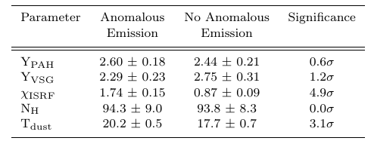
Introduction – Previous Works – C. Tibbs et al. (2011)
C. Tibbs+ (2011) - “Spitzer characterisation of dust in an anomalous emission region: the Perseus cloud”

Slide 21
Introduction – Previous Works – C. Tibbs et al. (2011)
C. Tibbs+ (2011) - “Spitzer characterisation of dust in an anomalous emission region: the Perseus cloud”

Slide 22
Introduction – Previous Works – C. Tibbs et al. (2011)
C. Tibbs+ (2011) - “Spitzer characterisation of dust in an anomalous emission region: the Perseus cloud”

Slide 23
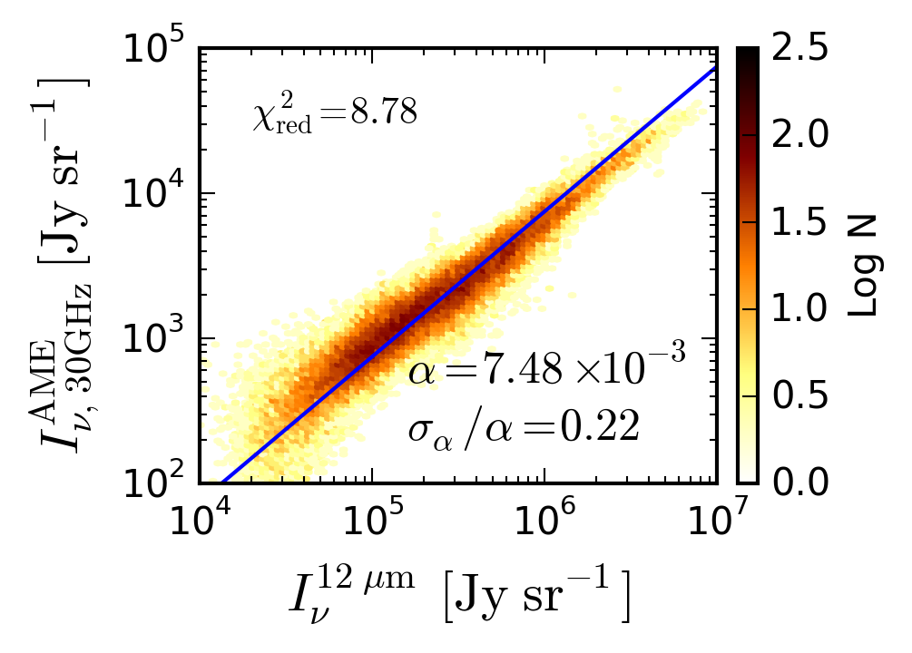
Introduction - Past Works – B. Hensley, et al. (2016)
WISE
Notes:
Additionally, the claim that scaling by the ISRF gives a nicer correlation too. This is what we’d expect from a spinning dust sceneario, since spinning dust emission shouldn’t significantly depend on the radiation field- just on the dust abundance.

Slide 24
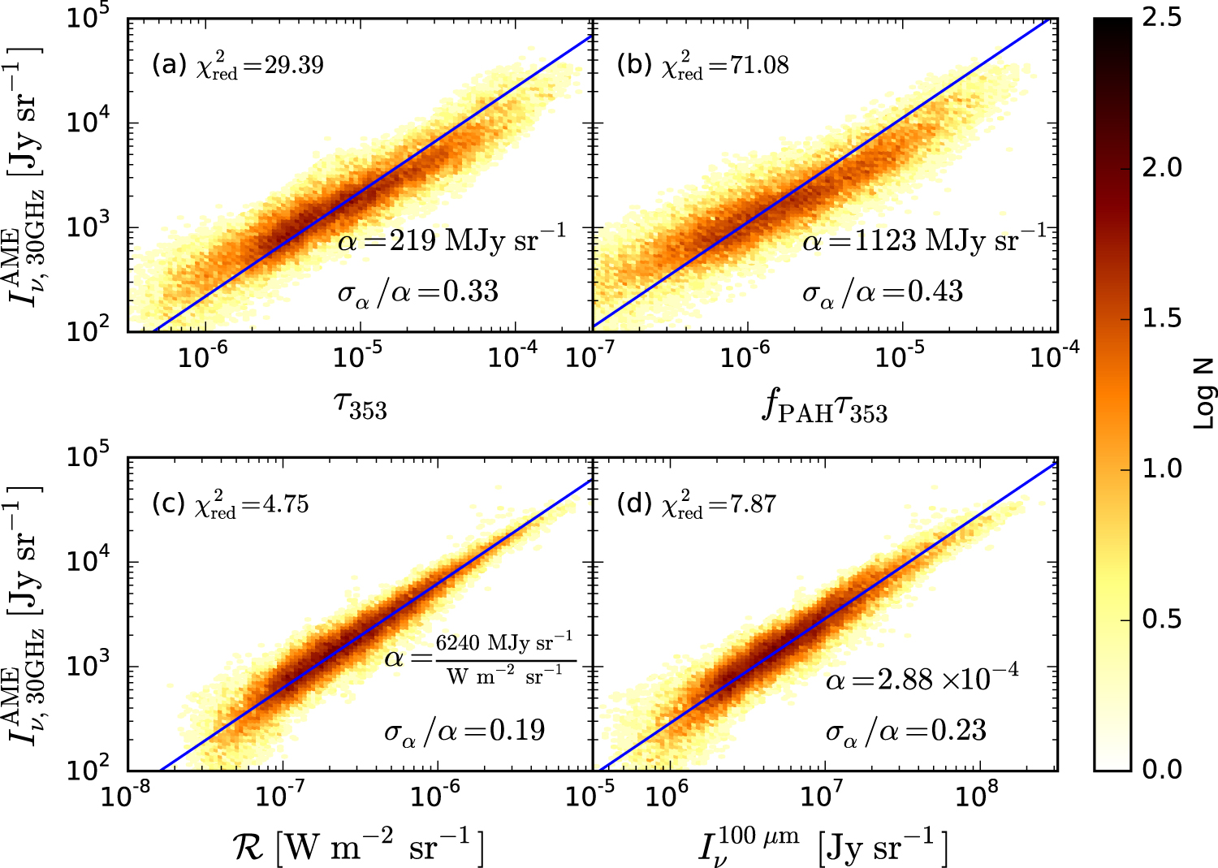
Introduction - Past Works – B. Hensley, et al. (2016)
Notes:
Additionally, the claim that scaling by the ISRF gives a nicer correlation too. This is what we’d expect from a spinning dust sceneario, since spinning dust emission shouldn’t significantly depend on the radiation field- just on the dust abundance.

Slide 25
Introduction - Past Works – B. Hensley, et al. (2016)
Notes:
Additionally, the claim that scaling by the ISRF gives a nicer correlation too. This is what we’d expect from a spinning dust sceneario, since spinning dust emission shouldn’t significantly depend on the radiation field- just on the dust abundance.

Slide 26
Introduction - Past Works – B. Hensley, et al. (2016)
Notes:
Additionally, the claim that scaling by the ISRF gives a nicer correlation too. This is what we’d expect from a spinning dust sceneario, since spinning dust emission shouldn’t significantly depend on the radiation field- just on the dust abundance.

Slide 27
Introduction - Past Works – B. Hensley, et al. (2016)
Notes:
Additionally, the claim that scaling by the ISRF gives a nicer correlation too. This is what we’d expect from a spinning dust sceneario, since spinning dust emission shouldn’t significantly depend on the radiation field- just on the dust abundance.

Slide 28
Introduction – Testing a Spinning PAH Hypothesis
Dust parameters:
  PAH luminosity:
  Radiation field:
  PAH abundance:
AME Parameters:
  AME Intensity:
  via Planck Coll. (2015)
  Carrier abundance:

Slide 29
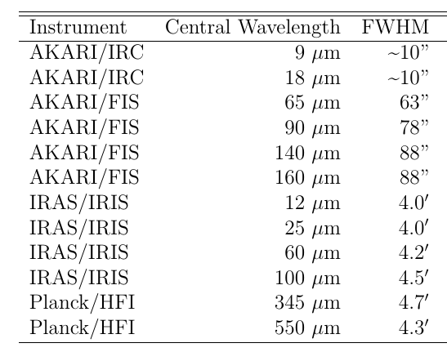
Data - Infrared
Which IR data can help solve the AME puzzle?
Notes:
Because AME correlates spatially with dust,
We look at IR data that traces the dust SED.
This includes the smallest dust, ~10nm, like PAH molecules, to the larger grains up to ~0.1 micron.

Slide 30
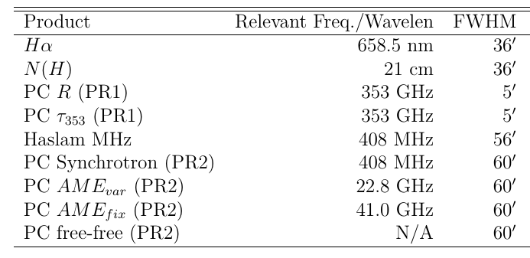
Data - Microwave
Which data can help solve the AME puzzle?
Notes:
Because AME correlates spatially with dust,
We look at IR data that traces the dust SED.
This includes the smallest dust, ~10nm, like PAH molecules, to the larger grains up to ~0.1 micron.

Slide 31
Data - Microwave
Which data can help solve the AME puzzle?
AME Data limits our analysis to ~1 degree resolution!
Notes:
Because AME correlates spatially with dust,
We look at IR data that traces the dust SED.
This includes the smallest dust, ~10nm, like PAH molecules, to the larger grains up to ~0.1 micron.

Slide 32
Data - Microwave
Which data can help solve the AME puzzle?
AME Data limits our analysis to ~1 degree resolution!
AME resolution is limited by use of Haslam+ (1982) synchrotron constraints
Notes:
Because AME correlates spatially with dust,
We look at IR data that traces the dust SED.
This includes the smallest dust, ~10nm, like PAH molecules, to the larger grains up to ~0.1 micron.

Slide 33
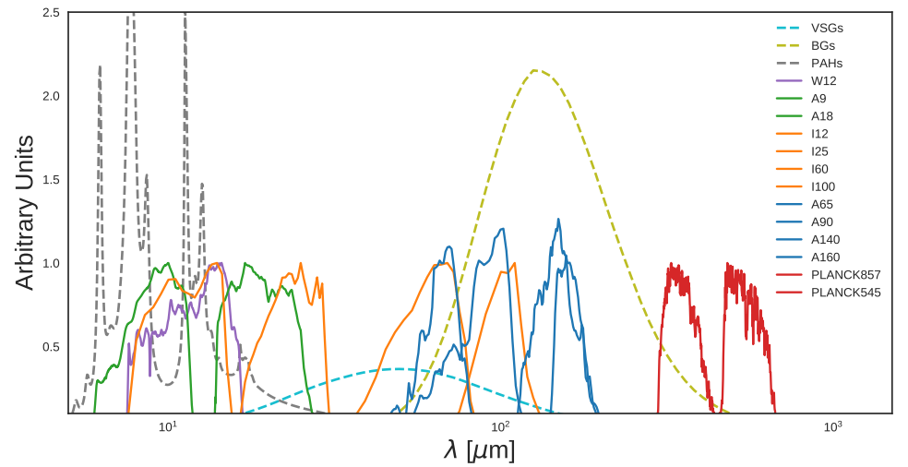
Data - Infrared
Which data can help solve the AME puzzle?
Notes:
Because AME correlates spatially with dust,
We look at IR data that traces the dust SED.
This includes the smallest dust, ~10nm, like PAH molecules, to the larger grains up to ~0.1 micron.

Slide 34
Data – Infrared – PAH Features
Which data can help solve the AME puzzle?
PAH Emission
duo
trio
UV photon
quartet
H
H
H
H
C
C
H
C
C
C
H
C
C
C
C
C
H
C
C
C
C
C
C
C
H
C
C
C
C
C
C
H
H
solo
Notes:
Because AME correlates spatially with dust,
We look at IR data that traces the dust SED.
This includes the smallest dust, ~10nm, like PAH molecules, to the larger grains up to ~0.1 micron.

Slide 35
Data – Infrared – Very Small Grains
Which data can help solve the AME puzzle?
PAH Emission
VSGs
quartet
H
UV photon
C
H
C
C
H
C
C
C
C
H
C
C
duo
H
solo
C
H
C
C
C
C
C
C
H
C
C
C
trio
C
C
H
C
C
H
H
Notes:
Because AME correlates spatially with dust,
We look at IR data that traces the dust SED.
This includes the smallest dust, ~10nm, like PAH molecules, to the larger grains up to ~0.1 micron.

Slide 36
Data – Infrared – Thermal Equilibrium Grains
PAH Emission
VSGs
BGs
(~Blackbody)
duo
trio
UV photon
quartet
H
H
H
H
C
C
C
H
C
C
H
C
C
C
C
C
H
C
C
C
C
C
C
C
C
H
C
C
C
C
C
H
H
solo
Notes:
Because AME correlates spatially with dust,
We look at IR data that traces the dust SED.
This includes the smallest dust, ~10nm, like PAH molecules, to the larger grains up to ~0.1 micron.

Slide 37
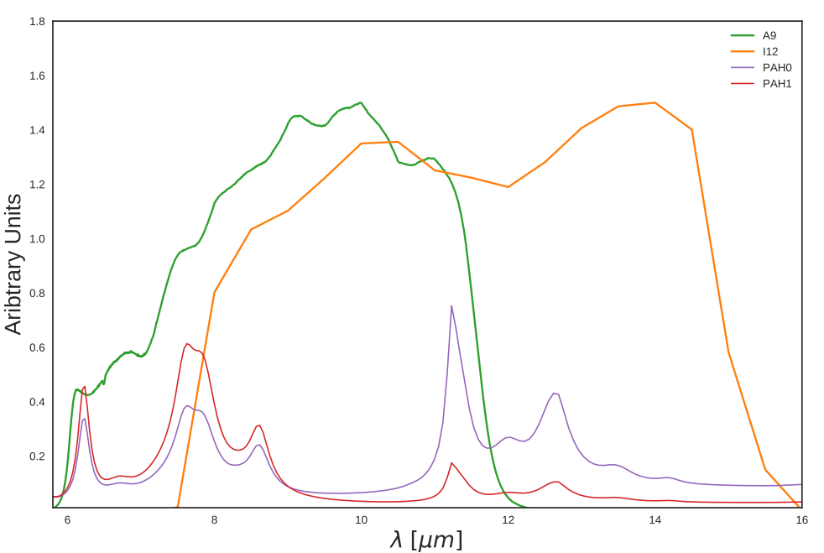
Data – Infrared – PAH Features
PAH Emission
IRAS 12 μm Bandpass
IRC 9 μm Bandpass
trio
H
H
duo
C
C
H
C
H
C
C
C
C
H
C
C
UV photon
C
C
H
C
quartet
C
C
C
C
C
H
C
C
C
H
solo
C
C
C
H
H
Notes:
Because AME correlates spatially with dust,
We look at IR data that traces the dust SED.
This includes the smallest dust, ~10nm, like PAH molecules, to the larger grains up to ~0.1 micron.

Slide 38
Data – Infrared – PAH Features – PAH Ionization
Mostly from ionized
PAHs
Mostly from neutral
PAHs
PAH Emission
7.7 µm
8.6 µm
11.2 µm
solo
6.2 µm
12.7 µm
H
C
C
H
C
C
C
C
H
C
C
C
H
C
C
C
C
C
C
C
C
C
H
C
C
C
H
trio
C
C
H
H
H
H
duo
quartet
UV photon
Notes:
Because AME correlates spatially with dust,
We look at IR data that traces the dust SED.
This includes the smallest dust, ~10nm, like PAH molecules, to the larger grains up to ~0.1 micron.

Slide 39
Analysis: Overview

Slide 40
Analysis: Overview
All-sky
Intensity Correlation Matrix: “How do IR intensities vary with AME? Each other?”
Bootstrap: “How precise are the correlation tests?”
Implication for Spinning PAHs: Essentially inconclusive...

Slide 41
Analysis: Overview
All-sky
Intensity Correlation Matrix: “How do IR intensities vary with AME? Each other?”
Bootstrap: “How precise are the correlation tests?”
Implication for Spinning PAHs: Essentially inconclusive...
λ Orionis
Intensity Correlation Matrix
Bootstrap
SED Fitting “What if we look at physical parameters of dust?”
Implication for Spinning PAHs: Supported

Slide 42
Analysis: All-sky

Slide 43
All-sky Analysis
Data mask

Slide 44
All-sky Analysis
Data mask
Masked correlation test

Slide 45
All-sky Analysis
Data mask
Masked correlation test
Bootstrap analysis

Slide 46
All-sky Analysis
Data mask
Masked correlation test
Bootstrap analysis

Slide 47
All-sky Analysis
Data mask
Masked correlation test
Bootstrap analysis
Conclusions
Future work?

Slide 48
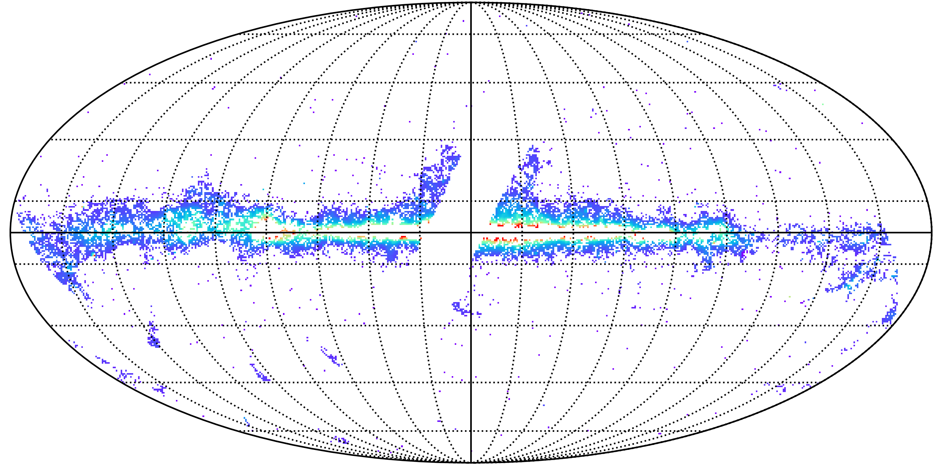
All-sky Analysis – Data Mask

Slide 49
All-sky Analysis – Data Mask
Pixel mask conditions:
  Zodiacal light
  Point-sources
  3σ signal:noise limit
  Galactic plane confusion
~7% of the sky remains
after masking

Slide 50
All-sky Analysis
Do AKARI-based results mirror previous works?

Slide 51
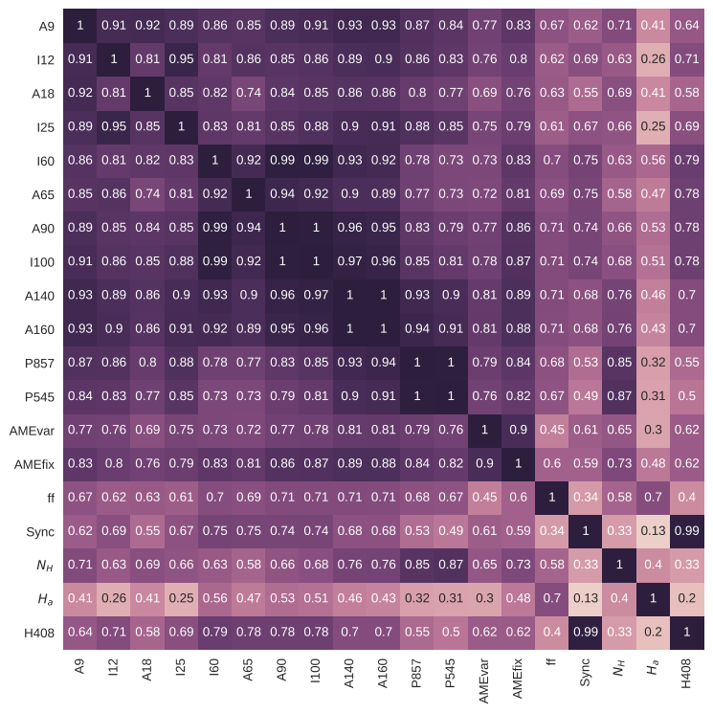
All-sky Analysis – Masked Analysis – Corr Matrix
AME correlates best with 140-160 micron emission.
But is it statistically better than AME vs. MIR emission?

Slide 52
All-sky Analysis – Masked Analysis – Corr Matrix
AME correlates best with 140-160 micron emission.
But is it statistically better than AME vs. MIR emission?

Slide 53
All-sky Analysis – Masked Analysis – Corr Matrix
AME correlates best with 140-160 micron emission.
But is it statistically better than AME vs. MIR emission?

Slide 54
All-sky Analysis – Masked Analysis – Corr Matrix
AME correlates best with 140-160 micron emission.
But is it statistically better than AME vs. MIR emission?

Slide 55
All-sky Analysis - Unmasked correlation test
Do AKARI-based results mirror previous works?
  Generally, yes.

Slide 56
All-sky Analysis – IR Intensity to AME Comparison
Bootstrap Analysis

Slide 57
All-sky Analysis – What is bootstrapping?
Why bootstrap?
  De-weight outliers
  Assess error in a statistic

Slide 58
All-sky Analysis – What is bootstrapping?
Original
sample
Re-sample
#1
Re-sample
#1
50
4
3
2
1
...Repeat...
Ideally, nPn times
Practically, n*log(n)
Mean
12

Slide 59
All-sky Analysis – What is bootstrapping?
Original
sample
Re-sample
#1
Re-sample
#1
50
3
2
1
4
...Repeat...
Ideally, nPn times
Practically, n*log(n)
Mean
12

Slide 60
All-sky Analysis – What is bootstrapping?
Original
sample
Re-sample
#1
Re-sample
#1
50
4
3
2
1
4
...Repeat...
Ideally, nPn times
Practically, n*log(n)
Mean
12

Slide 61
All-sky Analysis – What is bootstrapping?
Original
sample
Re-sample
#1
Re-sample
#1
50
3
2
1
4
4
...Repeat...
Ideally, nPn times
Practically, n*log(n)
Mean
12

Slide 62
All-sky Analysis – What is bootstrapping?
Original
sample
Re-sample
#1
Re-sample
#1
50
4
3
2
1
4
4
...Repeat...
Ideally, nPn times
Practically, n*log(n)
Mean
12

Slide 63
All-sky Analysis – What is bootstrapping?
Original
sample
Re-sample
#1
Re-sample
#1
50
4
2
1
4
4
3
...Repeat...
Ideally, nPn times
Practically, n*log(n)
Mean
12

Slide 64
All-sky Analysis – What is bootstrapping?
Original
sample
Re-sample
#1
Re-sample
#1
50
4
3
2
1
4
4
3
...Repeat...
Ideally, nPn times
Practically, n*log(n)
Mean
12

Slide 65
All-sky Analysis – What is bootstrapping?
Original
sample
Re-sample
#1
Re-sample
#1
50
4
3
1
4
4
3
2
...Repeat...
Ideally, nPn times
Practically, n*log(n)
Mean
12

Slide 66
All-sky Analysis – What is bootstrapping?
Original
sample
Re-sample
#1
Re-sample
#1
50
4
3
2
1
4
4
3
2
...Repeat...
Ideally, nPn times
Practically, n*log(n)
Mean
12

Slide 67
All-sky Analysis – What is bootstrapping?
Original
sample
Re-sample
#1
Re-sample
#1
50
4
3
2
4
4
3
2
1
...Repeat...
Ideally, nPn times
Practically, n*log(n)
Mean
12

Slide 68
All-sky Analysis – What is bootstrapping?
Original
sample
Re-sample
#1
Re-sample
#1
50
4
3
2
1
4
4
3
2
1
...Repeat...
Ideally, nPn times
Practically, n*log(n)
Mean
12

Slide 69
All-sky Analysis – What is bootstrapping?
Original
sample
Re-sample
#1
Re-sample
#1
50
4
3
2
1
4
4
3
2
1
...Repeat...
Ideally, nPn times
Practically, n*log(n)
Mean
12 2.8

Slide 70
All-sky Analysis – What is bootstrapping?
Original
sample
Re-sample
#1
Re-sample
#1
Re-sample
#2
50
4
3
2
1
4
4
3
2
1
50
4
3
3
1
...Repeat...
Ideally, nPn times
Practically, n*log(n)
Mean
12 2.8 12.2

Slide 71
All-sky Analysis – What is bootstrapping?
Original
sample
Re-sample
#1
Re-sample
#1
Re-sample
#2
Re-sample
#3
50
4
3
2
1
4
4
3
2
1
50
4
3
3
1
1
4
3
3
1
...Repeat...
Ideally, nPn times
Practically, n*log(n)
Mean
12 2.8 12.2 2.4

Slide 72
All-sky Analysis – What is bootstrapping?
Original
sample
Re-sample
#1
Re-sample
#1
Re-sample
#2
Re-sample
#3
50
4
3
2
1
4
4
3
2
1
50
4
3
3
1
1
4
3
3
1
...Repeat…
Ideally, nPn times
Practically, n*log(n)
Mean
12 2.8 12.2 2.4

Slide 73
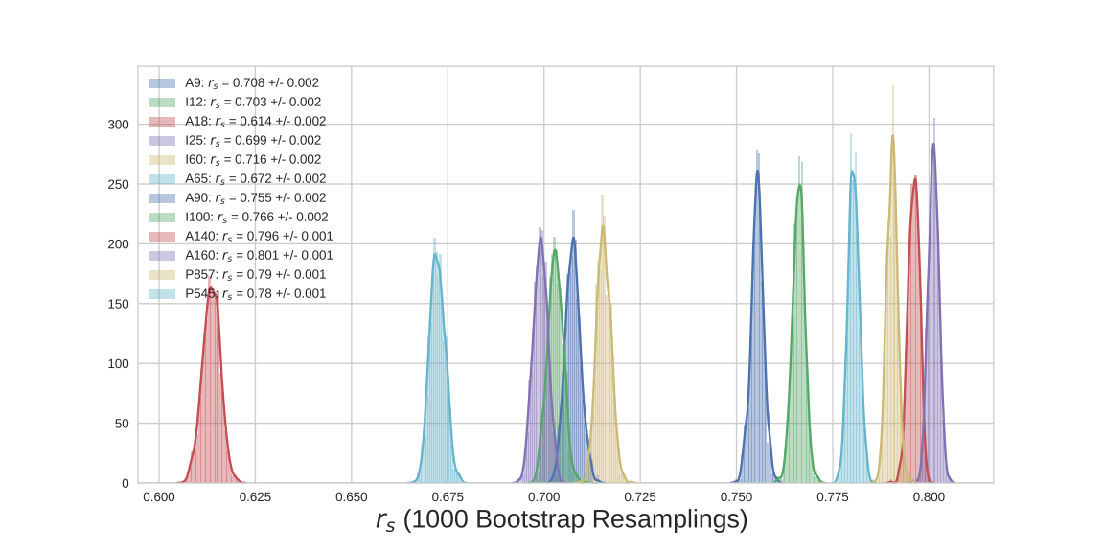
All-sky Analysis – Masked Analysis – Bootstrap
AKARI 160 μm
AKARI 9 μm
IRAS 12 μm
A140 and A160 vs. AME score stands-up to the bootstrap test.
FIR bands correlate best, within correlation errors.
A9 vs. AME shows best score among MIR.

Slide 74
All-sky Analysis – Masked Analysis – Bootstrap
AKARI 160 μm
AKARI 9 μm
IRAS 12 μm
A140 and A160 vs. AME score stands-up to the bootstrap test.
FIR bands correlate best, within correlation errors.
A9 vs. AME shows best score among MIR.

Slide 75
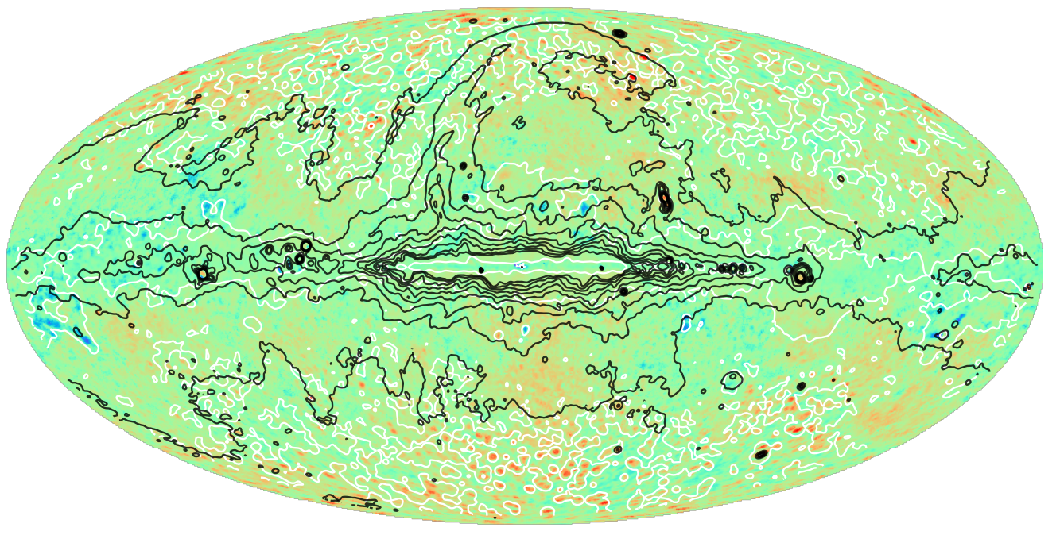
Discussion: Component separation artifacts
Image: I_{AME}/ R_{dust}
Black contours: Synchrotron
White contours: Free-free

Slide 76
Conclusions – All sky
AME-from-PAHs: Inconclusive

Slide 77
Conclusions – All sky
AME-from-PAHs: Inconclusive
Residual free-free: Possible for some regions
Residual Synchrotron: Possible for some regions

Slide 78
Conclusions – All sky
AME-from-PAHs: Inconclusive
Residual free-free: Possible for some regions
Residual Synchrotron: Possible for some regions
Signal-to-noise limits prevents a truly all-sky comparison with IR

Slide 79
Conclusions – All sky
AME-from-PAHs: Inconclusive
Residual free-free: Possible for some regions
Residual Synchrotron: Possible for some regions
Signal-to-noise limits prevents a truly all-sky comparison with IR
Previous works:
  Ysard+ (2010): Inconsistent
  Hensley+ (2016): Consistent (but different interpretation)

Slide 80
Conclusions – All sky
AME-from-PAHs: Inconclusive
Residual free-free: Possible for some regions
Residual Synchrotron: Possible for some regions
Signal-to-noise limits prevents a truly all-sky comparison with IR
Previous works:
  Ysard+ (2010): Inconsistent
  Hensley+ (2016): Consistent (but different interpretation)

Slide 81
Conclusions – All sky
AME-from-PAHs: Inconclusive
Residual free-free: Possible for some regions
Residual Synchrotron: Possible for some regions
Signal-to-noise limits prevents a truly all-sky comparison with IR
Previous works:
  Ysard+ (2010): Inconsistent
  Hensley+ (2016): Consistent (but different interpretation)
If component separation quality varies across the sky:
  Different results may be seen with different regions.

Slide 82
Analysis: λ Orionis Region

Slide 83
Analysis: λ Orionis Region
But first: A note on publication plans

Slide 84
Analysis: λ Orionis Region
But first: A note on publication plans
All-sky: Only Highlighted results from thesis

Slide 85
Analysis: λ Orionis Region
But first: A note on publication plans
All-sky: Only Highlighted results from thesis
λ Orionis: Essentially all analysis shown in thesis

Slide 86
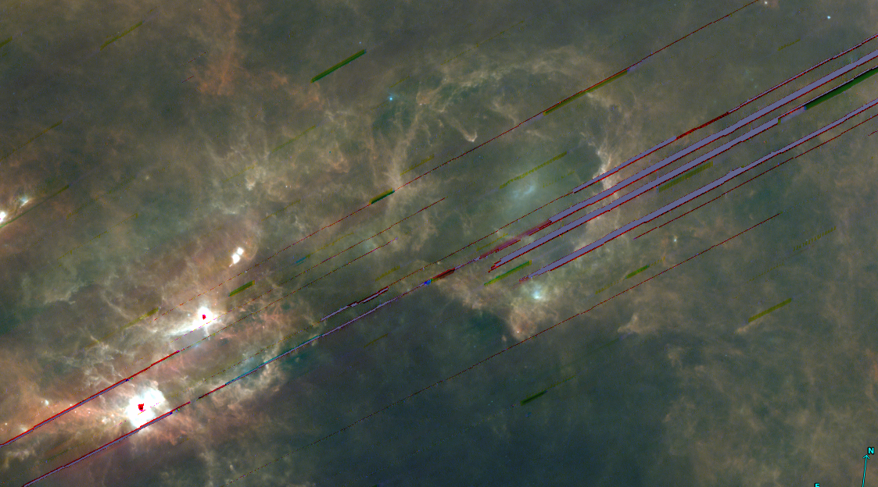
λ Orionis Region – “Why λ Orionis?”
AKARI/FIS (All-sky survey) RGB Image of greater λ Orionis region
Blue: FIS 65μm, Green: FIS 90μm, Red: FIS 140μm

Slide 87
λ Orionis Region – “Why λ Orionis?”
Large angular size
~10º across
AKARI/FIS (All-sky survey) RGB Image of greater λ Orionis region
Blue: FIS 65μm, Green: FIS 90μm, Red: FIS 140μm

Slide 88
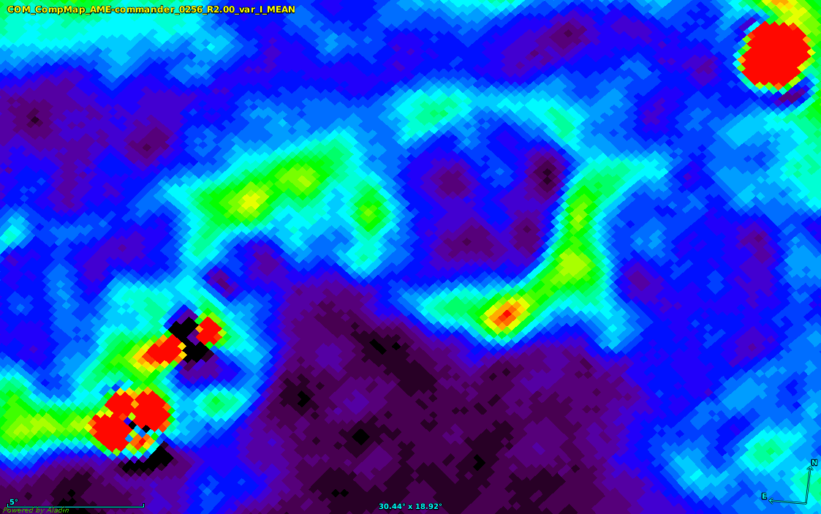
λ Orionis Region – “Why λ Orionis?”
AME Component Map
Planck Coll. (2015)
Large angular size
Resolved shape in AME map
~10º across
AME Map PSF ~1º

Slide 89
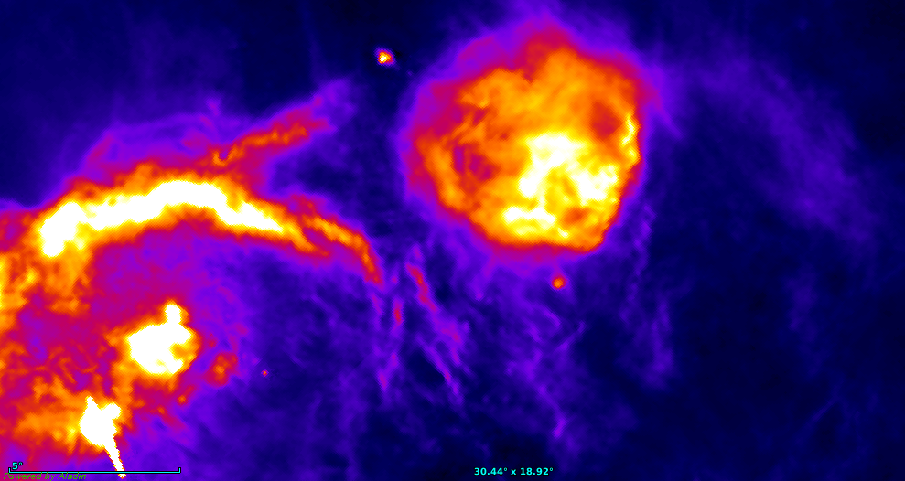
λ Orionis Region – “Why λ Orionis?”
Hα
Finkbeiner+ (2003)
Large angular size
Resolved shape in AME map
AME distinct from free-free
AME Map PSF ~1º

Slide 90
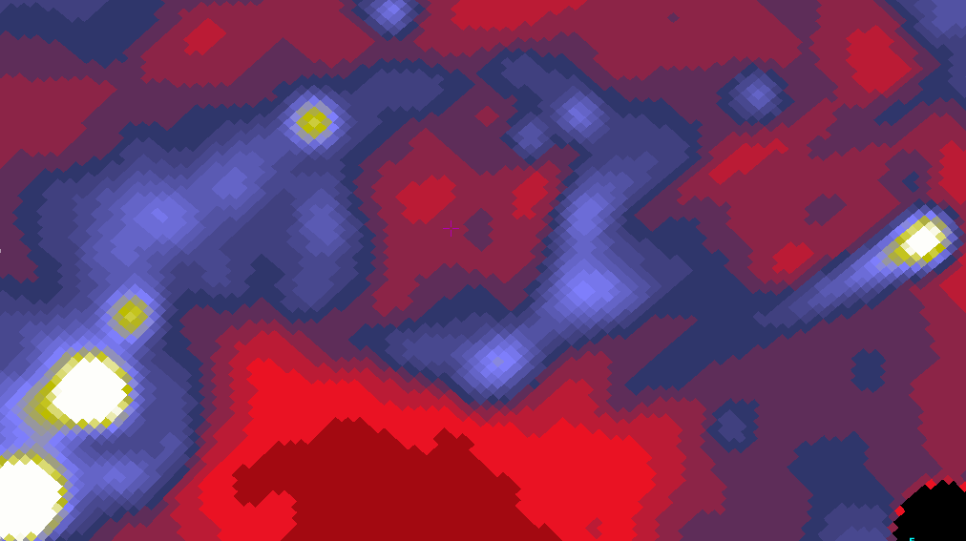
λ Orionis Region – “Why λ Orionis?”
AKARI/IRC 9 μm
Ishihara+ (in prep.)
Large angular size
Resolved shape in AME map
AME distinct from free-free
AME Map PSF ~1º

Slide 91
λ Orionis - Analysis
Compare AME and multi-band IR on common grid

Slide 92
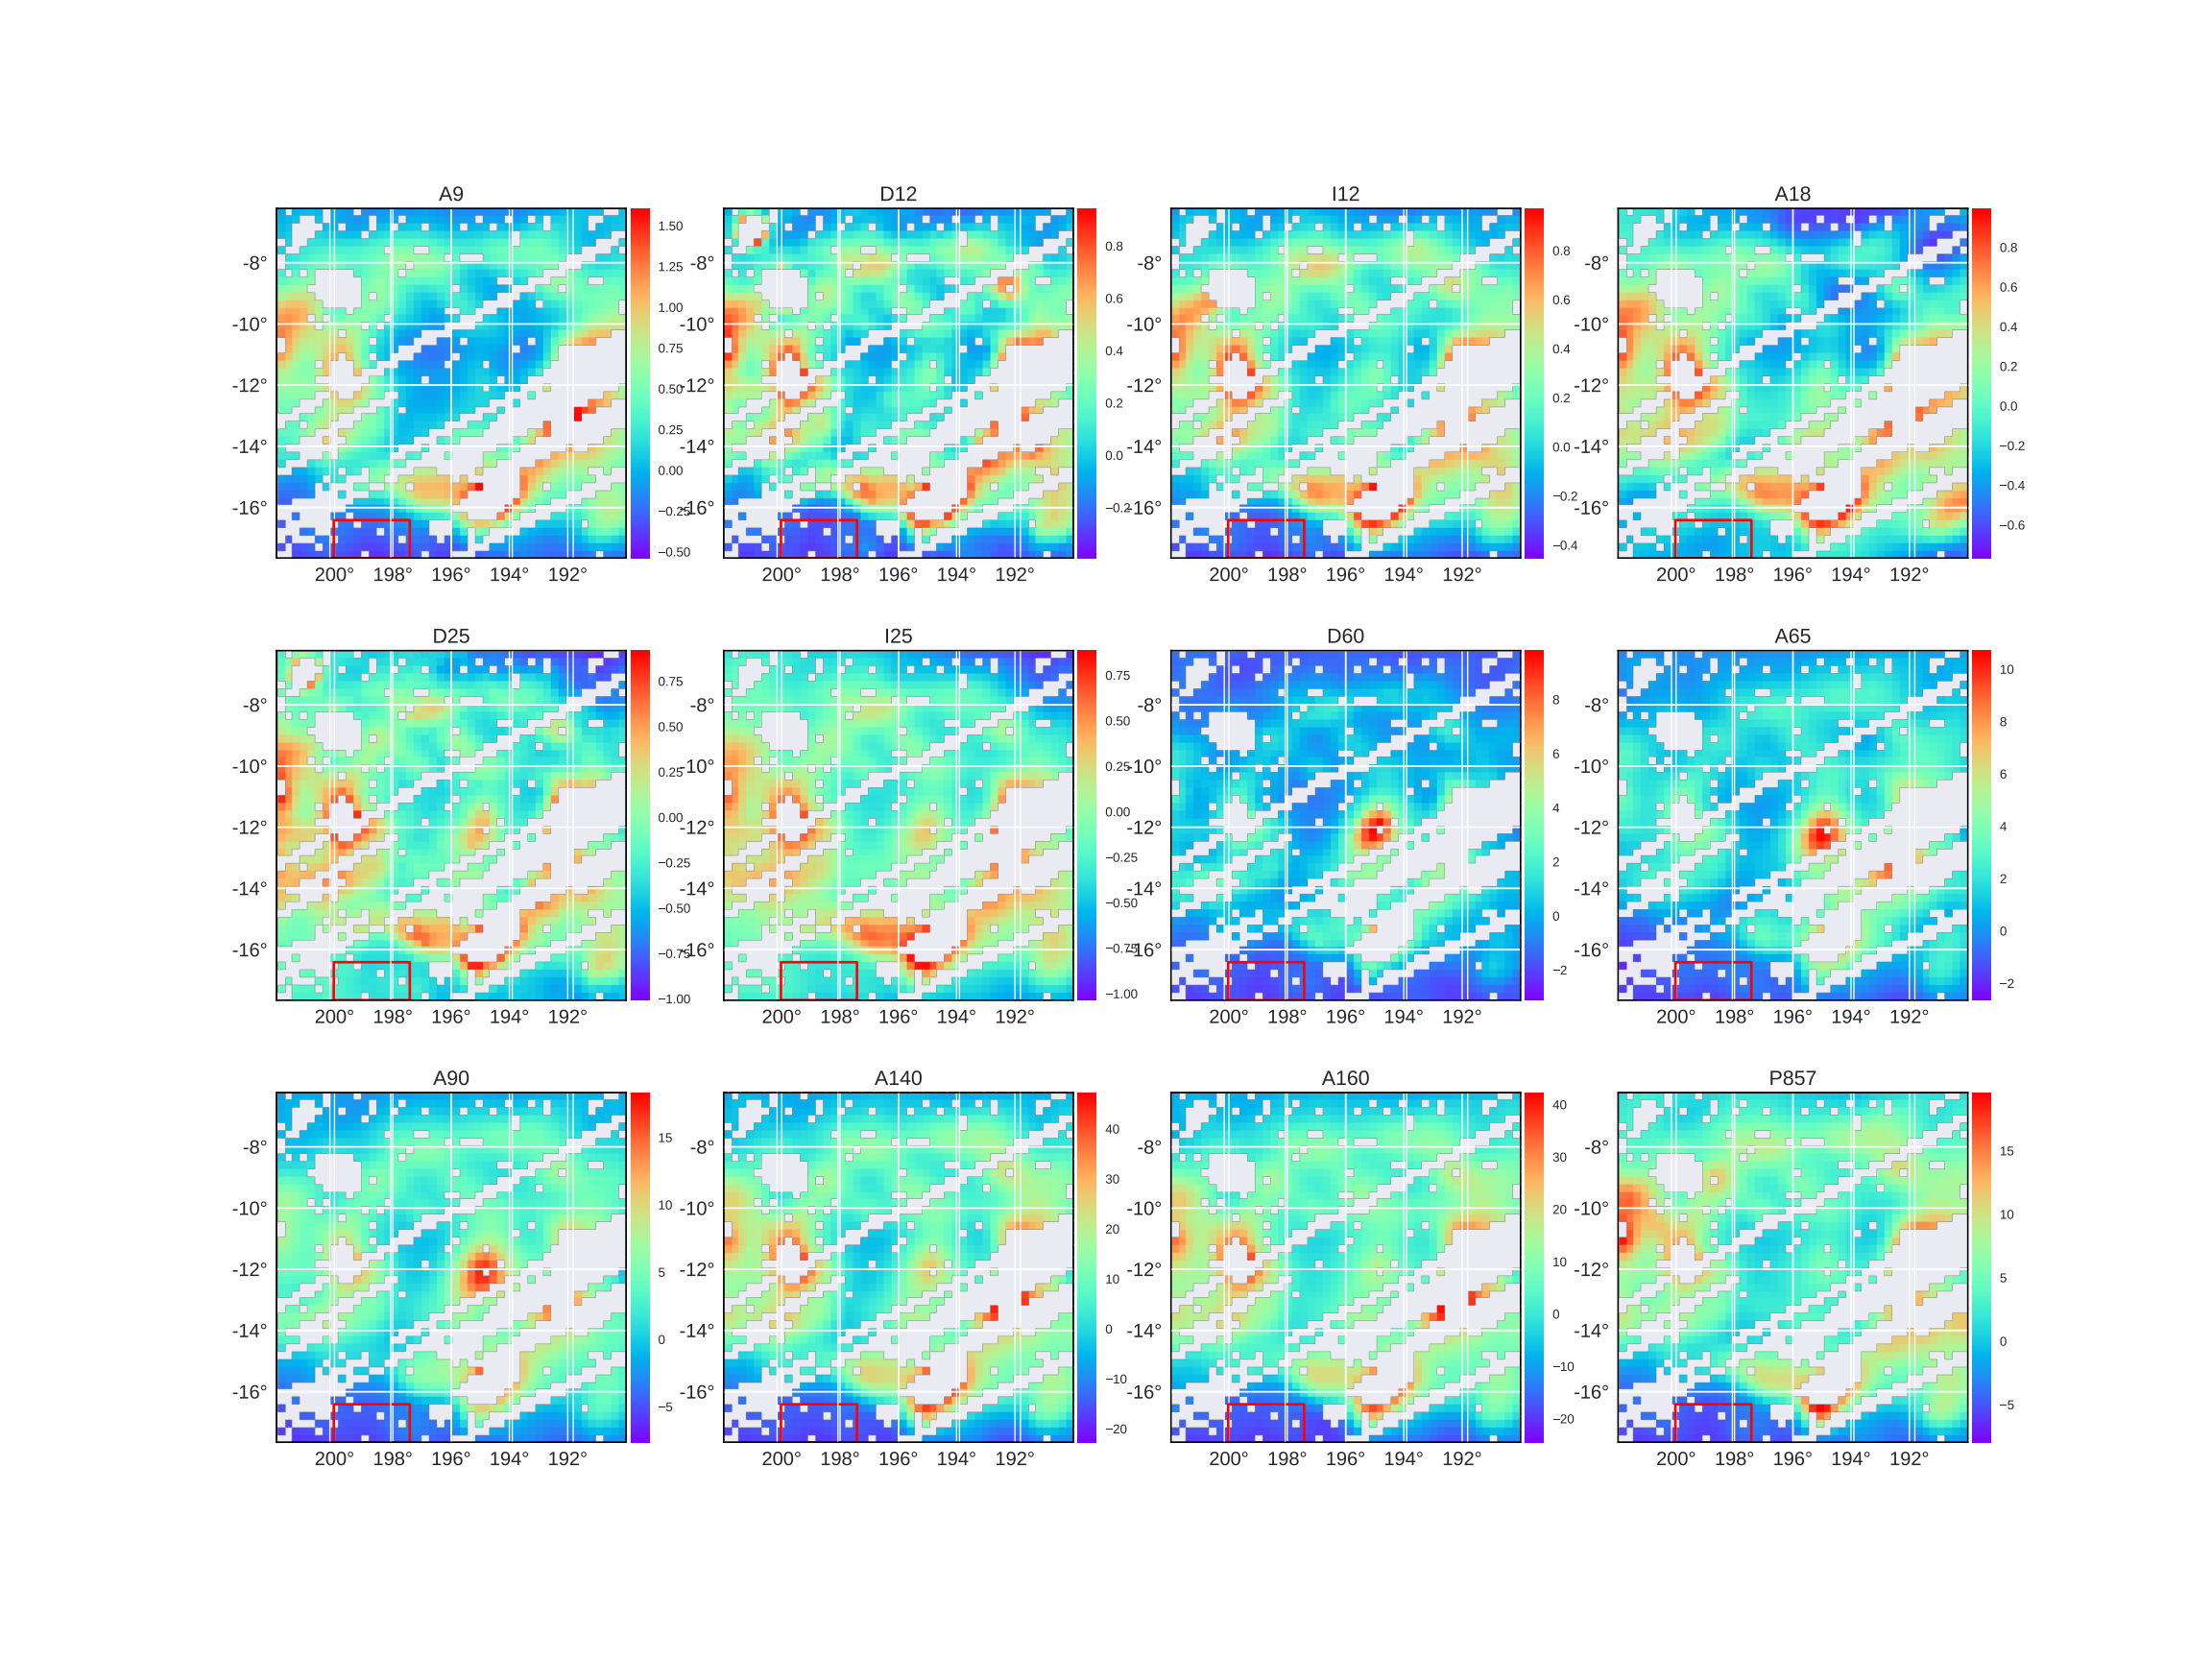

Slide 94
AKARI/IRC 9 μm band
Image size:
50 x 50 pixels
Galactic Longitude
MJy/sr/pix (15’x15’)
Background subtraction box
Effective PSF:
~60’ FWHM
Galactic Latitude

Slide 95
Orionis in the MIR
DIRBE
12 μm
IRAS
12 μm
AKARI/IRC
18 μm
AKARI/IRC
9 μm
Central region is relatively dimmer in MIR

Slide 98
λ Orionis
Which band correlates best with AME?

Slide 99
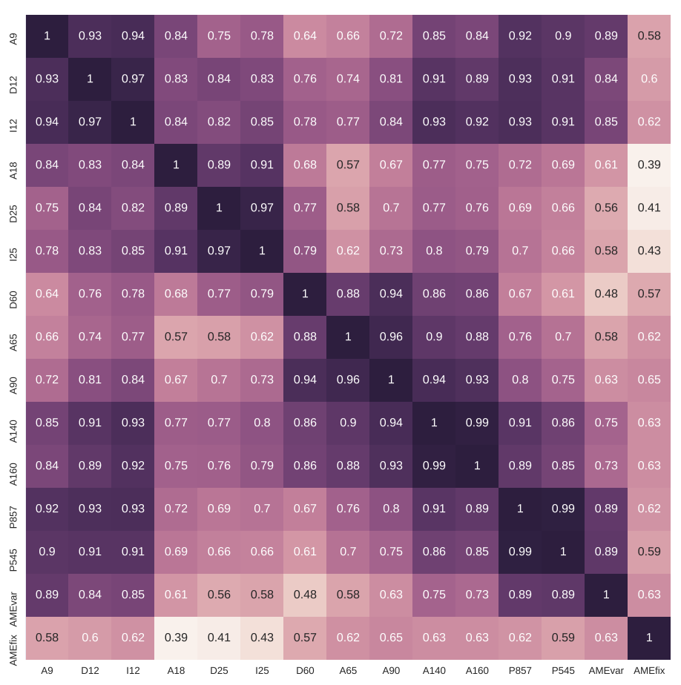
λ Orionis – IR Intensity to AME Comparison – Corr. Matrix

Slide 100
λ Orionis – IR Intensity to AME Comparison – Corr. Matrix

Slide 101
λ Orionis – IR Intensity to AME Comparison – Corr. Matrix

Slide 102
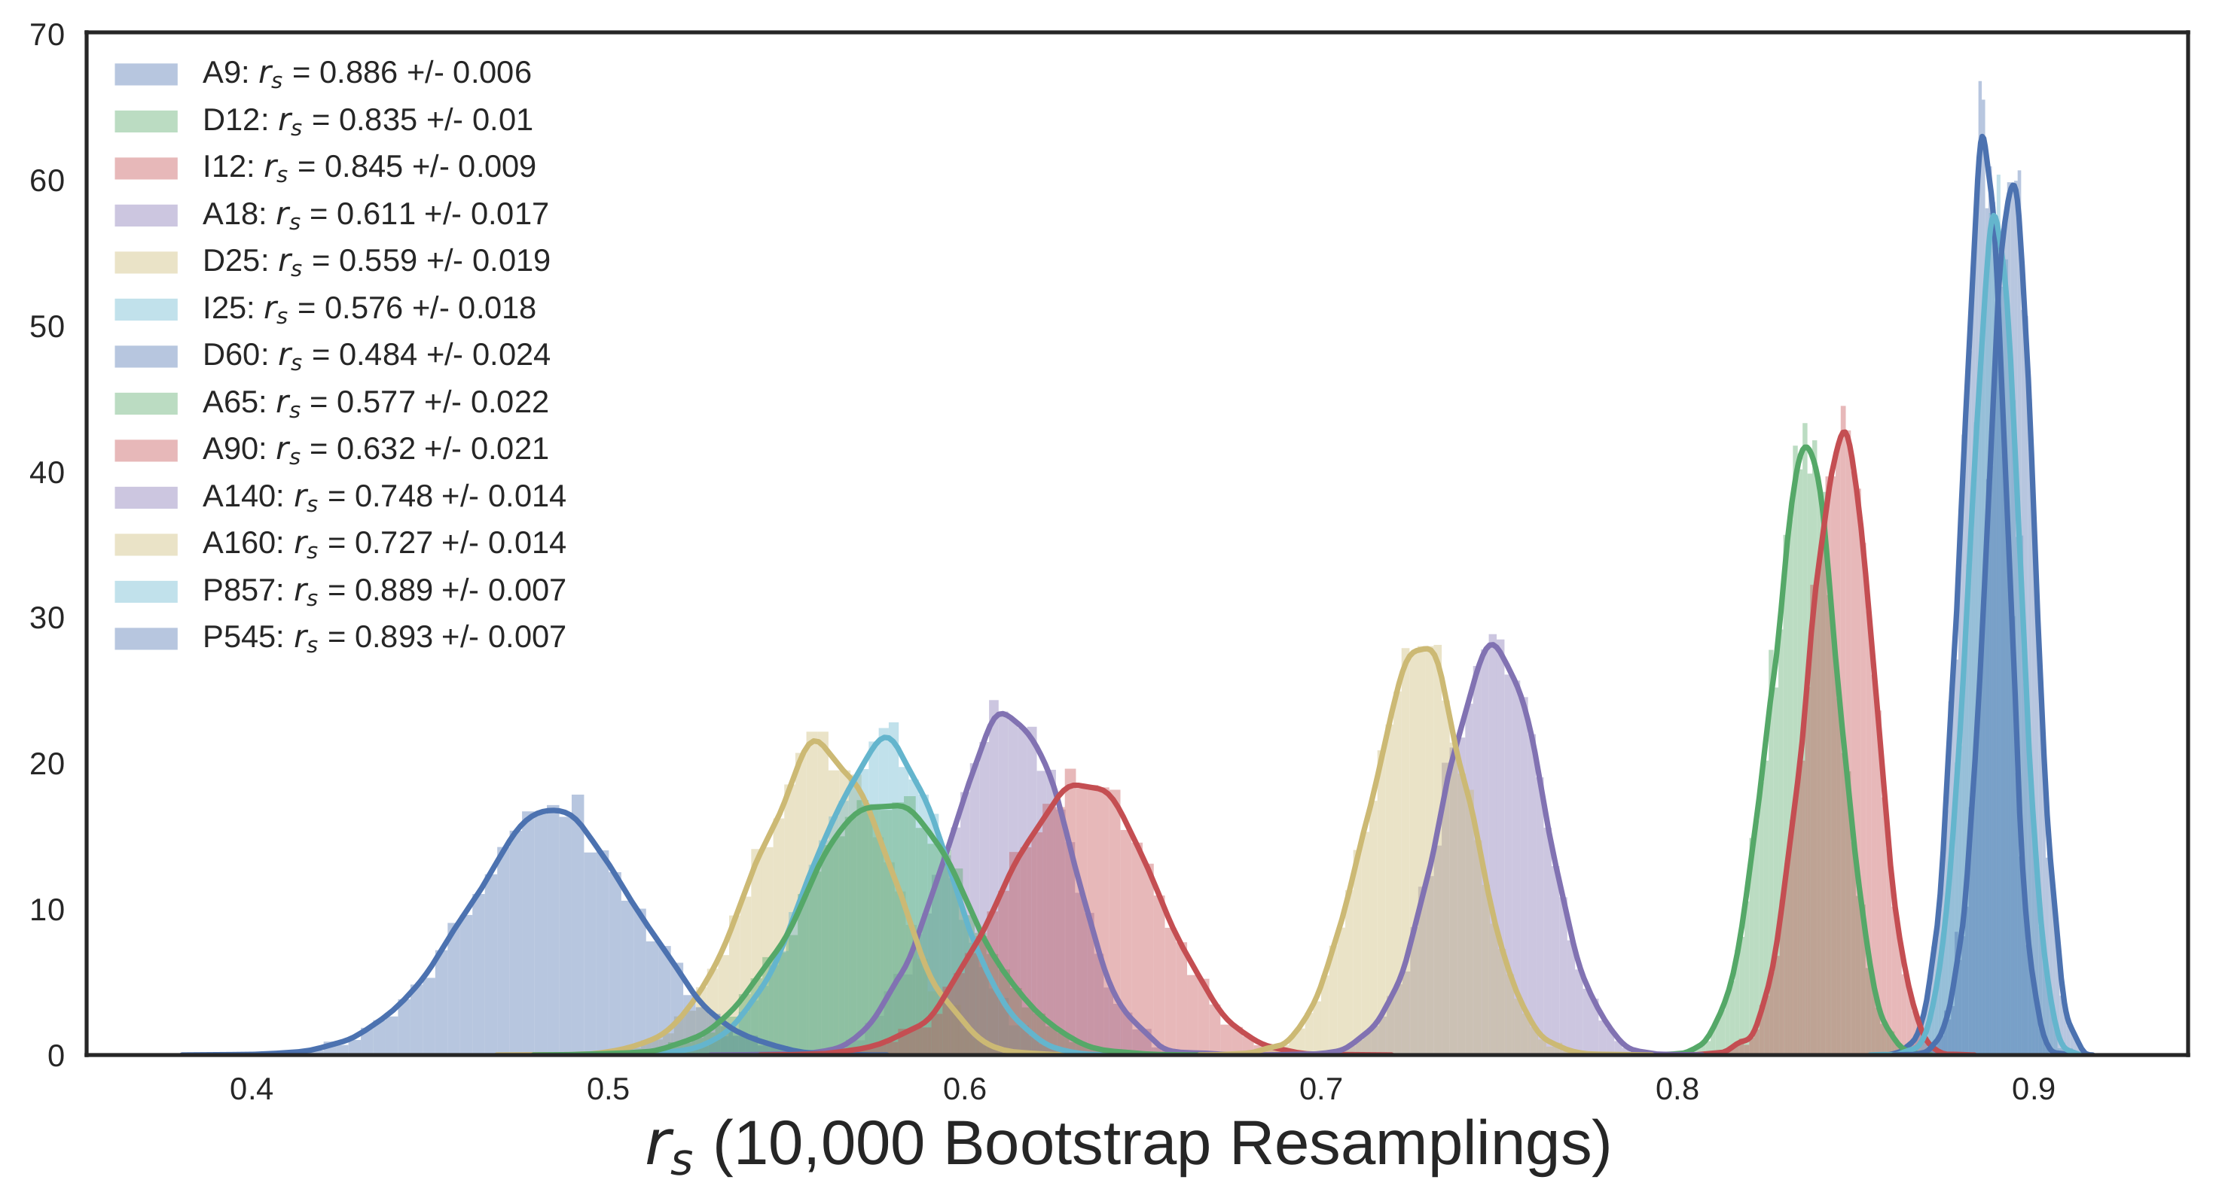
λ Orionis – IR Intensity vs AME – Bootstrap Results - rs

Slide 103
λ Orionis – IR Intensity vs AME – Bootstrap Results - r_{s}
P857, P545, and A9 vs. AME are the strongest 3 correlations

Slide 104
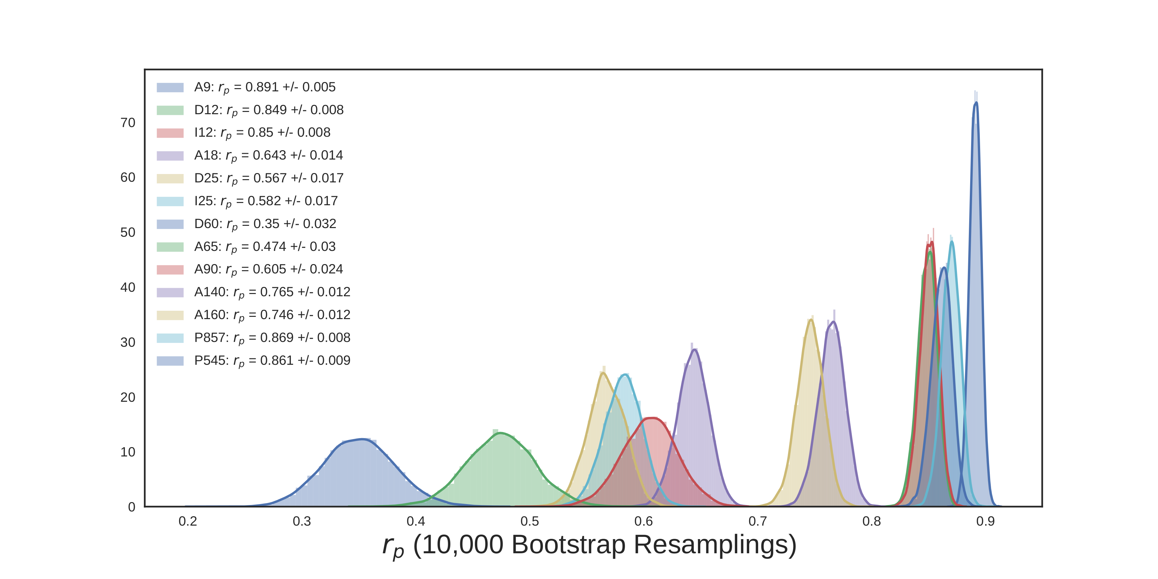
λ Orionis – IR Intensity vs AME – Bootstrap Results - r_{p}
In the Pearson case, A9 vs. AME is strongest.

Slide 105
λ Orionis – IR Intensity vs AME – Bootstrap Results - r_{p}
In the Pearson case, A9 vs. AME is strongest.

Slide 106
λ Orionis – SED Fitting (in collaboration With F. Galliano)
Which dust property correlates best with AME?
  Dust model fitting
  With the Hierarchical Bayesian framework, “HerBIE”, implemented by F. Galliano (2018)

Slide 107
λ Orionis – SED Fitting (in coll. With F. Galliano)
Advantages of Hierarchical Bayesian approach:
  Prior is inferred from data itself (No need to manually select a prior)

Slide 108
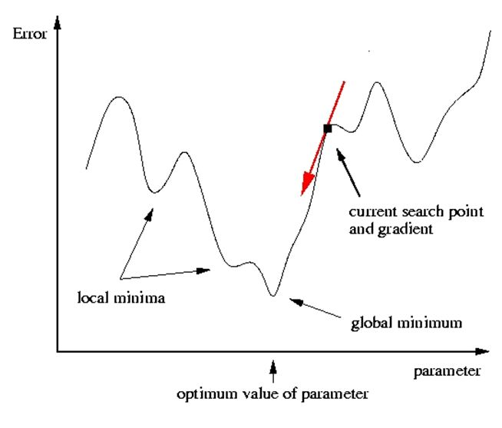
λ Orionis – SED Fitting (in coll. With F. Galliano)
Advantages of Hierarchical Bayesian approach:
  Prior is inferred from data itself (No need to manually select a prior)
  Less vulnerable to local minima

Slide 109
λ Orionis – SED Fitting (in coll. With F. Galliano)
Advantages of Hierarchical Bayesian approach:
  Prior is inferred from data itself (No need to manually select a prior)
  Less vulnerable to local minima
  Avoids noise-induced correlations

Slide 110
λ Orionis – SED Fitting (in coll. With F. Galliano)
Advantages of Hierarchical Bayesian approach:
  Prior is inferred from data itself (No need to manually select a prior)
  Less vulnerable to local minima
  Avoids noise-induced correlations
  Robust error-propagation

Slide 111
λ Orionis – SED Fitting (in coll. With F. Galliano)
Advantages of Hierarchical Bayesian approach:
  Prior is inferred from data itself (No need to manually select a prior)
  Less vulnerable to local minima
  Avoids noise-induced correlations
  Robust error-propagation
Disadvantages:
  Computationally expensive (relative to least-squares)

Slide 112
λ Orionis – SED Fitting (in coll. With F. Galliano)
Advantages of Hierarchical Bayesian approach:
  Prior is inferred from data itself (No need to manually select a prior)
  Less vulnerable to local minima
  Avoids noise-induced correlations
  Robust error-propagation
Disadvantages:
  Computationally expensive (relative to least-squares)
  Not valid for a single source.

Slide 113
λ Orionis – SED Fitting (in coll. With F. Galliano)
Advantages of Hierarchical Bayesian approach:
  Prior is inferred from data itself (No need to manually select a prior)
  Less vulnerable to local minima
  Avoids noise-induced correlations
  Robust error-propagation
Disadvantages:
  Computationally expensive (relative to least-squares)
  Not valid for a single source. (Can’t infer prior)
  No benefit when S/N < intrinsic parameter scatter

Slide 114
λ Orionis – SED Fitting (in coll. With F. Galliano)
Fit dust SED model to IR photometry:
  4 Free parameters:
    M_{DUST}: Total dust mass

Slide 115
λ Orionis – SED Fitting (in coll. With F. Galliano)
Fit dust SED model to IR photometry:
  4 Free parameters:
    M_{DUST}: Total dust mass
    qPAH: Fraction of M_{DUST} in PAHs

Slide 116
λ Orionis – SED Fitting (in coll. With F. Galliano)
Fit dust SED model to IR photometry:
  4 Free parameters:
    M_{DUST}: Total dust mass
    qPAH: Fraction of M_{DUST} in PAHs
    U: Radiation field strength

Slide 117
λ Orionis – SED Fitting
Fit dust SED model to IR photometry:
  4 Free parameters:
    M_{DUST}: Total dust mass
    qPAH: Fraction of M_{DUST} in PAHs
    U: Radiation field strength
    qPAH+: Fraction of chargedPAHs

Slide 118
λ Orionis – SED Fitting – Example Fit

Slide 119
λ Orionis – SED Fitting – Example Fit
One SED fit produced per pixel
Yellow curve:
Least-squares fit

Slide 120
λ Orionis – SED Fitting – Example Fit
One SED fit produced per pixel
Yellow curve:
Least-squares fit
Purple curve:
HB fit

Slide 121
λ Orionis – SED Fitting – Example Fit
One SED fit produced per pixel
Yellow curve:
Least-squares fit
Purple curve:
HB fit
HB fits some cases where least-squares fails:
Stuck in minima?
Error overestimation?

Slide 122
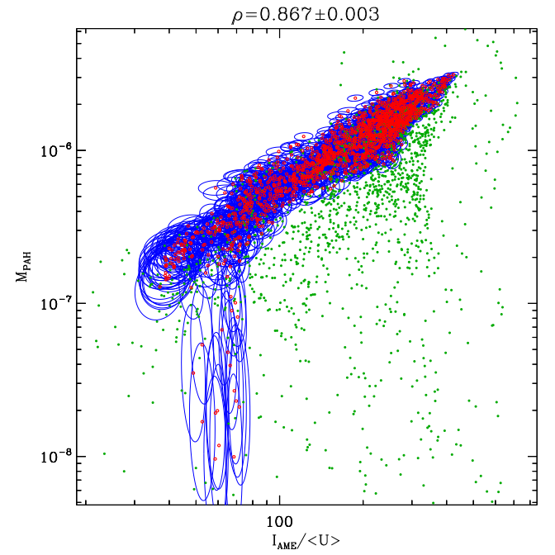
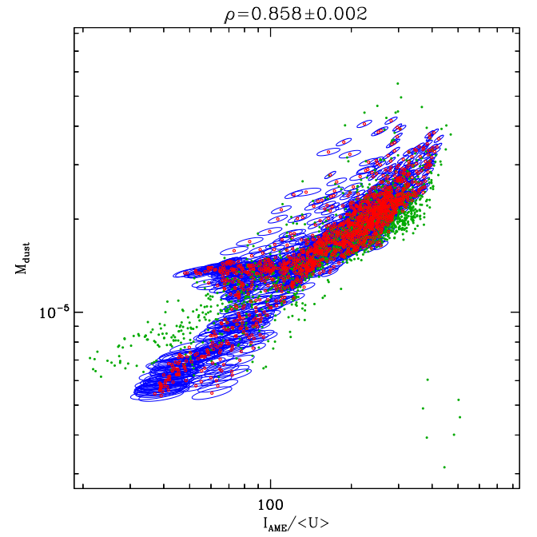
λ Orionis – SED Fitting – Dust Parameters vs AME
Blue:
Error ellipses
Red:
HB Results
Green:
Least Squares
Results
M_{Dust}
M_{PAH}
Assume:
σAME ∝ I_{AME} / U

Slide 123
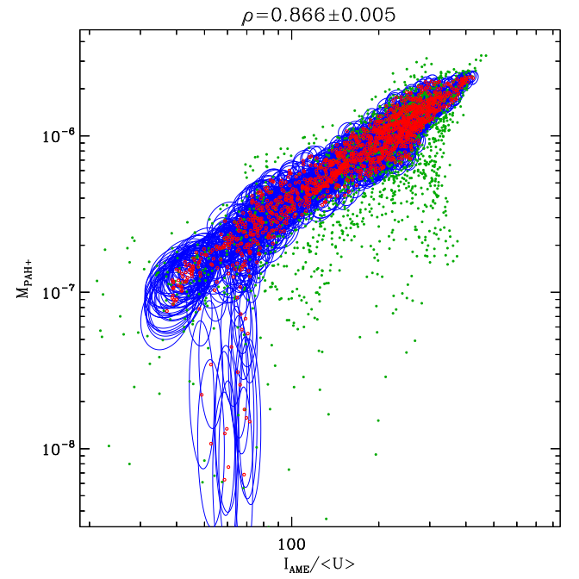
λ Orionis – SED Fitting - Dust Parameters vs AME -MPAH+
PAH Mass vs. AME
M_{PAH+}
M_{PAH}

Slide 124
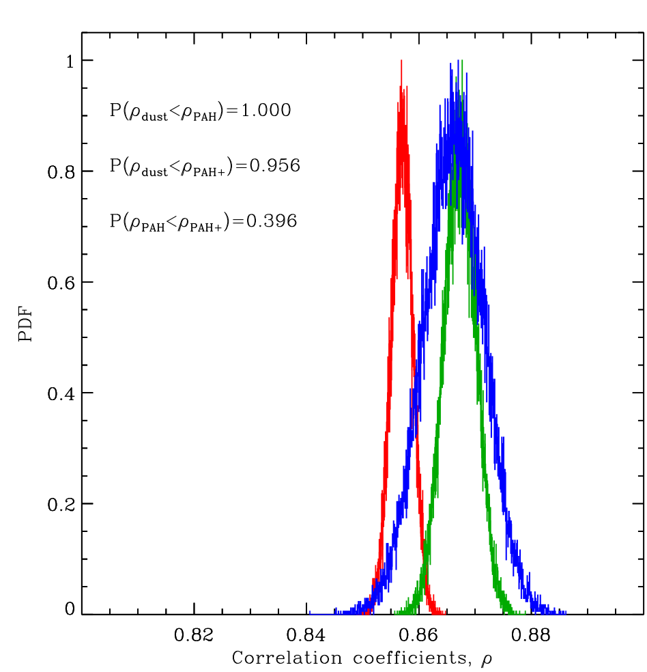
λ Orionis – SED Fitting – Correlation scores vs. AME
M_{PAH} correlates better than M_{dust}
...so does M_{PAH+}
M_{PAH+} doesn’t correlate better than M_{PAH}
Red: ρ_{dust}
Green: ρ_{PAH}
Blue: ρ_{PAH+}

Slide 125
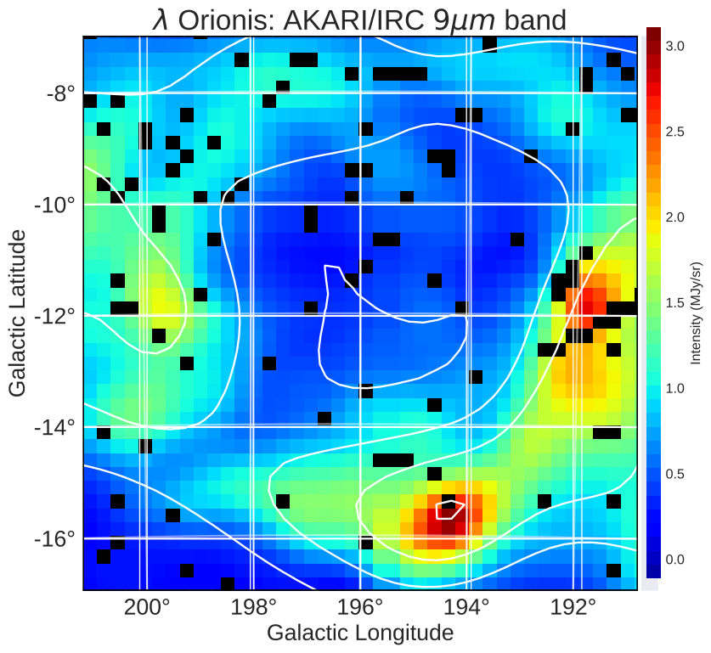
λ Orionis – Conclusions
Central region:
  Stronger ISRF, Warmer dust, free-free
  Less abundant PAHs → Less AME

Slide 126
λ Orionis – Conclusions
Central region:
  Stronger ISRF, Warmer dust, free-free
  Less abundant PAHs → Less AME
Outer Ring:
  Cooler dust emission
  Shielding from ISRF
  Stronger PAH emission and AME
  More abundant PAHs → More AME

Slide 127
Conclusions - λ Orionis
AME-from-PAHs: Supported
AME-from-PAH+: Further investigation justified
Residual free-free emission: Unlikely (not ruled out.)
Consistent with previous literature:
  Ysard (2010): Yes – MIR vs. AME is stronger.
  Tibbs (2011): Yes: – PAH hypothesis supported
  No: – AME-ISRF relationship is flipped
  Hensley (2016): No

Slide 128
Take away:
Current AME data may be too low resolution
Localized investigation results may differ from all-sky
We must consider characteristics of each region.
λ Orionis may show the first evidence of a preferential PAH-AME relationship.
Further all-sky analysis with present data is not likely to solve the mystery.

Slide 129
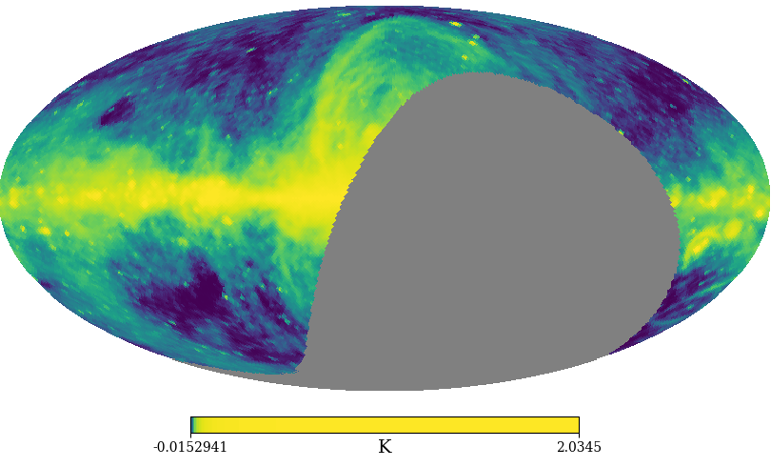
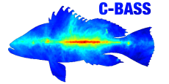
Future possibilities: Data
Improved all-sky low-freq. constraints from C-BASS

Slide 130
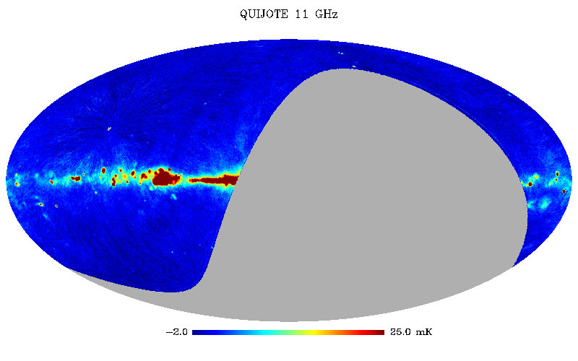
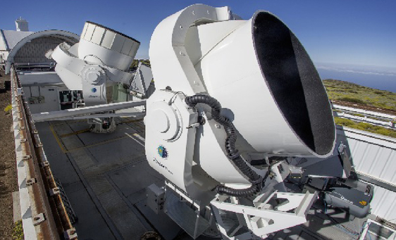
Future possibilities: Data
Improved all-sky low-freq. constraints from C-BASS
Higher resolution AME data by Q-U-I JOint Tenerife Experiment (QUIJOTE)

Slide 131
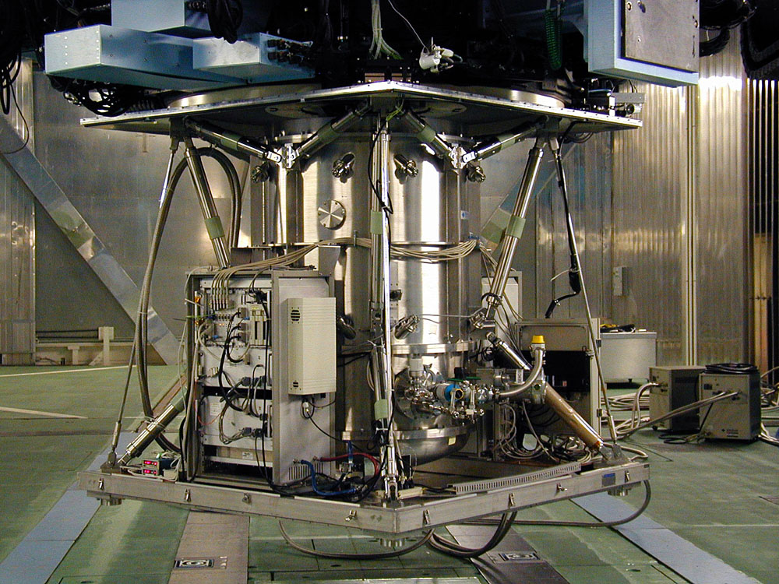
Future possibilities: Data
Improved all-sky low-freq. constraints from C-BASS
Higher resolution AME data by Q-U-I JOint Tenerife Experiment (QUIJOTE)
Detailed comparison of Lambda Orionis AME spectrum with PAH MIR spectroscopy (via COMICS?)

Slide 132
Future possibilities: Analysis
Analyze surrounding λ Orionis region:

Slide 133
Future possibilities: Analysis
Analyze surrounding λ Orionis region
Improve AME Component Separation?

Slide 134
Future possibilities: Analysis
Analyze surrounding λ Orionis region
Improve AME Component Separation?
Machine Learning approach:
  Blind component separation (Independent Component Analysis, etc.)

Slide 135
WARNING:
The Following Contents are Backup Slides
Proceed at your own risk.

Slide 136
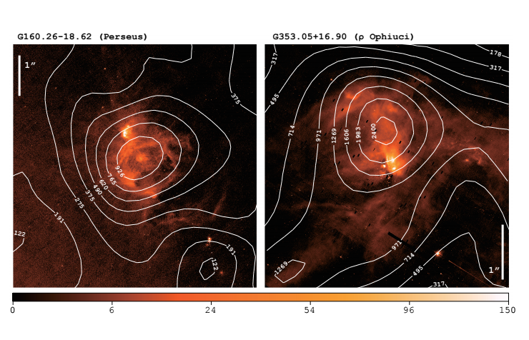
Introduction: What is AME?
Unexplained dust-correlated emission
Image: AKARI/ IRC 9 micron data of famous AME regions, Perseus and rho Oph.

Slide 137
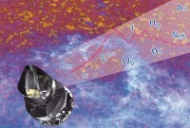
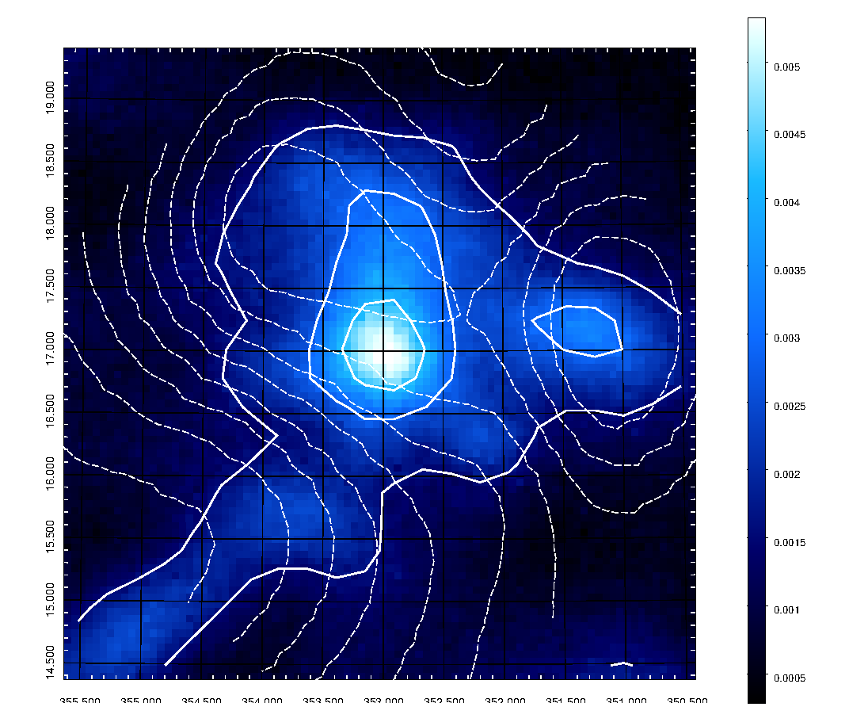

rho Ophiuchi at 30GHz via Planck LFI
Solid contours: Planck 30Ghz
Two local maxima-
Left peak =
Star forming region
Dashed contours:
T^6 (A rough ISRF approximation. Assuming a dust emissivity of )

Slide 138

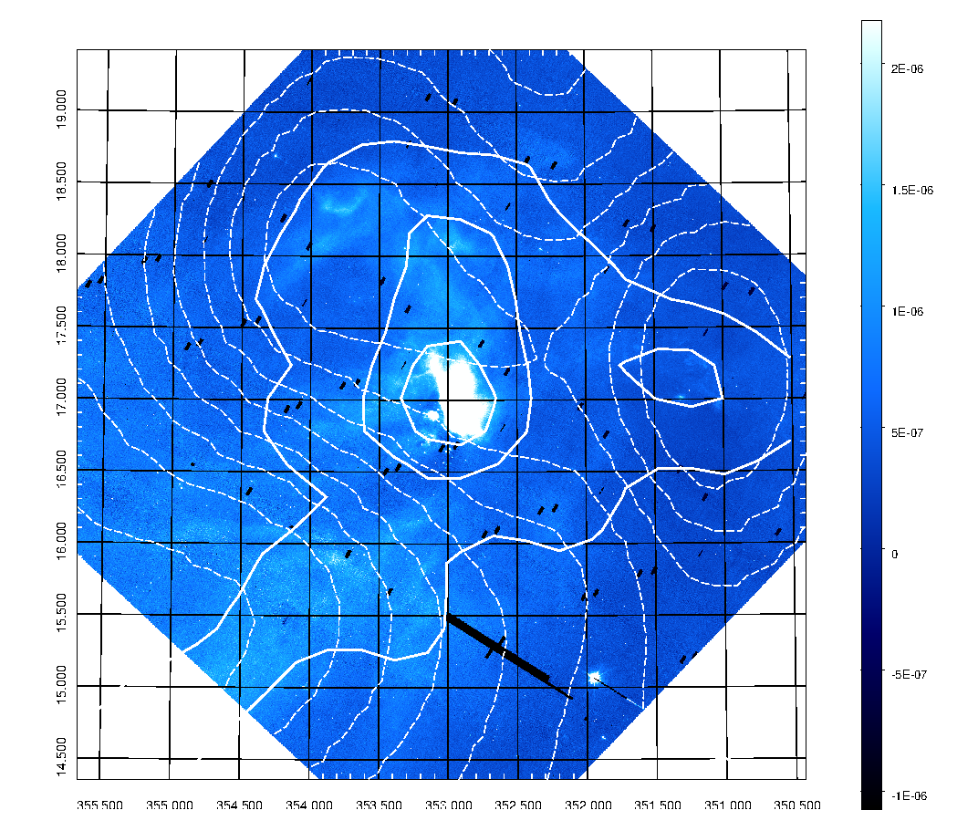
rho Ophiuchi at 9um via AKARI
Solid contours:
Planck 30Ghz
Dashed contours:
T^6 (A rough ISRF approximation)
A ratio map of 9um / ISRF
Note that the peak on the right side disappears after dividing by T^6.
The left peak (a star forming region) remains

Slide 139
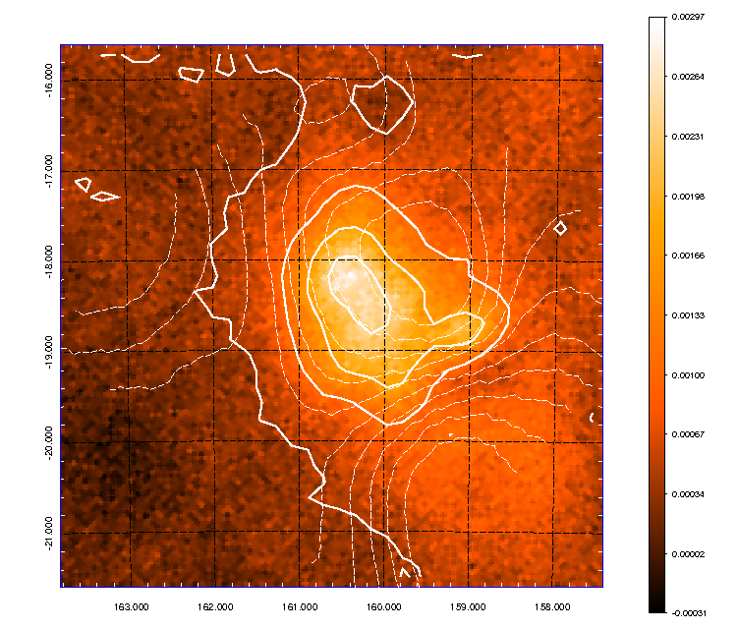

Perseus at 30 GHz via Planck
Solid contours:
Planck 30Ghz (this image)
Dashed contours:
T^6 (A rough ISRF approximation)

Slide 140
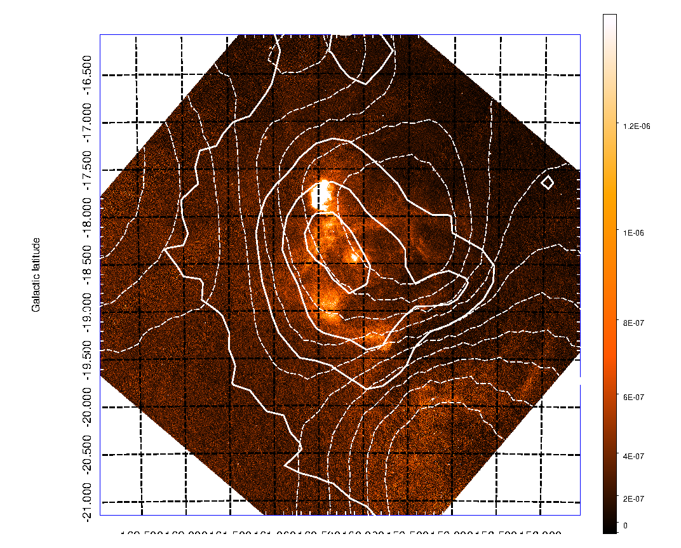
Perseus at 9um via AKARI/IRC
Solid contours:
Planck 30Ghz
Dashed contours:
T^6 (A rough ISRF approximation)

Slide 141
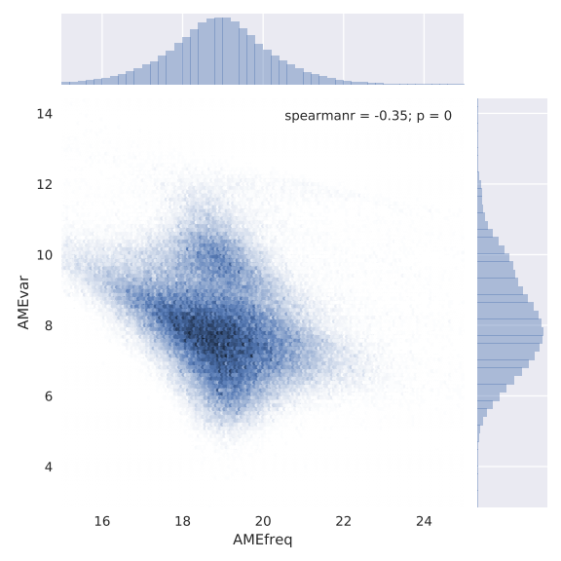

Slide 142
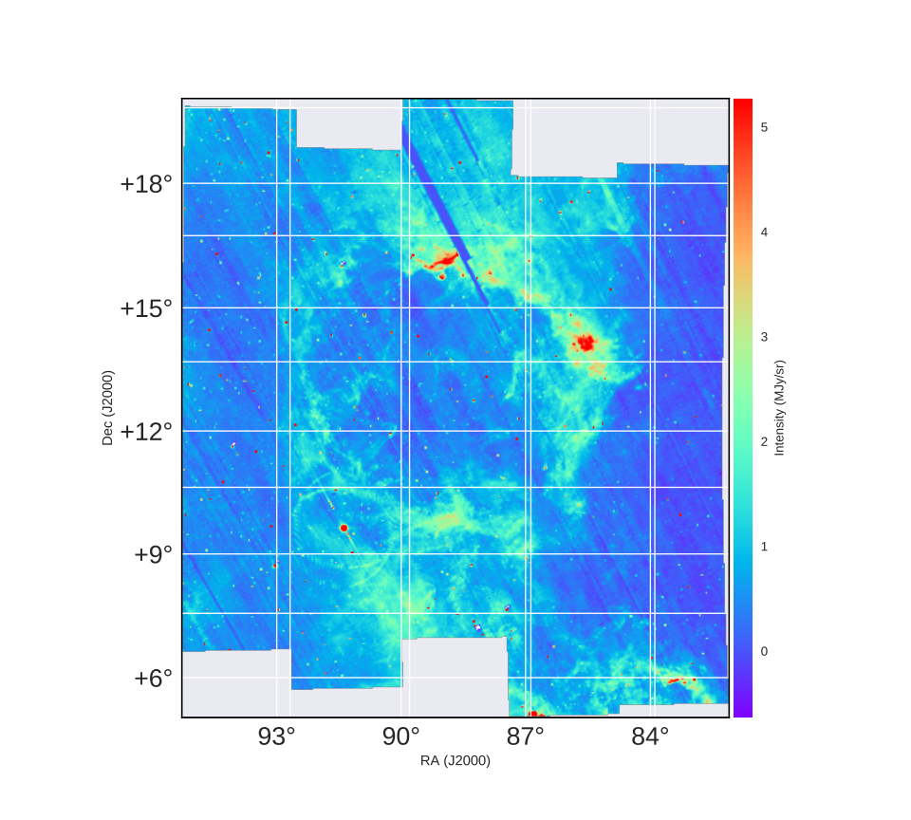

Slide 143
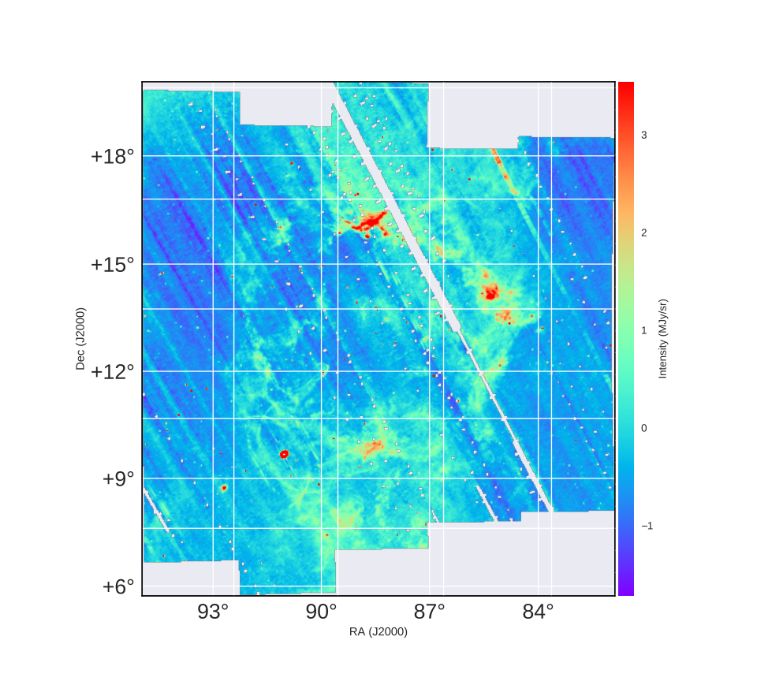

Slide 144
Predictions of Spinning PAH Hypothesis
If PAHs are a dominant AME carrier:
AND
A9 band emission is dominated by PAH luminosity
AND
Measuring the ISRF gives PAH abundance from PAH luminosity
THEN
We might expect a stronger correlation between A9 and AME than with other bands and AME
IF
We don’t see a tighter correlation in intensity, either PAHs are not the carrier OR
ISRF variations, radiative transfer, blur the A9 intensity:AME intensity correlation.
THEN:
We need PAH abundance estimates rather than A9 intensity.

Slide 145
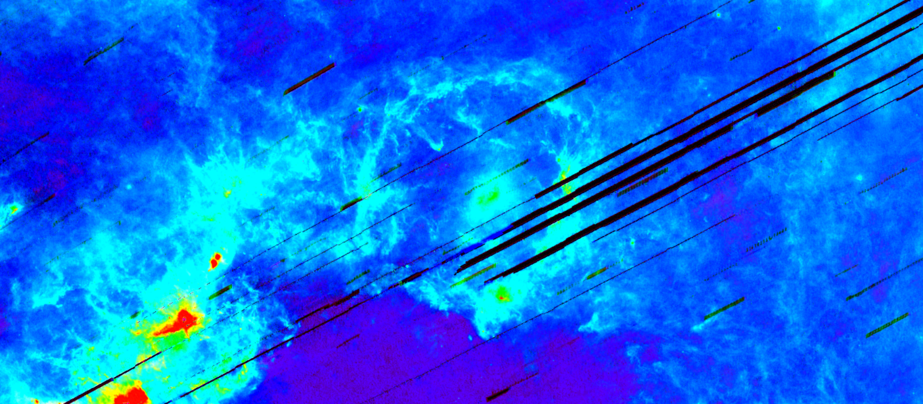
λ Orionis
AKARI FIS: Total FIR Emission Image of greater λ Orionis region:
http://aladin.unistra.fr/AladinLite/?target=05%2034%2057.626%2B09%2039%2029.05&fov=25.42&survey=CDS%2FP%2FAKARI%2FFIS%2FColor

Slide 146
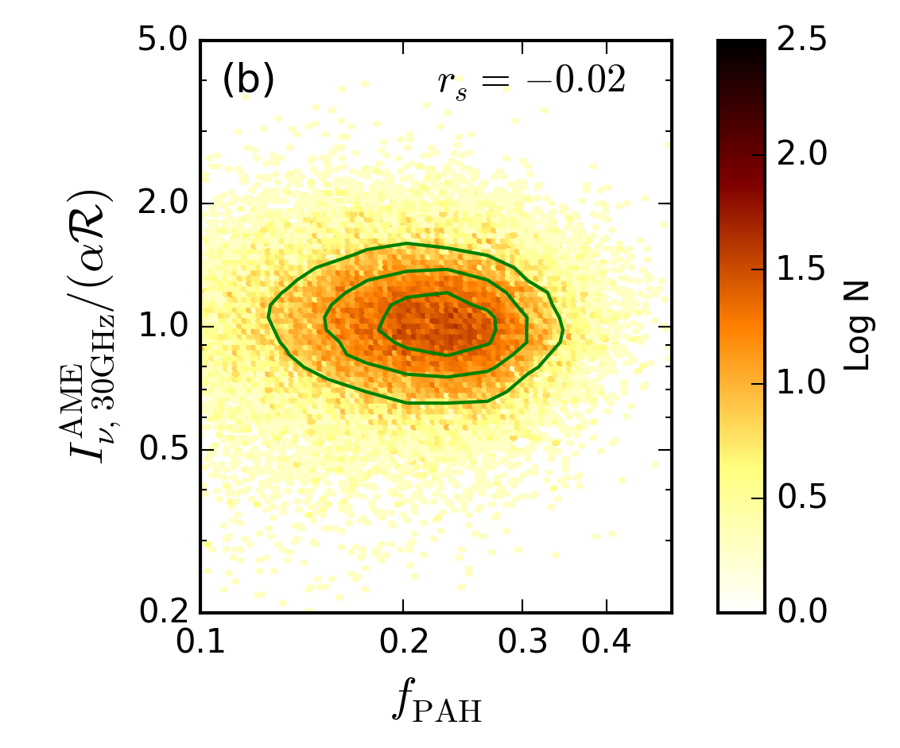
Introduction - Past Works – B. Hensley, et al. (2016)
Intro: A Previous Dust vs. AME Study
Notes:
Additionally, the claim that scaling by the ISRF gives a nicer correlation too. This is what we’d expect from a spinning dust sceneario, since spinning dust emission shouldn’t significantly depend on the radiation field- just on the dust abundance.

Slide 147
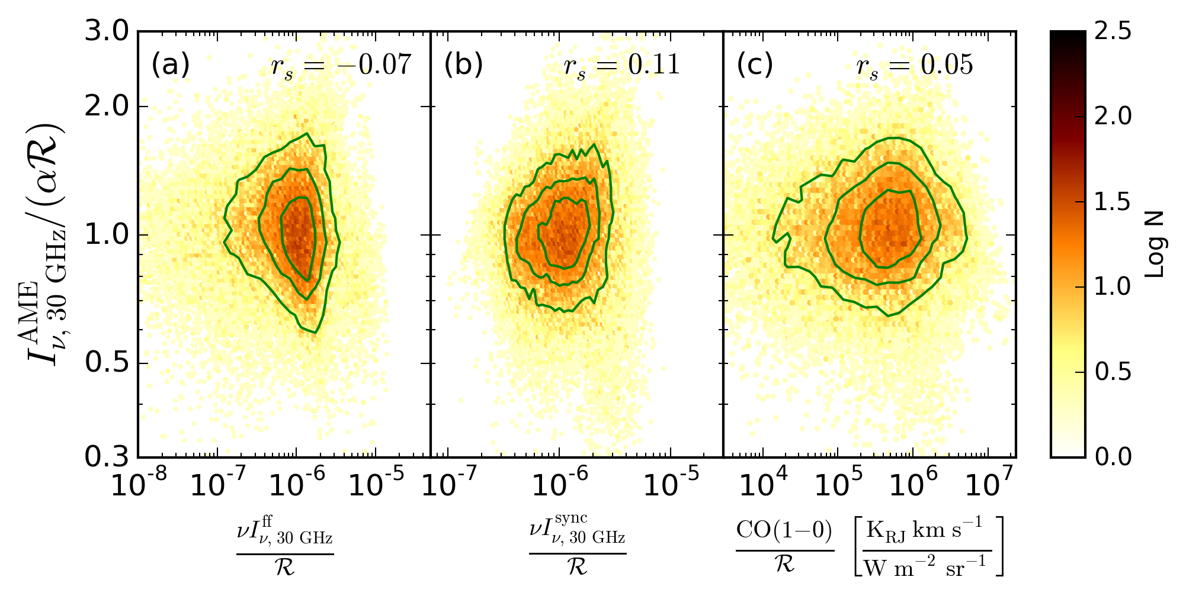
Introduction - Past Works – B. Hensley, et al. (2016)
Notes:
Additionally, the claim that scaling by the ISRF gives a nicer correlation too. This is what we’d expect from a spinning dust sceneario, since spinning dust emission shouldn’t significantly depend on the radiation field- just on the dust abundance.

Slide 148

λ Orionis
(
Image:
Hα (Finkbeiner+, 2003)
Contours:
AME (Planck Coll., 2015)

Slide 149
λ Orionis
Ionized center with molecular ring showing AME

Slide 150
Introduction: Dust SED Parameters
PAH Abundance
Temperature and Emissivity Index from the modified blackbody fitting |  | T = temperature, β = emissivity index
Total Far-Infrared Emission |  | τ is optical depth at 100μm λ = wavelength B _{λ}(T) is the Planck function.
Interstellar Radiation Field Strength |  | U is the ISRF
AME Carrier Abundance??

Slide 151
Introduction: Dust SED Parameters
PAH Abundance
Temperature and Emissivity Index from the modified blackbody fitting |  | T = temperature, β = emissivity index
Total Far-Infrared Emission |  | τ is optical depth at 100μm λ = wavelength B _{λ}(T) is the Planck function.
Interstellar Radiation Field Strength |  | U is the ISRF
AME Carrier Abundance??

Slide 152

What’s left of the all-sky data, after applying the mask?

Slide 153
λ Orionis – SED Fitting – Example Fits

Slide 154

Introduction – What is AME? - Spinning PAH Spectrum
Y. Ali-Haimoud (2013) - “Rotational Spectroscopy of PAHs”

Slide 155
Introduction – What is AME? - Perseus Cloud
C. Tibbs+ (2011) - “Spitzer characterisation of dust in an anomalous emission region: the Perseus cloud”

Slide 156
Introduction - Past Works – Y. Ali-Haimoud (2008)
Notes:
There is another, overlapping idea: magnetic dipole emission from dust. This hasn’t been explored as much, but does predict a level of polarization of the AME which has not been detected yet. Anyways, we focus on the spinning dust hypothesis here, but acknowledge that both should be explored.

Slide 157

All-sky Analysis - Unmasked correlation test
Do the λ Orionis results generalize to full-sky?

Slide 158

Introduction: What is AME?
An unexplained microwave foreground
Sample low-res microwave SED from the rho Ophiuchus region.
Planck LFI 28 GHz All-sky Map: ESA/Planck Collaboration
Notes:
If we take a look at the infrared to radio SED of the most prominent region in this AME map, Perseus, we get this.

Slide 159

Introduction: What is AME?
An unexplained microwave foreground
Sample low-res microwave SED from the rho Ophiuchus region.
Planck LFI 28 GHz All-sky Map: ESA/Planck Collaboration
Notes:
If we take a look at the infrared to radio SED of the most prominent region in this AME map, Perseus, we get this.

Slide 160

Introduction: What is AME?
An unexplained microwave foreground
Sample low-res microwave SED from the rho Ophiuchus region.
Planck LFI 28 GHz All-sky Map: ESA/Planck Collaboration
Notes:
If we take a look at the infrared to radio SED of the most prominent region in this AME map, Perseus, we get this.

Slide 161

Introduction: What is AME?
An unexplained microwave foreground
Sample low-res microwave SED from the rho Ophiuchus region.
Planck LFI 28 GHz All-sky Map: ESA/Planck Collaboration
Notes:
If we take a look at the infrared to radio SED of the most prominent region in this AME map, Perseus, we get this.

Slide 162

Introduction: What is AME?
An unexplained microwave foreground
Sample low-res microwave SED from the rho Ophiuchus region.
Planck LFI 28 GHz All-sky Map: ESA/Planck Collaboration
Notes:
If we take a look at the infrared to radio SED of the most prominent region in this AME map, Perseus, we get this.

